Slide 1
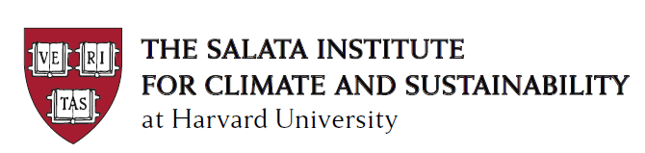
XXVI Annual Conference of the Central Bank of Chile
Implications of Climate Change and Ecosystem Services Degradation For Macroeconomic and Financial Stability
The Macroeconomics of Climate Change
and the Energy Transition
Adrien Bilal
Department of Economics, Harvard University
Jim Stock
Department of Economics, Harvard University
Harvard Kennedy School
November 27, 2023

Slide 2
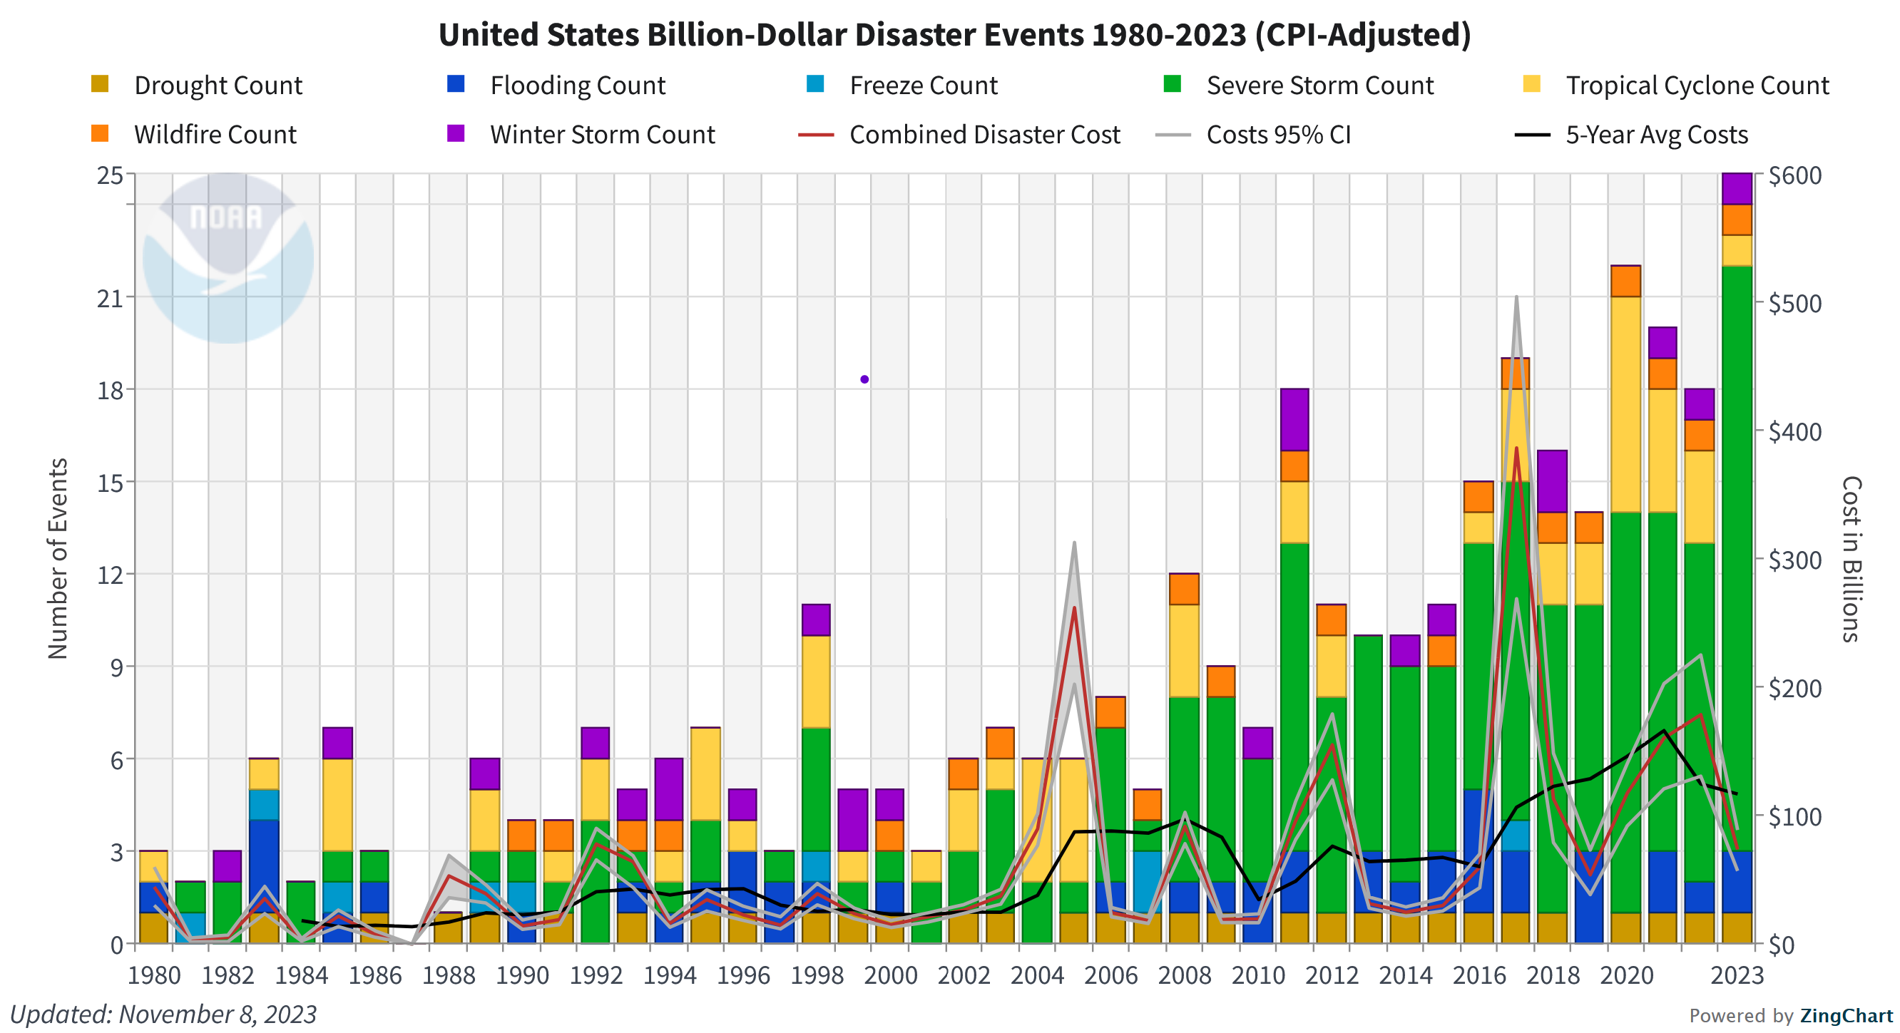
Climate and macro: physical risks,

Slide 3
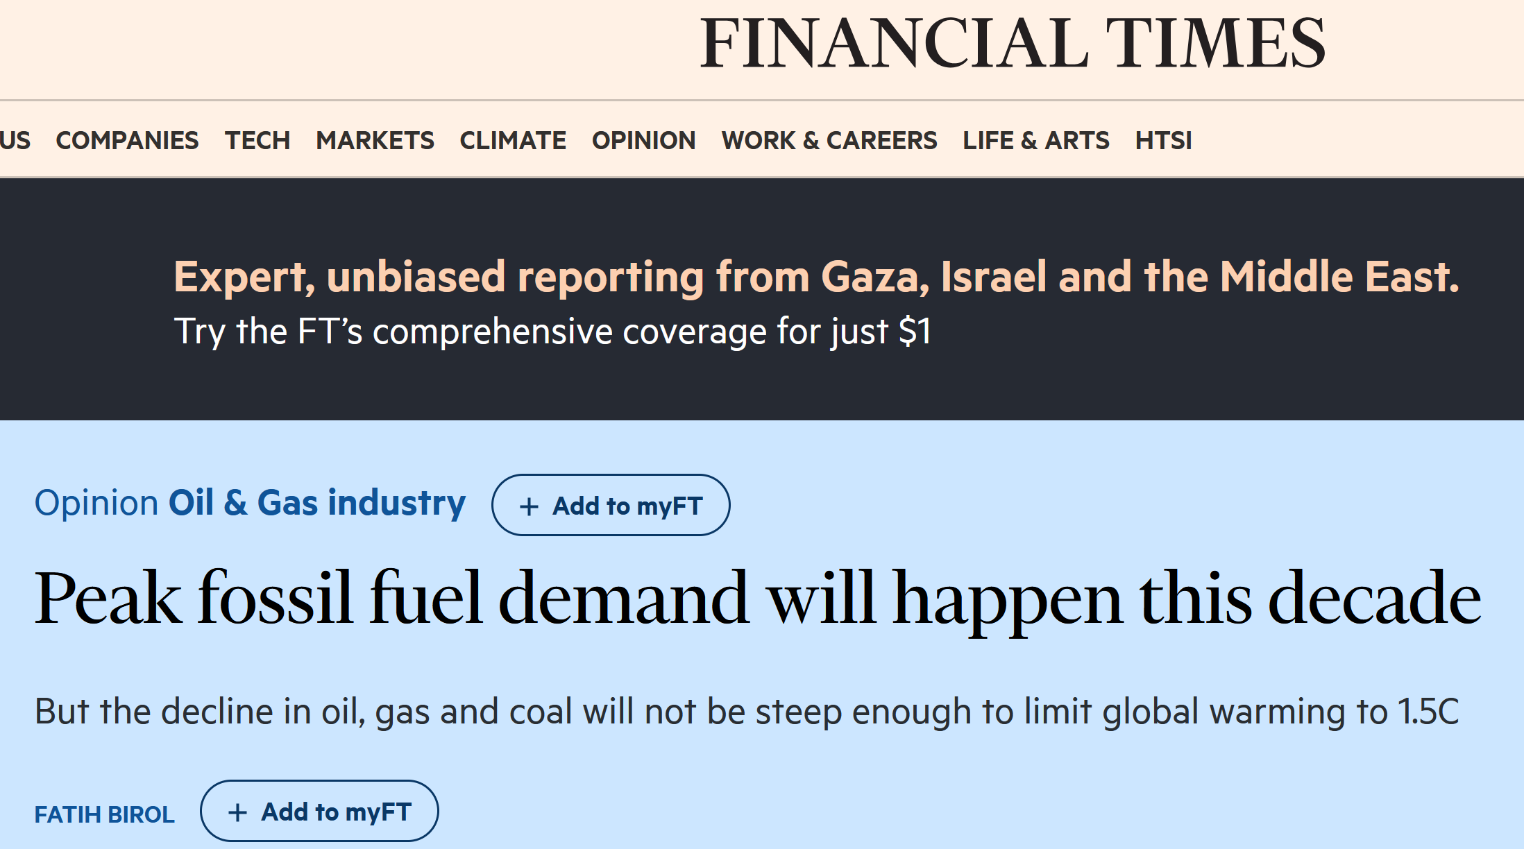
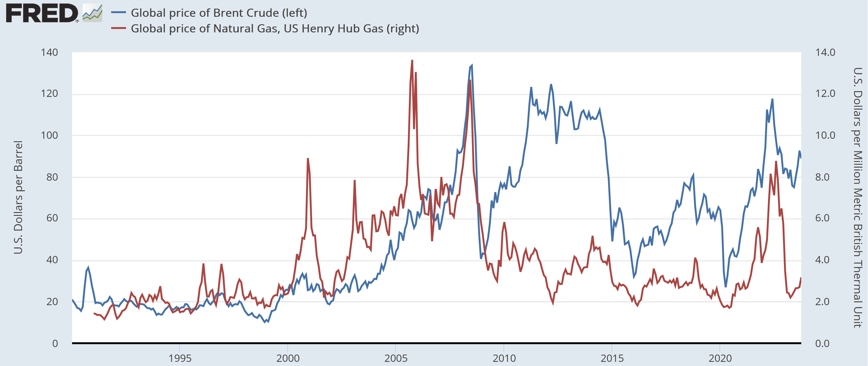
Transition risks in energy markets

Slide 4
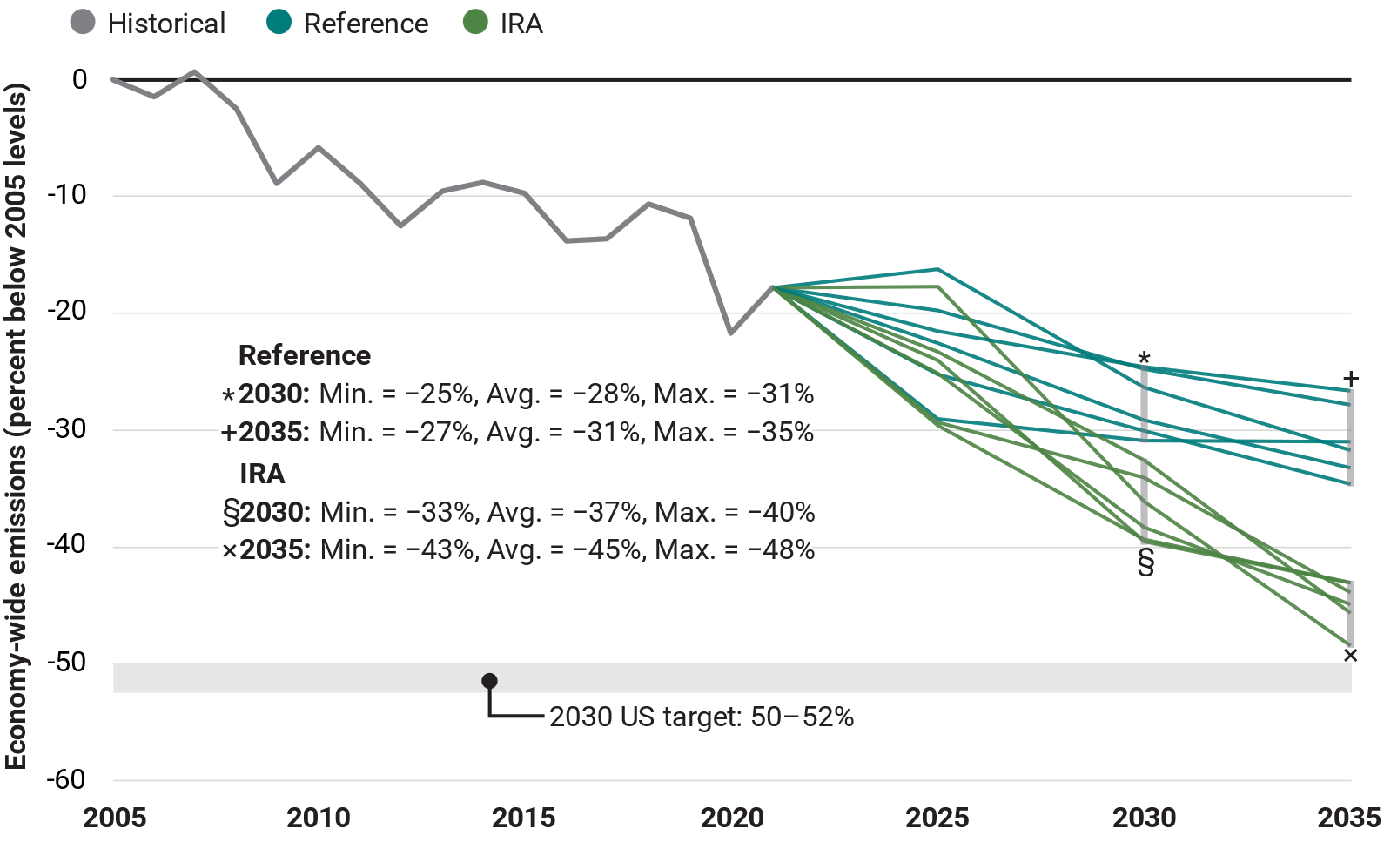

Transition risks in climate policy
The IRA contributes approx. 10 pp to emissions reductions in 2030, relative to 2005
No IRA: 25% - 31%
With IRA: 33% - 40%
Different trajectories are from different models evaluated under same exogenous drivers
Source: Bistline et al (Science, July 2023)

Slide 5
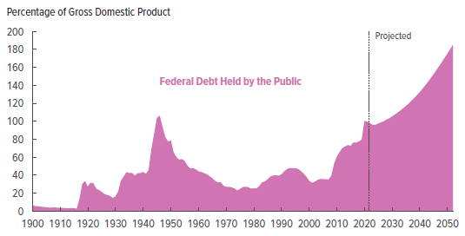
Transition risks in fiscal policy
Fiscal impacts of IRA climate provisions
CBO long-term fiscal outlook (May 2023)
Source/date | Date | Components | Amount (‘22-’31)
CBO/JCT (final) | Sept. 2023 | All* | $392B
CBO/JCT (final) | Sept. 2022 | LDV tax credits | $8B
CBO/JCT (final) | Sept. 2022 | H2 (45V) | $13B
Cole et al | Aug 2022 | LDV tax credits | $440B
Credit Suisse | Nov 2022 | All* | $800B
Bistline, Mehrotra, Wolfram (BPEA) | March 2023 | All* | $800B
JCT | May 2023 | All* | $660B
JCT | May 2023 | LDV tax credits | $99B (23-33)
Bistline & Blandford | Nov 2023 | H2 (45V) | $390-$750B (lifetime)
Bistline et al (2024) | Nov 2023 | All* | $1.6T (23-33)
IRA cost factors
The main tax credits are uncapped
EPA tailpipe rule & power plant rules proposed post-IRA, not yet finalized
Hard to model CCS (45Q) and H2 (45V) take-up
* “All” includes power sector and transportation tax credits, capped manufacturing credits, clean fuel credits, and 45Q and 45V credits, however in early estimates 45Q and 45V modeling was limited.

Slide 6
Economists have a key role to play in guiding climate-related policy: climate fiscal policy, & monetary
This paper: a survey of climate & macro
  Where can scarce commodity - economic research – be allocated for greatest impact?
Multiple dimensions of the growing macro-climate literaturer
  Micro -> macro
  Risks: physical/transitional (Carney 2015)
  Positive-normative: Economic impacts of CC -> policy design
  Policy perspective: climate policy/fiscal policy/monetary policy
  Horizon: <10 years/10-50 years/>50 years
  Trends -> volatility -> uncertainty -> deep uncertainty/tail risks
Notes:
Source:
U.S. Bureau of Economic Analysis
Release:
Gross Domestic Product
Units:
Chained 2012 Dollars, Seasonally Adjusted Annual Rate
Frequency:
Quarterly
BEA Account Code: A939RXFor more information about this series, please visit the Bureau of Economic Analysis.
U.S. Bureau of Economic Analysis,
Real gross domestic product per capita [A939RX0Q048SBEA],
retrieved from FRED,
Federal Reserve Bank of St. Louis;
https://fred.stlouisfed.org/series/A939RX0Q048SBEA,
January 20, 2023.
Source:
U.S. Bureau of Labor Statistics
Release:
Employment Situation
Units:
Thousands of Persons, Seasonally Adjusted
Frequency:
Monthly
All Employees: Total Nonfarm, commonly known as Total Nonfarm Payroll, is a measure of the number of U.S. workers in the economy that excludes proprietors, private household employees, unpaid volunteers, farm employees, and the unincorporated self-employed. This measure accounts for approximately 80 percent of the workers who contribute to Gross Domestic Product (GDP).This measure provides useful insights into the current economic situation because it can represent the number of jobs added or lost in an economy. Increases in employment might indicate that businesses are hiring which might also suggest that businesses are growing. Additionally, those who are newly employed have increased their personal incomes, which means (all else constant) their disposable incomes have also increased, thus fostering further economic expansion.Generally, the U.S. labor force and levels of employment and unemployment are subject to fluctuations due to seasonal changes in weather, major holidays, and the opening and closing of schools. The Bureau of Labor Statistics (BLS) adjusts the data to offset the seasonal effects to show non-seasonal changes: for example, women's participation in the labor force; or a general decline in the number of employees, a possible indication of a downturn in the economy. To closely examine seasonal and non-seasonal changes, the BLS releases two monthly statistical measures: the seasonally adjusted All Employees: Total Nonfarm (PAYEMS) and All Employees: Total Nonfarm (PAYNSA), which is not seasonally adjusted.The series comes from the 'Current Employment Statistics (Establishment Survey).'The source code is: CES0000000001
U.S. Bureau of Labor Statistics,
All Employees, Total Nonfarm [PAYEMS],
retrieved from FRED,
Federal Reserve Bank of St. Louis;
https://fred.stlouisfed.org/series/PAYEMS,
January 20, 2023.

Slide 7
Economists have a key role to play in guiding climate-related policy: climate fiscal policy, & monetary
This paper: a survey of climate & macro
  Where can scarce commodity - economic research – be allocated for greatest impact?
Multiple dimensions of the growing macro-climate literaturer
  Micro -> macro
  Risks: physical/transitional (Carney 2015)
  Positive-normative: Economic impacts of CC -> policy design
  Policy perspective: climate policy/fiscal policy/monetary policy
  Horizon: <10 years/10-50 years/>50 years
  Trends -> volatility -> uncertainty -> deep uncertainty/tail risks
Organizing framework
Physical and transition risks (Carney (2015))
capacious definition of transition risks to incorporate human/economic/institutional aspects of the energy transition (beyond narrow policy risk interpretation)
  Physical risks:
    Physical risks: Economic damages and macro impacts of climate change
  Transition risks:
    Mitigation risk: Macroeconomics of mitigation policy and the energy transition
    Adaptation risk: Macroeconomics of climate adaptation
    Implications for fiscal and monetary policy
Notes:
Source:
U.S. Bureau of Economic Analysis
Release:
Gross Domestic Product
Units:
Chained 2012 Dollars, Seasonally Adjusted Annual Rate
Frequency:
Quarterly
BEA Account Code: A939RXFor more information about this series, please visit the Bureau of Economic Analysis.
U.S. Bureau of Economic Analysis,
Real gross domestic product per capita [A939RX0Q048SBEA],
retrieved from FRED,
Federal Reserve Bank of St. Louis;
https://fred.stlouisfed.org/series/A939RX0Q048SBEA,
January 20, 2023.
Source:
U.S. Bureau of Labor Statistics
Release:
Employment Situation
Units:
Thousands of Persons, Seasonally Adjusted
Frequency:
Monthly
All Employees: Total Nonfarm, commonly known as Total Nonfarm Payroll, is a measure of the number of U.S. workers in the economy that excludes proprietors, private household employees, unpaid volunteers, farm employees, and the unincorporated self-employed. This measure accounts for approximately 80 percent of the workers who contribute to Gross Domestic Product (GDP).This measure provides useful insights into the current economic situation because it can represent the number of jobs added or lost in an economy. Increases in employment might indicate that businesses are hiring which might also suggest that businesses are growing. Additionally, those who are newly employed have increased their personal incomes, which means (all else constant) their disposable incomes have also increased, thus fostering further economic expansion.Generally, the U.S. labor force and levels of employment and unemployment are subject to fluctuations due to seasonal changes in weather, major holidays, and the opening and closing of schools. The Bureau of Labor Statistics (BLS) adjusts the data to offset the seasonal effects to show non-seasonal changes: for example, women's participation in the labor force; or a general decline in the number of employees, a possible indication of a downturn in the economy. To closely examine seasonal and non-seasonal changes, the BLS releases two monthly statistical measures: the seasonally adjusted All Employees: Total Nonfarm (PAYEMS) and All Employees: Total Nonfarm (PAYNSA), which is not seasonally adjusted.The series comes from the 'Current Employment Statistics (Establishment Survey).'The source code is: CES0000000001
U.S. Bureau of Labor Statistics,
All Employees, Total Nonfarm [PAYEMS],
retrieved from FRED,
Federal Reserve Bank of St. Louis;
https://fred.stlouisfed.org/series/PAYEMS,
January 20, 2023.

Slide 8
High-level takeaways
Declare victory (truce?) on the SCC, Carbon Price of Warming, and Target-Consistent Price
Notes:
Source:
U.S. Bureau of Economic Analysis
Release:
Gross Domestic Product
Units:
Chained 2012 Dollars, Seasonally Adjusted Annual Rate
Frequency:
Quarterly
BEA Account Code: A939RXFor more information about this series, please visit the Bureau of Economic Analysis.
U.S. Bureau of Economic Analysis,
Real gross domestic product per capita [A939RX0Q048SBEA],
retrieved from FRED,
Federal Reserve Bank of St. Louis;
https://fred.stlouisfed.org/series/A939RX0Q048SBEA,
January 20, 2023.
Source:
U.S. Bureau of Labor Statistics
Release:
Employment Situation
Units:
Thousands of Persons, Seasonally Adjusted
Frequency:
Monthly
All Employees: Total Nonfarm, commonly known as Total Nonfarm Payroll, is a measure of the number of U.S. workers in the economy that excludes proprietors, private household employees, unpaid volunteers, farm employees, and the unincorporated self-employed. This measure accounts for approximately 80 percent of the workers who contribute to Gross Domestic Product (GDP).This measure provides useful insights into the current economic situation because it can represent the number of jobs added or lost in an economy. Increases in employment might indicate that businesses are hiring which might also suggest that businesses are growing. Additionally, those who are newly employed have increased their personal incomes, which means (all else constant) their disposable incomes have also increased, thus fostering further economic expansion.Generally, the U.S. labor force and levels of employment and unemployment are subject to fluctuations due to seasonal changes in weather, major holidays, and the opening and closing of schools. The Bureau of Labor Statistics (BLS) adjusts the data to offset the seasonal effects to show non-seasonal changes: for example, women's participation in the labor force; or a general decline in the number of employees, a possible indication of a downturn in the economy. To closely examine seasonal and non-seasonal changes, the BLS releases two monthly statistical measures: the seasonally adjusted All Employees: Total Nonfarm (PAYEMS) and All Employees: Total Nonfarm (PAYNSA), which is not seasonally adjusted.The series comes from the 'Current Employment Statistics (Establishment Survey).'The source code is: CES0000000001
U.S. Bureau of Labor Statistics,
All Employees, Total Nonfarm [PAYEMS],
retrieved from FRED,
Federal Reserve Bank of St. Louis;
https://fred.stlouisfed.org/series/PAYEMS,
January 20, 2023.

Slide 9
High-level takeaways
Declare victory (truce?) on the SCC, Carbon Price of Warming, and Target-Consistent Price
Key tensions
Quality of IAMs as policy guides
  Pindyck 2013, Stern (2016), Stern-Stiglitz-Taylor (2022)…
  Limitations of damage functions
    Top-down: focuses on GDP
    Bottom-up: excludes many damages
  Structure doesn’t capture uncertainty (Barnett et al (2022))
  Discounting debate
Challenge premise: warming in perpetuity v. temperature ceiling (=> uncertain carbon budget)
  Carbon price = Hotelling with modifications
  Cost-benefit v. cost-effectiveness approach
Historically low SCC’s (DICE) rejected by climate science community
  Rising et al (2022), Bastien-Olvera & Moore (2022)
Notes:
Source:
U.S. Bureau of Economic Analysis
Release:
Gross Domestic Product
Units:
Chained 2012 Dollars, Seasonally Adjusted Annual Rate
Frequency:
Quarterly
BEA Account Code: A939RXFor more information about this series, please visit the Bureau of Economic Analysis.
U.S. Bureau of Economic Analysis,
Real gross domestic product per capita [A939RX0Q048SBEA],
retrieved from FRED,
Federal Reserve Bank of St. Louis;
https://fred.stlouisfed.org/series/A939RX0Q048SBEA,
January 20, 2023.
Source:
U.S. Bureau of Labor Statistics
Release:
Employment Situation
Units:
Thousands of Persons, Seasonally Adjusted
Frequency:
Monthly
All Employees: Total Nonfarm, commonly known as Total Nonfarm Payroll, is a measure of the number of U.S. workers in the economy that excludes proprietors, private household employees, unpaid volunteers, farm employees, and the unincorporated self-employed. This measure accounts for approximately 80 percent of the workers who contribute to Gross Domestic Product (GDP).This measure provides useful insights into the current economic situation because it can represent the number of jobs added or lost in an economy. Increases in employment might indicate that businesses are hiring which might also suggest that businesses are growing. Additionally, those who are newly employed have increased their personal incomes, which means (all else constant) their disposable incomes have also increased, thus fostering further economic expansion.Generally, the U.S. labor force and levels of employment and unemployment are subject to fluctuations due to seasonal changes in weather, major holidays, and the opening and closing of schools. The Bureau of Labor Statistics (BLS) adjusts the data to offset the seasonal effects to show non-seasonal changes: for example, women's participation in the labor force; or a general decline in the number of employees, a possible indication of a downturn in the economy. To closely examine seasonal and non-seasonal changes, the BLS releases two monthly statistical measures: the seasonally adjusted All Employees: Total Nonfarm (PAYEMS) and All Employees: Total Nonfarm (PAYNSA), which is not seasonally adjusted.The series comes from the 'Current Employment Statistics (Establishment Survey).'The source code is: CES0000000001
U.S. Bureau of Labor Statistics,
All Employees, Total Nonfarm [PAYEMS],
retrieved from FRED,
Federal Reserve Bank of St. Louis;
https://fred.stlouisfed.org/series/PAYEMS,
January 20, 2023.

Slide 10
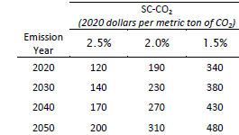
High-level takeaways
Declare victory (truce?) on the SCC, Carbon Price of Warming, and Target-Consistent Price
Key tensions
Long-term emissions path: warming in perpetuity v. temperature ceiling (=> carbon budget)?
  SCC consistent with long-term warming path
  What about +2C ceiling? (Olijslagers et al (2023) etc)
  Cost-benefit v. cost-effectiveness approach
  With cap: Carbon price = Hotelling with modifications
Quality of IAMs as policy guides
  Pindyck 2013, Stern (2016), Stern-Stiglitz-Taylor (2022)…
  Limitations of damage functions
    Top-down: focuses on GDP
    Bottom-up: excludes many damages
  IAM structure doesn’t capture uncertainty (Barnett et al (2022))
  Discounting debate
Historically low SCC’s (DICE) rejected by climate science community
  Rising et al (2022), Bastien-Olvera & Moore (2022)
In practice, at this point these debates don’t matter (at least for now)
EPA (2022) SCC and near-term Ramsey discount rate
RFF team (Science 2022): $185/ton
Moore et al. (2023) SCC meta-study: $467/ton
Notes:
Source:
U.S. Bureau of Economic Analysis
Release:
Gross Domestic Product
Units:
Chained 2012 Dollars, Seasonally Adjusted Annual Rate
Frequency:
Quarterly
BEA Account Code: A939RXFor more information about this series, please visit the Bureau of Economic Analysis.
U.S. Bureau of Economic Analysis,
Real gross domestic product per capita [A939RX0Q048SBEA],
retrieved from FRED,
Federal Reserve Bank of St. Louis;
https://fred.stlouisfed.org/series/A939RX0Q048SBEA,
January 20, 2023.
Source:
U.S. Bureau of Labor Statistics
Release:
Employment Situation
Units:
Thousands of Persons, Seasonally Adjusted
Frequency:
Monthly
All Employees: Total Nonfarm, commonly known as Total Nonfarm Payroll, is a measure of the number of U.S. workers in the economy that excludes proprietors, private household employees, unpaid volunteers, farm employees, and the unincorporated self-employed. This measure accounts for approximately 80 percent of the workers who contribute to Gross Domestic Product (GDP).This measure provides useful insights into the current economic situation because it can represent the number of jobs added or lost in an economy. Increases in employment might indicate that businesses are hiring which might also suggest that businesses are growing. Additionally, those who are newly employed have increased their personal incomes, which means (all else constant) their disposable incomes have also increased, thus fostering further economic expansion.Generally, the U.S. labor force and levels of employment and unemployment are subject to fluctuations due to seasonal changes in weather, major holidays, and the opening and closing of schools. The Bureau of Labor Statistics (BLS) adjusts the data to offset the seasonal effects to show non-seasonal changes: for example, women's participation in the labor force; or a general decline in the number of employees, a possible indication of a downturn in the economy. To closely examine seasonal and non-seasonal changes, the BLS releases two monthly statistical measures: the seasonally adjusted All Employees: Total Nonfarm (PAYEMS) and All Employees: Total Nonfarm (PAYNSA), which is not seasonally adjusted.The series comes from the 'Current Employment Statistics (Establishment Survey).'The source code is: CES0000000001
U.S. Bureau of Labor Statistics,
All Employees, Total Nonfarm [PAYEMS],
retrieved from FRED,
Federal Reserve Bank of St. Louis;
https://fred.stlouisfed.org/series/PAYEMS,
January 20, 2023.

Slide 11
Survey of recent literature on macro and climate
Remember, GPD ≠ Welfare
EPA SCC damage function is bottom up and includes mortality, energy, labor productivity, agriculture, & coastal SLR
What about:
Morbidity
Migration
Conflict
Ecosystem services
Biodiversity
Natural capital (Dasgupta Review)
Rights of nature
Notes:
Source:
U.S. Bureau of Economic Analysis
Release:
Gross Domestic Product
Units:
Chained 2012 Dollars, Seasonally Adjusted Annual Rate
Frequency:
Quarterly
BEA Account Code: A939RXFor more information about this series, please visit the Bureau of Economic Analysis.
U.S. Bureau of Economic Analysis,
Real gross domestic product per capita [A939RX0Q048SBEA],
retrieved from FRED,
Federal Reserve Bank of St. Louis;
https://fred.stlouisfed.org/series/A939RX0Q048SBEA,
January 20, 2023.
Source:
U.S. Bureau of Labor Statistics
Release:
Employment Situation
Units:
Thousands of Persons, Seasonally Adjusted
Frequency:
Monthly
All Employees: Total Nonfarm, commonly known as Total Nonfarm Payroll, is a measure of the number of U.S. workers in the economy that excludes proprietors, private household employees, unpaid volunteers, farm employees, and the unincorporated self-employed. This measure accounts for approximately 80 percent of the workers who contribute to Gross Domestic Product (GDP).This measure provides useful insights into the current economic situation because it can represent the number of jobs added or lost in an economy. Increases in employment might indicate that businesses are hiring which might also suggest that businesses are growing. Additionally, those who are newly employed have increased their personal incomes, which means (all else constant) their disposable incomes have also increased, thus fostering further economic expansion.Generally, the U.S. labor force and levels of employment and unemployment are subject to fluctuations due to seasonal changes in weather, major holidays, and the opening and closing of schools. The Bureau of Labor Statistics (BLS) adjusts the data to offset the seasonal effects to show non-seasonal changes: for example, women's participation in the labor force; or a general decline in the number of employees, a possible indication of a downturn in the economy. To closely examine seasonal and non-seasonal changes, the BLS releases two monthly statistical measures: the seasonally adjusted All Employees: Total Nonfarm (PAYEMS) and All Employees: Total Nonfarm (PAYNSA), which is not seasonally adjusted.The series comes from the 'Current Employment Statistics (Establishment Survey).'The source code is: CES0000000001
U.S. Bureau of Labor Statistics,
All Employees, Total Nonfarm [PAYEMS],
retrieved from FRED,
Federal Reserve Bank of St. Louis;
https://fred.stlouisfed.org/series/PAYEMS,
January 20, 2023.

Slide 12
High-level takeaways
Policy design: Beyond carbon pricing
Multiple externalities, multiple tools
Meet the political process where it is – or risk irrelevance
Notes:
Source:
U.S. Bureau of Economic Analysis
Release:
Gross Domestic Product
Units:
Chained 2012 Dollars, Seasonally Adjusted Annual Rate
Frequency:
Quarterly
BEA Account Code: A939RXFor more information about this series, please visit the Bureau of Economic Analysis.
U.S. Bureau of Economic Analysis,
Real gross domestic product per capita [A939RX0Q048SBEA],
retrieved from FRED,
Federal Reserve Bank of St. Louis;
https://fred.stlouisfed.org/series/A939RX0Q048SBEA,
January 20, 2023.
Source:
U.S. Bureau of Labor Statistics
Release:
Employment Situation
Units:
Thousands of Persons, Seasonally Adjusted
Frequency:
Monthly
All Employees: Total Nonfarm, commonly known as Total Nonfarm Payroll, is a measure of the number of U.S. workers in the economy that excludes proprietors, private household employees, unpaid volunteers, farm employees, and the unincorporated self-employed. This measure accounts for approximately 80 percent of the workers who contribute to Gross Domestic Product (GDP).This measure provides useful insights into the current economic situation because it can represent the number of jobs added or lost in an economy. Increases in employment might indicate that businesses are hiring which might also suggest that businesses are growing. Additionally, those who are newly employed have increased their personal incomes, which means (all else constant) their disposable incomes have also increased, thus fostering further economic expansion.Generally, the U.S. labor force and levels of employment and unemployment are subject to fluctuations due to seasonal changes in weather, major holidays, and the opening and closing of schools. The Bureau of Labor Statistics (BLS) adjusts the data to offset the seasonal effects to show non-seasonal changes: for example, women's participation in the labor force; or a general decline in the number of employees, a possible indication of a downturn in the economy. To closely examine seasonal and non-seasonal changes, the BLS releases two monthly statistical measures: the seasonally adjusted All Employees: Total Nonfarm (PAYEMS) and All Employees: Total Nonfarm (PAYNSA), which is not seasonally adjusted.The series comes from the 'Current Employment Statistics (Establishment Survey).'The source code is: CES0000000001
U.S. Bureau of Labor Statistics,
All Employees, Total Nonfarm [PAYEMS],
retrieved from FRED,
Federal Reserve Bank of St. Louis;
https://fred.stlouisfed.org/series/PAYEMS,
January 20, 2023.

Slide 13
High-level takeaways
Policy design: Beyond carbon pricing
Multiple externalities, multiple tools
Meet the political process where it is – or risk irrelevance
Mitigation policies
  Carbon pricing
  Innovation policy
  Mixed policies & sectoral/targeted policies
    Acemoglu et al (2012), Stern-Stiglitz (2017), Cole et. al (2023)
  Supply-side subsidies & industrial policy (IRA)
  International coordination
    Climate clubs – Nordhaus (2015)
  Carbon dioxide removal and nature-based solutions
    Overshoot commission (2023);
    Will we/what if we spend 2-3% of GDP on CDR?
  Corporate targets and voluntary measures
    Kaplan and Ramanna (2021), Bolton and Kacperczyk (2022, 2023)
  Degrowth
Notes:
Source:
U.S. Bureau of Economic Analysis
Release:
Gross Domestic Product
Units:
Chained 2012 Dollars, Seasonally Adjusted Annual Rate
Frequency:
Quarterly
BEA Account Code: A939RXFor more information about this series, please visit the Bureau of Economic Analysis.
U.S. Bureau of Economic Analysis,
Real gross domestic product per capita [A939RX0Q048SBEA],
retrieved from FRED,
Federal Reserve Bank of St. Louis;
https://fred.stlouisfed.org/series/A939RX0Q048SBEA,
January 20, 2023.
Source:
U.S. Bureau of Labor Statistics
Release:
Employment Situation
Units:
Thousands of Persons, Seasonally Adjusted
Frequency:
Monthly
All Employees: Total Nonfarm, commonly known as Total Nonfarm Payroll, is a measure of the number of U.S. workers in the economy that excludes proprietors, private household employees, unpaid volunteers, farm employees, and the unincorporated self-employed. This measure accounts for approximately 80 percent of the workers who contribute to Gross Domestic Product (GDP).This measure provides useful insights into the current economic situation because it can represent the number of jobs added or lost in an economy. Increases in employment might indicate that businesses are hiring which might also suggest that businesses are growing. Additionally, those who are newly employed have increased their personal incomes, which means (all else constant) their disposable incomes have also increased, thus fostering further economic expansion.Generally, the U.S. labor force and levels of employment and unemployment are subject to fluctuations due to seasonal changes in weather, major holidays, and the opening and closing of schools. The Bureau of Labor Statistics (BLS) adjusts the data to offset the seasonal effects to show non-seasonal changes: for example, women's participation in the labor force; or a general decline in the number of employees, a possible indication of a downturn in the economy. To closely examine seasonal and non-seasonal changes, the BLS releases two monthly statistical measures: the seasonally adjusted All Employees: Total Nonfarm (PAYEMS) and All Employees: Total Nonfarm (PAYNSA), which is not seasonally adjusted.The series comes from the 'Current Employment Statistics (Establishment Survey).'The source code is: CES0000000001
U.S. Bureau of Labor Statistics,
All Employees, Total Nonfarm [PAYEMS],
retrieved from FRED,
Federal Reserve Bank of St. Louis;
https://fred.stlouisfed.org/series/PAYEMS,
January 20, 2023.

Slide 14
High-level takeaways
We know little about the economic implications of the energy transition
Economic fluctuations from policy implementation & policy uncertainty
Energy security & global energy markets of the future
Long run effects on: r*, TFP growth, growth rate of (productive) capital
Notes:
Source:
U.S. Bureau of Economic Analysis
Release:
Gross Domestic Product
Units:
Chained 2012 Dollars, Seasonally Adjusted Annual Rate
Frequency:
Quarterly
BEA Account Code: A939RXFor more information about this series, please visit the Bureau of Economic Analysis.
U.S. Bureau of Economic Analysis,
Real gross domestic product per capita [A939RX0Q048SBEA],
retrieved from FRED,
Federal Reserve Bank of St. Louis;
https://fred.stlouisfed.org/series/A939RX0Q048SBEA,
January 20, 2023.
Source:
U.S. Bureau of Labor Statistics
Release:
Employment Situation
Units:
Thousands of Persons, Seasonally Adjusted
Frequency:
Monthly
All Employees: Total Nonfarm, commonly known as Total Nonfarm Payroll, is a measure of the number of U.S. workers in the economy that excludes proprietors, private household employees, unpaid volunteers, farm employees, and the unincorporated self-employed. This measure accounts for approximately 80 percent of the workers who contribute to Gross Domestic Product (GDP).This measure provides useful insights into the current economic situation because it can represent the number of jobs added or lost in an economy. Increases in employment might indicate that businesses are hiring which might also suggest that businesses are growing. Additionally, those who are newly employed have increased their personal incomes, which means (all else constant) their disposable incomes have also increased, thus fostering further economic expansion.Generally, the U.S. labor force and levels of employment and unemployment are subject to fluctuations due to seasonal changes in weather, major holidays, and the opening and closing of schools. The Bureau of Labor Statistics (BLS) adjusts the data to offset the seasonal effects to show non-seasonal changes: for example, women's participation in the labor force; or a general decline in the number of employees, a possible indication of a downturn in the economy. To closely examine seasonal and non-seasonal changes, the BLS releases two monthly statistical measures: the seasonally adjusted All Employees: Total Nonfarm (PAYEMS) and All Employees: Total Nonfarm (PAYNSA), which is not seasonally adjusted.The series comes from the 'Current Employment Statistics (Establishment Survey).'The source code is: CES0000000001
U.S. Bureau of Labor Statistics,
All Employees, Total Nonfarm [PAYEMS],
retrieved from FRED,
Federal Reserve Bank of St. Louis;
https://fred.stlouisfed.org/series/PAYEMS,
January 20, 2023.

Slide 15
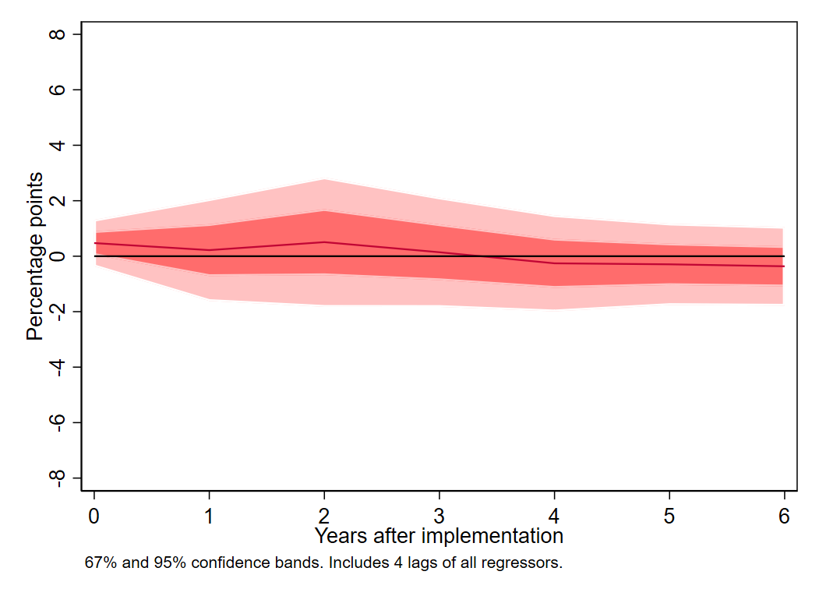
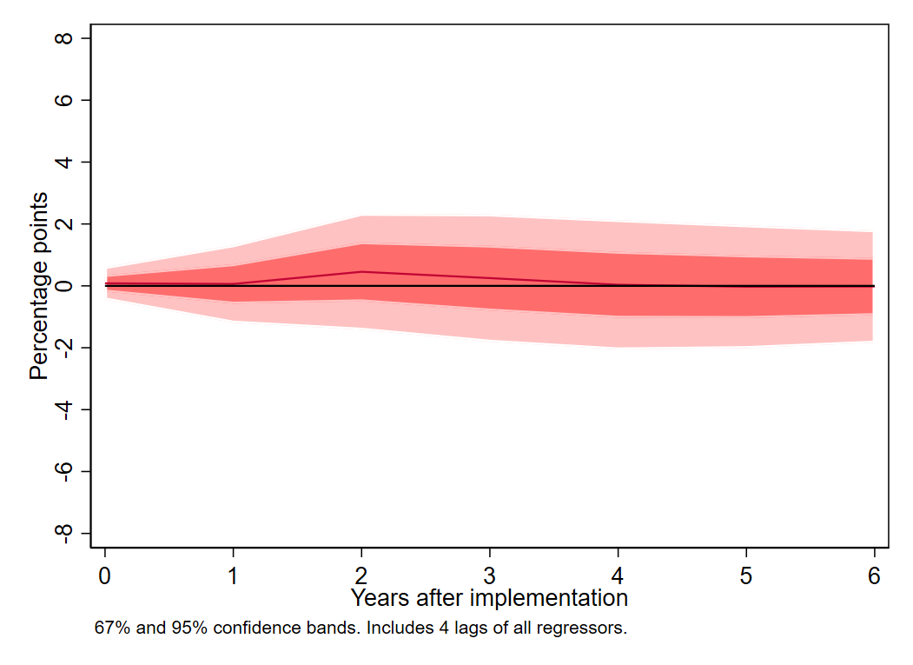
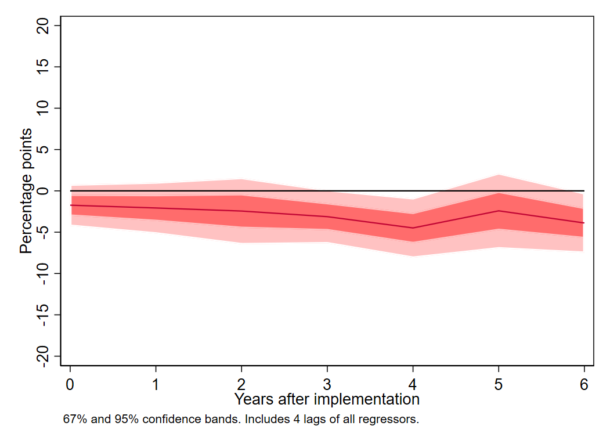
Example: short-term macro effects of a carbon tax (Metcalf-Stock 2023) v. cap & trade (Känzig 2023)
Data
EU+ (31 countries in EU-ETS)
15 have carbon taxes, imposed mainly on transport sector, at different levels, starting at different dates
Method:
Panel local projections, identified by tax timing
Findings:
Negligible effect on GDP or employment
Modest effect on emissions
  In line with elasticity of demand for petroleum
Caveats:
Aggregate effect masks sectoral & regional reallocation & job loss/gain
Possibly greater macro costs from cap & trade system (EU ETS – Känzig 2023), perhaps b/c of price volatility, perhaps sectoral coverage
CARBON TAX: Metcalf-Stock (2023)
GDP (log level)
No effect
Impulse responses: effect of a $40 carbon tax on 30% of emissions
Emissions in covered sectors (log level)
2-6% reduction
Employment (log level)
No effect

Slide 16
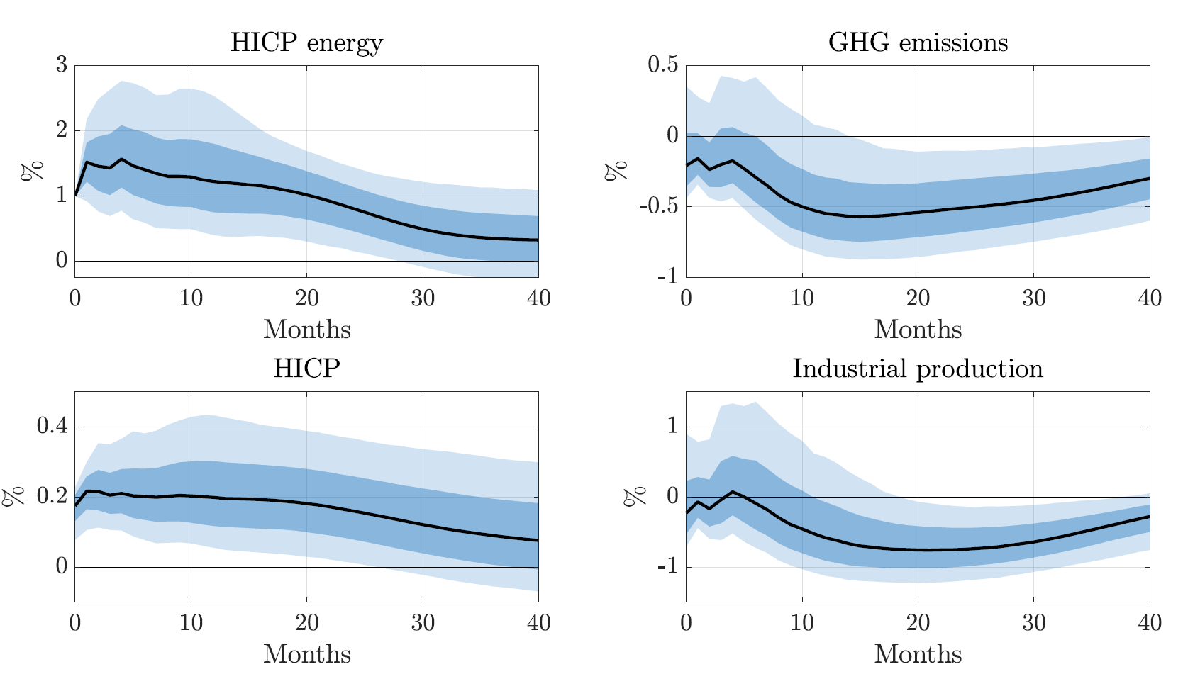
Example: short-term macro effects of a carbon tax (Metcalf-Stock 2023) v. cap & trade (Känzig 2023)
CAP AND TRADE: Känzig (2023)
Effect of a EU-ETS shock on Euro-wide:
Data:
EU-wide macro time series
EU-ETS prices
Method:
SVAR-IV
Instrument: ETS price changes around ETS announcement windows
Results:
Inflationary pressures + decline in economic activity
Decline in GHG emissions largely in line with direct effect being reduction in activity
Source: Käanzig (2023)

Slide 17
High-level takeaways
We know little about the economic implications of the energy transition
Economic fluctuations from policy implementation & policy uncertainty
Energy security & global energy markets of the future
Long run effects on: r*, TFP growth, growth rate of (productive) capital
Notes:
Source:
U.S. Bureau of Economic Analysis
Release:
Gross Domestic Product
Units:
Chained 2012 Dollars, Seasonally Adjusted Annual Rate
Frequency:
Quarterly
BEA Account Code: A939RXFor more information about this series, please visit the Bureau of Economic Analysis.
U.S. Bureau of Economic Analysis,
Real gross domestic product per capita [A939RX0Q048SBEA],
retrieved from FRED,
Federal Reserve Bank of St. Louis;
https://fred.stlouisfed.org/series/A939RX0Q048SBEA,
January 20, 2023.
Source:
U.S. Bureau of Labor Statistics
Release:
Employment Situation
Units:
Thousands of Persons, Seasonally Adjusted
Frequency:
Monthly
All Employees: Total Nonfarm, commonly known as Total Nonfarm Payroll, is a measure of the number of U.S. workers in the economy that excludes proprietors, private household employees, unpaid volunteers, farm employees, and the unincorporated self-employed. This measure accounts for approximately 80 percent of the workers who contribute to Gross Domestic Product (GDP).This measure provides useful insights into the current economic situation because it can represent the number of jobs added or lost in an economy. Increases in employment might indicate that businesses are hiring which might also suggest that businesses are growing. Additionally, those who are newly employed have increased their personal incomes, which means (all else constant) their disposable incomes have also increased, thus fostering further economic expansion.Generally, the U.S. labor force and levels of employment and unemployment are subject to fluctuations due to seasonal changes in weather, major holidays, and the opening and closing of schools. The Bureau of Labor Statistics (BLS) adjusts the data to offset the seasonal effects to show non-seasonal changes: for example, women's participation in the labor force; or a general decline in the number of employees, a possible indication of a downturn in the economy. To closely examine seasonal and non-seasonal changes, the BLS releases two monthly statistical measures: the seasonally adjusted All Employees: Total Nonfarm (PAYEMS) and All Employees: Total Nonfarm (PAYNSA), which is not seasonally adjusted.The series comes from the 'Current Employment Statistics (Establishment Survey).'The source code is: CES0000000001
U.S. Bureau of Labor Statistics,
All Employees, Total Nonfarm [PAYEMS],
retrieved from FRED,
Federal Reserve Bank of St. Louis;
https://fred.stlouisfed.org/series/PAYEMS,
January 20, 2023.

Slide 18


Example: Macro costs of climate policy uncertainty
Literature
Gavriilidis (2021)
Basaglia et al (2021)
Noailly et al (2022)
Fried, Novan, & Peterman (2021)
Engle et al (2020)
Sautner et al (2020)
Not just the U.S.!
Carbon tax in Canada
Carbon tax in Australia
U.K. and EVs, FF production
Germany and coal

Slide 19
Measuring climate policy uncertainty
Data set:
Climate policy uncertainty index (CPU): Gavriilidis (2021); cf. Engel et al (2020)
  Akin to Baker-Bloom-Davis Economic Policy Uncertainty construction
  15 million news articles from 8 newspapers starting mid-80s
  Dictionary method:
    climate (carbon dioxide, climate change, emission(s),…)
    + policy (legislative, white house, regulation, carbon tax,…)
    + uncertainty
    - exclusions (business climate, economic climate,…)
  including climate terms and policy terms and uncertainty
  Correlation with BBD EPU ≈ 0.7
  Monthly
Method: LP & SVAR
Identification: CPU shock satisfies conditional mean independence given contemporaneous control variables: BBD-EPU, IP, unemployment rate, PCE inflation, WTI price, 90-day T-bill rate
Caveats: Usual BBD EPU caveats

Slide 20
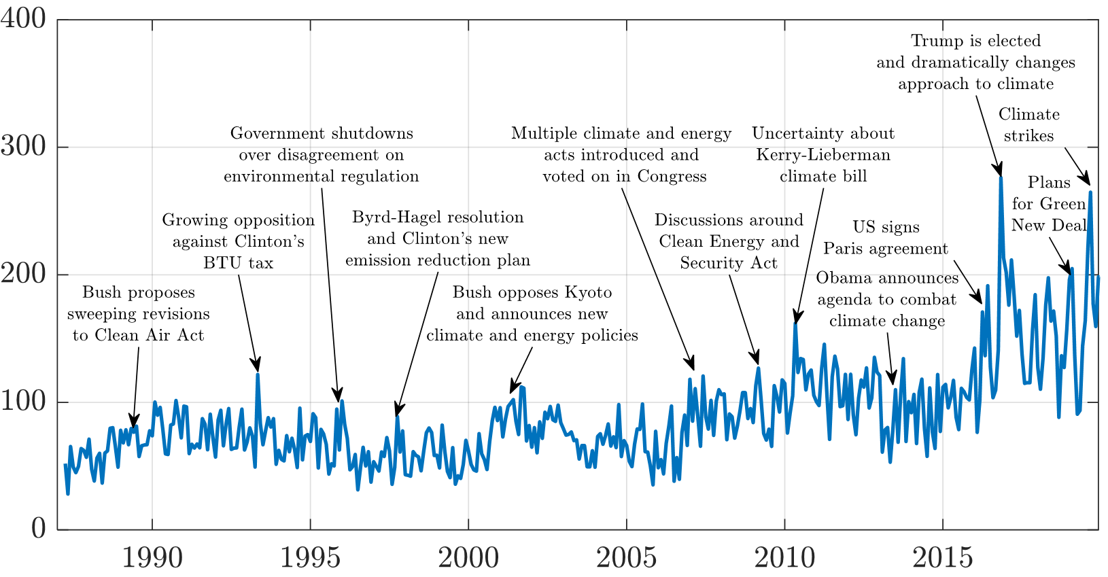
Measuring climate policy uncertainty
Climate policy uncertainty index
Source: Gavriilidis, Känzig, & Stock (in progress)

Slide 21
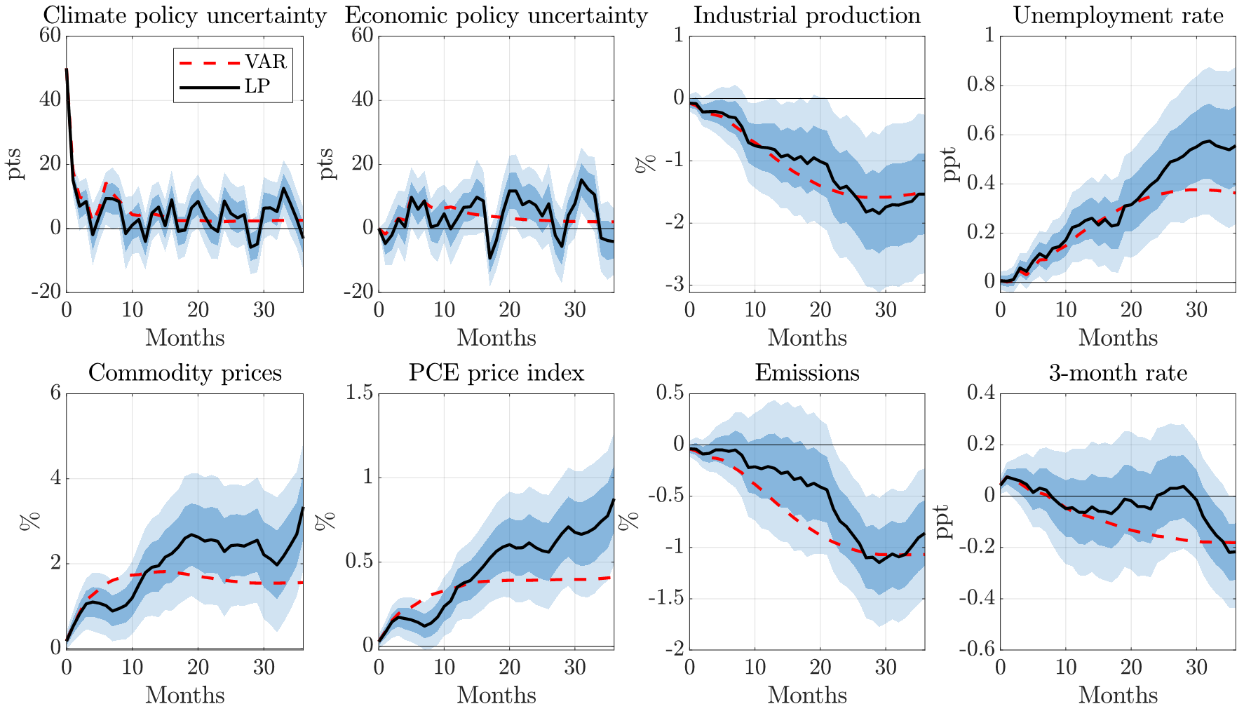
Climate policy uncertainty: IRFs, 50 point CPU shock, LP

Slide 22
High-level takeaways
We know little about the economic implications of the energy transition
Economic fluctuations from policy implementation & policy uncertainty
Energy security & global energy markets of the future
Long run effects on: r*, TFP growth, growth rate of (productive) capital
Notes:
Source:
U.S. Bureau of Economic Analysis
Release:
Gross Domestic Product
Units:
Chained 2012 Dollars, Seasonally Adjusted Annual Rate
Frequency:
Quarterly
BEA Account Code: A939RXFor more information about this series, please visit the Bureau of Economic Analysis.
U.S. Bureau of Economic Analysis,
Real gross domestic product per capita [A939RX0Q048SBEA],
retrieved from FRED,
Federal Reserve Bank of St. Louis;
https://fred.stlouisfed.org/series/A939RX0Q048SBEA,
January 20, 2023.
Source:
U.S. Bureau of Labor Statistics
Release:
Employment Situation
Units:
Thousands of Persons, Seasonally Adjusted
Frequency:
Monthly
All Employees: Total Nonfarm, commonly known as Total Nonfarm Payroll, is a measure of the number of U.S. workers in the economy that excludes proprietors, private household employees, unpaid volunteers, farm employees, and the unincorporated self-employed. This measure accounts for approximately 80 percent of the workers who contribute to Gross Domestic Product (GDP).This measure provides useful insights into the current economic situation because it can represent the number of jobs added or lost in an economy. Increases in employment might indicate that businesses are hiring which might also suggest that businesses are growing. Additionally, those who are newly employed have increased their personal incomes, which means (all else constant) their disposable incomes have also increased, thus fostering further economic expansion.Generally, the U.S. labor force and levels of employment and unemployment are subject to fluctuations due to seasonal changes in weather, major holidays, and the opening and closing of schools. The Bureau of Labor Statistics (BLS) adjusts the data to offset the seasonal effects to show non-seasonal changes: for example, women's participation in the labor force; or a general decline in the number of employees, a possible indication of a downturn in the economy. To closely examine seasonal and non-seasonal changes, the BLS releases two monthly statistical measures: the seasonally adjusted All Employees: Total Nonfarm (PAYEMS) and All Employees: Total Nonfarm (PAYNSA), which is not seasonally adjusted.The series comes from the 'Current Employment Statistics (Establishment Survey).'The source code is: CES0000000001
U.S. Bureau of Labor Statistics,
All Employees, Total Nonfarm [PAYEMS],
retrieved from FRED,
Federal Reserve Bank of St. Louis;
https://fred.stlouisfed.org/series/PAYEMS,
January 20, 2023.

Slide 23


Changing natural gas market (Stock & Zaragosa-Watkins (2023))
Ukraine, natural gas prices, & cyclical implications
of fossil fuel price shocks for US
  Three regimes in US gas markets:
  <= ~2006: growing & large imports
  2010 – 2016: Fracking & “locked in”
  2016 – present: LNG exports
Cheniere Sabine Pass Train 1 was placed into service May 2016.
Fast LNG facility

Slide 24
Natural gas prices, LNG, and macro implications: Summary
Because of increasing LNG exports, accelerated by the invasion of Ukraine, U.S. natural gas prices are reconnecting to global natural gas & oil markets
We can therefore anticipate a prolonged period of U.S. higher natural gas prices ($6-$8?)
The impact of this price increase on power sector emissions, relative to recent projections (e.g., AEO 2022) is roughly that of a $50 carbon tax, and larger than the IRA

Slide 25
Global natural gas prices track oil prices

Slide 26
Cointegration results by institutional regime, U.S.
Ib
Ia
II
III

Slide 27
Implications
Implications for the macroeconomy
  Increased domestic exposure to global energy price shocks
Scenario | HH price (2022 $/mmBtu) | 2030 emissions relative to 2007 peak | Delta from BAU (pp)
BAU | $3.10 | 46% | -
IRA only | $3.10 | 62% | -15 pp
LNG only | $5.10 | 57% | -11 pp
IRA + LNG | $5.10 | 72% | -26 pp
IRA + LNG | $7.10 | 76% | -30 pp
Implications for the energy transition
  Back-of-envelope estimates of U.S. power sector emissions in 2030, relative to 2007 peak, for various natural gas prices
Implications for long-term energy markets?
  Ammonia, e-fuels, bio-based SAFs will all compete in the same global markets – presumably, alongside petroleum with CDR/DAC
  Continuing threats to “energy security”?
Notes: LNG emissions counterfactuals use Stock & Stuart (2021a) ReEDS simulations for the power sector

Slide 28
High-level takeaways
We know little about the economic implications of the energy transition
Economic fluctuations from policy implementation & policy uncertainty
Energy security & global energy markets of the future
Long run effects on: r*, TFP growth, growth rate of (productive) capital
 | Long run π*, r*, u*, μ
Physical | Lower average crop yields Lower productivity sea level rise adaptation costs,…
Transition (Human systems) | green investment demand shifts in types of jobs/skills monetary policy decision (no accommodation of smooth increase) Fiscal theory of price level concerns Long run productivity growth Growth of productive capital (think CDR)
Notes:
Source:
U.S. Bureau of Economic Analysis
Release:
Gross Domestic Product
Units:
Chained 2012 Dollars, Seasonally Adjusted Annual Rate
Frequency:
Quarterly
BEA Account Code: A939RXFor more information about this series, please visit the Bureau of Economic Analysis.
U.S. Bureau of Economic Analysis,
Real gross domestic product per capita [A939RX0Q048SBEA],
retrieved from FRED,
Federal Reserve Bank of St. Louis;
https://fred.stlouisfed.org/series/A939RX0Q048SBEA,
January 20, 2023.
Source:
U.S. Bureau of Labor Statistics
Release:
Employment Situation
Units:
Thousands of Persons, Seasonally Adjusted
Frequency:
Monthly
All Employees: Total Nonfarm, commonly known as Total Nonfarm Payroll, is a measure of the number of U.S. workers in the economy that excludes proprietors, private household employees, unpaid volunteers, farm employees, and the unincorporated self-employed. This measure accounts for approximately 80 percent of the workers who contribute to Gross Domestic Product (GDP).This measure provides useful insights into the current economic situation because it can represent the number of jobs added or lost in an economy. Increases in employment might indicate that businesses are hiring which might also suggest that businesses are growing. Additionally, those who are newly employed have increased their personal incomes, which means (all else constant) their disposable incomes have also increased, thus fostering further economic expansion.Generally, the U.S. labor force and levels of employment and unemployment are subject to fluctuations due to seasonal changes in weather, major holidays, and the opening and closing of schools. The Bureau of Labor Statistics (BLS) adjusts the data to offset the seasonal effects to show non-seasonal changes: for example, women's participation in the labor force; or a general decline in the number of employees, a possible indication of a downturn in the economy. To closely examine seasonal and non-seasonal changes, the BLS releases two monthly statistical measures: the seasonally adjusted All Employees: Total Nonfarm (PAYEMS) and All Employees: Total Nonfarm (PAYNSA), which is not seasonally adjusted.The series comes from the 'Current Employment Statistics (Establishment Survey).'The source code is: CES0000000001
U.S. Bureau of Labor Statistics,
All Employees, Total Nonfarm [PAYEMS],
retrieved from FRED,
Federal Reserve Bank of St. Louis;
https://fred.stlouisfed.org/series/PAYEMS,
January 20, 2023.

Slide 29
High-level takeaways
Macroeconomics of adaptation: provide underpinnings of future adaptation policy
Notes:
Source:
U.S. Bureau of Economic Analysis
Release:
Gross Domestic Product
Units:
Chained 2012 Dollars, Seasonally Adjusted Annual Rate
Frequency:
Quarterly
BEA Account Code: A939RXFor more information about this series, please visit the Bureau of Economic Analysis.
U.S. Bureau of Economic Analysis,
Real gross domestic product per capita [A939RX0Q048SBEA],
retrieved from FRED,
Federal Reserve Bank of St. Louis;
https://fred.stlouisfed.org/series/A939RX0Q048SBEA,
January 20, 2023.
Source:
U.S. Bureau of Labor Statistics
Release:
Employment Situation
Units:
Thousands of Persons, Seasonally Adjusted
Frequency:
Monthly
All Employees: Total Nonfarm, commonly known as Total Nonfarm Payroll, is a measure of the number of U.S. workers in the economy that excludes proprietors, private household employees, unpaid volunteers, farm employees, and the unincorporated self-employed. This measure accounts for approximately 80 percent of the workers who contribute to Gross Domestic Product (GDP).This measure provides useful insights into the current economic situation because it can represent the number of jobs added or lost in an economy. Increases in employment might indicate that businesses are hiring which might also suggest that businesses are growing. Additionally, those who are newly employed have increased their personal incomes, which means (all else constant) their disposable incomes have also increased, thus fostering further economic expansion.Generally, the U.S. labor force and levels of employment and unemployment are subject to fluctuations due to seasonal changes in weather, major holidays, and the opening and closing of schools. The Bureau of Labor Statistics (BLS) adjusts the data to offset the seasonal effects to show non-seasonal changes: for example, women's participation in the labor force; or a general decline in the number of employees, a possible indication of a downturn in the economy. To closely examine seasonal and non-seasonal changes, the BLS releases two monthly statistical measures: the seasonally adjusted All Employees: Total Nonfarm (PAYEMS) and All Employees: Total Nonfarm (PAYNSA), which is not seasonally adjusted.The series comes from the 'Current Employment Statistics (Establishment Survey).'The source code is: CES0000000001
U.S. Bureau of Labor Statistics,
All Employees, Total Nonfarm [PAYEMS],
retrieved from FRED,
Federal Reserve Bank of St. Louis;
https://fred.stlouisfed.org/series/PAYEMS,
January 20, 2023.

Slide 30

High-level takeaways
Much more work is needed on risk cascades, tail risks, and deep uncertainty of the energy transition
Climate-prudential monetary policy (NGFS, ongoing)
Risk cascades:
  Example: wildfires and California home insurance as a (small) risk cascade
Tail risk:
  Example: Geopolitical risk
Events that economists missed include:
Great Depression
Oil crisis & inflation of 1970s
Financial crisis
COVID & post-COVID inflation
Invasion of Ukraine
What lurks in the energy transition?
Notes:
Source:
U.S. Bureau of Economic Analysis
Release:
Gross Domestic Product
Units:
Chained 2012 Dollars, Seasonally Adjusted Annual Rate
Frequency:
Quarterly
BEA Account Code: A939RXFor more information about this series, please visit the Bureau of Economic Analysis.
U.S. Bureau of Economic Analysis,
Real gross domestic product per capita [A939RX0Q048SBEA],
retrieved from FRED,
Federal Reserve Bank of St. Louis;
https://fred.stlouisfed.org/series/A939RX0Q048SBEA,
January 20, 2023.
Source:
U.S. Bureau of Labor Statistics
Release:
Employment Situation
Units:
Thousands of Persons, Seasonally Adjusted
Frequency:
Monthly
All Employees: Total Nonfarm, commonly known as Total Nonfarm Payroll, is a measure of the number of U.S. workers in the economy that excludes proprietors, private household employees, unpaid volunteers, farm employees, and the unincorporated self-employed. This measure accounts for approximately 80 percent of the workers who contribute to Gross Domestic Product (GDP).This measure provides useful insights into the current economic situation because it can represent the number of jobs added or lost in an economy. Increases in employment might indicate that businesses are hiring which might also suggest that businesses are growing. Additionally, those who are newly employed have increased their personal incomes, which means (all else constant) their disposable incomes have also increased, thus fostering further economic expansion.Generally, the U.S. labor force and levels of employment and unemployment are subject to fluctuations due to seasonal changes in weather, major holidays, and the opening and closing of schools. The Bureau of Labor Statistics (BLS) adjusts the data to offset the seasonal effects to show non-seasonal changes: for example, women's participation in the labor force; or a general decline in the number of employees, a possible indication of a downturn in the economy. To closely examine seasonal and non-seasonal changes, the BLS releases two monthly statistical measures: the seasonally adjusted All Employees: Total Nonfarm (PAYEMS) and All Employees: Total Nonfarm (PAYNSA), which is not seasonally adjusted.The series comes from the 'Current Employment Statistics (Establishment Survey).'The source code is: CES0000000001
U.S. Bureau of Labor Statistics,
All Employees, Total Nonfarm [PAYEMS],
retrieved from FRED,
Federal Reserve Bank of St. Louis;
https://fred.stlouisfed.org/series/PAYEMS,
January 20, 2023.

Slide 31
Additional Slides

Slide 32
2. Mitigation risk: Mitigation policy and the energy transition
  Mitigation policy
    Carbon pricing
    Innovation policy
    Mixed policies & sectoral/targeted policies
      Acemoglu et al (2012), Stern-Stiglitz (2017), Cole et. al (2023)
    International coordination
      Climate clubs – Nordhaus (2015)
    Carbon dioxide removal and nature-based solutions
      Overshoot commission (2023); 2-3% of GDP on CDR?
    Corporate targets and voluntary measures
      Kaplan and Ramanna (2021), Bolton and Kacperczyk (2022, 2023)
    Degrowth
  Short- and medium-term macro effects of mitigation policies
    Carbon tax
    Cap-and-trade
    Subsidies
    Industrial policy
    Climate policy uncertainty
  Energy security
  Long-run effects (r*, TFP growth, growth of (productive) capital
  Risk cascades and risk amplifiers
  Tail risk (e.g., declining petro states, climate migration)
Notes:
Source:
U.S. Bureau of Economic Analysis
Release:
Gross Domestic Product
Units:
Chained 2012 Dollars, Seasonally Adjusted Annual Rate
Frequency:
Quarterly
BEA Account Code: A939RXFor more information about this series, please visit the Bureau of Economic Analysis.
U.S. Bureau of Economic Analysis,
Real gross domestic product per capita [A939RX0Q048SBEA],
retrieved from FRED,
Federal Reserve Bank of St. Louis;
https://fred.stlouisfed.org/series/A939RX0Q048SBEA,
January 20, 2023.
Source:
U.S. Bureau of Labor Statistics
Release:
Employment Situation
Units:
Thousands of Persons, Seasonally Adjusted
Frequency:
Monthly
All Employees: Total Nonfarm, commonly known as Total Nonfarm Payroll, is a measure of the number of U.S. workers in the economy that excludes proprietors, private household employees, unpaid volunteers, farm employees, and the unincorporated self-employed. This measure accounts for approximately 80 percent of the workers who contribute to Gross Domestic Product (GDP).This measure provides useful insights into the current economic situation because it can represent the number of jobs added or lost in an economy. Increases in employment might indicate that businesses are hiring which might also suggest that businesses are growing. Additionally, those who are newly employed have increased their personal incomes, which means (all else constant) their disposable incomes have also increased, thus fostering further economic expansion.Generally, the U.S. labor force and levels of employment and unemployment are subject to fluctuations due to seasonal changes in weather, major holidays, and the opening and closing of schools. The Bureau of Labor Statistics (BLS) adjusts the data to offset the seasonal effects to show non-seasonal changes: for example, women's participation in the labor force; or a general decline in the number of employees, a possible indication of a downturn in the economy. To closely examine seasonal and non-seasonal changes, the BLS releases two monthly statistical measures: the seasonally adjusted All Employees: Total Nonfarm (PAYEMS) and All Employees: Total Nonfarm (PAYNSA), which is not seasonally adjusted.The series comes from the 'Current Employment Statistics (Establishment Survey).'The source code is: CES0000000001
U.S. Bureau of Labor Statistics,
All Employees, Total Nonfarm [PAYEMS],
retrieved from FRED,
Federal Reserve Bank of St. Louis;
https://fred.stlouisfed.org/series/PAYEMS,
January 20, 2023.

Slide 33
Natural gas 101
Prices: $/mmBTU
Quantities:
1 Mcf (1000 cubic feet ) = 1.037 mmBTU
In 2021, U.S. consumed 30 B mmBtu
US Henry Hub 2021 average price = $6.45/mmBtu
Total value = ~$200B
Cf: crude oil consumption = ~$575B in 2021
Natural gas is difficult to transport. Two methods:
Pipeline
Liquified natural gas (LNG)

Slide 34
Background: Climate Risks (Carney 2015)
1. Physical
Timeline of macro impacts
Low frequency
  Long-term damages
  Social Cost of Carbon
Business cycle frequency
Heat waves
Storms
Regional crop failures
Sea level rise
Climate migration
2. Transition
Asset revaluation
Energy price volatility
Sectoral reallocation
Food price volatility
Policy effects
3. Liability
  Corporate (ExxonMobil suits, etc.)
  Sovereign (Loss and damage)

Slide 35
Background: Which climate impacts (“climate risks”)?
Risks
Abrupt irreversible events
Climate migration
Sea level rise
Geopolitical strife
Demographic consequences
Regional crop failures
Food insecurity
Novel health risks
Energy price volatility
Climate policy variability
Food price volatility
Sectoral labor reallocation
Insurance market stress
Heat waves
Key
Policy uncertainty
Physical risks
Asset revaluation
Storms
Human impacts
Floods
Energy transition
Horizon
Monetary policy
Growth, fiscal projections
Social Cost of Carbon
Timing and magnitudes are illustrative.

Slide 36
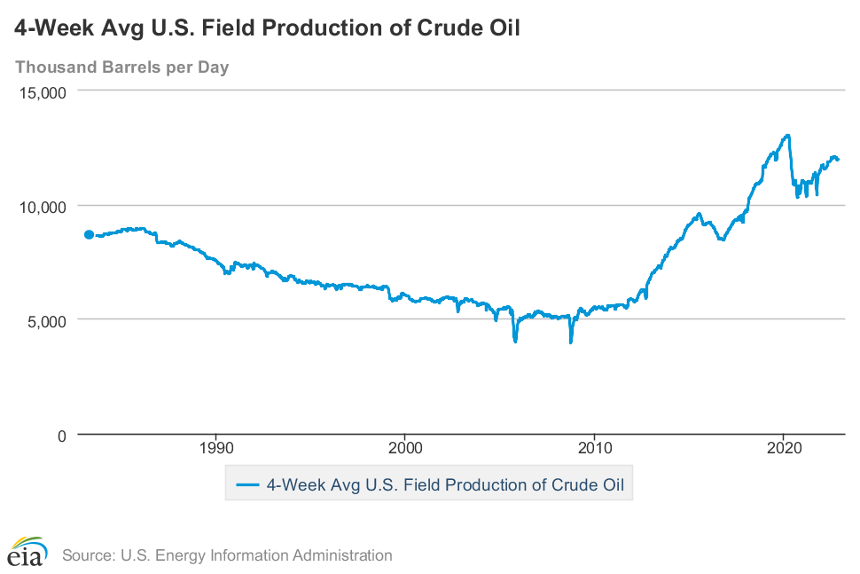
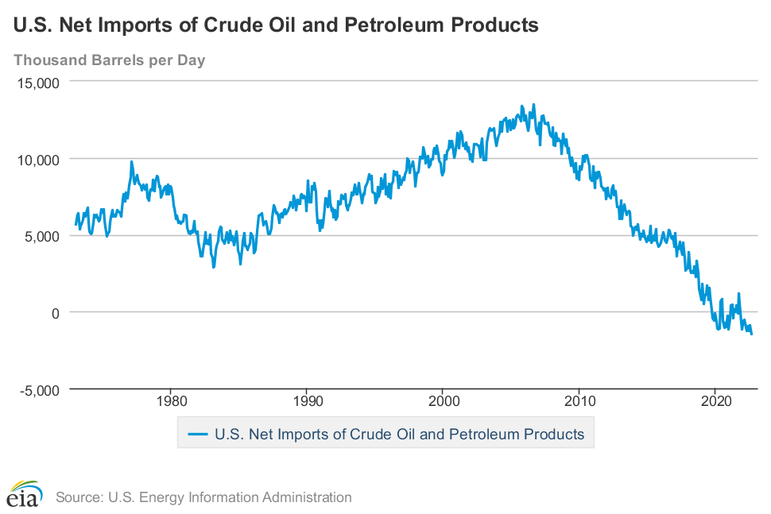
The U.S. has become a net oil exporter
Key references on macro impacts of oil shocks: Känzig (AER, 2021), Baumeister & Kilian (BPEA, 2016)
Notes:
Source:
U.S. Bureau of Labor Statistics
Release:
Employment Situation
Units:
Percent, Seasonally Adjusted
Frequency:
Monthly
The unemployment rate represents the number of unemployed as a percentage of the labor force. Labor force data are restricted to people 16 years of age and older, who currently reside in 1 of the 50 states or the District of Columbia, who do not reside in institutions (e.g., penal and mental facilities, homes for the aged), and who are not on active duty in the Armed Forces.
This rate is also defined as the U-3 measure of labor underutilization.
The series comes from the 'Current Population Survey (Household Survey)'
The source code is: LNS14000000
U.S. Bureau of Labor Statistics,
Unemployment Rate [UNRATE],
retrieved from FRED,
Federal Reserve Bank of St. Louis;
https://fred.stlouisfed.org/series/UNRATE,
November 9, 2022.
Source:
Federal Reserve Bank of St. Louis
Release:
Spliced Oil Price
Units:
Dollars per Barrel, Not Seasonally Adjusted
Frequency:
Monthly
This series was created by the Federal Reserve Bank of St. Louis to expand the history of the monthly West Texas Intermediate oil price series in FRED. We simply combined these two FRED series: https://fred.stlouisfed.org/series/OILPRICE and https://fred.stlouisfed.org/series/MCOILWTICO. From January 1946 through July 2013, the series used is OILPRICE. From August 2013 to present, the series used is MCOILWTICO.
Federal Reserve Bank of St. Louis,
Spot Crude Oil Price: West Texas Intermediate (WTI) [WTISPLC],
retrieved from FRED,
Federal Reserve Bank of St. Louis;
https://fred.stlouisfed.org/series/WTISPLC,
November 9, 2022.

Slide 37
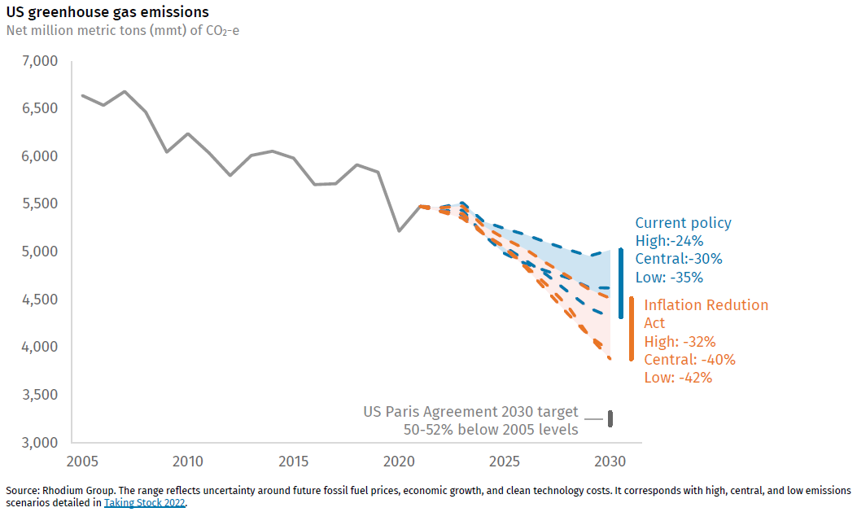
IRA emissions reductions (Biden new Paris/Glasgow target: 50% reduction by 2030, rel. to 2005)
Rhodium
  2030 projections with IRA: 32% - 42%
  IRA Delta = 7pp - 10pp

Slide 38
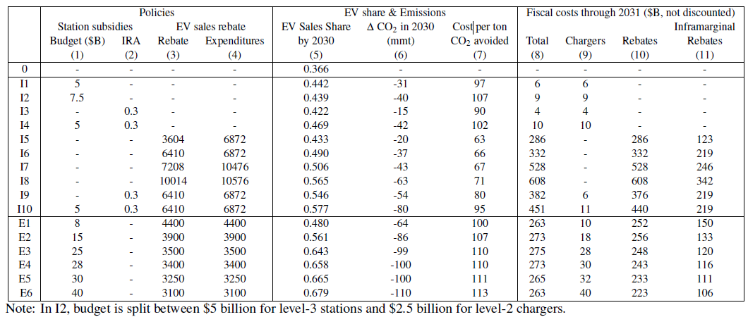
Fiscal costs and cost per ton: EV components (LDVs only) of IIJA & IRA
Source: Cole, Droste, Knittel, Li, & Stock (AER P&P 2023)
Incentives included:
$3750 EV purchase tax credit if FTA-sourced minerals, s.t. income & price caps
$3750 EV purchase tax credit if battery assembled in North America , s.t. income & price caps
$4000 used EV tax credit, s.t. income & price caps
$5B interstate Fast charger state grants (IIJA)
$2.5B disadvantaged community charger grants (IIJA)
30% charger tax credit (available to ~99% of municipalities)
CBO/JCT score of these IIJA
  + IRA provisions = $15.6B
Back of envelope:
  8.5m EVs x $7500 = $64B in 2030
More? Mehrotra & Wolfram,
BPEA, Spring 2023

