Slide 1
47 quarters
Macrodynamics During
the COVID Crisis
James H. Stock, Harvard University
Mark W. Watson, Princeton University
Forecasting Club of New York
February 11, 2021
New UI claims
41 weeks

Slide 2
  Motivating questions and analytical framework
Have macrodynamics changed during the COVID crisis?
If so, is there a low-dimensional way to characterize the changes?
What are implications for the post-pandemic recovery?
(Methods) how can we do macroeconometrics post-pandemic?
Framework
135 variable dynamic factor model, estimated by principal components (real activity variables)
Estimate 3 “old” factors and factor loadings over 1984m1-2019m12
Use old factor loadings to construct 2020 values of “old” factors
Given 2020 values of factors, do old factor loadings explain the movements of observed variables?
Is there a new pandemic factor (yes)
Check if factor dynamics have changed (1-step ahead POOS forecasts using pre-2019 factor VAR)
What are implications for post-pandemic recovery?

Slide 3
  Data
135 monthly macro time series
PCE (23)
Retail sales (19)
Personal income (14)
Establishment survey (30)
Household survey (13)
Industrial production (36)
Transform to stationarity (mainly growth rates)
Standardize over 1984m1-2019m12
Factor estimation:
Three full-sample factors, estimated by principal components 1984m1-2019m12
A single “2020” factor: = 0 <=2019m12
Estimation:
  Compute factor 1-3 values for 2020 using pre-2020 factor loadings
  Compute residual of each series from its “old factor” common component
  Compute principal component of residualized series

Slide 4
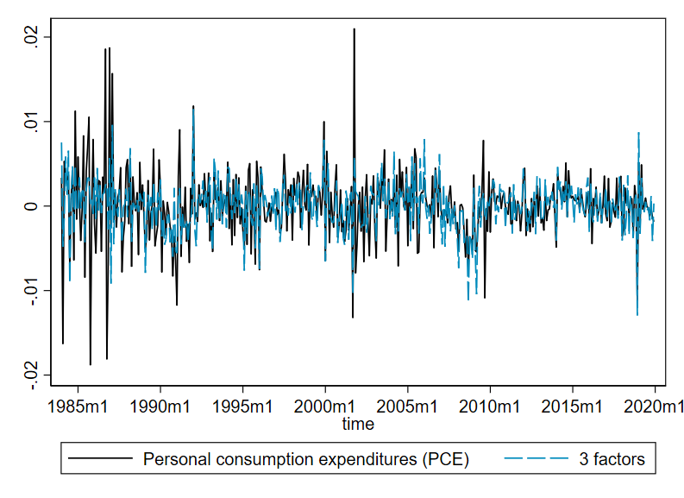
  Data and common component for “old” factors – selected series

Slide 5
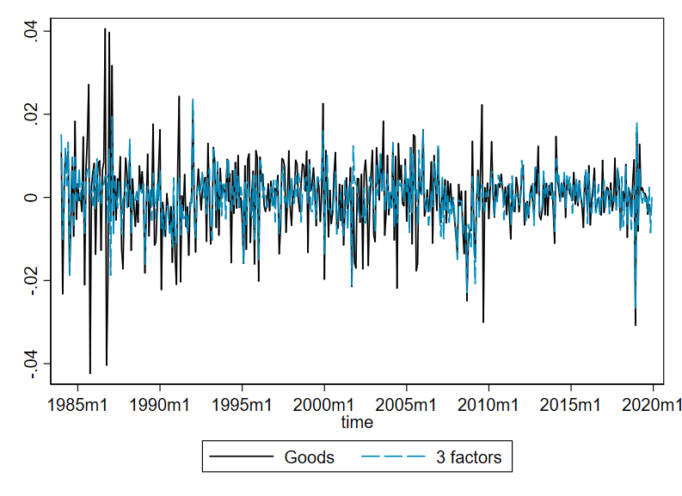
  Data and common component for “old” factors – selected series

Slide 6
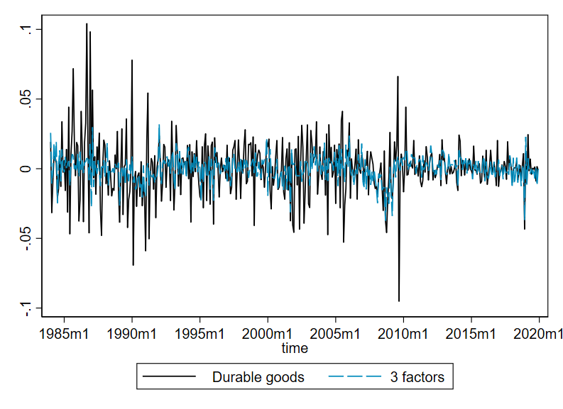
  Data and common component for “old” factors – selected series

Slide 7
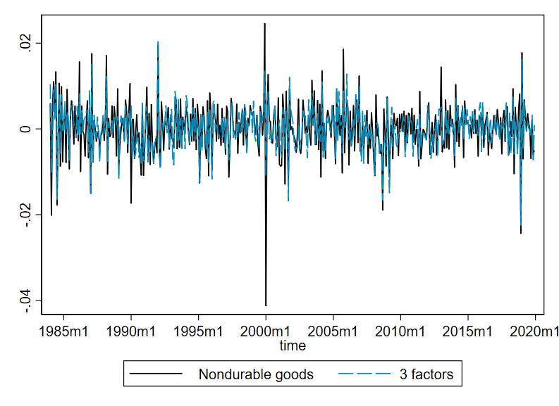
  Data and common component for “old” factors – selected series

Slide 8
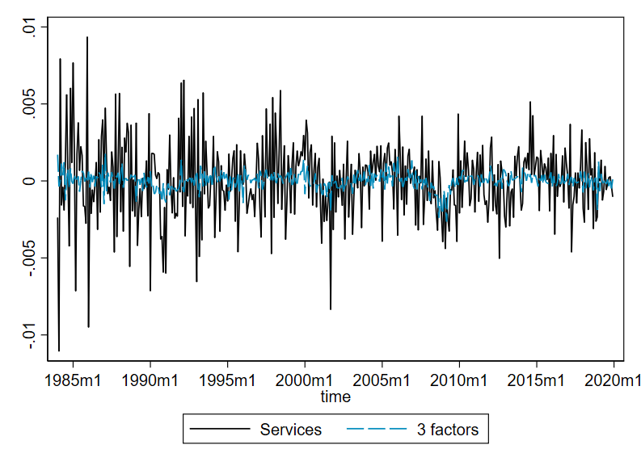
  Data and common component for “old” factors – selected series

Slide 9
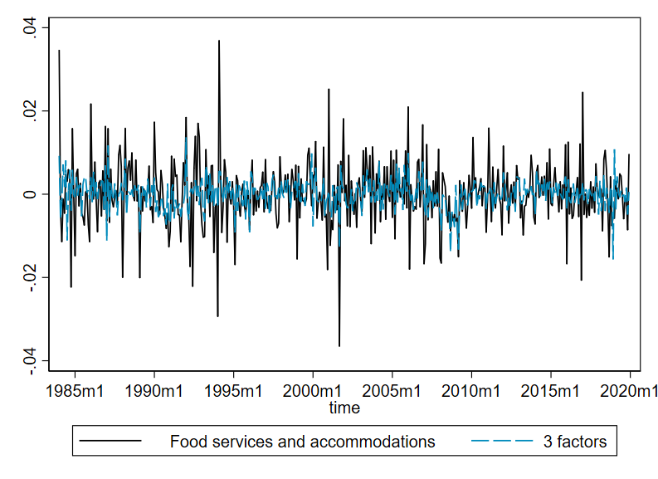
  Data and common component for “old” factors – selected series

Slide 10
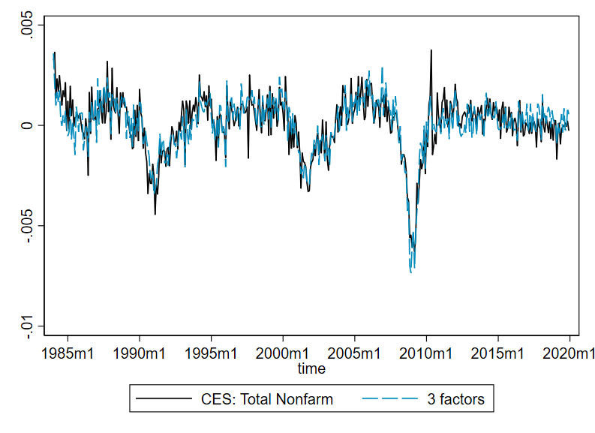
  Data and common component for “old” factors – selected series

Slide 11
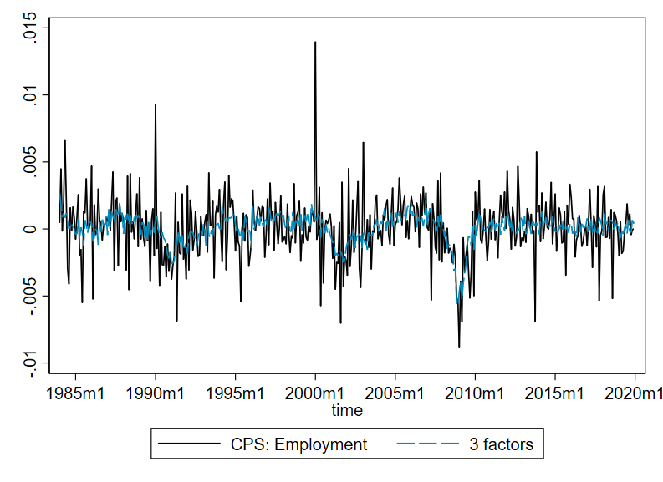
  Data and common component for “old” factors – selected series

Slide 12
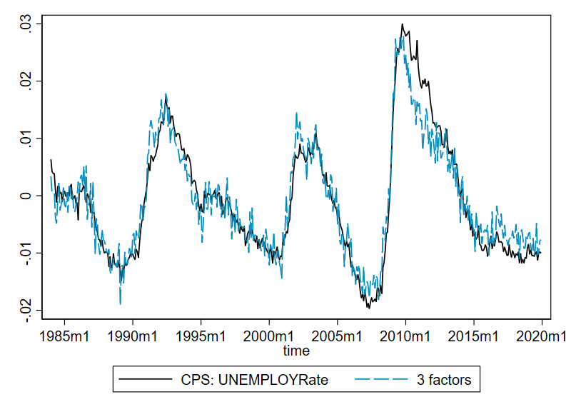
  Data and common component for “old” factors – selected series

Slide 13
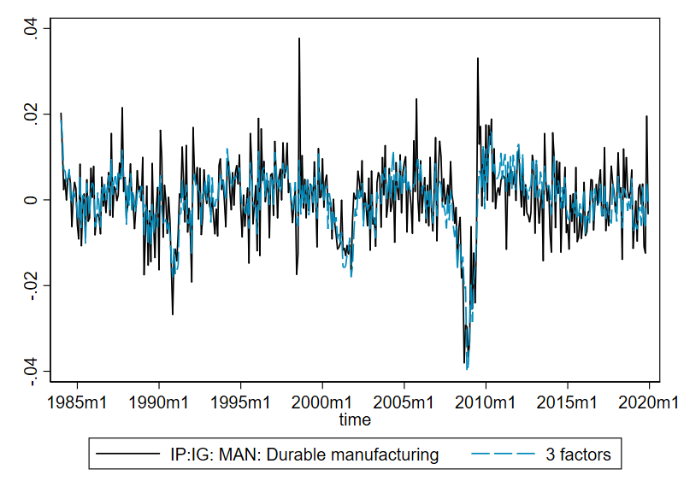
  Data and common component for “old” factors – selected series

Slide 14
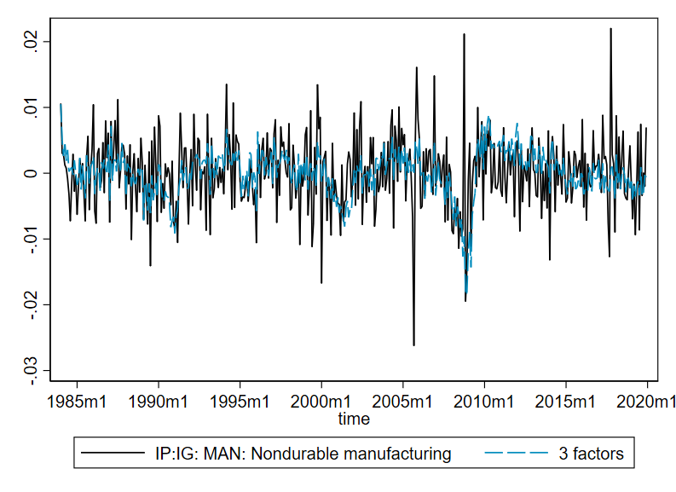
  Data and common component for “old” factors – selected series

Slide 15
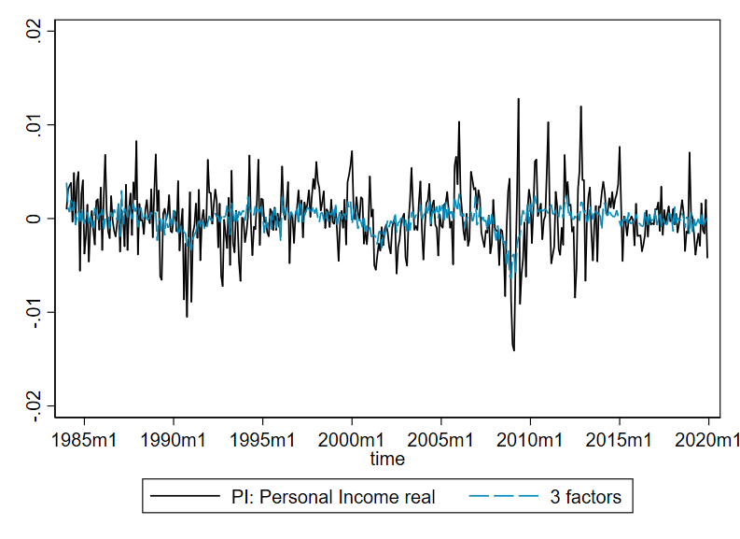
  Data and common component for “old” factors – selected series

Slide 16
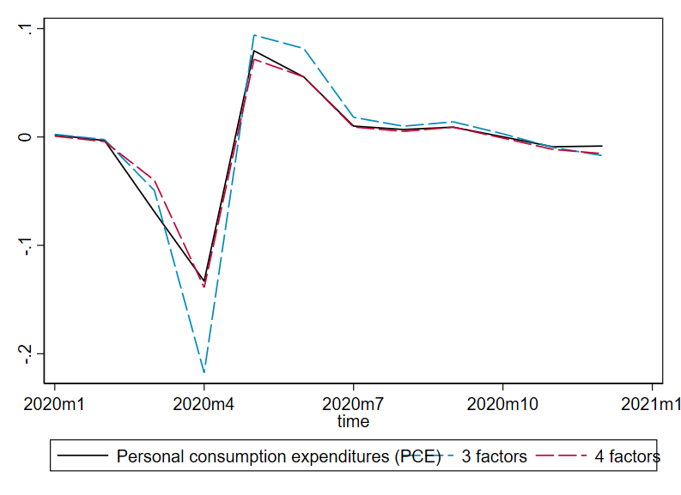
  Data and common component for “old” and “old+new” factors

Slide 17
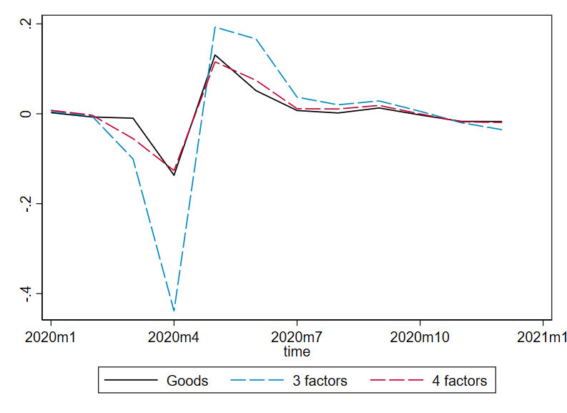
  Data and common component for “old” and “old+new” factors

Slide 18
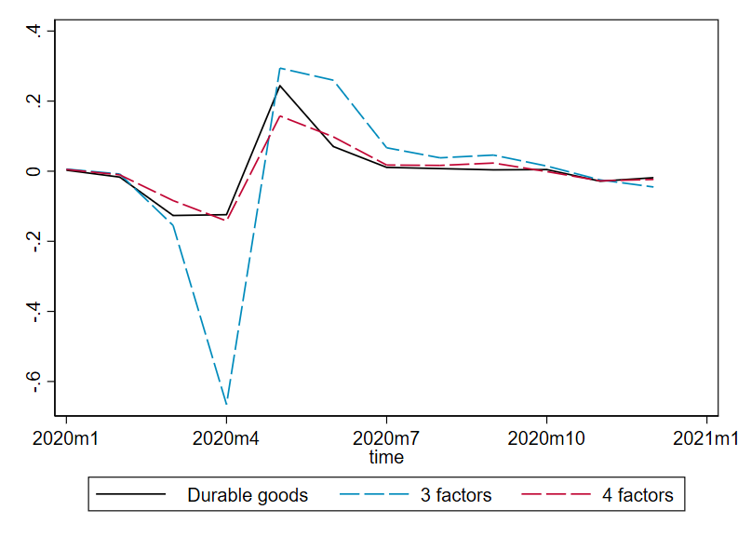
  Data and common component for “old” and “old+new” factors

Slide 19
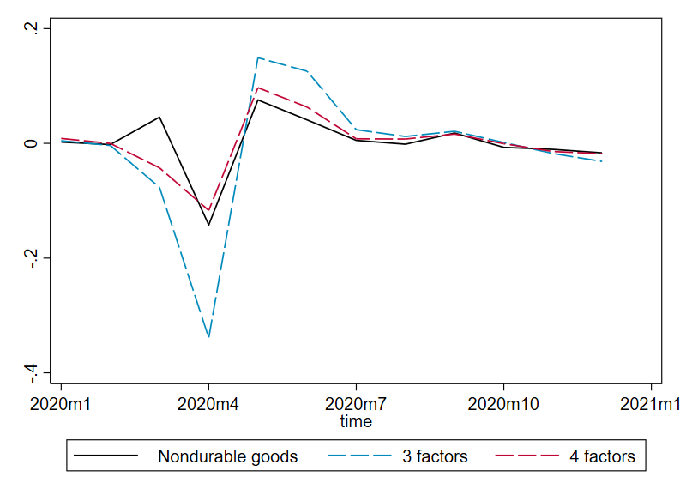
  Data and common component for “old” and “old+new” factors

Slide 20
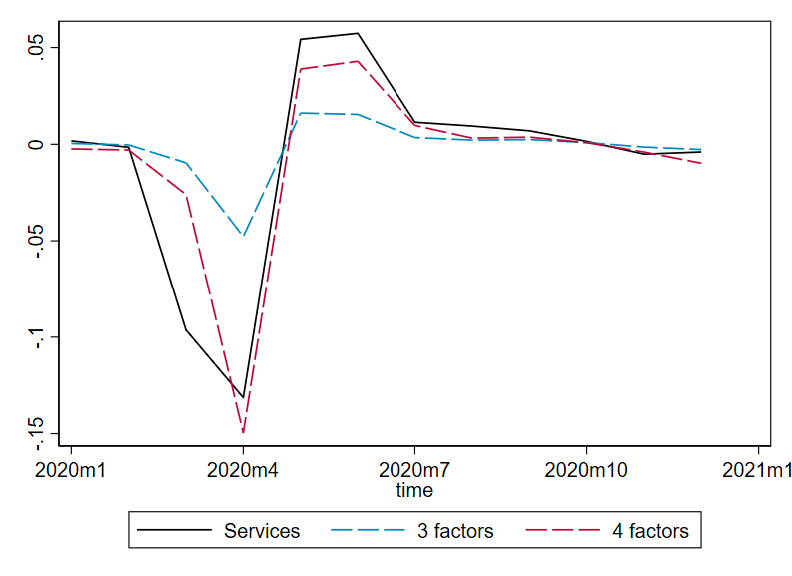
  Data and common component for “old” and “old+new” factors

Slide 21
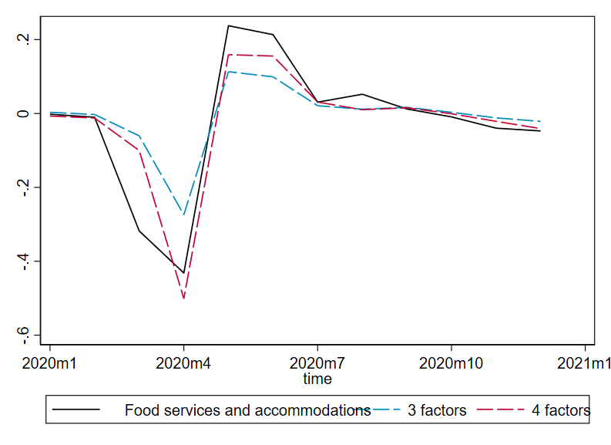
  Data and common component for “old” and “old+new” factors

Slide 22
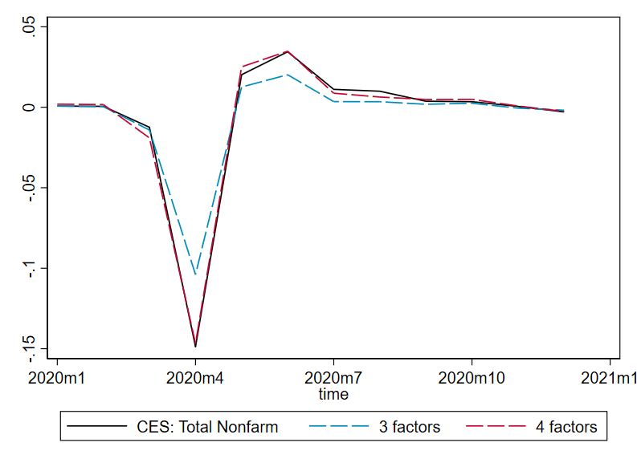
  Data and common component for “old” and “old+new” factors

Slide 23
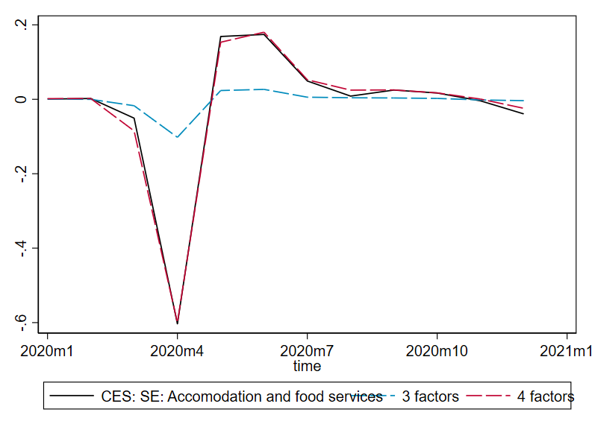
  Data and common component for “old” and “old+new” factors

Slide 24
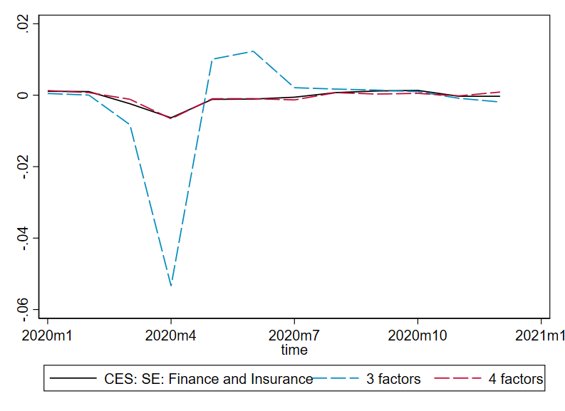
  Data and common component for “old” and “old+new” factors

Slide 25
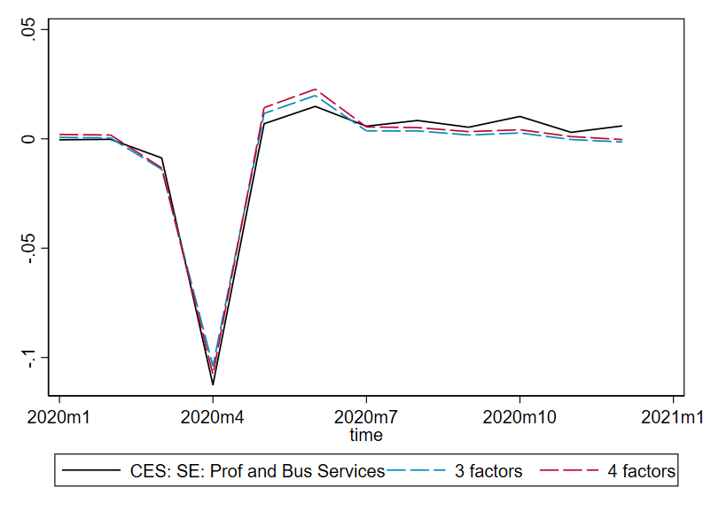
  Data and common component for “old” and “old+new” factors

Slide 26
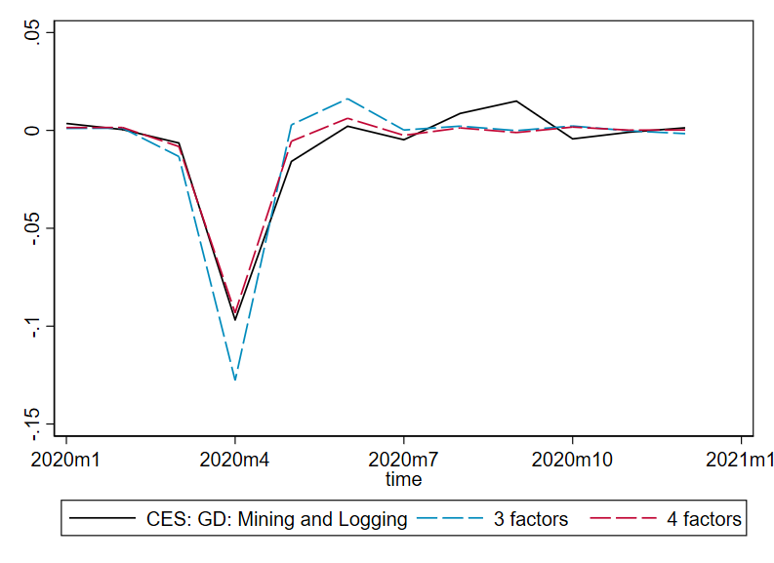
  Data and common component for “old” and “old+new” factors

Slide 27
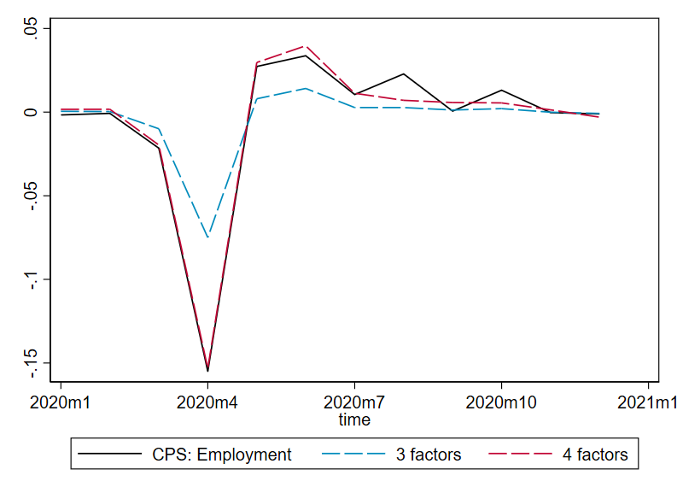
  Data and common component for “old” and “old+new” factors

Slide 28
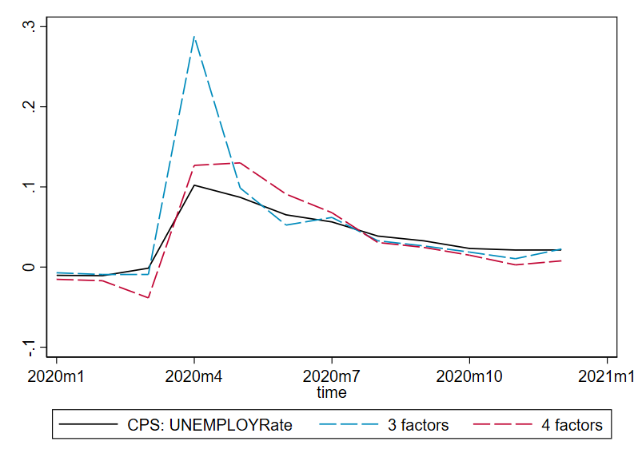
  Data and common component for “old” and “old+new” factors

Slide 29
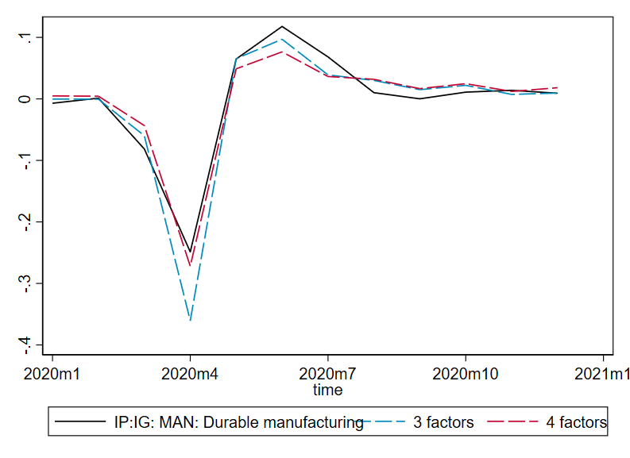
  Data and common component for “old” and “old+new” factors

Slide 30
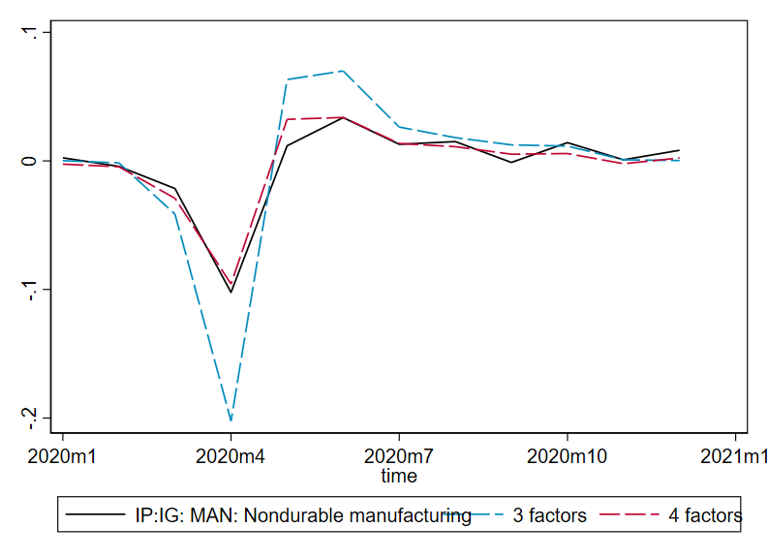
  Data and common component for “old” and “old+new” factors

Slide 31
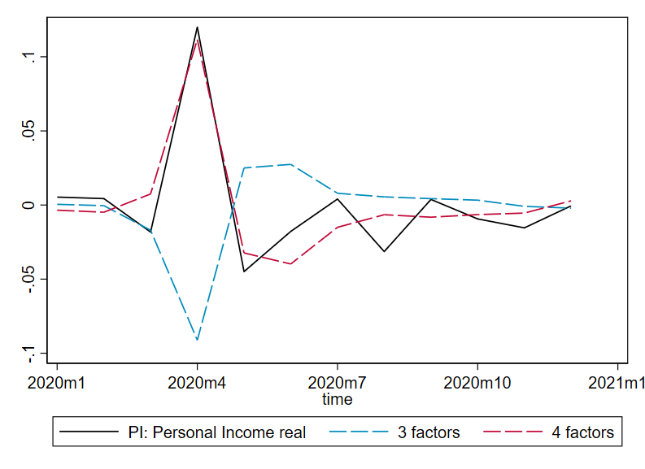
  Data and common component for “old” and “old+new” factors

Slide 32
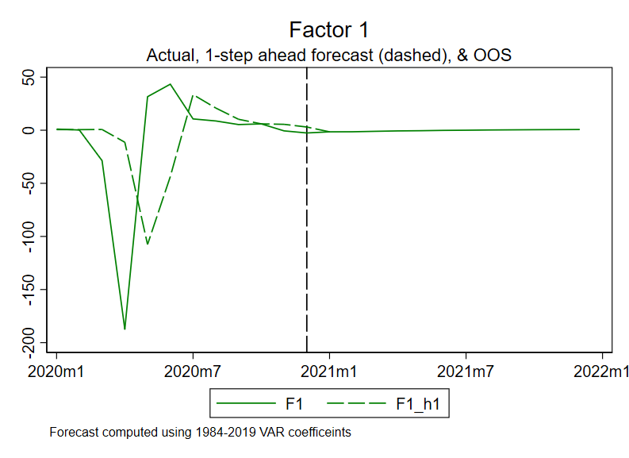
  Factor dynamics

Slide 33
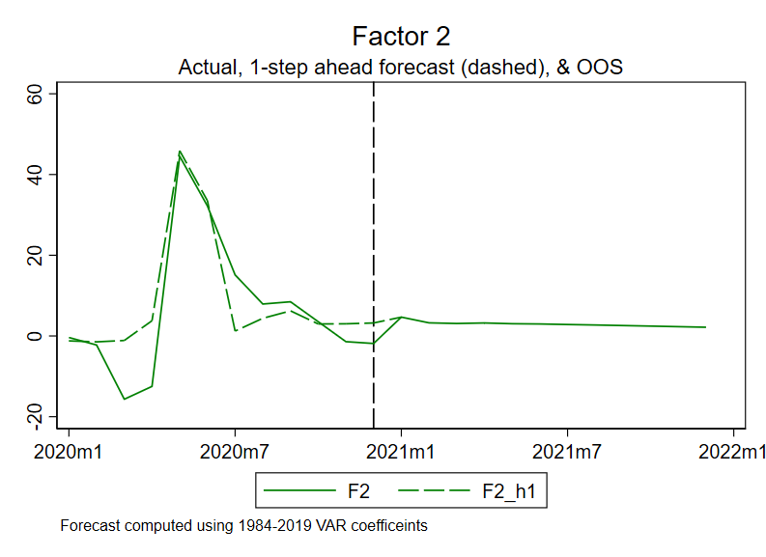
  Factor dynamics

Slide 34
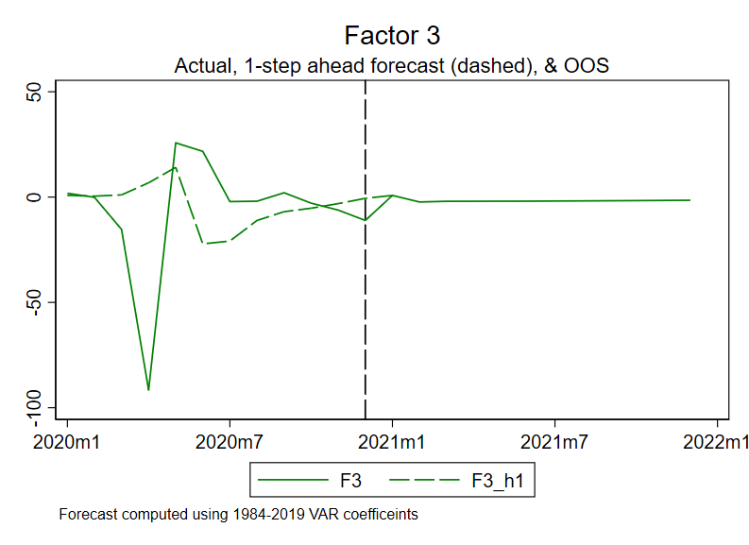
  Factor dynamics

Slide 35
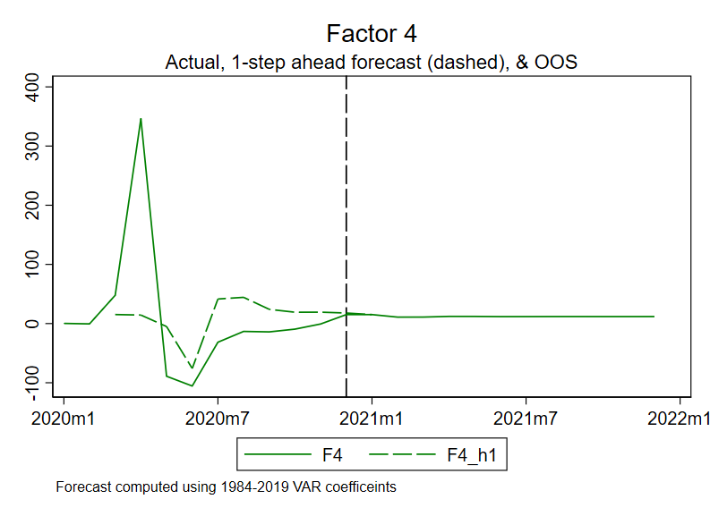
  Factor dynamics

Slide 36
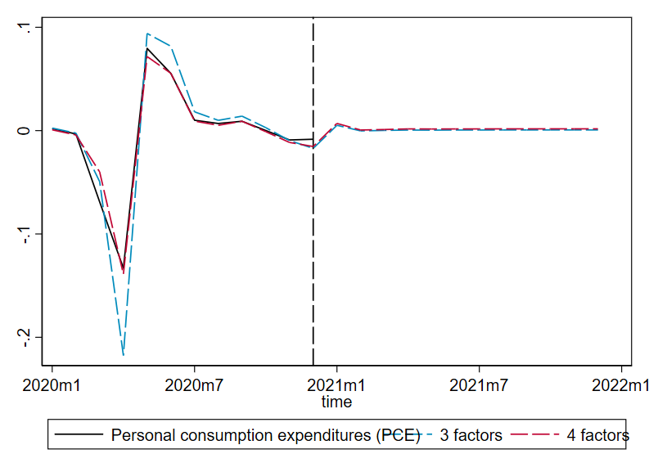
  Projections: post-pandemic recovery

Slide 37
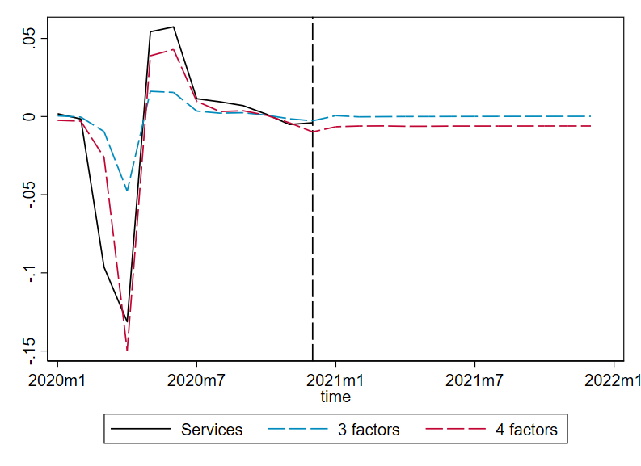
  Projections: post-pandemic recovery

Slide 38
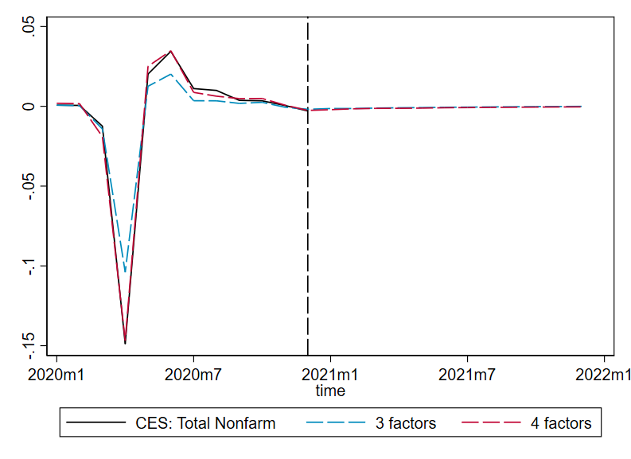
  Projections: post-pandemic recovery

Slide 39
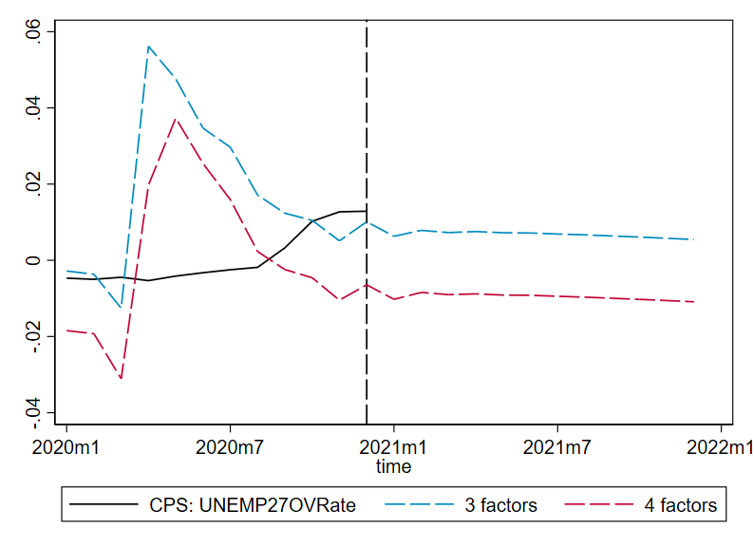
  Projections: post-pandemic recovery

Slide 40
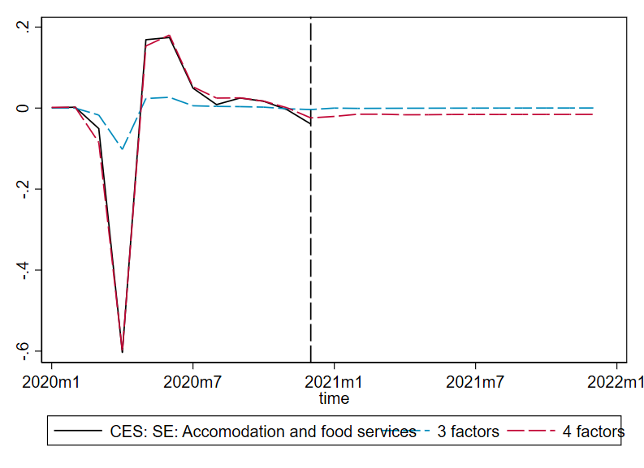
  Projections: post-pandemic recovery

Slide 41
  Summary
Have macrodynamics changed during the COVID crisis?
Not, it seems, the “old” dynamics – but a new factor
2. If so, is there a low-dimensional way to characterize the changes?
Yes, a single new COVID (sectoral shift) factor
3. What are implications for the post-pandemic recovery?
Pre-pandemic dynamics seem OK at explaining “old” factors
4. (Methods) how can we do macroeconometrics post-pandemic?
  Maybe, DFM setup with transient factor…
What are implications for post-pandemic recovery?
TBD…

