Slide 1

International Monetary Fund
IMF short course on:
The Macroeconomic Impact of
Carbon Pricing
James H. Stock
Economics Department, Harvard University
Harvard Kennedy School
Salata Institute for Climate & Sustainability
January 22, 2024

Slide 2
Course outline
I. Introduction
Big picture: Substitution v. energy efficiency
Big picture: Carbon policy menu
II. Elements of macro of carbon pricing
Macro of carbon pricing: Nordhaus (1982)
Carbon pricing and variants: comparative statics
  Carbon tax, cap & trade: demand restraint, substitution of factors of production
  Clean energy standards; production tax credits
CT v. C&T: Differences in practice (ref: Stavins NBER-EEPE 2022)
  Administration, allowance allocation
  Static uncertainty (Weitzman)
  Investment under uncertainty
Macro costs of carbon pricing – conventional toolkit
  CGE models
  [DICE (Nordhaus (1992) ) -> IAMs]
III. Empirical evidence
Methods: LP, SVAR, LP-IV, SVAR-IV
  Stock-Watson (EJ 2018), Plagborg-Møller & Wolf (ECMA 2022)
Carbon tax: Metcalf-Stock (2023)
Cap & trade: Känzig (2021)
Climate policy uncertainty
Concluding remarks

Slide 3
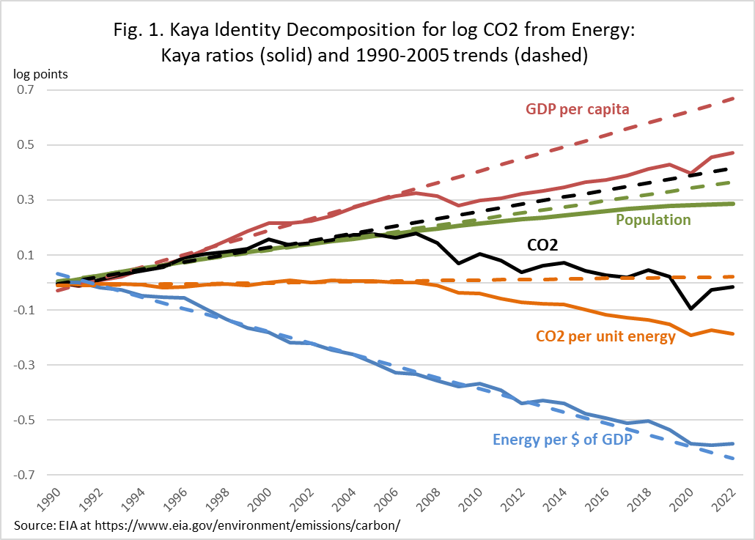
IA. Big picture: Kaya identity for the US: 1990-2022
Kaya identity:
In growth rates:
U.S. data: long-span growth at annual rates
 | CO2 | CO2/E | E/GDP | GDP/Pop | Pop
1990-2005 | 1.2% | 0.0% | -1.9% | 2.0% | 1.1%
2005-2022 | -1.1% | -1.1% | -1.7% | 1.0% | 0.7%
Difference | -2.3% | -1.2% | 0.2% | -1.0% | -0.4%
How does this relate to carbon pricing? The main action comes from CO2/Energy, not Energy/GDP

Slide 4
IB. Big picture: Carbon policy options (partial list)
Externalities
Greenhouse gas externality
Innovation externality
Other
  Financial market failures
  Network externalities
  Chicken-and-egg (e.g., EVs and charging stations)
Economy-wide or sectoral policies
Carbon tax
Cap & trade
Tradeable performance standards
Innovation policy
Green investment incentives (green industrial policy)
Sectoral policies
Clean electricity standard
Renewable portfolio standard
Low-carbon fuel standard
Green consumption subsidies (e.g., EV tax credits)
Information provision (e.g., energy efficiency labels)
Specialized: transmission policies, charging station policies,…
Supply side policies (fossil fuel leasing)
The focus of this course is the macro impact of carbon pricing – but carbon pricing is only one tool in the decarbonization toolkit, and other (large) policies could have macro consequences too.

Slide 5
Course outline
I. Introduction
Big picture: Substitution v. energy efficiency
Big picture: Carbon policy menu
II. Elements of macro of carbon pricing
Macro of carbon pricing: Nordhaus (1982)
Carbon pricing and variants: comparative statics
  Carbon tax, cap & trade: demand restraint, substitution of factors of production
  Clean energy standards; production tax credits
CT v. C&T: Differences in practice (ref: Stavins NBER-EEPE 2022)
  Administration, allowance allocation
  Static uncertainty (Weitzman)
  Investment under uncertainty
Macro costs of carbon pricing – conventional toolkit
  CGE models
  [DICE (Nordhaus (1992) ) -> IAMs]
III. Empirical evidence
Methods: LP, SVAR, LP-IV, SVAR-IV
  Stock-Watson (EJ 2018), Plagborg-Møller & Wolf (ECMA 2022)
Carbon tax: Metcalf-Stock (2023)
Cap & trade: Känzig (2021)
Climate policy uncertainty
Concluding remarks

Slide 6
IIA. Carbon pricing fundamentals: Nordhaus (1982)
Economic policy for mitigating emissions emerged when low-carbon energy was prohibitively expensive
Nordhaus (AER P&P 1982):
where
f = economy-wide production function assuming energy use is proportional to emissions
h = damage function from cumulative CO2 emissions
b = CO2 Earth uptake rate (close to zero – very long half-life in atmosphere)
Social planner optimal steady state: Let q(t) = shadow value of carbon = incremental consumption cost from increment in emissions. In steady state along the optimal path,
In words: Shadow cost of carbon = marginal cost of abatement = marginal NPV of damages
That is: Carbon price = marginal cost of abatement = SCC (dynamic version of Pigouvian taxation)
Key features: o Basic idea: Marginal cost = marginal benefit
o Single energy source, single externality, single policy tool (carbon price)
o No technical progress (exogenous or endogenous)
=> economics of self-restraint

Slide 7
IIB. Carbon pricing fundamentals: economics of self-restraint
Review of carbon tax and cap-and-trade: Static case/no uncertainty
Consider market for demand for electricity generated from natural gas:
(a) with a carbon tax (b) under cap-and-trade
Price
Price
P’
S
P’
S
P*
P*
Price of tradeable permit
tax
D
Q’
Q*
Quantity of electricity
Q’
Q*
Quantity of electricity
Implementation
Downstream: Tax on fossil fuel consumption (emitters)
Upstream: Mine mouth/gas collection hub/refinery with rebate for exports
  Usual suggestion is upstream
Implementation
Auction off tradeable permits
Or, hand out permits to all obligated parties, then allow trading
Hand in 1 allowance for each ton emitted

Slide 8
IIB. Carbon pricing fundamentals: substitution of clean for dirty – power sector example
Carbon tax and cap-and-trade: Static case/no uncertainty
Suppose there are two sources of power: coal and solar
(a) No policy
Price
S-solar
S-coal
S-total = S-coal + S-solar
P*
D
Q*-solar
Q*-coal
Q*
Quantity of electricity
Demand for electricity is demand for electrons regardless of source
Coal and solar generators receive the same price

Slide 9
Carbon tax in power sector: incentive for substituting clean for dirty power
Carbon tax and cap-and-trade: Static case/no uncertainty
Suppose there are two sources of power: coal and solar
(b) Carbon tax or cap & trade with auctioned allowances
Price
S-solar
S’-coal
S-coal
S’
S-total = S-coal + S-solar
P’
P*
tax
D
Q*-solar
Q*-coal
Q*
Quantity of electricity
Demand for electricity is demand for electrons regardless of source
Coal and solar generators receive the same price per kWh – but coal generators must pay a carbon tax

Slide 10
Carbon tax in power sector: incentive for substituting clean for dirty power
Carbon tax and cap-and-trade: Static case/no uncertainty
Suppose there are two sources of power: coal and solar
(b) Carbon tax or cap & trade with auctioned allowances
Price
S-solar
S’-coal
S-coal
S’
S-total = S-coal + S-solar
P’
Emissions reductions come from both substitution in production of power (generally, energy services) and demand effect of a change in the price of power.
The more inelastic is power demand, the more important is the substitution in production channel
P*
tax
D
Q*-solar
Q’-solar
Q’-coal
Q*-coal
Q’
Q*
Quantity of electricity
Demand for electricity is demand for electrons regardless of source
Consumer price goes up, total quantity decreases, quantity of solar increases, quantity of coal declines by more than quantity of solar increases
Price of additional solar generation, and closing coal plants, is borne by electricity customers

Slide 11
Carbon tax in power sector: incentive for substituting clean for dirty power
Carbon tax and cap-and-trade: Static case/no uncertainty
Suppose there are two sources of power: coal and solar
(c) Subsidy for solar through production tax credit (PTC)
Price
S-solar
S’-solar
S-coal
S-total = S-coal + S-solar
S’
P*
P’
PTC
D
Q*-solar
Q’-solar
Q’-coal
Q*-coal
Q*
Q’
Quantity of electricity
Demand for electricity is demand for electrons regardless of source
Consumer price goes down, total quantity increases, quantity of solar increases, quantity of coal declines by less than quantity of solar increases
Price of additional solar generation, and closing coal plants, is borne by taxpayer (future generations, if deficit financed)

Slide 12
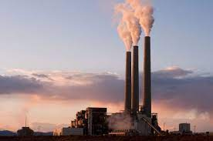



Carbon pricing fundamentals: how standards with tradable allowances work
Standards: how the tradable allowance system works
Standards regulate on a per-unit of output basis (miles per gallon; tons CO2/MWh; % clean per MWh, etc.)
Example: Clean Electricity Standard (CES) with an 80% clean mandate administered by US EPA, trading clean energy credits (CECs)
Coal plant generates 1 MWSh, must retire 0.8x1 = 0.8 CECs, which it must buy on the market
EPA retires credits but does not buy/sell CECs, so no fiscal impact
0.8 CEC
$ for CEC
0.8 CEC
3.2 CECs
1 MWh
Bump in electricity price to pay for more expensive solar
Solar farm produces 4 MWh of clean power => generates 4 CECs, & must retire 0.8x4 = 3.2 CECs
4 MWh
The CES in effect is a tax on fossil generation & a subsidy to renewable generation, where the tax & subsidy net out systemwide
Price of CEC adjusts so that demand for fossil generation equals 20% of market; importance of pass-through
This results in a (possibly small) increase in consumer electricity price
  If the CEC price > 0 then the CEC is binding – so the additional clean build would not have happened on its own (more expensive)
  Even if solar is cheaper than coal, solar needs to be accompanied by storage and/or transmission buildout
That price increase can be partially or fully offset by tax credits to renewable producers
Theory: Goulder, Hafstead, & Williams (JEP 2016), Goulder-Hafstead (book, 2019)

Slide 13
Carbon pricing fundamentals
Cash flows and prices under various carbon pricing strategies
Example: generation is by coal or solar (only); C&T & CES assume 80% emissions reduction relative to all-coal.
Static accounting and prices:
If C&T permits are auctioned off, C&T is equivalent to a carbon tax
If the only fossil fuel generation is coal (undifferentiated) and if demand is inelastic (a good approximation for electricity), then C&T with permits given to generators is equivalent to CES
If demand is elastic, then CES is equivalent to carbon tax with an output subsidy
Who? | Carbon tax | Cap & trade with permits auctioned | Clean electricity standard (80%)
Coal generator | -$40 | -$40 | -$32
Solar generator | 0 | 0 | +$8
Ratepayer: price | Up to cover $40 + new wind system cost | Up to cover $40 + new wind system cost | Up to cover new wind system cost
Government | +$40 | +$40 | 0

Slide 14
Carbon tax in power sector: incentive for substituting clean for dirty power
Carbon tax and cap-and-trade: Static case/no uncertainty
Suppose there are two sources of power: coal and solar
(d) Tax-and-subsidy scheme through Renewable Portfolio Standard (RPS) with tradable RECs
equivalently: Clean Energy Standard (CES) with Clean Energy Credits (CECs)
Price
S-solar
S’-solar
S-coal
S’
S-total = S-coal + S-solar
Portfolio standards regulate the fraction of generation (kWh) from specific sources (“Renewable”, “Clean”, etc.)
Intensity standards = Tradable Performance Standards (TPS) regulate emissions per unit of output (kWh)
  With only coal & solar, RPS & TPS are equivalent; but they aren’t with solar, coal, & gas
P’
P*
D
Q’-coal
Q’
Quantity of electricity
Q*-solar
Q’-solar
Q*-coal
Q*
Demand for electricity is demand for electrons regardless of source
Consumer price goes down, total quantity increases, quantity of solar increases, quantity of coal declines by less than quantity of solar increases
Price of additional solar generation, and closing coal plants, is borne by taxpayer (future generations, if deficit financed)

Slide 15
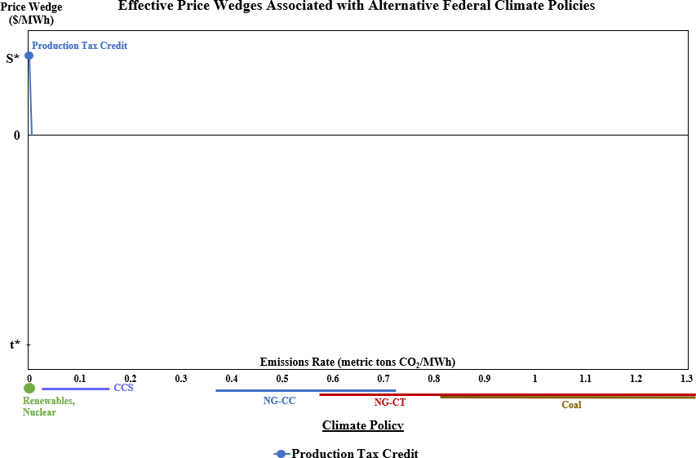
Different policy instruments yield different price wedges
Source: Stock and Stuart (NBER WP 28677, 2021)

Slide 16
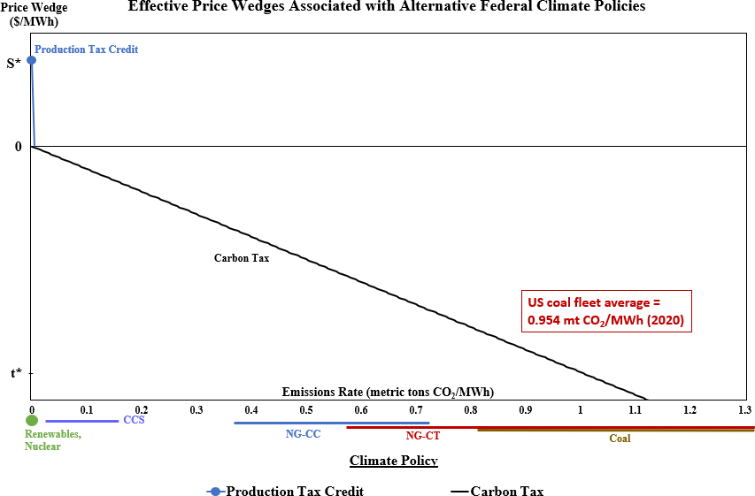
Different policy instruments yield different price wedges

Slide 17
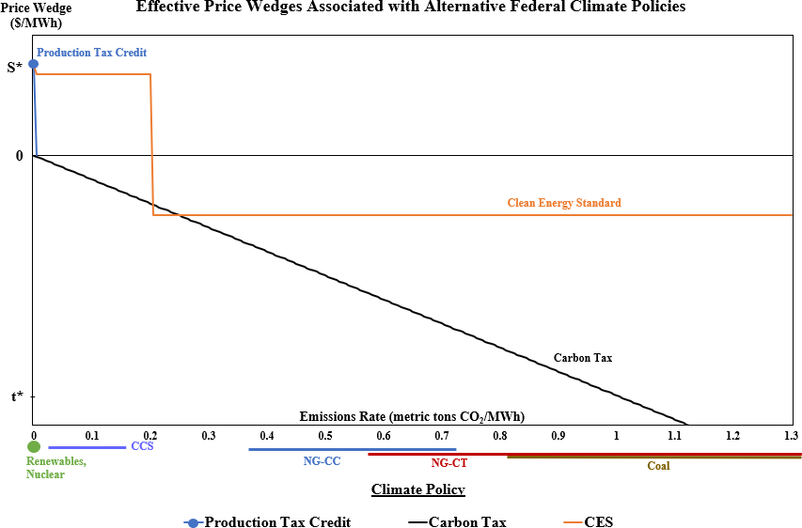
Different policy instruments yield different price wedges
Assume CCS is treated as “clean”

Slide 18
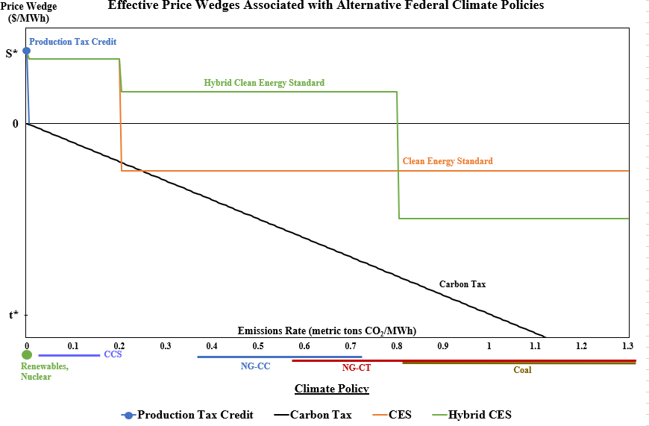
Different policy instruments yield different price wedges
Partial crediting for natural gass

Slide 19
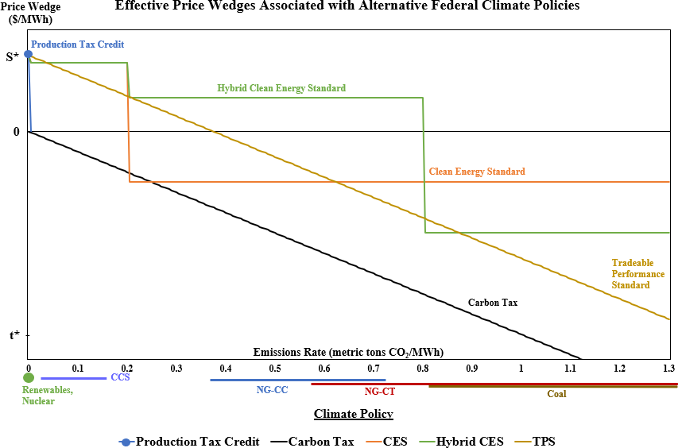
Different policy instruments yield different price wedges

Slide 20
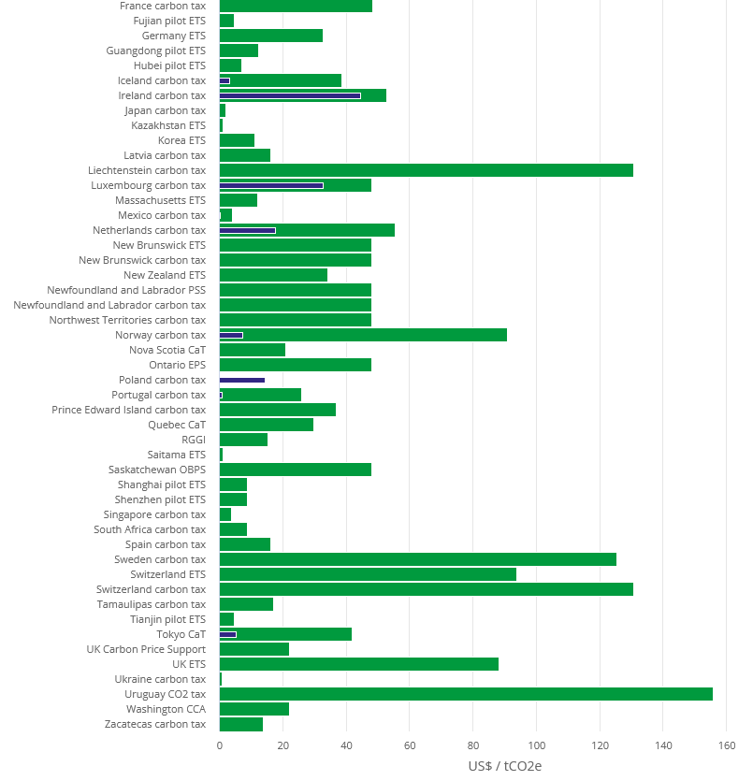
Carbon pricing fundamentals: Actual carbon pricing policies
In practice, 23% of global emissions covered by a carbon price (WB Carbon Pricing Dashboard)

Slide 21
IIC. Carbon pricing fundamentals: Differences between CT and C&T in practice
Selected differences between carbon tax and cap & trade in practice
ref: Stavins (NBER EEPE 2022)
Administration
  Point of regulation: emitter (C&T) v. upstream option with CT
  Both require border adjustment
  Allowance allocation in C&T typically has grandfathering (public subsidy to reduce end costs to consumer – reduces total demand reduction effect)
  Assessment, review, and resetting process
    Term nature of C&T and standards
    Opens process to recurring political economy forces
Uncertainty: aggregate and sectoral shocks
  Macro: effect of future supply and demand shocks differ CT v. C&T
    With shocks to aggregate demand or aggregate supply, C&T allowance prices are countercyclical
    Energy-sector shocks – more complicated (EU ETS & Ukraine)
  Micro/welfare: uncertainty, no investment/innovation
    Weitzman (1974),…, Karp & Traeger (2018),…, Aldy & Armitage (2022)
  Uncertainty with investment
    Pindyck (1988, 1991), Dixit & Pindyck (2012)

Slide 22
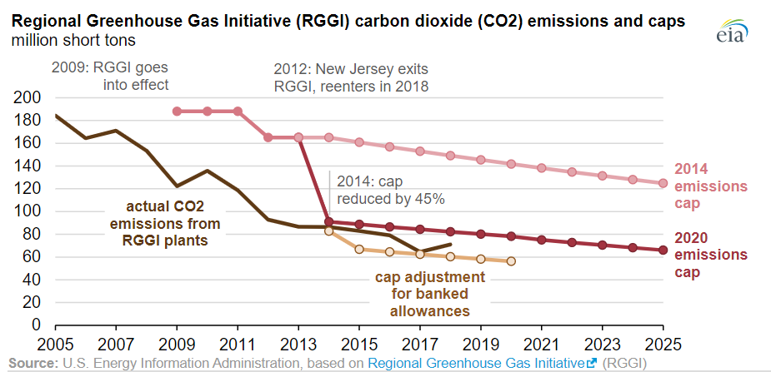
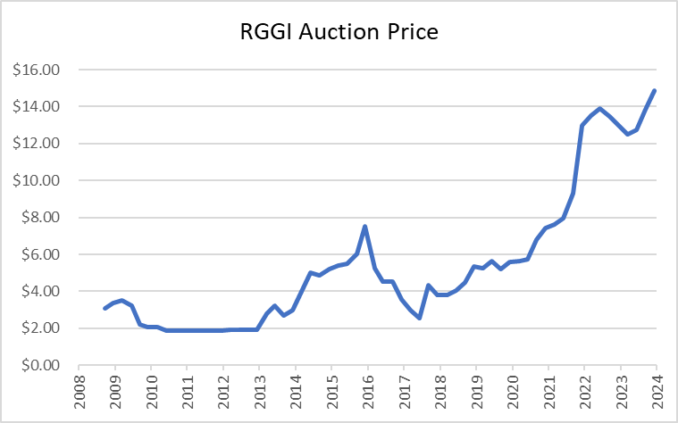
Carbon pricing fundamentals: Allowance price variability
Cap & trade in practice: Multiple sources of price volatility
(i) Regional Greenhouse Gas Initiative (10 East-coast States) - RGGI
RGGI emissions caps
RGGI tradable allowance prices
In 2009, the US Congress considered economy-wide CO2 cap & trade legislation (Waxman-Markey), which was defeated

Slide 23
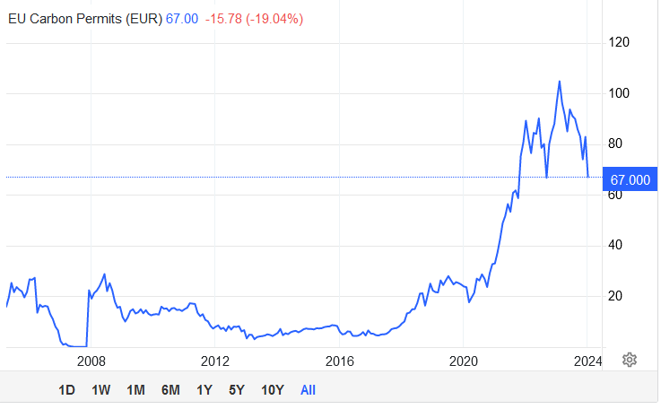
Carbon pricing fundamentals: Allowance price variability
Cap & trade in practice: Multiple sources of price volatility
(ii) EU Emissions Trading System (ETS) carbon permit price
EU ETS carbon permit price (€/metric ton CO2)
Source: Trading Economics, 1/17/24

Slide 24
Carbon pricing: Issues
Issues
Price uncertainty under tradable allowance programs (cap & trade, standards) retards green investment
  real options theory of investment
Are carbon taxes regressive?
  Depends on how revenues are used
  Per-capita redistribution (“fee & dividend”)
  Metcalf (Energy Policy 2019) (survey with references)
Political economy
  Visible taxation is politically unpopular
  C&T, standards have problem of diffuse benefits but concentrated entities bearing transition costs (owners & employees of coal plants are not the same as owners & employees of wind & solar)
What rate?
  CT ≠ SCC with tax distortions or with leakage
  Domestic or global damages?
Without CBAM, incentives for international relocation (leakage + economic inefficiency)
Carbon pricing (especially taxes) is bad for economic growth & employment (address later)
Carbon pricing increases energy prices
Carbon pricing won’t produce necessary emissions reductions
Recent references: many including Green (2021a,b), Gordon (2023) [, Stock (2022)]

Slide 25
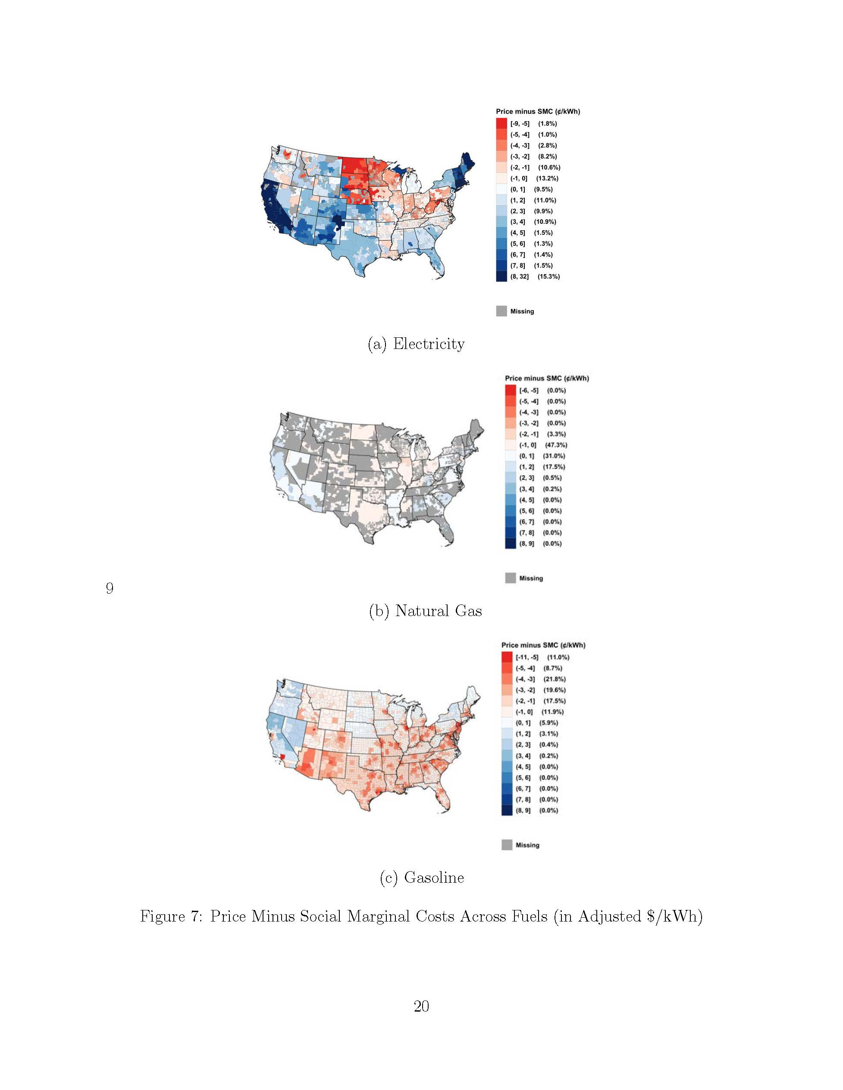
(vii) Carbon pricing increases energy prices
Initial reaction – isn’t that the point? But that reaction assumes the no-tax price is at private marginal cost
Estimates of retail prices of electricity, gas, & gasoline minus social marginal cost (in ¢/kWh equivalent)
  Source: Borenstein & Bushnell (NBER WP 29118, August 2021)
  Social marginal cost = private marginal cost + external costs
  External costs: carbon cost; air pollution; not driving externalities for gasoline
  Prices are estimates of residential marginal prices (subtracting off fixed component)
Major implication for “electrify everything” - electricity prices are already “too high” in much of the country
Favors CES or tax credits, or combination, over (sectoral) carbon tax or C&T

Slide 26
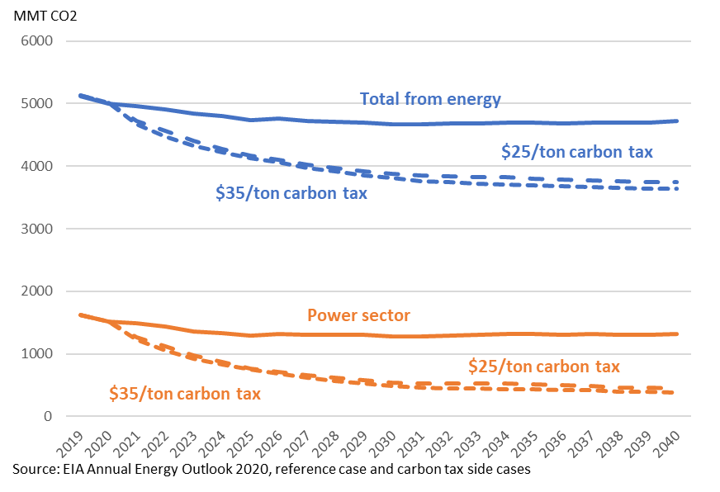
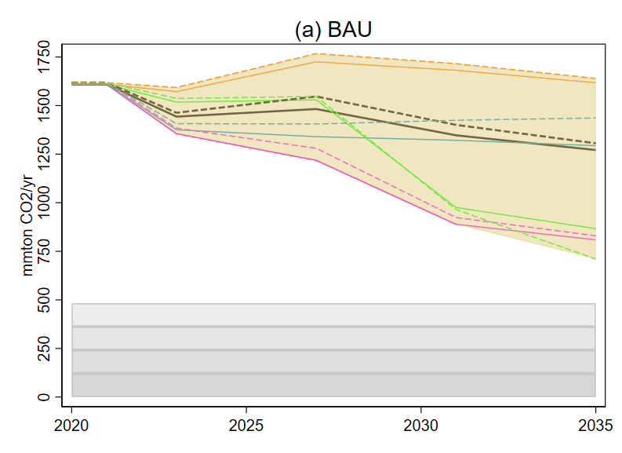
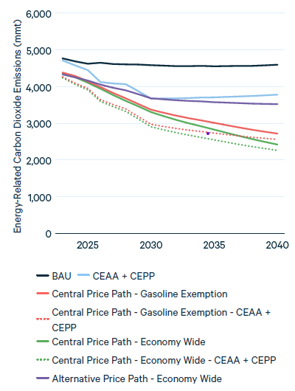
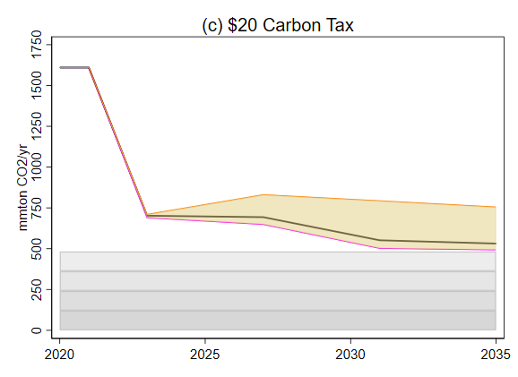
(viii) Carbon pricing won’t produce necessary emissions reductions
Growing evidence that existing carbon taxes have small effect on emissions (Green (2021a), Metcalf-Stock (2023))
But most CT’s – like the EU CT – cover mainly the transportation sector, where demand is inelastic & few substitutes are available.
In the power sector, low-carbon substitutes are available, so emissions elasticities are likely much larger than in the general CT literature.
Three Pre-IRA Carbon Tax Simulations for the US
(a) EIA (2021):
Reference case and $25 & $35 carbon tax cases
(b) Stock & Stuart (2021):
BAU & TPS, power sector only
(c) RFF (2021):
BAU and $15 carbon tax cases
$15 Carbon tax excluding gasoline

Slide 27
IID. Macro costs of carbon pricing – conventional toolkit
Computable general equilibrium models with climate policy capabilities: examples
Jorgenson (2013)
Goulder and Hafstead, Confronting the Climate Challenge (2018) (RFF Carbon Pricing Calculator)
IMF GMMET model (Carton et al IMF WP/23/269) (CGE + New Keynesian short-run macrodynamics)
G-CUBED (McKibbin – Wilcoxen)
…
Basic structure (CGE)
Production function(s) depend on K, L, E [,M, S]
Exogenous technical change or no technical change
Optimal household decisions on labor supply and investment given wages, returns, taxes
International trade
(Fairly) detailed energy sector
Public sector – options for revenue recycling (reduce corporate tax rate, lump-sum, etc.)

Slide 28
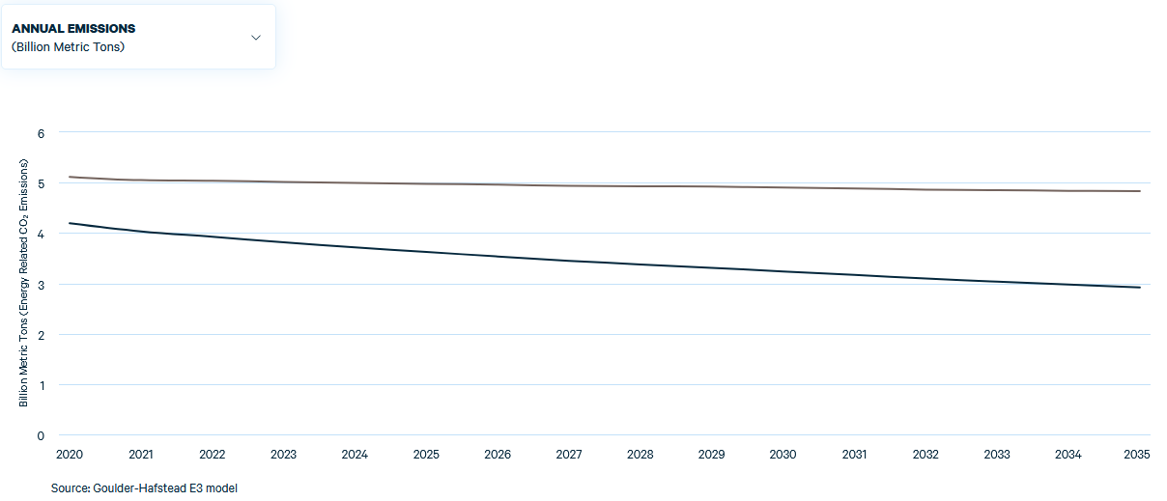
Impacts of a carbon tax: E3 model (Goulder-Hafstead) - results
Economy-wide carbon tax of $40/ton @5%/year GDP with per-capita rebate (“tax & dividend”) starting in 2020
 | Change, 2035, relative to BAU
Emissions | -39.5%
GDP
Digression: estimated 46% reduction in 2030, relative to 2005, is deeper than any of the IRA estimates in Bistline et al (Science 2023) and almost achieves the 50-52% Paris NDC.
Source: RFF Carbon Pricing Calculator at https://www.rff.org/cpc/

Slide 29
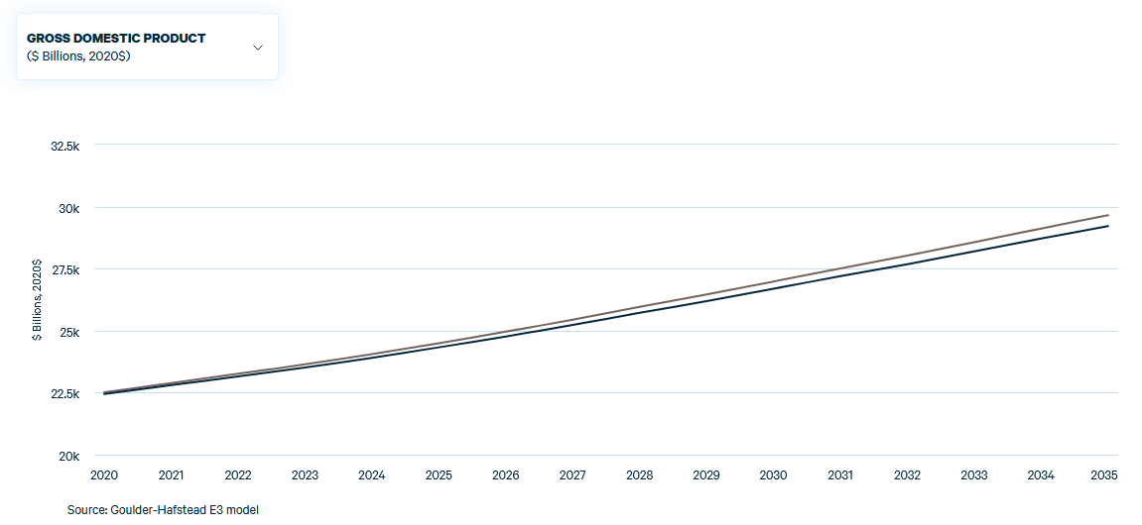
Impacts of a carbon tax: E3 model (Goulder-Hafstead) - results
Economy-wide carbon tax of $40/ton @5%/year GDP with per-capita rebate (“tax & dividend”) starting in 2020
 | Change, 2035, relative to BAU
Emissions | -39.5%
GDP | -1.5%
Source: RFF Carbon Pricing Calculator at https://www.rff.org/cpc/

Slide 30
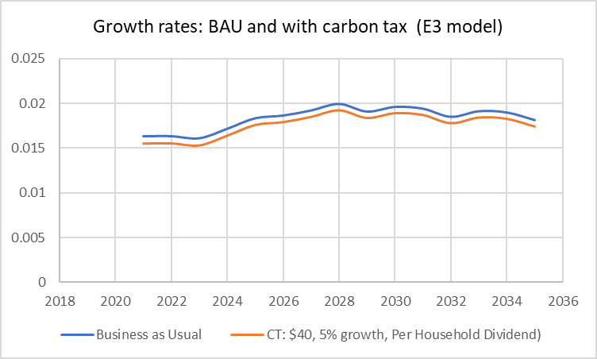
Impacts of a carbon tax: E3 model (Goulder-Hafstead) - results
Economy-wide carbon tax of $40/ton @5%/year GDP with per-capita rebate (“tax & dividend”) starting in 2020
Delta ≈ 8 bp/year
Source: RFF Carbon Pricing Calculator at https://www.rff.org/cpc/

Slide 31
Course outline
I. Introduction
Big picture: Substitution v. energy efficiency
Big picture: Carbon policy menu
II. Elements of macro of carbon pricing
Macro of carbon pricing: Nordhaus (1982)
Carbon pricing and variants: comparative statics
  Carbon tax, cap & trade: demand restraint, substitution of factors of production
  Clean energy standards; production tax credits
CT v. C&T: Differences in practice (ref: Stavins NBER-EEPE 2022)
  Administration, allowance allocation
  Static uncertainty (Weitzman)
  Investment under uncertainty
Macro costs of carbon pricing – conventional toolkit
  CGE models
  [DICE (Nordhaus (1992) ) -> IAMs]
III. Empirical evidence
Methods: LP, SVAR, LP-IV, SVAR-IV
  Stock-Watson (EJ 2018), Plagborg-Møller & Wolf (ECMA 2022)
Carbon tax: Metcalf-Stock (2023)
Cap & trade: Känzig (2021)
Climate policy uncertainty
Concluding remarks

Slide 32
IIIA. Time series methods
Structural VARs (SVARs), Local Projections (LP), and IV variants (SVAR-IV, LP-IV)
References: Stock & Watson (EJ, 2018), Plagborg-Møller and Wolf (ECMA 2021) + references therein
Key ideas:
SVARs identify structural impulse response functions (IRFs) given key identification assumption (invertibility + identification of structural shock)
LP is a single-equation method which also estimates structural IRFs given some identification assumptions.
  Some in the literature claim – incorrectly, see below – that that LP is more robust than VAR because it requires specifying only a single equation – so avoids misspecification of the other equations
SW (2018) [Stock (2008), Ramey (2016)] extend standard IV identification ideas to SVARs and to LP, and provide conditions (either invertibility or conditions on instrument) under which both SVAR-IV and LP-IV consistently estimate
P-M & W (2021) show:
  Under stationarity and using the same identification method: SVAR = LP nonparametrically in population
    same estimand regardless of whether the identification assumption is correct or (true) model is linear
    Nonparametrics: no. of lags -> infinity
  Extend SW (2018) IV results to show SVAR-IV and LP-IV equivalence under invertibility, and suggests alternative method (proxy VAR) which is more robust to non-invertibility.

Slide 33
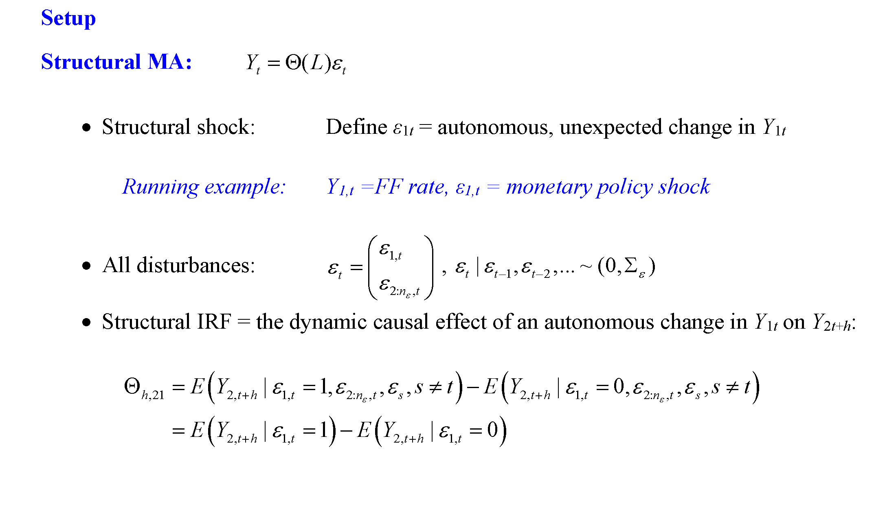
Time series methods: Implementation math

Slide 34
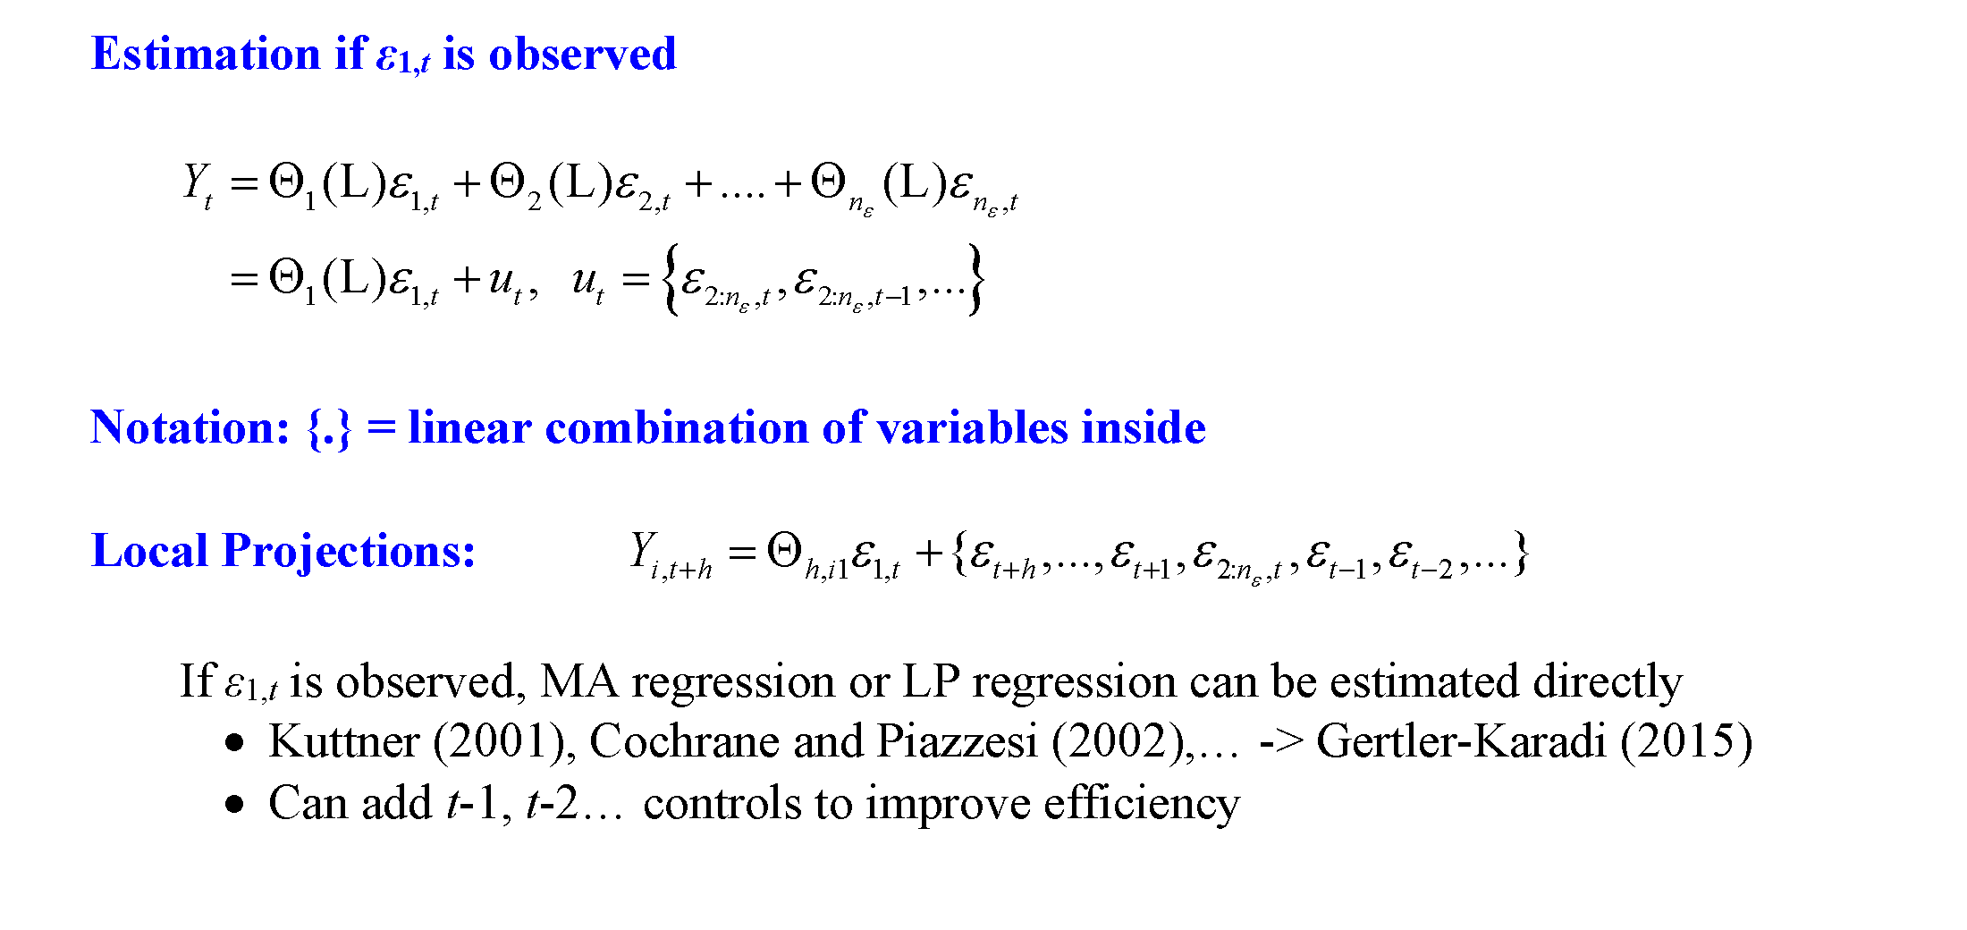
Time series methods: Implementation math

Slide 35
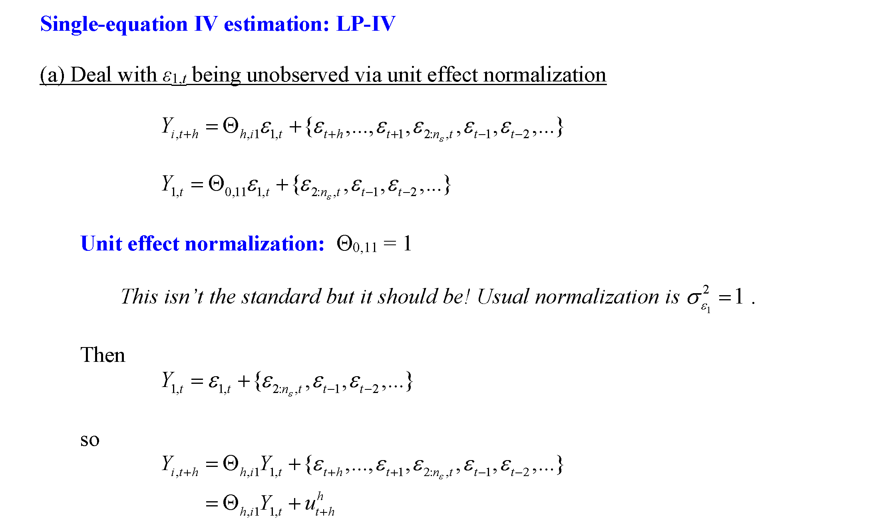
Time series methods: Implementation math

Slide 36
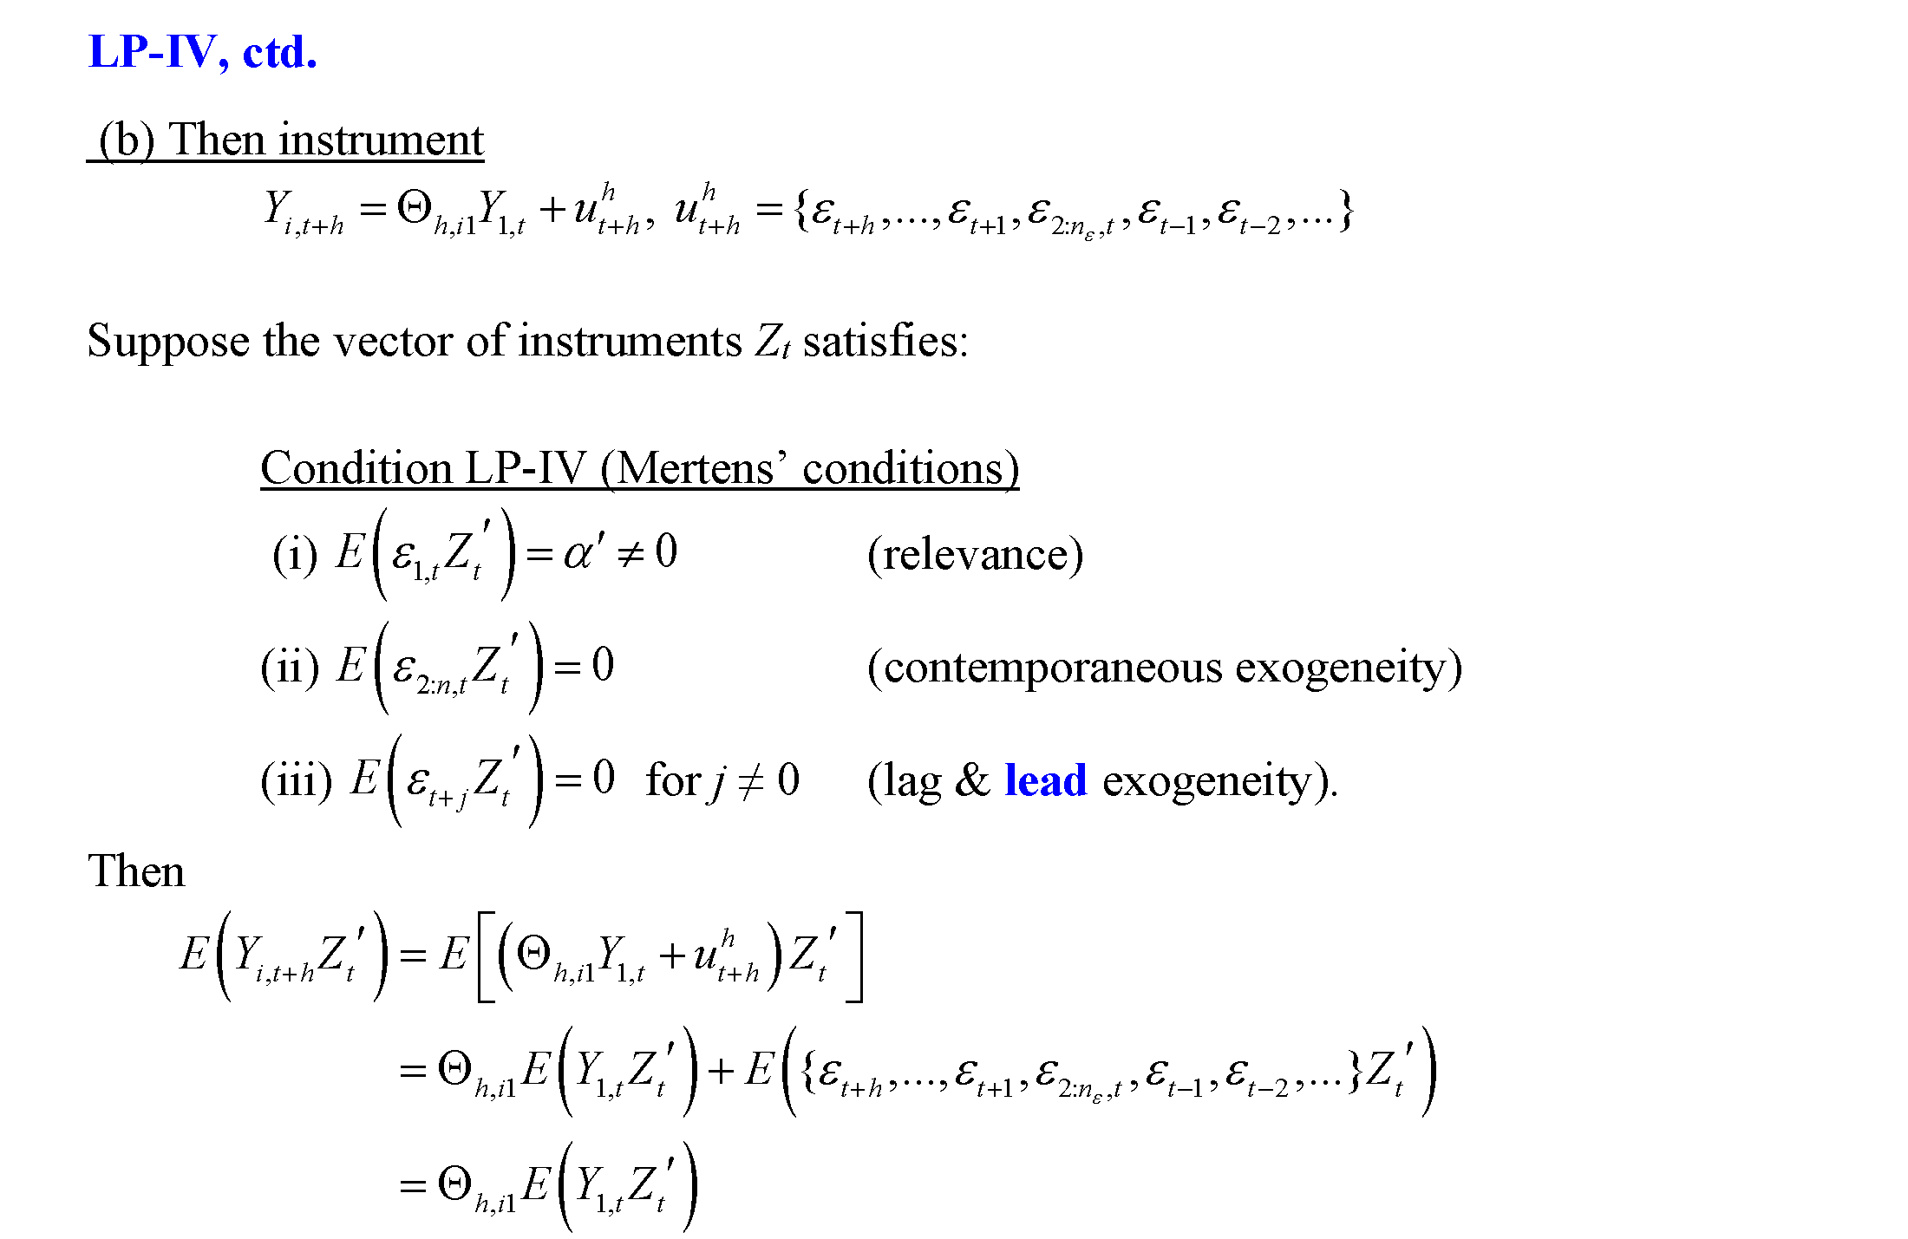
Time series methods: Implementation math

Slide 37
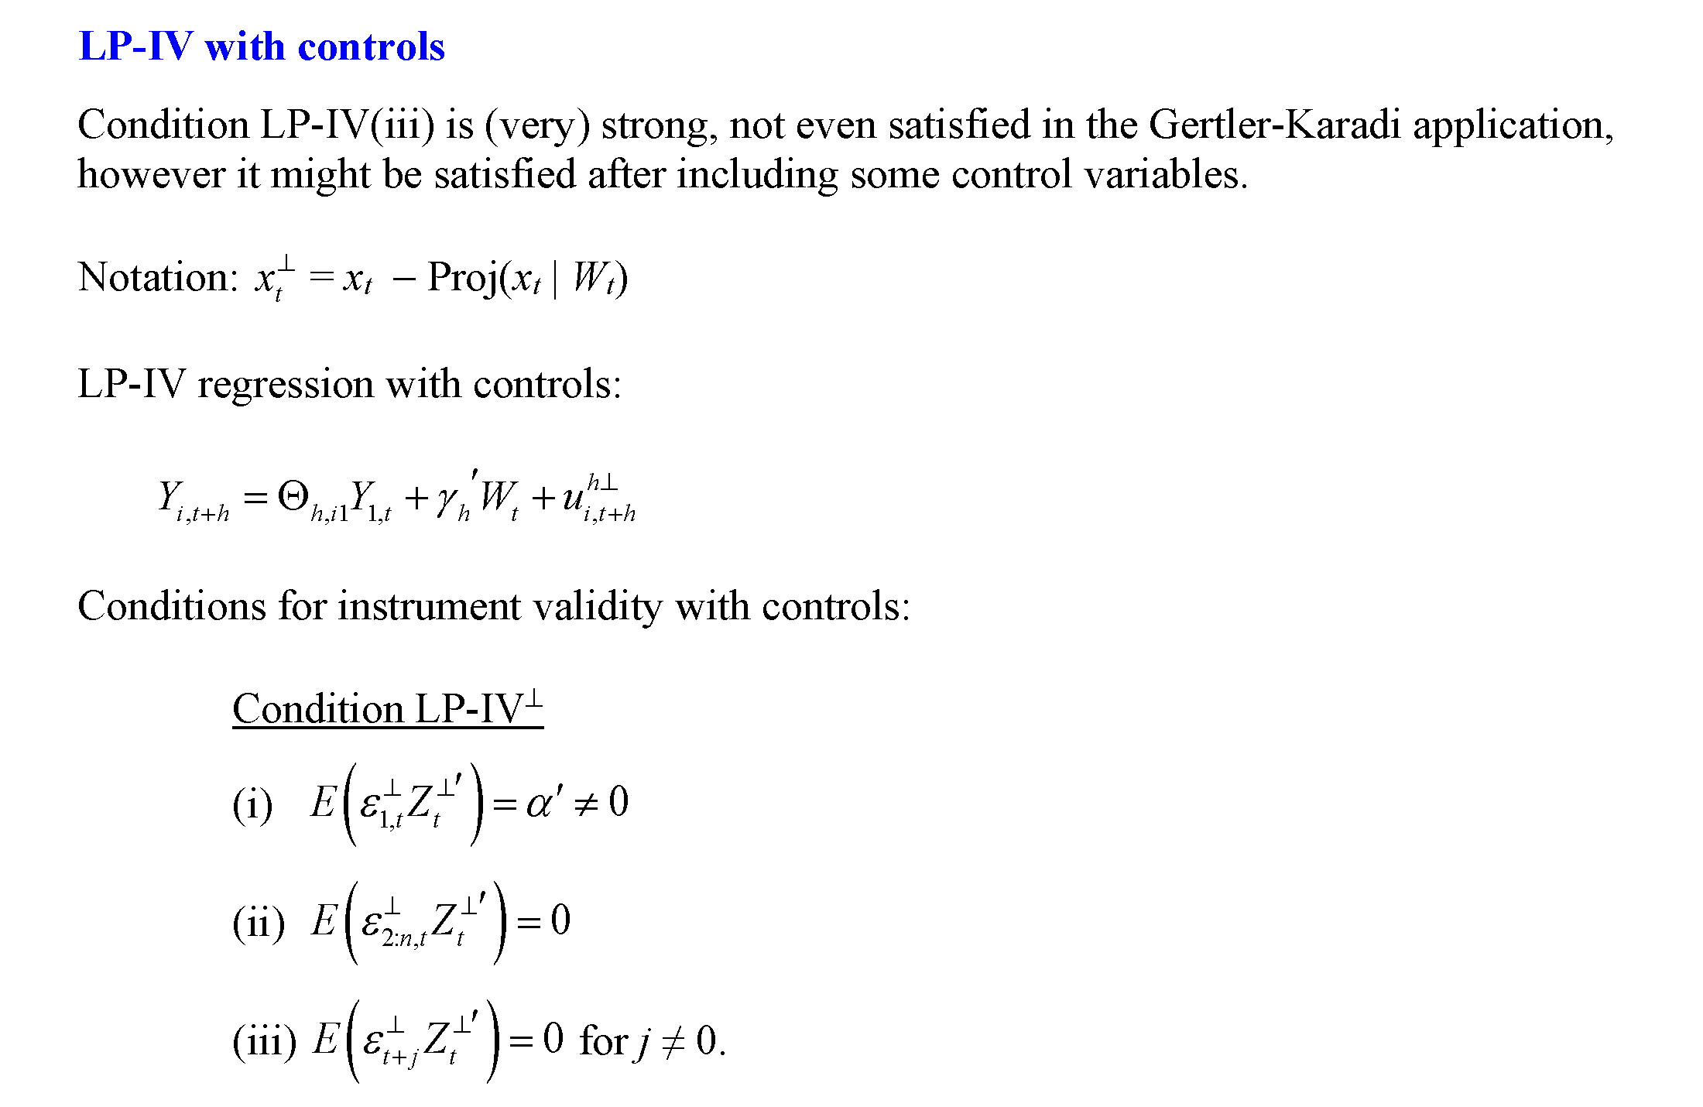
Time series methods: Implementation math

Slide 38
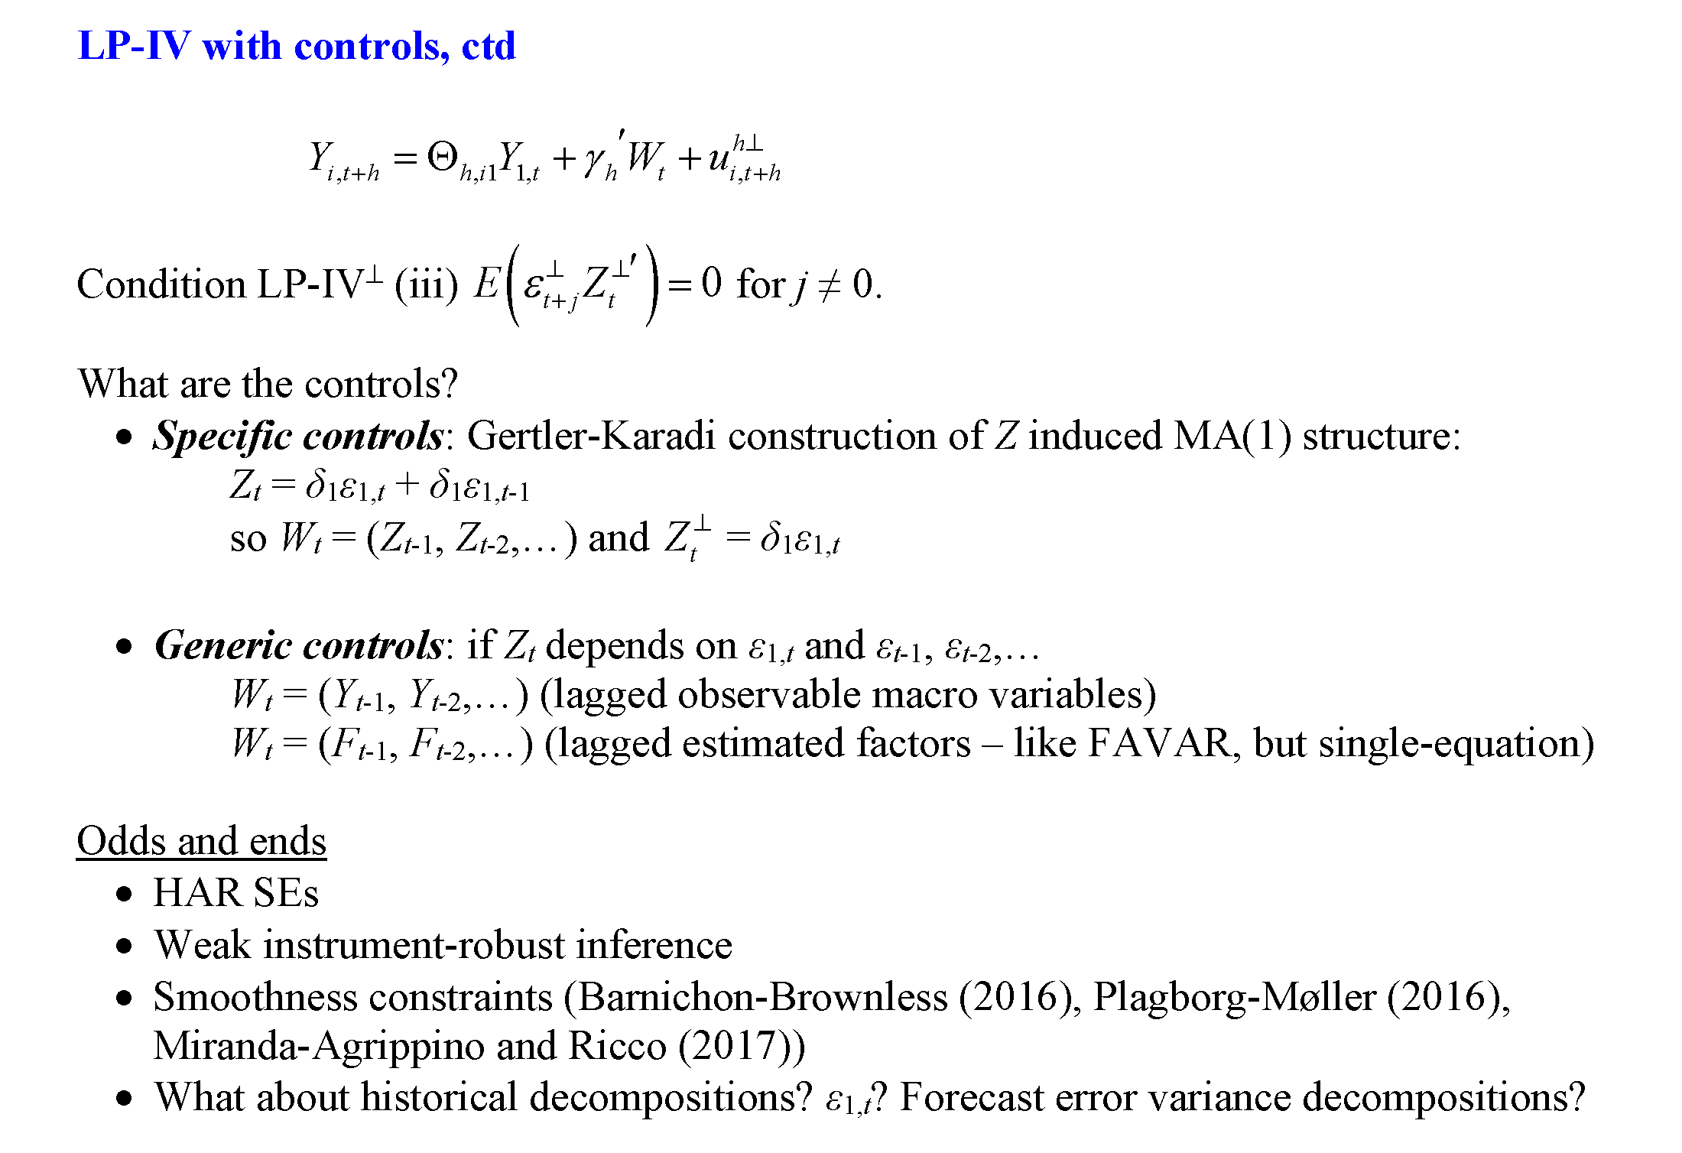
Time series methods: Implementation math

Slide 39
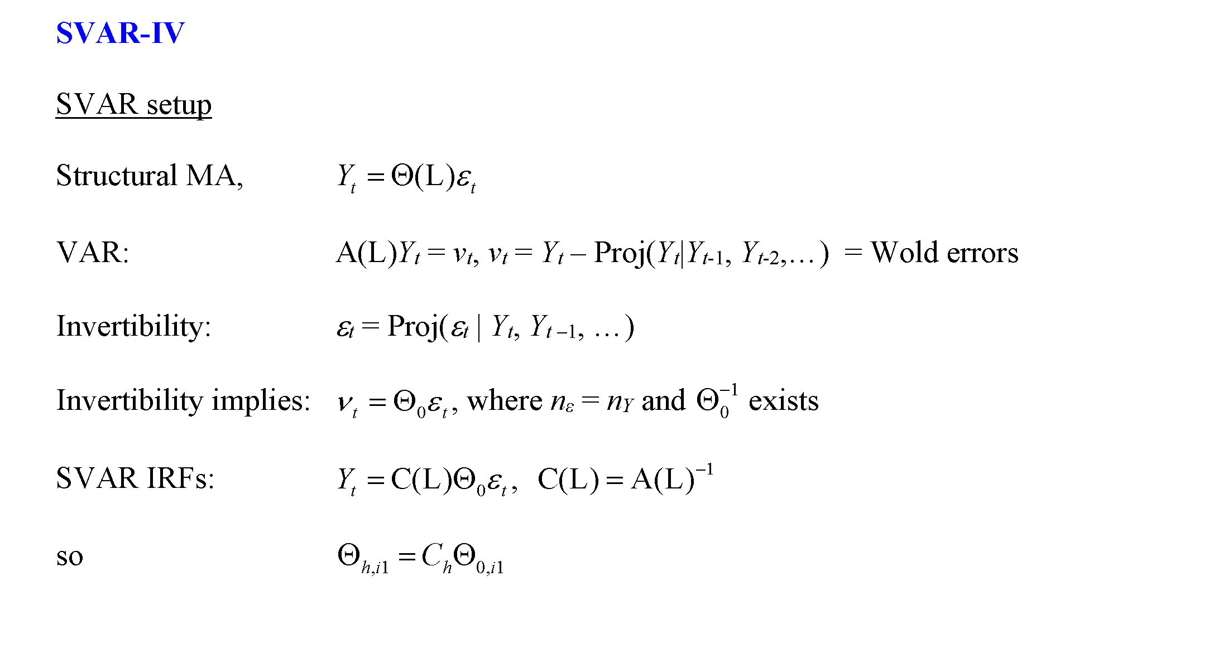
Time series methods: Implementation math

Slide 40
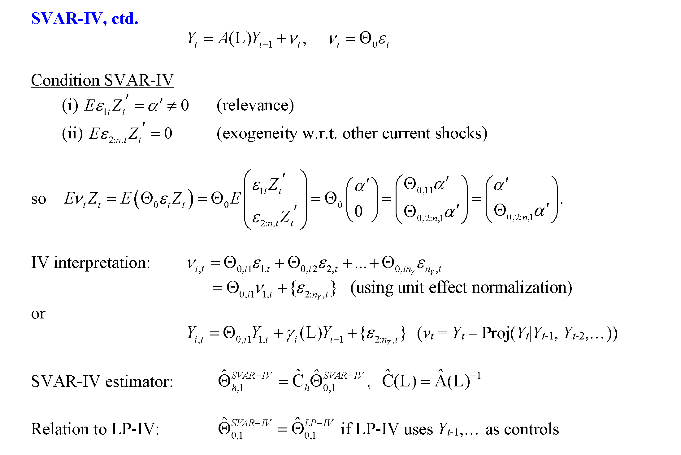
Time series methods: Implementation math

Slide 41
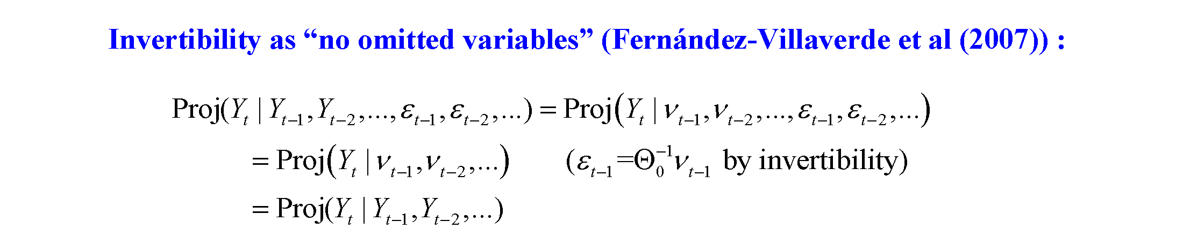
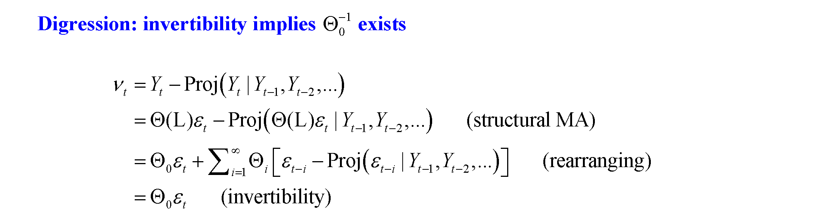
Time series methods: Invertibility

Slide 42
IIIB. Case study: Macro effects of a carbon tax - Literature review
A fair number of studies examine carbon tax effect on emissions: partial list
  Lin and Li (2011) – Scandinavia + Netherlands
  Rivers and Schaufele (2012) – BC transportation emissions
  Murray and Rivers (2015) – review of older literature on BC carbon tax
  Haites et. al. (2018) – carbon pricing generally, effectiveness and political economy
  Dolphin, Pollitt, and Newberry (2019) – political economy of carbon tax rates (not effectiveness)
  Pretis (2019) – BC
  Andersson (2019) – Sweden (carbon tax + VAT on fuel)
  Runst and Thonipara (2019) – Swedish residential sector
  Hajek et al (2019), energy sector emissions (SWE, FIN, DNK, IRE, SLO)
  He at al (2019) OECD environmental taxes
  Fauceglia et al. (2019) – Swiss industry
  Abrell et al. (2019) – UK Carbon Price Support on top of EU-ETS, plant-level
  Rafaty, Dolphin, Pretis (2020) - OECD
Fewer study the effect on GDP and employment
  Elgie and McClay (2013) – BC income
  Yamazaki (2017), Yip (2018) – BC employment
  Metcalf (2015, 2019) – BC (2015) and EU (2019)
  Bernard et. al. (2018) – BC carbon tax and provincial income (VAR on with-tax fuel price)
  Olale et. al. (2019) – BC carbon tax and net farm income
  Mundaca (2017) – eliminating fuel tax subsidies in Middle East/North Africa

Slide 43
Case study: Macro effects of EU Carbon tax (Metcalf-Stock, AEJ-Macro 2023)*
Data set:
EU + Iceland + Norway + Switzerland (n = 31) – all countries in the European emissions trading system
  Of which, 15 also have a carbon tax, almost entirely on emissions not covered by the ETS
Annual, 1985 - 2018
  EU ETS started in 2005 (power sector and certain energy-intensive industries) (subsequently expanded to aviation)
Sources:
Carbon prices: World Bank (new carbon price data)
  Carbon tax rates are real local currency, scaled to 2018 USD using 2018 PPP
  Some countries have multiple tax rates, WB data set has highest and lowest rate and fuels to which it applies; we used the highest rate (typically this is the rate on gasoline & diesel)
  Weighted for coverage of tax
  Sensitivity check with new data from Dolphin et al (2020)
GDP, population: World Bank except
  Norway – we use mainland GDP
  Ireland – we use Ireland official statistics
Employment: Eurostat
Fuel prices and fuel taxes: IEA
Emissions: Eurostat; Dolphin et al (2019) as robustness check
  emissions in road transport, commercial & institutional, and household sectors
  Alternatively, emissions from fuel consumption
*G. Metcalf & JH Stock, “The Macroeconomic Impact of Europe’s Carbon Taxes,” AEJ-Macro (2023)

Slide 44
History and Coverage
Carbon taxes in 2018
Source: World Bank
https://carbonpricingdashboard.worldbank.org/
Country | Year of Adoption | Rate in 2018 (USD) | Coverage (2019)
Finland | 1990 | $70.65 | 0.36
Poland | 1990 | 0.16 | 0.04
Norway | 1991 | 49.30 | 0.62
Sweden | 1991 | 128.91 | 0.40
Denmark | 1992 | 24.92 | 0.40
Slovenia | 1996 | 29.74 | 0.24
Estonia | 2000 | 3.65 | 0.03
Latvia | 2004 | 9.01 | 0.15
Switzerland | 2008 | 80.70 | 0.33
Ireland | 2010 | 24.92 | 0.49
Iceland | 2010 | 25.88 | 0.29
UK | 2013 | 25.71 | 0.23
Spain | 2014 | 30.87 | 0.03
France | 2014 | 57.57 | 0.35
Portugal | 2015 | 11.54 | 0.29

Slide 45
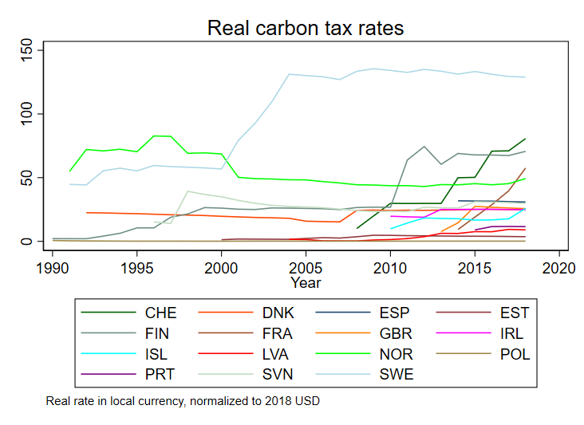
Considerable Variation in Tax Rates Across Countries and Time
Carbon tax history for the 15 countries with carbon taxes
Data source: World Bank (carbon price data in press)
Carbon tax rates are real local currency, scaled to 2018 USD using 2018 PPP
GDP growth: World Bank (except as noted below)

Slide 46
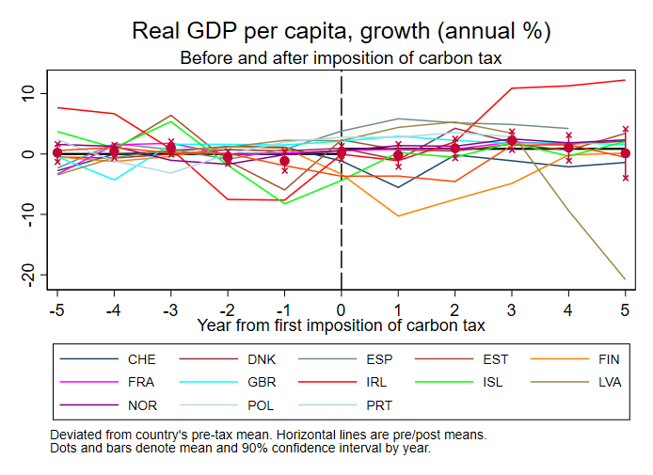
Data description

Slide 47
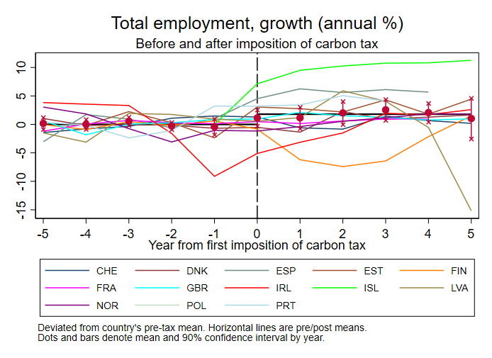
Data description

Slide 48
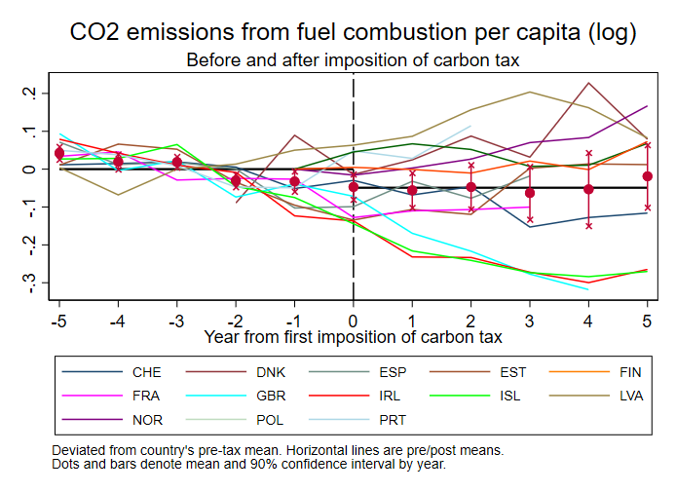
Data description

Slide 49
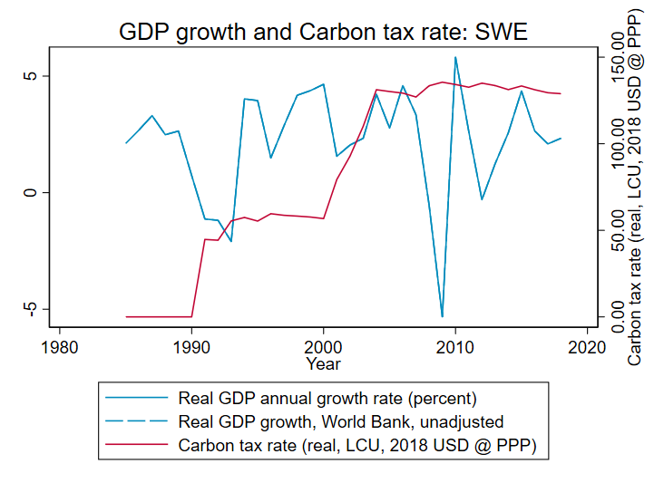
Data description
Sweden

Slide 50
Methods: Regressions and identifying assumptions
Estimand: cumulative dynamic causal effect of change in tax rate on real variables
Local projections (panel)
  Note: is h-period ahead cumulative impulse response function in VAR jargon
Identification condition:
  In words: Because tax rates are set in advance, this year’s tax rate can’t depend on this year’s macro shocks – which is what makes up u_{t}.
  Identification is coming from the time series variation: think “SVAR”, not “event study”
Panel SVAR (sensitivity check): Same identifying assumption as LP – estimates same IRF as LP [PM-W (2021)] for long lags but estimates will differ in sample, with different SEs, and IRF estimates are different (LP v. VAR) for horizons > included no. of lags
Restricted or unrestricted: Impose zero long-run effect on growth rate (restricted), or not (unrestricted)

Slide 51
Methods: Additional Details
Regression and Simulation Details
All regressions include country & year fixed effects
Carbon tax enters weighted by coverage share
Standard errors: heteroskedasticity-robust for SVAR and LP [Montiel Olea and Plagborg-Møller (2021)]
Effects calibrated to $40 carbon tax at 0% real increase; tax covers 30 percent of emissions
  Tax innovations are solved from IRF of tax shock to tax rate IRF (Sims (1986) method)
4 lags of control variables used (base case) (BIC selects 2, AIC selects 4 in VAR)

Slide 52
Results: Tests of parallel paths restriction
 | GDP | Employment | Emissions
LP | 0.33 0.75 | -0.63 0.53 | -2.09 0.04
SVAR | 1.34 0.18 | 0.62 0.53 | -1.26 0.21
Revenue Recycling Countries
LP | 0.05 0.96 | -0.72 0.47 | -0.95 0.34
SVAR | 1.39 0.16 | 0.17 0.87 | -0.40 0.69
Large Carbon Tax Countries
LP | -0.41 0.69 | 0.14 0.89 | -0.53 0.60
SVAR | 1.00 0.32 | 1.23 0.22 | -0.34 0.73
Scandinavian Countries
LP | -0.44 0.66 | 0.80 0.42 | 0.19 0.85
SVAR | 0.95 0.34 | 1.04 0.30 | 0.16 0.87
t-statistics testing long-run effect of change carbon tax level on the growth rate of y = 0
(p-values in second line)
For SVAR, this is implied long-run IRF
For LP, this is 8-year effect
Fail to reject “parallel paths” restriction
Results shown below impose the “parallel paths” restriction
  Results not imposing parallel paths restriction are very similar but with larger SEs especially at longer lags

Slide 53
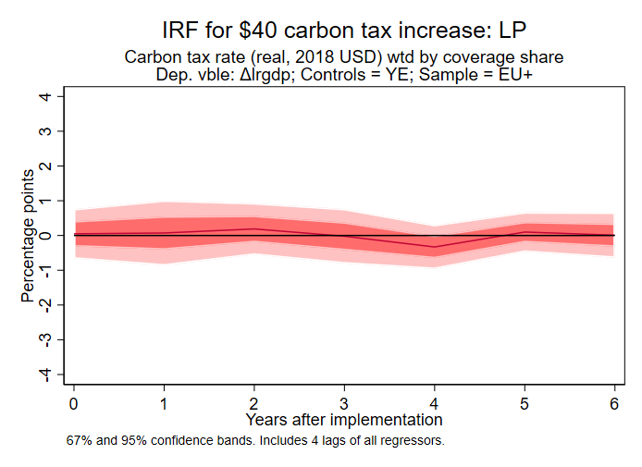
Results: GDP growth
Sample: EU+
Method: Linear Projection
Restricted

Slide 54
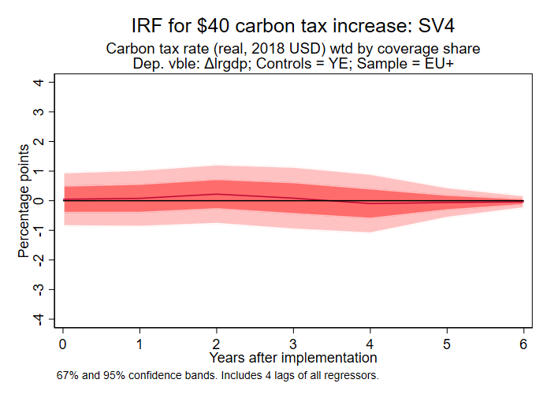
Results: GDP growth
Sample: EU+
Method: SVAR
Restricted

Slide 55
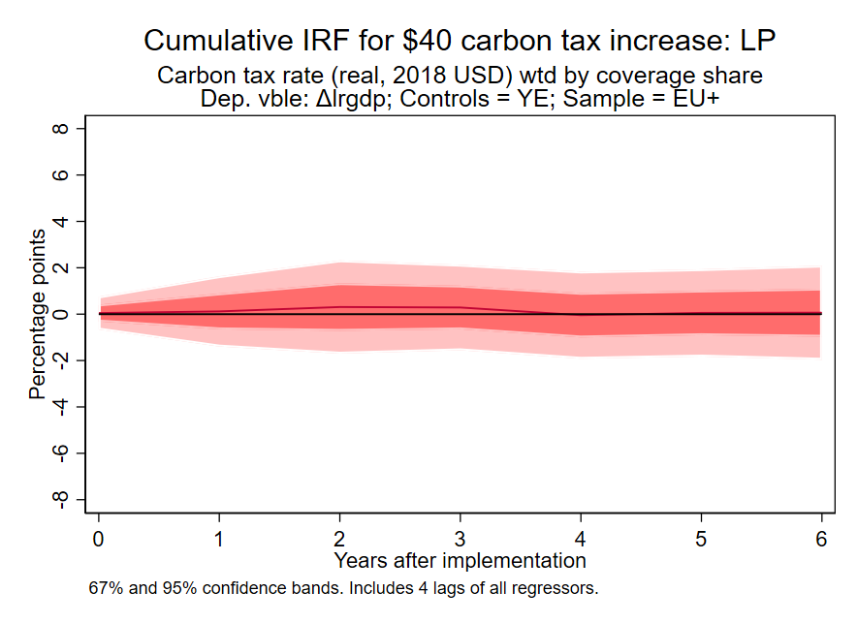
Results: GDP log level
Sample: EU+
Method: LP
Restricted
This cumulative IRF is the estimated effect of the tax increase on the level of log(GDP), imposing the “parallel path” assumption
This is the empirical counterpart to the CGE counterfactual

Slide 56
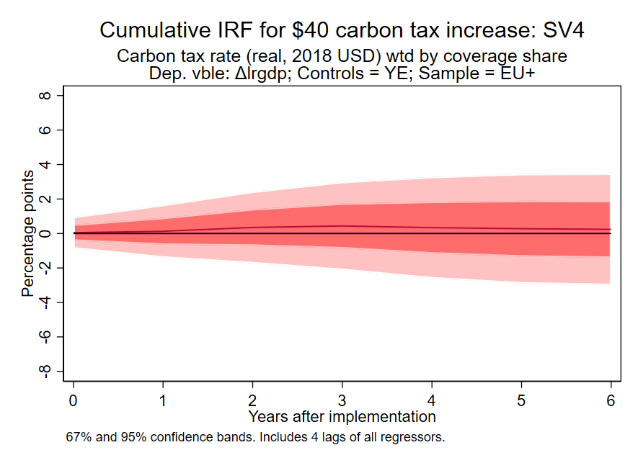
Results: GDP log level
Sample: EU+
Method: SVAR
Restricted
This cumulative IRF is the estimated effect of the tax increase on the level of log(GDP), imposing the “parallel path” assumption
This is the empirical counterpart to the CGE counterfactual

Slide 57
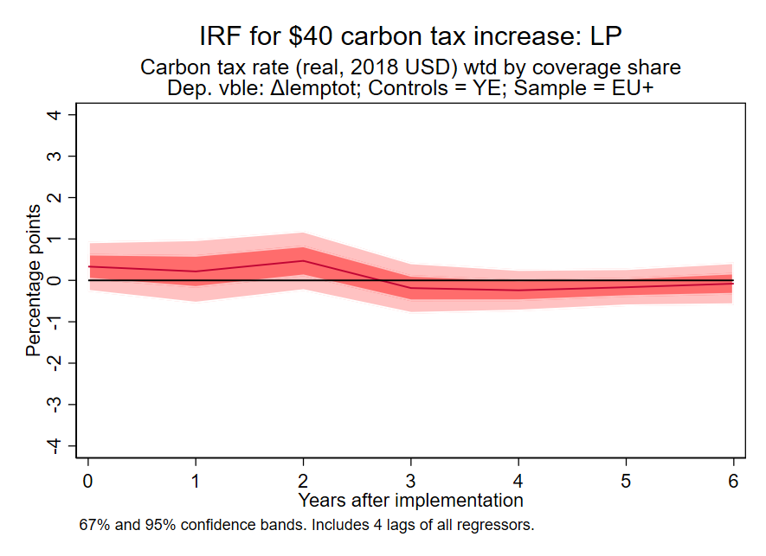
Results: Employment growth
Sample: EU+
Method: LP
Restricted

Slide 58
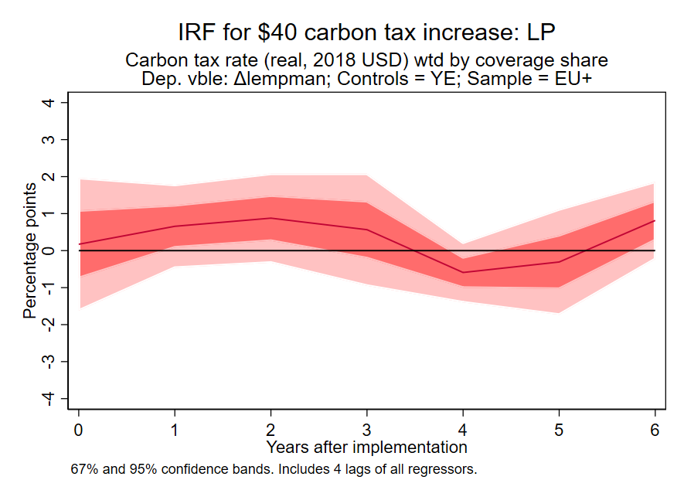
Results: Manufacturing employment growth
Sample: EU+
Method: LP
Restricted

Slide 59
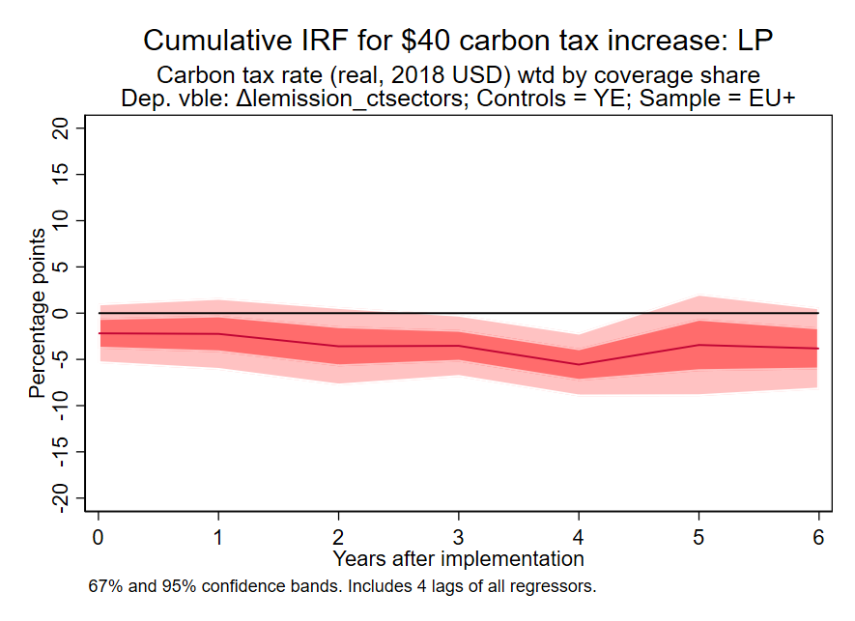
Results: Emissions log level
Sample: EU+
Method: LP
Restricted
Cumulative IRF
This cumulative IRF is the estimated effect of the tax increase on the level of log(emissions), imposing the “parallel path” assumption
Emissions series:
  Emissions in sectors exposed to the carbon tax

Slide 60
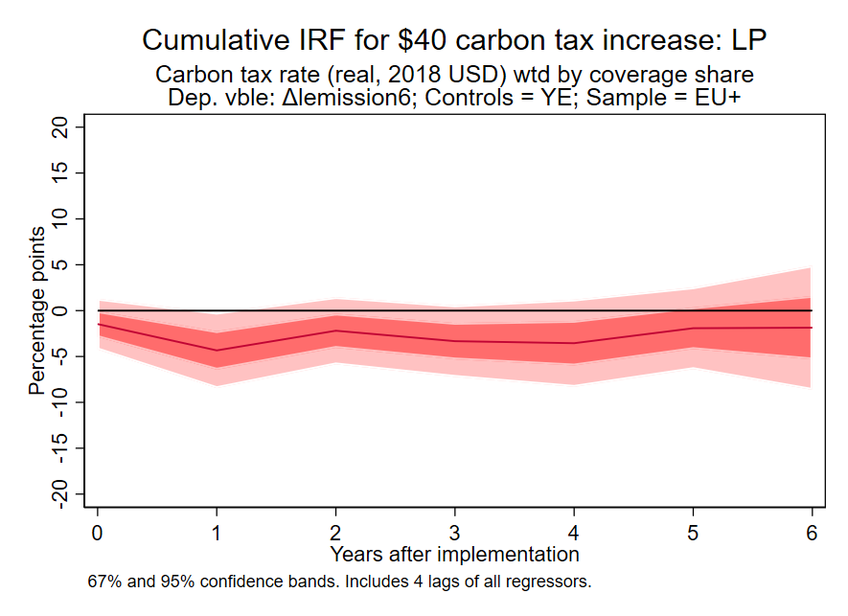
Results: Emissions log level
Sample: EU+
Method: LP
Restricted
Cumulative IRF
This cumulative IRF is the estimated effect of the tax increase on the level of log(emissions), imposing the “parallel path” assumption
Emissions series:
  Emissions from fuel consumption

Slide 61
Results: Additional questions + sensitivity analysis
Are the results driven by:
  Scandinavia?
    No: results for SCA-only, or EUxSCA, are similar to overall results, just noisier
  Countries that have low taxes?
    No: very similar results if you use only countries with tax of at least $10/ton share-weighted ($40/ton x 30% coverage = $12/ton share-weighted)
  Carbon tax data decisions?
    No. Essentially no difference in results if we use the Dolphin et al. (2019) carbon tax rates, see the paper
Are the positive GDP and employment results a consequence of how the country uses the revenue?

Slide 62
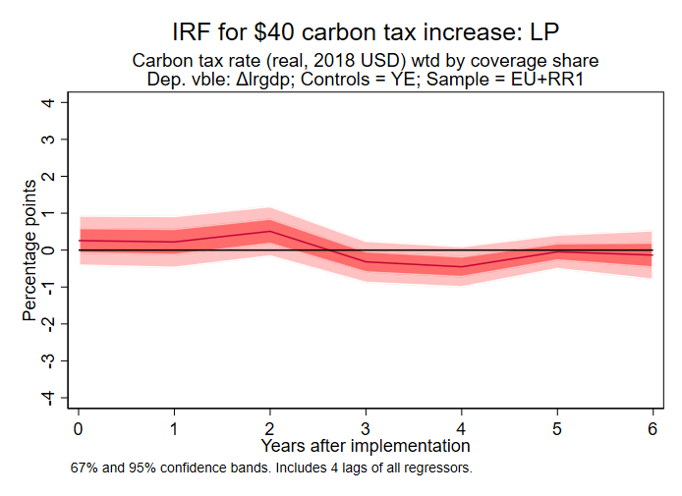
Results: Effect of revenue recycling
Sample: EU+
Revenue recycling
Dep vble: GDP growth
Method: LP
Restricted
Revenue recycling countries
Denmark, Sweden, Norway, Finland, Switzerland, Portugal

Slide 63
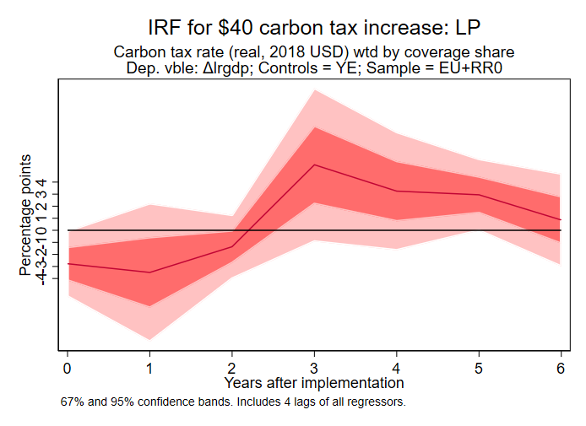
Results: Effect of revenue recycling
Sample: EU+
No revenue recycling
Dep vble: GDP growth
Method: LP
Restricted
Revenue recycling countries
Denmark, Sweden, Norway, Finland, Switzerland, Portugal

Slide 64
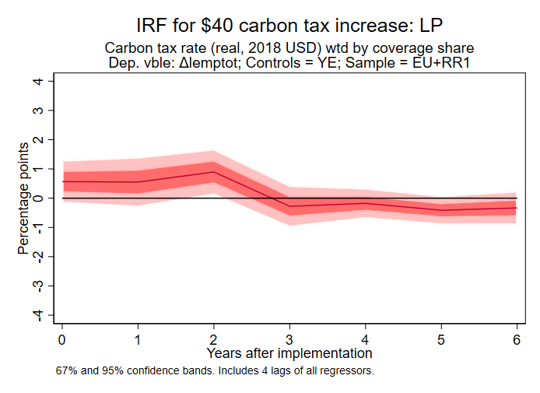
Results: Effect of revenue recycling
Sample: EU+
Revenue recycling
Dep vble: Empl. growth
Method: LP
Restricted
Revenue recycling countries
Denmark, Sweden, Norway,
Finland, Switzerland, Portugal

Slide 65
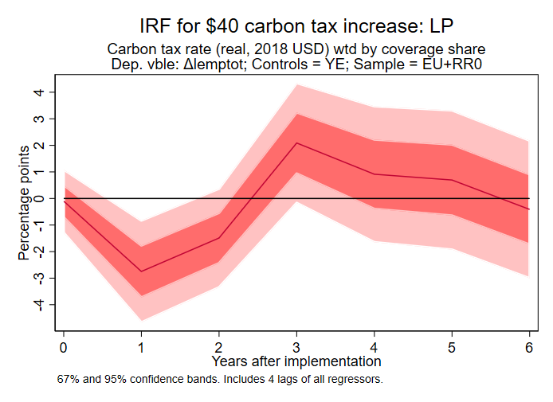
Results: Effect of revenue recycling
Sample: EU+
No revenue recycling
Dep vble: Empl. growth
Method: LP
Restricted
Revenue recycling countries
Denmark, Sweden, Norway, Finland, Switzerland, Portugal

Slide 66
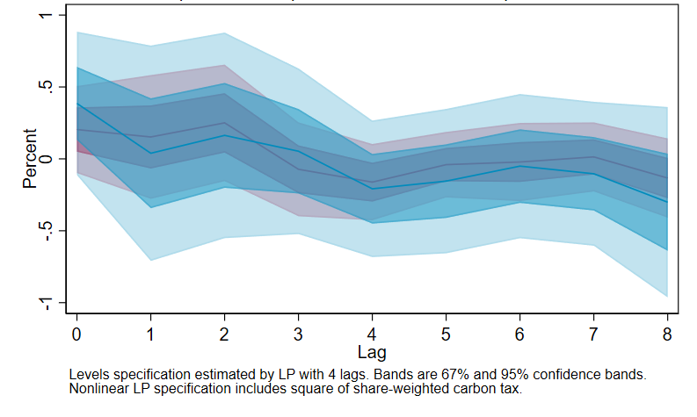
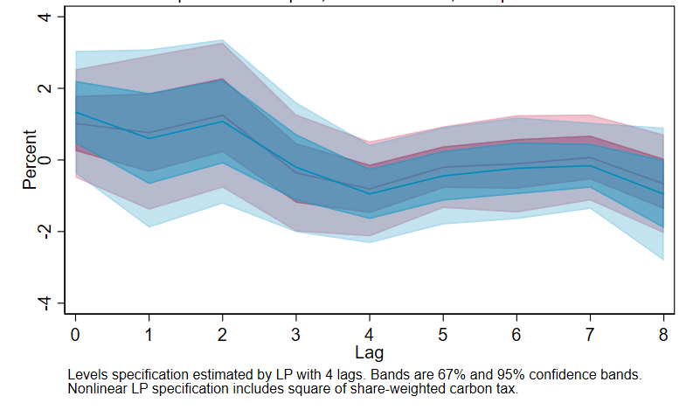
Results: Nonlinearities? EU+ sample, LP, unrestricted
(A) Does the effect depend on the size of the tax?
Sample: EU+
Variable: Employment Growth
Specification: + (share-wtd tax rate)²
        (a) $20 tax increase (b) $100 tax increase

Slide 67
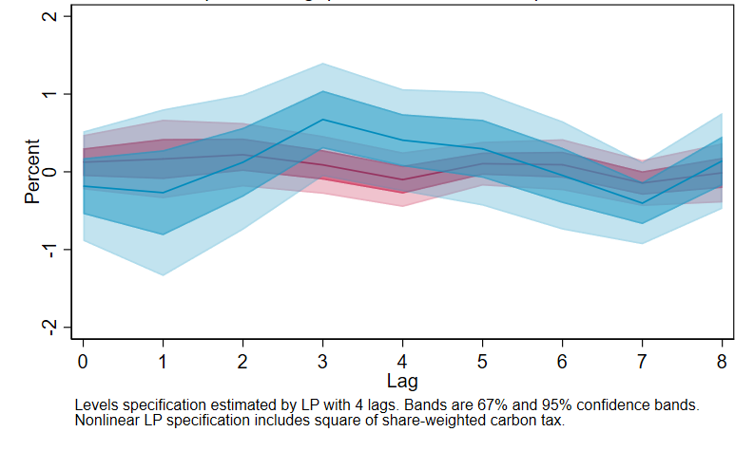
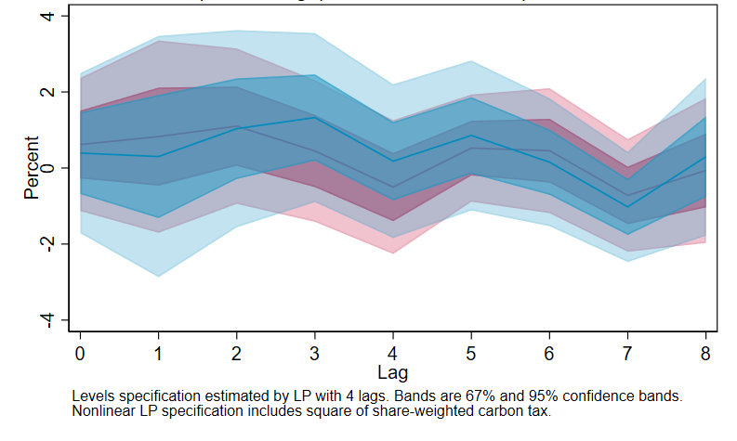
Results: Nonlinearities? EU+ sample, LP, unrestricted
(A) Does the effect depend on the size of the tax?
Sample: EU+
Variable: GDP Growth
Specification: + (share-wtd tax rate)²
        (a) $20 tax increase (b) $100 tax increase

Slide 68


Results: Nonlinearities? EU+ sample, LP, unrestricted
(A) Does the effect depend on the size of the tax?
Sample: EU+
Variable: Emissions Growth
Specification: + (share-wtd tax rate)²
        (a) $20 tax increase (b) $100 tax increase

Slide 69


Results: Nonlinearities? EU+ sample, LP, unrestricted
(B) Does the effect depend on the scope (share of emissions covered)?
Sample: EU+
Variable: Employment Growth
Specification: + (share-wtd tax rate × share)
        (a) $20 tax increase (b) $100 tax increase

Slide 70


Results: Nonlinearities? EU+ sample, LP, unrestricted
(B) Does the effect depend on the scope (share of emissions covered)?
Sample: EU+
Variable: GDP Growth
Specification: + (share-wtd tax rate × share)
        (a) $20 tax increase (b) $100 tax increase

Slide 71


Results: Nonlinearities? EU+ sample, LP, unrestricted
(B) Does the effect depend on the scope (share of emissions covered)?
Sample: EU+
Variable: Emissions Growth
Specification: + (share-wtd tax rate × share)
        (a) $20 tax increase (b) $100 tax increase

Slide 72

Summary
GDP growth
No effect
Emissions (level) in covered sectors
2-6% reduction
Employment
growth
No effect
initial positive bump?
Dynamic responses of GDP growth, aggregate employment growth, and the level of emissions for a $40/ton carbon tax covering 30% of emissions, based on the EU data.
Taxes mainly cover the transportation sector
Estimation uses time series identification – carbon tax rates predetermined within the calendar year
Source: Metcalf & Stock (AEJ-macro, forthcoming)

Slide 73

IIIC. EU ETS: Macro impacts: Känzig (2021)
What have been emissions & GDP effects of EU ETS?
Important question: how much of decline in emissions intensity of IP is due to EU-ETS increasing energy prices?
Identification problem: fluctuations in aggregate demand and supply drive demand for electricity and manufactured goods and thus drive the EU-ETS price – so endogeneity problem
Identification strategy:
  Use exogenous surprises in the EU-ETS price as an instrument – changes in the ETS price around program change announcement windows
EU-ETS started in 2005
EU GHG emissions intensity of IP
= GHG emissions/IP
EU ETS price

Slide 74

EU ETS: Macro impacts: Känzig (2021)
Identification strategy
SVAR-IV
Control variables: 7 macro variables (contemporaneous)
IV: Carbon policy price surprise = futures price (for date t) on day of regulatory event – futures price (for same date) on trading day before
Method: SVAR-IV
Stock (2008)
Sensitivity check: LP-IV
Stock & Watson (EJ, 2018), Plagborg-Møller & Wolf (2021)
A shock instrument (like this one) satisfies condition LP-IV so allows identification of IRF without requiring invertibility (no need for control variables to span structural shocks)

Slide 75

EU ETS: Macro impacts: Känzig (2021)*
*This slides and several of the following slides in this section are from the deck on Känzig’s Web site.

Slide 76

EU ETS: Macro impacts: Känzig (2021)
First-stage F = 17.43

Slide 77

EU ETS: Macro impacts: Känzig (2021)

Slide 78

IIIC. EU ETS: Macro impacts: Känzig (2021)

Slide 79

EU ETS: Macro impacts: Känzig (2021)
Sensitivity check: SVAR-IV (blue) v. LP-IV (red)

Slide 80
EU ETS: Macro impacts: Känzig (2021)
Känzig (2021)
Metcalf-Stock (2023)
$40 ETS price with full pass-through
  ~12% increase in energy prices (US)
  5% fall in IP after 1 year
Cf: fall in IP during financial crisis:
  22% in EU
  17% in US
Also finds regressive distributional consequences – only partially explained by lower income families having higher energy shares of consumption

Slide 81

Reconciliation of Metcalf-Stock (2023) and Känzig (2021)?
Possibilities :
Somebody made an econometric error
Data frequency: K is monthly EU time series data, M-S is annual country-level
  M-S might be subject to temporal aggregation bias but that bias doesn’t go from an effect to no effect!
Identification problems: K?
  Maybe LP-IV(ii) (instrument exogeneity) doesn’t hold
    Regulatory announcements could be taken in light of economic forecasts – but sign is wrong (recession fears -> looser regs -> smaller price shock -> corr(shock, future GDP) >0
  If LP-IV(ii) holds then non-Invertibility isn’t a problem as long as price innovations are truly non-forecastable (plausible and empirically verified)
  Insufficient controls? Maybe surprise loosening/tightening aligns with ECB announcements, US growth, etc. (not an issue for M-S b/c M-S has year FE)
Autocorrelation function of ETS price surprise

Slide 82
Reconciliation of Metcalf-Stock (2023) and Känzig (2021)?
Possibilities :
Somebody made an econometric error
Data frequency: K is monthly EU time series data, M-S is annual country-level
  M-S might be subject to temporal aggregation bias but that bias doesn’t go from an effect to no effect!
Identification problems: K?
  Maybe LP-IV(ii) (instrument exogeneity) doesn’t hold
    Regulatory announcements could be taken in light of economic forecasts – but sign is wrong (recession fears -> looser regs -> smaller price shock -> corr(shock, future GDP) >0
  If LP-IV(ii) holds then non-Invertibility isn’t a problem as long as price innovations are truly non-forecastable (plausible and empirically verified)
  Insufficient controls? Maybe surprise loosening/tightening aligns with ECB announcements, US growth, etc. (not an issue for M-S b/c M-S has year FE)
Identification problems: M-S?
  tax rate determined in advance so predetermined assumption is accurate
  Maybe announced tax rate schedule isn’t linearly predictable? If so innovations aren’t shocks – linear innovations would be (nonlinearly) predictable so agents could prepare for them (so a small effect)
  Requires invertibility – no OVB – perhaps tax rate change is based on expected economic activity not spanned by the control variables (GDP, tax rate, year & country FE – but robust to including employment, emissions as controls)
  Ignores spillovers from other countries (but tax rate is on transport and home heating so should be minimal leakage and spillovers)

Slide 83
Reconciliation of Metcalf-Stock (2023) and Känzig (2021)?
Possibilities :
Monetary policy responds differently to induced pass-through inflation from ETS and from CT
  ETS is EU-wide so ECB tightens after ETS hike - but not after country-specific CT hike?
    M-S data spans pre-Euro and post-Euro regimes and includes some non-Euro countries, so the contrast isn’t clean
    But shouldn’t the ECB know enough to accommodate the ETS price spike?
Känzig:

Slide 84
Reconciliation of Metcalf-Stock (2023) and Känzig (2021)?
Possibilities :
Monetary policy responds differently to induced pass-through inflation from ETS and from CT
  ETS is EU-wide so ECB tightens after ETS hike - but not after country-specific CT hike?
    M-S data spans pre-Euro and post-Euro regimes and includes some non-Euro countries, so the contrast isn’t clean
    But shouldn’t the ECB know enough to accommodate the ETS price spike?
EU ETS covers power & manufacturing, EU CT’s cover fuels (transport & heating).
  Both are short-run inelastic, although Moll et al (BPEA 2023) show a large margin of substitution for German mfging

Slide 85
Reconciliation of Metcalf-Stock (2023) and Känzig (2021)?
Possibilities :
Monetary policy responds differently to induced pass-through inflation from ETS and from CT
  ETS is EU-wide so ECB tightens after ETS hike - but not after country-specific CT hike?
    M-S data spans pre-Euro and post-Euro regimes and includes some non-Euro countries, so the contrast isn’t clean
    But shouldn’t the ECB know enough to accommodate the ETS price spike?
EU ETS covers power & manufacturing, EU CT’s cover fuels (transport & heating).
  Both are short-run inelastic, although Moll et al (BPEA 2023) show a large margin of substitution for German mfging
Carbon tax, but not ETS, has potential for revenue recycling
  But revenue recycling supply side reforms should take time, and M-S don’t find statistical difference between countries with rev. recycling or not

Slide 86
Reconciliation of Metcalf-Stock (2023) and Känzig (2021)?
Possibilities :
Monetary policy responds differently to induced pass-through inflation from ETS and from CT
  ETS is EU-wide so ECB tightens after ETS hike - but not after country-specific CT hike?
    M-S data spans pre-Euro and post-Euro regimes and includes some non-Euro countries, so the contrast isn’t clean
    But shouldn’t the ECB know enough to accommodate the ETS price spike?
EU ETS covers power & manufacturing, EU CT’s cover fuels (transport & heating).
  Both are short-run inelastic, although Moll et al (BPEA 2023) show a large margin of substitution for German mfging
Carbon tax, but not ETS, has potential for revenue recycling
  But revenue recycling supply side reforms should take time, and M-S don’t find statistical difference between countries with rev. recycling or not
Maybe cap & trade actually has worse macro consequences than a carbon tax
  Price volatility of a cap & trade system can retard investment in low-carbon capital, delaying decarbonization and increasing costs (Borenstein et al, JAERE 2019)
  Price volatility also implies inflation volatility (pass-through of tax & permit price)
Personal guess: (5) + (8)

Slide 87


IIID. Climate policy uncertainty*
*K. Gavrilis, D. Känzig, & JH Stock (in progress)

Slide 88

Climate policy uncertainty

Slide 89

Climate policy uncertainty

Slide 90


Climate policy uncertainty

Slide 91

Climate policy uncertainty

Slide 92

Climate policy uncertainty
SVAR – 6 lags
Increase in CPU =>
Fall in IP
Fall in emissions (IP elasticity ~.7)
Increase in unemployment
Increase in commodity and consumer prices

Slide 93

Climate policy uncertainty
LP – 6 lags
Results are robust to using LP instead of SVAR

Slide 94

Climate policy uncertainty
CPU = residual from projecting CPU on 3 macro factors from DFM
Results are robust to using controlling for 3 macro factors from DFM
Work in progress:
Refine CPU measure:
  Use E&E News articles
  Use LLM to categorize the article (improve upon dictionary approach)

Slide 95
IIIE. Concluding Remarks
Take standard macro (CGE) estimates of macro costs of carbon pricing policies with a grain of salt (lack of directed technical progress)
Empirical evaluation of macro effects of climate policy – when possible – is important for practical policy advice
Preliminary conclusions:
  Monetary policy response matters (accommodate one-off supply-side price shocks)
  Climate policy uncertainty seems to retard economic growth (theory + empirical)
  Carbon tax appears benign for economic growth & employment empirically – whereas cap & trade has negative macro consequences. A plausible channel is price uncertainty in C&T
  Price uncertainty also retards investment and R&D so slows the energy transition (CO2 costs)
Methods: SVAR-IV and LP-IV (and proxy VAR-IV) are most convincing methods currently (but need a valid instrument)
More work is needed: on macro & innovation effects of price uncertainty under C&T, TPS, and RPS.
Big picture:
  Carbon pricing should be deployed in conjunction with innovation & investment policy
  Carbon pricing is most effective & has least cost impacts when nearly-economic low-carbon substitution alternatives exist
  Results in literature support second-stage (post-innovation) sectoral carbon pricing with price certainty: in order,
    Sectoral CT
    Sectoral TPS with price collars and infrequent resets
    Sectoral C&T with price collars and infrequent resets

Slide 96
Additional Slides

Slide 97
Carbon pricing fundamentals: overlapping policies
Overlapping policies
In practice, there can be multiple policies with same mitigation goal
Example: Carbon tax and cap & trade
(a) C&T nonbinding (b) C&T binding
Price
Price
P’’
P’
S
P’
Permit price
S
P*
P*
tax
tax
D
Q’
Q’’
Q*
Quantity of electricity
Q’’
Q’
Q*
Quantity of electricity
Prices add, quantities don’t
Examples
California cap-and-trade (AB32) + economy-wide carbon tax
  If RGGI is binding, leakage
State RPS + economy-wide CES
  If state RPS is binding, leakage
State\Nation | Carbon Tax | C&T
Carbon tax | additionality | No effect or leakage
C&T | No effect or additionality | Near-complete leakage

Slide 98

Carbon tax & CES: Graphical representation (Borenstein & Kellogg 2022)
Both a CES and a carbon price truncate the distribution of fossil fuel generators
Distribution of fossil fuel generators, characterized by e (emissions per MWh) and c (cost per MWh)
No FF generators will be dispatched if their marginal cost exceeds R
Private cost of renewables
Source: Borenstein & Kellogg (2022)

Slide 99

Carbon tax & CES: Graphical representation (Borenstein & Kellogg 2022)
Both a CES and a carbon price truncate the distribution of fossil fuel generators
A carbon price introduces a clean/FF price wedge that depends linearly on the emissions intensity
FF generators that won’t produce under a carbon price, but will under a CES
FF generators that won’t produce under a CES, but will under a carbon tax
A CES without partial crediting introduces a price wedge t between clean and undifferentiaged non-clean (FF) generation
Source: Borenstein & Kellogg (2022)

Slide 100

Carbon tax & CES: Graphical representation (Borenstein & Kellogg 2022)
Both a CES and a carbon price truncate the distribution of fossil fuel generators
Eventually, a carbon price and a CES end up in (nearly) the same place
Source: Borenstein & Kellogg (2022)

Slide 101

Carbon tax & CES: Graphical representation (Borenstein & Kellogg 2022)
Both a CES and a carbon price truncate the distribution of fossil fuel generators
The greater the correlation between c and e in the FF fleet, the less the difference between a carbon price and a CES
Source: Borenstein & Kellogg (2022)

Slide 102


Carbon tax & CES: Graphical representation (Borenstein & Kellogg 2022)
Both a CES and a carbon price truncate the distribution of fossil fuel generators
At 2019 natural gas prices, corr(e,c) = 0.66: a CT and CES largely sweep out the same generators
At high natural gas prices, corr(e,c) = -0.33: a CT sweeps out coal, a CES sweeps out gas
Source: Borenstein & Kellogg (2022)

Slide 103


Carbon tax & CES: Graphical representation (Borenstein & Kellogg 2022)
Both a CES and a carbon price truncate the distribution of fossil fuel generators
At 2019 natural gas prices, corr(e,c) = 0.66: a CT and CES largely sweep out the same generators
At high natural gas prices, corr(e,c) = -0.33: a CT sweeps out coal, a CES sweeps out gas
Emissions along the reduction path
Source: Borenstein & Kellogg (2022)

Slide 104
Investment & production tax credits
Both a CES and a carbon price truncate the distribution of fossil fuel generators
PTC provides a given subsidy per MWh of clean generation (e.g., $0.023/kWh)
ITC pays for a given percentage of clean investment (e.g., 30%)
Comparisons:
PTC incentivizes maintenance and choosing productive sites; but the owner has similar incentives under the ITC.
PTC allows wind & solar to bid in at negative prices while they are operating – can cause problems for baseload sources like nuclear which must continue to run but potentially at a loss – leading to nuclear subsidies as an unintended consequence
Negative prices are an occasional problem now, when natural gas (or coal) is the marginal producer (so it sets the market price in wholesale markets)
But in the future negative marginal pricing (or zero pricing) will be more frequent
Complicated grid economics! Storage?

