Slide 1

Study Center Gerzensse: Advanced Courses in Economics
The Economics and Econometrics of Climate Change Policy:
E. Macro Implications
of the Energy Transition – Part II
James H. Stock
Economics Department and Harvard Kennedy School,
Harvard University
May 30 – June 3, 2022

Slide 2
Course outline
I. Introduction
Introduction & Overview
  Climate change science and CC econometrics (brief)
  Framework economic concepts
  Cost-benefit analysis, cost effectiveness analysis, SCC & TCP
  Marginal abatement curve
III. Damages
Macroeconomic implications of the energy transition
  Overview: Physical & transition costs
  Long run
  Short run
    Case studies – short run policy transition costs
      Carbon tax
      Cap & trade
      Policy uncertainty
The Social Cost of Carbon: Recent developments (time permitting)
II. Emissions reduction (mitigation/decarbonization)
Sectoral carbon policies – theory & empirical evidence
  Carbon tax, cap & trade
  Clean energy standards; investment & production tax credits
  Policy simulations
  Criticisms & the case for sectoral standards
Carbon pricing with leakage: Supply side policies
  Supply side policies as carbon pricing with leakage
  Supply side policy with leakage: US O&G royalties
  Extension to international trade & BCA
The electric vehicle revolution
  Transport sector overview, EVs, & literature review
  Modeling charging station v. vehicle subsidies
  More on charging stations & current research

Slide 3
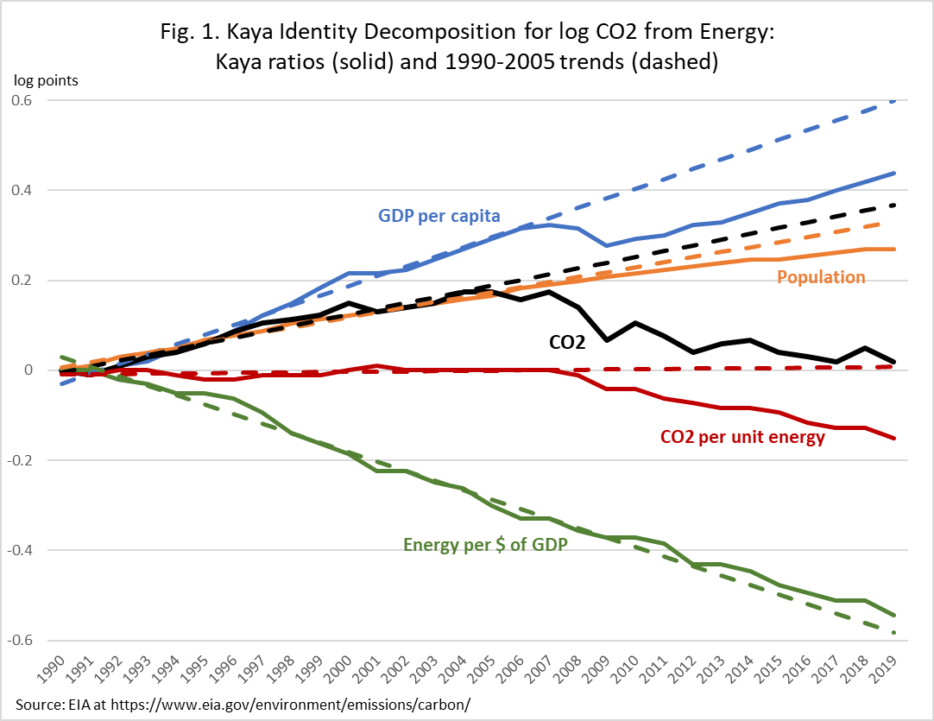
Kaya identity for the US: 1990-2019
Log scale
13-year growth rates
Mean growth in: | 1992-2005 | 2006-2019 | Δ
CO2/E | 0.0 | -1.1 | -1.1
E/GDP | -2.0 | -1.5 | +0.5
GDP/Pop | 2.0 | 0.9 | -1.1
Pop | 1.0 | 0.6 | -0.4
CO2 | 1.2 | -1.0 | -2.2

Slide 4
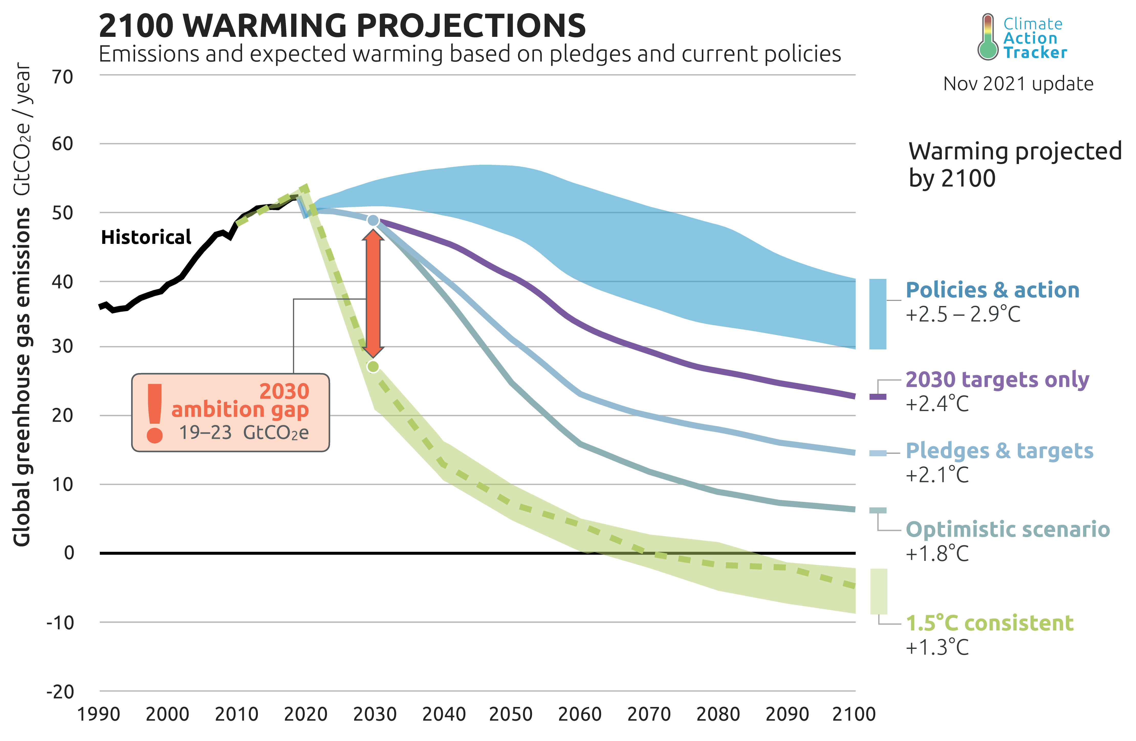
Timeline of physical and transition risks Macro impacts
Examples of channels at different horizons
 | Long run π*, R*, u*, μ | Short run π, u, shocks, business cycles
Physi-cal | Lower average crop yields Lower productivity sea level rise adaptation costs,… | Hurricanes Floods & fires droughts (food price shocks, famines) heat waves (acute productivity shocks) Grid failures/blackouts
Transi-tion | green investment demand shifts in types of jobs/skills monetary policy decision (no accommodation of smooth increase) long run productivity growth | Energy price shocks Asset price shocks Transitional unemployment (mine closures, battery factory openings, etc.) Policy transition shocks (implementation of carbon price,…) Policy uncertainty shocks
Physical
Heat waves
Storms
Regional crop failures
Sea level rise
Climate migration
Transition
Asset revaluation
Energy price volatility
Sectoral reallocation
Food price volatility
Policy effects

Slide 5
3(b). Macro impacts of climate change: transition/short run
Outline
Physical costs of climate change: damage estimates
Macro costs of efficient climate policy
  Case study: EU carbon taxes
  Remarks on other efficient policies and channels
Macro costs of inefficient & uncertain climate policy
  Case study: climate policy uncertainty in the US
  Remarks on second best policies
Conclusions
This section draws on…
G. Metcalf & JH Stock, “The Macroeconomic Impact of Europe’s Carbon Taxes,” AEJ-Macro (forthcoming)
D. Känzig and JH Stock, “The Macroeconomic Cost of Climate Policy Uncertainty” (in progress)

Slide 6
3(b)(i) Case study: Macro effects of a carbon tax - Literature review
A fair number of studies examine carbon tax effect on emissions: partial list
  Lin and Li (2011) – Scandinavia + Netherlands
  Rivers and Schaufele (2012) – BC transportation emissions
  Murray and Rivers (2015) – review of older literature on BC carbon tax
  Haites et. al. (2018) – carbon pricing generally, effectiveness and political economy
  Dolphin, Pollitt, and Newberry (2019) – political economy of carbon tax rates (not effectiveness)
  Pretis (2019) – BC
  Andersson (2019) – Sweden (carbon tax + VAT on fuel)
  Runst and Thonipara (2019) – Swedish residential sector
  Hajek et al (2019), energy sector emissions (SWE, FIN, DNK, IRE, SLO)
  He at al (2019) OECD environmental taxes
  Fauceglia et al. (2019) – Swiss industry
  Abrell et al. (2019) – UK Carbon Price Support on top of EU-ETS, plant-level
  Rafaty, Dolphin, Pretis (2020) - OECD
Fewer study the effect on GDP and employment
  Elgie and McClay (2013) – BC income
  Yamazaki (2017), Yip (2018) – BC employment
  Metcalf (2015, 2019) – BC (2015) and EU (2019)
  Bernard et. al. (2018) – BC carbon tax and provincial income (VAR on with-tax fuel price)
  Olale et. al. (2019) – BC carbon tax and net farm income
  Mundaca (2017) – eliminating fuel tax subsidies in Middle East/North Africa

Slide 7
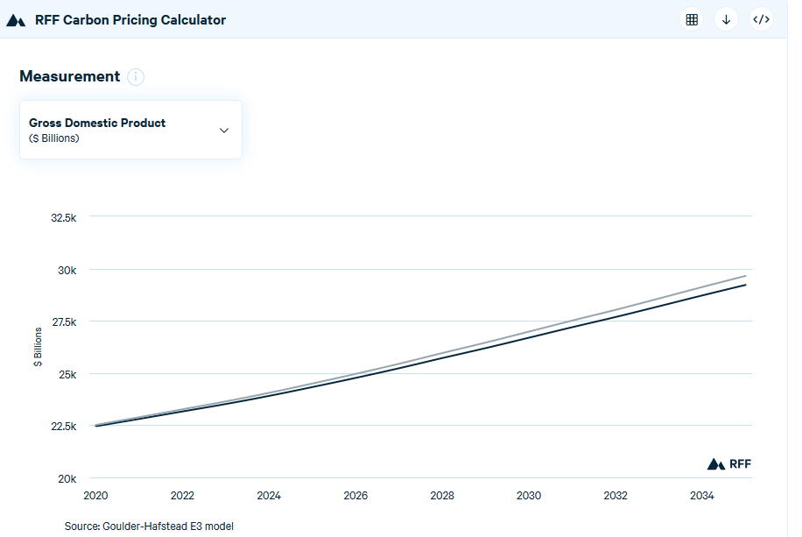
Impacts of a carbon tax: theory
Computable general equilibrium models:
GDP effect (e.g. Goulder and Hafstead, Confronting the Climate Challenge (2018); Jorgenson (2013), etc.; RFF Carbon Pricing Calculator
Employment effect:
  Hafstead and Williams, NBER EEPE, (2019)
Parallel shift down
Importance of revenue recycling method
Example:
  Tax of $40/ton @5%/year GDP loss in 2035 =
  -1.5% (tax & dividend)
  -1.2% (payroll tax cut)
Survey: Metcalf (BPEA, 2019)
Source: RFF Carbon Pricing Calculator at https://www.rff.org/cpc/

Slide 8
Case study: Macro effects of EU Carbon tax (Metcalf-Stock, forthcoming)*
Data set:
EU + Iceland + Norway + Switzerland (n = 31) – all countries in the European emissions trading system
  Of which, 15 also have a carbon tax, almost entirely on emissions not covered by the ETS
Annual, 1985 - 2018
  EU ETS started in 2005 (power sector and certain energy-intensive industries) (subsequently expanded to aviation)
Sources:
Carbon prices: World Bank (new carbon price data)
  Carbon tax rates are real local currency, scaled to 2018 USD using 2018 PPP
  Some countries have multiple tax rates, WB data set has highest and lowest rate and fuels to which it applies; we used the highest rate (typically this is the rate on gasoline & diesel)
  Weighted for coverage of tax
  Sensitivity check with new data from Dolphin et al (2020)
GDP, population: World Bank except
  Norway – we use mainland GDP
  Ireland – we use Ireland official statistics
Employment: Eurostat
Fuel prices and fuel taxes: IEA
Emissions: Eurostat; Dolphin et al (2019) as robustness check
  emissions in road transport, commercial & institutional, and household sectors
  Alternatively, emissions from fuel consumption
*G. Metcalf & JH Stock, “The Macroeconomic Impact of Europe’s Carbon Taxes,” AEJ-Macro (forthcoming)

Slide 9
History and Coverage
Carbon taxes in 2018
Source: World Bank
https://carbonpricingdashboard.worldbank.org/
Country | Year of Adoption | Rate in 2018 (USD) | Coverage (2019)
Finland | 1990 | $70.65 | 0.36
Poland | 1990 | 0.16 | 0.04
Norway | 1991 | 49.30 | 0.62
Sweden | 1991 | 128.91 | 0.40
Denmark | 1992 | 24.92 | 0.40
Slovenia | 1996 | 29.74 | 0.24
Estonia | 2000 | 3.65 | 0.03
Latvia | 2004 | 9.01 | 0.15
Switzerland | 2008 | 80.70 | 0.33
Ireland | 2010 | 24.92 | 0.49
Iceland | 2010 | 25.88 | 0.29
UK | 2013 | 25.71 | 0.23
Spain | 2014 | 30.87 | 0.03
France | 2014 | 57.57 | 0.35
Portugal | 2015 | 11.54 | 0.29

Slide 10
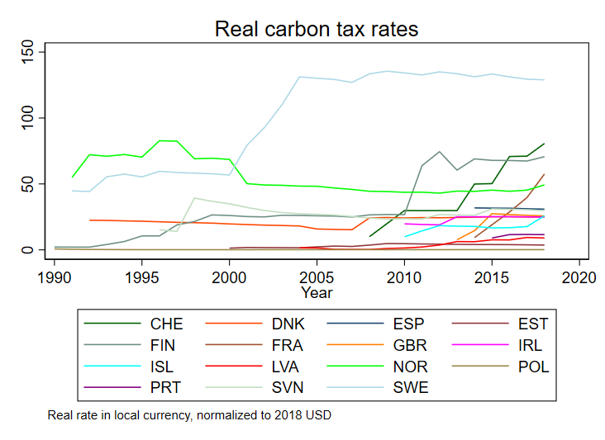
Considerable Variation in Tax Rates Across Countries and Time
Carbon tax history for the 15 countries with carbon taxes
Data source: World Bank (carbon price data in press)
Carbon tax rates are real local currency, scaled to 2018 USD using 2018 PPP
GDP growth: World Bank (except as noted below)

Slide 11
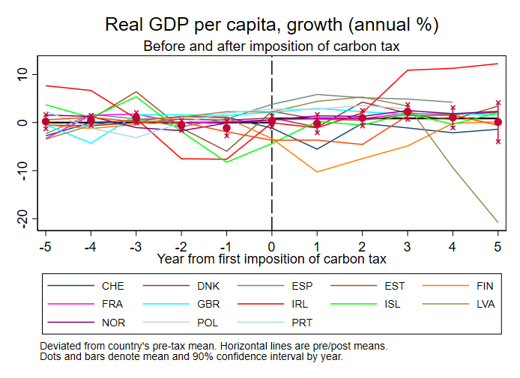
Data description

Slide 12
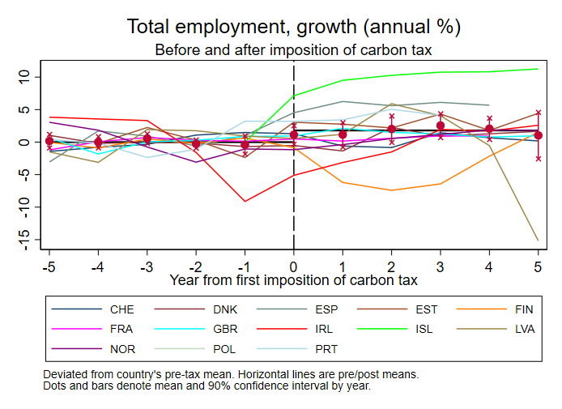
Data description

Slide 13
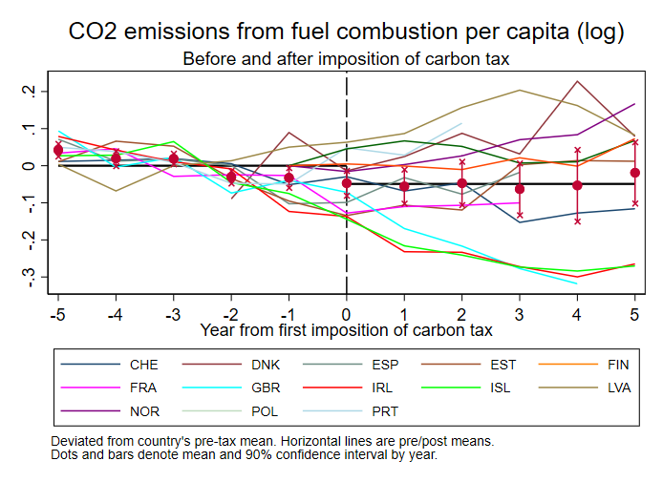
Data description

Slide 14
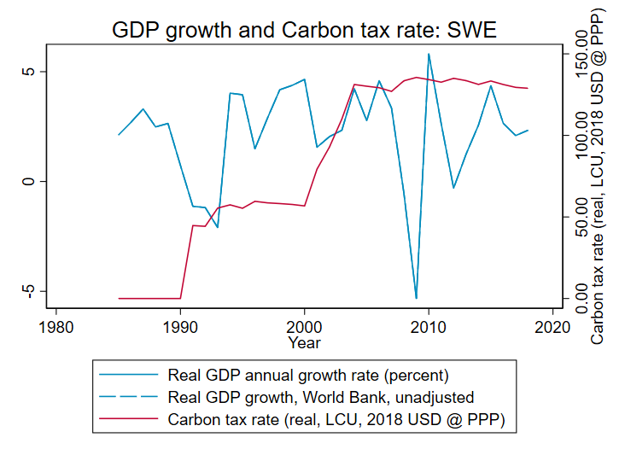
Data description
Sweden

Slide 15
Methods: Regressions and identifying assumptions
Estimand: cumulative dynamic causal effect of change in tax rate on real variables
Two methods, one exogeneity condition (identifying assumptions)
Local projections (panel)
  Exogeneity condition:
  Note: is h-period ahead cumulative impulse response function in VAR jargon
Panel VAR: Same identifying assumption as LP
Restricted or unrestricted: Impose zero long-run effect on growth (restricted), or not (unrestricted)
Identification is coming from the time series variation: think “SVAR”, not “event study”

Slide 16
Methods: Additional Details
Regression and Simulation Details
All regressions include country & year fixed effects
Carbon tax enters weighted by coverage share
Standard errors: heteroskedasticity-robust for SVAR and LP (Plagborg-Møller and Wolf (2019))
Effects calibrated to $40 carbon tax at 0% real increase; tax covers 30 percent of emissions
  Tax innovations are solved from IRF of tax shock to tax rate IRF (Sims (1986) method)
4 lags of control variables used (base case) (BIC selects 2, AIC selects 4 in VAR)

Slide 17
Results: Tests of parallel paths restriction
 | GDP | Employment | Emissions
LP | 0.33 0.75 | -0.63 0.53 | -2.09 0.04
SVAR | 1.34 0.18 | 0.62 0.53 | -1.26 0.21
Revenue Recycling Countries
LP | 0.05 0.96 | -0.72 0.47 | -0.95 0.34
SVAR | 1.39 0.16 | 0.17 0.87 | -0.40 0.69
Large Carbon Tax Countries
LP | -0.41 0.69 | 0.14 0.89 | -0.53 0.60
SVAR | 1.00 0.32 | 1.23 0.22 | -0.34 0.73
Scandinavian Countries
LP | -0.44 0.66 | 0.80 0.42 | 0.19 0.85
SVAR | 0.95 0.34 | 1.04 0.30 | 0.16 0.87
t-statistics testing long-run effect of change carbon tax level on the growth rate of y = 0
(p-values in second line)
For SVAR, this is implied long-run IRF
For LP, this is 8-year effect
Fail to reject “parallel paths” restriction
Results shown today impose the “parallel paths” restriction

Slide 18
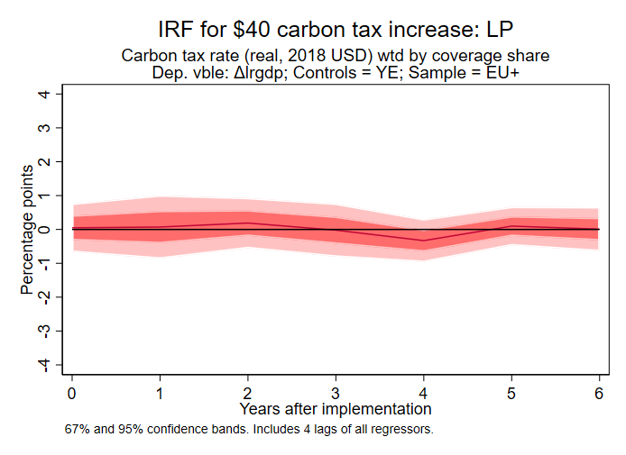
Results: GDP growth
Sample: EU+
Method: Linear Projection
Restricted

Slide 19
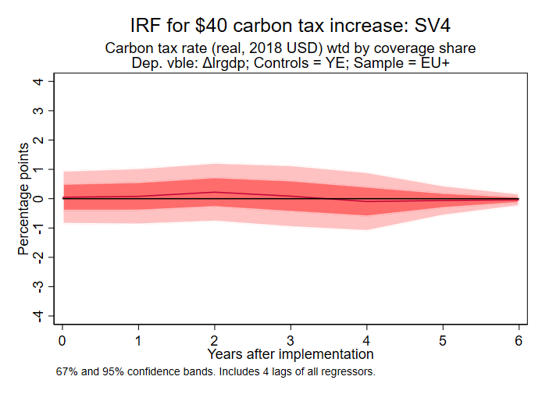
Results: GDP growth
Sample: EU+
Method: SVAR
Restricted

Slide 20
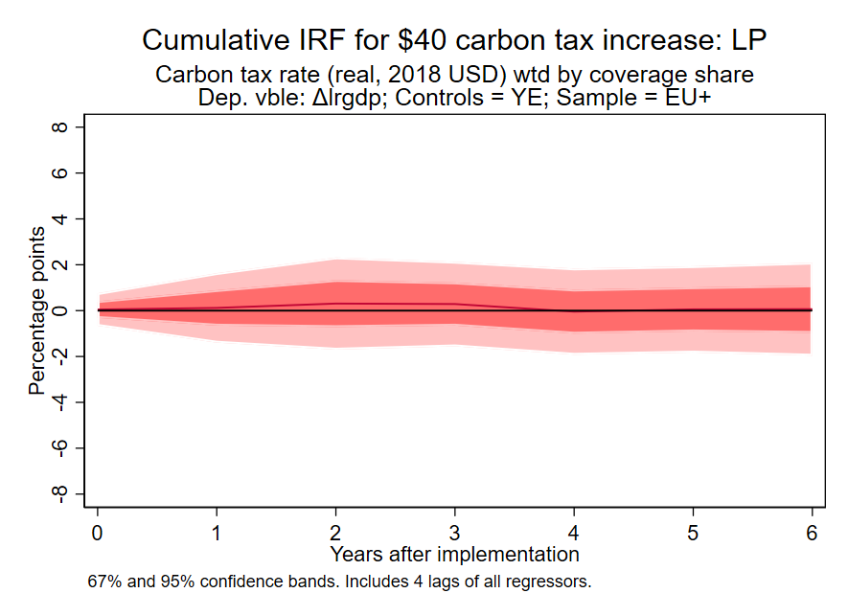
Results: GDP log level
Sample: EU+
Method: LP
Restricted
This cumulative IRF is the estimated effect of the tax increase on the level of log(GDP), imposing the “parallel path” assumption
This is the empirical counterpart to the CGE counterfactual

Slide 21
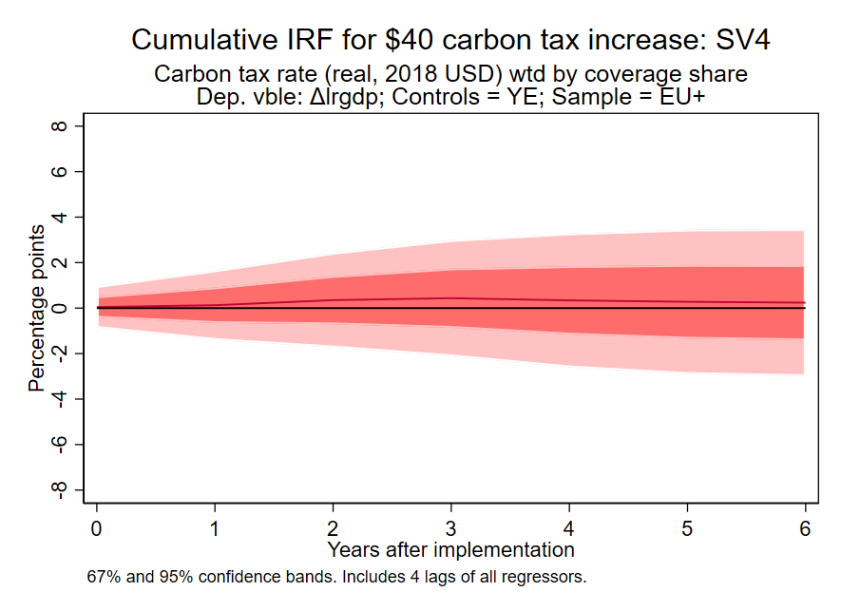
Results: GDP log level
Sample: EU+
Method: SVAR
Restricted
This cumulative IRF is the estimated effect of the tax increase on the level of log(GDP), imposing the “parallel path” assumption
This is the empirical counterpart to the CGE counterfactual

Slide 22
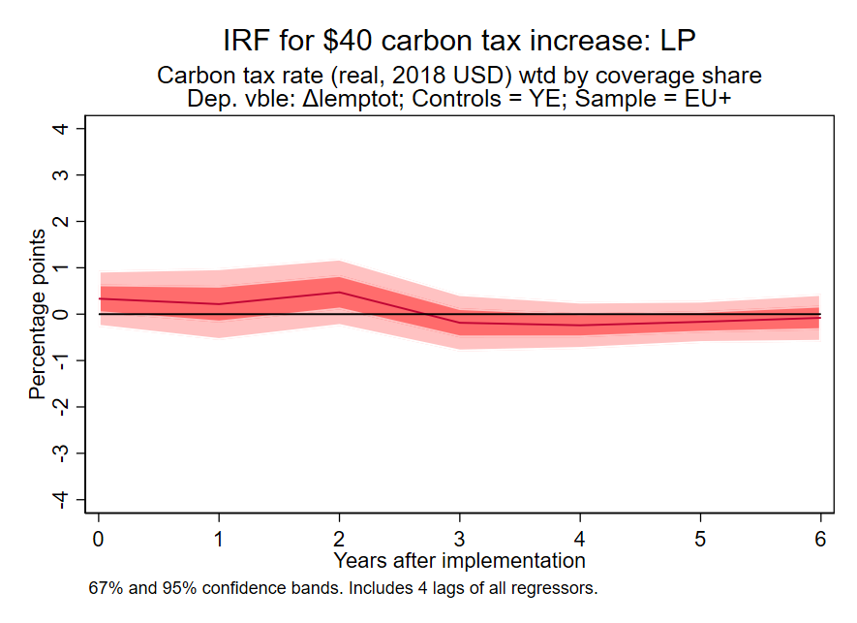
Results: Employment growth
Sample: EU+
Method: LP
Restricted

Slide 23
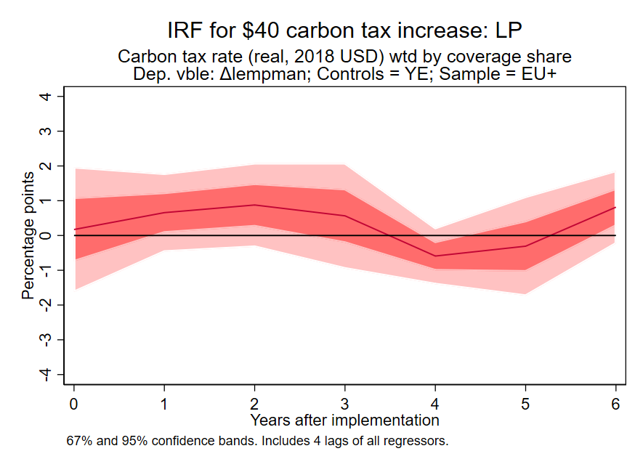
Results: Manufacturing employment growth
Sample: EU+
Method: LP
Restricted

Slide 24
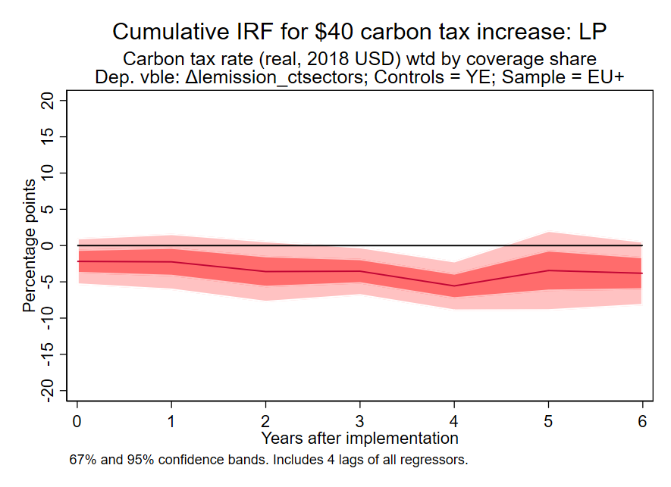
Results: Emissions log level
Sample: EU+
Method: LP
Restricted
Cumulative IRF
This cumulative IRF is the estimated effect of the tax increase on the level of log(emissions), imposing the “parallel path” assumption
Emissions series:
  Emissions in sectors exposed to the carbon tax

Slide 25
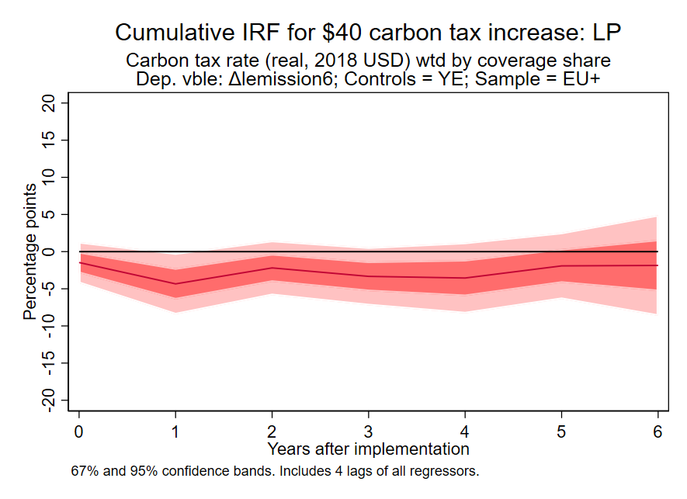
Results: Emissions log level
Sample: EU+
Method: LP
Restricted
Cumulative IRF
This cumulative IRF is the estimated effect of the tax increase on the level of log(emissions), imposing the “parallel path” assumption
Emissions series:
  Emissions from fuel consumption

Slide 26
Results: Additional questions + sensitivity analysis
Are the results driven by:
  Scandinavia?
    No: results for SCA-only, or EUxSCA, are similar to overall results, just noisier
  Countries that have low taxes?
    No: very similar results if you use only countries with tax of at least $10/ton share-weighted ($40/ton x 30% coverage = $12/ton share-weighted)
  Carbon tax data decisions?
    No. Essentially no difference in results if we use the Dolphin et al. (2019) carbon tax rates, see the paper
Are the positive GDP and employment results a consequence of how the country uses the revenue?

Slide 27
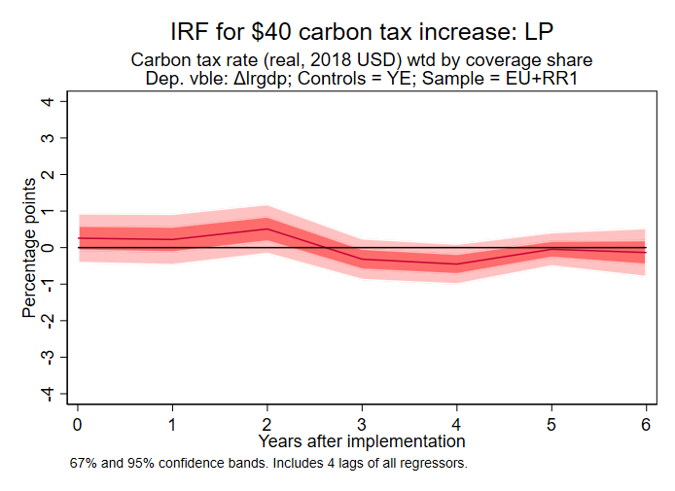
Results: Effect of revenue recycling
Sample: EU+
Revenue recycling
Dep vble: GDP growth
Method: LP
Restricted
Revenue recycling countries
Denmark, Sweden, Norway, Finland, Switzerland, Portugal

Slide 28
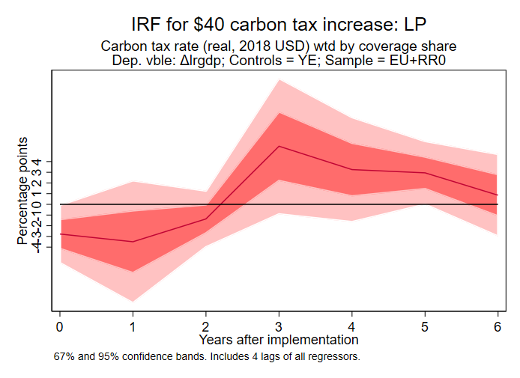
Results: Effect of revenue recycling
Sample: EU+
No revenue recycling
Dep vble: GDP growth
Method: LP
Restricted
Revenue recycling countries
Denmark, Sweden, Norway, Finland, Switzerland, Portugal

Slide 29
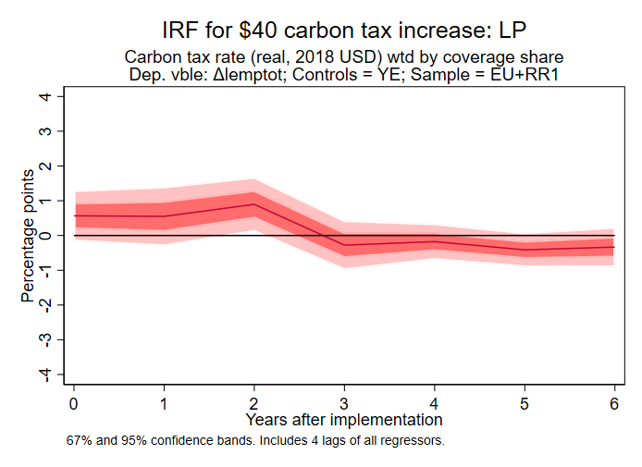
Results: Effect of revenue recycling
Sample: EU+
Revenue recycling
Dep vble: Empl. growth
Method: LP
Restricted
Revenue recycling countries
Denmark, Sweden, Norway, Finland, Switzerland, Portugal

Slide 30
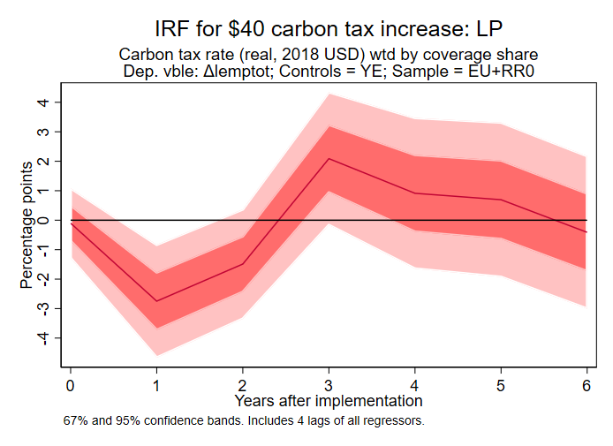
Results: Effect of revenue recycling
Sample: EU+
No revenue recycling
Dep vble: Empl. growth
Method: LP
Restricted
Revenue recycling countries
Denmark, Sweden, Norway, Finland, Switzerland, Portugal

Slide 31
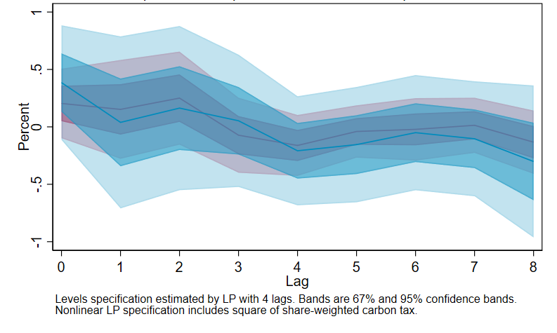
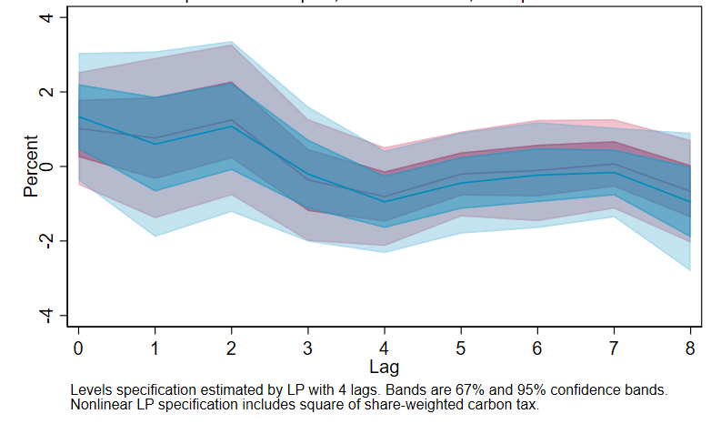
Results: Nonlinearities? EU+ sample, LP, unrestricted
(A) Does the effect depend on the size of the tax?
Sample: EU+
Variable: Employment Growth
Specification: + (share-wtd tax rate)²
        (a) $20 tax increase (b) $100 tax increase

Slide 32
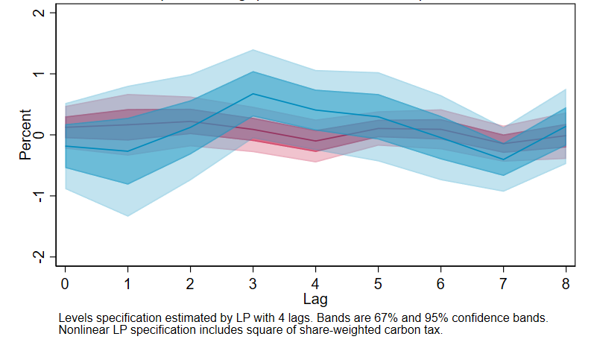
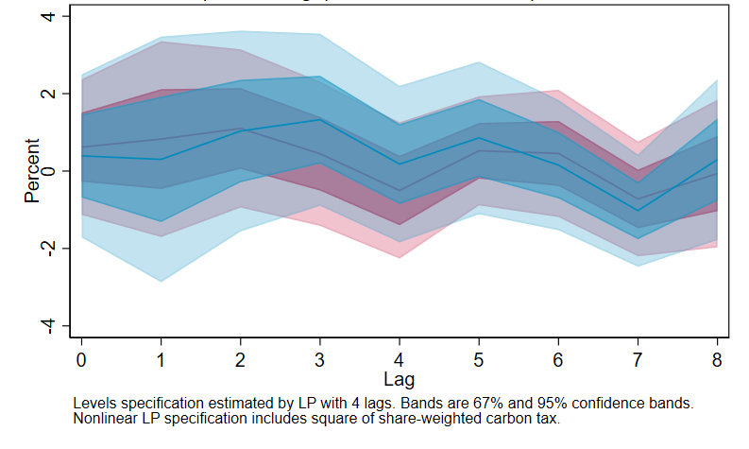
Results: Nonlinearities? EU+ sample, LP, unrestricted
(A) Does the effect depend on the size of the tax?
Sample: EU+
Variable: GDP Growth
Specification: + (share-wtd tax rate)²
        (a) $20 tax increase (b) $100 tax increase

Slide 33
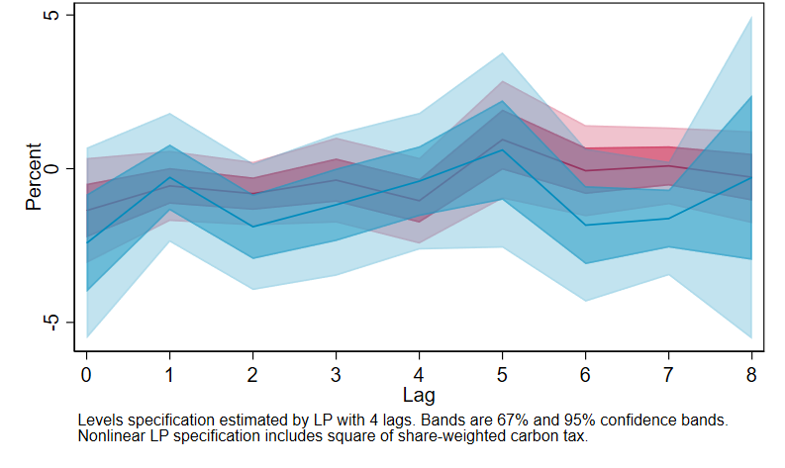
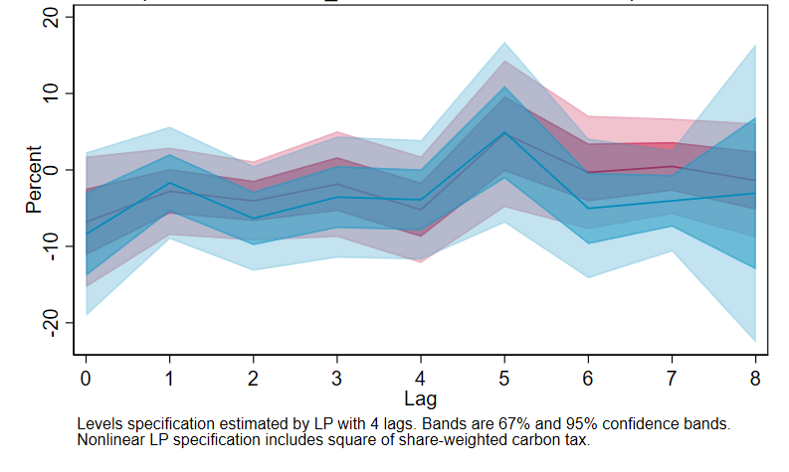
Results: Nonlinearities? EU+ sample, LP, unrestricted
(A) Does the effect depend on the size of the tax?
Sample: EU+
Variable: Emissions Growth
Specification: + (share-wtd tax rate)²
        (a) $20 tax increase (b) $100 tax increase

Slide 34
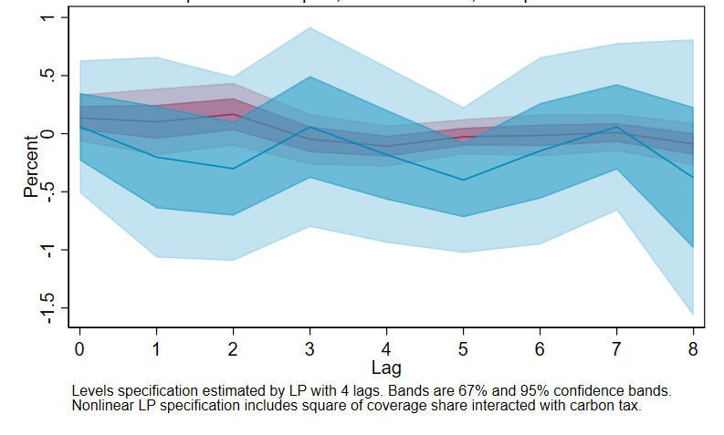
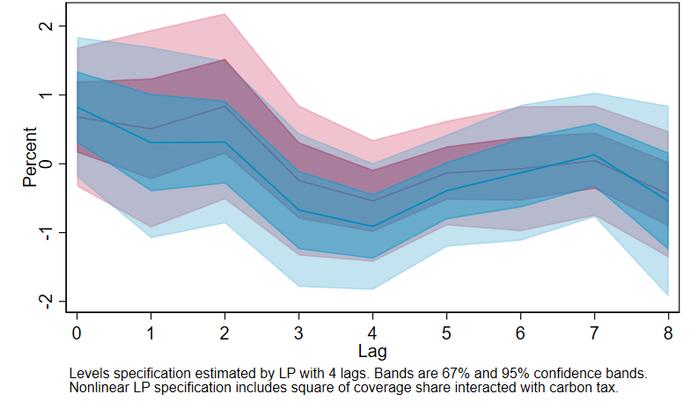
Results: Nonlinearities? EU+ sample, LP, unrestricted
(B) Does the effect depend on the scope (share of emissions covered)?
Sample: EU+
Variable: Employment Growth
Specification: + (share-wtd tax rate × share)
        (a) $20 tax increase (b) $100 tax increase

Slide 35
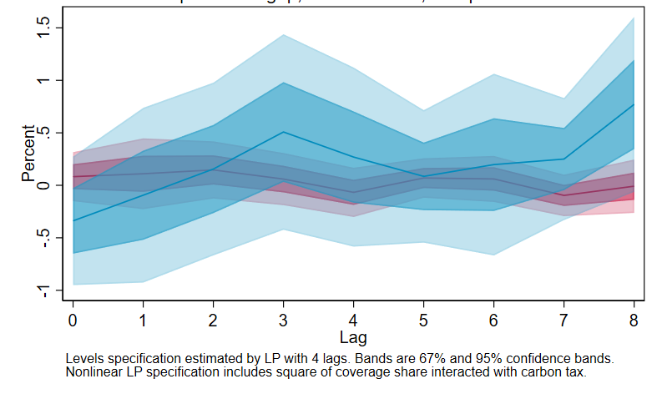
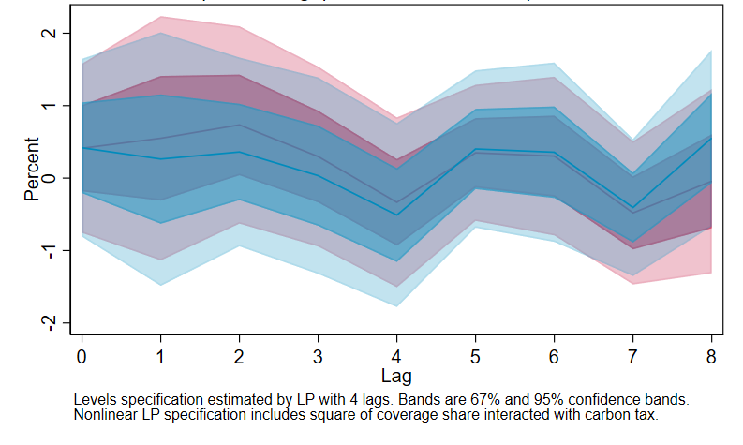
Results: Nonlinearities? EU+ sample, LP, unrestricted
(B) Does the effect depend on the scope (share of emissions covered)?
Sample: EU+
Variable: GDP Growth
Specification: + (share-wtd tax rate × share)
        (a) $20 tax increase (b) $100 tax increase

Slide 36
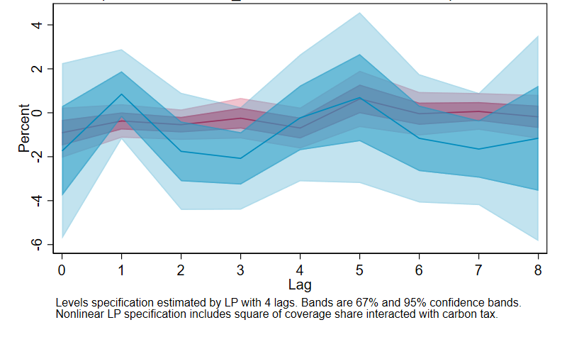
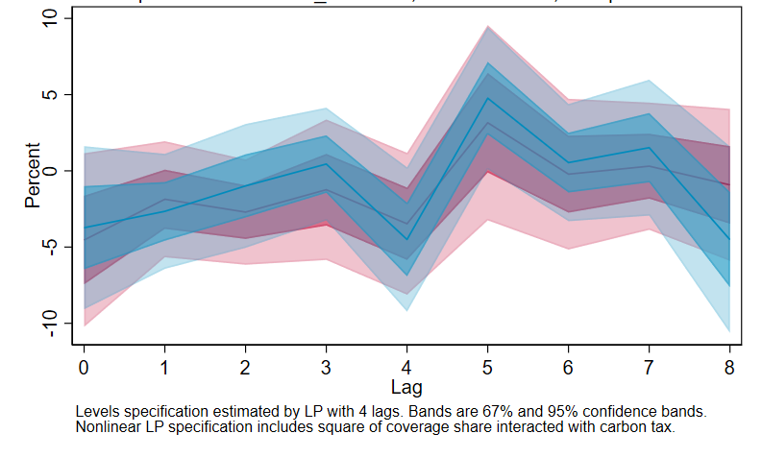
Results: Nonlinearities? EU+ sample, LP, unrestricted
(B) Does the effect depend on the scope (share of emissions covered)?
Sample: EU+
Variable: Emissions Growth
Specification: + (share-wtd tax rate × share)
        (a) $20 tax increase (b) $100 tax increase

Slide 37
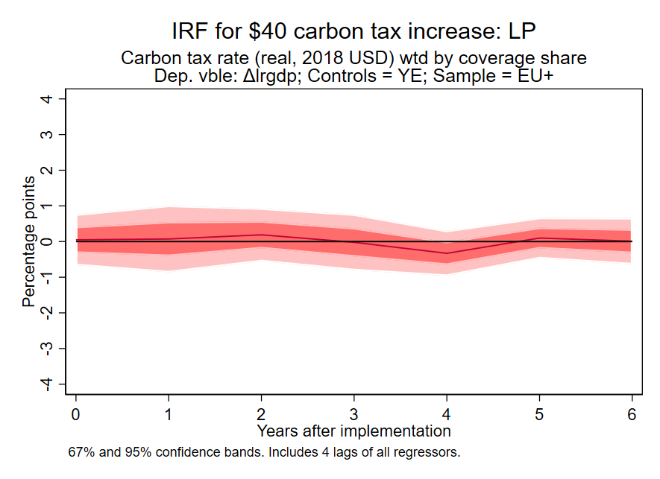
Summary
GDP growth
No effect
Emissions (level) in covered sectors
2-6% reduction
Employment
growth
No effect
initial positive bump?
Dynamic responses of GDP growth, aggregate employment growth, and the level of emissions for a $40/ton carbon tax covering 30% of emissions, based on the EU data.
Taxes mainly cover the transportation sector
Estimation uses time series identification – carbon tax rates predetermined within the calendar year
Source: Metcalf & Stock (AEJ-macro, forthcoming)

Slide 38
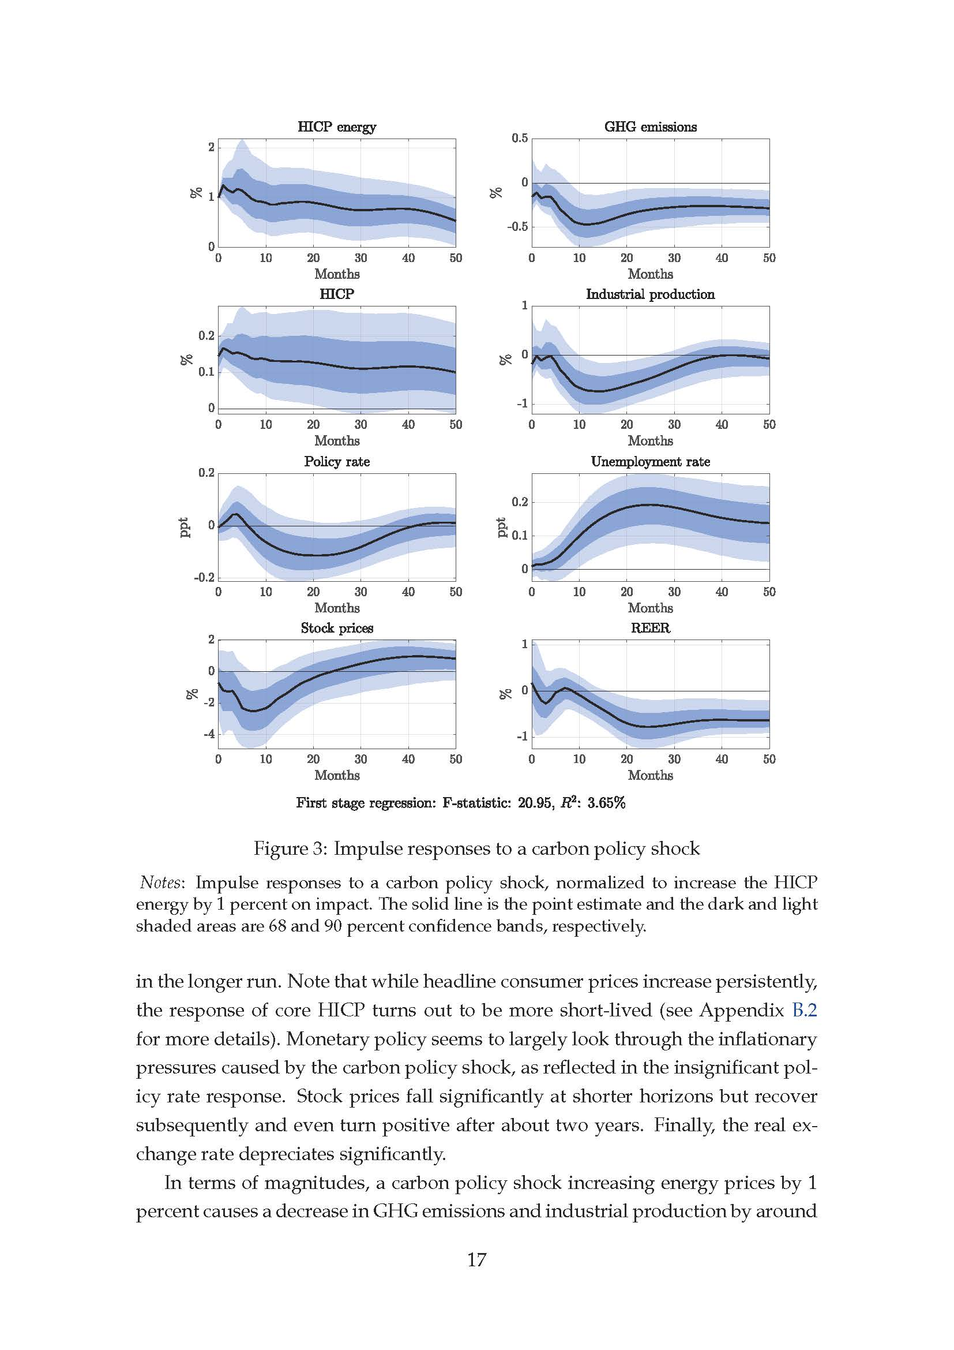
EU ETS: Macro impacts: Känzig (2021)
SCE Session “Macro Identification Using High-Frequency and Micro Data”
What have been emissions & GDP effects of EU ETS?
Important question: how much of decline in emissions intensity of IP is due to EU-ETS increasing energy prices?
Convincing identification strategy
Provocative results
Results
$40 carbon price with full pass-through
  ~12% increase in energy prices (US)
  5-12% fall in IP after 1 year
Cf: fall in IP during financial crisis:
  22% in EU
  17% in US
Why so large?
EU-ETS started in 2005
EU GHG emissions intensity of IP
= GHG emissions/IP
Känzig (2021), Fig. 3
ETS Carbon price shock → IP
Normalized to 1% increase in HICPE
EU-ETS, 1999-2018
Data: EU aggregate
SVAR-IV & LP-IV (announcement ID)

Slide 39
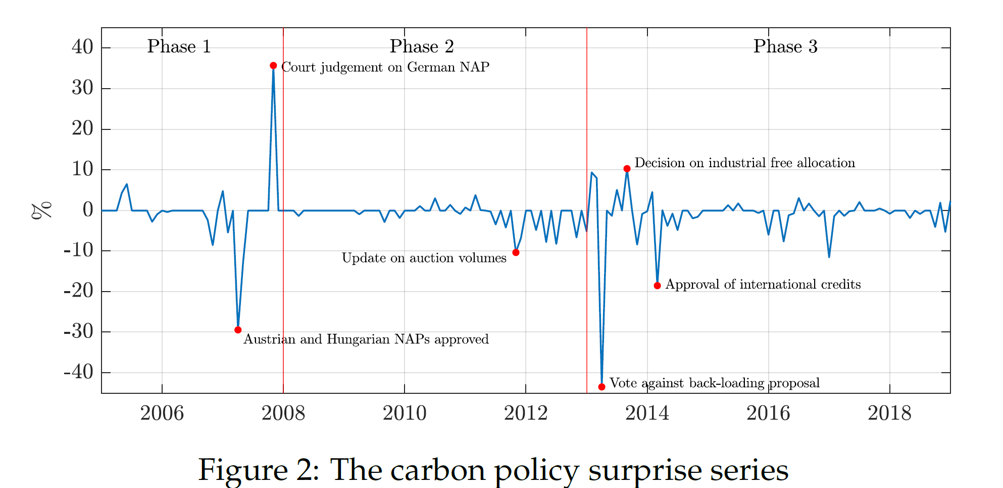
EU ETS: Macro impacts: Känzig (2021)
SCE Session “Macro Identification Using High-Frequency and Micro Data”
Identification strategy
SVAR-IV
Control variables: 8 macro variables (contemporaneous)
IV: Carbon policy price surprise = futures price (for date t) on day of regulatory event – futures price (for same date) on trading day before
SVAR-IV
Stock (2008)
LP-IV
Stock & Watson (EJ, 2018), Plagborg-Møller & Wolf (2021)
A shock instrument (like this one) will allow identification of IRF without requiring invertibility (no need for control variables to span structural shocks)

Slide 40
Känzig (2021): Instrument validity? (yes)
Percentage change or nominal Euro value change?
EU-ETS futures
price
Känzig surprise:
pctage and €
Linear predictability & first stage (2005m6-2018m12) (EU-ETS started January 2005)
 | Percentage
F-test (p-val) of linear predictability: AR | .30 (.938)
F-test (p-val) of linear predictability: ARx | .60 (.918)
First-stage F (HR, controls x) | 11.42
Notes: X = lags 1, 2 of Känzig controls, in first differences (so number of X’s = 2×8 = 16)

Slide 41
Känzig (2021): Exploit “clean” instrument?
Instrument satisfies Stock-Watson (2018) condition LP-IV:
  SVAR-IV requires invertibility but LP-IV does not
  LP-IV valid without controls, or with any set of lagged controls to reduce SEs
LP-IV, 2005m6-2018m12
Controls:
2 lags of 8 Känzig variables
No controls
ln(HICP-E) ln(IP) ln(Emissions)
cf. Känzig, fig. B3
Test invertibility?
LP-IV and SVAR-IV

Slide 42
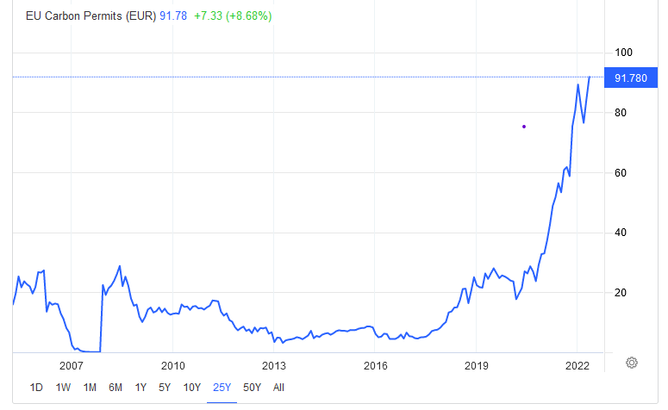
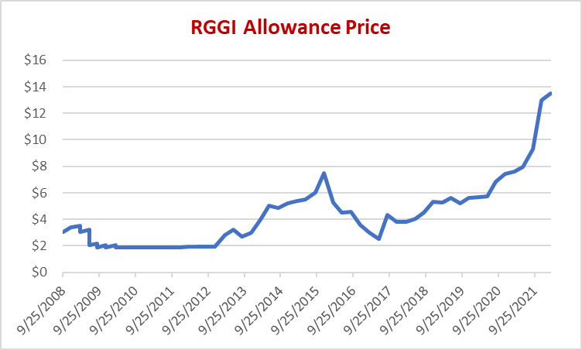
Impacts of a carbon tax: Caveats (1/2)
Important distributional considerations (micro not macro):
  Potentially large sectoral employment shifts
  Regressive or progressive depending on how rebates are structured
Results for a cap & trade system might not be the same as for a carbon tax
  Price volatility of a cap & trade system can retard investment in low-carbon capital, delaying decarbonization and increasing costs (Aldy & Armitage 2022)
  Price volatility also implies inflation volatility (pass-through of tax & permit price)
  Känzig (2021)
Increasing carbon tax will pass through to inflation
  Carbon tax design should have predictable path
  CB can accommodate (although this isn’t what happened in EU carbon taxes since mainly the countries were in the Eurozone when they implemented the tax or the tax hikes)
EU ETS Permit Price

Slide 43
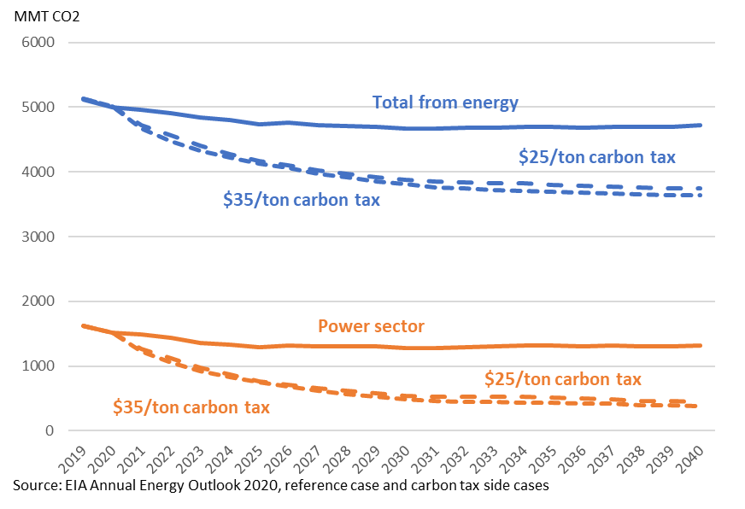
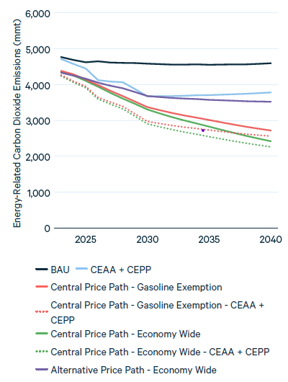
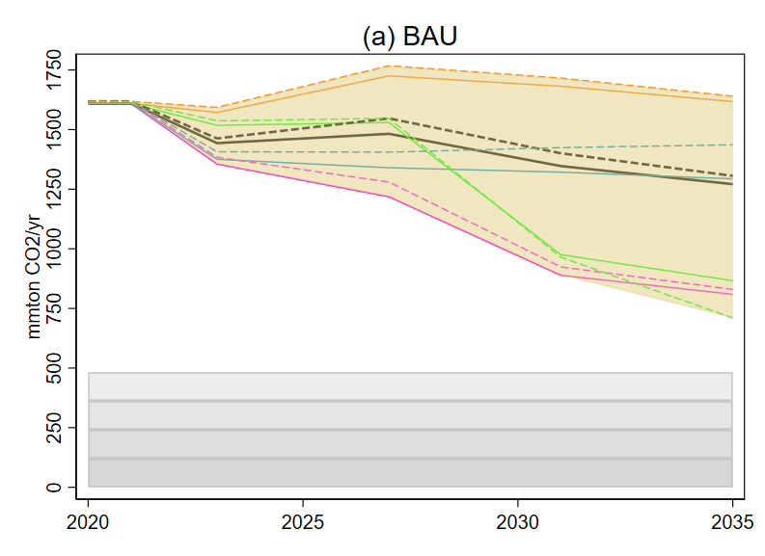
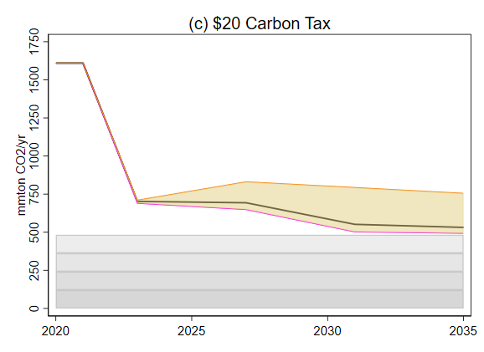
Impacts of a carbon tax: Caveats (2/2)
Growing evidence that carbon tax has small effect on emissions (Green (2021), Metcalf-Stock)
But most CT’s – like the EU CT – cover mainly the transportation sector.
In the US, a CT would cover the power sector too, where much greater emissions reductions are possible.
Three Recent Carbon Tax Simulations for the US
(a) EIA (2021):
Reference case and $25 & $35 carbon tax cases
(b) Stock & Stuart (2021):
BAU & $20 carbon tax, power sector only
(c) RFF (2021):
BAU and $15 carbon tax cases
$15 Carbon tax excluding gasoline

Slide 44


3(b)(ii). Transition policy case study #2: Climate policy uncertainty*
*Gavrilis, D. Känzig, & JH Stock, work in progress

Slide 45
Transition policy case study #2: Climate policy uncertainty
Climate policy uncertainty indicators
(based on 2 & 8 newspapers)
Data set:
Climate policy uncertainty index (CPU): Gavriilidis (2021); cf Engel et al (2020)
  Akin to Baker-Bloom-Davis Economic Policy Uncertainty construction
  News articles including climate terms and policy terms and uncertainty
  8 (2) newspapers: 2000m1-2021m12 (1984m1-2020m12)
  Policy news spikes include: Kyoto, Fuel economy rules, Clean Power Plan, Trump withdrawal from Paris, etc.
  Correlation with BBD EPU : 0.07 (8-paper) and 0.02 (2-paper) (!)
Method: LP & SVAR
Identification: CPU is CMI given contemporaneous control variables: BBD-EPU, IP, unemployment rate, PCE inflation, WTI price, 90-day T-bill rate
Caveats: Usual BBD EPU caveats

Slide 46
2. Macroeconomics of inefficient climate policy: Climate policy uncertainty
Preliminary results
Impulse response function with respect to 1 std dev. increase in the climate change news indexes
Estimated by local projections
2-newspaper (longer) measure, monthly, 1985m3-2019m12
Control variables: BBD-EPU, IP, unemployment rate, PCE inflation, WTI price, 90-day T-bill rate
Robust to no. lags, control variable choice, use of 2- or 8-newspaper measure; similar, less noisy estimates with SVARs

Slide 47

3(b)(iii). “Non-transition” risk: Energy security & Ukraine
Ukraine, natural gas prices, & cyclical implications
of fossil fuel price shocks for US
  Three regimes in US gas markets:
  <= ~2009: growing & large imports
  2010 – 2016: Fracking & “locked in”
  2016 – present: LNG exports
Cheniere Sabine Pass Train 1 was placed into service May 2016.
Quantities

Slide 48
“Non-transition” risk: Energy security & Ukraine
Ukraine, natural gas prices, & cyclical implications
of fossil fuel price shocks for US
  Three regimes in US gas markets:
  <= ~2009: growing & large imports
  2010 – 2016: Fracking & “locked in”
  2016 – present: LNG exports
Correlation between n-week pct change of Brent crude & Henry Hub gas
 | 2-week | 4-week
I. 2000-2009 | 0.28 | 0.21
II. 2010-April 2016 | 0.08 | 0.03
III. May 2016-present (x 2020) | 0.18 | 0.22
Prices

Slide 49
“Non-transition” risk: Energy security & Ukraine
Ukraine, natural gas prices, & cyclical implications
of fossil fuel price shocks for US
  Three regimes in US gas markets:
  <= ~2009: growing & large imports
  2010 – 2016: Fracking & “locked in”
  2016 – present: LNG exports
Correlation between n-week pct change of Brent crude & Henry Hub gas
 | 2-week | 4-week
I. 2000-2009 | 0.28 | 0.21
II. 2010-April 2016 | 0.08 | 0.03
III. May 2016-present (x 2020) | 0.18 | 0.22
Discussion
Henry Hub & EU gas prices are currently not linked
  Liquifaction + transport + regasification
  ≈ $4-7/mmBTU
But suppose:
  Russian gas partially shut in over 5-year horizon
  Expansion of US LNG export capacity & EU liquefaction capacity
$5-6 US gas?
Volatile oil prices for the foreseeable future?
Volatile US gas prices for the foreseeable future?
Oil price shocks will impact power & industrial sectors?
Greater macro (business cycle) exposure to oil price shocks?

Slide 50
Timeline of physical and transition risks Macro impacts
Examples of channels at different horizons
 | Long run π*, R*, u*, μ | Short run π, u, shocks, business cycles
Physi-cal | Lower average crop yields Lower productivity sea level rise adaptation costs,… | Hurricanes Floods & fires droughts (food price shocks, famines) heat waves (acute productivity shocks) Grid failures/blackouts
Transi-tion | green investment demand shifts in types of jobs/skills monetary policy decision (no accommodation of smooth increase) long run productivity growth | Energy price shocks Asset price shocks Transitional unemployment (mine closures, battery factory openings, etc.) Policy transition shocks (implementation of carbon price,…) Policy uncertainty shocks
Physical
Heat waves
Storms
Regional crop failures
Sea level rise
Climate migration
Transition
Asset revaluation
Energy price volatility
Sectoral reallocation
Food price volatility
Policy effects

Slide 51
Concluding remarks: Macro climate risks
Macro policy transition risk and non-transition risk is arguably the most important risk for monetary policy over the ten-year horizon.
  Relative price volatility
  Inflation volatility
  Potential negative demand and/or productivity and/or supply shocks
Transition costs depend in part on how policy is conducted
  Macro costs of a carbon tax are small
    Arguably also true for durable & predictable second-best policies like investment tax credits, power sector CES, or innovation policy
  Climate policy uncertainty appears to have macro costs
  Absence of policy delays the energy transition so increase future transition costs and physical risks
  Policy swings that result in policy stagnation further impose macro costs
The recent tragedy in Ukraine highlights non-transition risks
  Because of war-induced LNG investments, arguably exacerbates US vulnerability to international oil price shocks, and
  Suggests a world with higher and more volatile natural gas and oil prices which, all else equal will expedite the energy transition
Asset revaluation
Energy price volatility
Sectoral reallocation
Food price volatility
Policy effects Large enough to matter at macro level

