Slide 1
Federal Coal Program Reform, the Clean Power Plan, and the Interaction of Upstream and Downstream Climate Policies
Todd Gerarden, HKS
Spencer Reeder, Vulcan Philanthropy
Jim Stock, Harvard Economics and HKS
Harvard Seminar in Environmental Economics & Policy
September 14, 2016

Slide 2
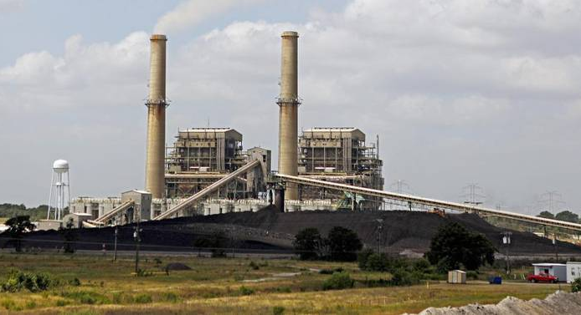
Upstream, Downstream
Downstream
The Clean Power Plan
Covers power sector
National rule, state implementation
Mass and rate options
Leakage:
  only generators >25MW covered
  peakers not covered
  rate: separate coverage of new and existing
  additional leakage if mixed mass & rate

Slide 3
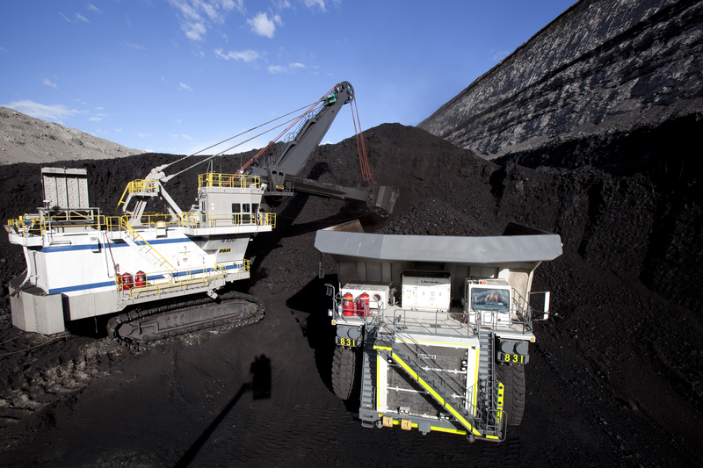
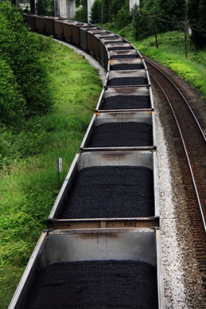
Upstream, Downstream
Upstream
Federal Coal Leasing Program
41% of US coal is mined on federal lands
13% of US energy-related GHG emissions
80% of federal coal is surface mined in the Powder River Basin (PRB)
PRB coal costs ~1/3 of nonfederal coal per Btu
Downstream
The Clean Power Plan
Covers power sector
National rule, state implementation
Mass and rate options
Leakage:
  only generators >25MW covered
  peakers not covered
  rate: separate coverage of new and existing
  additional leakage if mixed mass & rate

Slide 4
Outline
Introduction
U.S. coal production, the federal coal program, and the DOI PEIS
Comparative statics
IPM research design
IPM results
Policy recommendation and conclusion

Slide 5
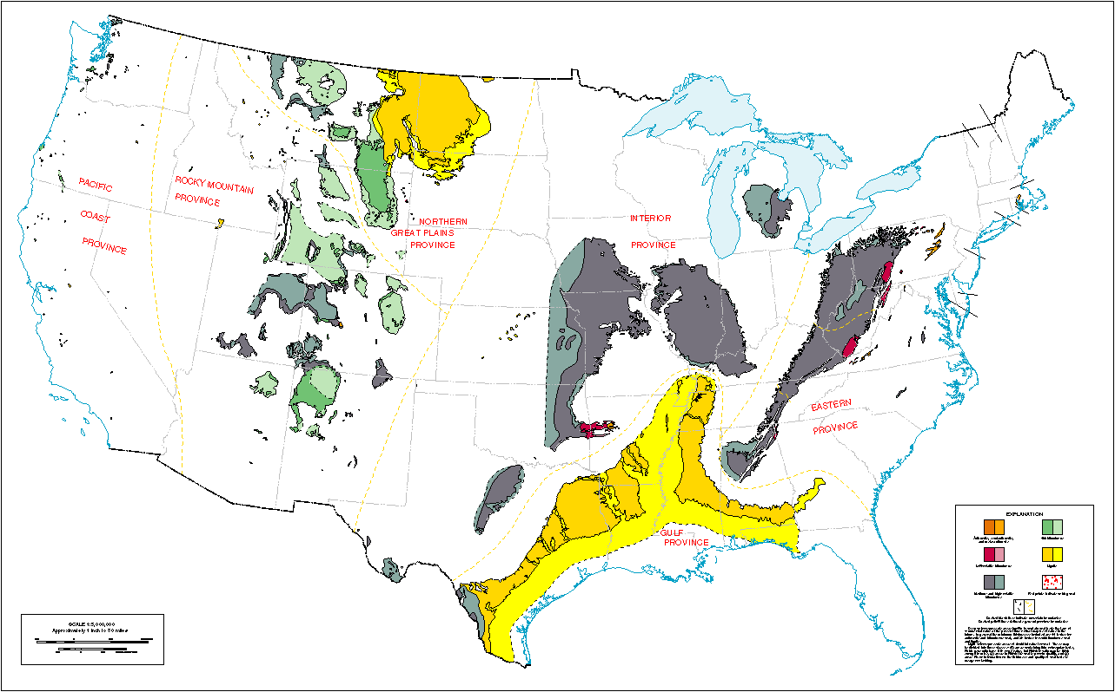
U.S Coal Basins
2. U.S. coal program
Source: USGS at http://pubs.usgs.gov/of/1996/of96-092/Comp/main.gif

Slide 6
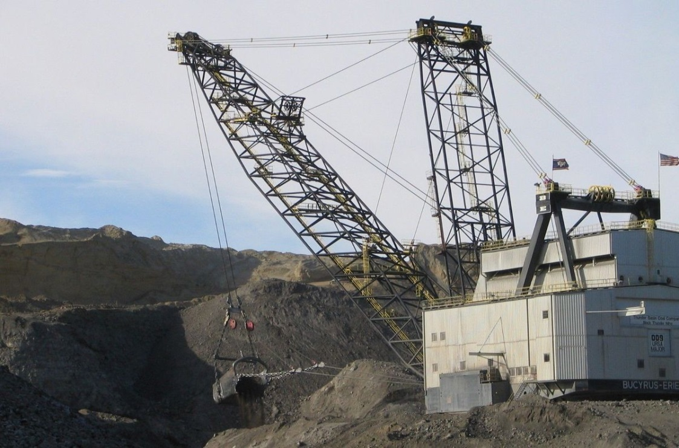
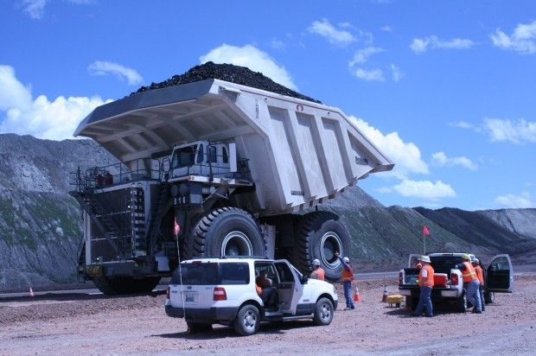
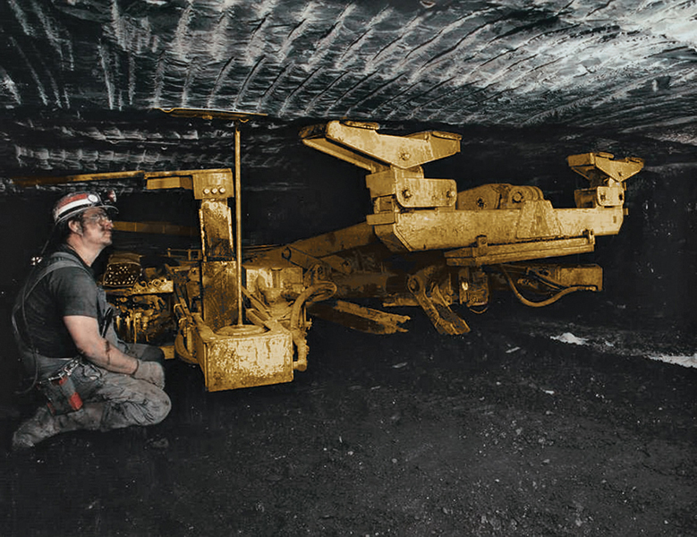
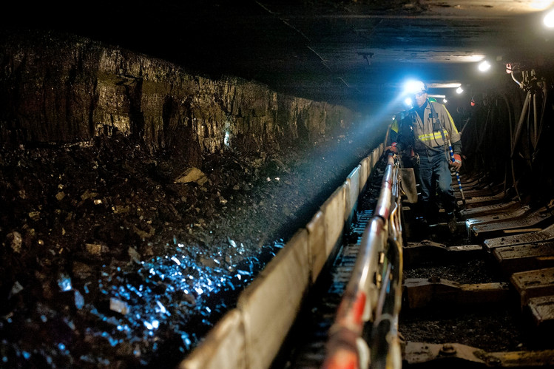
Surface and Underground Coal Mining
Drag line, Black Thunder Mine, Arch Coal, PRB
Truck that holds 447 tons of coal. North Antelope Rochelle Mine, Peabody Coal, PRB
Roof bolter for
room and pillar
mining
Long wall
mining in PA

Slide 7
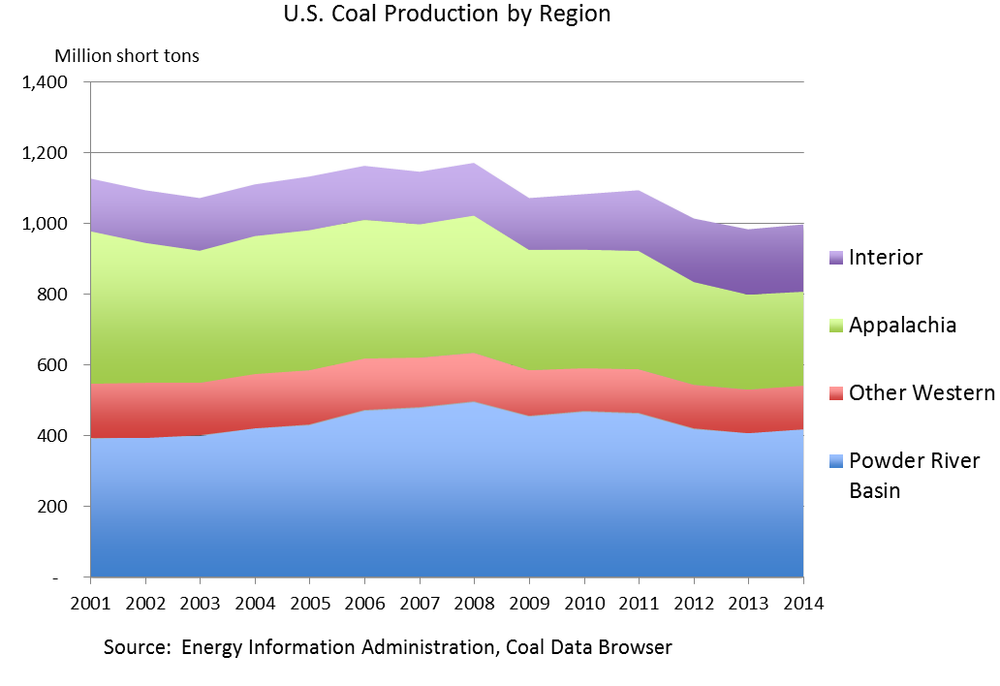
Federal coal at a glance
Federal coal facts
41% of U.S. coal production
13% of U.S. energy-related CO2 emissions
94% of federal coal is mined in Wyoming, Montana, Colorado, and Utah
80% is surface mining in the PRB
Annual Federal and Non-Federal Coal Production
(millions of short tons)
State | Total, 2014 | Federal, FY2014 | Federal percent
Wyoming | 396 | 337 | 86%
Montana | 45 | 27 | 61%
Colorado | 24 | 17 | 71%
Utah | 17 | 14 | 81%
Other | 502 | 26 | 5%
Total | 983 | 421 | 43%
Prompt month coal prices, $/short ton, 7/15/16
Central Appalachia | 12,500 Btu, 1.2 SO₂ | $41.10
Northern Appalachia | 13,000 Btu, < 3.0 SO₂ | $43.35
Illinois Basin | 11,800 Btu, 5.0 SO₂ | $32.00
Powder River Basin | 8,800 Btu, 0.8 SO₂ | $8.70
Uinta Basin | 11,700 Btu, 0.8 SO₂ | $39.40
Sources: EIA Annual Coal Report 2015, Sales of Fossil Fuels Produced from Federal and Indian Lands FY2003 through FY 2014.
Sources: EIA, SNL

Slide 8
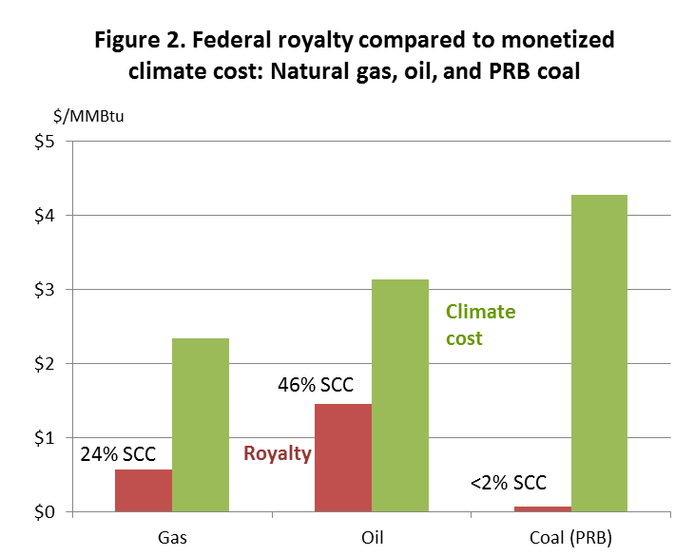
Upstream, Downstream
“Many stakeholders highlighted the tension between producing very large quantities of Federal coal while pursuing policies to reduce US GHG emissions substantially, including from coal combustion”
DOI PEIS NOI, 81 FR 17724, March 30, 2016

Slide 9
DOI Programmatic EIS: Federal Coal Program
Jan. 15, 2016: Secretary Jewell announces PEIS process, places moratorium on new leases
March 30, 2016: DOI Notice of Intent to Prepare EIS
    (c) Climate impacts
    With respect to the climate impacts of the Federal coal program, the Programmatic EIS will examine how best to measure and assess the climate impacts of continued Federal coal production, transportation, and combustion. …
    It will also consider [mitigation by] land use planning, adjustments to the scale and pace of leasing, adjustments to royalties or other means of internalizing externalities, mitigation through greenhouse gas reductions elsewhere, information disclosure, and other approaches.
    The Programmatic EIS will examine the climate impacts of the coal program in the context of the Nation's climate objectives, as well as the Nation's energy and security needs.
    FR 81 17725
Sept. 15, 2016: NOI comments due
~Dec., 2016: PEIS scoping document expected

Slide 10
“Keep it in the ground” – or not?
Climate scientists’ letter to Secretary Jewell – PEIS comment
The science is clear: … to hold global temperature increase well below 2ºC, the US must keep the vast majority of its coal in the ground. We urge you to end federal coal leasing, extraction, and burning in order to advance US climate objectives…
James Hansen (Columbia)
Susan Solomon (MIT)
Ken Arrow (Stanford)
Mark Jacobson (Stanford)
Kerry Emanuel (MIT)
67 total
July 27, 2016
The case for downstream regulation only
Substitution of non-Federal coal for Federal coal undercuts “keep it in the ground” policy
The “double counting” problem: Upstream regulation is economically inefficient if strong, binding downstream regulation is in place (strong CPP).
Federal extraction communities hit hard if the moratorium becomes permanent

Slide 11
Policy research questions
How do upstream and downstream policies interact in theory?
  Specific upstream policies:
    Carbon adder to coal royalties
    Quantity cap, e.g. permanent moratorium
Can we estimate the effects of carbon adder, given various implementations of the CPP taking into account “real world” complexities
  Estimates undertaken using the IPM model
  IPM is the model EPA used for the CPP RIA (for example)

Slide 12
Related literature
Instrument choice and overlapping policies
  Holland (2012)
  Mansur (2012)
  Goulder and Stavins (2012)
  Goulder, Jacobsen, and van Benthem (2012)
  Fischer and Newell (2008)
  Fischer, Newell, Preonas (2013)
Fair value
  US DOI-IG (2013), US GAO (2014), Haggerty and Haggerty (2015), CEA (2016)
Closest to this paper
  Bushnell, Holland, Hughes, Knittel (2015)
  Fischer and Preonas (2010) (static model setup)
  Harstad (2012) (supply side to stem leakage outside international agreement)
  Hein and Howard (2015) (emissions from coal production)
  Horowitz and Linn (2015) (technological innovation and rate-based regs)
  Haggerty, Lawson, and Pearcy (2015) (selected NEMS equations to effect on coal prices of assessing coal royalty on delivered price instead of mine-mouth price)
  Krupnick et. al. (2015) (legal framework for carbon adder in coal royalty)

Slide 13
Comparative Statics of Upstream/Downstream
Cases
No downstream regulation
Textbook cap-and-trade
Mass-based cap-and-trade with non-covered sources
  Strong mass version of CPP has interstate trading but excludes gas CT <25MW + other carve-outs
Rate regulation with non-covered sources
  CPP rate-based version (likely FIP) regulates existing fossil sources only
  New fossil sources are regulated under 111(b) (which doesn’t cover small gas CT)

Slide 14
Static model: Setup
Fuels: federal coal (q_{FC} ), non-federal coal (q_{NFC} ),
other covered (q_{O} ) (gas), uncovered (q_{U})
Generation units: MWh produced by burning 1 ton coal
Emissions units: tons CO2 produced by burning 1 ton coal
λ = tons CO2 produced by 1MWh of other (other = gas)
λ_{U} = tons CO2 produced by 1MWh of uncovered
Representative firm profits:
Emissions:
Welfare:
Constraints:
Mass cap:
Rate regulation:
r = federal coal royalty adder
Analytics: Take derivatives of firm’s first order conditions and social welfare wrt r

Slide 15
Comparative statics: (a) only federal coal, no CPP
Federal coal only
No emissions regulation
per-ton coal royalty adder r:
  Effective marginal cost of generation increases
  electricity price increases
  quantity of generation drops
S’
p
S
p*
p₀
r
D
Q*
Q₀

Slide 16

(b) only Fed coal, mass-based
Federal coal only
Binding mass-based cap & trade
per-ton coal royalty adder r:
  Price, quantity, and emissions remain the same
  t+r remains constant (t = allowance price)
S’
p
S
p*
t’
t
r
D
Q

Slide 17

(b’’) Fed coal & other (gas); mass-based
Federal coal & other (gas) , which emits a fraction λ of what coal emits per MWh
Binding mass-based cap & trade
per-ton coal royalty adder r:
  Higher marginal cost of coal induces shift into gas
  This moves out the MWh associated with the emissions limit
  So price falls, emissions remain constant, quantity of electricity increases
  Tradable permit price falls by more than the price
  If uncovered sources: leakage is reduced (price drops, relative mc of covered generation falls)
p
S’’’
S
p*
p**
t’’’
D
Q

Slide 18
(d) Fed coal & other (gas); rate-based
Federal coal & other (gas) , which emits a fraction λ of what coal emits per MWh
Binding rate-based regulation
per-ton coal royalty adder r:
  Coal & gas are used in fixed proportion
  Royalty adder increases cost of coal-gas bundle
  Price increases, generation declines, tradeable permit price falls, covered emissions decline
  Uncovered generation and uncovered emissions increase
S’
p
S
p*
p₀
(r×
share)
D
Q*
Q₀

Slide 19
IPM Research Design
IPM
Proprietary model, ICF International; used by EPA for RIAs, e.g. MATS, CPP
Dynamic perfect foresight linear programming model, computes least-cost capacity expansion, electricity dispatch, transmission, subject to existing environmental regulations and reliability constraints – makes plant-level generation decisions
Endogenously solves for fuel prices
Coal component: 36 coal supply regions, 14 coal grades, coal transport network
Coal supply curves are developed off-line using mine-level engineering cost curves
Key assumptions
Aligned to EPA final CPP RIA (IPM v.5.15)
Policy frozen Oct. 2015 (no Jan 2016 PTC, ITC extension)
Baseline gas prices, renewables prices, demand from AEO2015
Demand is exogenous (“scenarios”); no induced energy efficiency
Base cases
No CPP
Mass-based CPP with regional trading
  Follows CPP final rule mass-based version with new source complements
  Covers all fossil units ≥ 25 MW
Rate-based CPP with regional trading
  Rate regulation covers existing fossil units ≥ 25 MW
  New sources are covered by §111(b)
Full report: http://www.vulcan.com/news/articles/2016/coal-leasing-report

Slide 20
IPM coal supply curves modification
Modification for royalty adder
The royalty adder schedule is an additional cost per ton by year on federal coal
Adders were set at 20%, 50%, 100% of USG SCC (OMB 2013)
The mine-level data in the coal supply curve module were updated to include federal/non-federal percentages by mine and cost curve step, WY, MT, CO, UT (only) (LMU concept)
The adder was then applied by mine/step/year and regional cost curves were constructed
The same adder was imposed regardless of grade and regardless of mining method (surface/underground)
The application of the royalty adder to new leases only was modeled by a linear phase-in of the adder (incorporating mine lease history into the coal supply curve module was infeasible)
Table 2. Simulated Phased-in Royalty Adders for Federal Coal
Indexed to SCC with 10-year linear phase-in (2015$)
 | 20% SCC | 50% SCC | 100% SCC
2016 | $1.53 | $3.83 | $7.67
2020 | $8.67 | $21.69 | $43.37
2025 | $18.96 | $47.41 | $94.81
2030 | $20.98 | $52.45 | $104.90
Notes: Computed for sub-bituminous coal (heat content 9130 Btu/lb). The SCC is the 2013 USG estimate (OMB 2013).

Slide 21
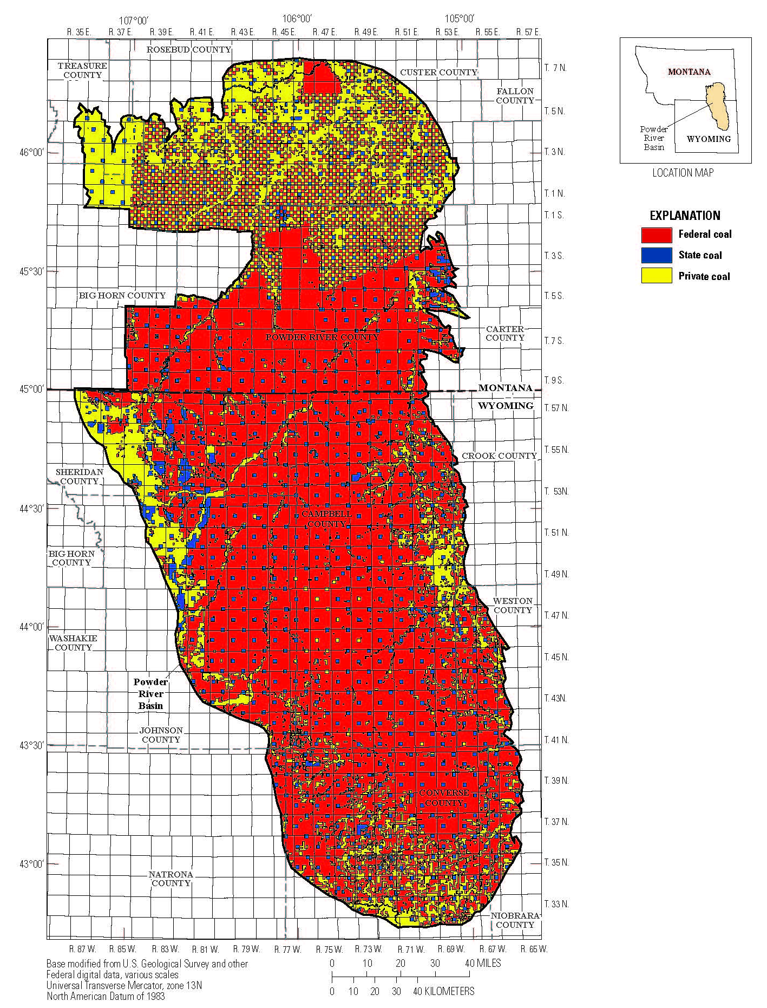
Mineral Rights in the PRB
State mineral rights, and some tribal rights, are checkerboarded inholdings
Drag line mining follows seams and crosses tracts with different rights ownerships
It is not economically feasible to mine only tracts within seams
Mines are configured into Logical Mining Units (LMUs); federal royalties are typically paid in proportion to reserves
Drag line, Black Thunder Mine, Arch Coal, PRB
Source: ONRR; USGS at https://pubs.er.usgs.gov/publication/pp1809

Slide 22
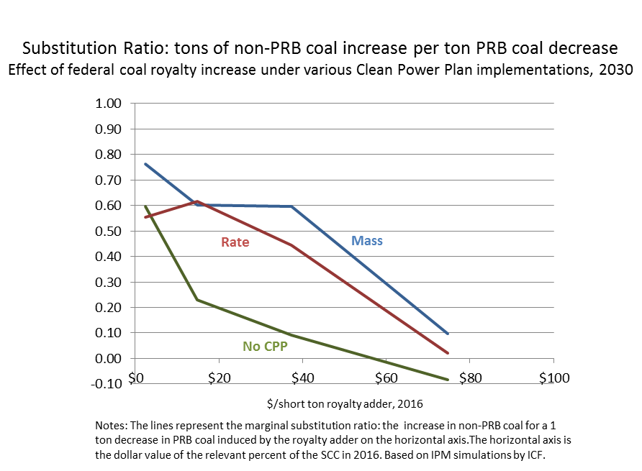
Marginal PRB/non-PRB substitution (ICF/IPM analysis)

Slide 23
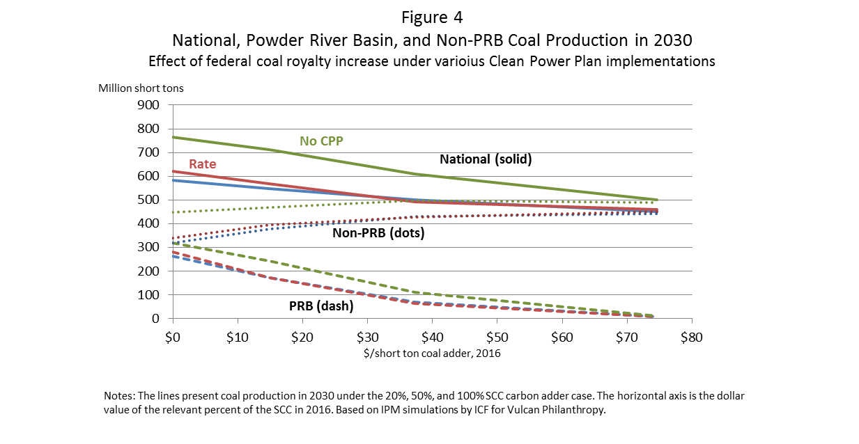
IPM Results: Coal production

Slide 24
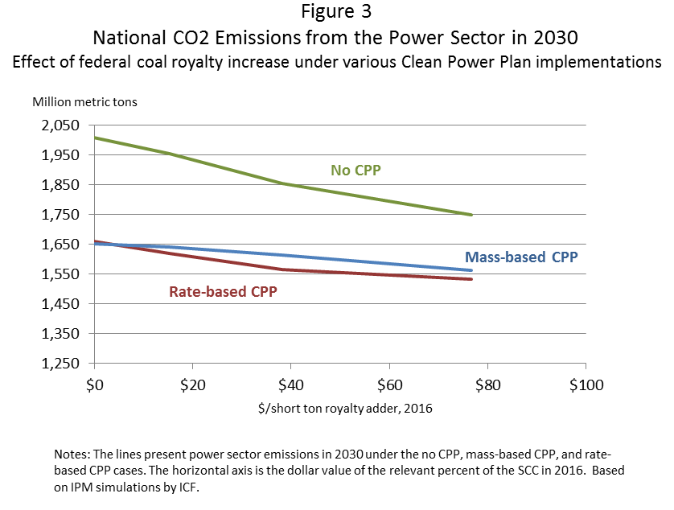
IPM Results: Emissions

Slide 25
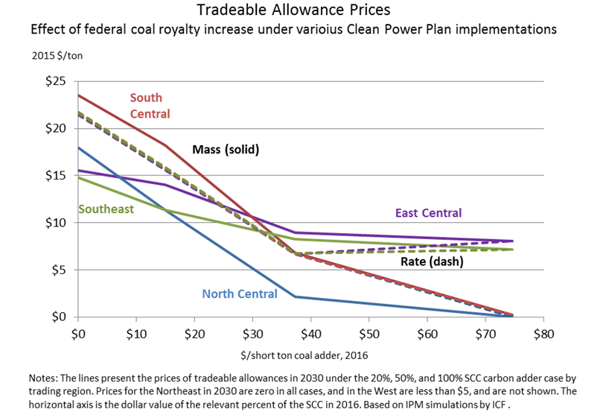
IPM Results: Allowance prices
Note: no-adder allowance price in 2030 is $4/$0 (mass/rate) for West, $0/$0 for Northeast

Slide 26
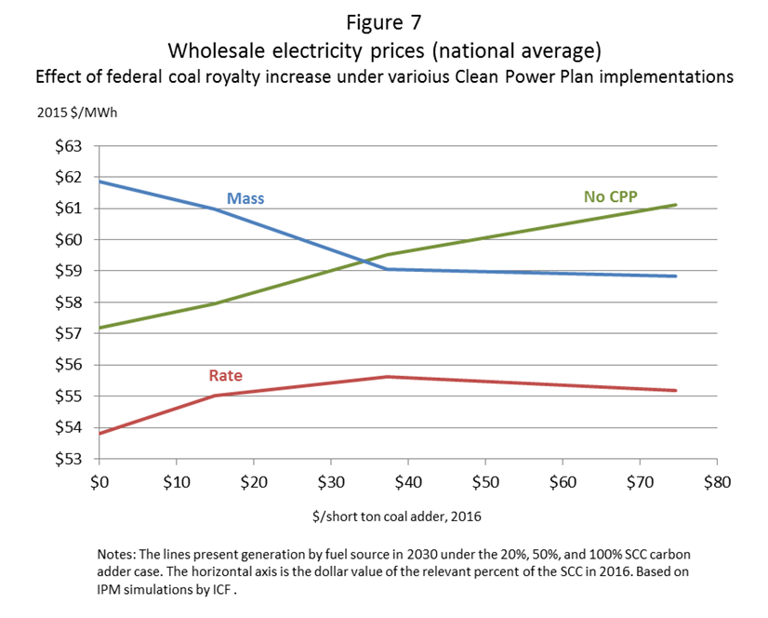
IPM Results: Wholesale electricity prices

Slide 27
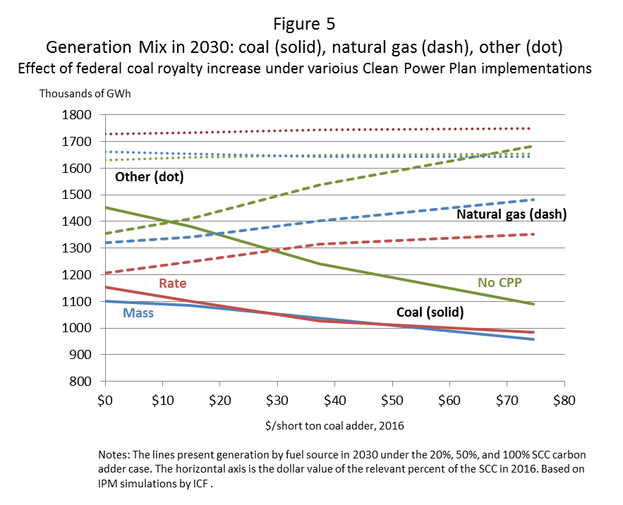
IPM Results: Generation mix

Slide 28
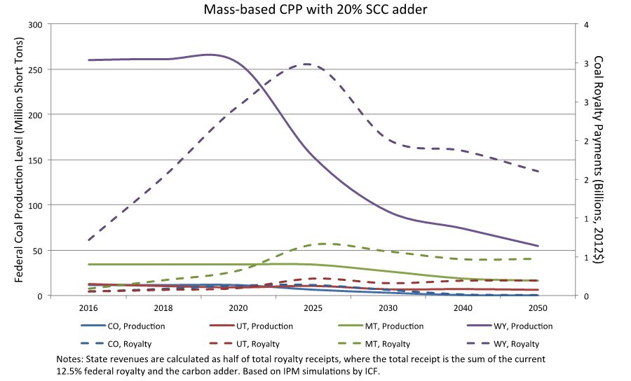
IPM Results: State production & royalty revenues
Production
(left scale)
Revenues (right scale)

Slide 29
IPM Results: No new or renewed leases
Comparison of Upstream Policies under Mass-based CPP
Prices and Quantities in 2040

Slide 30
A Proposal
Four Principles
Federal fossil fuel leasing policy should take into account the climate externality of burning of those fuels.
Avoid double-counting by recognizing interactions with downstream regulation
Focus on net climate effects: assess likely substitution
Incorporate climate considerations into leasing in a way that supports market efficiency and is consistent with climate policy goals.
Specific Proposal: A Carbon Adder to Federal Coal Royalties
Incorporate carbon adder into new & renewed federal coal leases, valued at [20%] of Social Cost of Carbon (SCC).
Half of royalty receipts directed to affected states (automatic)
Half of royalty receipts to fund Federal programs on coal community transitions (requires Congressional action).

Slide 31
Why a carbon adder?
Why a royalty carbon adder instead of a quantity restriction (permanent moratorium)?
Price signal allows market to choose most efficient mines
A permanent moratorium double counts the climate externality (outcomes are essentially the same as a 100% SCC adder)
Royalty adder generates revenues (~$3B/yr additional) for affected states and Federal coal community transition
Administratively straightforward and arguably less complicated than a partial moratorium
  Can be assessed on tonnage, or on carbon content, at mine mouth
  Federal coal fraction assessed at level of LMU (current royalty practice)
  Per-ton adder avoids issues of determining arms-length price

Slide 32
Why 20%?
The economically “optimal” rate depends on precise upstream regulation.
  With (a) upstream regulation with leakage and (b) partial substitution, economically optimal rate is >0 and < 100%
  20% is a conservative value, that could move higher if (say) CPP is vacated.
  20% puts a floor on CPP
20% SCC aligns coal royalty with oil (30-46% SCC) and gas (16-24% SCC)
20% roughly aligns PRB coal prices with Eastern and Midwestern prices per Btu
20% SCC allows continued production – consistent with multiple use mandate
20% SCC royalty adder generates revenues (~$3B/yr additional) for affected states and Federal coal community transition
  CEA estimates that royalties are maximized at 30% SCC – but that excludes reductions in State severance and sales taxes

Slide 33
Effect of 20% Carbon Adder (IPM)

Slide 34
Discussion and Conclusions
Framework for upstream policies in complex regulatory regime
  Laid out way to think through combustion externalities for federal fossil fuel leasing
  Royalty rate should avoid double-counting
  Details matter
  Theory, but not numbers, generalize to other federal fossil fuels
Depending on CPP implementation, a large royalty adder can have large emissions effects
  No CPP: 100% SCC produces ~3/4 of the emissions reduction of mass-based CPP
  Rate CPP: 50% SCC reduces emissions by 95 MMT/yr
Main effects of royalty adder (mass-based):
  allowance price falls
  wholesale electricity price falls
  uncovered generation falls (reduced leakage)
  emissions fall (in large adder cases, CPP ceases to be binding)
  Eastern coal production and mining employment rises (but self-limiting)
  revenues are large and increasing up to ~30% SCC adder
What have we omitted?
  Conventional fair return (“good government”) issues
  Other externalities (e.g., methane emissions)
  Impact on other state revenues (income tax, severance taxes,…)

Slide 35
Additional Slides

Slide 36
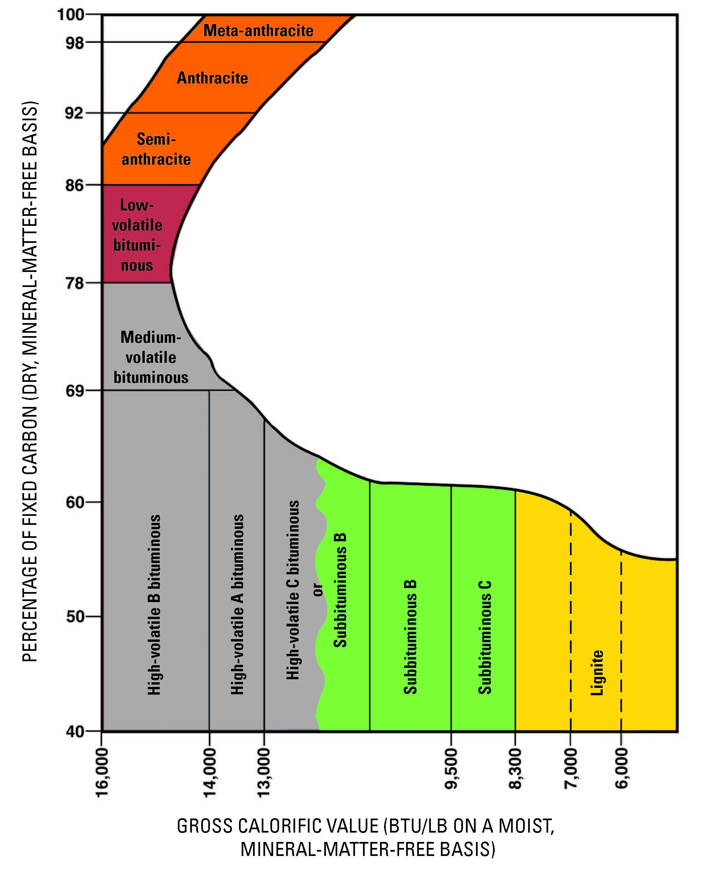
Coal Rank
Source: USGS National Coal Assessment Overview

Slide 37
Employment
Approximately 90,000 workers were employed at coal mines nationally in 2012.
Employment in coal mining is down 1,800 since 2008, and is half of what it was in the early 1980s.
Employment in oil and natural gas extraction grew by 133,000 between 2010 to 2013.

Slide 38
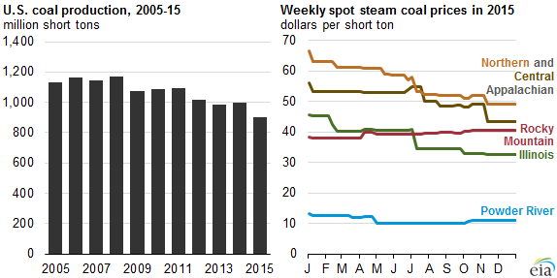
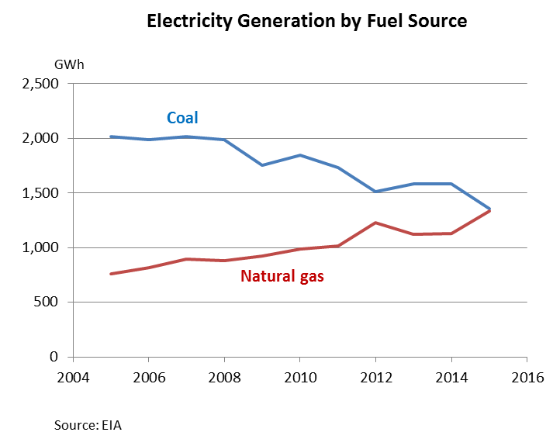
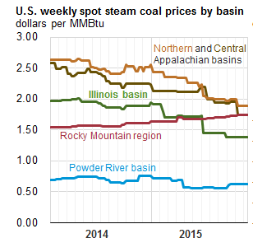
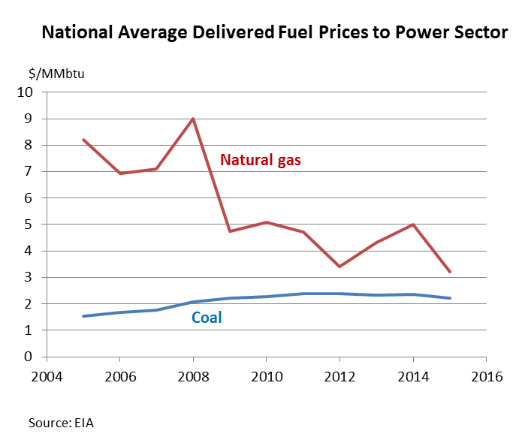
Recent trends in coal and natural gas markets
Source: EIA, Today in Energy, Jan. 8, 2016

Slide 39
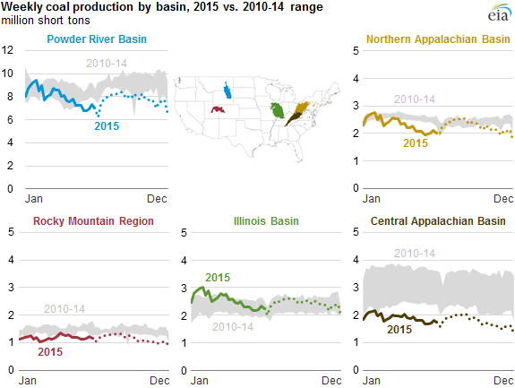
Coal production: by region, federal/non-federal
Source: EIA, Today in Energy, Jan. 8, 2016

Slide 40
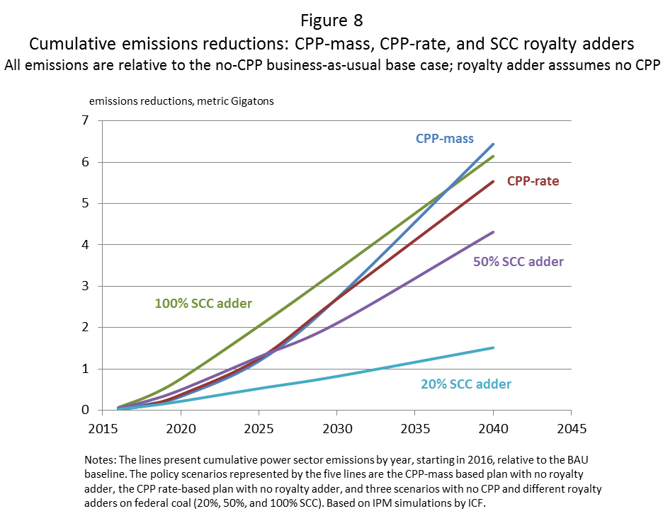
IPM Results: Cumulative emissions

