Slide 1
Federal Coal Program Reform, the Clean Power Plan, and the Interaction of Upstream and Downstream Climate Policies
NBER WP 22214, April 2016
Todd Gerarden, HKS
Spencer Reeder, Vulcan Philanthropy
Jim Stock, Harvard Economics and HKS
Federal Minerals Leasing Reform and Climate Policy
The Hamilton Project: Policy Paper 2016-07, December 2016
Ken Gillingham, Yale University
Jim Stock, Harvard Economics and HKS
AERE Session: Energy Policy in Practice
ASSA Meetings, Chicago IL, January 7, 2017

Slide 2
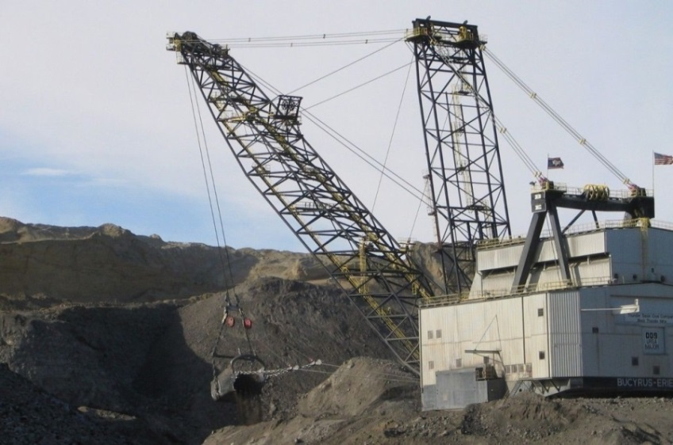
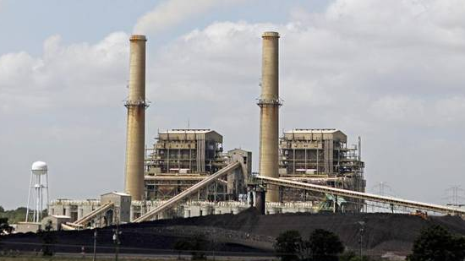
Policy Questions
Policy Questions
How should we (economists) think about upstream policies?
How do upstream and downstream policies interact?
What is the optimal upstream policy (if any)?
Federal coal:
~40% of US coal
13% of energy-related GHG emissions
PRB price ~1/3 nonfederal coal
Downstream:
Clean Power Plan (?), RPSs, etc

Slide 3
Setting (for next 2 weeks): DOI PEIS for the Federal Coal Program
1980s: Prior EIS and Congressional review
Jan. 15, 2016: Secretary Jewell announces PEIS process, places moratorium on new leases
March 30, 2016: DOI Notice of Intent to Prepare EIS
    (c) Climate impacts
    With respect to the climate impacts of the Federal coal program, the Programmatic EIS will examine how best to measure and assess the climate impacts of continued Federal coal production, transportation, and combustion. …
    It will also consider [mitigation by] land use planning, adjustments to the scale and pace of leasing, adjustments to royalties or other means of internalizing externalities, mitigation through greenhouse gas reductions elsewhere, information disclosure, and other approaches.
    The Programmatic EIS will examine the climate impacts of the coal program in the context of the Nation's climate objectives, as well as the Nation's energy and security needs.
    FR 81 17725
Sept. 15, 2016: NOI comments due
Jan. 2017 : PEIS scoping document/coal program report expected

Slide 4
Four principles for upstream policy
Federal fossil fuel leasing policy should take into account the climate externality of burning of those fuels.
Avoid double-counting by recognizing interactions with existing downstream regulation
Focus on net climate effects: assess likely substitution
Incorporate climate considerations into leasing in a way that supports market efficiency and is consistent with climate policy goals.

Slide 5
Upstream/downstream in a second-best world
Downstream (CPP)
In theory, downstream regulation can implement the first-best
But CAA does not enable first-best:
  Leakage from non-covered units
  Departures from national mass-based trading merging 111(d) & 111(b)
  Stringency uncertainty
  Legal uncertainty
Upstream (Federal coal program)
In theory, upstream regulation can implement the first-best
But Federal coal policy cannot achieve first-best:
  Only covers federal minerals (oil, gas, coal)
  Potential substitution to non-federal coal

Slide 6
This presentation: Summary
Federal coal program has a big footprint, and coal is vastly underpriced relative to SCC.
Comparative statics : optimal royalty carbon adder is nonzero with downstream leakage.
Numerical results using the IPM model.
  If the CPP is struck down (or CO₂ removed from the CAA), imposing a carbon royalty adder on Federal coal could achieve ~75% of the emission reductions of the CPP
There are reasons to prefer upstream price to quantity regulation (royalty adder over carbon budget)

Slide 7
Related literature
Fair value
  US DOI-IG (2013), US GAO (2014), Haggerty and Haggerty (2015), CEA (2016)
Closest to this paper
  Burger (2016) (legal – carbon royalty adder)
  Hein and Cecot (2016) (legal – carbon royalty adder)
  Krupnick et. al. (2015) (legal – superceded by Burger, Hein & Cecot)
  Hein and Howard (2015) (legal – but only emissions from coal production)
  Bushnell, Holland, Hughes, Knittel (2015) (CPP with rate&mass)
  Fischer and Preonas (2010) (static model setup)
  Harstad (2012) (supply side to stem leakage outside international agreement)
  Horowitz and Linn (2015) (technological innovation and rate-based regs)
  Haggerty, Lawson, and Pearcy (2015) (selected NEMS equations to effect on coal prices of assessing coal royalty on delivered price instead of mine-mouth price)
Instrument choice and overlapping policies
  Holland (2012)
  Mansur (2012)
  Goulder and Stavins (2012)
  Goulder, Jacobsen, and van Benthem (2012)
  Fischer and Newell (2008)
  Fischer, Newell, Preonas (2013)

Slide 8
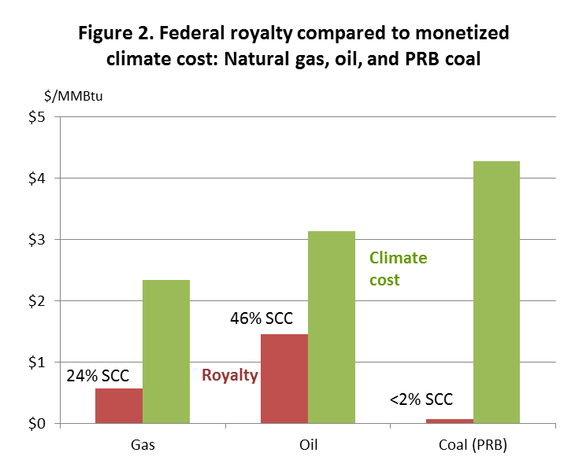
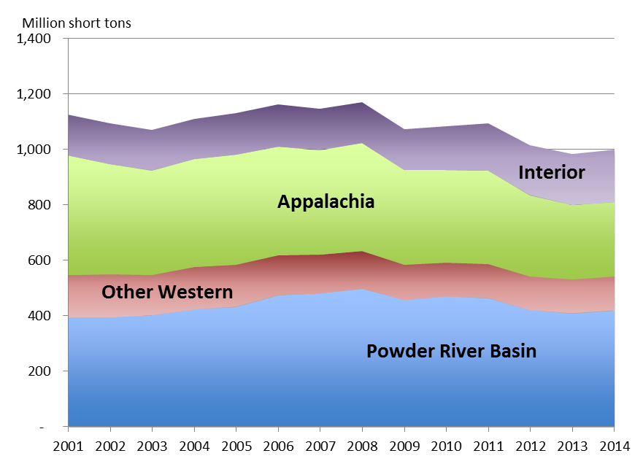
Upstream, Downstream
Federal coal policy remains important despite the decline in coal production
Coal production by region, 2001-2014 (mst)

Slide 9
Upstream, Downstream
Comparative statics of upstream, downstream in second-best world

Slide 10

Upstream/downstream: Economic principles
Climate scientists’ letter to Secretary Jewell – PEIS comment
The science is clear: … to hold gobal temperature increase well below 2ºC, the US must keep the vast majority of its coal in the ground. We urge you to end federal coal leasing, extraction, and burning in order to advance US climate objectives…
James Hansen (Columbia)
Susan Solomon (MIT)
Ken Arrow (Stanford)
Mark Jacobson (Stanford)
Kerry Emanuel (MIT)
67 total
July 27, 2016
The case for downstream regulation only
Substitution of non-Federal for Federal
The “double counting” problem:
Federal extraction communities hit hard if the moratorium becomes permanent
p
S’
S
p*
t’
t
r
D
Q

Slide 11

(c) Fed coal & other (gas); mass-based
Federal coal & other (gas) , which emits a fraction λ of what coal emits per MWh
Binding mass-based cap & trade
per-ton coal royalty adder r:
  Higher marginal cost of coal induces shift into gas
  This moves out the MWh associated with the emissions limit
  So price falls, emissions remain constant, quantity of electricity increases
  Tradable permit price falls by more than the price
  If uncovered sources: leakage is reduced (price drops, relative mc of covered generation falls)
p
S’’’
S
p*
p**
t’’’
D
Q

Slide 12
Upstream, Downstream
IPM Results:
  For federal coal policy, the numbers are big: 100% SCC royalty adder = ¾ of CPP if CPP is struck down.

Slide 13
IPM Research Design
IPM
Proprietary model, ICF International; used by EPA for RIAs, e.g. MATS, CPP
Dynamic perfect foresight linear programming model, computes least-cost capacity expansion, electricity dispatch, transmission, subject to existing environmental regulations and reliability constraints – makes plant-level generation decisions
Endogenously solves for fuel prices
Coal component: 36 coal supply regions, 14 coal grades, coal transport network
Coal supply curves are developed off-line using mine-level engineering cost curves
Key assumptions
Aligned to EPA final CPP RIA (IPM v.5.15)
Policy frozen Oct. 2015 (no Jan 2016 PTC, ITC extension)
Baseline gas prices, renewables prices, demand from AEO2015
Demand is exogenous (“scenarios”); no induced energy efficiency
Base cases
No CPP
Mass-based CPP with regional trading
  Follows CPP final rule mass-based version with new source complements
  Covers all fossil units ≥ 25 MW
Rate-based CPP with regional trading
  Rate regulation covers existing fossil units ≥ 25 MW
  New sources are covered by §111(b)
Full report: http://www.vulcan.com/news/articles/2016/coal-leasing-report

Slide 14
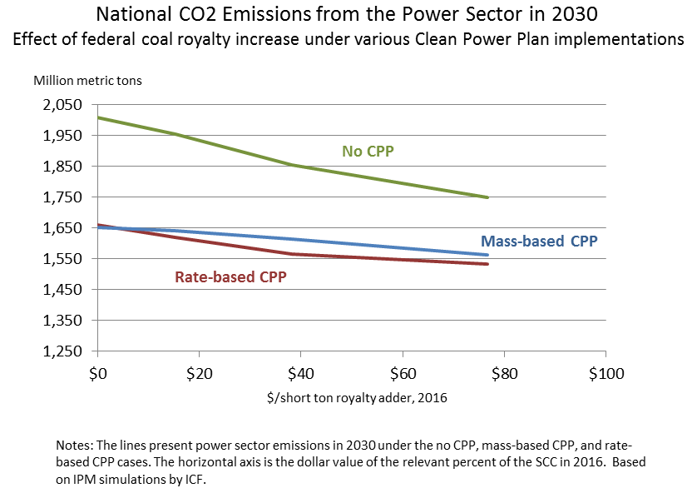
IPM Results: Emissions

Slide 15
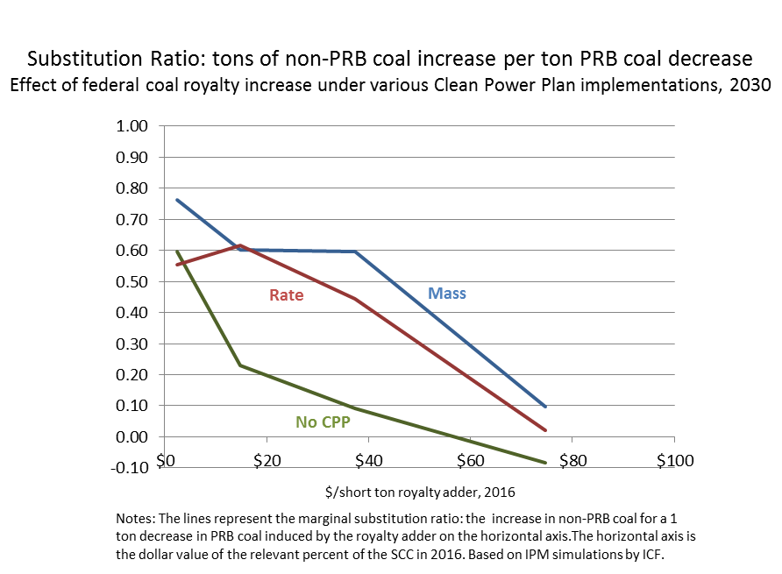
IPM results: Marginal PRB/non-PRB substitution

Slide 16
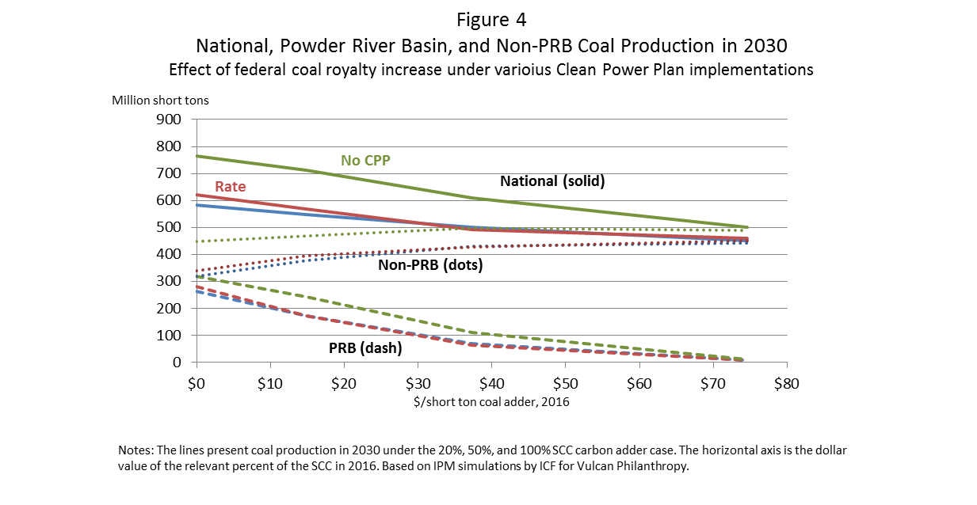
IPM Results: Coal production

Slide 17
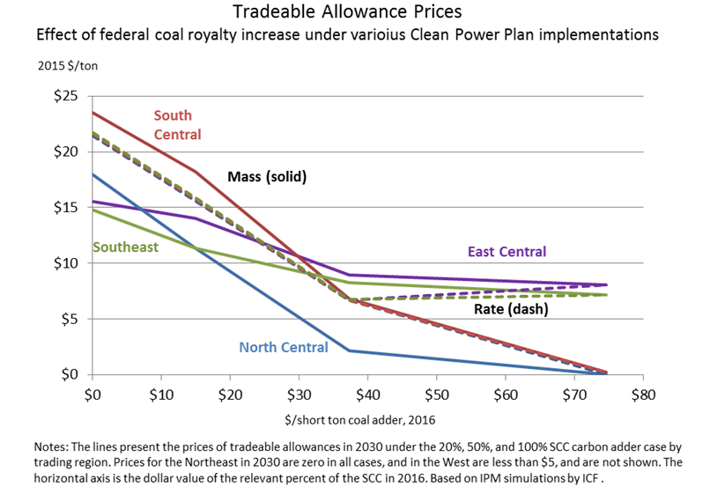
IPM Results: Allowance prices
Note: no-adder allowance price in 2030 is $4/$0 (mass/rate) for West, $0/$0 for Northeast

Slide 18
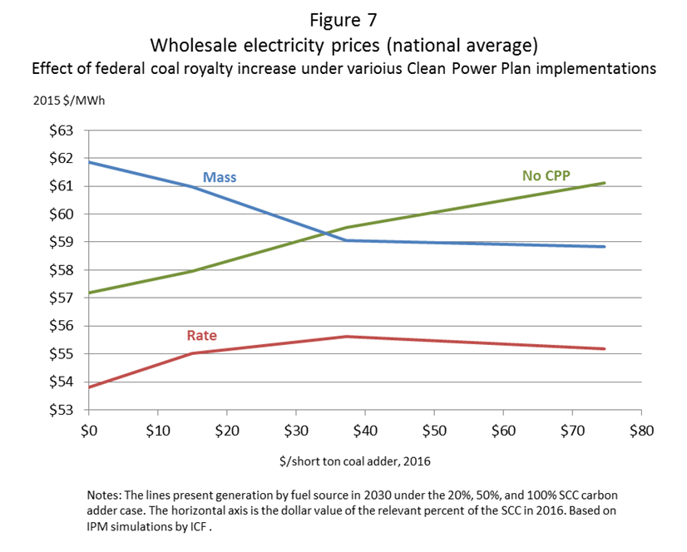
IPM Results: Wholesale electricity prices

Slide 19
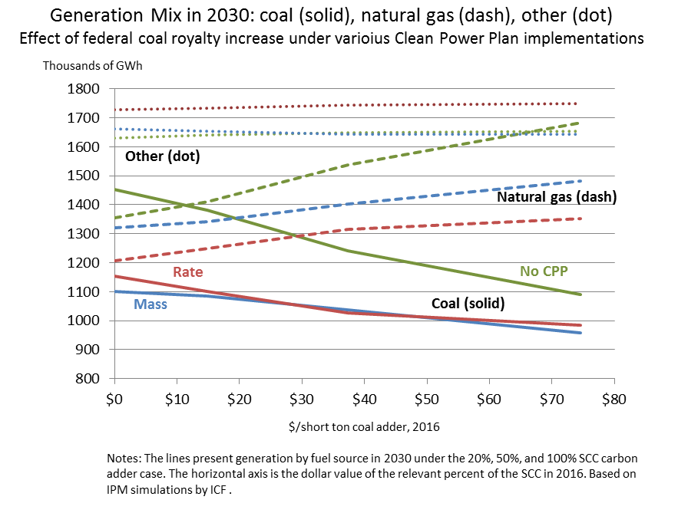
IPM Results: Generation mix

Slide 20
Effect of 20% Carbon Adder (IPM)

Slide 21
Upstream, Downstream
There are reasons to prefer upstream price to quantity regulation (royalty adder v. carbon budget)

Slide 22
Why a carbon adder?
Why a royalty carbon adder instead of a quantity restriction (permanent moratorium)?
Royalty v. capped auction (“C&T”): Royalty is assessed per ton extracted, but bonus bids are on right to mine a tract – bonus bids don’t change marginal cost per ton
Price signal allows market to choose most efficient mines
A permanent moratorium double counts the climate externality (outcomes are essentially the same as a 100% SCC adder)
Royalty adder generates revenues (~$3B/yr additional) for affected states and Federal coal community transition
Administratively straightforward and arguably less complicated than a partial moratorium
  Can be assessed on tonnage, or on carbon content, at mine mouth
  Federal coal fraction assessed at level of LMU (current royalty practice)
  Per-ton adder avoids issues of determining arms-length price

Slide 23
Why 20%?
The economically “optimal” rate depends on precise upstream regulation.
  With (a) upstream regulation with leakage and (b) partial substitution, economically optimal rate is >0 and < 100%
  20% is a conservative value, that could move higher if (say) CPP is vacated.
  20% puts a backstop on CPP
20% SCC aligns coal royalty with oil (30-46% SCC) and gas (16-24% SCC)
20% roughly aligns PRB coal prices with Eastern and Midwestern prices per Btu
20% SCC allows continued production – consistent with multiple use mandate
20% SCC royalty adder generates revenues (~$3B/yr additional) for affected states and Federal coal community transition
  CEA estimates that royalties are maximized at 30% SCC – but that excludes reductions in State severance and sales taxes

Slide 24
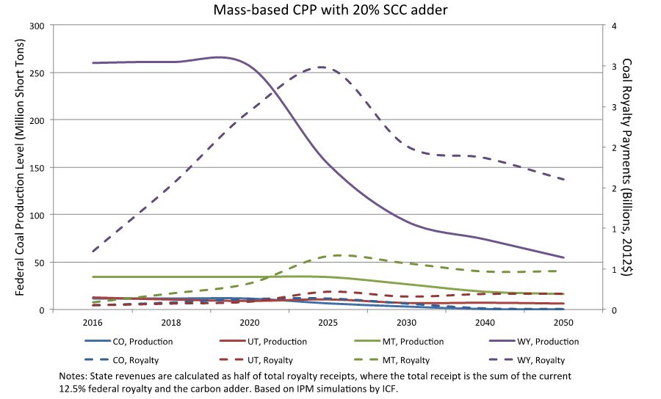
IPM Results: State production & royalty revenues
Production
(left scale)
Revenues (right scale)

Slide 25
Discussion and Conclusions
There is a disciplined way for economists to think about upstream policy as part of climate policy.
The numbers are big.
  No CPP: 100% SCC produces ~3/4 of the emissions reduction of mass-based CPP
  Rate CPP: 50% SCC reduces emissions by 95 MMT/yr
The literature is tiny and there are lots of open questions
  CBA (including health co-benefits)?
  Better understanding of mine economics
  How do upstream and downstream interact in presence of uncertainty?
  Interaction with rail system
  Improve modeling of employment effects and local revenues (include severance taxes, sales taxes, etc.)
  Historical evidence differentiating PRB from other prices, and effects
  Better understanding of substitution
  What does NEMS say about this?
  Generally, additional evidence outside the black box of the IPM (or NEMS)
And, now you have time to work on these issues.

Slide 26
Additional Slides

Slide 27
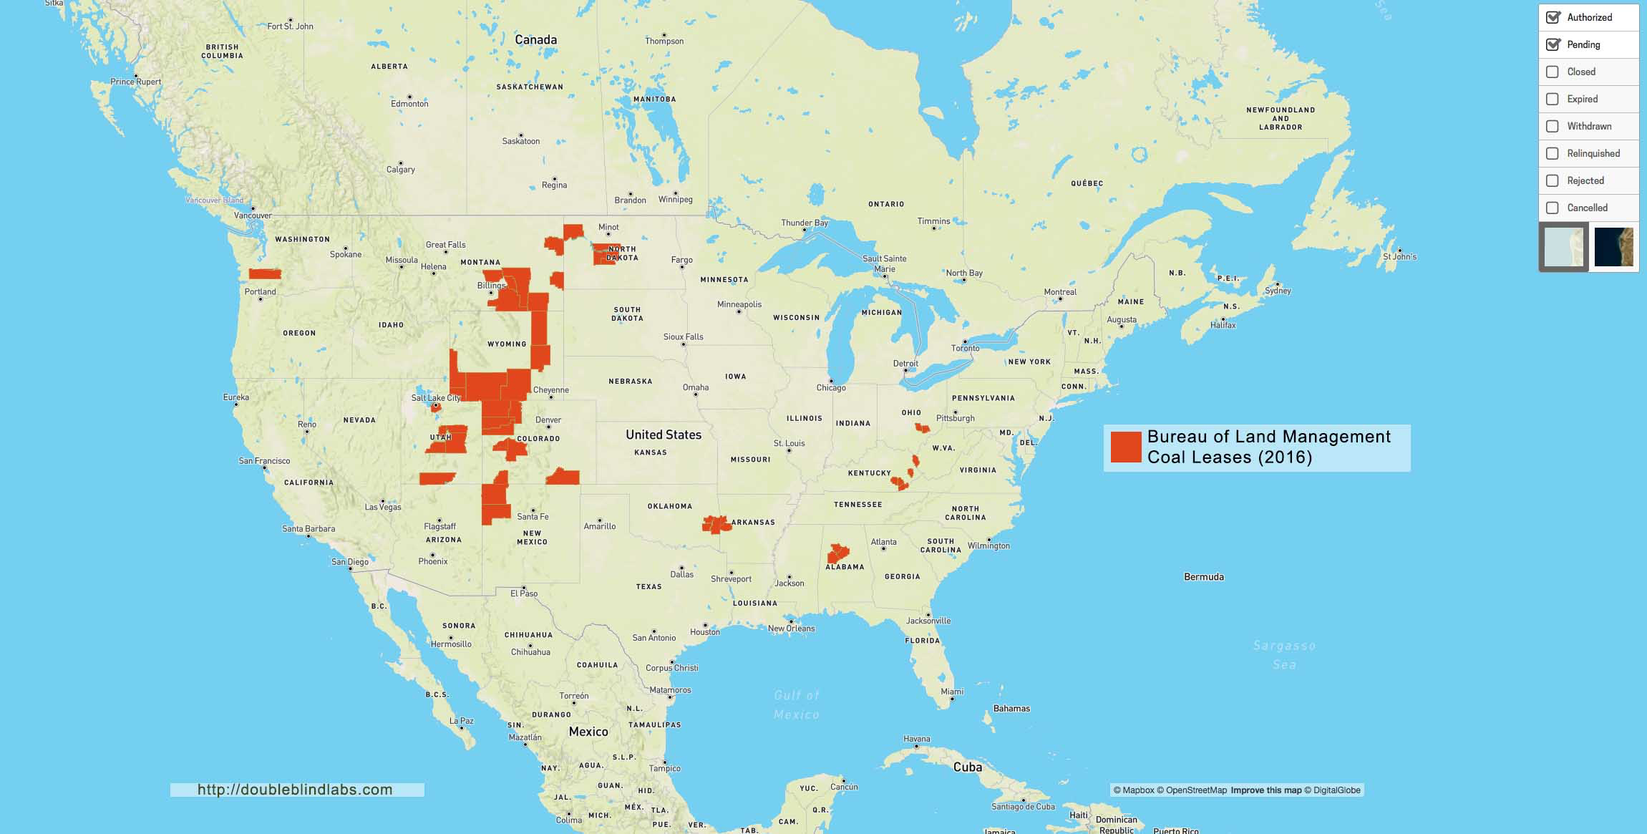
BLM coal leases, by county
Source: BLM and thecoalfields.com

Slide 28
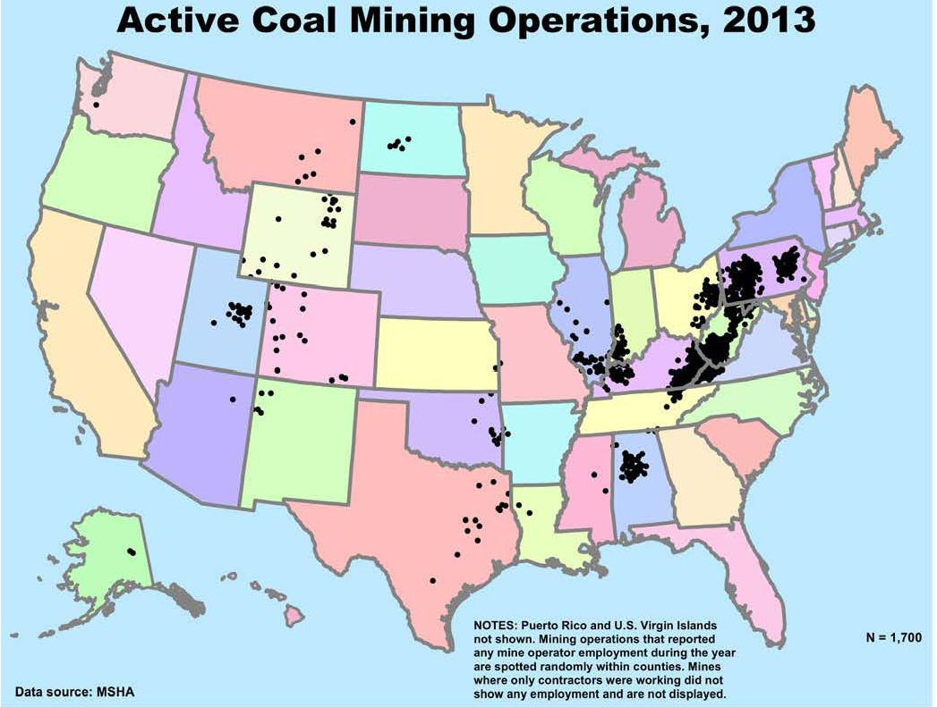
U.S Coal Mines
Source: NIOSH at http://www.cdc.gov/niosh/mining/statistics/coaloperators.html

Slide 29
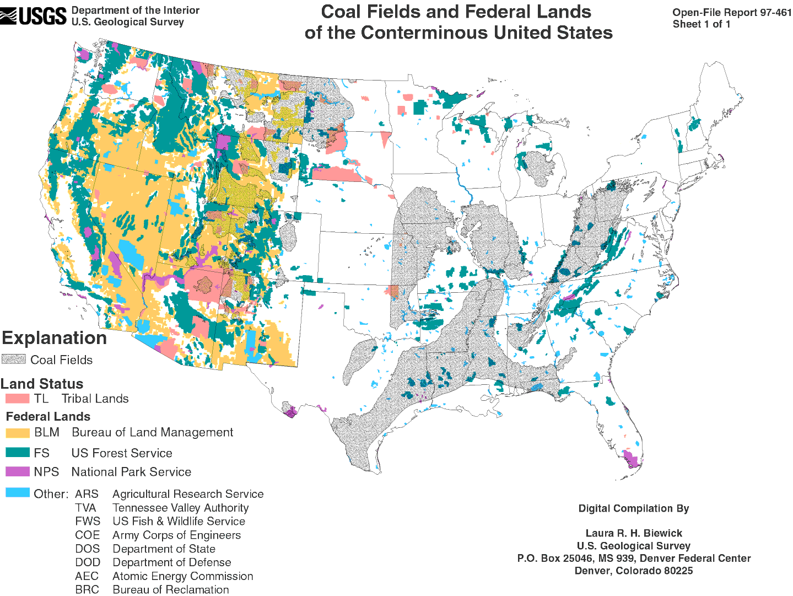

Slide 30
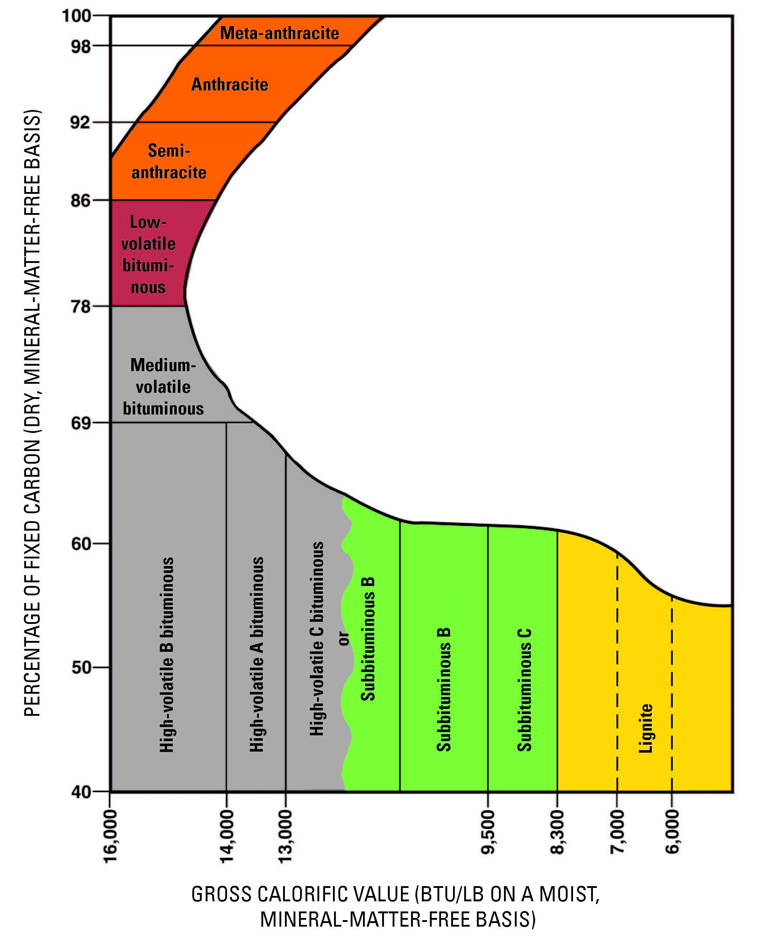
Coal Rank
2. U.S. coal program
Source: USGS National Coal Assessment Overview

Slide 31
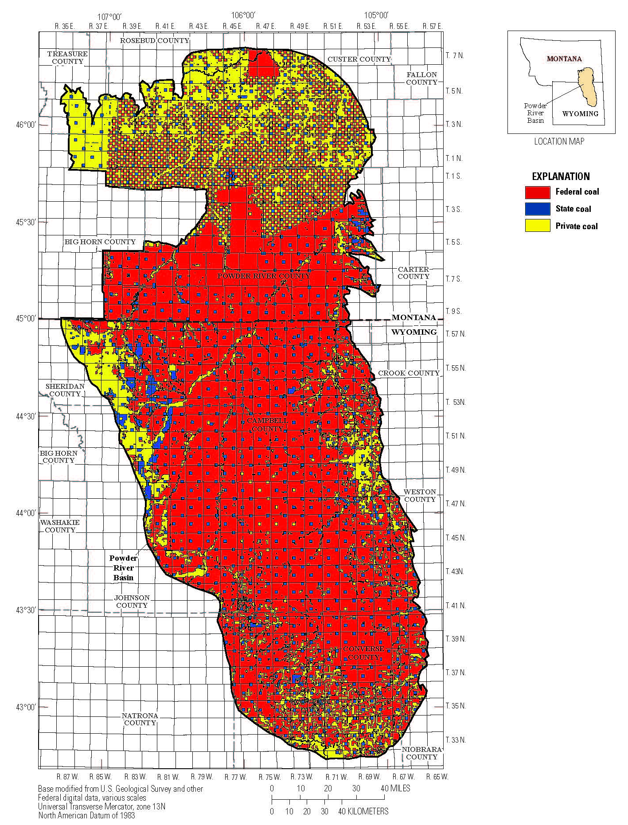

Mineral Rights in the PRB
State mineral rights, and some tribal rights, are checkerboarded inholdings
Drag line mining follows seams and crosses tracts with different rights ownerships
It is not economically feasible to mine only tracts within seams
Mines are configured into Logical Mining Units (LMUs); federal royalties are typically paid in proportion to reserves
Drag line, Black Thunder Mine, Arch Coal, PRB
Source: ONRR; USGS at https://pubs.er.usgs.gov/publication/pp1809

Slide 32
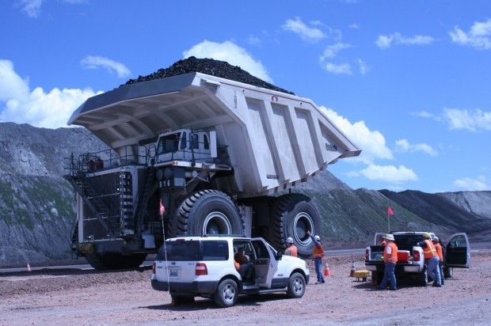
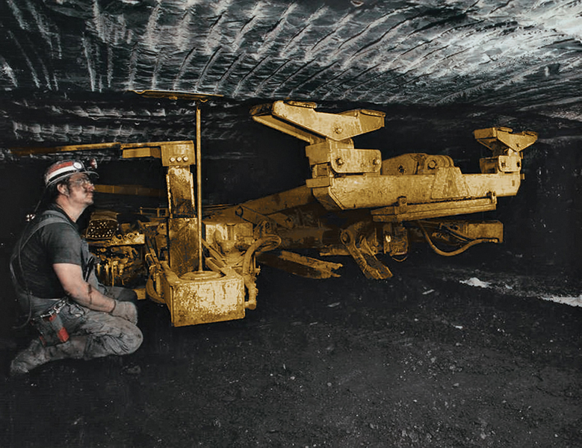
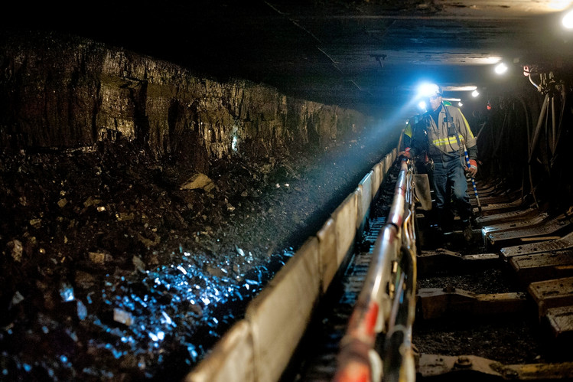
Surface and Underground Coal Mining
Drag line, Black Thunder Mine, Arch Coal, PRB
Truck that holds 447 tons of coal. North Antelope Rochelle Mine, Peabody Coal, PRB
Roof bolter for
room and pillar
mining
Long wall
mining in PA

Slide 33
SCC value of burning PRB coal is ~$80/short ton coal
“Many stakeholders highlighted the tension between producing very large quantities of Federal coal wile pursuing policies to reduce US GHG emissions substantially, including from coal combustion”
DOI PEIS NOI, 81 FR 17724, March 30, 2016

Slide 34
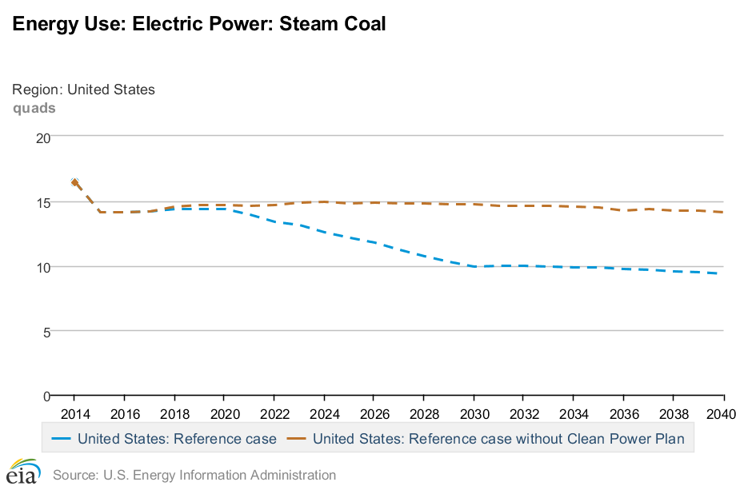
U.S. coal production has declined because of natural gas prices
Coal production by region, 2001-2014 (mst)
EIA AEO 2016 Steam coal projection 2015-2040 (Quad Btu)
with and without the CPP
Prompt month coal prices, $/short ton, 10/14/16
Central Appalachia | 12,500 Btu, 1.2 SO₂ | $45.05
Northern Appalachia | 13,000 Btu, < 3.0 SO₂ | $42.25
Illinois Basin | 11,800 Btu, 5.0 SO₂ | $33.25
Powder River Basin | 8,800 Btu, 0.8 SO₂ | $9.00
Uinta Basin | 11,700 Btu, 0.8 SO₂ | $39.40
Sources: EIA AEO 2016; Annual Coal Report 2015, Sales of Fossil Fuels Produced from Federal and Indian Lands FY2003 through FY 2014.

Slide 35
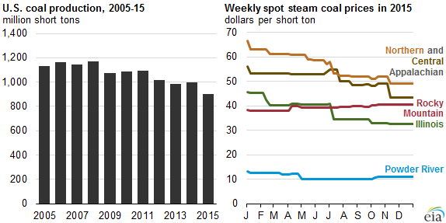
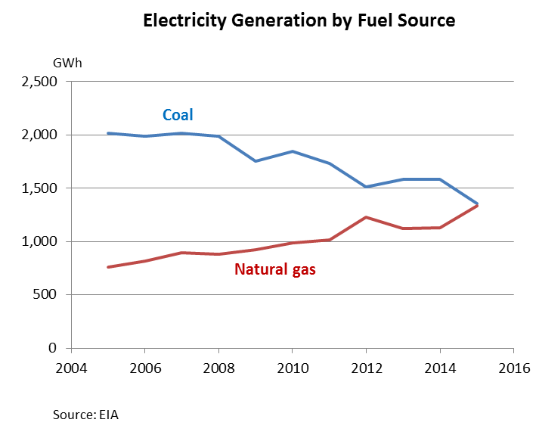
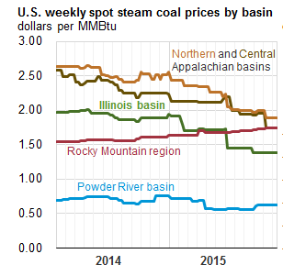
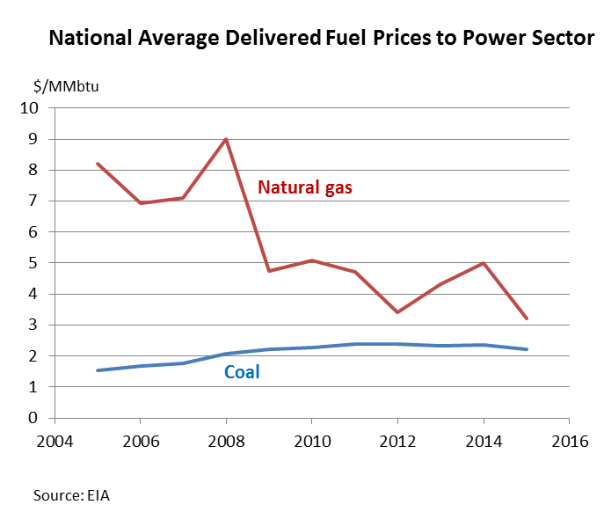
Recent trends in coal and natural gas markets
Source: EIA, Today in Energy, Jan. 8, 2016

Slide 36
Employment
2. U.S. coal program
Approximately 90,000 workers were employed at coal mines nationally in 2012.
Employment in coal mining is down 1,800 since 2008, and is half of what it was in the early 1980s.
Employment in oil and natural gas extraction grew by 133,000 between 2010 to 2013.

Slide 37
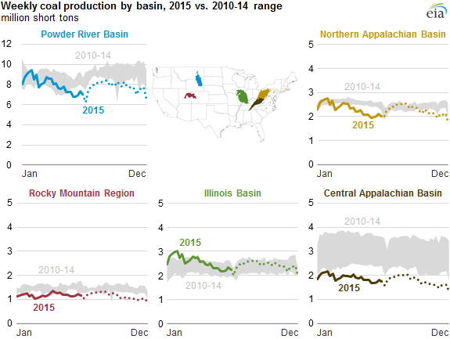
Coal production: by region, federal/non-federal
Source: EIA, Today in Energy, Jan. 8, 2016

Slide 38
Comparative Statics
Cases
No downstream regulation, Federal coal only
C&T, no leakage: federal coal only
C&T, no leakage: federal coal and gas
In NBER WP (not here):
Mass-based cap-and-trade with non-covered sources
  Strong mass version of CPP has interstate trading but excludes gas CT <25MW + other carve-outs
Rate regulation with non-covered sources
  CPP rate-based version (likely FIP) regulates existing fossil sources only
  New fossil sources are regulated under 111(b) (which doesn’t cover small gas CT)

Slide 39
Static model: Setup
Fuels: federal coal (q_{FC} ), non-federal coal (q_{NFC} ),
other covered (q_{O} ) (gas), uncovered (q_{U})
Generation units: MWh produced by burning 1 ton coal
Emissions units: tons CO2 produced by burning 1 ton coal
λ = tons CO2 produced by 1MWh of other (other = gas)
λ_{U} = tons CO2 produced by 1MWh of uncovered
Representative firm profits:
Emissions:
Welfare:
Constraints:
Mass cap:
Rate regulation:
r = federal coal royalty adder
Analytics: Take derivatives of firm’s first order conditions and social welfare wrt r

Slide 40
Comparative statics: (a) only federal coal, no CPP
Federal coal only
No emissions regulation
per-ton coal royalty adder r:
  Effective marginal cost of generation increases
  electricity price increases
  quantity of generation drops
S’
p
S
p*
p₀
r
D
Q*
Q₀

Slide 41
(b) only Fed coal, mass-based
Federal coal only
Binding mass-based cap & trade
per-ton coal royalty adder r:
  Price, quantity, and emissions remain the same
  t+r remains constant (t = allowance price)
S’
p
S
p*
t’
t
r
D
Q

Slide 42
(b’) Fed & non-Fed coal, mass-based
Federal coal, non-federal coal (no other)
Binding mass-based cap & trade
per-ton coal royalty adder r:
  Price, quantity, and emissions remain the same
  Supply curve shifts up, by less than r (and not at all with perfect substitution)
  t+r remains constant
p
S’’
S
p*
t’’
t
<r
D
Q

Slide 43
(c) Carbon royalty adder: comparative statics
Effect of per-ton coal royalty adder r with mix of coal and natural gas
  Higher marginal cost of coal induces shift into gas
  This moves out the MWh associated with the emissions limit
  So price falls, emissions remain constant, quantity of electricity increases
  Tradable permit price falls by more than the price
  If uncovered sources: leakage is reduced (price drops, relative marginal cost of covered generation falls)
p
S’’’
S
p*
p**
t’’’
D
Q

Slide 44
(e’) Fed coal & other (gas); rate-based
Federal coal & other (gas) , which emits a fraction λ of what coal emits per MWh
Binding rate-based regulation
per-ton coal royalty adder r:
  Coal & gas are used in fixed proportion
  Royalty adder increases cost of coal-gas bundle
  Price increases, generation declines, tradeable permit price falls, covered emissions decline
  Uncovered generation and uncovered emissions increase
S’
p
S
p*
p₀
(r×
share)
D
Q*
Q₀

Slide 45
IPM coal supply curves modification
Modification for royalty adder
The royalty adder schedule is an additional cost per ton by year on federal coal
Adders were set at 20%, 50%, 100% of USG SCC (OMB 2013)
The mine-level data in the coal supply curve module were updated to include federal/non-federal percentages by mine and cost curve step, WY, MT, CO, UT (only) (LMU concept)
The adder was then applied by mine/step/year and regional cost curves were constructed
The same adder was imposed regardless of grade and regardless of mining method (surface/underground)
The application of the royalty adder to new leases only was modeled by a linear phase-in of the adder (incorporating mine lease history into the coal supply curve module was infeasible)
Table 2. Simulated Phased-in Royalty Adders for Federal Coal
Indexed to SCC with 10-year linear phase-in (2015$)
 | 20% SCC | 50% SCC | 100% SCC
2016 | $1.53 | $3.83 | $7.67
2020 | $8.67 | $21.69 | $43.37
2025 | $18.96 | $47.41 | $94.81
2030 | $20.98 | $52.45 | $104.90
Notes: Computed for sub-bituminous coal (heat content 9130 Btu/lb). The SCC is the 2013 USG estimate (OMB 2013).

Slide 46
IPM Results: No new or renewed leases
Comparison of Upstream Policies under Mass-based CPP
Prices and Quantities in 2040

Slide 47
IPM Results: Emissions and PRB Production

Slide 48
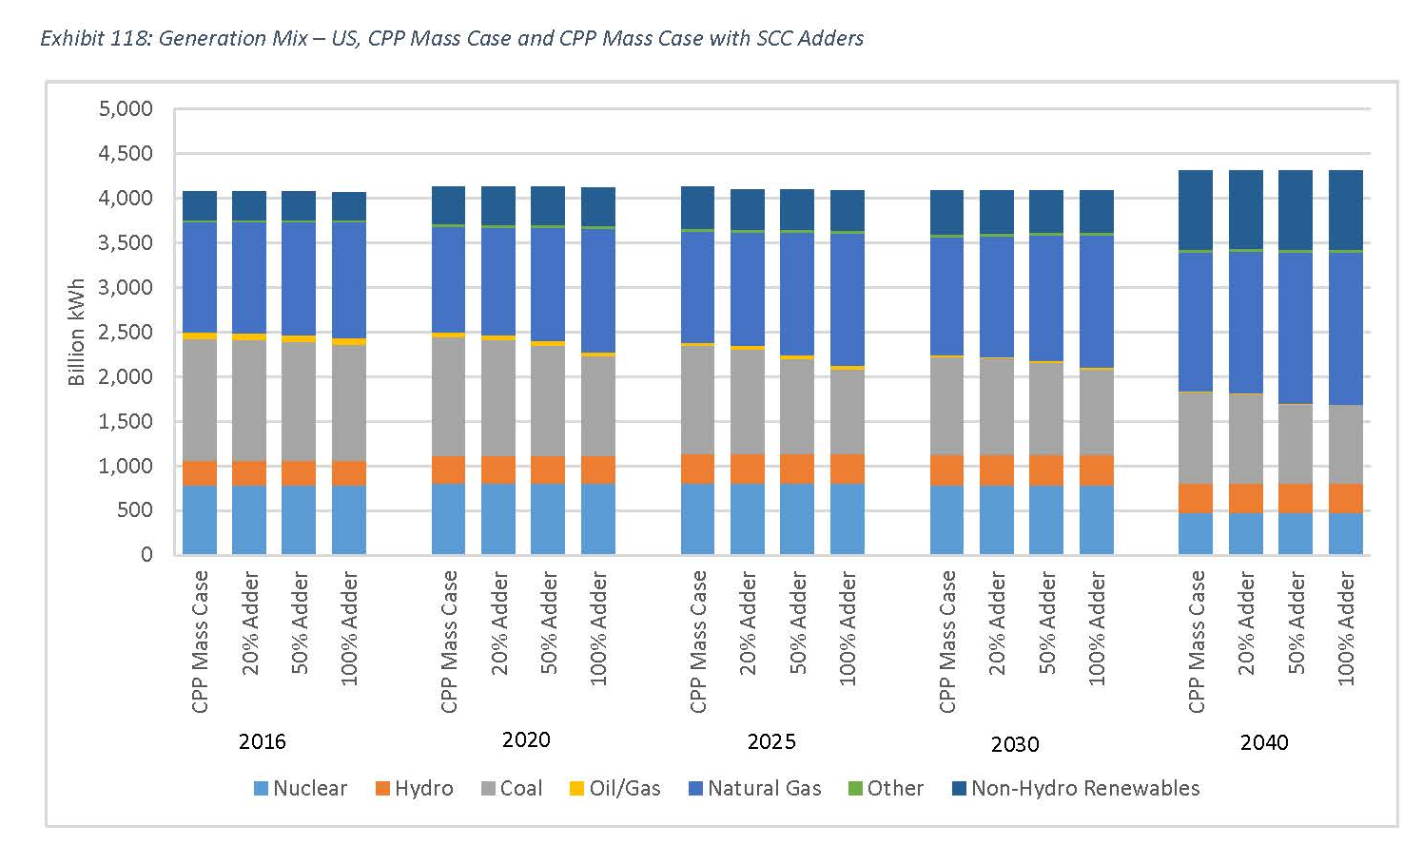
IPM Results: Generation Mix

Slide 49
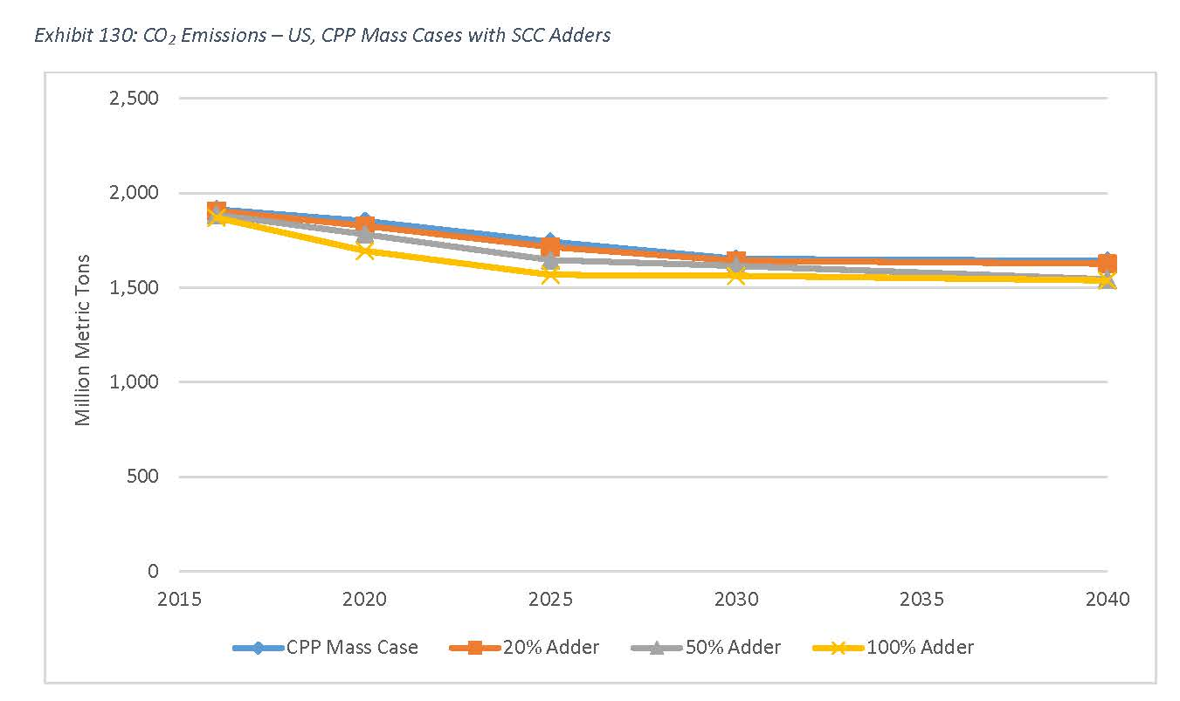
IPM Results: Emissions

