Slide 1
RIN Price Pass-Through:
Exchange and Bulk Wholesaleª,
Exchange to Retailª, and Rack to Retail^{b}
Jim Stock
Department of Economics and Kennedy School, Harvard University
Iowa State, April 4, 2016
Joint work with
ªChris Knittel (MIT) and Ben Meiselman (Michigan)
^{b}Jing Li (Harvard)

Slide 2
Summary
The Renewable Fuel Standard (RFS) imposes a tax on petroleum fuels and a subsidy for biofuels.
In theory, the RFS tax/subsidy is transmitted through the price of RINs, the tradeable compliance certificates under the RFS.
In practice, do RIN prices pass through to fuel prices?
  To exchange and bulk wholesale prices?
    Yes: pass-through coefficient = 1.01 (SE = 0.12)
    Most of pass-through (~70%) is in first day, complete pass-through within 3 days
  To retail prices (E85 relative to E10)?
    No: pass-through coefficient, market to retail = .20 (SE = .09)
  From rack to retail? MN E85: 30% pass-through, considerable station-level heterogeneity.

Slide 3
1. RIN prices fully pass through to bulk hub petroleum prices
– mainly within 2-3 days
Note: By “Bulk wholesale” we mean either exchange-traded prices (e.g., NYMEX RBOB-NYH) or EIA spot hub prices (Gulf diesel).

Slide 4
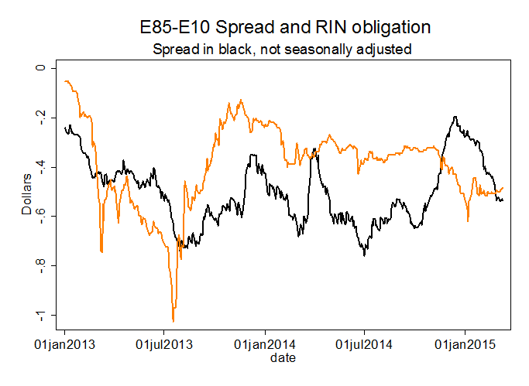
2. But only a fraction of RIN prices pass through to retail E85
Note: E10 and E85 prices are national average retail prices (AAA/Bloomberg).

Slide 5
3. The MN E85 data suggest that some, perhaps much,
of the lack of pass-through is at the station level
Dependent variable | E10-E85 retail spread
Regressor
E85-E10 cost spread, current month | 0.173** (0.012)
E85-E10 cost spread, prior month | 0.092** (0.011)
Sum | 0.265** (0.015)
Monthly controls | yes
Data are for service stations offering E85 in Minnesota (source: Minnesota Department of Commerce). Data are for 2007-2015, for all service stations with at least 24 monthly observations (N = 10,870). Regressions are panel data regressions with station-level fixed effects. Station-level pass-through coefficients are deconvoluted to adjust for sampling variation; the panel data regressions measure the average pass-through. Wholesale costs are rack costs (OPIS).

Slide 6
Outline & Literature
Summary of main results
The RFS: a brief review
RIN prices and pass-through under perfect competition
Empirical strategy
Results: bulk wholesale
Minnesota data and initial results
Literature
Pass-through of gasoline prices:
  Borenstein, Cameron, and Gilbert (1997), Ye et. al. (2005), Deltas (2008), Tappata (2009) and Lewis (2011), Chesnes (2015),…
Pass-through of RIN prices:
  Burkholder (2015), Burkhardt (2015)

Slide 7
The RFS
Rulemaking
Statutory volumes
Waiver authorities:
  Cellulosic
  General
Annual rulemaking converts volumes to annual fractional obligation, invoking waiver authorities if justified
Scope: surface transportation fuels
Compliance
Biofuel producers generate RINs
Obligated parties (refiners, importers) hand in RINs to EPA
RINs are storable & tradeable
  RINs are separated upon blending
  RINs have a nested structure: advanced (D5) can fill the conventional obligation, etc.
Conventional (D6)
Lifecycle reduction in greenhouse gas emissions: 20%
Ex: corn kernel ethanol, conventional biodiesel
Advanced (D5)
Lifecycle reduction in greenhouse gas emissions: 50%
Ex: sugarcane ethanol, bionaptha
Cellulosic (D3)
Lifecycle reduction in greenhouse gas emissions: 60%
Ex: corn stover ethanol
Landfill biogas
Biomass-based diesel (D4)
Lifecycle reduction in greenhouse gas emissions: 50%
Ex: soybean oil, waste grease
Source: Environmental Protection Agency
2014-15-16 Proposed Rule
Invokes general waiver authority
Envisions selling up to 600 mgal of E85, with a total ethanol content of 10.18-10.28% - beyond the E10 blend wall.

Slide 8
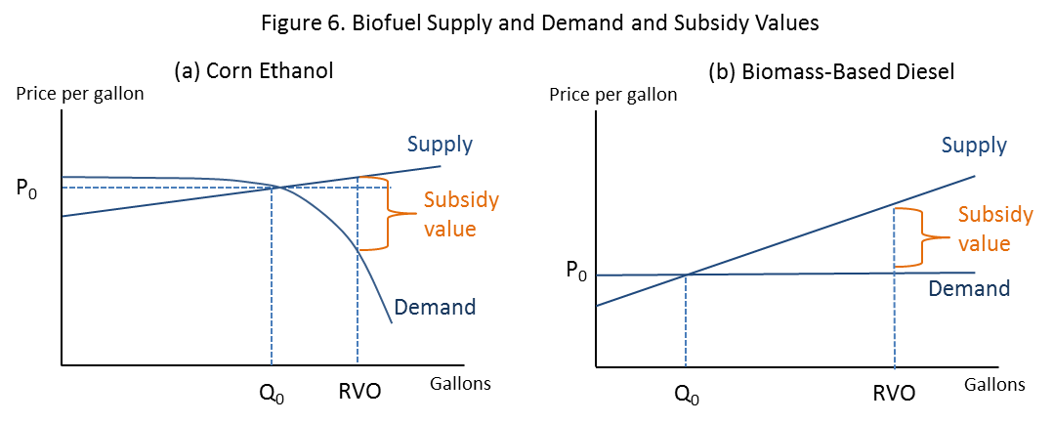
Theory of Static Equilibrium RIN Price Determination
RIN prices are determined by:
Subsidy value (static fundamentals)
Value of holding and exercising later (dynamic – reflects expectations of future policy, economic conditions, etc)
Conditions in other biofuels markets via the RFS nesting structure

Slide 9
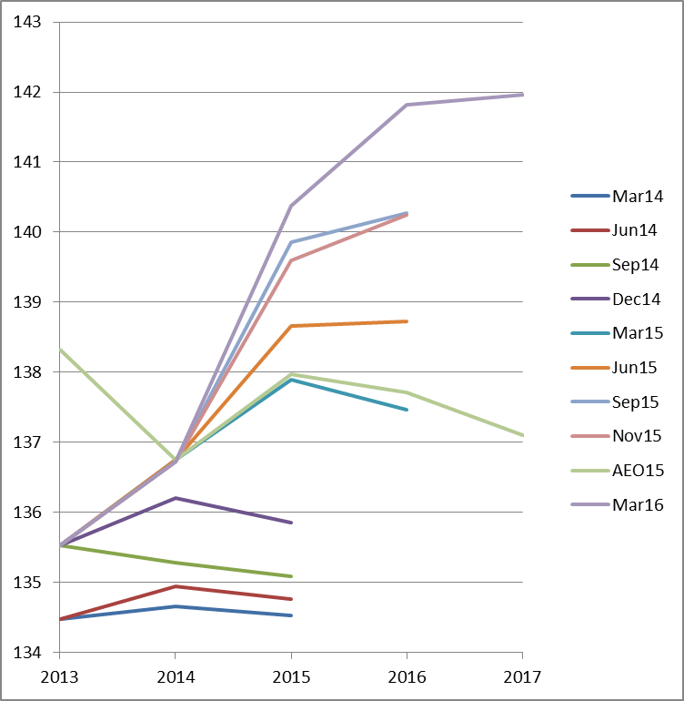
EIA/STEO Gasoline Demand Forecast Revisions
EIA publishes gasoline demand forecasts in its Short Term Energy Outlook (STEO)
Those forecasts are used to set RFS rate obligations by projecting volumes of renewable fuels and dividing by volumes of petroleum fuels (excl. AK)
EIA volume projections have been consistently low – even though their price forecasts have been close

Slide 10

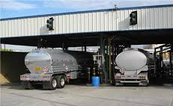
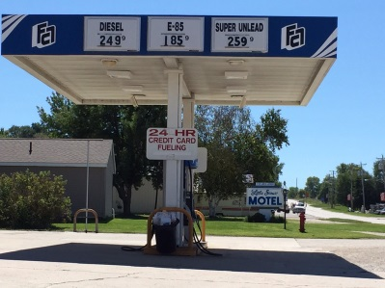


Fuel and RIN flows (simplified)
Corn
D6
E100
E10
E10
Consumer
E85
E85
E0
Oil
D4, D5, D6
.0113D4 + .0049D5 + .0812 D6
(“RIN bundle”)

Slide 11
Pass-through under perfect competition
Corn
D6
E100
E10
E10
Consumer
E85
E85
E0
Oil
D4, D5, D6
.0113D4 + .0049D5 + .0812 D6
(“RIN bundle”)

Slide 12
Implications for Spreads Between Fuels with Differing Obligations
Bulk wholesale
Obligated bulk petroleum :
Non-obligated bulk petroleum :
Spread:
Retail
E10:
E85:
Spread:
General form:
Spread = net RIN obligation + error term

Slide 13
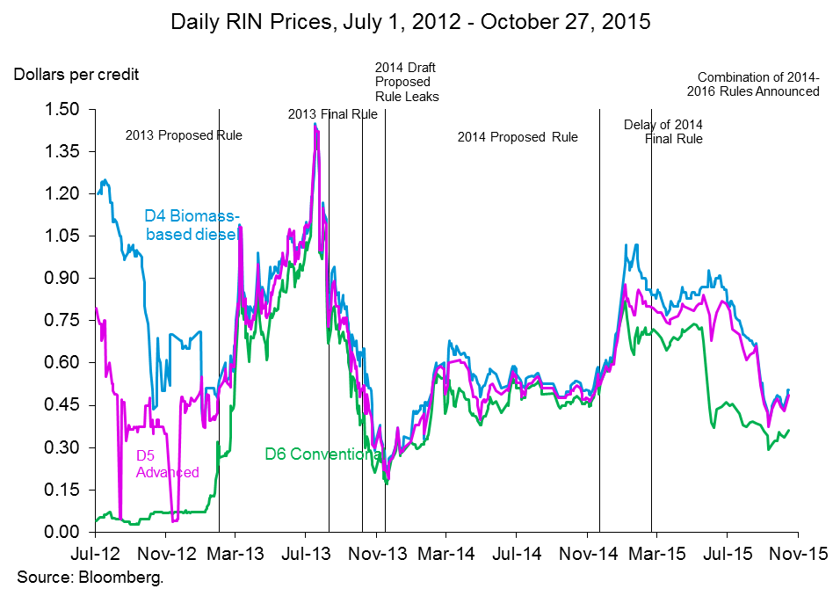
RIN Prices and Policy Uncertainty
In theory, RIN prices move based on current and expected fundamentals
The 2013 jump in RIN prices was associated with demand (blend wall fundamentals)
Subsequently, policy uncertainty & expectations have been majors drivers of RIN prices

Slide 14
Econometric methods
1. Check for unit roots and cointegration (digression: spread is already
error-correction term, cf. Borenstein, Cameron and Gilbert (1997))
2. Levels regression: equilibrium/long-run relationship by OLS [& dynamic OLS]:
(a) individual spreads; (b) pooled
3. Estimate dynamics (cumulative impulse response functions) using structural VAR in first differences (Cholesky with RIN shock ordered first): (a) individual spreads; (b) pooled
4. Sensitivity checks: Seasonals, distributed lag regressions, 5-day smoothed (averaged) data, subsample regressions, Brent as a control

Slide 15
Data Sources
Fuel | Spot/future | Source
RIN prices (D4, D5, D6) | Spot | PFL, OPIS, Bloomberg
RBOB-NYH | Future | NYMEX/EIA
RBOB-LA | Spot | EIA
ULS Diesel-NYH | Spot | EIA
ULS Diesel-Gulf | Spot | EIA
Jet Fuel-Gulf | Spot | EIA
EBOB-Rotterdam | Spot | Argus
Diesel-Rotterdam | Spot | Argus
E10, E85 retail nat’l avg | Pump | AAA (Bloomberg)
Daily trading days, Jan. 1, 2013 – March 10, 2015 (N = 551)

Slide 16
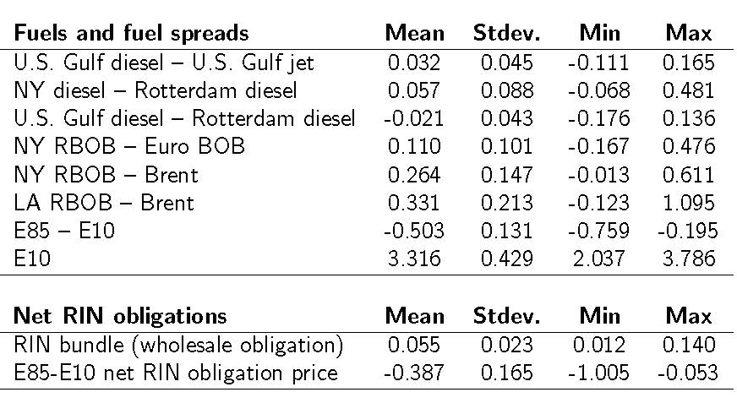
Summary Statistics
Data sources:
Bulk wholesale prices: Bloomberg, EIA, Argus.
RINs: PFL, OPIS, Bloomberg
E10, E85: Bloomberg (AAA)
Daily trading days, Jan. 1, 2013 – March 10, 2015 (N = 551)

Slide 19
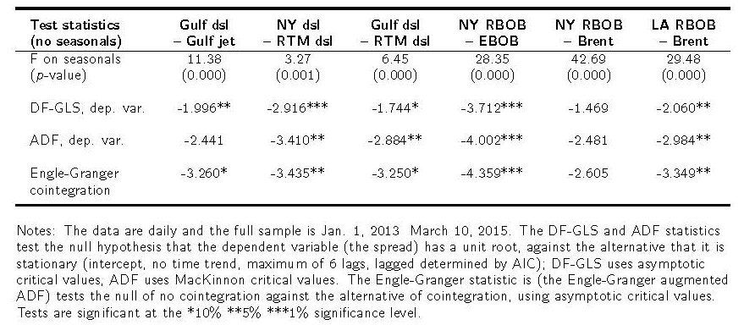
Results: Unit root analysis
Mixed results
RIN prices are well-approximated as having a unit root
Wholesale spreads don’t seem to have unit root
Over this sample period, results tend to suggest no unit root, so the primary specifications are levels OLS (not OLS) and VARs (not VECMs)

Slide 20
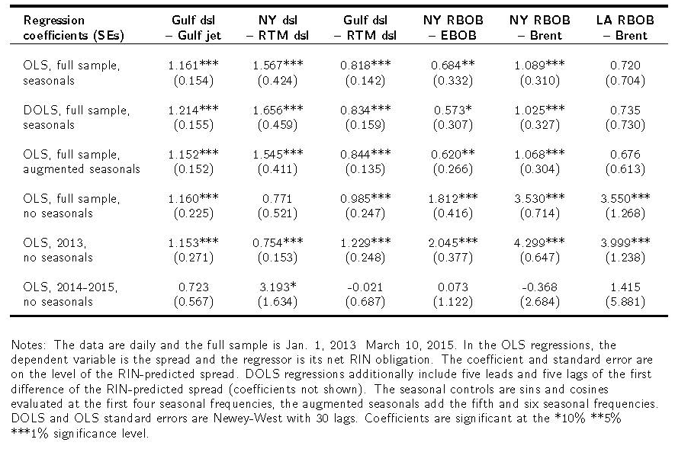
Results: Levels Regressions, Bulk Fuels

Slide 21
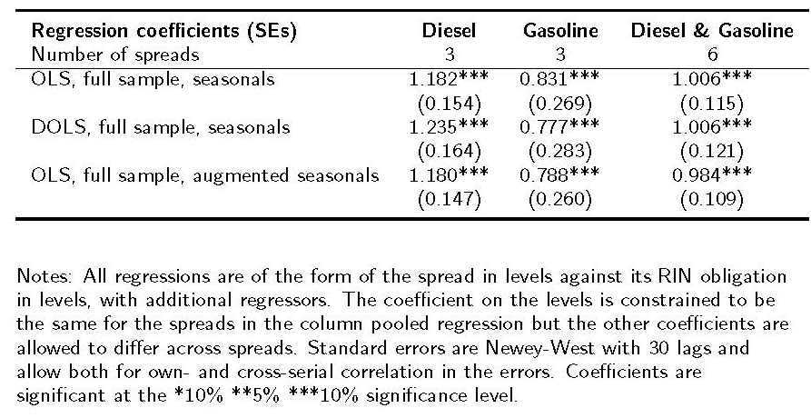
Results: Pooled Levels Regression, Bulk Fuels

Slide 22
Daily SVARs: Pooled bulk fuel spreads

Slide 23
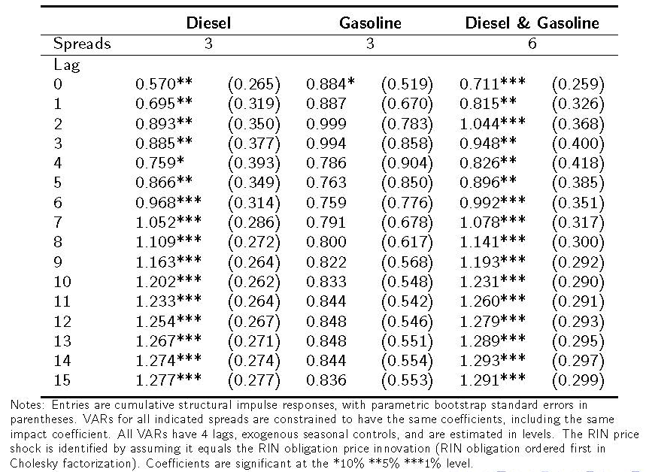
Results: Pooled SVARs, bulk fuels

Slide 24
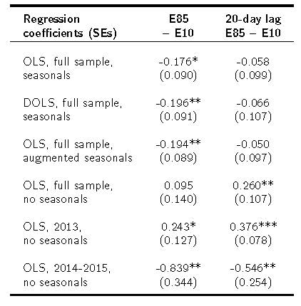
Results: Levels regressions, retail prices

Slide 25
Results: Weekly SVARs, retail prices
Lag | Weekly E85-E10
 | IRF | Std Error
0 | -0.050 | (0.070)
1 | 0.068 | (0.117)
2 | 0.170 | (0.159)
3 | 0.203 | (0.188)
4 | 0.288 | (0.212)
5 | 0.308 | (0.222)
6 | 0.312 | (0.222)
7 | 0.297 | (0.216)
8 | 0.289 | (0.214)
Seasonally unadjusted, full sample, End-of-week data

Slide 26
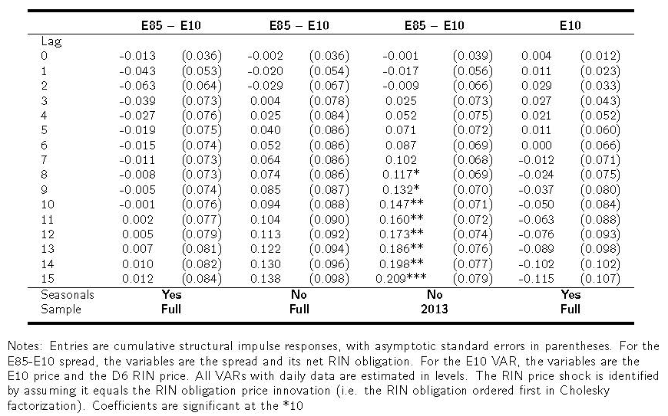
Results: Daily SVARs, retail prices

Slide 27
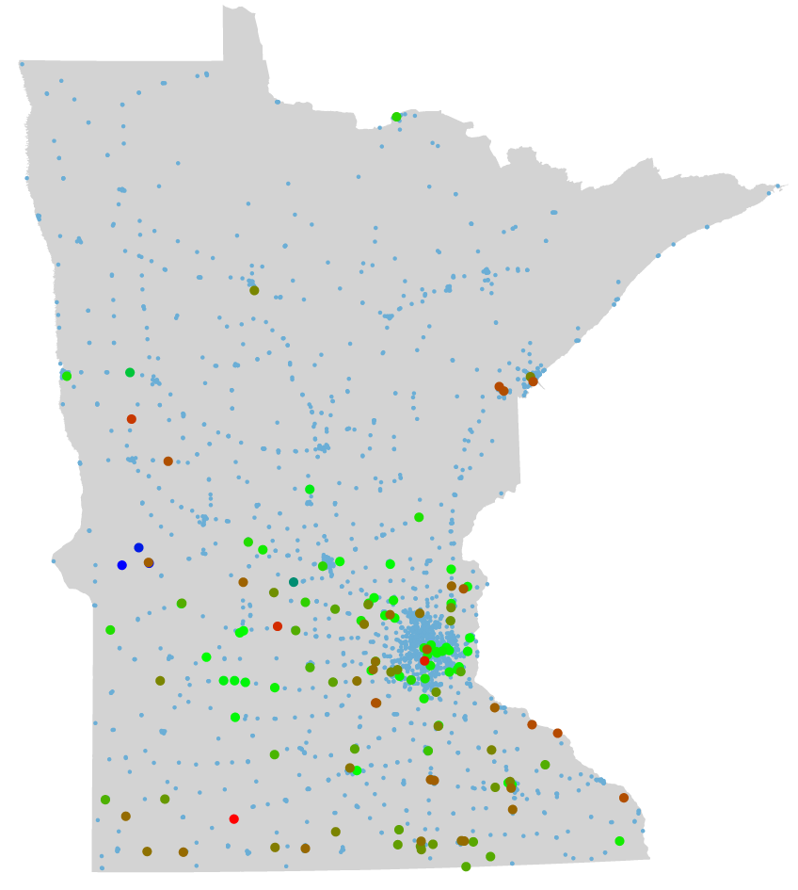
Rack-Retail Evidence:
Station-level Pass-Through, Minnesota E85 data
with Jing Li, Harvard Economics
Minnesota Dept. of Commerce E85 data through April 2015
Monthly E85, E10 retail price and E85 quantity by station
Augmented with OPIS estimated wholesale E10 prices, Bloomberg E100 rack prices (Alexandria, Duluth, Fargo)
Minnesota gas stations
January, 2015 (n = 2,454)
Small dots: no E85
Large dots: E85 (n = 185)
Red = high E85/E10 price ratio
Green = low E85/E10 price ratio (~.8)
Mean E85/E10 = .89, SD = .11

Slide 28
Station-level Pass-Through, Minnesota E85 data (-4/15):
Panel data regressions, levels with station FE

Slide 29
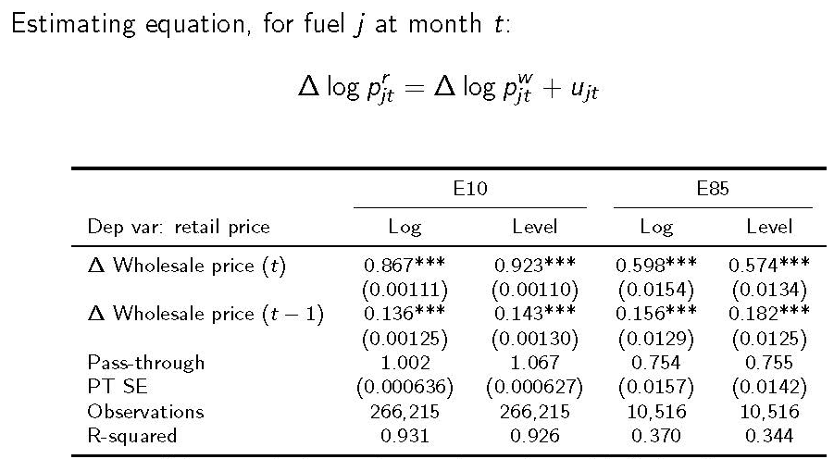
Rack-Retail Evidence:
Station-level Pass-Through, Minnesota E85 data (-4/15)
Note: standard errors clustered at gas station level, no adjustment for cross-sectional correlation

Slide 30
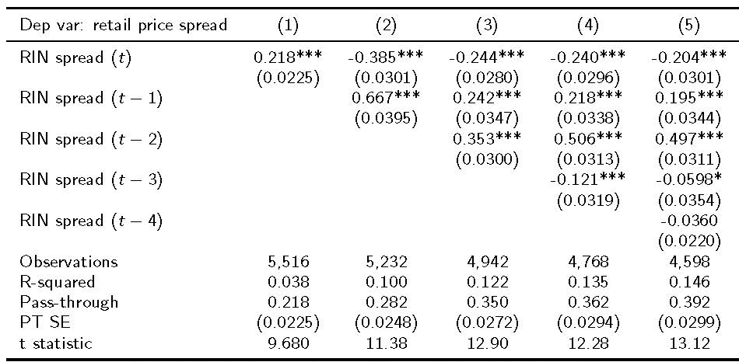
Rack-Retail Evidence:
Station-level Pass-Through, Minnesota E85 data (-4/15)
Note: standard errors clustered at gas station level, no adjustment for cross-sectional correlation

Slide 31
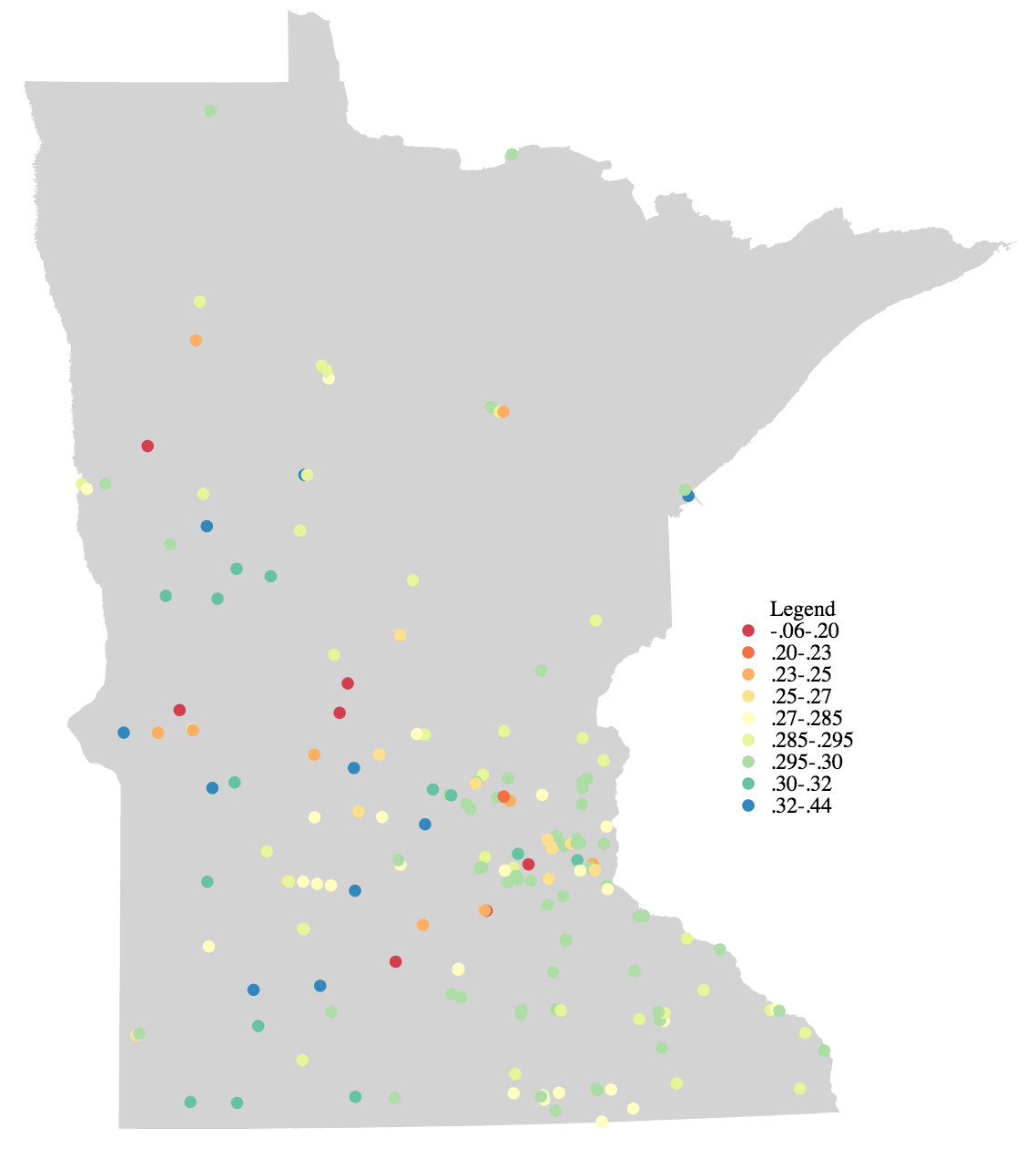
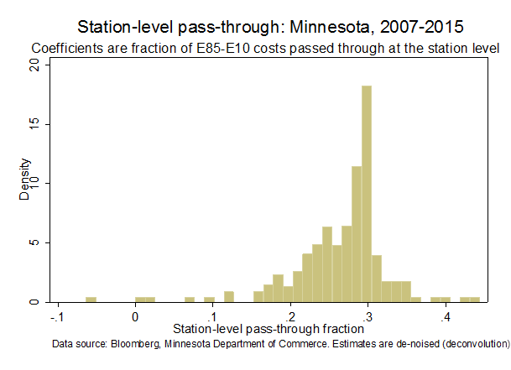
Heterogeneity in MN E85-E10 Pass-through Coefficients at the Station Level
Heat plot: Red is lowest (<.2),
dark blue is highest (>.32)
Deconvoluted empirical distribution

Slide 32
Summary
The RFS, RIN Prices, and the 2014-15-16 Proposed Rule
High-level questions:
Does the RIN price system work?
Would non-RFS measures affect RIN price pass-through?
More specific research questions:
(This paper) Is there pass-through of RIN prices into: Exchange traded fuels? Wholesale blender (rack) prices? Retail prices?
  Do wholesale (market) prices of petroleum and non-petroleum fuels reflect RIN prices? (Yes)
  Are RIN price subsidies passed on to the consumer? (No)
(Broader research program) How does market structure affect retail pricing?
  What can we learn from the Minnesota E85 data about station density and pricing?
  Is the impediment at the rack or at the retailer?
  What non-RFS measures (if any) would affect RIN price pass-through?
    USDA blender pump program (June 2015) ($100m federal matching grant)
    Changing the obligated party from the refiner/importer to the owner of the fuel at the rack gate?

Slide 33


Slide 34
Additional Slides

Slide 35
Additional RFS detail: 2014-15-16 Proposed Rule

Slide 36
EPA Proposed Rule & USDA Blender Pump Program
EPA’s middle path
  Recognize that the statutory volumes are infeasible
  But goes well beyond the blendwall – up to 600 mgal E85 in 2016
  Strong support for advanced/2nd Gen biofuels
  Invokes general waiver authority using novel legal interpretation
USDA blender pump program (June 2015)
  Up to $100m of grants for blender pumps (+ $100m matching grant)
    Would double number of pumps (increase no. stations by 50%)
  Announced 5/30, FR 6/15, applications due 7/15, funds fully disbursed 9/30
  Evaluation grand awarded by end of year…
  Big experiment! What is the effect of more pumps on E85 pricing and pass-through?

Slide 37
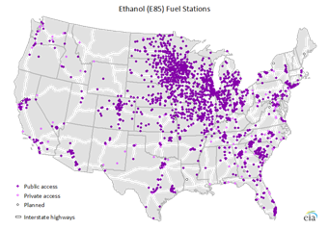
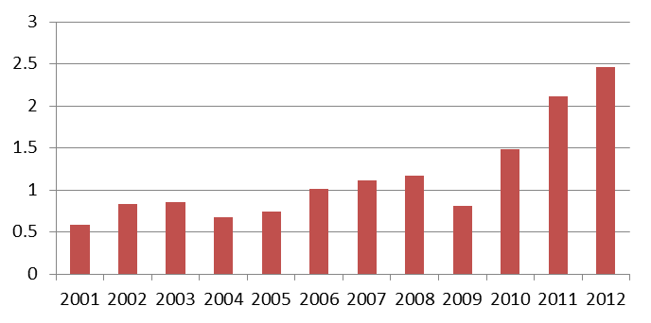
E15 and E85
E15
EPA approved E15 for use in model year 2001 and newer light duty vehicles, estimated to be 170 million vehicles out of 250 million in the fleet.
E15 is controversial.
  Harmful: “Significant numbers” of fuel pumps, fuel system components and fuel-level senders failed after 50,000-60,000 miles of exposure to E15 (American Petroleum Institute/Coordinated Research Council, May 2010).
  Benign: Study showed “no statistically significant loss of vehicle performance attributable to the use of E15 fuel compared to straight gasoline” (U.S. Department of Energy, May 2012).
  Obstacles: Automakers threaten to void warranty coverage if E15 is used. AAA recommended non flex-fuel consumers avoid E15.
  There are only 20 E15 stations in the U.S. (Renewable Fuels Association).
E85
If each of the 11.5 million FFVs used 8 gallons per week, consumption would be 4.8 bgals.
If each of the 2,647 E85 stations had an average tank size of 10,000 gallons, and refilled 3 times per week, the throughput capacity would be 4.1 bgals.
E85 capacity is unknown and controversial, with industry and expert disagreement. The geographic distribution of E85 stations and limited FFVs is a major factor.
Source: Energy Information Administration
Number of E85 Flex Fuel Vehicles Sold by Year
Millions of Vehicles
Source: Energy Information Administration

Slide 38
RFS Reform?
RFS reform goals should be:
Provide RIN price certainty
Have RIN prices reflect their “externality values”
Support 2nd gen fuels and innovators
Partner programs to address the network externality
Administrative reform
Opportunity of 2017 reset: forward guidance
Recraft annual rulemaking as a feedback rule (based on RIN price targets)
Details that matter (point of obligation, pathway approval, administration of cellulosic waiver credits,…)
Continue USDA BIP program & evaluation
Legislative reform
RIN price collar tied to externality values
Separate biodiesel from advanced (so BBD RINs can’t satisfy advanced obligation)
Eliminate $1 biodiesel tax credit (externality value = $0.16)
10-year $1/gal advanced, non-BBD producer tax credit (volumetric cap phaseout)
Partner programs to address network externality & R&D externality

Slide 39
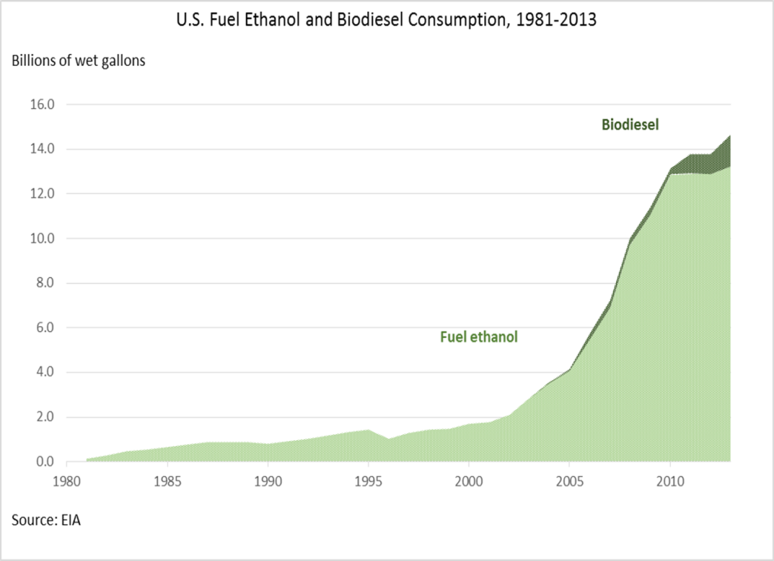
Energy Independence and Security Act of 2007 (EISA)
and the Renewable Fuel Standard (RFS)
Four externalities
GHG externality
Energy security externality
R&D externality
Network externality
The case for biofuels
Liquid fuels will be needed into the distant future
Second gen biofuels fuels can reduce emissions during the transition from petroleum
Promise of E30
[Energy security]
Main biofuels policy tools
Renewable Fuel Standard (RFS)
California LCFS
Federal tax credits (biodiesel, cellulosic, other)
State incentives (e.g. MN producer payment, 1986-1998)
DOE grants (mainly ARRA)
2014 USDA blender pump initiative ($100m)
Stated goals of EISA
Reduce CO₂ emissions
Enhance energy security

