Slide 1
RIN Pricing, the Market for Renewable Fuel, and the RFS
Jim Stock
Department of Economics, Harvard University & HKS
Harvard Seminar in Environmental Economics and Policy
April 1, 2015

Slide 2
Outline
Background
  The RFS: Legislative authority and nested fuel structure
  Fuel categories and RINs
  Biofuels expansion: Statutory goals, actuals, and waiver authorities
RIN prices
  The Blendwall
  RIN price fundamentals
  RIN price history
  Pass-through of RIN prices to fuel prices
A Dynamic Model of the RFS and US Biofuels Markets
  Model structure
  Simulations
Policy issues
  Policy goals
  Regulatory (EPA): 2014/15/16 rule and 2016/17/18 reset
  Administrative but not regulatory
  Legislative

Slide 3
A. Background
  The RFS: Legislative authority and nested fuel structure
  Fuel categories and RINs
  Biofuels expansion: Statutory goals, actuals, and waiver authorities

Slide 4
Legislative and Energy Context
A: Background
Legislative Context
The Energy Policy Act of 2005 established the Renewable Fuel Standard (RFS), which set a minimum volume of biofuels to be used in the national surface transportation fuel supply each year.
The Energy Independence and Security Act (EISA) of 2007 expanded the standard and increased the minimum volumes.
The stated goals of EISA are (1) to reduce CO₂ emissions in liquid transportation fuels, (2) increase energy security.
Energy/Environmental Context
Transportation fuels are approximately 24% of carbon dioxide (CO₂) emissions.

Slide 5
RFS Nested Fuel Structure
A: Background
Conventional (D6)
Lifecycle reduction in greenhouse gas emissions: 20%
Main fuel for blending: ethanol
Main feedstock: grain corn
Advanced (D5)
Lifecycle reduction in greenhouse gas emissions: 50%
Main fuel for blending: ethanol
Main feedstock: sugarcane
Feedstock Example | RIN Category | Mandate Eligibility
corn stover switchgrass | D3 | cellulosic, advanced, conventional
soybean oil canola oil animal fats | D4 | biodiesel, advanced, conventional
sugarcane sugar beets | D5 | advanced, conventional
grain corn | D6 | conventional
Cellulosic (D3)
Lifecycle reduction in greenhouse gas emissions: 60%
Main fuel for blending: ethanol
Main feedstock: corn stover
Biomass-based diesel (D4)
Lifecycle reduction in greenhouse gas emissions: 50%
Main fuel for blending: biodiesel
Main feedstock: soybean oil
Source: Environmental Protection Agency
The RFS mandate differentiates between types of renewable fuels.
Renewable Identification Numbers (RINs) are the mechanism that enforces the RFS mandate.

Slide 6
Feedstock and Blended Fuels
A: Background
Typical Feedstock
Fuel for Blending
Blended Fuel
Soybean Oil (D4)
Biodiesel
Blended Diesel
(B5, B20)
Other (D4)
Petroleum Diesel
Crude Oil
Petroleum Gasoline
Corn Stover (D3)
Drop-Ins
Blended Gasoline
(E10, E15, E85)
Sugarcane (D5)
Other (D5)
Ethanol
Grain Corn (D6)
Other (D6)
“Drop-ins” are renewable fuels that are sufficiently similar to petroleum gasoline to be compatible with the current petroleum-geared infrastructure, fuel systems, and engines.

Slide 7
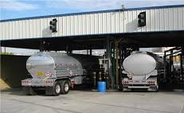
Simplified Flow of RINs and Blended Fuel (Ethanol Only)
A. Background
Compliance through the RIN System
Corn
Refiner/
Importer
Distiller
RINs
BOB
RINs
Ethanol
EPA
Blender
E10, E85
Pump E10/E85

Slide 8
Statutory RFS2 Mandate Volumes
A: Background
Mandate Volumes (billions of gallons)
Year | Cellulosic (D3) | Biomass-Based Diesel (D4) | Other Advanced (D5) | Other Renewable (D6) | Total Advanced (D3 + D4 + D5) | Total Renewable (D3 + D4 + D5 + D6)
2011 | 0.25ª | 0.80 | 0.2 | 12.6 | 1.35 | 13.95
2012 | 0.5^{b} | 1.00 | 0.5 | 13.2 | 2.00 | 15.20
2013 | 1^{c} | 1.28^{d} | 0.47 | 13.8 | 2.75 | 16.55
2014 | 1.75 | 1.00e | 1 | 14.4 | 3.75 | 18.15
2015 | 3.00 | 1.00e | 1.5 | 15.0 | 5.50 | 20.50
2016 | 4.25 | 1.00e | 2 | 15.0 | 7.25 | 22.25
2017 | 5.50 | 1.00e | 2.5 | 15.0 | 9.00 | 24.00
2018 | 7.00 | 1.00e | 3 | 15.0 | 11.00 | 26.00
2019 | 8.50 | 1.00e | 3.5 | 15.0 | 13.00 | 28.00
2020 | 10.50 | 1.00e | 3.5 | 15.0 | 15.00 | 30.00
2021 | 13.50 | 1.00e | 3.5 | 15.0 | 18.00 | 33.00
2022 | 16.00 | 1.00e | 4 | 15.0 | 21.00 | 36.00
ª Changed to 0.006 billions of gallons by EPA waiver.
^{b} Changed to 0.010 billions of gallons by EPA waiver.
^{c} Changed to 0.014 billions of gallons by EPA waiver.
^{d} Proposed rule
^{e} The biomass-based diesel mandate is unspecified but must be at least 1.00 billions of gallons for 2013 onwards.
Source: Congressional Research Service, Environmental Protection Agency

Slide 9
Change in CO₂ Emissions under Statutory Mandate
A: Background
Note: Projections based on 2013 EIA projections for total fuel usage (Annual Energy Outlook, Reference Case). The projection with RFS2 assumes that the statutory mandate will hold without any changes. The projection without RFS2 assumes that only nonrenewable fuel would be used to meet fuel requirements.
Sources: EIA Annual Energy Outlook 2013, 2010, USDE Alternative Fuels Data Center, EPA RFS2 Regulatory Impact Analysis, Biomass Energy Centre, and CEA Calculations
The GHG/Corporate Average Fuel Economy (CAFE) standards are independent of the RFS mandates and require improvements in the fuel efficiency of cars.
RFS2 effects to date show the CO₂ effect of E10 adoption, relative to the 100% nonrenewable “without RFS2” case.

Slide 10
EPA Authority under the RFS
A: Background
EPA establishes fractional standards for Cellulosic, Biomass-based diesel, Total Advanced, and Total renewable annually.
  Volumetric counterparts (RVOs) are computed and fractions established based on estimated coming-year volumes.
Waiver Authorities.
General waiver authority. EPA has the authority to temporarily waive the RFS renewable fuel requirements partially or completely, under two conditions:
  Based on a determination that implementation of the requirement would severely harm the economy or environment of a state, a region, or the United States; or
  Based on a determination by the Administrator, after public notice and opportunity for comment, that there is an inadequate domestic supply.
Cellulosic Waiver Authority. EPA may waive the cellulosic portion of the renewable fuel mandate if the supply of cellulosic biofuel is insufficient. The waiver must be made by the EPA by November 30 of the prior calendar year.

Slide 11
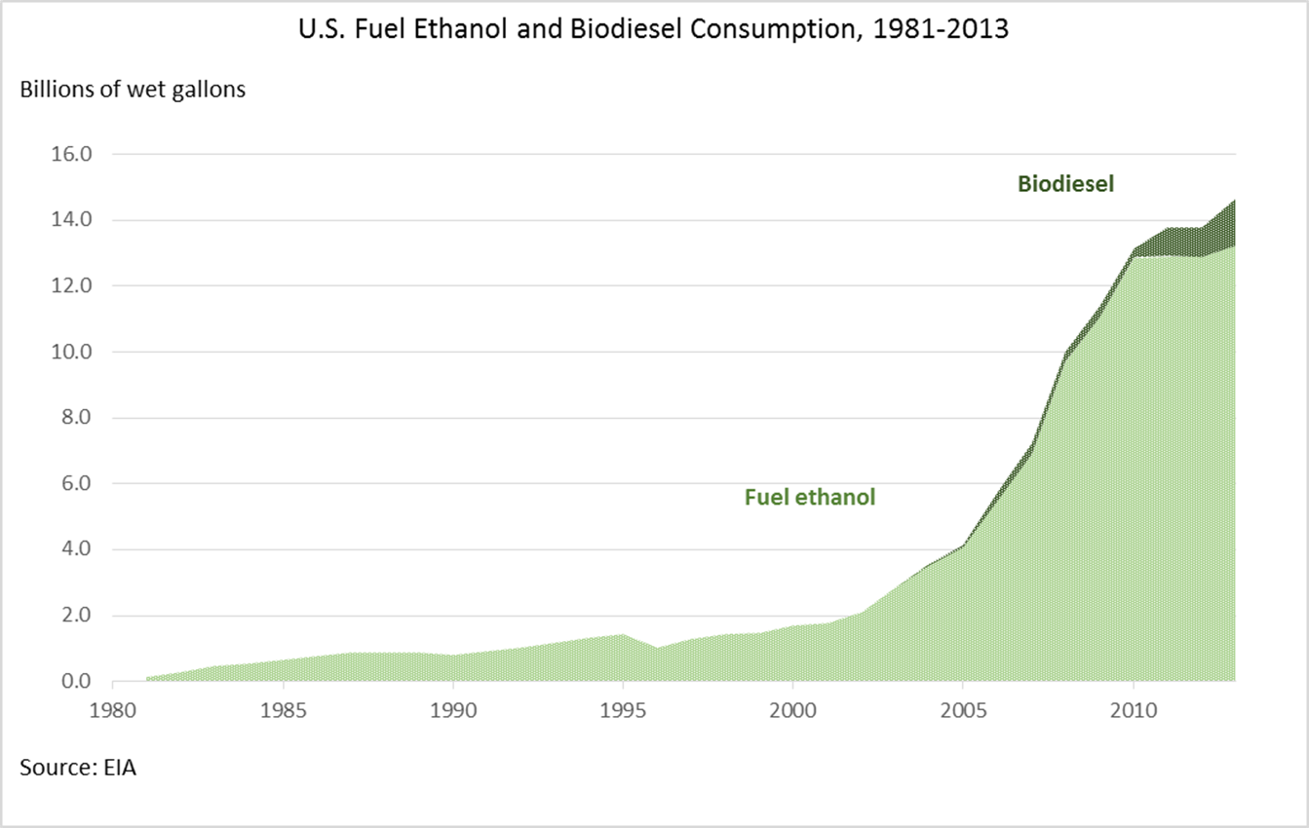
Biofuels Consumption History
A: Background

Slide 12
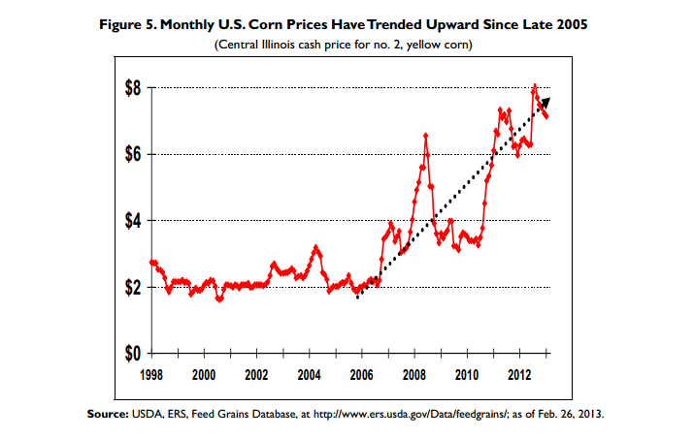
Corn & Farmland Prices
A: Background
Source: Iowa State University & Iowa Realtors Land Institute
In 2013, USDA estimates 42% of U.S. corn crop will be used for corn ethanol (approximately 28% after accounting for by-products e.g. distillers dried grains).
Farmland values have surged during the past decade.
  IA and NE posted the highest gains (350%+)
  IA and NE are also the top 2 ethanol producers
Demand for ethanol is estimated to have increased corn prices by 25%-36% (Louden et al 2013, Hochman et al 2013, Babcock and Fabiosa 2011).
Mandated ethanol blending reduces elasticity of corn demand so supply shocks likely have a bigger effect on corn prices.
Source: Renewable Fuels Association

Slide 13
B. RIN prices
  The E10 Blend Wall
  RIN price fundamentals
  RIN price history
  Pass-through of RIN prices to fuel prices

Slide 14
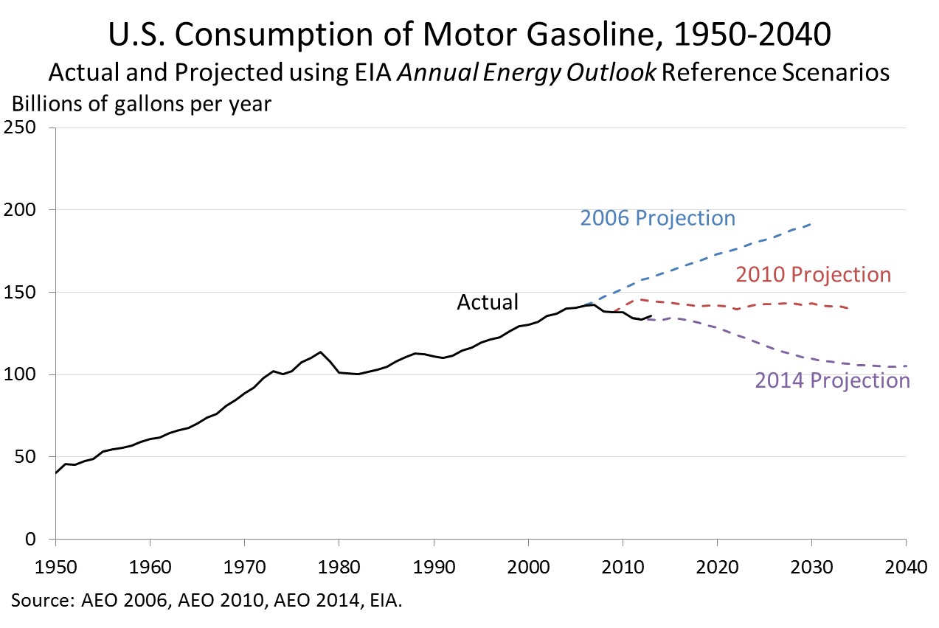
The E10 Blend Wall: Gasoline Consumption
B: RIN Prices
Actual gasoloine consumption is much lower than expected in 2007 due to the recession, high oil prices, and improved fuel economy.

Slide 15
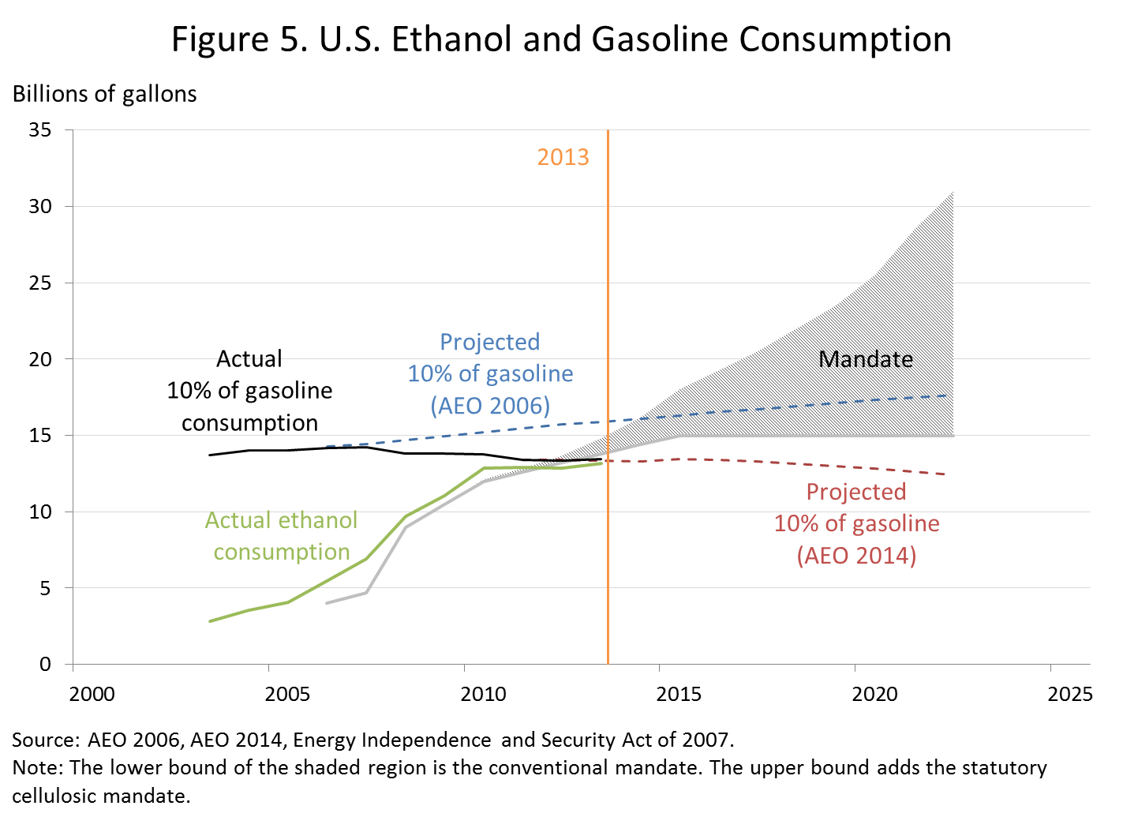
The E10 Blend Wall, Then and Now
B: RIN Prices

Slide 16
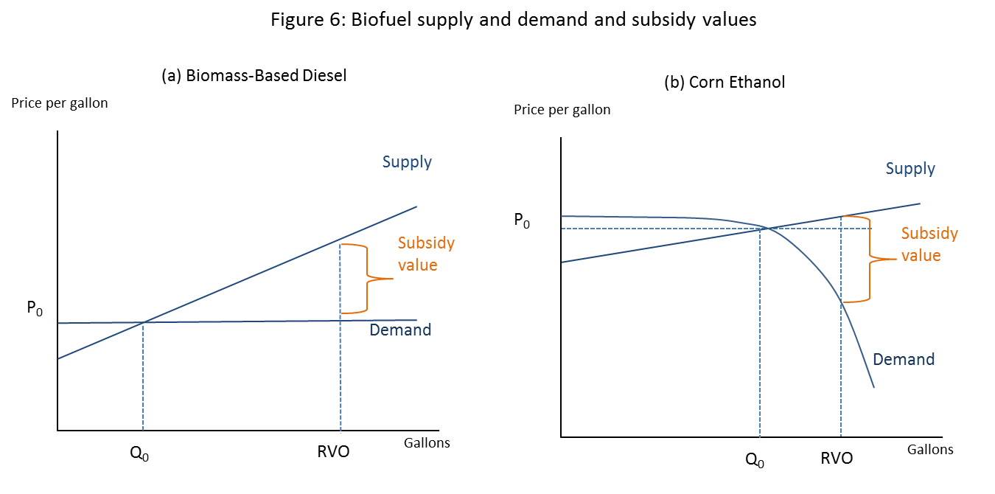
RINs as a Cross-Subsidy
B. RIN Prices
More generally, RIN prices are determined by:
Subsidy value (static fundamentals)
Value of holding and exercising later (dynamic – reflects expectations of future policy, economic conditions, etc)
Conditions in other biofuels markets via the RFS nesting structure

Slide 17
RIN Externality Arithmetic
B. RIN Prices
Subsidy on corn ethanol
Difference in emissions, priced at the social cost of carbon
Tax on petroleum gasoline
D6 wedge = P_{D6} + (ρ₃P_{D3} + ρ₄P_{D4 +} ρ₅P_{D5 +} ρ₆P_{D6})
D5 wedge = P_{D5} + (ρ₃P_{D3} + ρ₄P_{D4 +} ρ₅P_{D5 +} ρ₆P_{D6})
D4 wedge = 1.5*P_{D4} + (ρ₃P_{D3} + ρ₄P_{D4 +} ρ₅P_{D5 +} ρ₆P_{D6})
D3 wedge = P_{D3} + (ρ₃P_{D3} + ρ₄P_{D4 +} ρ₅P_{D5 +} ρ₆P_{D6})
Rough estimates of externality-based RIN prices (SCC = $42/ton)
 | D4 | D5 | D6
GHG externality | $.13-.22 | $.12-.17 | $.05-.08
Energy security (EIA RIA) | $.12 | $.18 | $.18
Total | $.25-.33 | $.30-.35 | $.22-.26

Slide 18
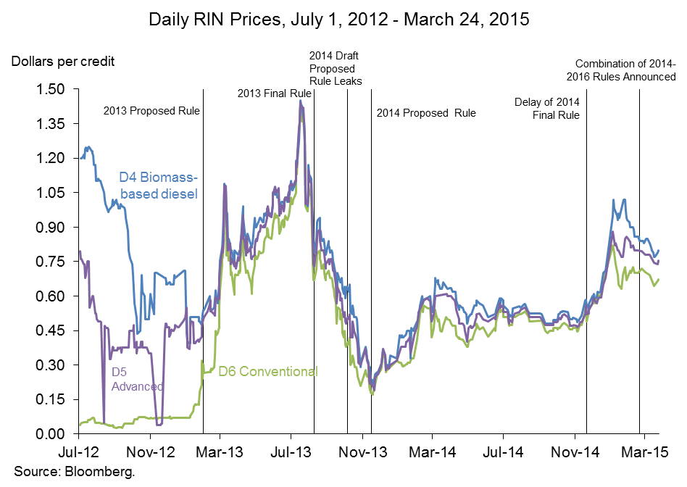
RIN Price History
B. RIN Prices

Slide 19
RIN Price Pass-through?
(With Ben Meiselman and Chris Knittel)
B. RIN Prices

Slide 20
RIN Pass-through Regressions
B. RIN Prices

Slide 21
RIN Pass-through Regressions
B. RIN Prices

Slide 22
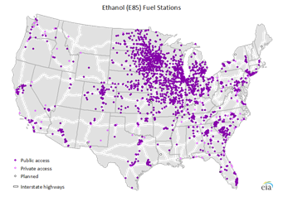
E15 and E85
B: RIN Prices
E15
EPA approved E15 for use in model year 2001 and newer light duty vehicles, estimated to be 170 million vehicles out of 250 million in the fleet.
E15 is controversial.
  Harmful: “Significant numbers” of fuel pumps, fuel system components and fuel-level senders failed after 50,000-60,000 miles of exposure to E15 (American Petroleum Institute/Coordinated Research Council, May 2010).
  Benign: Study showed “no statistically significant loss of vehicle performance attributable to the use of E15 fuel compared to straight gasoline” (U.S. Department of Energy, May 2012).
  Obstacles: Automakers threaten to void warranty coverage if E15 is used. AAA recommended non flex-fuel consumers avoid E15.
  There are only 20 E15 stations in the U.S. (Renewable Fuels Association).
E85
If each of the 11.5 million FFVs used 8 gallons per week, consumption would be 4.8 bgals.
If each of the 3,026 E85 stations had an average tank size of 10,000 gallons, and refilled 3 times per week, the throughput capacity would be 4.7 bgals.
E85 capacity is unknown and controversial, with industry and expert disagreement. The geographic distribution of E85 stations and limited FFVs is a major factor.
Source: Energy Information Administration
Number of E85 Flex Fuel Vehicles Sold by Year
Millions of Vehicles
Source: Energy Information Administration

Slide 23
C. A Dynamic Model of the RFS
(with Jing Li and Aaron Smith)
  Model structure
  Simulations

Slide 24
Model Structure
C. RFS Model
Setup
Three fuels: Biomass-based diesel (BBD), Sugarcane ethanol (SE), Corn ethanol (CE)
Markets for fuels clear in a single year.
No storage of feedstocks (corn, sugarcane, soybeans)
No storage of liquid fuels
RINs are bankable and are bought and sold by a profit-maximizing RIN trader.
Given start-of-year and end-of-year RIN inventory, EPA fractional standards, and (exogenous) total demand for passenger car & truck Btu’s, the fuel markets clear and determine RIN prices and biofuels production.

Slide 25
Model Structure
C. RFS Model

Slide 26
Model Structure
C. RFS Model

Slide 27
Model Structure
C. RFS Model

Slide 28
Simulation Results
C. RFS Model
Linearized version of previous model
Static case, calibrated to 2013
Three fuels: BBD (D4), Sugar Cane Ethanol (D5), Corn Ethanol (D6)
Experiments:
  Increase BBD, holding TA, TR constant
  Increase TA, holding BBD, TR constant
  Increase BBD and TA, holding TR constant
  Increase BBD, TA, TR all one-for-one

Slide 29
1. Increase V_{BBD} Holding V_{TA} and V_{TR} Constant
For low values of V_{BBD}, excess BBD is produced (2.33 Bgal total), but no excess cane is produced (the TA RVO and TR RVO are binding but the BBD RVO is not). So P_{D4} = P_{D5} > P_{D6} = 0 (regime (b)).
At V_{BBD} = 2.34, V_{BBD} becomes binding – so all three RVO’s bind and P_{D4} > P_{D5} > P_{D6} > 0 (regime (a)). The D4 RIN price rises as the V_{BBD} increases, but the D5 RIN price falls as less cane is needed to fill the TA RVO (so cane imports fall).
At V_{BBD} = 2.5, V_{TA} ceases to bind and cane is imported in excess of what is needed to fill the TA RVO, so cane starts to fill the TR RVO and P_{D4} > P_{D5} = P_{D6} > 0. As the TR residual falls, P_{D5} and P_{D6} fall and the quantities of cane and corn both fall.
Technical details: Demand and supply (1)-(3) are linear, parameters are calibrated to approximate real-world values, no parameters are econometrically estimated – so numerical results are not to be taken literally. Volumes are in ethanol-equivalent Bgal (so 1.28 wet Bgal biodiesel appears here as 1.92 Bgal).

Slide 30
2. Increase V_{TA} Holding V_{BBD} and V_{TR} Constant
For V_{TA} < 2.1, the BBD mandate is binding but TA is not, so excess cane is imported and P_{D4} > P_{D5} = P_{D6} > 0 (regime (c)).
At V_{TA} = 2.1, V_{TA} becomes binding, so P_{D5} starts to rise and no excess cane is imported, and for 2.1 < V_{TA} < 2.2 each RVO is binding and P_{D4} > P_{D5} > P_{D6} > 0 (regime (a)). In this range, the D4 RIN price is constant, the D5 RIN price rises and more cane is imported, but the TR residual contracts so less corn is used and the D6 RIN price falls.
For 2.2 < V_{TA} < 2.95, as V_{TA} increases the TA residual increases so the required cane increases and the D5 RIN price increases. But because of the RFS nesting, this drives up the D4 RIN price, so BBD is produced in excess of the BBD RVO. Because (i) more BBD enters the system, the E100 needed to satisfy the TR RVO drops, putting additional downward pressure on the D6 RIN price (the D5 RIN price is increasing because V_{TA} is binding). Here, P_{D4} = P_{D5} > P_{D6} = 0 (regime (b))
Eventually, for V_{TA} > 2.95, the D6 RIN price goes to zero – no more subsidy is needed to supply the <12.1 Bgal of corn required to fill the RVO. In fact, in this range corn used exceeds the TR residual and total renewable production exceeds the TR RVO (at V_{TA} = 4, 11.76 Bgal of corn are produced, for a total renewable volume of 15.76 Bgal (regime (zb)).

Slide 31
3. Increase V_{BBD} and V_{TA} Holding V_{TR} Constant
For V_{TA} < 2.9, excess BBD is produced and excess cane+BBD is produced so P_{D4} = P_{D5} = P_{D6} > 0 (regime (d)).
As the BBD and TA mandate increase, more BBD is put in the system, reducing the amount of E100 needed, so E100 demand declines. For 2.9 < V_{TA} < 3.35, the TA RVO is binding (but the BBD RVO is not), so the D5 RIN price increases and the D6 RIN price tracks D5. The reduced E100 demand and increased cane results in the amount of corn supplied dropping, and the D6 RIN price detaches from D5 and D6 and corn supplied drops. Here, P_{D4} = P_{D5} > P_{D6} > 0 (regime (b)).
For 2.9 < V_{TA} < 3.35, the BBD RVO starts to bind and the D4 RIN price detaches from D5. Because increasing BBD reduces the total amount of ethanol needed, but the TA residual remains constant, the D5 RIN price drops, and the D6 RIN price also drops. Here, P_{D4} > P_{D5} > P_{D6} > 0 (regime (a)).
For V_{TA} > 3.35, the D6 RIN price has hit the floor of zero, and corn is produced in excess of the TR residual. The BBD RVO is binding and the D4 RIN price continues to increase. But because the TA residual is constant (at 0.6 Bgal), 0.6 Bgal of cane enter the system throughout this range and the D5 RIN price is constant throughout this range. Here, the BBD and TA RVOs are binding and the TR is not, and P_{D4} > P_{D5} > P_{D6} = 0 (regime (zd)).

Slide 32
4. Increase V_{BBD}, V_{TA}, and V_{TR} one-for-one
For V_{BBD} < 2.55, excess BBD is produced and excess cane+BBD is produced so P_{D4} = P_{D5} = P_{D6} > 0 (regime (d)). As the BBD, TA, and TR mandate increase, only the TR mandate is binding – which drives up the D6 RIN price and, which pulls along the D5 and D4 RIN price. The higher D4 RIN price pulls more in more BBD – but pulls it in more slowly than the BBD RVO is increasing, so the amount of E100 in the system increases (consistent with the increasing D6 RIN price). Both the volumes of cane and corn increase as the D5 and D6 RIN prices increase.
At V_{BBD} = 2.55, the TA RVO begins to bind and the D6 RIN price separates from the D4 and D5 RIN prices. For 2.55 < V_{TA} < 3.25, BBD is increasing, but not as fast as the BBD RVO, so the amount of excess BBD decreases and E100 rises – so the D6 RIN price also rises. P_{D4} = P_{D5} > P_{D6} > 0 (regime (b)).
At V_{BBD} = 3.25, the BBD RVO binds and at this point all three RVOs are binding, so the RIN prices separate. Now the amount of corn in the system, and cane, are constant, so those prices stabilize at high values, while the D4 price continues to rise with the BBD RVO. Here, P_{D4} > P_{D5} > P_{D6} > 0 (regime (a)).

Slide 33
D. Policy Issues
  The Total Renewable Gap
  Policy goals
  Regulatory (EPA): 2014/15/16 rule and 2016/17/18 reset
  Administrative but not regulatory
  Legislative

Slide 34
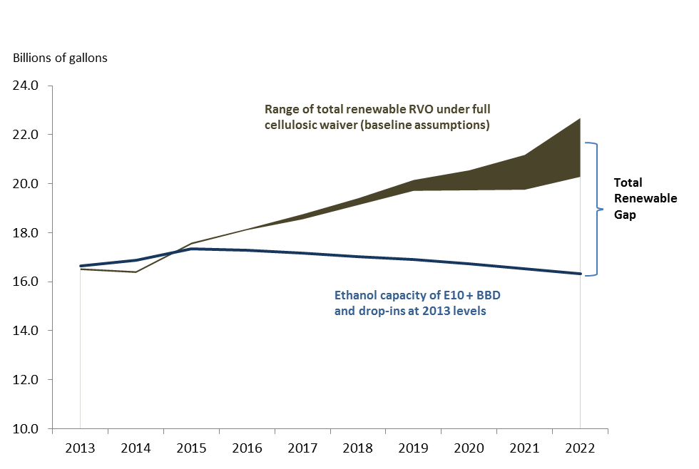
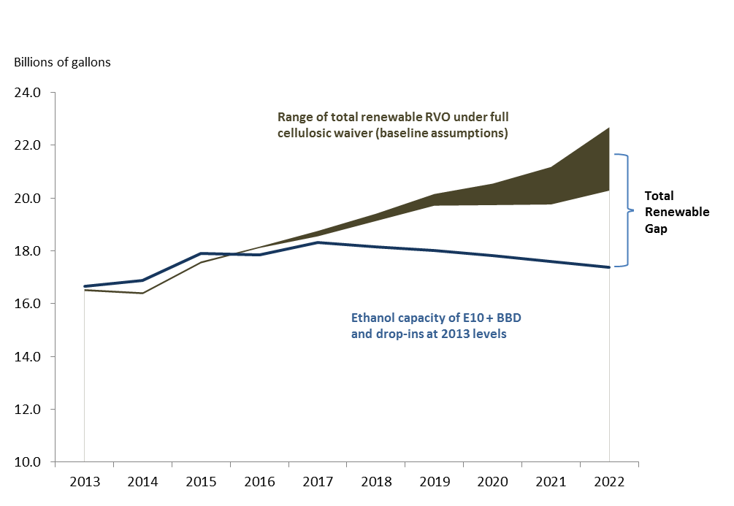
The Total Renewable Gap
D. Policy Issues
The Total Renewable Gap under the Cellulosic Waiver:
EIA AEO 2014 projections (left) and High Gasoline Demand Scenario (right)
The lower line is 2013 BBD and drop-in production plus projected ethanol supply with no higher blends, the upper line is the total renewable RVO under the full cellulosic waiver authority and a range of assumptions, and the difference is the “total renewable gap.”
In the high gasoline demand scenario, gasoline consumption exceeds EIA projections by 4% to reflect potential additional growth in demand in response to low gasoline prices. See the notes to Figure 9. Source: Author’s calculations

Slide 35
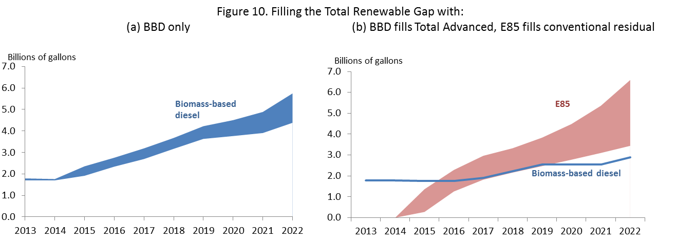
Filling the Total Renewable Gap (EIA Scenario)
D. Policy Issues

Slide 36
Policy Options and Goals
D. Policy Issues
Policy Goals
EISA:
  Reduce GHG emissions from surface transportation sector
  Enhance energy security
Provide economically efficient support for advanced domestic low-GHG fuels
Policy Options – High Level
  Status quo, annual rulemakings, retain discretion
  Pull back from blend wall (use general waiver authority; 2014 draft rule)
  Ambitious path – use Cellulosic waiver authority combined with 2016/17/18 reset
    What methodology for fractions or volumes?
    How to support economic efficiency?

Slide 37
Administrative and Legislative Options
D. Policy Issues
Administrative
Improve E85 pricing transparency
Support regionally focused E85 penetration (increase E85 station density)
Legislative
RIN price collar
Change RIN generation from energy-equivalent to GHG-reduction values
Change cellulosic credit formula and address “neutral estimate” court ruling
Support higher fraction of flex fuel vehicles

