Slide 1
The Renewable Fuel Standard:
Concerns, Risks, Deals, Reform
Jim Stock
Economics Department & Kennedy School
Harvard University
CEEPR Fall Conference
November 15, 2018

Slide 2
Summary and Outline
Brief review of the RFS
Six Concerns and Risks
Announced administrative reform (the “Trump deal”)
Elements of legislative reform
This talk draws on:
  Knittel, Meiselman, and Stock, JAERE (2017)
  Li and Stock, JEEM (forthcoming)
  Pouliot, Smith, and Stock (2017)
  Irwin, McCormack, and Stock (2018)
  Stock (2018)
  Irwin and Stock (in progress)

Slide 3
A. Quick Review of the RFS
Statutory authority: EISA 2007
Policy goals
  Reduce CO₂ emissions from liquid transportation fuels,
  Increase energy security, and
  Support rural incomes

Slide 4
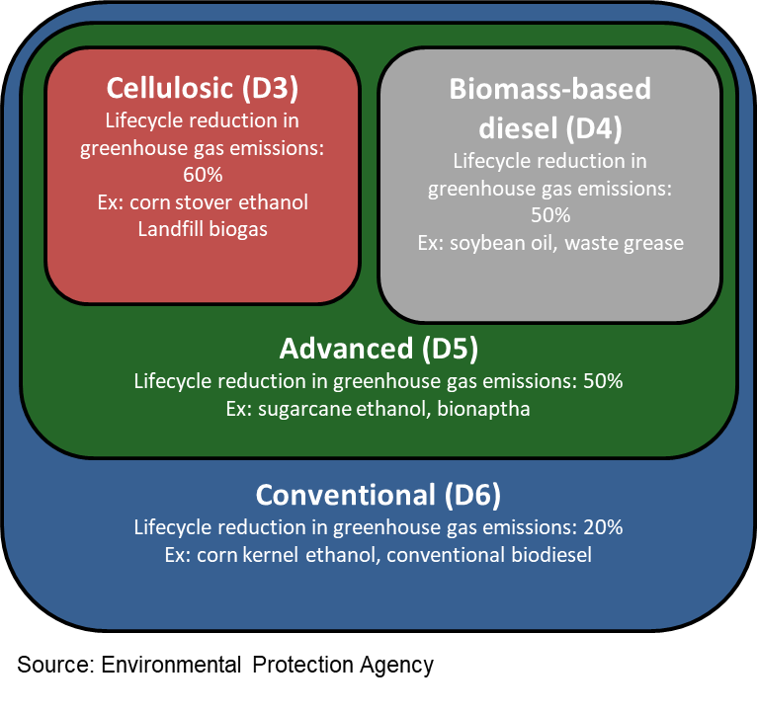
A. Quick Review of the RFS
Statutory authority: EISA 2007
Policy goals
  Reduce CO₂ emissions from liquid transportation fuels,
  Increase energy security, and
  Support rural incomes
RIN nesting structure
Administrative elements
  EPA sets renewable volume obligation (RVO) through annual rulemakings
    Starting point is statutory volumes
    EPA has multiple waiver authorities
    EPA converts RVO to fractional standard
  Compliance is via the RIN system
    RINS are tradeable compliance certificates generated when biofuels are produced and detached when they are blended
    Obligated parties are refiners and refined product importers

Slide 5
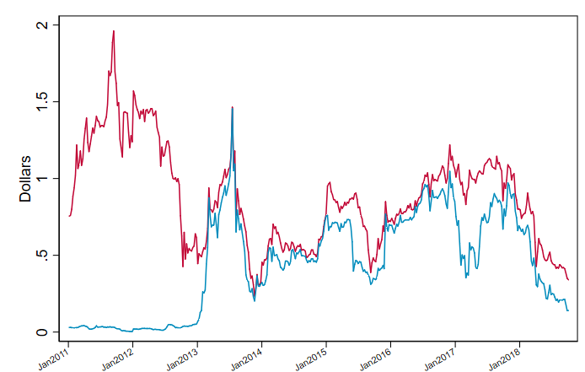
Quick Review of the RFS
RIN prices are the economic mechanism of the RFS
D4 (red) and D6 RIN prices, Jan. 2011 – Oct. 2018
RIN prices:
Equate supply & demand for biofuels so that consumption = RVO
  Subsidize production of high marginal cost fuels
  Subsidize consumption of higher ethanol blends
Stimulate infrastructure investments

Slide 6
Six Concerns and Risks
6

Slide 7
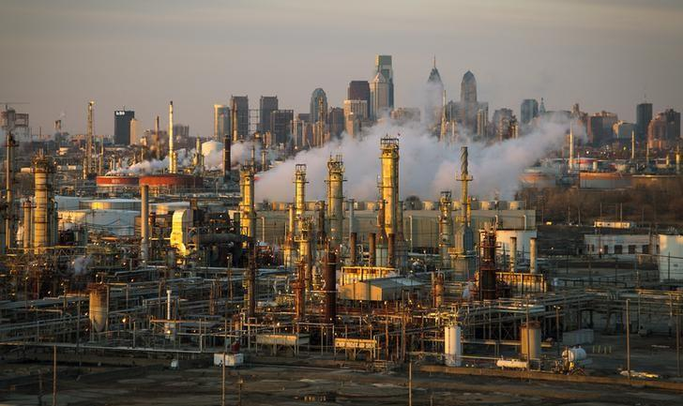
1. RIN burden on refiners
Merchant refiners claim they are disproportionately burdened by RIN obligations
Philadelphia Energy Solutions declared bankruptcy in Jan. 2018. EPA Administrator Pruitt told Fox News that the main reason was high RIN costs.

Slide 8
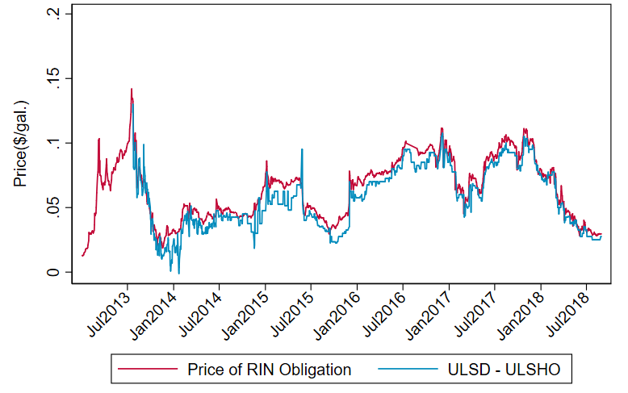
1. RIN burden on refiners
Merchant refiners claim they are disproportionately burdened by RIN obligations
Philadelphia Energy Solutions declared bankruptcy in Jan. 2018. EPA Administrator Pruitt told Fox News that the main reason was high RIN costs.
Daily Gulf ULSD-ULSHO spread and RIN obligation, 2011-2018: pass-through coefficient = 1.015 (SE 0.019)
…but RIN prices pass through to refined product prices
Knittel, Meiselman, & Stock (2016); Irwin & Stock (2018)

Slide 9
1. RIN burden on refiners
Merchant refiners claim they are disproportionately burdened by RIN obligations
Philadelphia Energy Solutions declared bankruptcy in Jan. 2018. EPA Administrator Pruitt told Fox News that the main reason was high RIN costs.
…but RIN prices pass through to refined product prices
Knittel, Meiselman, & Stock (2016); Irwin & Stock (2018)
Still:
  RIN price risk
  Pass-through might fail in special cases
Response of Gulf ULSD-ULSHO spread to a 1-cent RIN obligation increase, estimated by VAR(5), 2011-2018

Slide 10
2. RIN price volatility
Volatile RIN prices undercut their investment subsidy role
Speculation? Market manipulation?
D4 price

Slide 11
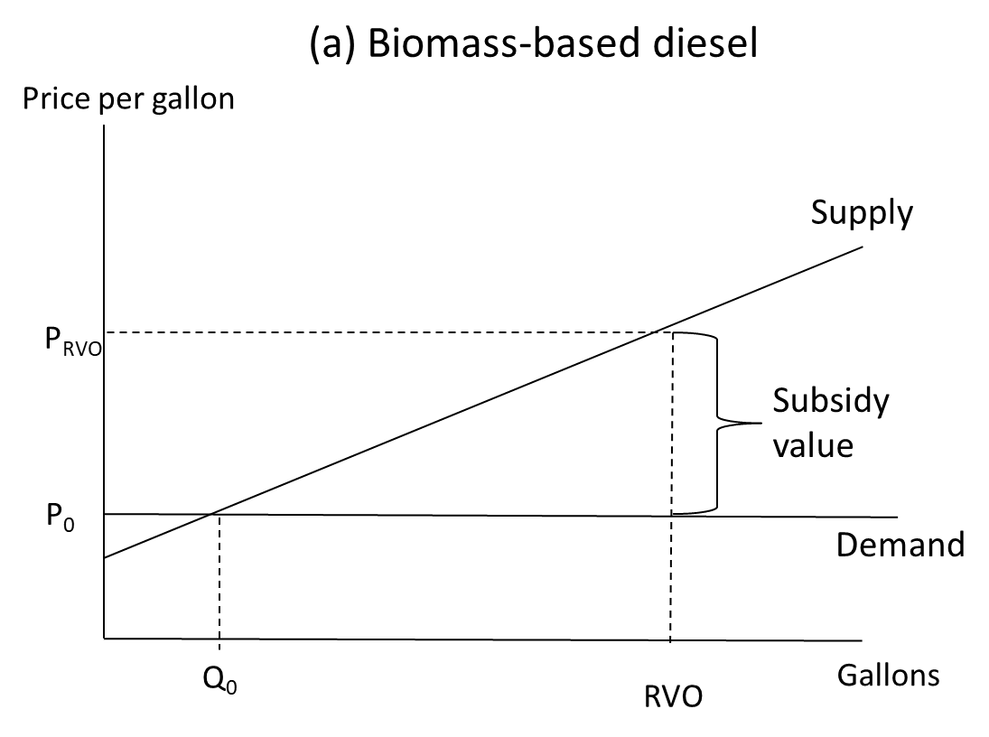
2. RIN price volatility
Volatile RIN prices undercut their investment subsidy role
Speculation? Market manipulation?
In theory, RIN prices equate supply and demand →
D4 price
D4 price
Fundamental value

Slide 12
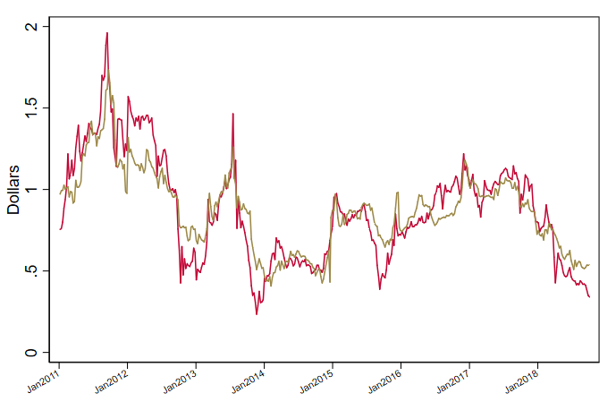
2. RIN price volatility
Volatile RIN prices undercut their investment subsidy role
Speculation? Market manipulation?
In theory, RIN prices equate supply and demand →
D4 price
…and they do!
Irwin, McCormack & Stock (2018) (left) based on biodiesel-ULSD spread and biodiesel blender tax credit
RIN price volatility is not a consequence of market manipulation: It is an intrinsic feature of the RFS
Fundamental value

Slide 13
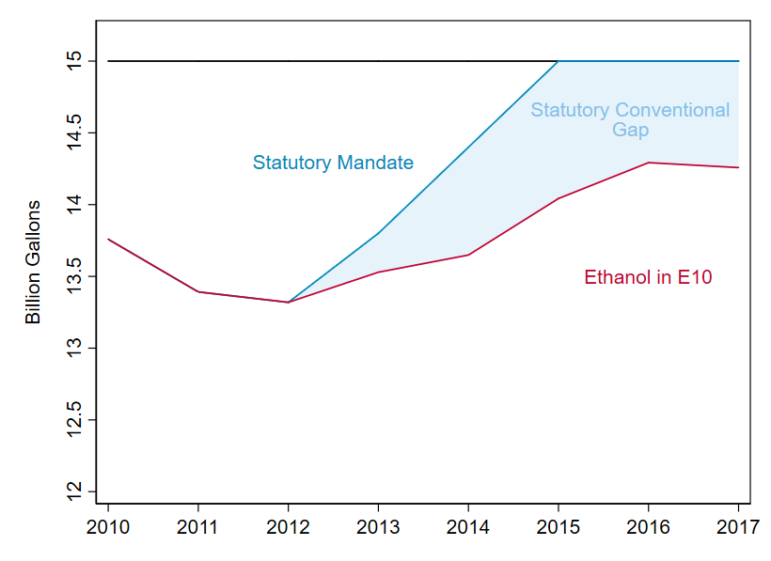
3. What happens if we breech the E10 blend wall?
The conventional statutory RVO hit its 15Bgal cap in 2015

Slide 14
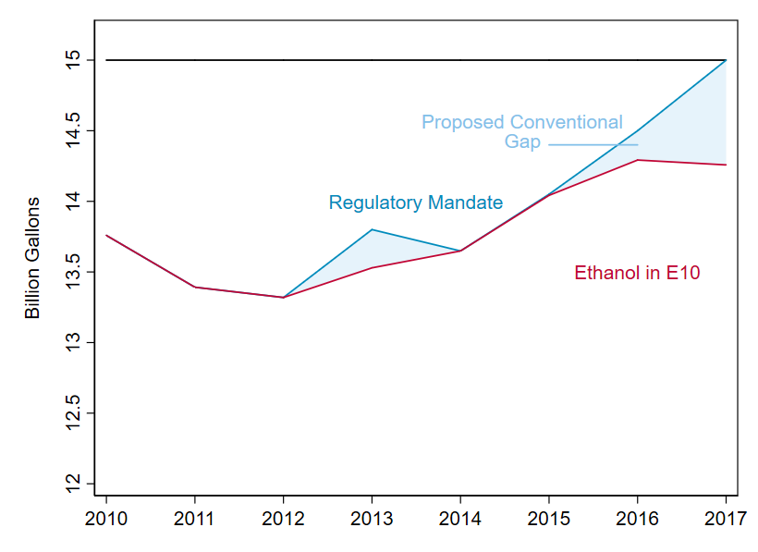
3. What happens if we breech the E10 blend wall?
The conventional statutory RVO hit its 15Bgal cap in 2015
In 2014-15, volumes were reduced using the general waiver authority

Slide 15
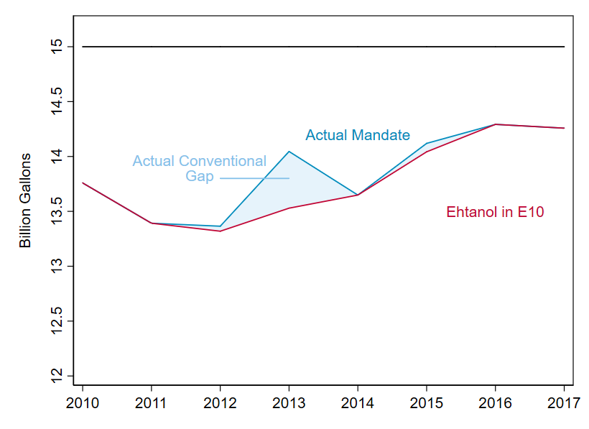
3. What happens if we breech the E10 blend wall?
The conventional statutory RVO hit its 15Bgal cap in 2015
In 2014-15, volumes were reduced using the general waiver authority
In 2016-18, volumes were reduced by ex-post secret granting of small refinery exemptions

Slide 16
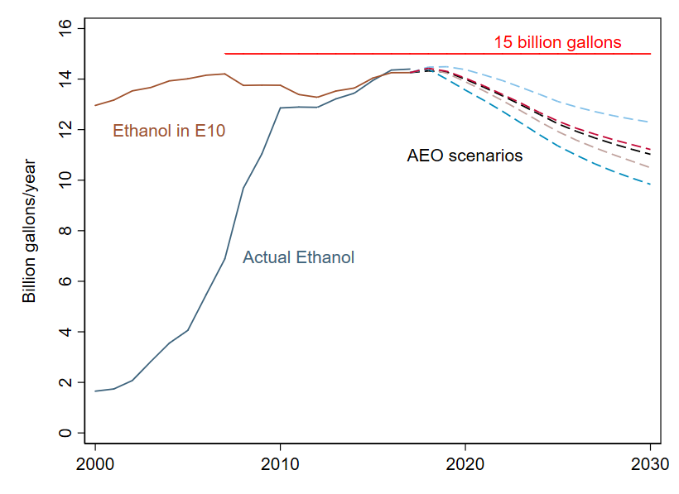
3. What happens if we breech the E10 blend wall?
The conventional statutory RVO hit its 15Bgal cap in 2015
In 2014-15, volumes were reduced using the general waiver authority
In 2016-18, volumes were reduced by ex-post secret granting of small refinery exemptions
Here is the conventional gap going forward…

Slide 17
3. What happens if we breech the E10 blend wall?
The conventional statutory RVO hit its 15Bgal cap in 2015
In 2014-15, volumes were reduced using the general waiver authority
In 2016-18, volumes were reduced by ex-post secret granting of small refinery exemptions
Here is the conventional gap going forward…
Upcoming administrative events:
Reset!
Set!

Slide 18
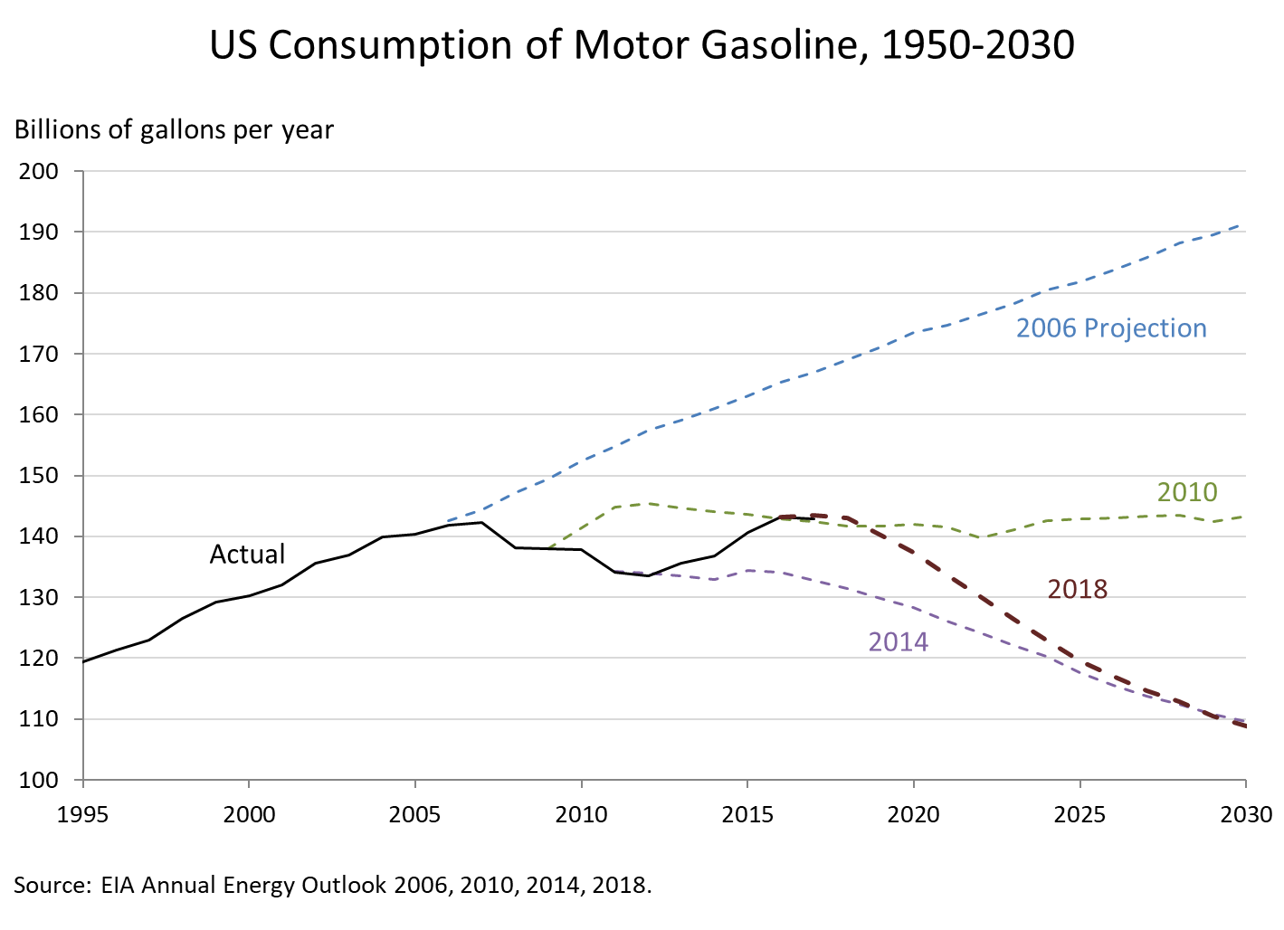
4. Without higher blends, ethanol is a declining industry
EIA-AEO projects gasoline demand to peak in 2018 and to decline by 15% in 2025

Slide 19
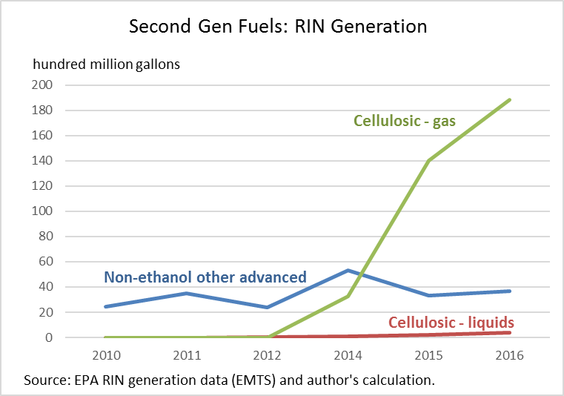
5. D3 Biogas
Biogas from landfills and wastewater treatment plants is a 1G technology
Cellulosic (D3) pathway was certified in 2014
In 2017, $760 million of D3 RINs were generated by biogas producers

Slide 20
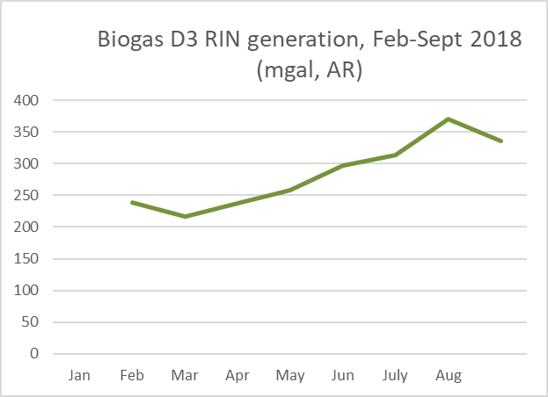
5. D3 Biogas
Biogas from landfills and wastewater treatment plants is a 1G technology
Cellulosic (D3) pathway was certified in 2014
In 2017, $760 million of D3 RINs were generated by biogas producers
In 2018, likely to top $1B

Slide 21
5. D3 Biogas
Biogas from landfills and wastewater treatment plants is a 1G technology
Cellulosic (D3) pathway was certified in 2014
In 2017, $760 million of D3 RINs were generated by biogas producers
In 2018, likely to top $1B
Currently 80-100 landfills are certified to generate D3 RINs - out of 3000 landfills nation-wide.
RFS subsidy for cellulosic D3 CNG is ~$800/ton CO2 avoided (not counting LCFS)

Slide 22
6. Liquid 2G
Second generation liquid fuels were a centerpiece of the RFS, but have failed to materialize.
Corn kernel cellulosic (“Gen 1.5”) is viable and has a fast payback

Slide 23
6. Liquid 2G
Disposition of the $14.1B total RIN market value in 2017
Amount | End Disposition
$9.1B | E10 circular flow
$3.8B | Biomass-based diesel producers
$760m | Biogas producers
$40m | Cellulosic liquids
99.7% of RFS RIN flow is to 1G
The RFS has not made progress on the long-term goals of high value use in aviation, long haul, marine and remote applications
Second generation liquid fuels were a centerpiece of the RFS, but have failed to materialize.
Corn kernel cellulosic (“Gen 1.5”) is viable and has a fast payback

Slide 24
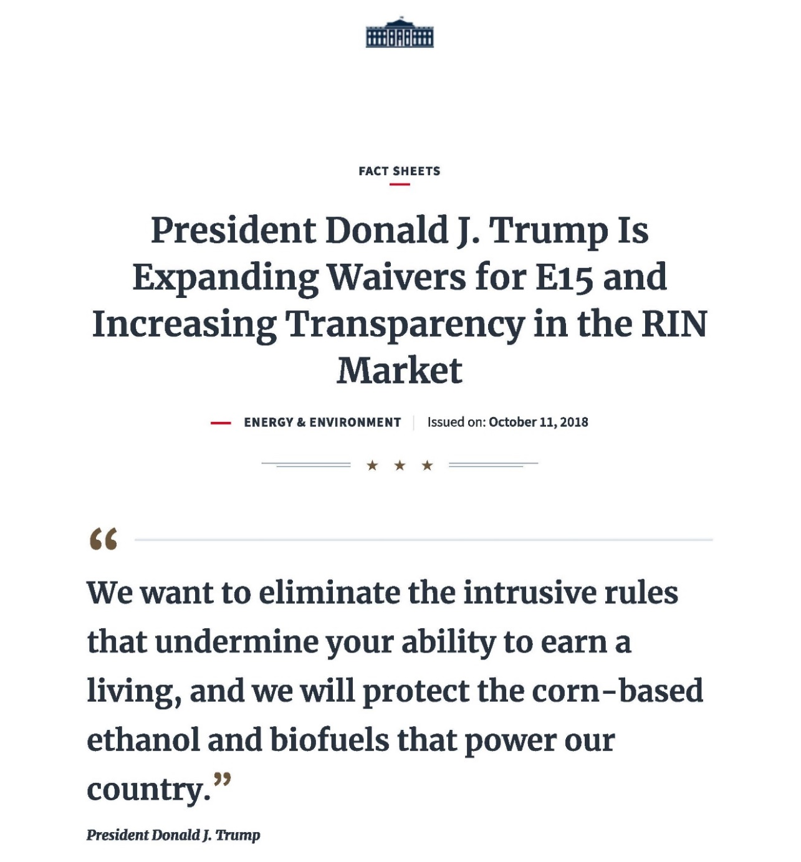

C. Administrative Reform: The “Trump Deal”

Slide 25
Administrative Reform: The “Trump Deal”
Extend E10 1-lb RVP waiver to E15
RIN market reforms

Slide 26
Administrative Reform: The “Trump Deal”
Extend E10 1-lb RVP waiver to E15
CAA §211(h)(4)
  For fuel blends containing gasoline and 10 percent denatured anhydrous ethanol, the Reid vapor pressure limitation under this subsection shall be one pound per square inch (psi) greater than the applicable Reid vapor pressure limitations established under paragraph (1).
EPA Misfueling Rule (2011)
76FR44408, July 2011
Trump EPA Legal argument: 15 is substantially equivalent to 10

Slide 27
Administrative Reform: The “Trump Deal”
Extend E10 1-lb RVP waiver to E15
Substance: will this unlock pent-up demand for E15?
  Unfamiliar fuel
  Motorist confusion & warranties
  Lack of infrastructure

Slide 28
Administrative Reform: The “Trump Deal”
Extend E10 1-lb RVP waiver to E15
Substance: will this unlock pent-up demand for E15?
  Unfamiliar fuel
  Motorist confusion & warranties
  Lack of infrastructure
What RIN price would compensate for the 1.7% energy loss?
  What RIN price would further support installing blender pumps?

Slide 29
Administrative Reform: The “Trump Deal”
Extend E10 1-lb RVP waiver to E15
Substance: will this unlock pent-up demand for E15?
  Unfamiliar fuel
  Motorist confusion & warranties
  Lack of infrastructure
What RIN price would compensate for the 1.7% energy loss?
  What RIN price would further support installing blender pumps?

Slide 30
Administrative Reform: The “Trump Deal”
Extend E10 1-lb RVP waiver to E15
RIN market reforms “to increase transparency and prevent price manipulation in the RIN market”
  Only obligated parties allowed to purchase RINs
  Public disclosure of large RIN holdings
  Limit on how long an obligated party can hold a RIN before retiring it

Slide 31
Administrative Reform: The “Trump Deal”
Extend E10 1-lb RVP waiver to E15
RIN market reforms “to increase transparency and prevent price manipulation in the RIN market”
  Only obligated parties allowed to purchase RINs
  Public disclosure of large RIN holdings
  Limit on how long an obligated party can hold a RIN before retiring it
D4 price
Fundamental value

Slide 32
E. Selected Legislative Reform Proposals
Categories of proposals
Proposals to reduce total compliance costs
  Effectively take E10 out of the RFS
Proposals to promote higher blends
  RVP extension for >E10 (not just E15)
  Funding for blender pumps
Sunset & backstops
  Sunset 1G
  Ethanol backstop options: E10? RON 95? RON 98?
  BBD backstop options: permanent blender tax credit?
2G reform
  Proposals to provide certainty to investors
  Focus on:
    GHG reductions, not feedstock
    Critical applications – aviation and other drop-ins
    Scalable pathways

Slide 33
RFS Reform: The D6/D8 + 2G Proposal
Goal | Policy mechanism
Eliminate regulatory uncertainty | Replace annual rulemaking by rules-based approach with guard rails
Reduce and stabilize compliance cost | Set the D6 RVO so it can be met by ethanol blended into E10 Ethanol blended in excess of 10% generates a D8 RIN, with D8 RIN price cap implemented by a D8 waiver credit Reduce regulatory uncertainty by replacing annual rulemaking with rules-based approach with guard rails
Promote higher ethanol blends | Extend the RVP waiver to blends >E10
Provide reliable support for second generation fuels | Stabilize RIN prices for second generation fuels Provide certainty that second gen plants will receive RIN price support for long enough to justify the capital expenditure and R&D
Provide revenues for biofuels infrastructure and conservation | From sales of D8 waiver credits
Sunset | Phase out D8 RVO and D8WC price after initial period Phase down D4 RIN price after initial period Second gen: Begin program with a cumulative RIN quantity cap Program sunsets after all RINs are used up
Second generation fuels have not taken off as hoped

Slide 34
Additional Slides

Slide 35
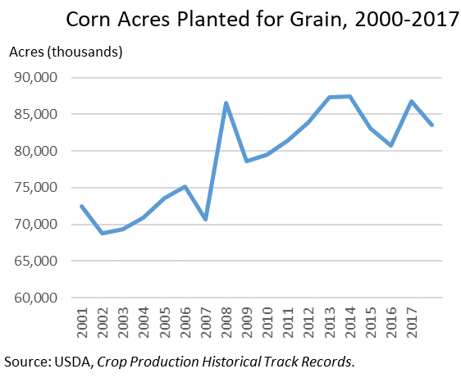
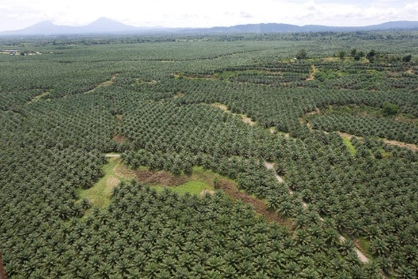
Concern #3: Land use implications of biofuels
Land use implications of biofuels
Ethanol consumption grew sharply from 2005-2011
~36% of the corn crop is used for corn ethanol (gross – less after subtracting out DDGs)
...but, because of increasing yields, corn acreage peaked in 2013
Although biodiesel ILU is a growing concern.

