Slide 1
RINs and RFS Reform Proposals
Jim Stock
Economics Department, Harvard University
RFA – National Ethanol Conference
San Antonio, Texas
February 13, 2018

Slide 2
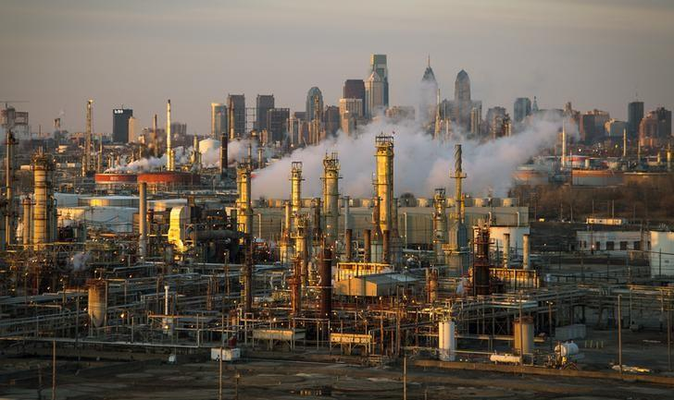
RFS in the news (again)
WASHINGTON (Reuters),
Feb. 1, 2018
  The head of the U.S. Environmental Protection Agency said on Thursday that the recent bankruptcy of a Pennsylvania oil refiner [Philadelphia Energy Solutions] was evidence the nation’s biofuel policy needs an overhaul…
EPA chief Scott Pruitt said in an interview with Fox News that the bankruptcy largely stemmed from the RFS, and cited the program’s requirement that refiners earn or purchase biofuel blending credits called RINs to prove to the EPA that they were meeting their obligations.
“We need RIN reform,” Pruitt said.

Slide 3
Legislative Reform of the RFS
Reform goals
Reduce compliance costs and compliance uncertainty (risk exposure) to obligated parties;
Create a path so that higher ethanol blends can compete in the marketplace, with no backsliding on E10; and
Provide meaningful and reliable support for second-generation fuels.

Slide 4
Legislative Reform of the RFS
Reform goals
Reduce compliance costs and compliance uncertainty (risk exposure) to obligated parties;
Create a path so that higher ethanol blends can compete in the marketplace, with no backsliding on E10; and
Provide meaningful and reliable support for second-generation fuels.
Prototype reform package
The “D6-D8” mechanism
RVP waiver for E10+ and “no backsliding” on E10
2nd Gen reforms
  Stabilize 2nd gen RIN prices, don’t make 2nd gen compete with 1st gen, focus 2nd gen part of program on technology development, redefine in terms of GHG reductions not feed stocks, simplify pathway approvals,…

Slide 5
Legislative Reform of the RFS
This presentation
The D6/D8 mechanism
  What is it?
  How would it work in practice?
The RVP E10+ waiver
What would be the economic effect of D6/D8 & E10+ RVP waiver?
Warning label: The package is a moving target! And the details matter!

Slide 6
The D6/D8 Concept: Motivation
What if the RIN obligation only had to be paid on the part of conventional that is not E10?
Illustrative calculation:
Currently, ethanol in E10 ≈ 14.2 Bgal
Conventional RVO ex ethanol in E10 = 15 – 14.2 = 0.8 Bgal
Say D6 RIN price is $0.75
Value of total D6 RIN obligation:
  Now: $0.75×15 Bgal = $11.25 B
  Ex ethanol in E10: $0.75×0.8 Bgal = $600m – a 95% reduction!

Slide 7
The Current RFS Nesting Structure
Conventional (D6)
Advanced (D5)
Cellulosic (D3)
Biomass-based
diesel (D4)

Slide 8
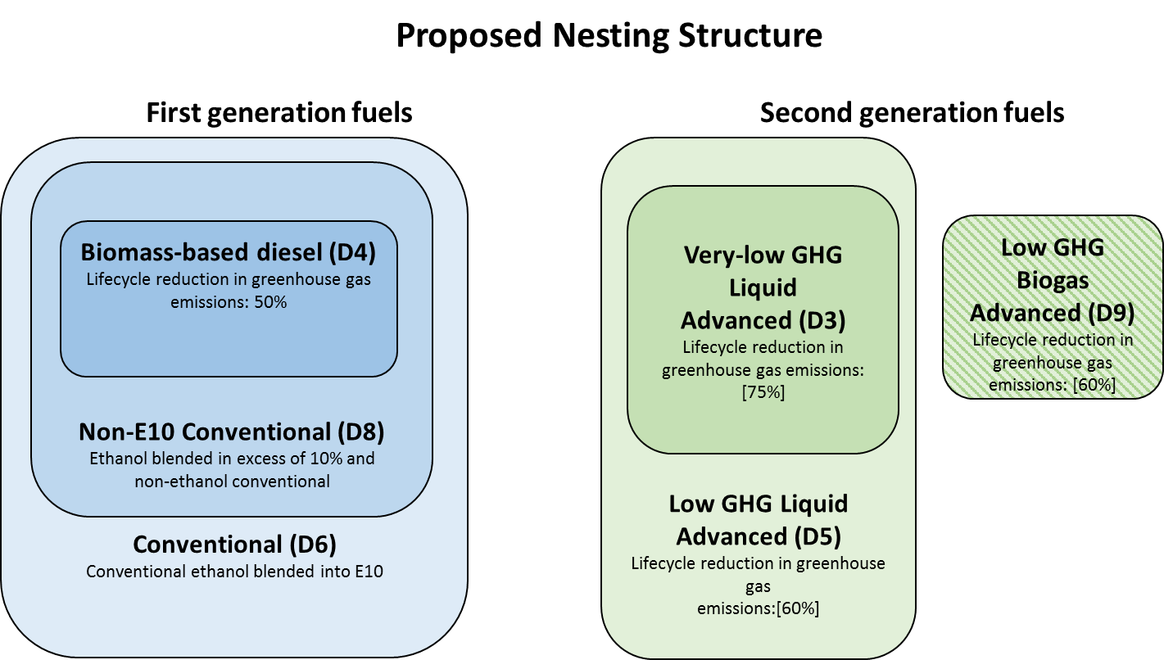
A Prototype D6/D8 nesting structure

Slide 9
A Prototype D6/D8 nesting structure
Examples:
1 gal E10 → 0.10 D6 and 0 D8
1 gal E15 → 0.10 D6 and 0.05 D8
1 gal conventional renewable diesel → 1.7 D8 RINs

Slide 10
A Prototype D6/D8 nesting structure
Examples:
1 gal E10 → 0.10 D6 and 0 D8
1 gal E15 → 0.10 D6 and 0.05 D8
1 gal conventional renewable diesel → 1.7 D8 RINs
Mechanics:
Generation by producer (as now)
Detaching upon blending (as now)

Slide 11
A Prototype D6/D8 nesting structure
Examples:
1 gal E10 → 0.10 D6 and 0 D8
1 gal E15 → 0.10 D6 and 0.05 D8
1 gal conventional renewable diesel → 1.7 D8 RINs
Mechanics:
Generation by producer (as now)
Detaching upon blending (as now)
RIN prices
D6 RVO is set so that D6 is always in oversupply, so D6 RIN price is ~0
D8 and D4 pricing would be like current D6 and D4 pricing

Slide 12
The E10+ RVP Waiver
E10 is granted a 1 pound waiver so that it can be sold year-round. This is the existing E10 RVP waiver.
The proposed RVP waiver would extend this to all blends E10+, so E15 could be sold year-round.
Economic effect of E10+ RVP waiver:
Increased demand for E15
Reduced pressure on conventional RIN price

Slide 13
Economic Implications of D6/D8 & E10+ RVP Waiver
RIN prices:
D6 ≈ 0
D8 - less than current D6 (because of RVP waiver)
D4 ≈ same or less than current D4 (at or above D8 price)
RIN price volatility – potentially reduced substantially
Fuel prices (all changes are in the pennies):
BOB price down
E10 pump price up
Diesel pump price down
E15-E10 & E85-E10 spreads about same as now
E0-E10 spread down
E100 & distillers’ margins – no effect
Ethanol sales
Up, but by how much depends on success of E15 marketing

Slide 14
RFS Reform
The details matter!
No-backsliding provisions
Must include second generation reform

Slide 15
Additional Slides (Q&A)

Slide 16
Possible Separate Nesting Structures and New RIN Categories

Slide 17
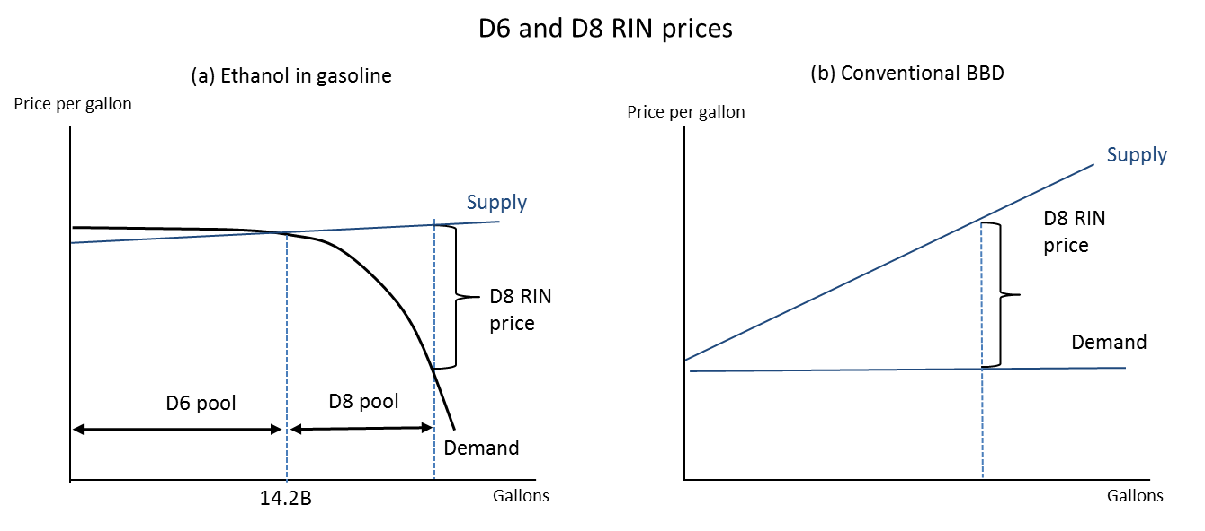
The D6/D8 Mechanism & Economics – Additional Detail
Upon production, ethanol generates a D6-8 “parent” RIN
Ethanol blended to 10% of gasoline detaches a D6 RIN
All other conventional fuels detach a D8 RIN upon blending
  Blending 1 gal E15 separates 0.10 D6 and 0.05 D8 RINs
  Ownership of the D6 and D8 RINs remain (as now) with the owner of the upstream ethanol
As now:
  D6, D8 RINs are bankable and tradeable
  Conventional BBD generates a D8 RIN

Slide 18
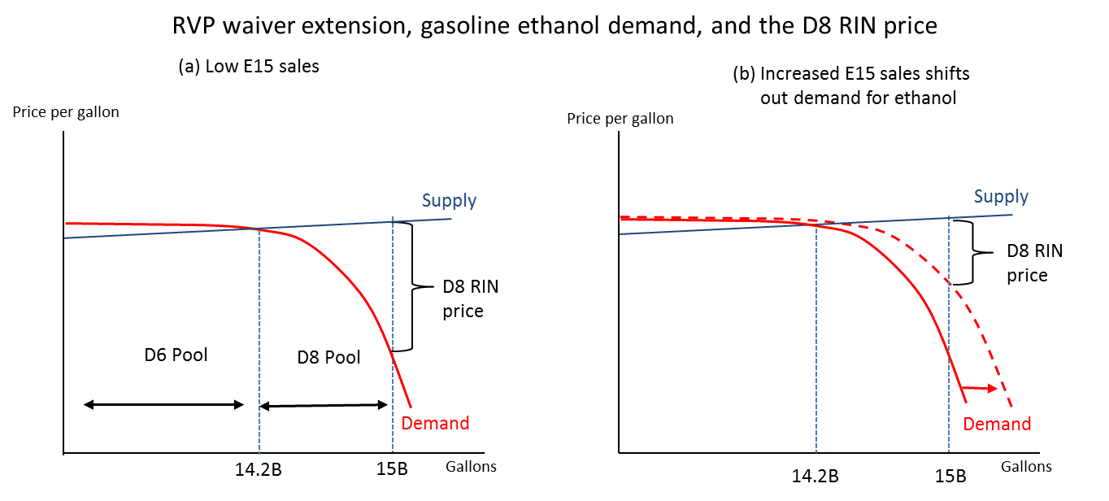
Economics of the E10+ RVP Waiver
Effect of RVP waiver for E10+: More E15, less CBBD

