Slide 1
  OECD and Banque de France
47 quarters
High-Frequency Behavior of the US Economy During the Pandemic
Danila Maroz, Harvard University
James H. Stock, Harvard University
Mark W. Watson, Princeton University
June 8, 2021
New UI claims
41 weeks
  New approaches to macroeconomic monitoring, nowcasting and forecasting

Slide 2
  Motivating questions and analytical framework
Have U.S. macrodynamics changed during the COVID crisis?
How has the relation between the fundamental shock (the pandemic) and economic activity evolved?
What are the implications for macrodynamics during the recovery?
(Methods) how can we do macroeconometrics post-pandemic?
47 quarters
New UI claims
41 weeks
Three ways to look at the data (all US):
  Weekly dynamic factor model (10 series) + deaths data
  Monthly dynamic factor model (135 series)
  Daily epidemiological model (time-varying SIR in Droste & Stock [AER P&P, 2021])
Main findings
Strong evidence of a “fast dynamics” pandemic factor overlaying “normal” macro factor(s)
  found in both the weekly and monthly data
Response of weekly pandemic factor (and weekly observable variables) to fundamental pandemic driver (deaths) diminishes over time
These time series results closely align with daily SIR findings

Slide 3
  (A) Weekly DFM
Methods
Transform to 52-week (log) changes (seasonal adjustment/stationarity transformation)
Standardize over Jan. 5, 2008 – February 29, 2020 (“pre-pandemic period”)
Estimate a “normal” pre-pandemic factor and a “pandemic” factor
“Normal” pre-pandemic factor:
  First principal component estimated on pre-pandemic sample (this is the WEI)
Pandemic factor:
  Using pre-pandemic factor loadings, compute the values of the normal factor during the pandemic
  Compute residual of each series from its “pre-pandemic” common component
  Estimate the pandemic factor as the first principal component of residualized series during the pandemic period
    Data set used for this analysis ends March 14, 2021

Slide 4
  (A) Weekly DFM: Data
10 weekly time series used to construct the NY Fed/Dallas Fed Weekly Economic Index
Timely availability
Full data span Jan. 5, 2008 – present
Stable definition and survey instrument
Note: Requiring series to have a long sample and stable definition/scope eliminates many interesting high frequency series such as credit card spending, mobility, etc.
 | Series | Native Units | Time available EST (days from reference week) | Notes
Consumption | Redbook Research: Same Store, Retail Sales | NSA, Y/Y % Chg. | 1st Tuesday, 9:00am (3 days) | Sales-weighted, year-over-year same-store sales growth, 9,000 stores (80% of the retail sales) (Redbook Research)
 | Rasmussen Consumer Index | Index, 3-day MA | Friday of reference week, 6:00pm (0 days) | Daily survey of 1500 American adults Sun-Thurs. (Rasmussen)
Labor mkts | Unemployment Insurance: Initial Claims | NSA, Thous. | 1st Thursday, 8:30am (5 days) | US DOL
 | Unemployment Insurance: Continued Claims | NSA, Thous. | 2nd Thursday, 8:30am (12 days) | US DOL
 | American Staffing Association Staffing Index | NSA, Jun-12-06=100 | 2nd Tuesday, 8:30am (10 days) | Stratified panel of small, medium, and large staffing companies (American Staffing Association)
 | Federal Withholding Tax Collections | Y/Y % Chg. | 1st Tuesday, 4:00pm (5 days) | Treasury receipts of income and payroll taxes withheld from paychecks, adjusted (Taxtracking.com)
Ind. Prodn. | Raw Steel Production | NSA, Thous. Net Tons | 1st Monday, 4:00pm (2 days) | 50% weekly production provided, 50% monthly production (American Iron & Steel Institute)
 | U.S Railroad Traffic | NSA, car-loads | 1st Wednesday, 9:00am (4 days) | Total carloads and intermodal units (Association of American Railroads)
Energy | US Fuel Sales to End Users | NSA, EOP, Thous. barrels/ day | 1st Wednesday 10:30am (4 days) | Weekly product supplied of finished gasoline and distillate fuels (US EIA)
 | Electric Utility Output | NSA, Gigawatt Hours | 1st Wednesday, 1:00pm (4 days) | U.S. (ex Alaska and Hawaii) investor-owned electric companies (Edison Electric Institute)

Slide 5
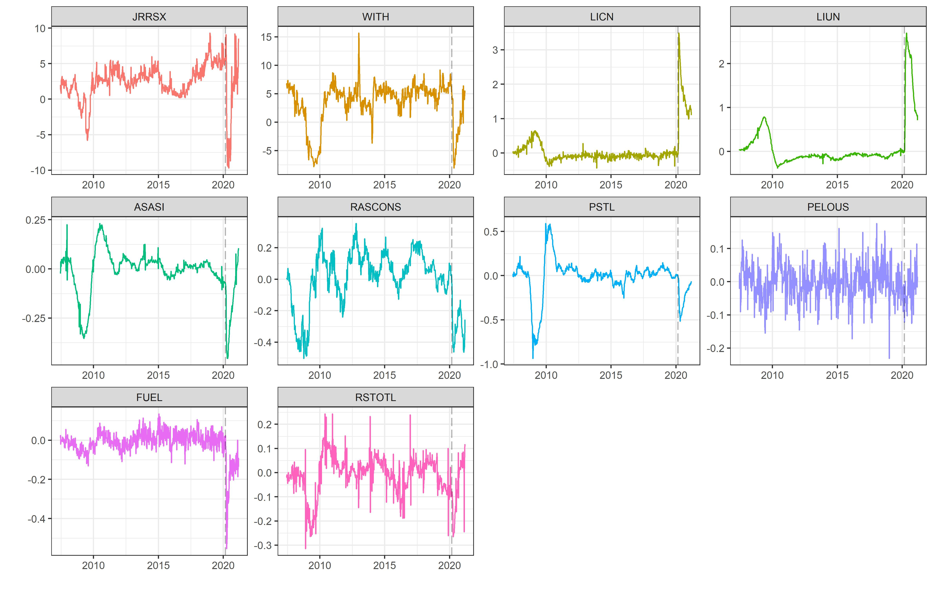
  (A) Weekly DFM: Data (52-week SA)
Same store sales
Withholdings
UI: new claims
UI: continuing claims
Staffing index
Consumer confidence
Steel production
Electricity generation
Fuel consumption
Railroad traffic

Slide 6
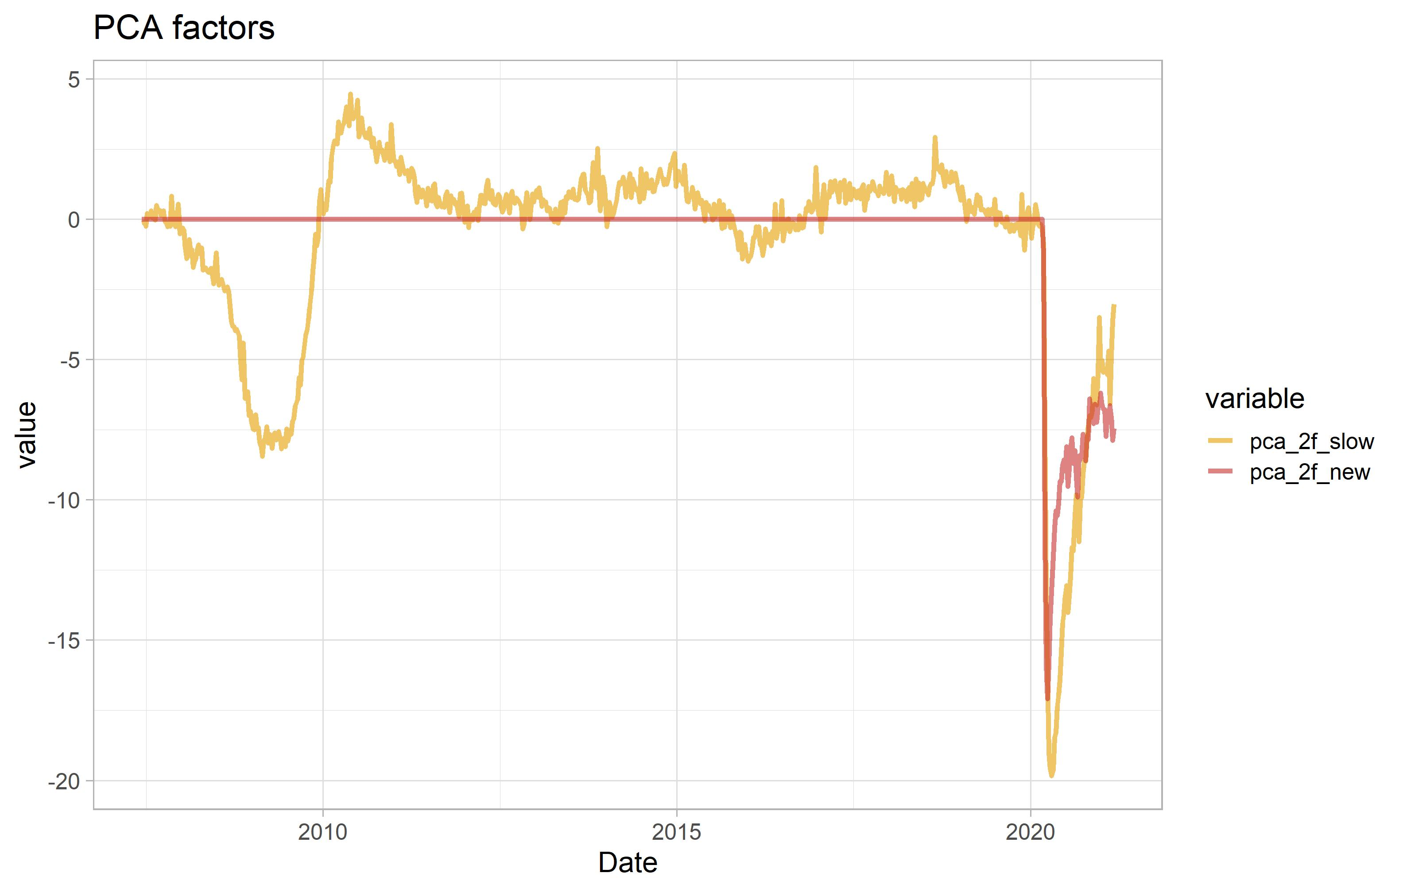
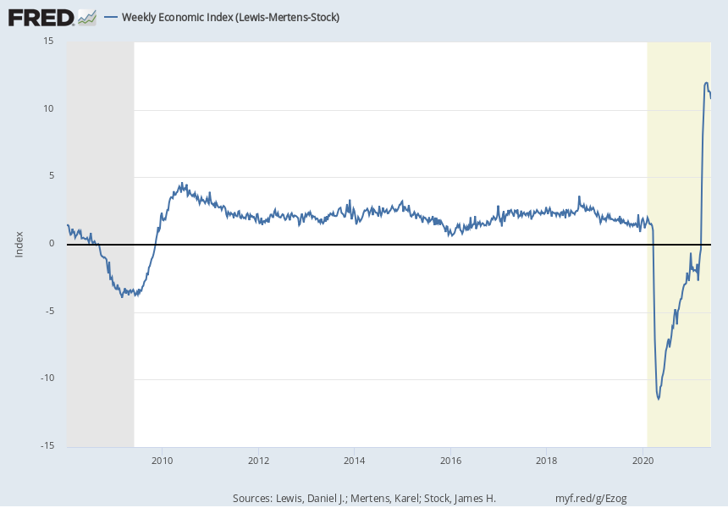
  (A) Weekly DFM: factors
WEI

Slide 7
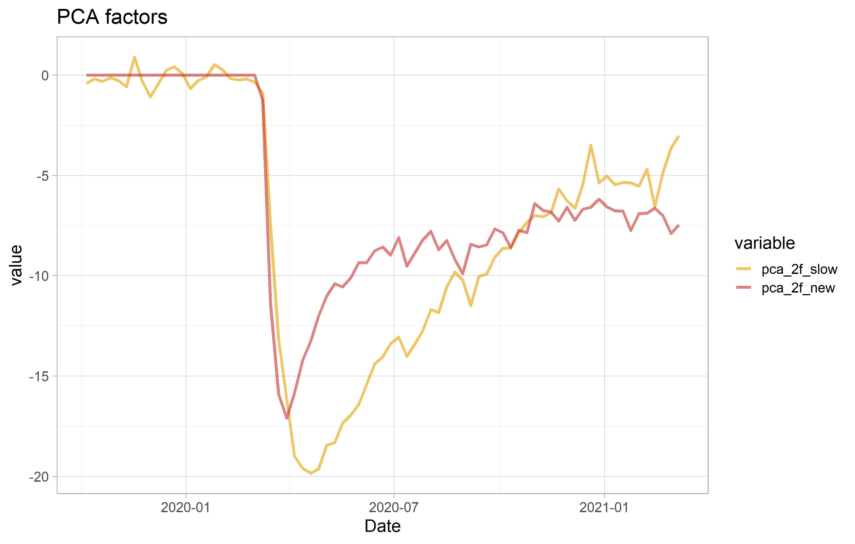
  (A) Weekly DFM: factors

Slide 8
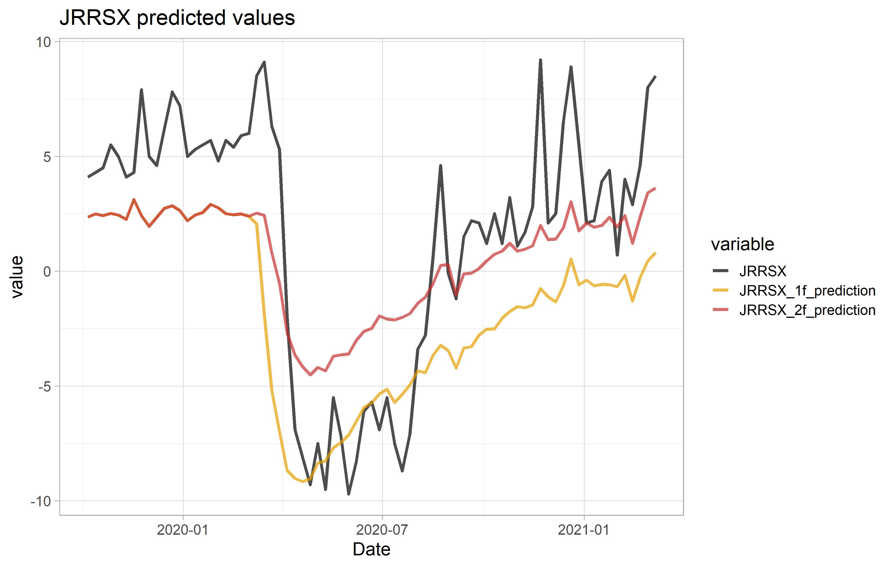
  (A) Weekly DFM: Common components (predicted values) over the pandemic
Same store sales

Slide 9
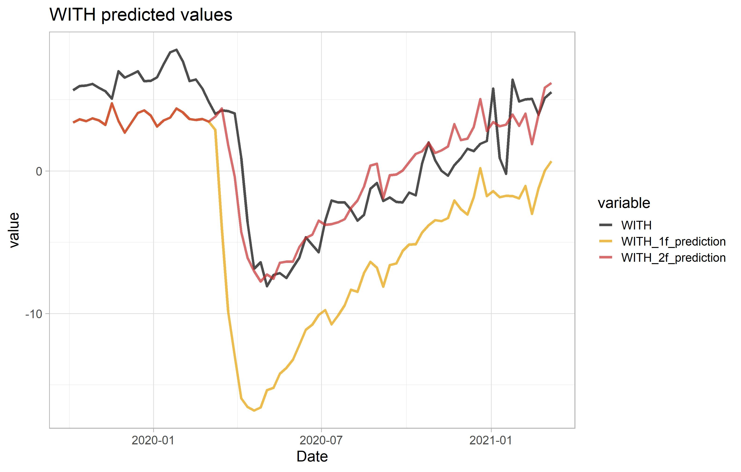
  (A) Weekly DFM: Common components (predicted values) over the pandemic
Withholdings

Slide 10
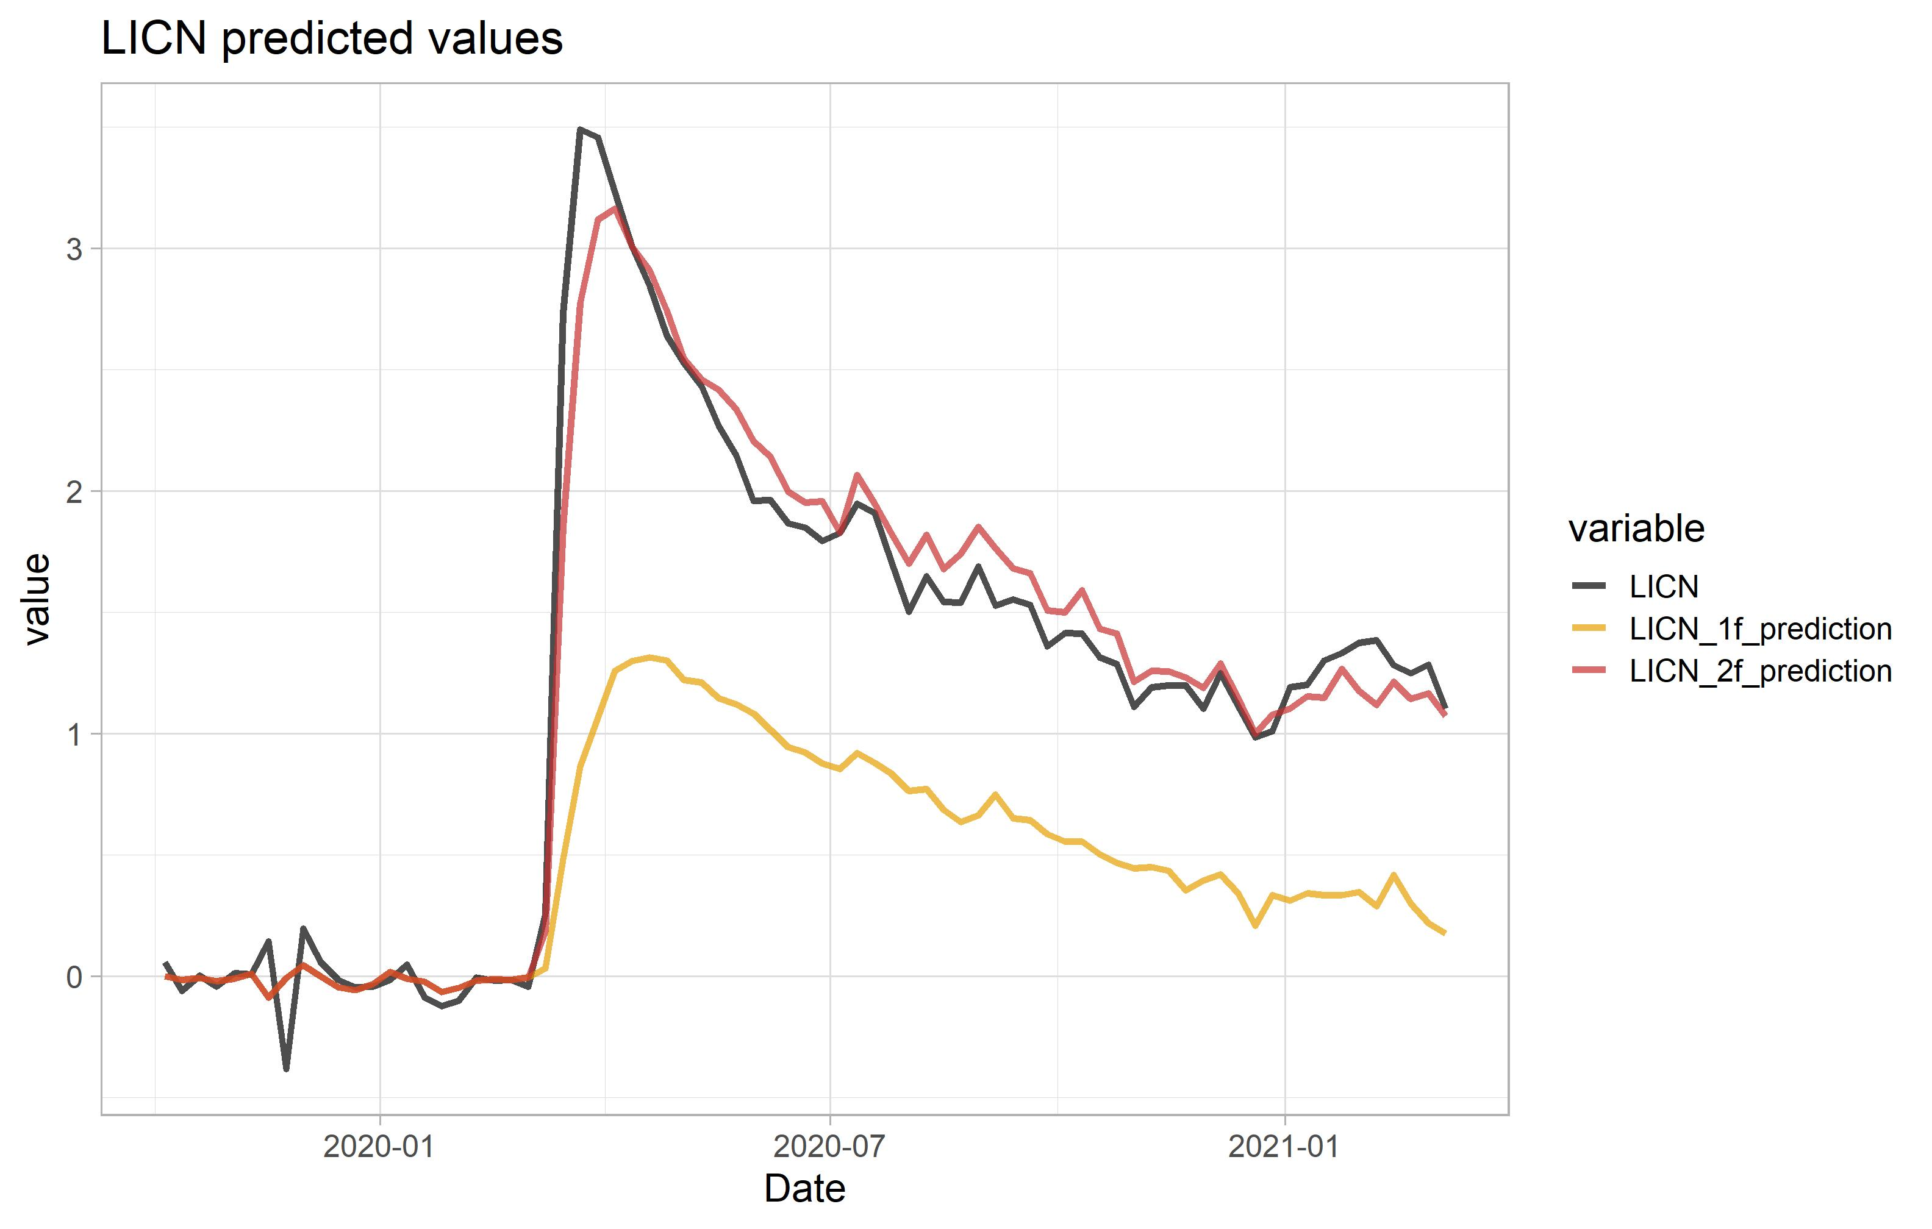
  (A) Weekly DFM: Common components (predicted values) over the pandemic
UI: new claims (log)

Slide 11
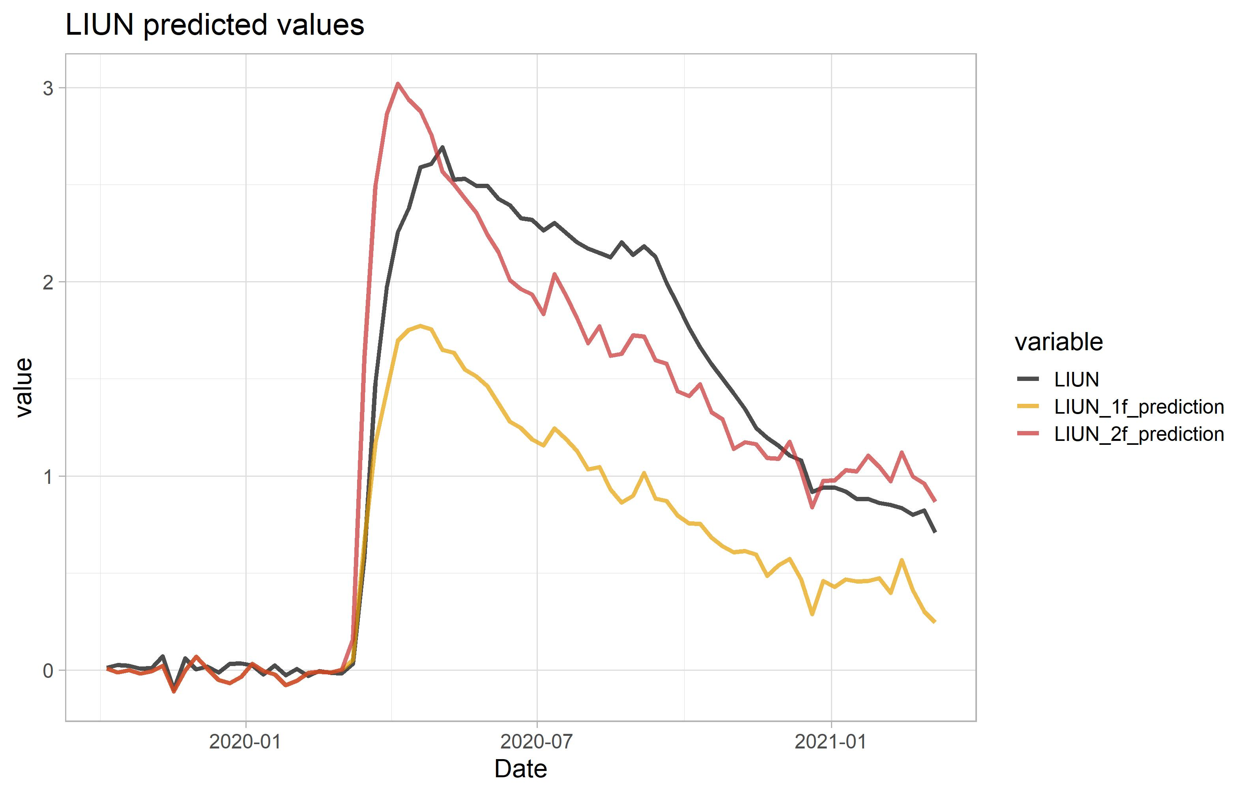
  (A) Weekly DFM: Common components (predicted values) over the pandemic
UI: continuing claims (log)

Slide 12
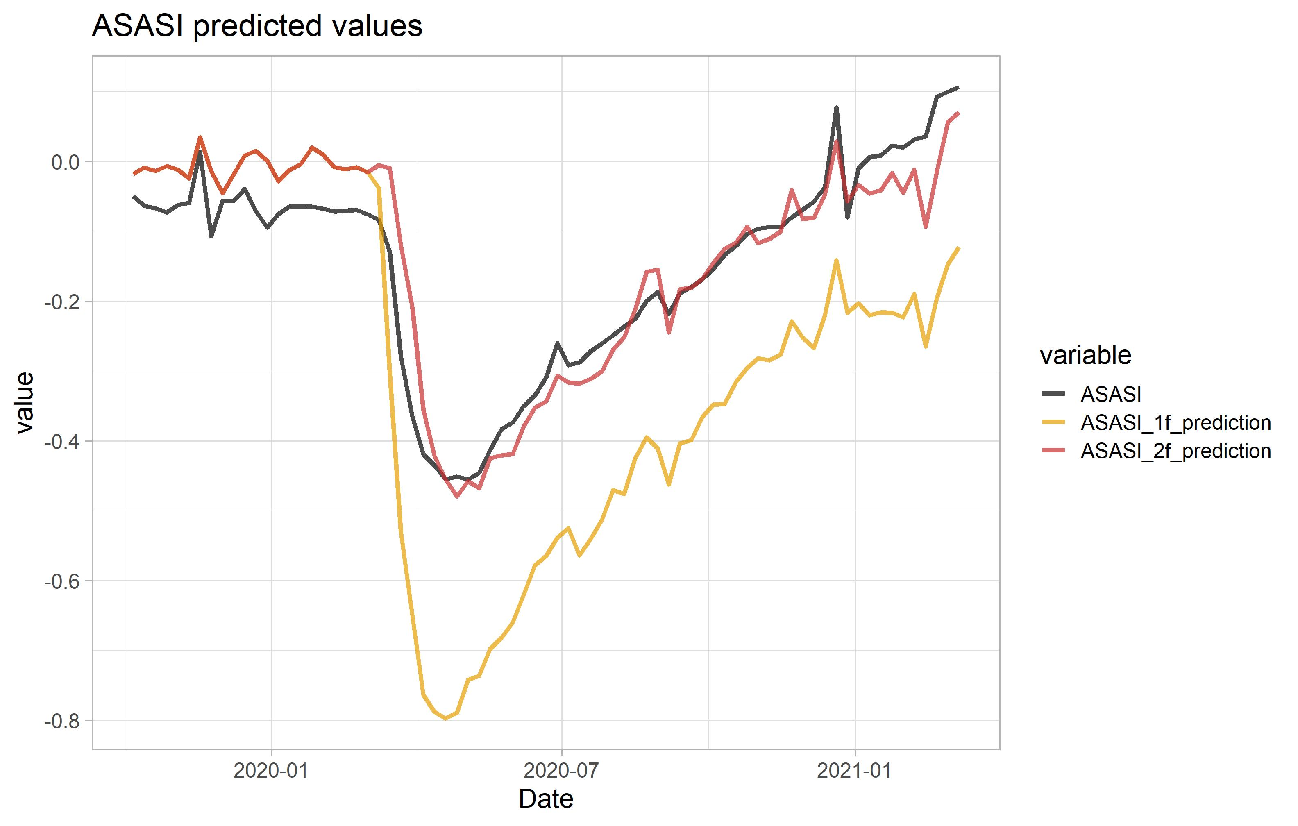
  (A) Weekly DFM: Common components (predicted values) over the pandemic
Staffing index

Slide 13
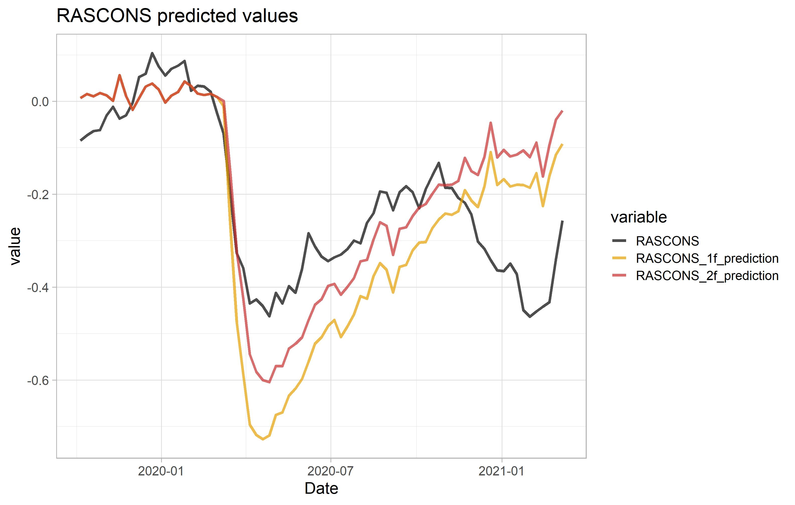
  (A) Weekly DFM: Common components (predicted values) over the pandemic
Consumer confidence

Slide 14
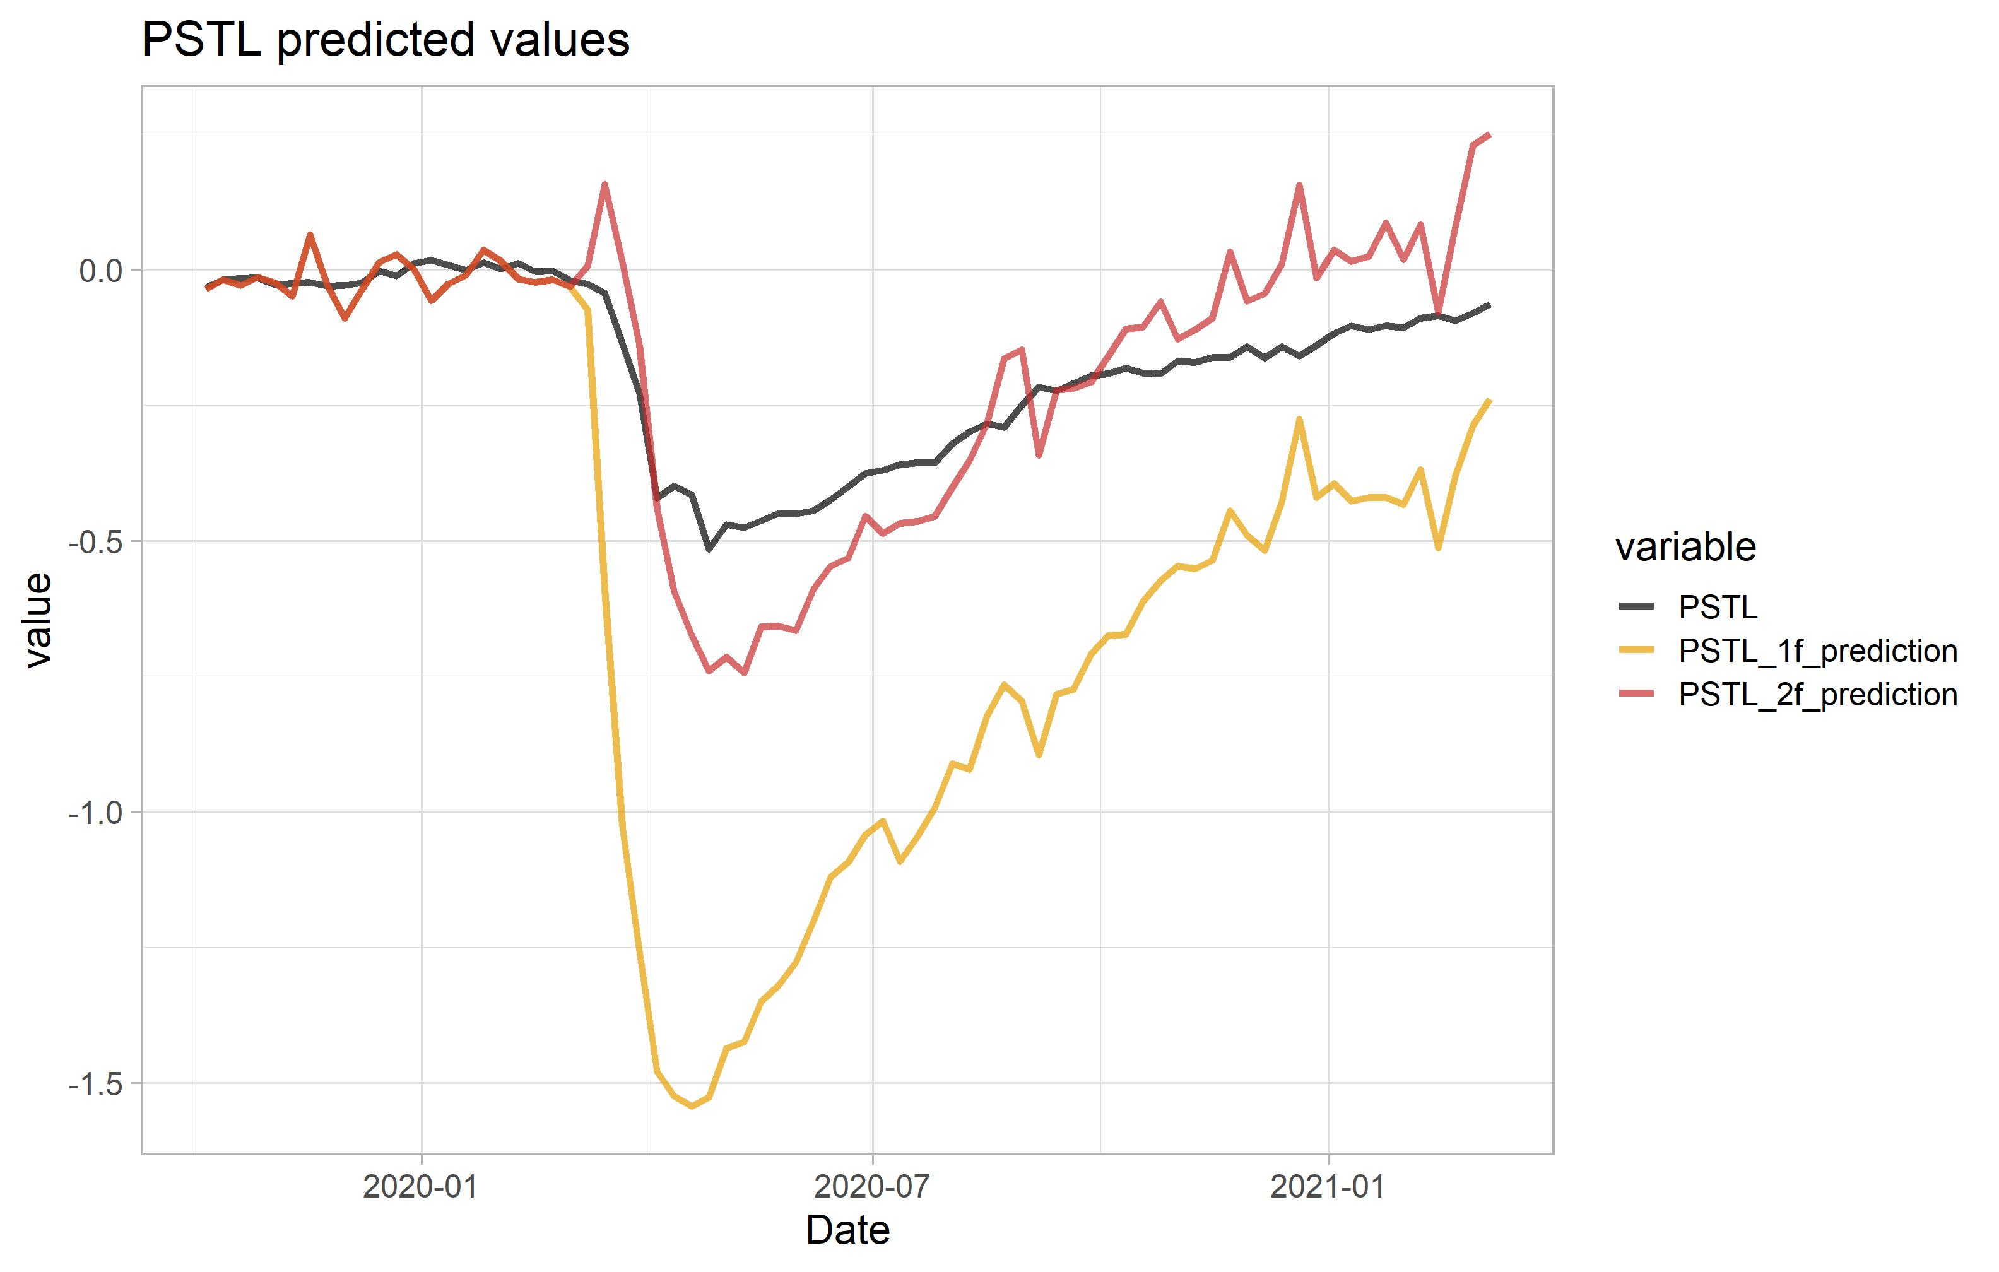
  (A) Weekly DFM: Common components (predicted values) over the pandemic
Steel production

Slide 15
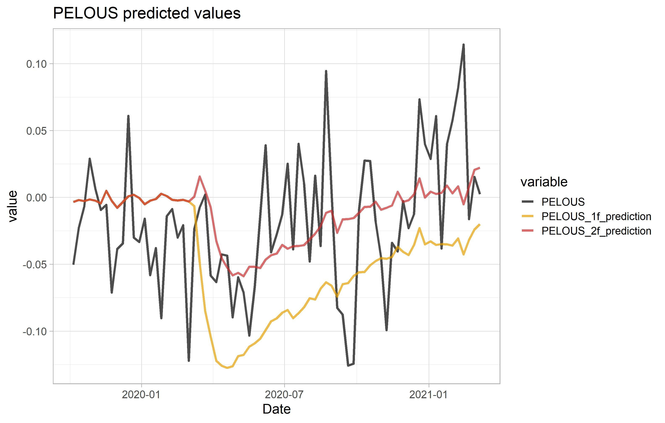
  (A) Weekly DFM: Common components (predicted values) over the pandemic
Electricity generation

Slide 16
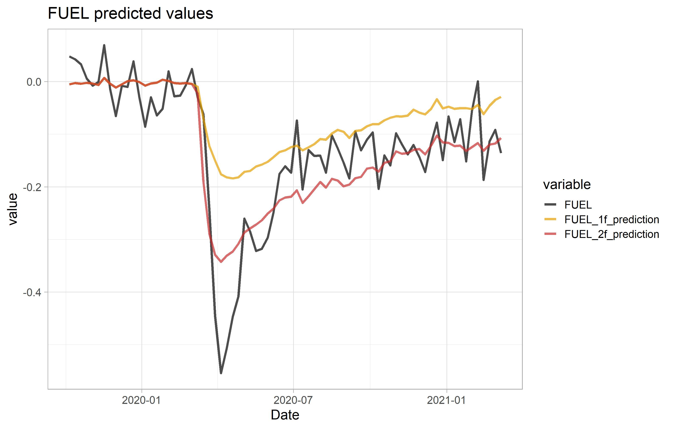
  (A) Weekly DFM: Common components (predicted values) over the pandemic
Fuel consumption

Slide 17
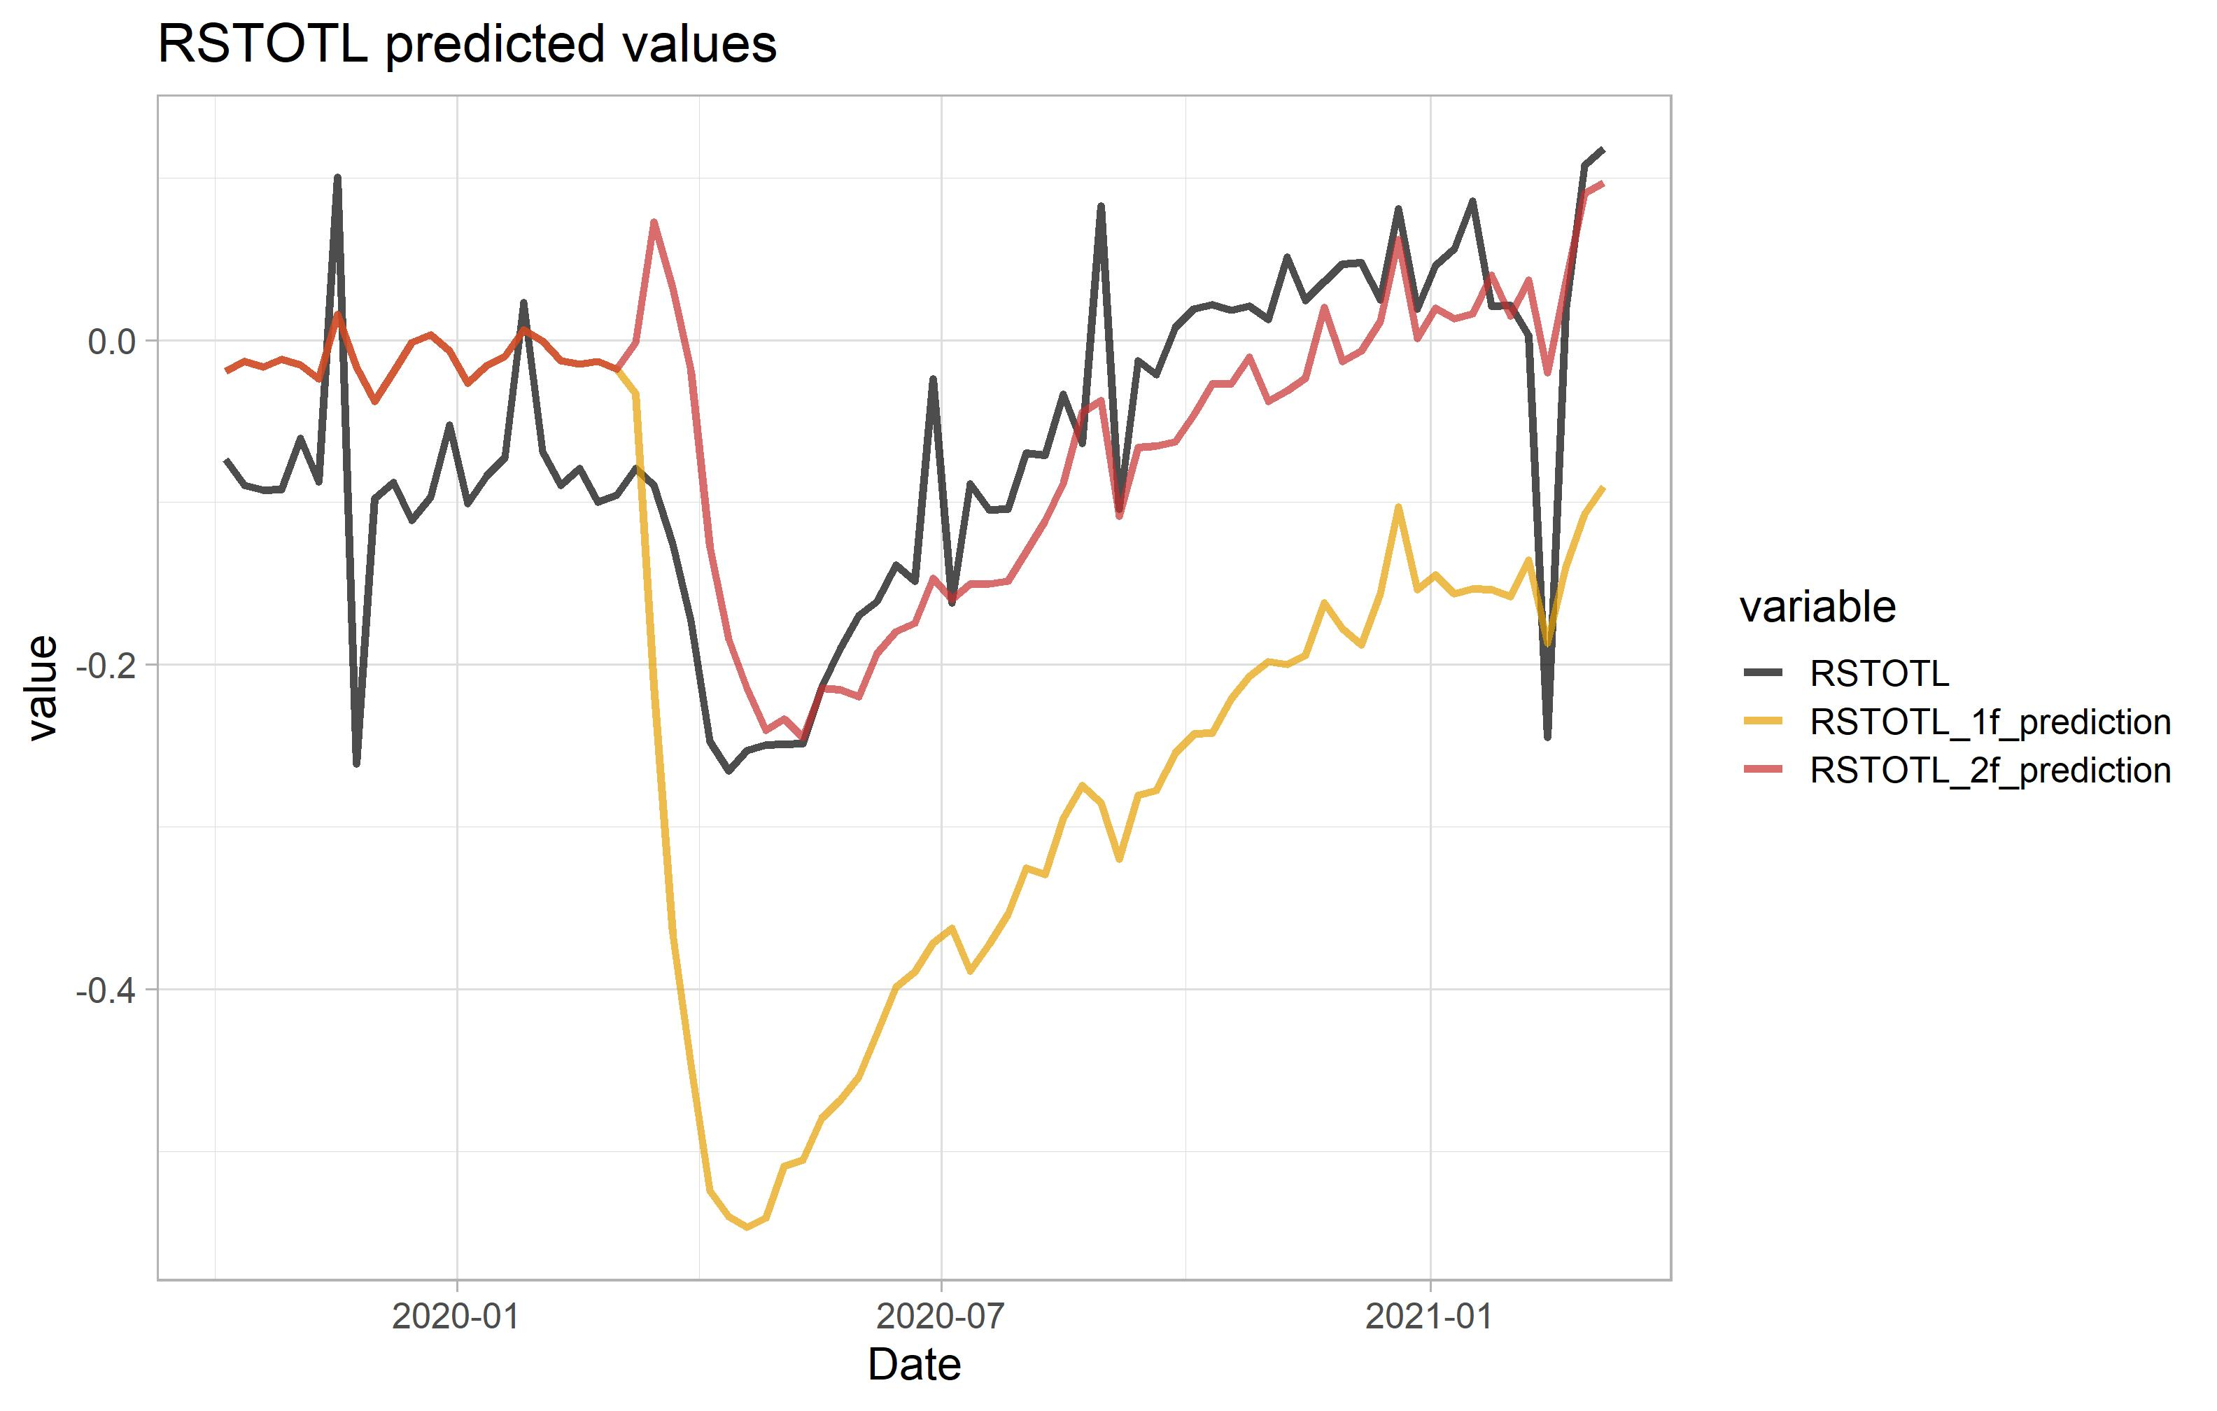
  (A) Weekly DFM: Common components (predicted values) over the pandemic
Railroad traffic

Slide 18
  (A) Weekly DFM: factor dynamics
Data description: AR(2) models of factors
 | Sum of AR coefficients |  | F-test of equal coefficients
 | Jan/05/2008 – Feb/29/2019 | Mar/01/2020 – Mar/14/2021
Factor 1 | 0.986 (0.006) 50 week half-life | 0.978 (0.013) 32 week half-life | p = 0.607
Pandemic Factor |  | 0.960 (0.019) 18 week half-life
The normal weekly factor is very persistent, no apparent change of dynamics in the pandemic
The pandemic factor has faster decay
Note: factors are based on 52-week differences

Slide 19
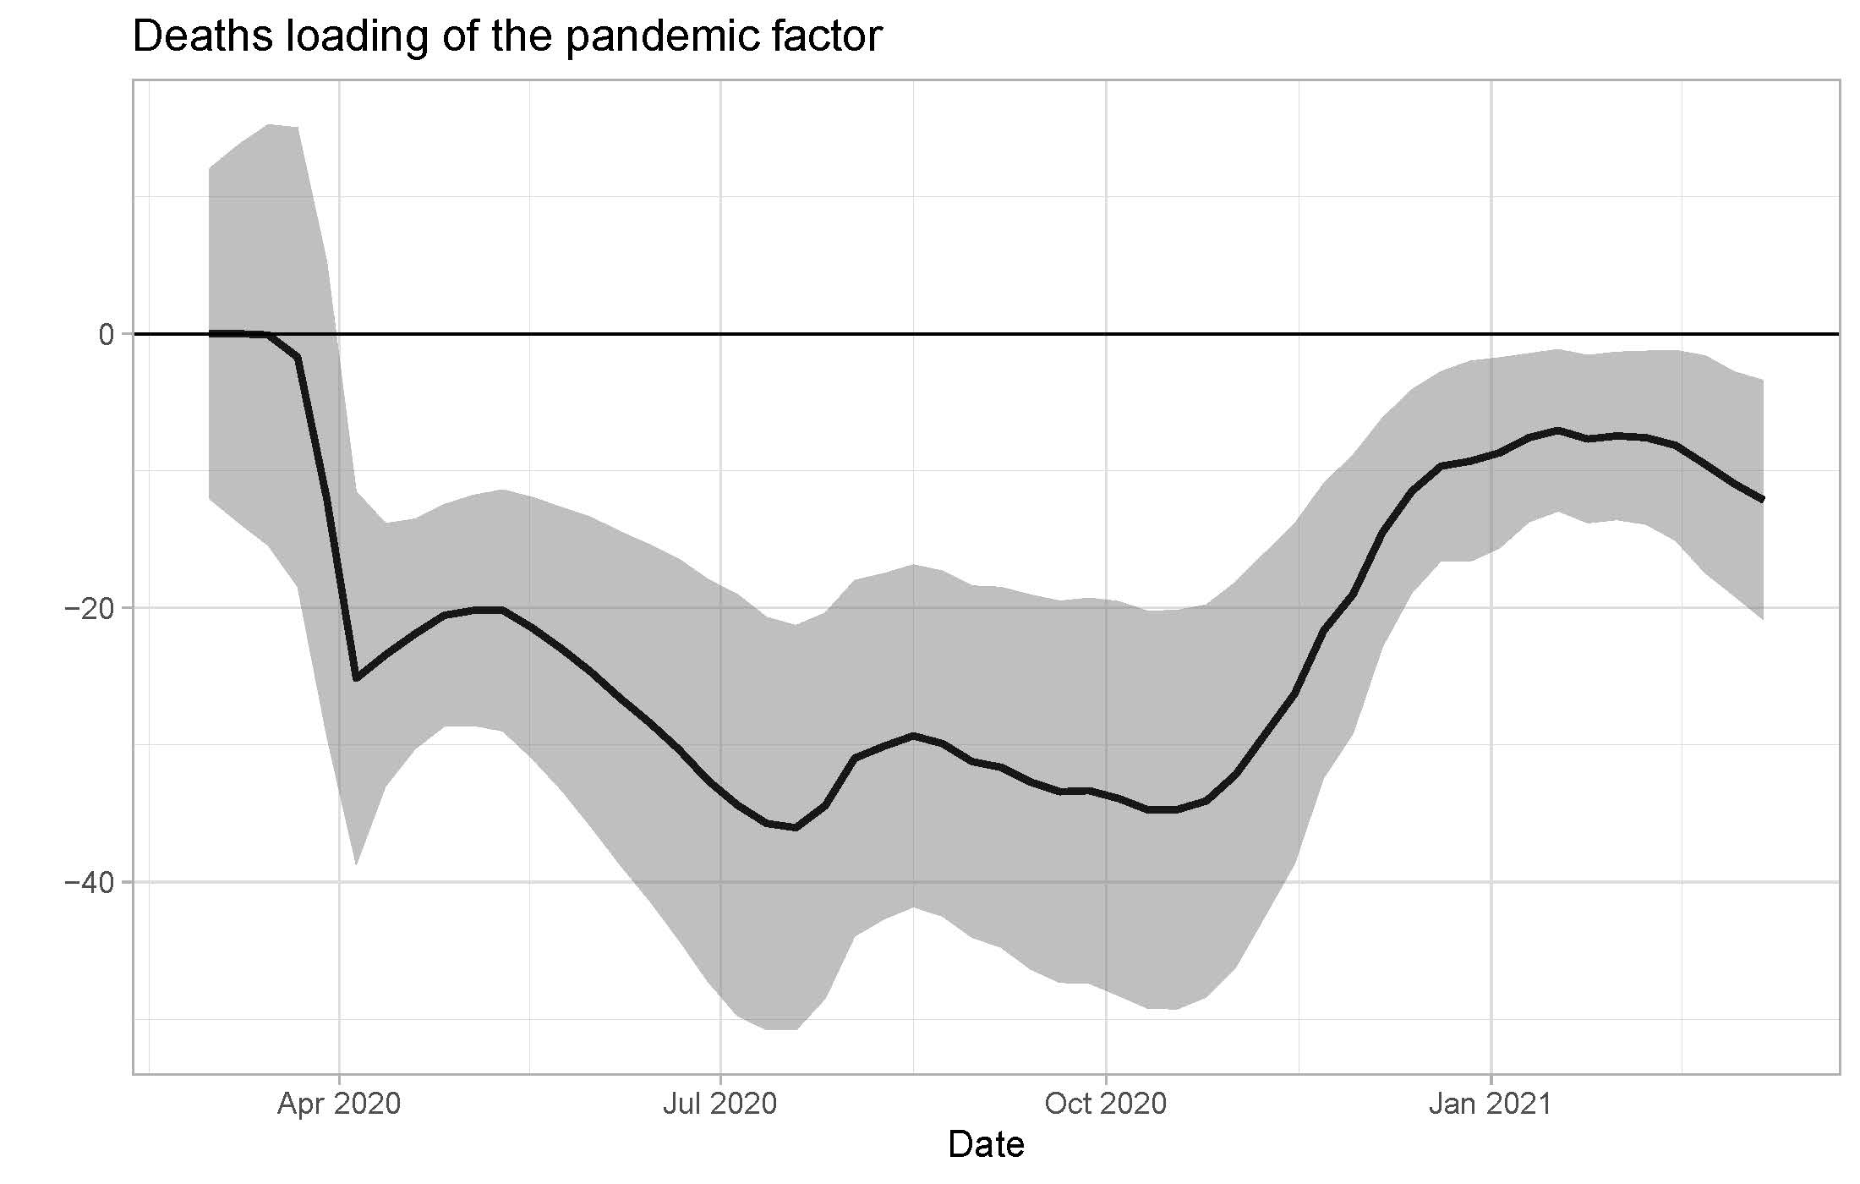
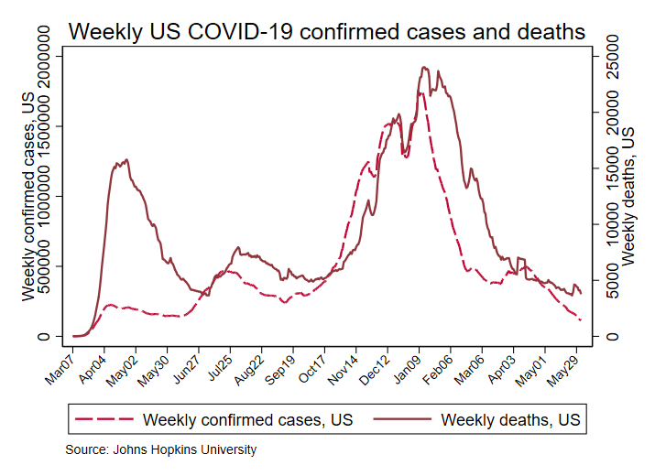
  (A) Weekly DFM: Time-varying parameters on 7-day MA of deaths
Notes:
y_{t} = β_{t}Deaths_{t} + u_{t}
β_{t} = β_{t-1} + η_{t}
7-day MA of US COVID-19 deaths
Kalman Filter MLE +/-1.96 SE band.

Slide 20
  (B) Monthly DFM
The same patterns are present in a larger monthly data set
135 monthly macro time series, 1984m1 – 2021m4
PCE (23)
Retail sales (19)
Personal income (14)
Establishment survey (30)
Household survey (13)
Industrial production (36)
All seasonally adjusted
Real variables in growth rates
Standardize over 1984m1-2019m12
Factor estimation:
Three “normal” factors, estimated by principal components 1984m1-2019m12
A single “pandemic” factor
  Compute factors 1-3 values for 2020 using pre-2020 factor loadings
  Compute residual of each series from its “old factor” common component
  Compute principal component of residualized series

Slide 21
  (B) Monthly DFM: pandemic factor
Monthly Weekly

Slide 22
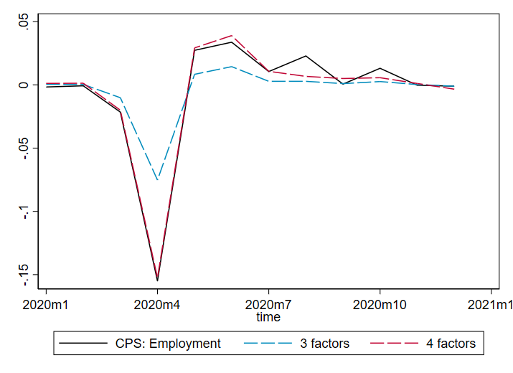
  (B) Monthly DFM: Common component, selected series

Slide 23
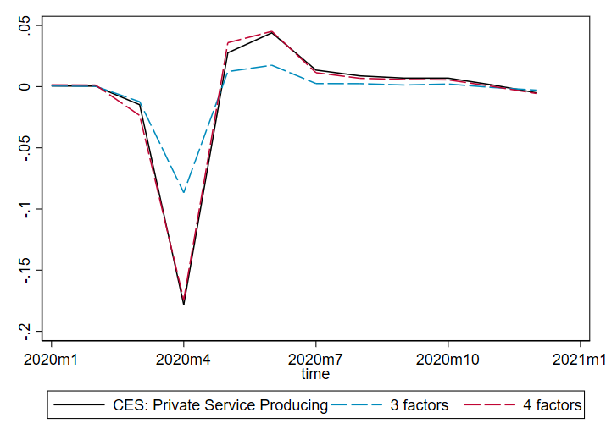
  (B) Monthly DFM: Common component, selected series

Slide 24
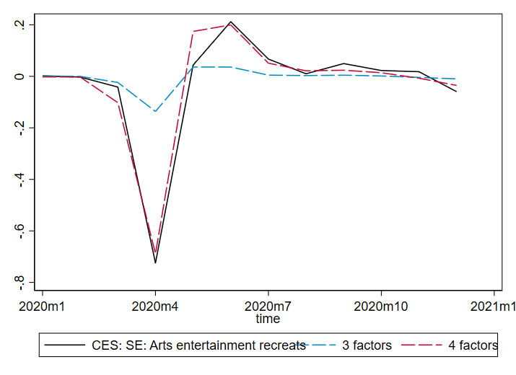
  (B) Monthly DFM: Common component, selected series

Slide 25
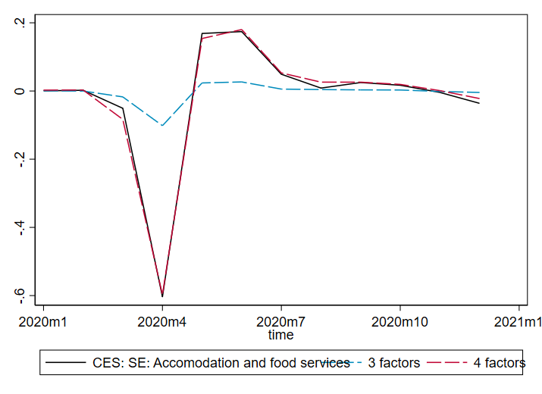
  (B) Monthly DFM: Common component, selected series

Slide 26
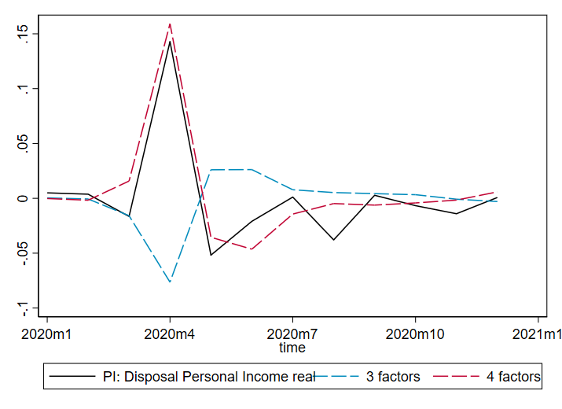
  (B) Monthly DFM: Common component, selected series

Slide 27
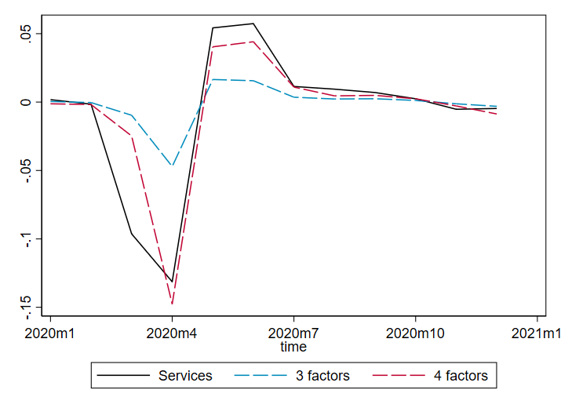
  (B) Monthly DFM: Common component, selected series

Slide 28
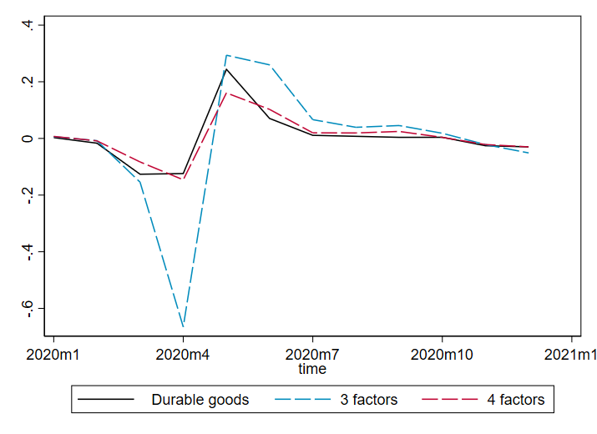
  (B) Monthly DFM: Common component, selected series

Slide 29
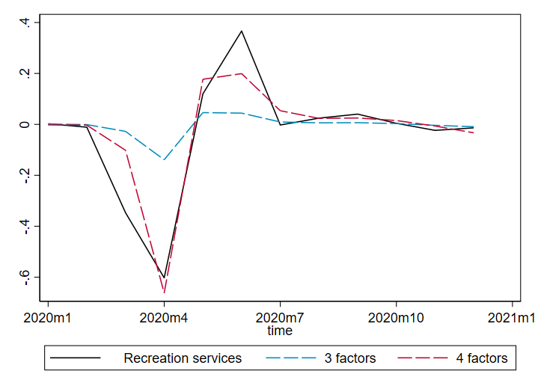
  (B) Monthly DFM: Common component, selected series

Slide 30
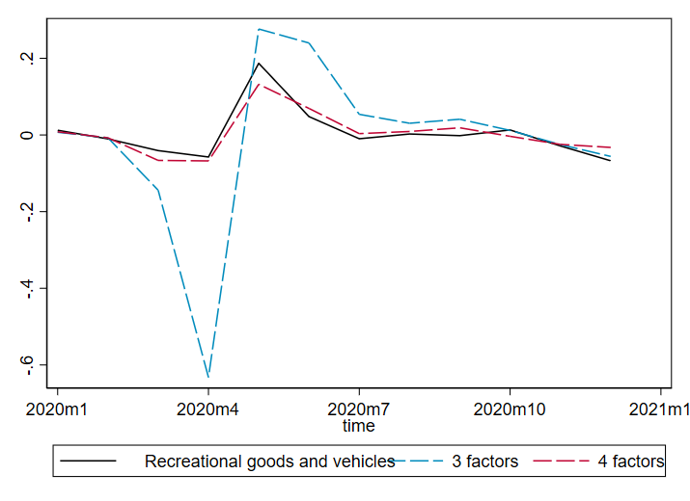
  (B) Monthly DFM: Common component, selected series

Slide 31
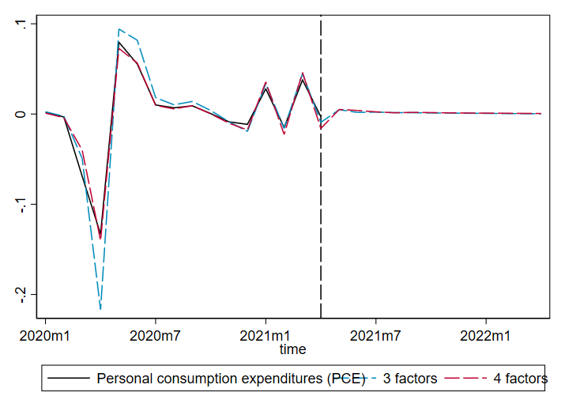
  (B) Monthly DFM: Forecasts

Slide 32
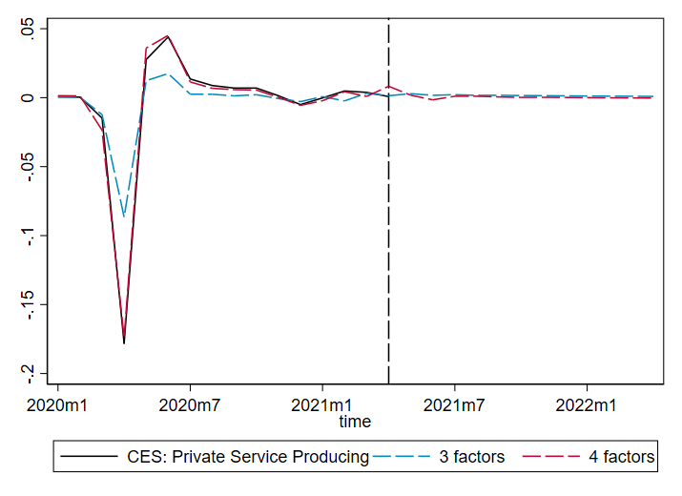
  (B) Monthly DFM: Forecasts

Slide 33
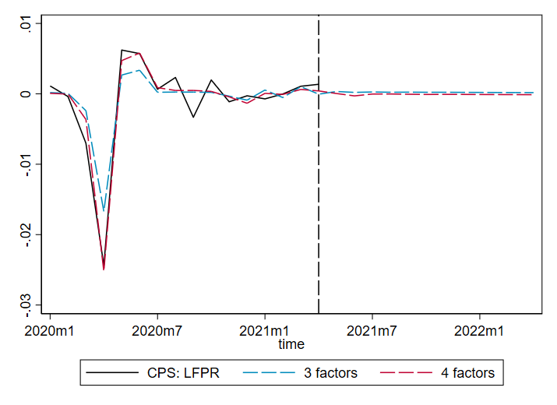
  (B) Monthly DFM: Forecasts

Slide 34
  (B) Monthly DFM: Factor dynamics
Data description: AR(2) models of factors
 | Sum of AR coefficients |  | F-test of equal coefficients
 | 1984m1-2019m12 | 2020m3-2021m4
Factor 1 | 0.821 (0.035) | -0.218 (0.394) | p < 0.001
Factor 2 | 0.800 (0.037) | 0.107 (0.361) | p = 0.092
Factor 3 | 0.463 (0.057) | -0.401 (0.414) | p < 0.001
Factor 4 |  | -0.286 (0.400)
Normally the factors are highly persistent
However, during the pandemic, the 3 historical factors have no persistence or anti-persistence
The pandemic factor also has anti-persistence.
Note: these dynamics are not directly comparable to weekly factors – monthly is for monthly SA growth rates, weekly is for 52-week growth rates.

Slide 35
  (C) Daily SIR: Time variation of economic response to deaths (Droste & Stock [AER P&P, 2021])
Behavioral SEIRD model
Susceptibles become exposed: (1)
(2)
captures both transmissibility and contacts; φ_{t} = seasonal
E then flows into usual I, R, D compartments
Activity affects contacts: (6)
which implies
Behavioral response: (7)
where
Comments
  Time unit = one day.
  Transmission model (6) assumes # contacts are (locally) linear in economic activity
  Behavioral rule (7) says activity depends on a pandemic observable, yesterday’s deaths
  Large literature on behavioral SIR, starting with Eichenbaum, Rebelo, Trabant (March 2020); see Atkeson (BPEA, March 2021) for references. But standard behavioral SIR doesn’t fit the post-spring data
  We introduce time-variation in:
    β_{0t}: non-economic shocks to transmissibility and contacts (masks, social distancing, church, Thanksgiving, etc.)
    β_{1t}: TV effect of activity on transmission (workplace safety, protections at barbershop, etc.)
    κ_{0t}: shocks to activity holding deaths constant – “binary pandemic effect” + other shocks
    κ_{1t}: TV effect of yesterday’s death rate on today’s activity (semi-elasticity). Note: we approximate the growth rate of deaths by average daily deaths over the past two days
    Not shown: seasonal in transmissibility (Tzampoglou and Loukidis 2020), TV-IFR (changing demographics)

Slide 36
  (C) Daily SIR: Estimation
Behavioral SEIRD model
Susceptibles become exposed: (1)
(2)
captures both transmissibility and contacts; φ_{t} = seasonal
E then flows into usual I, R, D compartments
Activity affects contacts: (6)
which implies
Behavioral response: (7)
Identification
  From timing + SIR functional cross-equation restrictions + functional forms in (6) and (7)
Estimation: “SIR Regression”
  Nonlinear generalized least squares:
  Rolling 8-week periods starting March 15, 2020, data through Dec. 17, 2020, reestimated every 7 days
  Parameters: β_{0t}, β_{1t}, κ_{0t}, κ_{1t}, and initial conditions for I₀ and E₀ (start of each rolling window).
Standard errors
  VARHAC (impose constant error variance over full sample)

Slide 37
  (C) Daily SIR: Estimation
Behavioral SEIRD model
Susceptibles become exposed: (1)
(2)
captures both transmissibility and contacts; φ_{t} = seasonal
E then flows into usual I, R, D compartments
Activity affects contacts: (6)
which implies
Behavioral response: (7)
Data
  Daily, US
  Deaths: 7-day MA (backwards-looking) (Johns Hopkins)
  Activity: labor hours (total private production & nonsupervisory) relative to Feb 2020 (index) for 12th day of month, interpolated to daily using (a) Chetty et al (2020) total employment and, when not available, (b) 7-day MA of Google mobility index (retail & recreation, transit stations, grocery & pharmacy)

Slide 38
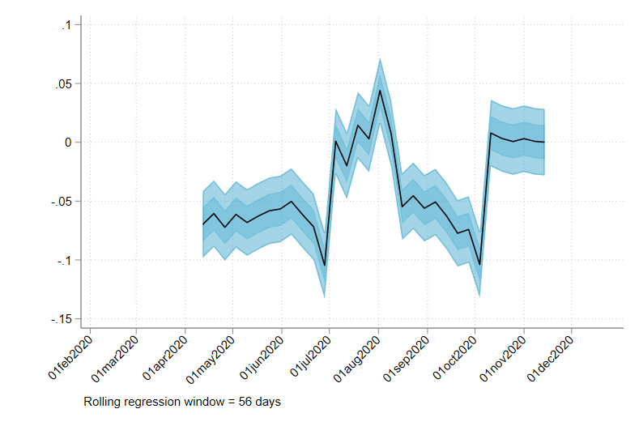
  (C) Daily SIR: Estimation results
Effect of 1000 daily deaths on economic activity (1000κ₁)
Large negative effect in spring and early fall (more deaths, less activity), with near-zero response in mid-summer and late fall/holiday season
The summer wave was regional so the summer diminution could be a compositional effect
The fall wave was/is national so the current diminution is more plausibly pandemic fatigue (accepting additional risk, understanding that mortality risk conditional on infection depends strongly conditional on age, race, comorbidities)

Slide 39
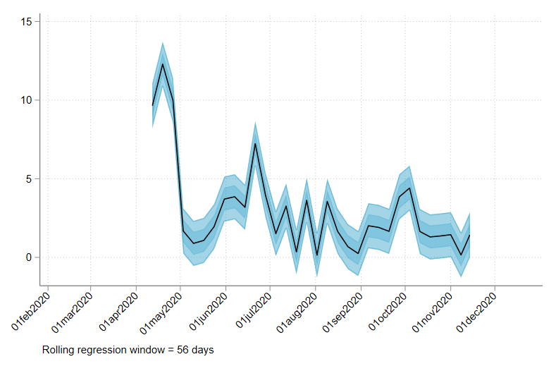
  (C) Daily SIR: Estimation results
Effect of economic activity on R_{t} (elasticity β₁)
Large positive effect in spring (more activity, more deaths)
Diminishes over time and stays low – effect from midsummer on is ~20% the effect of early spring
Consistent with masking-while-shopping starting in mid-late April (except for summer-wave states, where mask adoption was slower)

Slide 40
  (C) Daily SIR: Rolling estimation fit
Weekly deaths Activity index
56-day window
56-day window
Fit is worst in summer wave

Slide 41
  (C) Daily SIR: Activity_{t} = β_{t}Deaths_{t} + u_{t}, weekly DFM & daily SIR
DFM:
coefficient of pandemic economic factor on deaths
SIR:
Effect of 1000 daily deaths on log economic activity (1000κ₁)
Comparison: DFM and SIR
Both the DFM and SIR show diminution of effect of deaths on economic activity
Main difference in estimates is summer 2020
  TV-SIR attributes summer 2020 wave to relaxation of non-economic protections (no masks, Memorial Day parties, Sturgis SD, etc.)
  The DFM measures jointly determined outcome: result of both the reduction in the effect of economic activity on deaths, and of deaths on economic activity.

Slide 42
  Summary
Have macrodynamics changed during the COVID crisis?
  There is a new pandemic factor – one new factor suffices
  Open question on factor dynamics
    New factor is “fast”; evidence on change in “normal” factor dynamics is mixed
How has the relation between the fundamental shock (the pandemic) and economic activity evolved?
  There has been a weakening of the deaths -> economic activity channel, at a minimum since late fall 2020
What are the implications for macrodynamics during the recovery?
  We are arguably still in the “fast dynamics” period
  The contribution of the pandemic factor is small as of April 2021 – back to a 3-factor world
  Should we expect a return to normal dynamics? (mixed evidence)
(Methods) how can we do macroeconometrics post-pandemic?
  At both the weekly and monthly level, a single pandemic factor provides good in-sample fit.
  Could the pandemic factor be a useful “pandemic dummy variable” for future empirical work that spans the pandemic period?

