Slide 1
NBER conference: New Directions in Transportation Economics, Spring 2021
Estimating the Cost of Decarbonizing the Transportation Sector
James H. Stock
Economics Department and Harvard Kennedy School,
Harvard University
Thanks to Jim Archsmith, Sarah Armitage, Ken Gillingham, Chris Knittel, Shanjun Li, Erich Muehlegger,, and David Rapson for helpful conversations, and to Cassie Cole, Michelle Li, and Matej Cerman for research assistance.
June 17, 2021

Slide 2
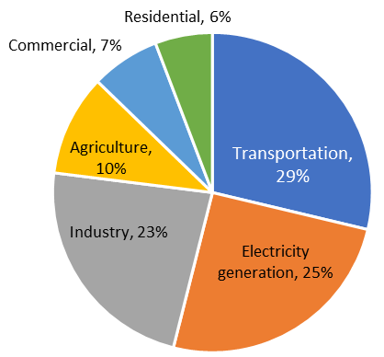
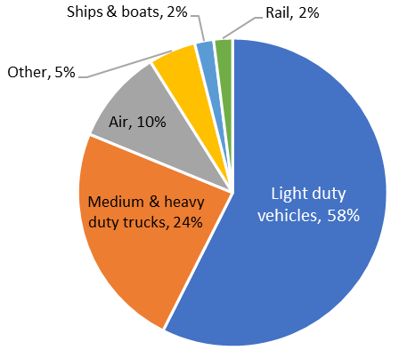
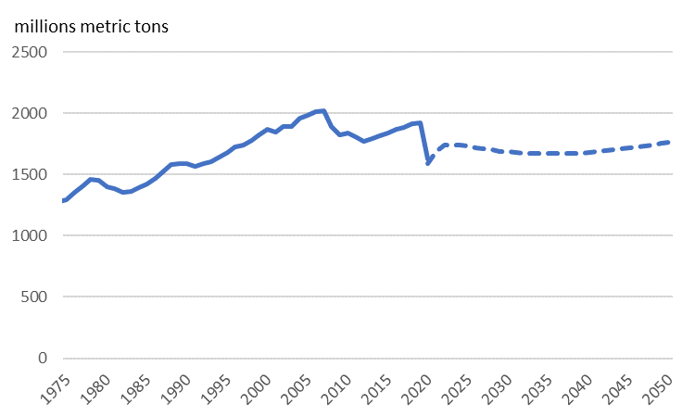
Emissions from the US Transportation Sector
US GHG Emissions by Sector, 2019
US Transport CO2 Emissions by Mode, 2019
Sources: EPA Greenhouse Gas Inventory, EIA AEO 2021
AEO 2021 reference scenario: Transport emissions

Slide 3
How much will it cost to decarbonize transportation?
What does “how much” mean?
Gross investment not the right concept
Technology cost vs. policy cost
Marginal abatement curve: static vs. dynamic
Externalities and multiple equilibria
Three externalities:
  GHG externality
  Innovation externality
  Network (chicken & egg) externality
+ induced technical change, learning-by-doing,…
Cost-benefit analysis vs. Cost effectiveness analysis
CBA uses the SCC
CEA (here) takes a target date as given
Policy framing
Transition to a cheaper, greener future or first step towards perpetual self-restraint?
Existing policies:
  RFS, CAFE/SAFE, BBTC, EVTC, [eRIN]; IDC, EOR,…; LCFS, TCI, ZEVs
  ICAO/CORSIA, [RJFTC]
  IMO MARPOL
This is work in progress…

Slide 4
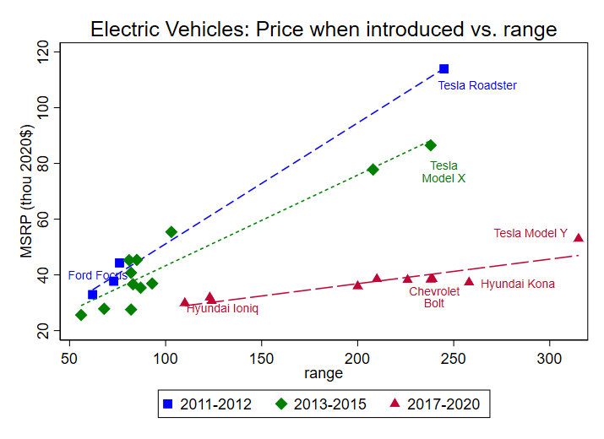
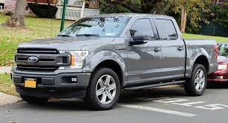
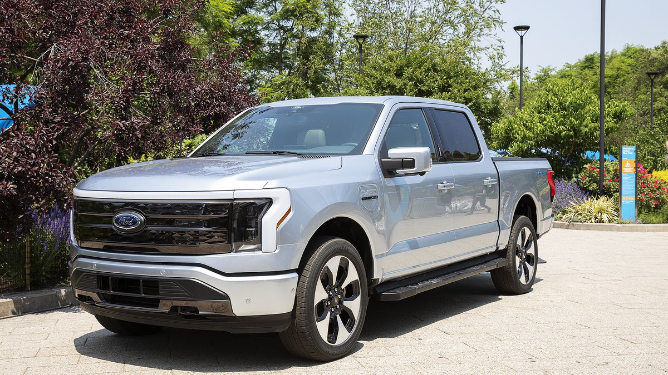
LDVs: Overview
The EV transition
Price
  Battery price declines
  EV-ICE price parity 2024-2030?
Attributes
  + : performance, other battery uses
  - : charging time & availability, range, cold weather
Penetration
  Norway: ~80% of new sales
  US: 2% of new LDV sales
Industry
  GM, Ford announcements
For another day
Hydrogen fuel cells, autonomous vehicles, flying cars,…

Slide 5
LDVs: Cost estimation strategy
Policy cost estimation
Focus on $/ton of policies
  total system costs = EVs – ICEs + O&M differential + charging stations + power system upgrades (all gross of federal support)
  not welfare
LDV model elements
Discrete choice model of EV demand (by cars, SUVs+), logistic, depends on:
  Full user cost (with myopia)
  Charging stations (Level 2, 3)
  Non-price attributes/tastes
Private charging station buildout
  Early adopters largely charge at home
  Insufficient Level 3 (DC fast chargers)
  Level 2 chargers for those without home charging capability
Ignore potential usage difference (Burlig et al. 2021)
Exogenous technical change
Multiple equilibria
Model structure & parameters drawn from literature
  Key references: Zhou & Li (2017, 2018), Springel (2020), Archsmith, Muehlegger, & Rapson (2021)

Slide 6
LDVs: Parameterization
Monte Carlo to handle parameter, technology, oil price uncertainty
Baseline & MC central values
Baseline: Growing but incomplete EV penetration (even by 2050)
Demand: price elasticity -2.5; charging station elasticity 0.37 (Springel 2020); consumer myopia parameter 0.75
Charger supply: elasticity 0.67 (Springel 2020) (Norway)
  steady state calibration = 0.1 L2/car & 60,000 L3 @ 10 plugs/facility (cf. 115,000 gas stations nationally)
  Costs: L2 @ $2k/plug, L3 @ $50k/plug, declining 2%/yr
ICE, SUV prices
  Manufacturing & usage breakdowns in Lutsey & Nicholas (2019) and Clinton, Knittel, and Metaxoglu (2020)
  Battery prices: -16% per year 2009-2019; project -9% with $50 floor
  Cars: 3.4 kWh/mi; SUVs: 2.0 kWh/mi; ICEs: CAFE standard projections (ICE component)
  Full user cost = Initial vehicle cost + valuation factor×O&M costs (after all taxes & incentives)
Oil price path from AEO 2021 + random AR(1) departure estimated 1990-2021
Selected references
Demand elasticity: Springel (2020): -1.5 to 2.0; Xing et al (2019): -2.7; Li (2019): -1.3; Muehlegger & Rapson (2018): -3.3; Archsmith, Muehlegger, & Rapson (2021) simulation values -1, -2 -3
Consumer myopia (all for ICEs) : Gillingham, Houde, & van Bentham (forthcoming): 0.16-0.39; Allcott & Wozny (2014): 0.72; Grigolon, Raynaert, and Verboven (2018): 00.91; Leard, Linn, and Zho (2019): 0.54 and <0.30. We use higher value because of salience at point of making ICE/EV decision.

Slide 7
LDVs: Policies
Baseline
  CAFE standards: SAFE through 2026, increase @ Obama rates 2027-2031, increase @1% thereafter
  Power sector: TPS starting from status quo in 2022, 80% emissions reduction by 2030, 90% by 2035, 100% by 2050
    Alternative: No power sector policy
Charging station subsidy
  50% cost-share for Level 2, 75% cost-share for Level 3, 2022-2028
EV showroom rebate
  $5000 federal instant rebate, 2022-2026, $3500 in 2027, $2000 in 2028
eRIN
  Biogas -> electricity pathway, 2022-2032; EV owner gets quarterly check; gasoline prices rise slightly
  Details: third part aggregator with access to OEM vehicle data; D3 RIN @ D5 floor = $1.50; RFS energy value 10 kWh/RIN (based on ICCT 2017 methodology, updated, see EPA (2014) & ICCT (2017))
All in: A + B + C
Enhanced Clean Air Act regulation
  Decouple EPA (CAA) & NHTSA (EPCA) rules.
  NHTSA sets (unchanged but binding) ICE mpg standard
  EPA implements CAA via clean vehicle standard (ZEV standard) with tradable allowance price cap
Carbon tax
  $40/ton starting in 2022 increasing 5%/year

Slide 8
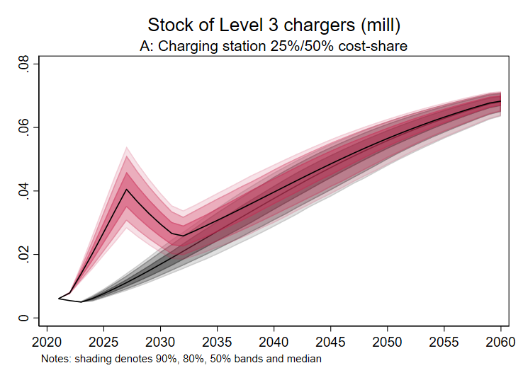
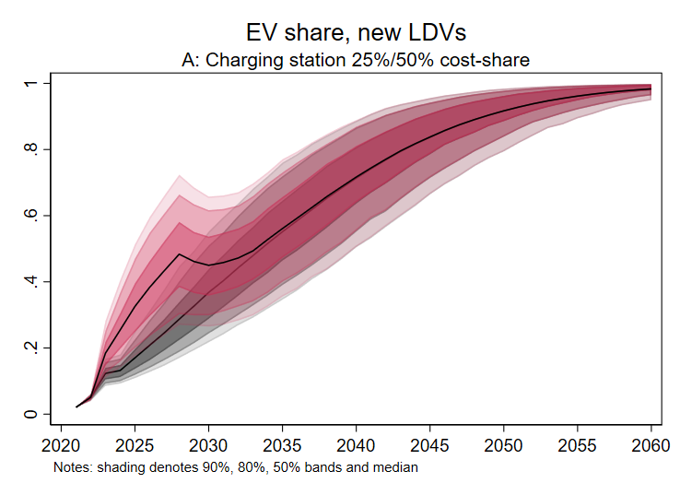
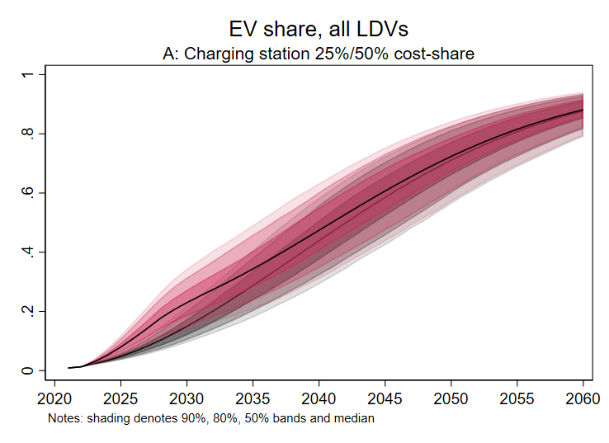
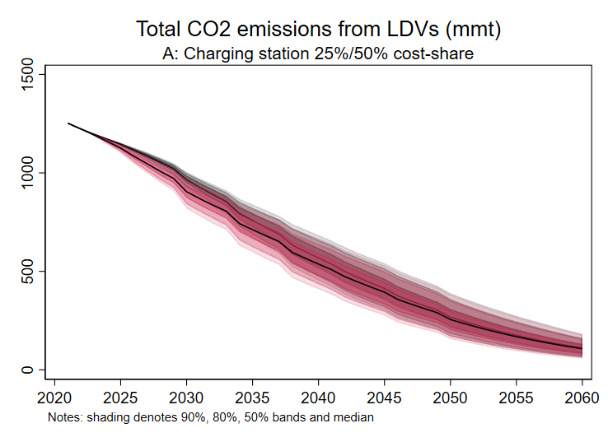
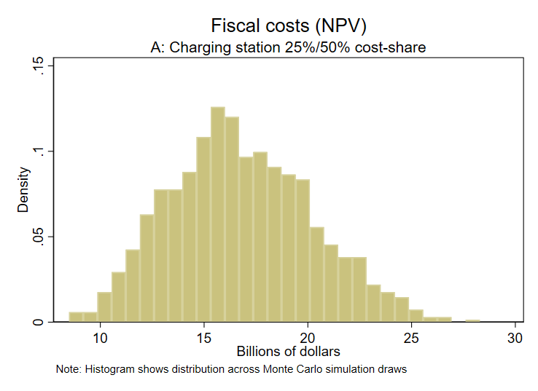
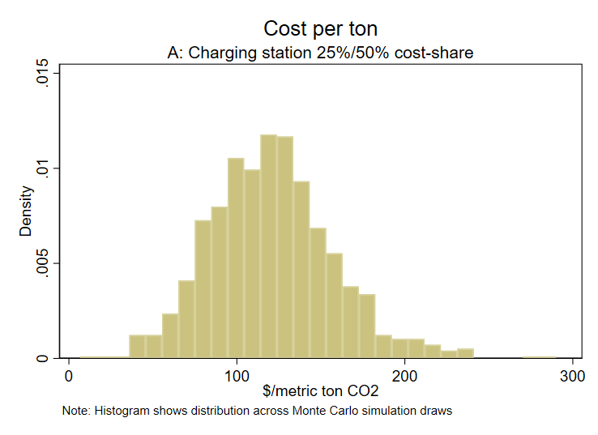
LDVs: Results for 50%/75% charging station cost-share
Notes: total new charging stations = 1.2m Level 2, 30k Level 3)

Slide 9
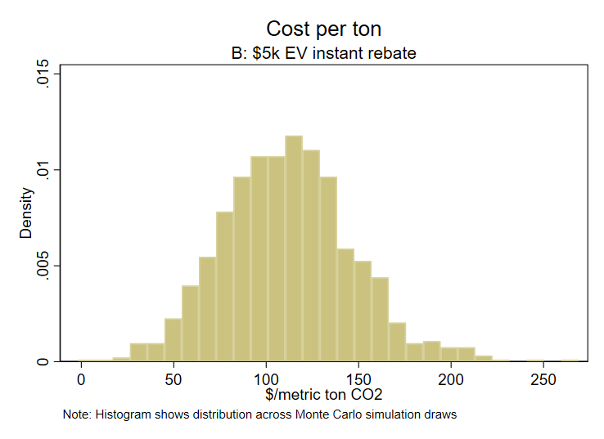
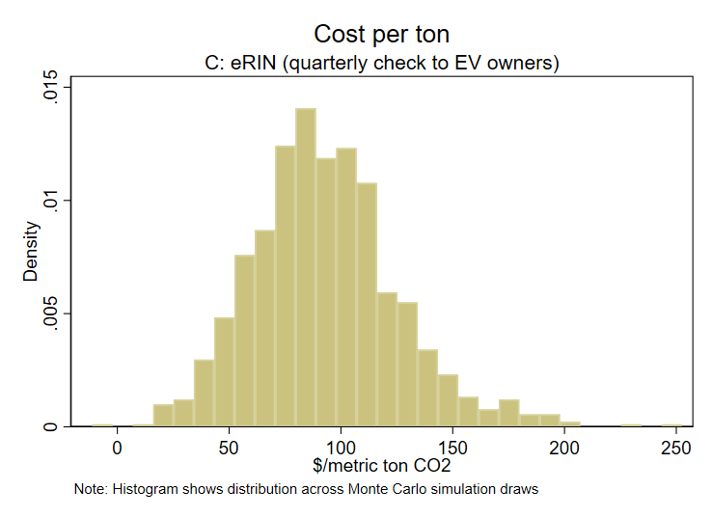
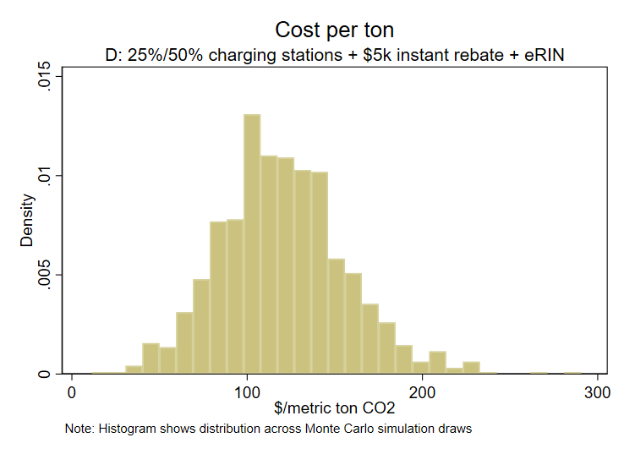
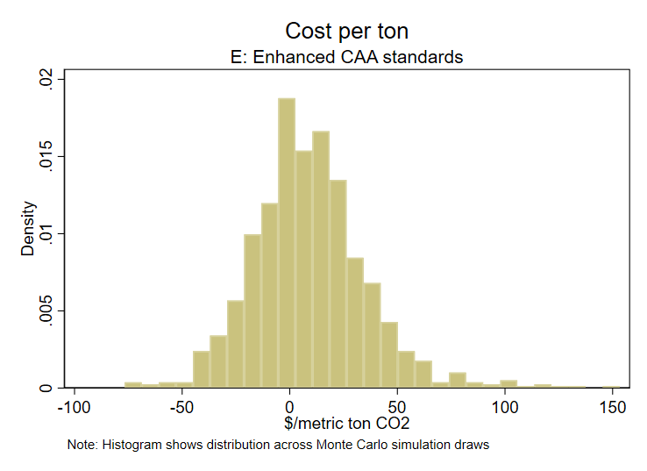
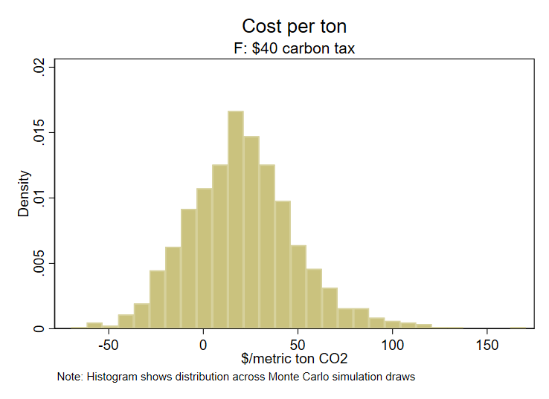
LDVs: Costs per ton, various policies

Slide 10
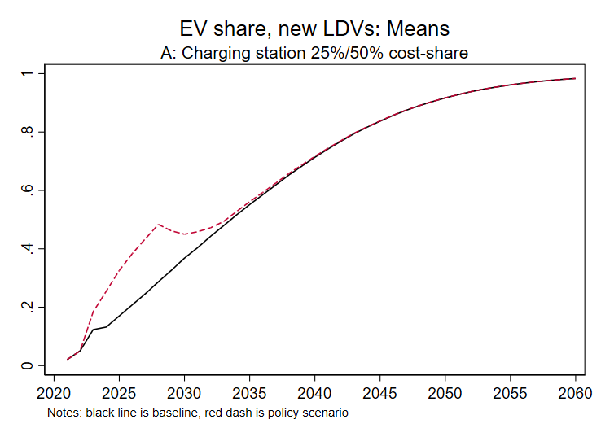
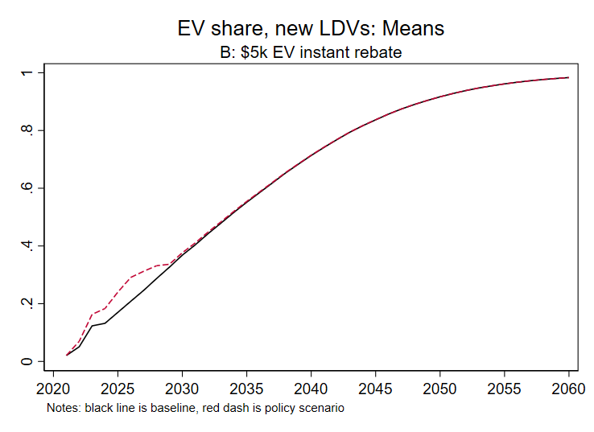
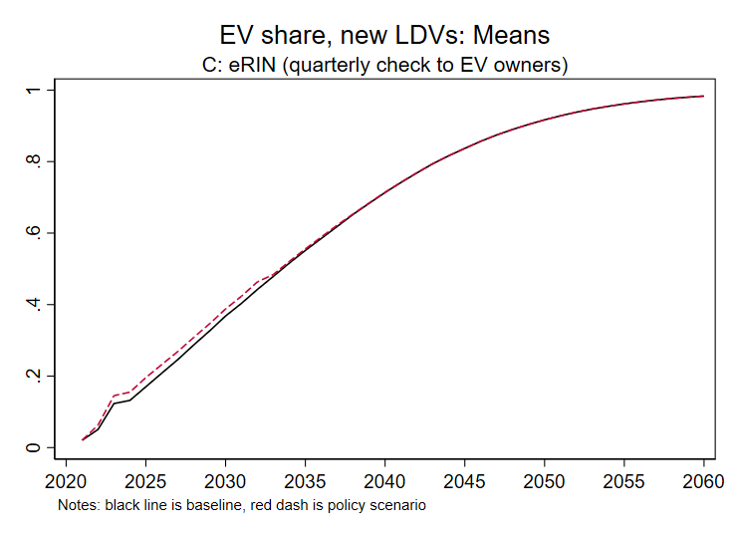
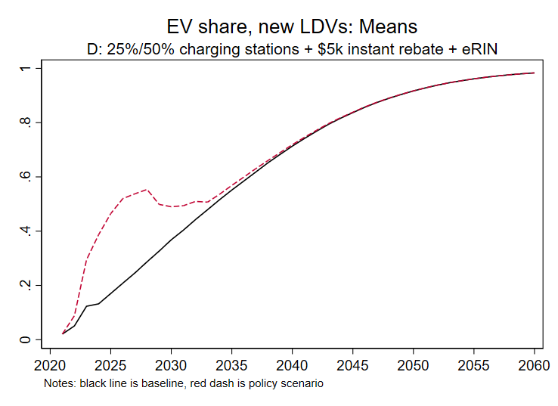
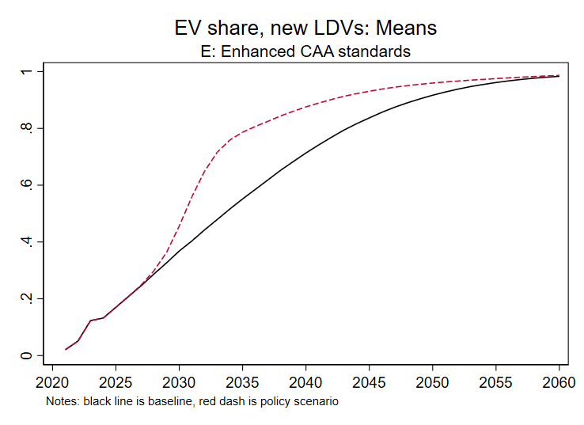
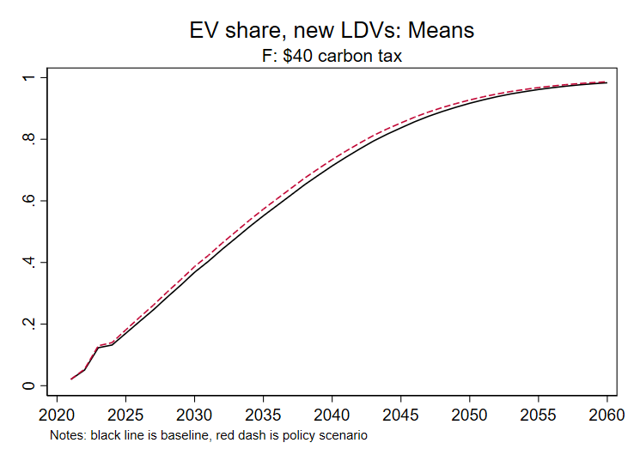
LDVs: New EV sales share, various policies (means)

Slide 11
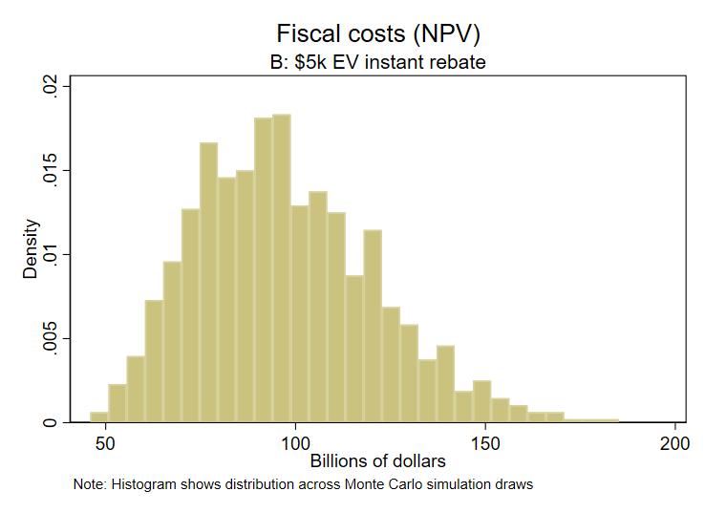
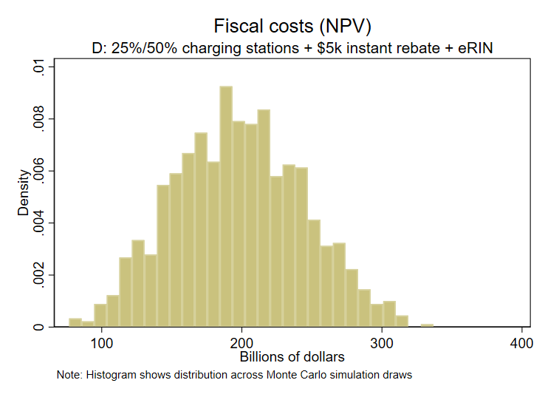
LDVs: Fiscal costs of policies with fiscal components

Slide 12
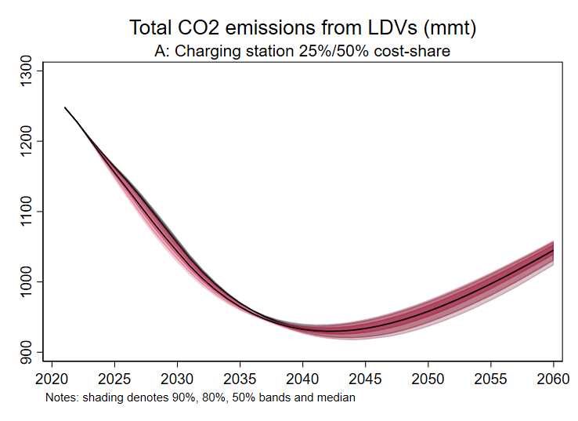
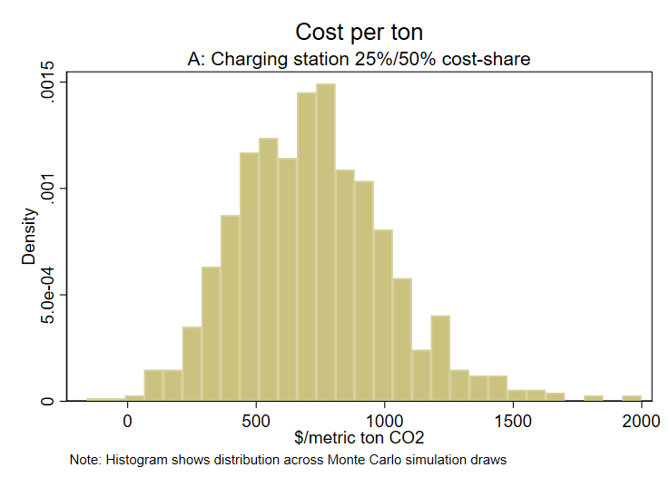
LDVs: Results – With and Without power sector policy
With power sector policy
Tradable performance standard (90% emission reduction by 2035), marginal emissions rates and costs from ReEDS (Stuart-Stock 2021)
No new power sector policy
Marginal power sector emissions from Holland et al (2021) (similar to AEO2021 NEMS)
Marginal emissions are high because coal plants have become marginal (load-following), see NARUC (2020)

Slide 13

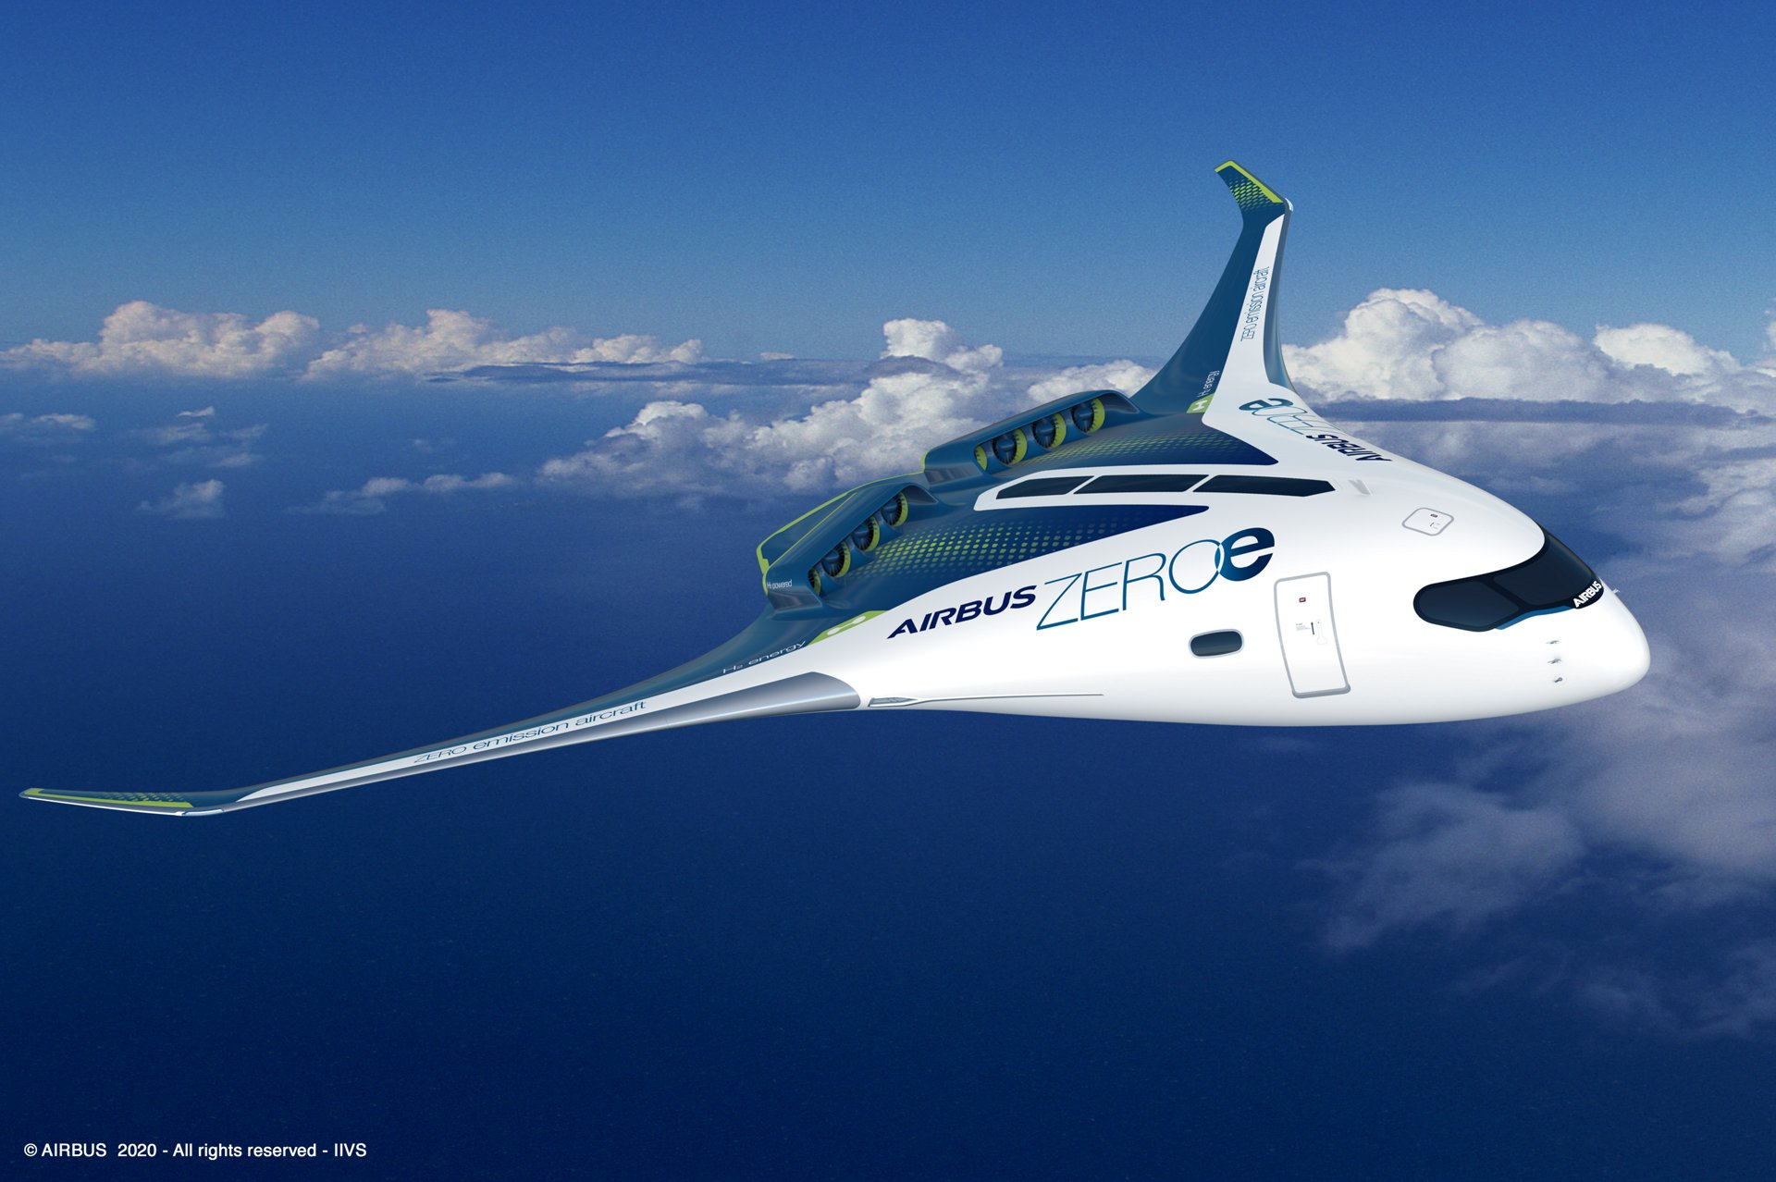

Air: Overview
Air poses major challenges
Technologies largely don’t exist
Focus here on drop-ins:
  Petroleum + firm offsets (e.g., direct air capture [DAC])
  Sustainable aviation fuels (SAF) – “drop-ins”
Other possibilities (not modeled):
  Electric
  Green hydrogen
  Green ammonia

Slide 14
Air: Model
Too much uncertainty to conduct transitional policy cost assessment
Transitional policies are largely technology policies
Still, some crude estimates are possible
Focus on 2050
  Use projections in literature of mature technology costs
  Suppose airlines required to fully offset emissions with firm offsets (DAC)
Airlines choose among drop-in fuels:
  Petroleum + 100% offset
  Vegetable or waste oil-based biojet (Hydroprocessed esters & fatty acids, HEFA)
    75% emission reduction + 25% offset
    limited feedstock supply (e.g., biomass-based diesel (~2Bgal/yr 2019)
  Advanced biojet (e.g., alcohol-to-jet (ATJ))
    100% emission reduction
    Less limited feedstock supply (e.g., corn ethanol ~14.5Bgal/yr 2019 + larger cellulosic capacity)
Supply and demand parameters with uncertainty ranges from economics, science, & techno-economic literatures
Baseline demand & jet fuel prices ($2.77/gal (!)) from AEO 2021 for 2050
Monte Carlo simulation over realizations of supply curves
Selected references for supply & demand curves
  Prest (2020), Balke & Brown, 2018); World Economic Forum/McKinsey (2020), Irwin & Good (2017), Lade & Lin-Lawell (2020), Roberts & Schlenker (2013), Wang et al. (2016), Wei et al (2019) ; Fuss et al. (2018), Fasihi et al. (2019), Hepburn et al. (2019), Keith et al. (2018); Pavlenko et al. (2019), Capaz et al. (2021), Graver et al. (ICCT 2020); Visnawathan et al. (2019), Gray et al. (2021)

Slide 15
Air: Results
Key points
Tough to beat petroleum jet fuel at $2.77/gal, even with offsets @ $100-200/ton
HEFA scalability limits its use for SAF
ATJ (and other advanced biojet) are scalable but existing cost projections do not give it a major role

Slide 16
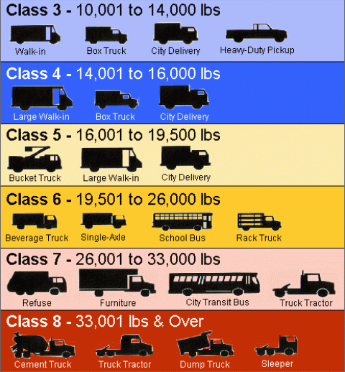
HDVs: Overview
Medium-duty vehicles are amenable to electrification
Delivery vans, buses, heavy-duty pickups (many class 3-6 vehicles)
Class 7-8 distance haulage less clear
Non-scalable technologies:
  low-carbon renewable diesel, low-carbon renewable natural gas
  Both have competing uses: renewable jet, eRIN
Scalable technologies:
  Batteries
  Green hydrogen
Medium & heavy-duty truck classes

Slide 17
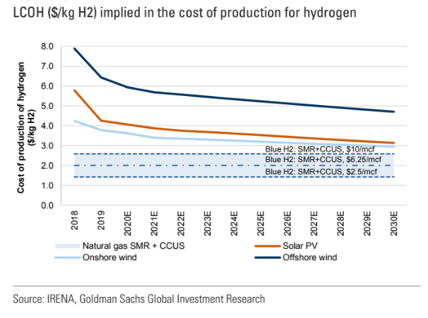
HDVs: Technologies for decarbonization
Hydrogen fuel cells
50 shades of hydrogen:
  Brown: coal gasification + reformation
  Grey: steam reformation of methane
  Blue: Grey + carbon capture & storage
  Turquoise: methane pyrolysis yielding solid carbon
  Green: water electrolysis from renewables.
Wave of enthusiasm:
  cheap renewables (1-2 ¢/kWh?)
  advances in electrolysis technology
  expected scale economies is driving a wave of enthusiasm about green hydrogen.
  $6-8 per kg considered to be cost parity with gasoline
Challenges:
  No fuel cell HDVs currently in production
  Major challenges:
    Power train redesign
    Fuel storage redesign
    New fueling infrastructure:
      DOE (2020) estimates H2 fueling station costs at $1.9m each for CA 111-station pilot

Slide 18
HDVs: EC Hydrogen Strategy
European Commission's hydrogen strategy
Goals:
  6 GW renewable hydrogen electrolyzers and production up to 1 million metric tons renewable hydrogen by 2024
  40 GW renewable hydrogen electrolyzers and 10 million metric tons production by 2030
  Large-scale deployment of mature renewable hydrogen electrolyzer technology especially in hard-to-decarbonize sectors between 2030 and 2050
Required investments
  €24-42 billion for electolyzers by 2030
  €220-340 billion to provide wind and solar electricity for electrolyzers through 2030
  €11 billion to retrofit existing plants with carbon capture
  €65 billion for hydrogen transport, storage, and initial refueling stations
  Estimate that construction of 400 additional refueling stations would require €850-1000 million
    In line with $1.9m/station from DOE (2020)

Slide 19
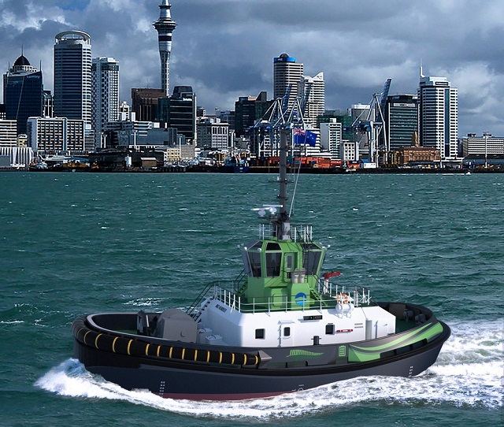
Marine
Like air & HDVs, the scalable technologies remain unproven
Non-scalable technologies:
  low-carbon renewable diesel, low-carbon renewable natural gas
  Both have competing uses: renewable jet, eRIN
Scalable technologies:
  Batteries for certain applications (tugs)
    Provides significant health co-benefits
    Gillingham & Huang (2020) estimate long-term NPV-positive electrification benefits in US waters currently requiring low-sulfur fuel
  Green hydrogen
  Ammonia
    Can be burned in ICEs or used in fuel cells
    Liquid at room temperature
    But substantial safety & environmental (NOx) challenges
    One estimate of full global transformation to green ammonia by 2050 is $1.2-1.6T (undiscounted, baseline unclear) (Getting to Zero/Global Maritime Forum/WEF (2020))
Jury out on whether the clean equilibrium is cheaper.
Port of Auckland all-electric tug

Slide 20
Summary
LDVs
Policy costs are comparable across policies
  Near term policies are typically in the $100-$150 range
  Later-implementation policies are
Charging infrastructure plays critical role (as in Springel 2020)
Non-policy path requires expensive oil, very significant attribute improvements, or a higher price elasticity than found in the literature so far.
Medium and some heavy-duty applications
Local delivery van fleets, buses,… ripe for electrification – and plausibly cheaper on full user cost basis (plus local health benefits)
Air, Long-distance HDVs, Marine
Based on current technology estimates, it is hard to be confident of a cheaper clean future
  Critical role for firm offsets (direct air capture)
  Critical role for RDD policy
More research needed
To inform cost-effective policy to achieve decarbonization goals

Slide 21
Decarbonizing Transportation
Additional Slides

Slide 22
LDVs: Model
Consumer demand
Two categories of vehicles: cars or SUVs (which includes light trucks & vans)
Within category, choose EV vs. ICE
Demand depends on relative price, charger availability (Level 2, Level 3), and other attributes/tastes
where
Notes: Based on Springel (2020), with the following modifications: (a) Springel uses price, I use log price. (b) Springel estimates demand at the vehicle model level, this aggregates to (EV, ICE) × (car, SUV); (c) Springel doesn’t differentiate among charging station level; I differentiate between Level 2 &3. Here L2 is treated on a per-vehicle basis, L3 is treated on geographic density (or equivalently per road-mile) basis. Springel and Zhou-Li (2017) use ln(N) specifications. (d) I follow Archsmith et al (2021) and introduce the term φ_{t} to capture attribute and taste drift (modeled here as a random walk). (e) I model consumer choice in year t as depending on (observed) charging stations in year t-1.

Slide 23
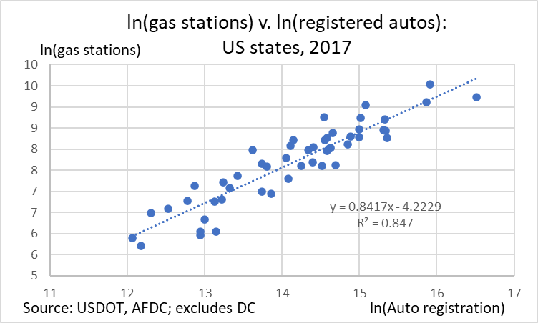
LDVs: Model
Private-sector charging station provision
Separately model L2 and L3 chargers because of different costs and different saturation values
where
Source: Zhou & Li (2018-US), Springel (2020)
Stock/flow accounting
LDV scrappage rate 10%/year
Charging station scrappage rate 10%/year
Calibration

Slide 24
LDVs: Parameterization & MC
Model:
Demand:
References: η_{P}: Springel (2020): -1.5 to 2.0; Xing et al (2019): -2.7; Li (2019): -1.3; Muehlegger & Rapson (2018): -3.9;
Archsmith, Muehlegger, & Rapson (2021) simulation values -1, -2 -3
η_{P}: Springel (2020): -0.418 (SE = 0.038) mean in random coefficients model @ ~12% market share (2014)
Technology: ICE, SUV price model follows Lutsey & Nicholas (ICCT (2019)), Clinton, Knittel, and Metaxoglu (2020).
      Full user cost = initial vehicle cost + valuation factor × O&M costs
      Manufacturing cost breakdown from Lutsey & Nicholas (2019).
      Valuation factor ~ U[0.5, 1].
        References, all for ICEs: Gillingham, Houde, & van Bentham (forthcoming): 0.16-0.39; Allcott & Wozny (2014): 0.72; Grigolon, Raynaert, and Verboven (2018): 00.91; Leard, Linn, and Zho (2019): 0.54 and <0.30; Goldberg (1998): near 1. We use higher value because of salience at point of making ICE/EV decision
      Battery prices: -16% per year 2009-2019; project N(-.09,.02), with $50 floor
      EV (kWh/mi): 3.4 (cars – Chevy Bolt), 2.0 (SUVs & lt trucks – Car & Driver estimate for F150 Lightening)

Slide 25
LDVs: Odds & ends
Odds & ends
Discount rate: 3% real
Prices & costs in 2020 $’s
Power sector marginal emissions rate and incremental costs from added EV load under TPS from ReEDS (Stock-Stuart (2021))
VMT growth from AEO 2021 reference case
eRIN value flows upstream (marginal cost of biogas ≤ marginal cost of natural gas & competitive auto industry)
System costs = additional power system costs, vehicle costs, & liquid fuel costs
Total costs = system costs + federal share (set marginal cost of public funds = 1)
Simulations span 2021-2060, 2021 fixed at (estimated) 2021 initial conditions
No expectational channels

Slide 26
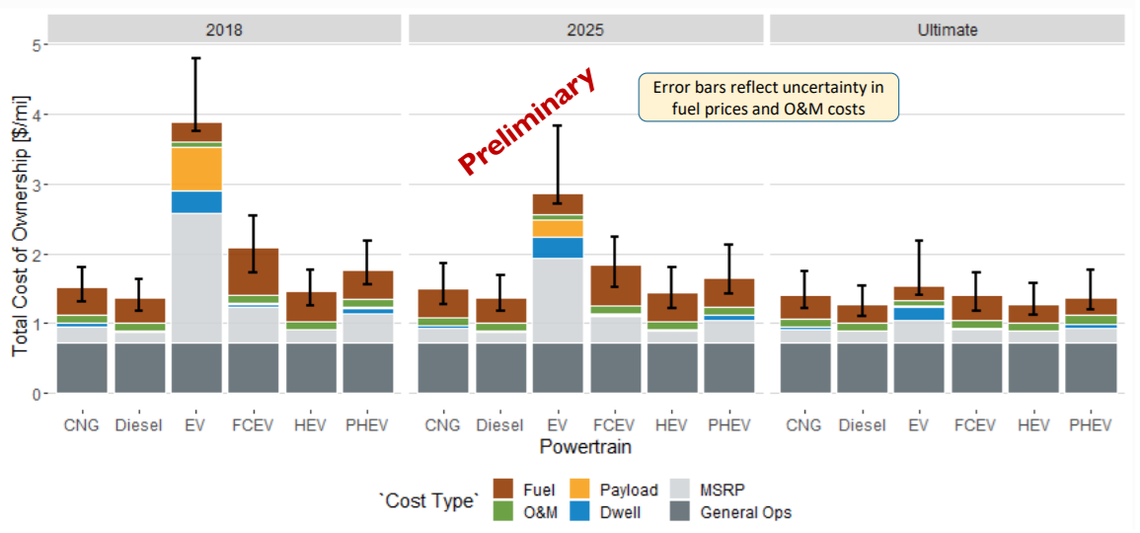
HDVs: Technologies for decarbonization
Projected total cost of ownership for class 8 trucks by fuel type
Source: National Renewable Energy Laboratory (2020)

