Slide 1
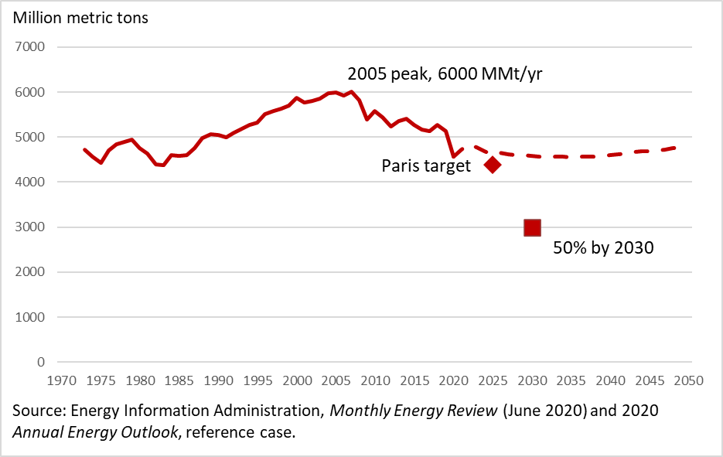
ASSA 2022 session “US Climate Policy: What is Needed to Reach the Paris (Glasgow) Goals?”
CO2 Emissions from Energy:
Paris & Glasgow targets & EIA projection
US Climate & Energy Policy: 2021 Progress & Future Agenda
James H. Stock
Vice Provost for Climate and Sustainability
Economics Dept. & Harvard Kennedy School
Harvard University
EIA projection (2021)
January 7, 2022

Slide 2
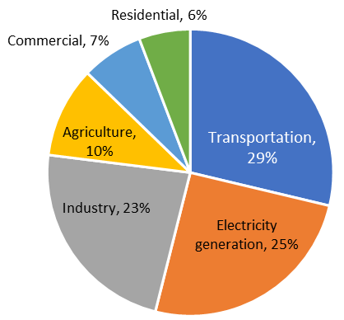
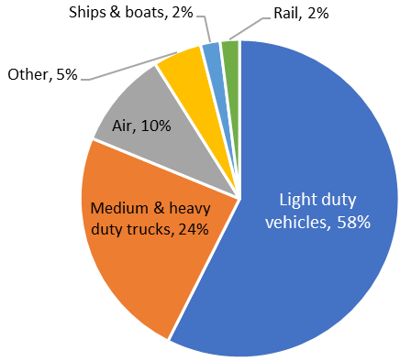
Overview: where we are, big-picture policy goals, 2021 policy accomplishments
A. Where we are now
US GHG Emissions
by Sector
US Transport CO2 Emissions by Mode
B. Big-picture policy goals
Decarbonize the power sector
Electrify light & medium duty vehicles
Get started on hard-to-decarbonize sectors like heavy duty vehicles and air transport
C. Multiple market failures implies multiple policy tools
GHG externality -> carbon price
  Explicit or implicit as in a clean electricity standard
  Not sufficient, but arguably necessary
Innovation externality -> Technology policy tools
Others, e.g. charging station chicken-and-egg -> charging station infrastructure investment
Efficient suite of policies, and timing, varies by sector

Slide 3
Biden Administration Climate Checklist (partial): Many wins
Category | Authority | Action | Status
International | Exec | Rejoin Paris; 50-52% reduction by 2030 (NDC/target) | 
 | Exec | Climate “at the center of US foreign policy” | 
Organizational | Exec | Create WH Office of Domestic Climate Policy, WH climate councils | 
 | Exec | “All of government” approach | 
 | Exec/Reg | Restart SCC | 
Power | Exec | 80% clean by 2030 (target) | 
 | Leg | Extend renewable tax credits | BBB
 | Leg | Clean Electricity Standard (CES) | X
 | Leg | CCS, grid, transmission $, extend nuclear fleet operation | BIP (), BBB
 | Reg | Accelerate offshore wind permitting (BOEM) | 
 | Exec | Focus FERC, DOE on transmission | 
Transport | Exec | 50% EV share of new LDV sales by 2030 (target) | 
 | Leg | EV charging infrastructure |  $7.5B in BIP
 | Leg | EV refundable tax credit | BBB
 | Reg | tighten CAFE standards |  (through MY 2026)
 | Exec/Leg | Fed fleet EV purchases |  (n process)
 | Exec | 3 Bgal Sustainable Aviation Fuel (SAF) by 2030 (target) | 
 | Leg | Biofuel tax credits (SAF, biodiesel, 2G, CFPTC) | BBB
Technology | Leg | R&D support | BBB
Supply side | Exec | Stop Keystone XL |  (but not Line 5)
 | Exec | O&G leasing review |  (but small bore)
 | Reg | O&G leasing moratorium | Implemented/suspended

Slide 4
Quantifying 2021 policy accomplishments and next steps
 | Power sector | LDVs/MDVs | Aviation
BIP (Bipartisan infrastructure package) | Grid investment | Charging stations ($7.5B) | - -
BBB (Build Back Better) | Renewable power tax credits | EV purchaser tax credit | SAF, Biodiesel, Clean Fuel tax credits
Regulatory/administrative – in progress | Weeds (FERC, etc.) | CAFE standards MY23-26 | [3 Bgal goal by 2030]
Legislative – future options | CES, sectoral carbon tax | Charging stations | 2nd generation tax credits
Regulatory/administrative – future options | Clean air act regulation | ZEV standard | RFS

Slide 5
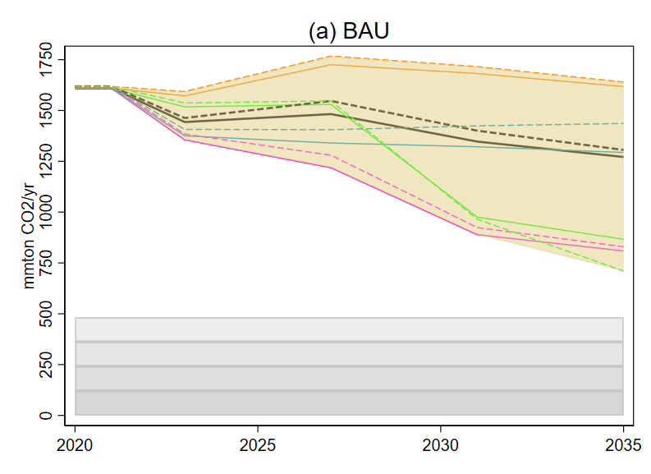
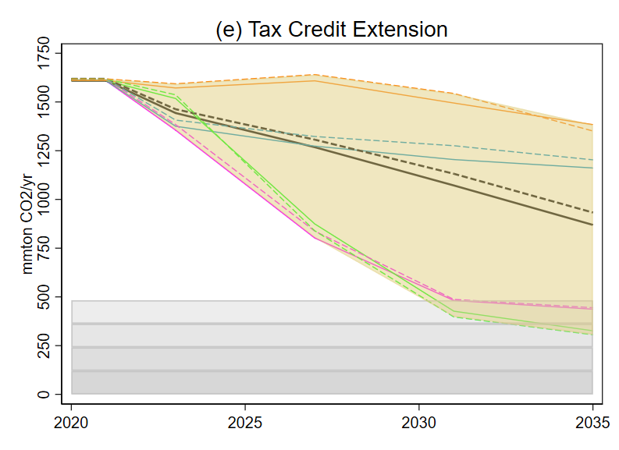
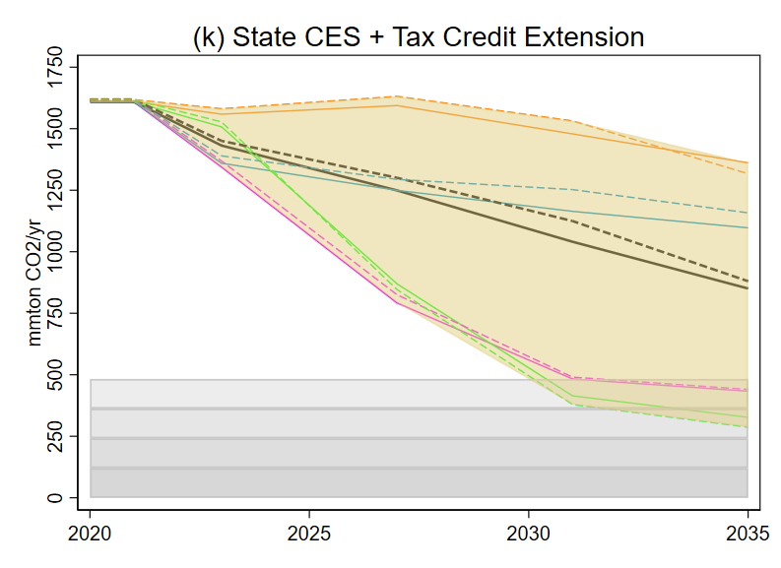
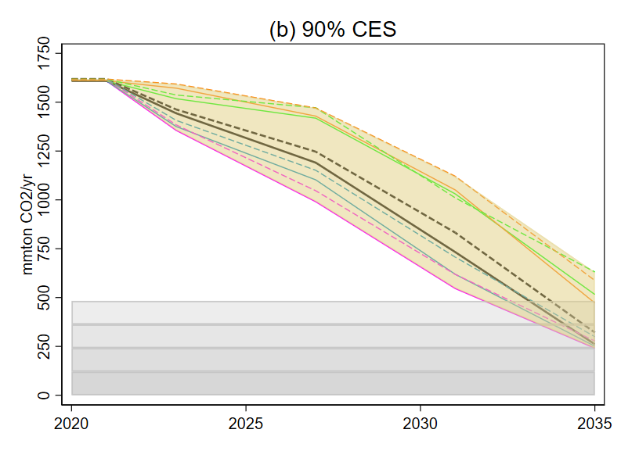
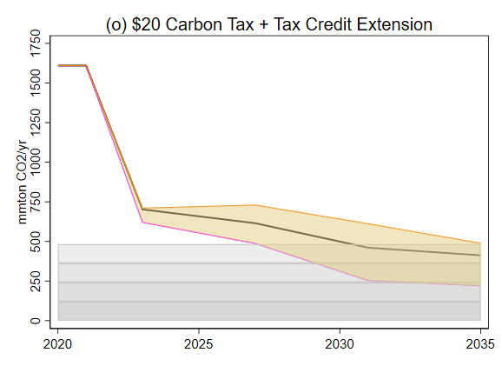
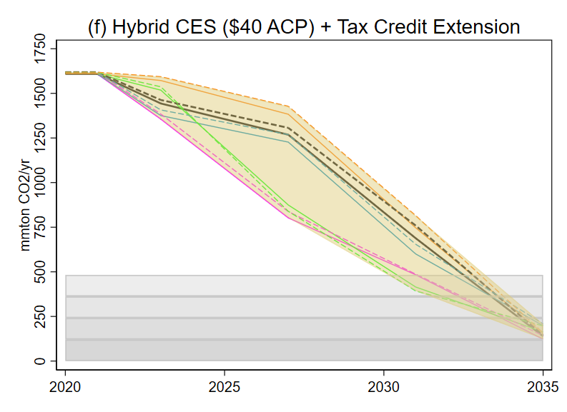
Quantifying 2021 policy accomplishments and next steps: Power sector
 | Power sector | LDVs/MDVs | Aviation
BIP | Grid investment | Charging stations ($7.5B) | - -
BBB | Renewable power tax credits | EV purchaser tax credit | SAF, Biodiesel, Clean Fuel tax credits
Regulatory/administrative – in progress | Weeds (FERC, etc.) | CAFE standards MY23-26 | [3 Bgal goal by 2030]
Legislative – future options | CES, sectoral carbon tax | Charging stations | 2nd generation tax credits
Regulatory/administrative – future options | Clean air act regulation | ZEV standard | RFS
Biden goal: 80% by 2030
No BBB BBB BBB + enhanced state ambition
Current &
in progress
- - 80%
No BBB + 90% CES BBB + $20 carbon tax on power sector BBB + very aggressive CAA regulation
Future options
Source:
Stock & Stuart (2021a, b)

Slide 6
Quantifying 2021 policy accomplishments and next steps: Light Duty Vehicles
 | Power sector | LDVs/MDVs | Aviation
BIP | Grid investment | Charging stations ($7.5B) | - -
BBB | Renewable power tax credits | EV purchaser tax credit | SAF, Biodiesel, Clean Fuel tax credits
Regulatory/administrative – in progress | Weeds (FERC, etc.) | CAFE standards MY23-26 | [3 Bgal goal by 2030]
Legislative – future options | CES, sectoral carbon tax | Charging stations | 2nd generation tax credits
Regulatory/administrative – future options | Clean air act regulation | ZEV standard | RFS
Biden goal: 50% EVs by 2030
Projected EV new sales share, 2030
 |  |  |  |  | EV share & Emissions
 |  | Charger subsidy | EV sales rebate | ZEV permit price cap ($) | EV Sales Share by 2030 | Cost/ton CO2 ($/ton) | ΔCO2 in 2030 (mmt)
 | Pre-BIP | - | - | - | 0.251 | - | -
Current & in progress | BIP | 7.5 | - | - | 0.330 | 146 | -24
 | BIP + BBB | 7.5 | 7,500 | - | 0.439 | 42 | -58
Future options | BIP + $22.5B chargers | 30 | - | - | 0.420 | 104 | -52
Future options | BIP + ZEV | 7.5 | - | 10,000 | 0.464 | 47 | -65
 | BIP + BBB + ZEV | 7.5 | 7,500 | 10,000 | 0.547 | 51 | -91
Notes: Costs are net resource costs including power sector upgrades. Power sector follows CES (90% by 2035). Model is choice of power train for representative car, SUV, light truck based on Springel (2021), Zhou & Li (2017). Source: Cole, Droste, Knittel, Li, & Stock (2021).

Slide 7
Quantifying 2021 policy accomplishments and next steps: Aviation
 | Power sector | LDVs/MDVs | Aviation
BIP | Grid investment | Charging stations ($7.5B) | - -
BBB | Renewable power tax credits | EV purchaser tax credit | SAF, Biodiesel, Clean Fuel tax credits
Regulatory/administrative – in progress | Weeds (FERC, etc.) | CAFE standards MY23-26 | [3 Bgal goal by 2030]
Legislative – future options | CES, sectoral carbon tax | Charging stations | 2nd generation tax credits
Regulatory/administrative – future options | Clean air act regulation | ZEV standard | RFS
Biden goal: 3 Bgal Sustainable Aviation Fuels by 2030
Projected Production of Sustainable Aviation Fuels (SAFs) in 2030
Billions of gallons
 | Total SAFs |  | Total second generation
 | JCT/CBO | Stock (2021) | JCT/CBO
BIP | - - | 0.25-1 Bgal | - -
BBB | 0.02 Bgal (2026) | 0.25-1 Bgal | 0.02 – 0.04 (2026)
Notes: First generation SAF/biodiesel is from animal fats, waste grease, and primarily (and on the margin) soybean oil. Second generation includes woody biomass, corn stover, energy grasses.

Slide 8
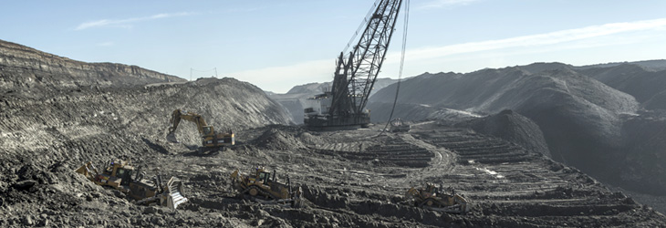
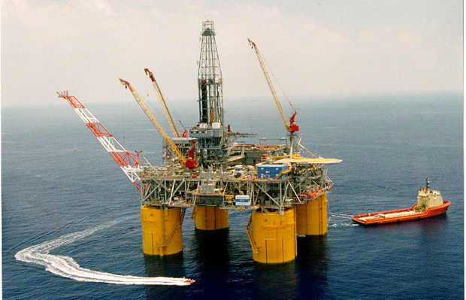
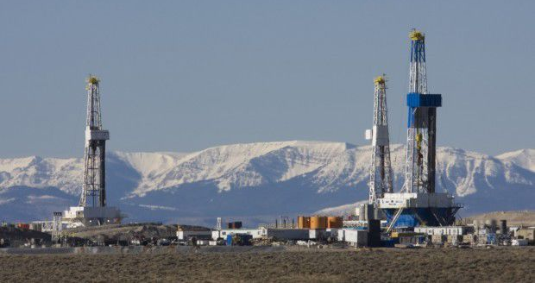
Supply side policies (Federal fossil fuel leasing program)
Federal fossil fuel leasing program
40% of US coal, 22% of US oil, 12% of US gas
O&G royalties are 12.5% (18.75% offshore)
Economics: Federal FF leasing program
Historically, economists ignore supply side climate policy
  Changing – e.g. climate finance
Traditional: focus on “fair value”
  e.g. raise all royalties to 18.75% - Covert & Kellogg (2021)
Alternative: focus on welfare
  Use royalties to internalize externalities – Gerarden, Reeder, Stock (2020), Prest & Stock (2021)
Biden reform efforts
EO 14008 (Jan. 27, 2021):
    “the Secretary of the Interior shall consider whether to adjust royalties…to account for corresponding climate costs.”
O&G leasing moratorium (lifted by court order)
Nov. 19, 2021: largest O&G lease in 3 years
DOI report on O&G reform (Nov. 26, 2021)
  heavy fair return orientation
  “The BLM also should consider limiting discretionary royalty relief”

Slide 9
Summary: 2030 Paris (Glasgow) target of 50-52%?
Goal | BIP | BIP + BBB | Source
80% power sector reductions by 2030 | 40% (30% - 55%) | 51% (35% - 75%) | Stuart-Stock (2021), Rhodium (2021), RFF (2021)
50% EVs in 2030 | 29% - 45% | 46% - 61% | Cole, Droste, Knittel, Li, & Stock (2021)
3 Bgal SAFs in 2030 | 0.25-1Bgal | 0.25-1Bgal | Stock (2021)
50-52% economy-wide CO2 reduction in 2030 | 35% - 42% | 39% - 46% | Rhodium (2021), RFF (2021), au calculations
Notes: Assumes no additional major policy beyond BIP or BIP + BBB .
Next steps: Federal policy
Pass BBB climate provisions (tweak for more EV charging infrastructure?)
Regulatory: Power sector? ZEV standard?
Future legislation: CES; (small) carbon tax
Next steps without federal policy
States
Private action
Finance (finance -> energy transition/climate)
Next steps for economists
Economists must play a central role in informing – guiding – the energy transition
Historically, economists have been deeply influential, but….
Move beyond carbon tax
Accept that some second-best policies are better than others
Does your research potentially contribute to solving the climate crisis?

