Slide 1
Marleau Lecture, University of Ottawa
Climate Change and the Macroeconomy:
Macro Transition Risk and Uncertain Climate Policy
James H. Stock
Economics Department and Harvard Kennedy School
Vice Provost for Climate and Sustainability
Harvard University
April 28, 2022

Slide 2
The macro costs of climate policy: The need for empirical evidence
Channels for macro costs of climate change (Carney 2015): Physical, liability, & transition risk
  Most quantitative macro/climate work focuses on physical risk (e.g., SCC)
  Transition costs are arguably most significant in the short run (decade)
  Transition costs are heavily dependent on climate policy
Macro costs of actual climate policies are understudied:
  Policy costs typically analyzed at micro level ($/ton)
  .. Or use highly stylized calibrated models (e.g., CGE) & model-optimal policy
In reality,
  Much of the pushback against climate policy is framed in macro terms (jobs, GDP)
  Climate policy is heterogenous, messy, and far from model-optimal!
So, what have been the macro costs of real-world climate policy?

Slide 3
The macro costs of climate policy: Empirical evidence
Outline
Introduction
Macro costs of efficient climate policy
  Case study: EU carbon taxes*
  Remarks on other efficient policies and channels
Macro costs of inefficient climate policy
  Case study: climate policy uncertainty in the US
  Remarks on second best policies
Digression on “non-transition” risk: energy security & Ukraine
Conclusions
This talk draws on…
G. Metcalf & JH Stock, “The Macroeconomic Impact of Europe’s Carbon Taxes,” AEJ-Macro (forthcoming)
JH Stock & D. Stuart, “Robust Decarbonization of the US Power Sector: Policy Options,” NBER Working Paper 28677 (2021)
C. Cole, M. Droste, S. Li, C. Knittel, & JH Stock, “Policies for Electrifying the Light-Duty Vehicle Fleet in the United States,” CEEPR WP 2021-014 (2021)
D. Känzig and JH Stock, “The Macroeconomic Cost of Climate Policy Uncertainty” (in progress)
*Substantial theoretical literature on combined technology policy + carbon tax
  Acemoglu, Aghion, Bursztyn, & Hémous (2012); Acemoglu, Akcigit, Hanley, & Kerr (2016); Aghion et al (2016); Casey (2021); Fried, Novan, & Peterman (2021); Hart (2019); Hassler, Krussel, Olovsson, & Reiter (2020); Hassler, Krusell, & Olovsson (2021); Lemoine & Rudik (2017); Lemoine (2020); Metcalf & Finkelstein Shapiro (2021)

Slide 4
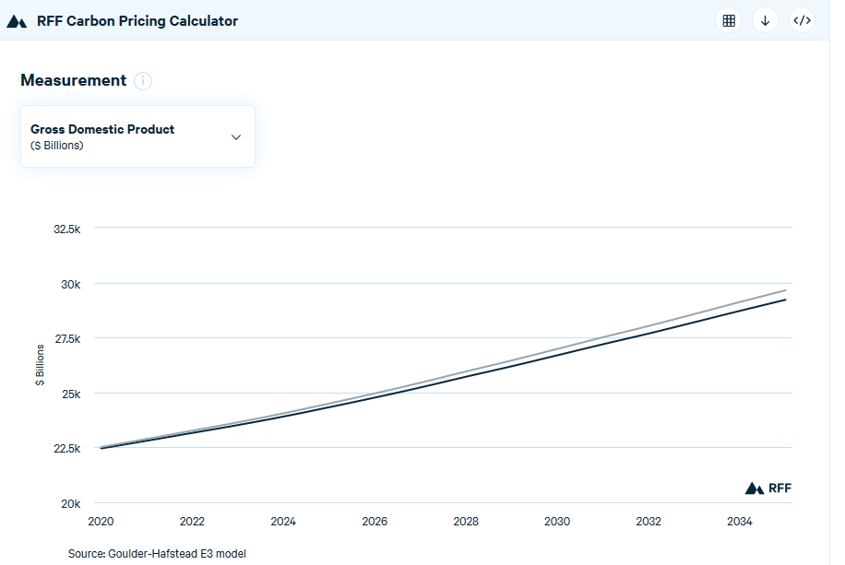
1. Macroeconomics of efficient climate policy: carbon tax theory & calibration
GDP effect of a $40/ton carbon tax, increasing at 5%/year from the Goulder-Hafstead E3 model, online at the RFF Carbon Pricing Calculator
Key features
Parallel shift down
Importance of revenue recycling method
Example:
  Tax of $40/ton @5%/year:
  GDP loss in 2035 =
  -1.5% (tax & dividend)
  -1.2% (payroll tax cut)
CGE model drawbacks:
  No uncertainty
  No induced technical change
  Highly aggregated
Source: RFF Carbon Pricing Calculator at https://www.rff.org/cpc/

Slide 5
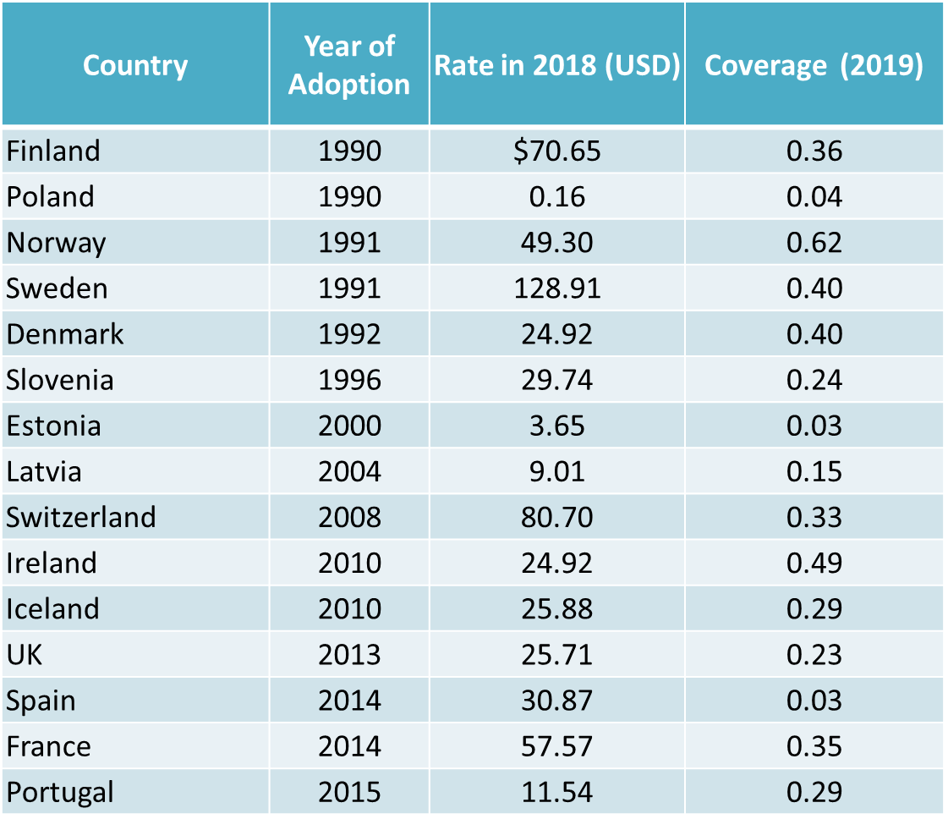
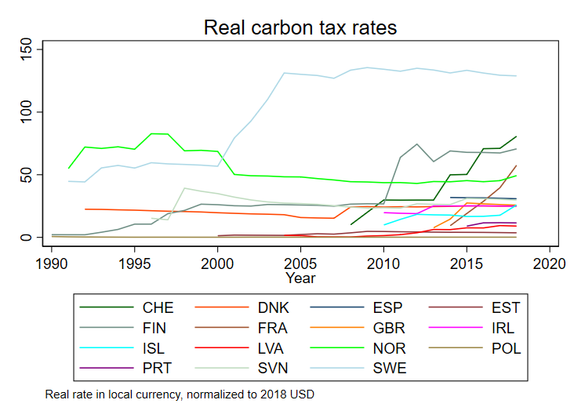
1. Macroeconomics of efficient climate policy: carbon tax evidence (Metcalf-Stock (forthcoming))
Data set:
EU + Iceland + Norway + Switzerland (n = 31)
  all countries in the European ETS
  Of which, 15 also have a carbon tax, almost entirely on emissions not covered by the ETS
Annual, 1985 - 2018
  EU ETS started in 2005
Data sources: World Bank, Eurostat, IEA, Norway, Ireland

Slide 6
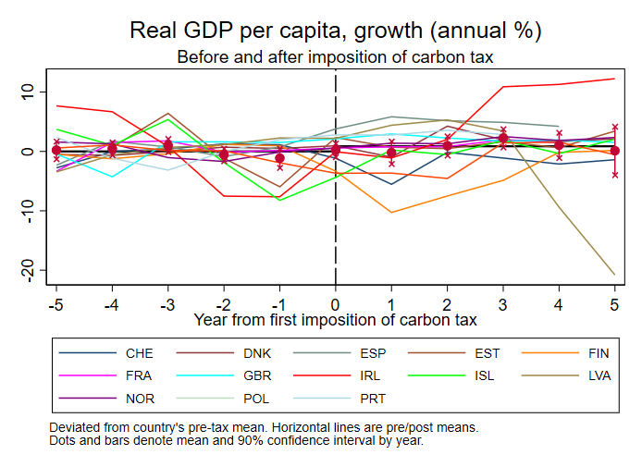
Data description
Event study figure:

Slide 7
Methods and identifying assumptions
Methods
Estimand: cumulative dynamic causal effect of change in tax rate on real variables
Two methods (LP, SVAR), one exogeneity condition (identifying assumptions)
Panel Local Projections:
  Exogeneity condition:
  Note: is h-period ahead cumulative impulse response function in VAR jargon
+ Country fixed effects (rich nations adopt CT)
+ year FE (EU-wide confounders, financial crisis, etc.)
Identification comes from the time series variation: think “SVAR”, not “event study”
Odds & ends:
LP control variables: GDP, total employment, manufacturing employment, GDP price deflator (all in growth rates, lags 1-4)
Also estimate panel structural VAR (bivariate)
Tax rate is interacted with coverage share
Results calibrated to $40 tax covering 30% of emissions
Test & fail to reject parallel paths assumption (i.e., no long-run growth rate effect) – results today impose parallel paths

Slide 8
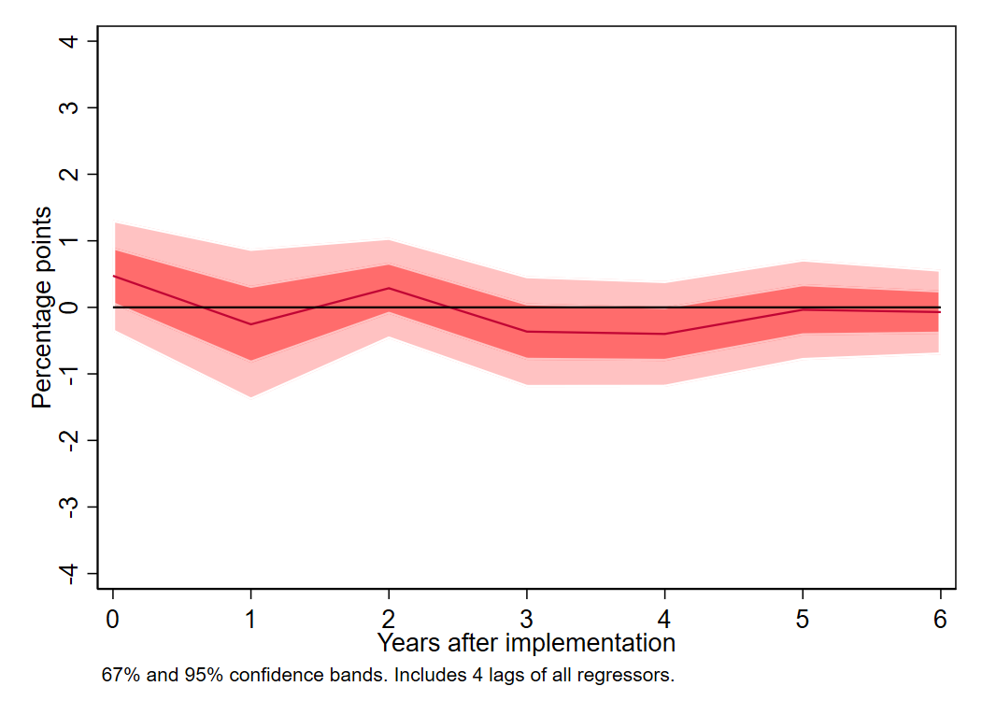
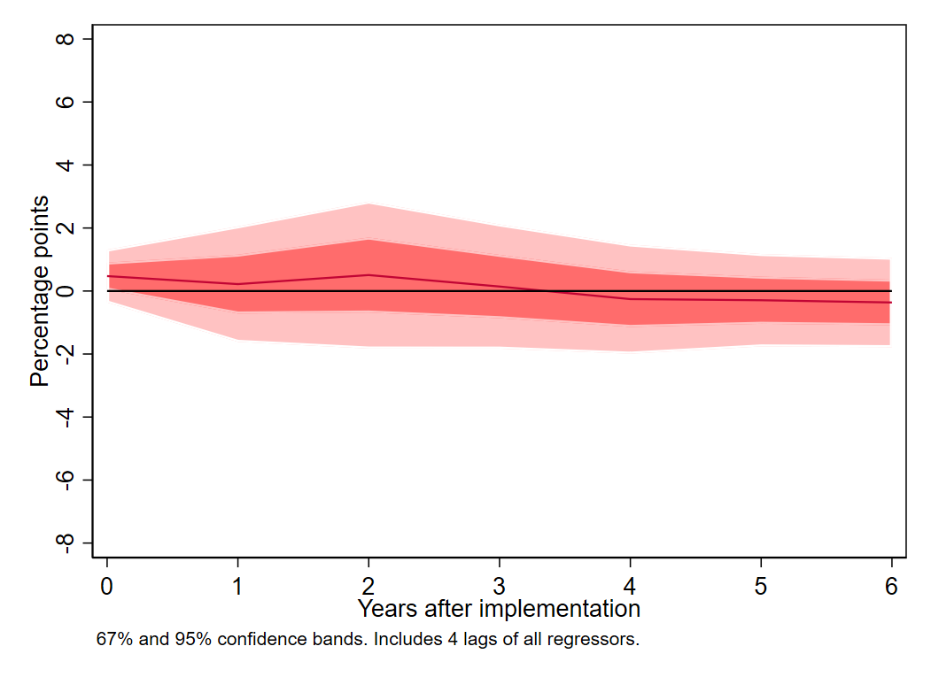
Results: GDP
Dynamic effect of imposing $40 carbon (covering 30% of emissions): GDP
  Sample: EU+
  Method: Panel Linear Projection
  Restricted (i.e., parallel paths)
(a) Growth rate
(b) Log level

Slide 9
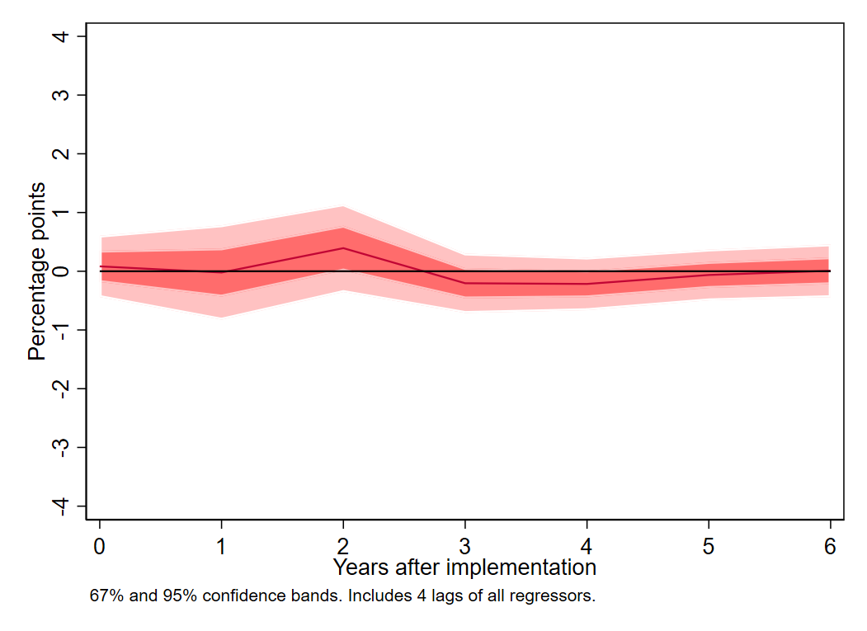
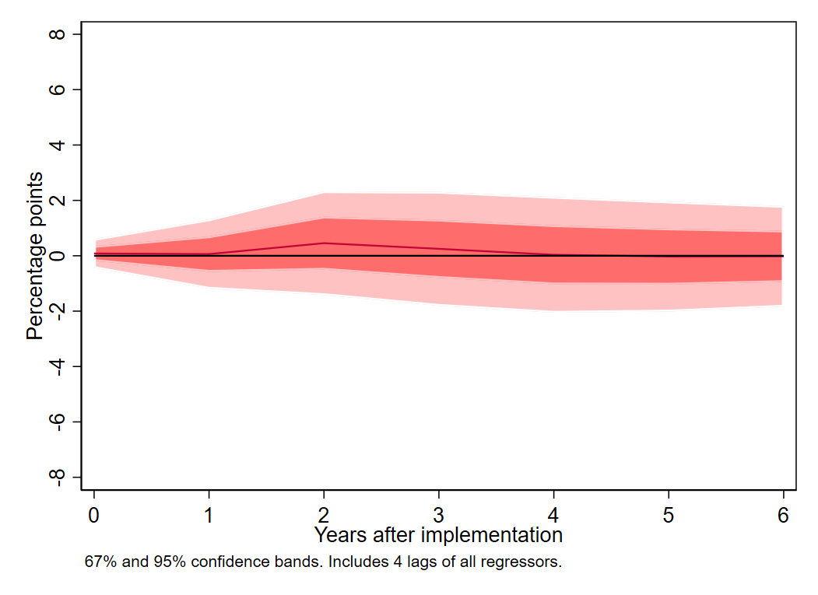
Results: Total employment
Dynamic effect of imposing $40 carbon (covering 30% of emissions): Employment
  Sample: EU+
  Method: Panel Linear Projection
  Restricted (i.e., parallel paths)
(a) Growth rate
(b) Log level

Slide 10
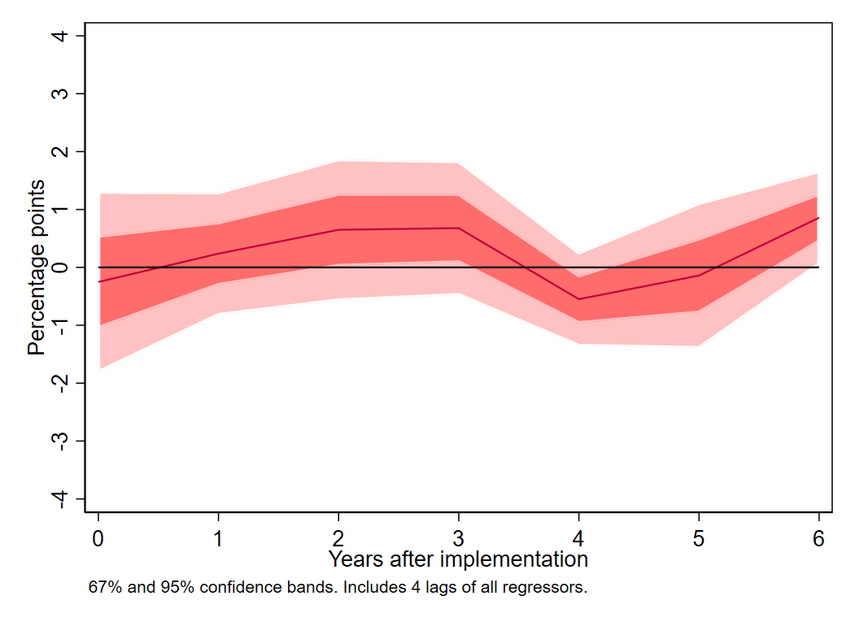
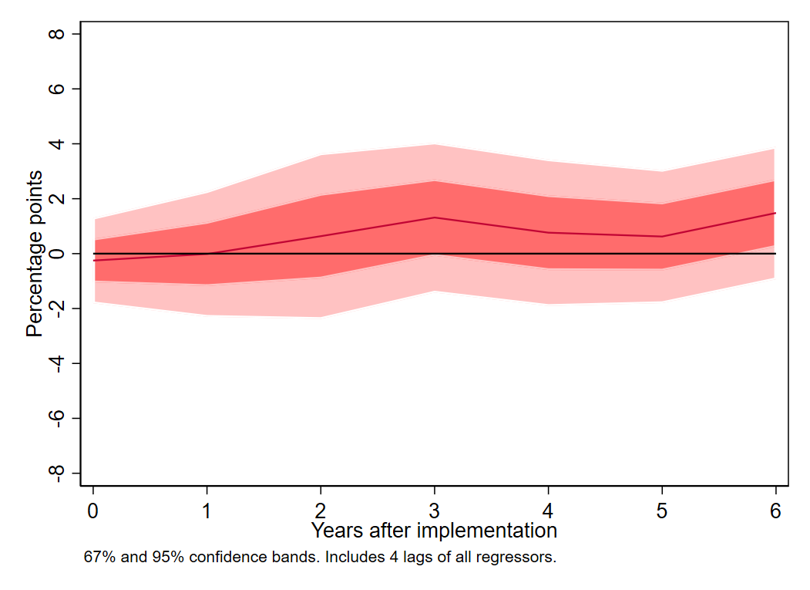
Results: Manufacturing employment
Dynamic effect of imposing $40 carbon (covering 30% of emissions): Manufacturing Employment
  Sample: EU+
  Method: Panel Linear Projection
  Restricted (i.e., parallel paths)
(a) Growth rate
(b) Log level

Slide 11
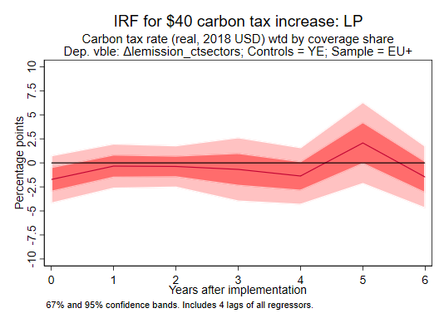
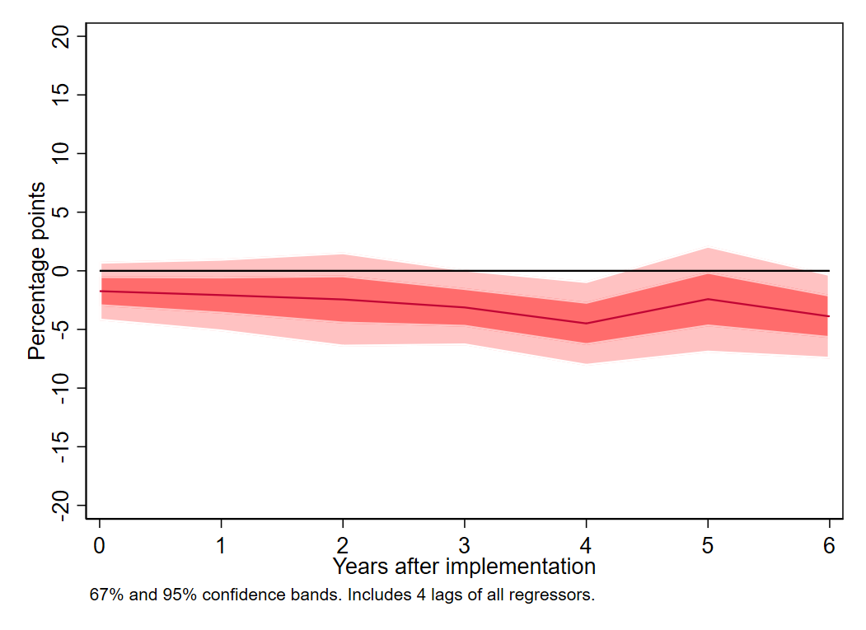
Results: CO2 emissions
Dynamic effect of imposing $40 carbon (covering 30% of emissions): C02 Emissions
  Sample: EU+
  Method: Panel Linear Projection
  Restricted (i.e., parallel paths)
(a) Growth rate
(b) Log level

Slide 12
Impacts of a carbon tax: summary
Key points:
Negligible effect on GDP or employment
  Is more going on? Shifting to clean energy jobs?
  Robust to various cuts of the data & nonlinear specifications
  Some evidence of benefits higher if CT is accompanied by revenue recycling (reductions in other taxes)
Small effect on emissions
  Found in other studies (Green [2021])
  In line with elasticity of demand for petroleum
  But be careful about interpreting this small effect…
GDP (log level)
No effect
Emissions in covered sectors (log level)
2-6% reduction
Employment
(log level)
No effect
initial positive bump?
Source:
Metcalf & Stock (forthcoming)

Slide 13
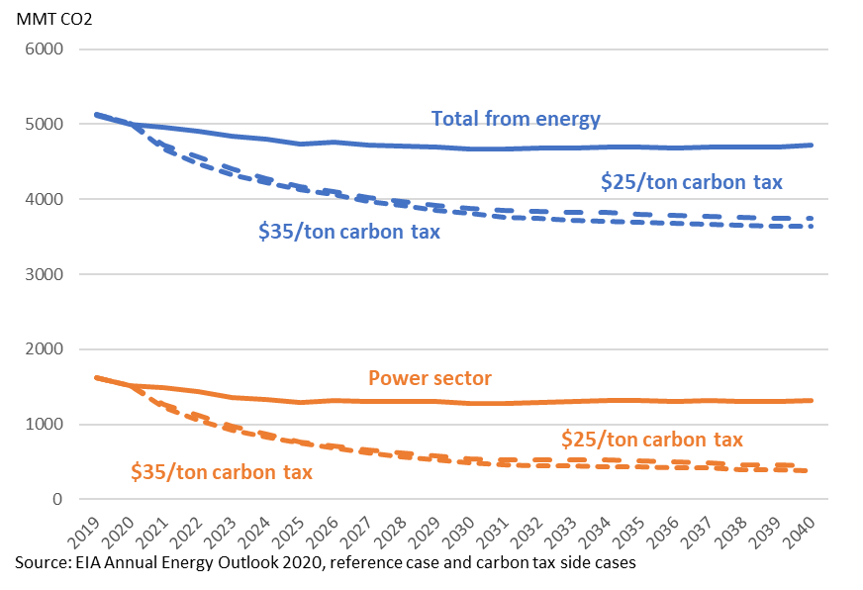
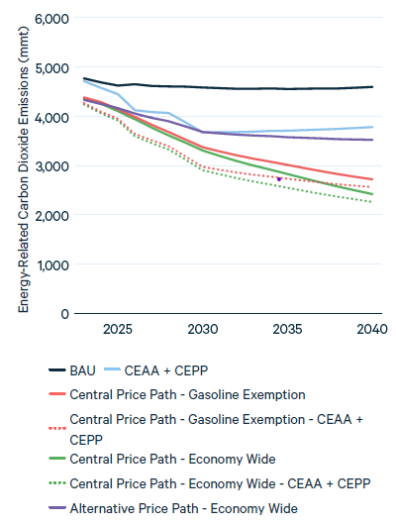
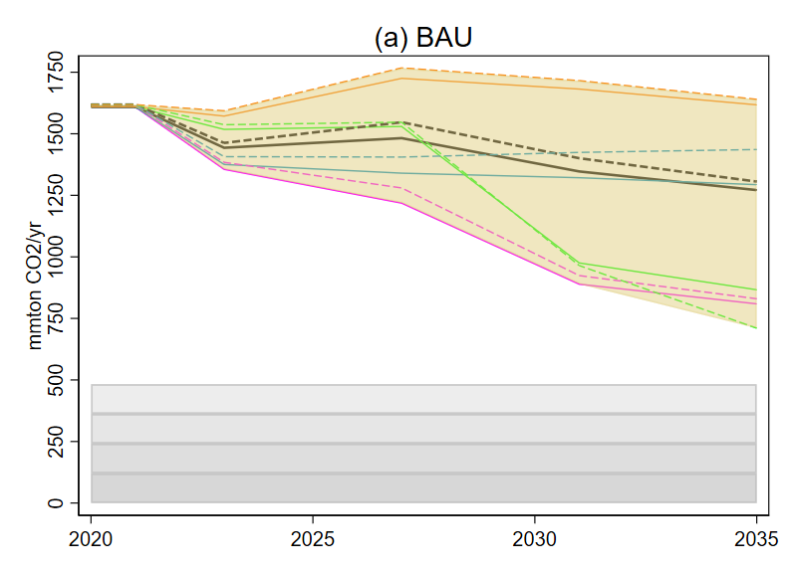
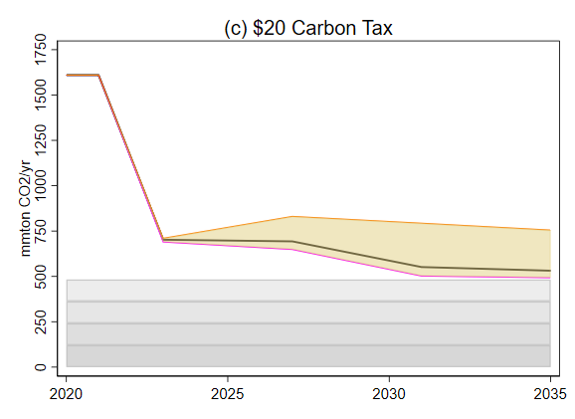
Carbon tax will be more effective if there is a low-carbon alternative!
Growing evidence that carbon tax has small effect on emissions (Green (2021), Metcalf-Stock)
But most CT’s – like the EU CT – cover mainly the transportation sector.
In the US, a CT would cover the power sector too, where much greater emissions reductions are possible.
Three Recent Carbon Tax Simulations for the US
(a) EIA (2021):
Reference case and $25 & $35 carbon tax cases
(b) Stock & Stuart (2021):
BAU & $20 carbon tax, power sector only
(c) RFF (2021):
BAU and $15 carbon tax cases
$15 Carbon tax excluding gasoline

Slide 14


2. Macroeconomics of inefficient climate policy: Policy uncertainty
US climate policy is best characterized as volatile and uncertain. Three examples:
Fuel economy standard
Power sector regulation & legislation (Waxman-Markey, CPP, ACE, CEPP, ???)
Federal Fossil Fuel Leasing Reform
  2015: Obama coal leasing Programmatic EIS & leasing moratorium
    Link royalties to carbon damages?
  2017: Trump reversal, expansion of oil & gas leasing
  Jan. 2021: Biden Executive Order; O&G leasing moratorium & review
    Link royalties to carbon damages?
  Nov. 2021: Largest single offshore lease sale in history
  April 2021: Increase royalties to 18.25% (with loopholes) & restart onshore leasing

Slide 15
2. Macroeconomics of inefficient climate policy: Policy uncertainty
Effect of uncertainty on investment & GDP growth: vast literature
  Theory: Bernanke (1983), Dixit & Pindyck (1994),…,Hassett & Metcalf,…, Aldy & Armitage (2021),…
  Empirical: Baker, Bloom, Davis (2016),…
Focus here on climate policy news
Method:
  Indicators of climate policy news
  SVAR, uncertainty shock ordered first
  VAR variables: industrial production, unemployment rate, CPI, VIX, S&P500, 1-year Tbill rate
  US post -19894, monthly
This work is in progress/preliminary

Slide 16
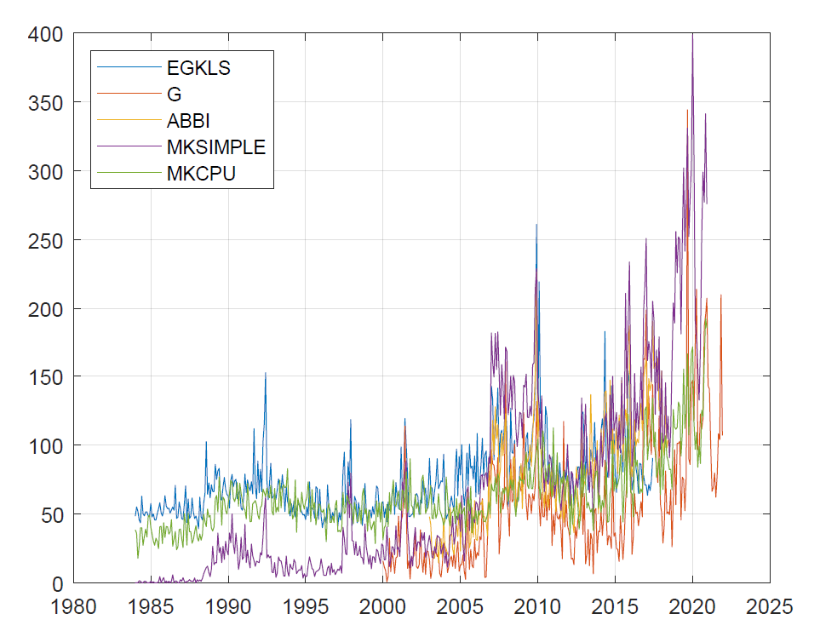
2. Macroeconomics of inefficient climate policy: climate uncertainty
Climate policy uncertainty measure from:
  Engle, Giglio, Kelly, Lee, and Stroebel (RFS 2020)
    EGKLS “Wall Street Journal Climate Change News Index”; vocabulary word cloud below
  Gavrilidis (2021), climate policy uncertainty (8 newspapers, articles including both climate terms and policy terms)
  We extend Gavrilidis (longer sample) using only WaPo & WSJ (MKCPU)
  Policy news spikes include: Kyoto, Fuel economy rules, Clean Power Plan, Trump withdrawal from Paris, etc.
Comment: how to interpret climate policy uncertainty?
    Same issue as the Baker-Bloom-Davis policy uncertainty measure: First or second moments?
Climate news indicators

Slide 17
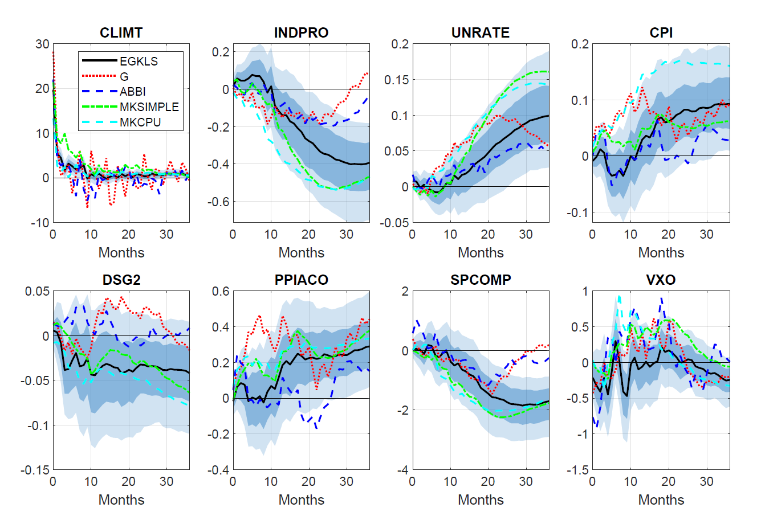
2. Macroeconomics of inefficient climate policy: Policy uncertainty
Preliminary results
Impulse response function with respect to 1 std dev. increase in the climate change news indexes
Note: G (Gavrilidis (2021)) and MKCPU are the two climate policy uncertainty measures; the others are general climate news

Slide 18

3. Digression: “Non-transition” risk: Energy security & Ukraine
Ukraine, natural gas prices, & cyclical implications
of fossil fuel price shocks for US
  Three regimes in US gas markets:
  <= ~2009: growing & large imports
  2010 – 2016: Fracking & “locked in”
  2016 – present: LNG exports
Cheniere Sabine Pass Train 1 was placed into service May 2016.
Quantities

Slide 19
3. Digression: “Non-transition” risk: Energy security & Ukraine
Ukraine, natural gas prices, & cyclical implications
of fossil fuel price shocks for US
  Three regimes in US gas markets:
  <= ~2009: growing & large imports
  2010 – 2016: Fracking & “locked in”
  2016 – present: LNG exports
Correlation between n-week pct change of Brent crude & Henry Hub gas
 | 2-week | 4-week
I. 2000-2009 | 0.28 | 0.21
II. 2010-April 2016 | 0.08 | 0.03
III. May 2016-present (x 2020) | 0.18 | 0.22
Prices

Slide 20
3. Digression: “Non-transition” risk: Energy security & Ukraine
Ukraine, natural gas prices, & cyclical implications
of fossil fuel price shocks for US
  Three regimes in US gas markets:
  <= ~2009: growing & large imports
  2010 – 2016: Fracking & “locked in”
  2016 – present: LNG exports
Correlation between n-week pct change of Brent crude & Henry Hub gas
 | 2-week | 4-week
I. 2000-2009 | 0.28 | 0.21
II. 2010-April 2016 | 0.08 | 0.03
III. May 2016-present (x 2020) | 0.18 | 0.22
Discussion
Henry Hub & EU gas prices are currently not linked
  Liquifaction + transport + regasification
  ≈ $4-7/mmBTU
But suppose:
  Russian gas partially shut in over 5-year horizon
  Expansion of US LNG export capacity & EU liquefaction capacity
$5-6 US gas?
Volatile oil prices for the foreseeable future?
Volatile US gas prices for the foreseeable future?
Oil price shocks will impact power & industrial sectors?
Greater macro (business cycle) exposure to oil price shocks?

Slide 21
Concluding remarks
Macro costs of a carbon tax are small
  Arguably true for durable & predictable second best policies like investment tax credits, power sector CES, or innovation policy
Climate policy uncertainty appears to have macro costs
  Uncertain policy isn’t the same as inefficient policy
  In the US, we have had policy uncertainty but few actual policy changes – essentially no meaningful federal climate policy aside from fuel economy standards
  No policy increase future transition costs and physical risks
  Policy swings that result in no policy further impose macro costs
The recent tragedy in Ukraine…
  highlights – and exacerbates going forward? – US vulnerability to international oil price shocks, and
  Suggests a world with higher natural gas and oil prices which, all else equal will expedite the energy transition

