Slide 1

Study Center Gerzensse: Advanced Courses in Economics
The Economics and Econometrics of Climate Change Policy:
A. Introduction and Overview
James H. Stock
Economics Department and Harvard Kennedy School,
Harvard University
May 30 – June 3, 2022

Slide 2


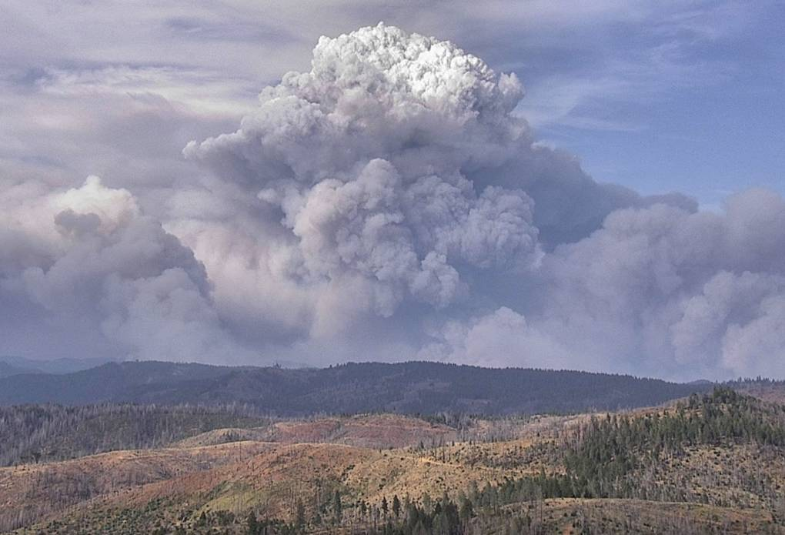
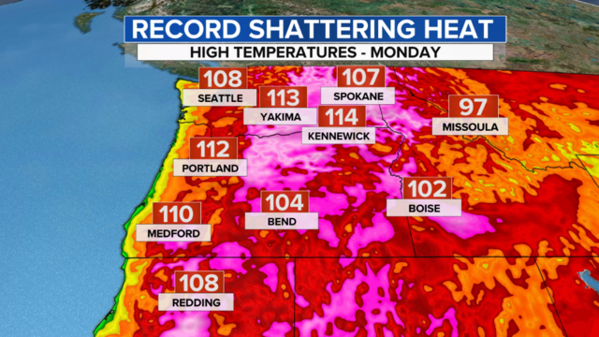
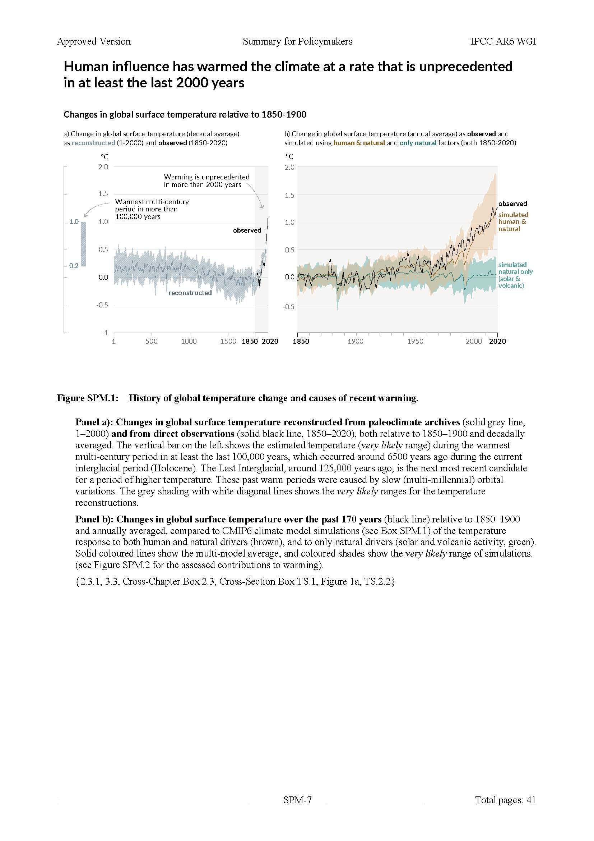




Why study climate economics?
Economists have a critical role in understanding the economic impacts of climate change and in shaping climate change policy.

Slide 3
Course outline
I. Introduction
Introduction & Overview
  Climate change science and CC econometrics (brief)
  Framework economic concepts
  Cost-benefit analysis, cost effectiveness analysis, SCC & TCP
  Marginal abatement curve
III. Damages
Macroeconomic implications of the energy transition
  Physical & transition costs
  Physical costs: damage estimates
  Transition costs: policy
    Carbon tax
    Cap & trade
    Policy uncertainty
The Social Cost of Carbon: Recent developments (time permitting)
II. Emissions reduction (mitigation/decarbonization)
Sectoral carbon policies – theory & empirical evidence
  Carbon tax, cap & trade
  Clean energy standards; investment & production tax credits
  Policy simulations
  Criticisms & the case for sectoral standards
Carbon pricing with leakage: Supply side policies
  Supply side policies as carbon pricing with leakage
  Supply side policy with leakage: US O&G royalties
  Extension to international trade & BCA
The electric vehicle revolution
  Transport sector overview, EVs, & literature review
  Modeling charging station v. vehicle subsidies
  More on charging stations & current research

Slide 4
1. Climate Science: Warming is rapid and anthropogenic
Source: IPCC AR6, WG1 (August 2021)

Slide 5
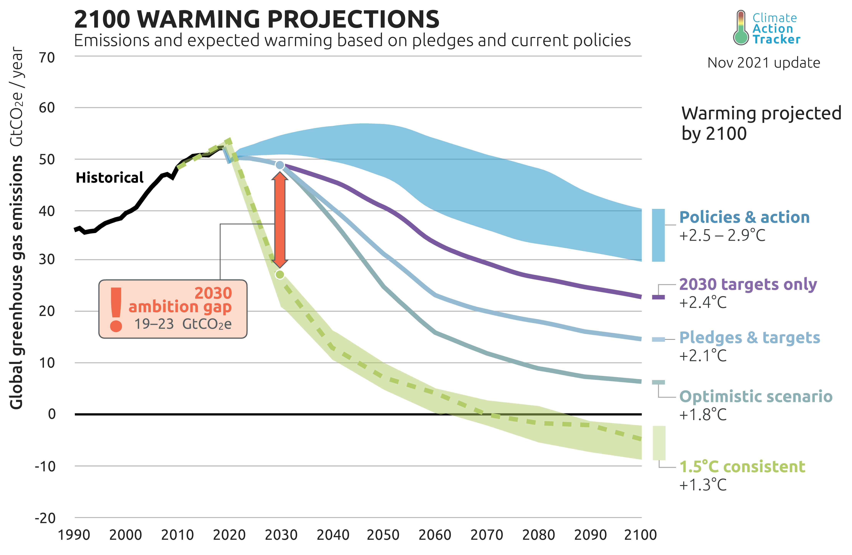
Climate Science: Emissions paths

Slide 6
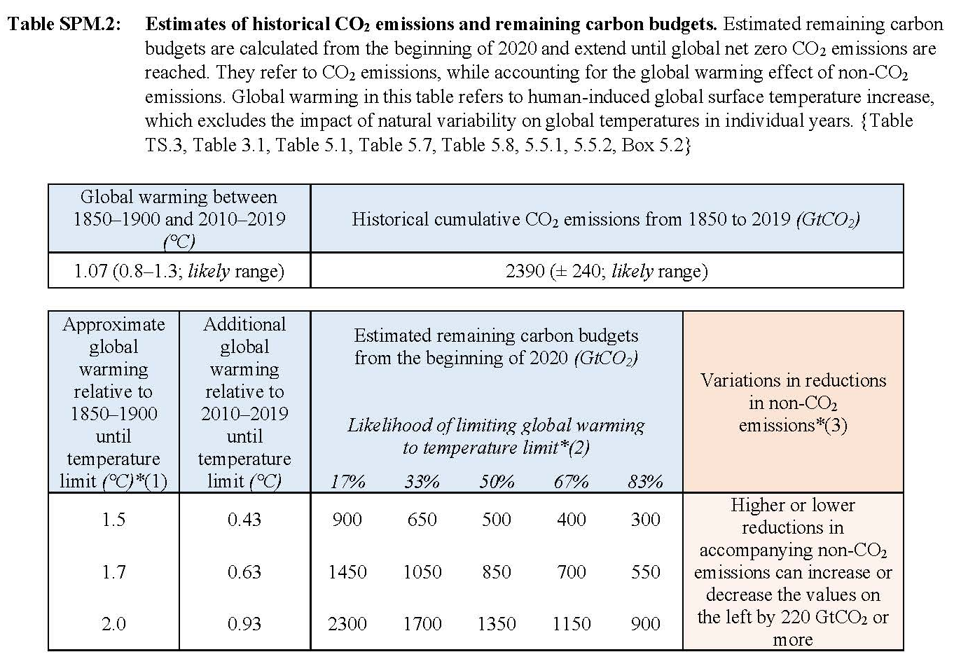
Climate Science: Carbon budgets
Source: IPCC AR6 SPM (August 2021)

Slide 7
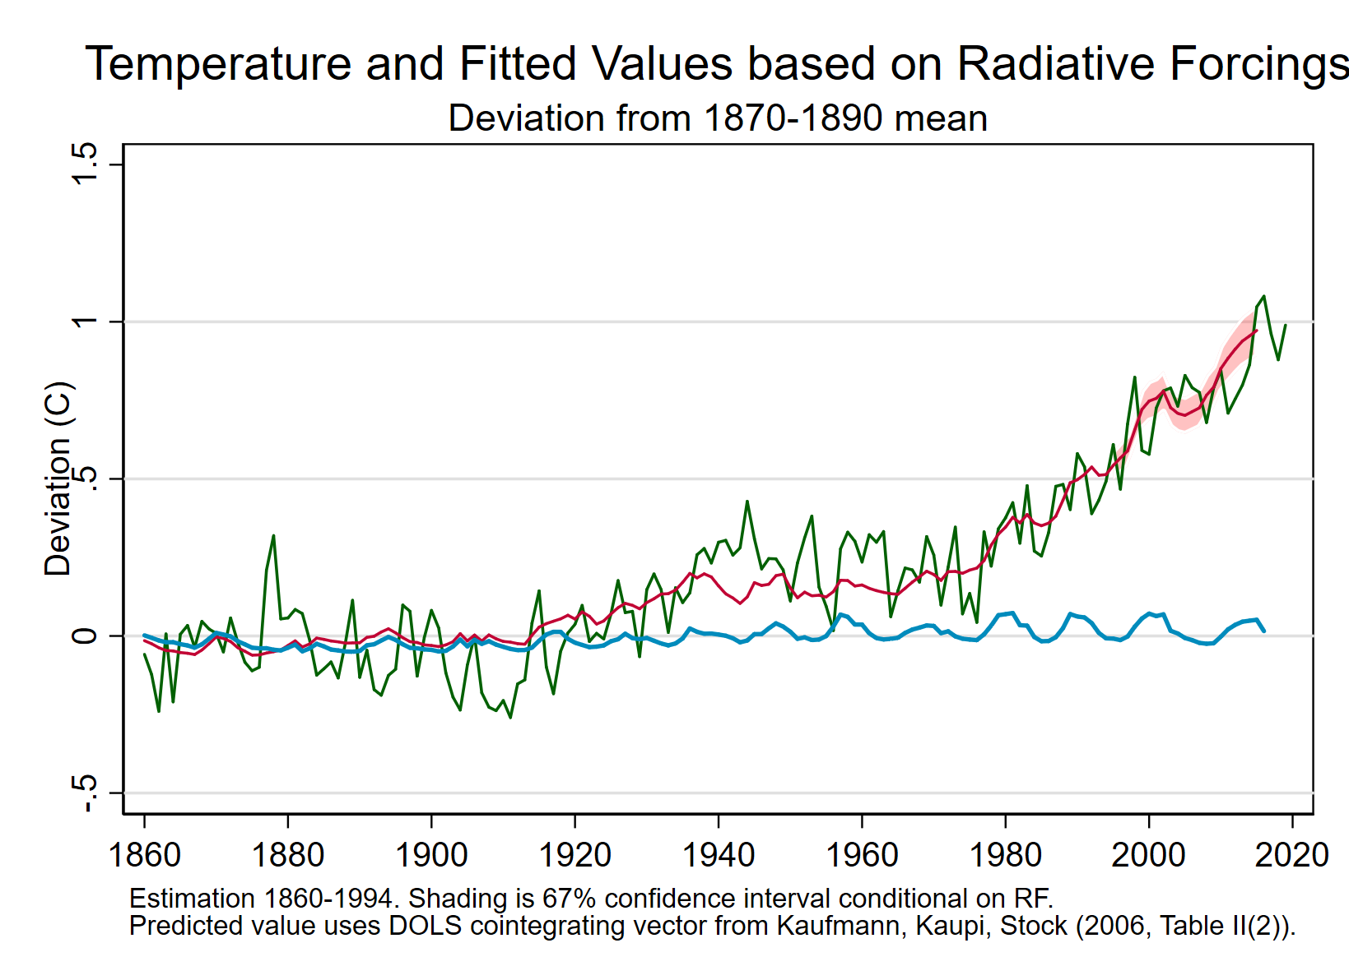
Climate Science & Climate Econometrics: Warming decomp
Climate models
Empirical models
Solar only (anthropogenic RF fixed at 1870-1890 means)
Data: annual data on temperature and Radiative Forcings from CO2, methane, CFCs, N2O, SOX, Solar, stratospheric sulfates; North Atlantic & southern oscillations.
Estimation method: Cointegration (DOLS)
Source: Kaufmann, Kauppi, & Stock (2006); Stock (2019)
Source: IPCC AR6 SPM (August 2021)

Slide 8
Climate Science & Climate Econometrics: short-term response (short-term TCR)
What are the short-run dynamics of temperature in response to a pulse of CO2? (Montamat-Stock ([2020])
Transient climate response = TCR = Temperature response to a doubling of CO2 concentrations @ 1%/year (= 70-year increase contemporaneous with a 70-year doubling)
h-year TCR: h-year response to h-years of 1% concentration growth, put into doubling units
Problems
Exogeneity issue: earth system feedback from temperature to CO2 – so emissions today = exogenous pulse (anthropogenic) + lagged endogenous responses. (Scatterplot has this problem.)
Stochastic trend (unit root)
Try natural experiments identification using short-run changes.
Lots of natural experiments:
~11-year solar cycles
Great depression
Montreal protocol (CFCs)
Widespread adoption of motor vehicles
Instrument lists
Solar, CO2 from vehicles
Non-vehicle anthropogenic CO2, anthropogenic SOX, CFCs
Source: Montamat & Stock (Climatic Change 2020)

Slide 9
Climate Science & Climate Econometrics: short-term response (short-term TCR)
Specification
  Δ_{h}Temp_{t} = β_{Temp}Δ_{h}RF_{t} + β_{Temp}Δ_{h}RF_{t}^{volcanic} + u_{t}
Estimand: h-year response to contemporaneous sustained CO2 pulse
  = h-year transient climate response (TCR) (normalized to doubling for comparability)
Instrument lists
  Solar + CO2 from vehicles
  All anthropogenic CO2 + anthropogenic SOX + CFCs
Econometric odds & ends
  Serially correlated error -> HAR SEs
  Potentially weak instruments -> Anderson-Rubin (1949) confidence intervals (with HAR SEs)
  Large window on Newey-West SEs -> fixed-b critical values for the AR t statistic (see Lazarus, Lewis, Stock ECMA (2021))
  Can test overidentifying restrictions if instruments are strong
Source: Montamat & Stock (Climatic Change 2020)

Slide 10
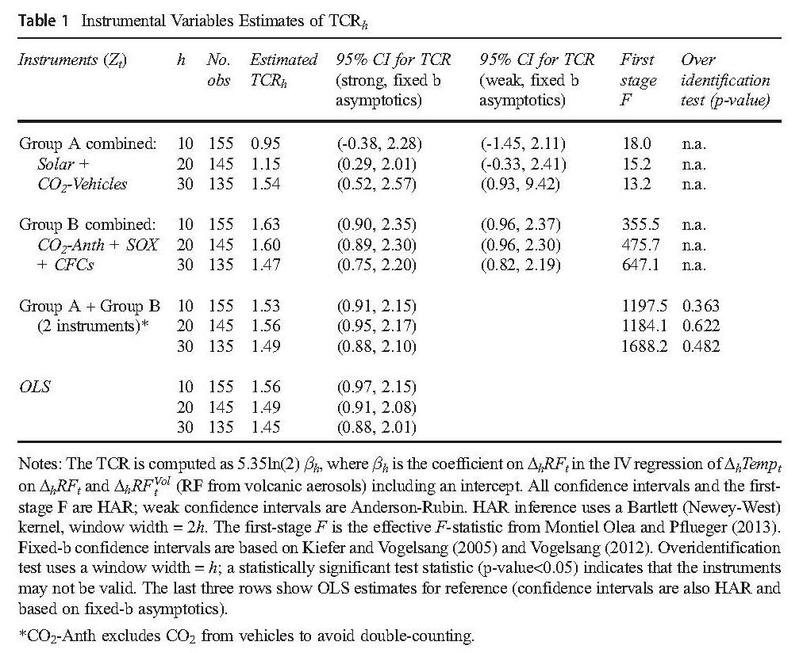
Climate Science & Climate Econometrics: short-term response (short-term TCR)
Source: Montamat & Stock (Climatic Change 2020)

Slide 11
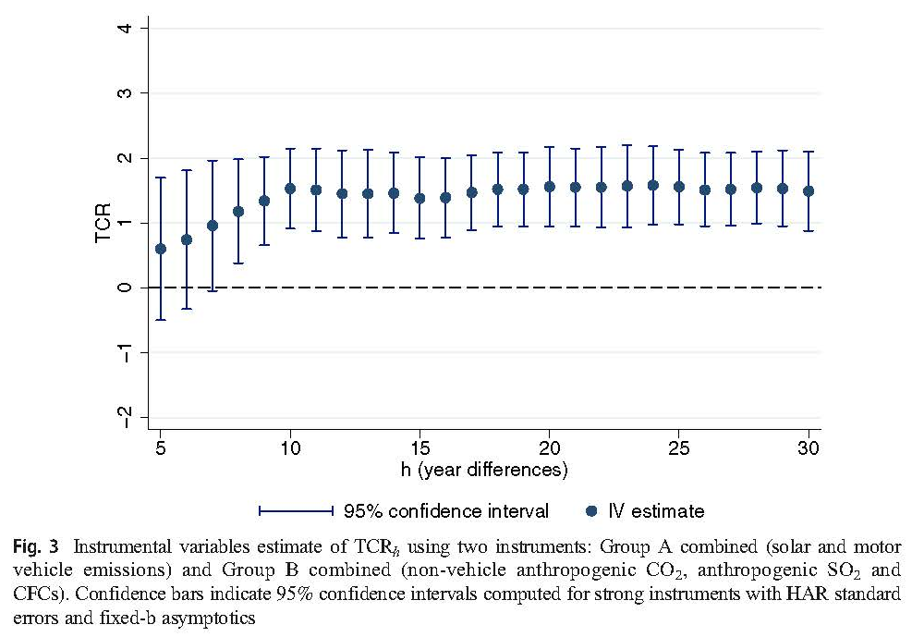
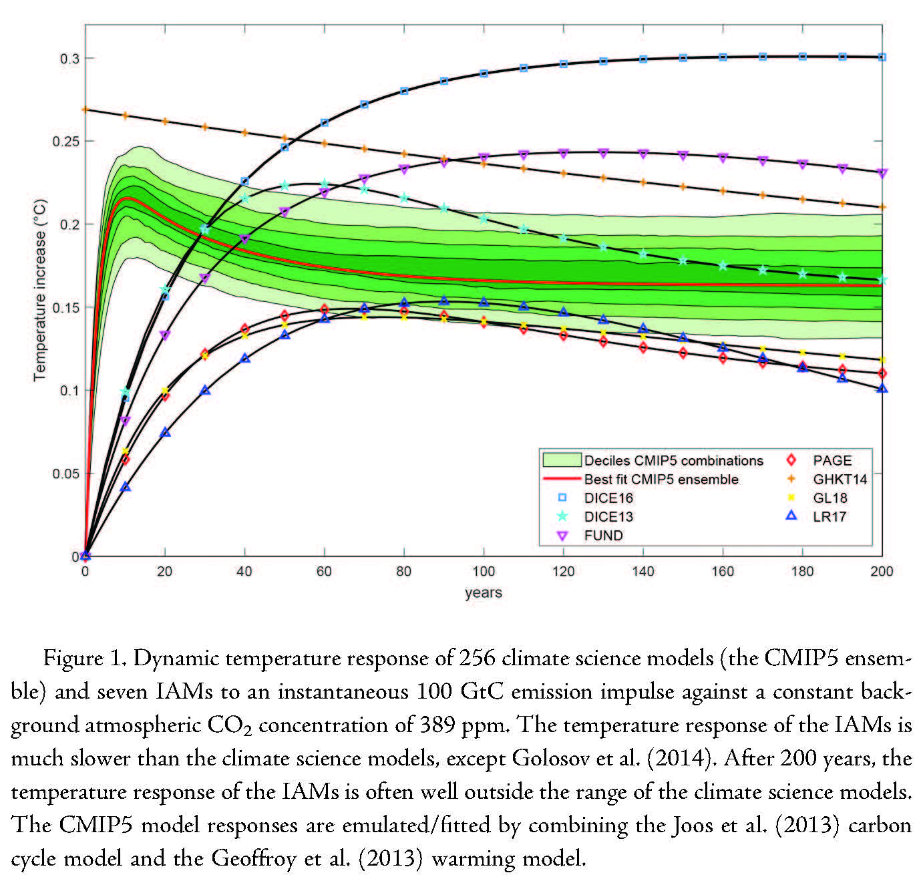
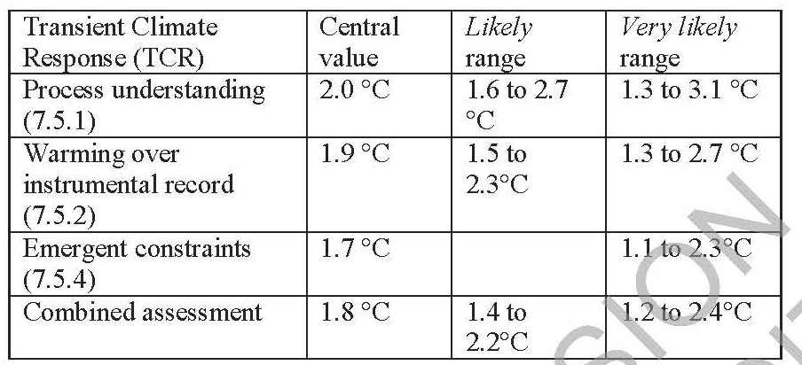
Climate Science & Climate Econometrics: short-term response (short-term TCR)
What are the short-run dynamics of temperature in response to a pulse of CO2?
Source: Montamat & Stock (Climatic Change 2020)
Table 7.14: Summary of TCR assessment
Source: IPCC AR6 WG1 ch. 7 (2021)
Source: Dietz et al (JAERE 2021)

Slide 12
Climate Science & Climate Econometrics: some references
Current research:
  http://www.climateeconometrics.org/conference2021/
Spatial-temporal
  Atak, Linton, and Xiao, J. Econometrics (2011)
  Bau, McInerny, and Stein, Environmetrics (2016)
  Castruccio and Stein, Ann. Appl. Stat. (2013)
  Chang et. al. (2016)
Longer data sets (500 year; paleo)
  Dergiades and Kaufmann, J Env Econ Mgt (2016)
  Davidsonm, Stephenson, Turasie, Environmetrics (2016)
  Kaufmann and Pretis, Climate of the Past DIscussions (2020)
ECS/TCR
  Kaufmann, Kauppi, Stock, Climatic Change (2006)
  Montamat & Stock, Climatic Change (2020)
  Pretis, J. Econometrics (2020)
  Storelvmo, Leirvik, Johmann, Phillips, Nature Geoscience (2016)

Slide 13
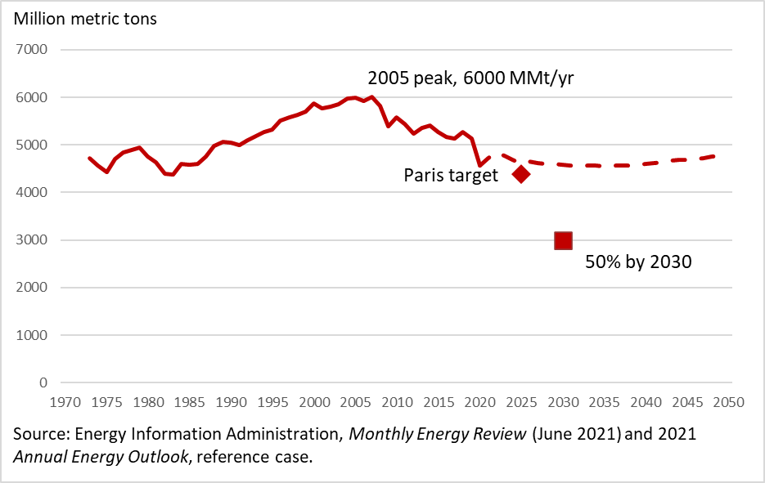
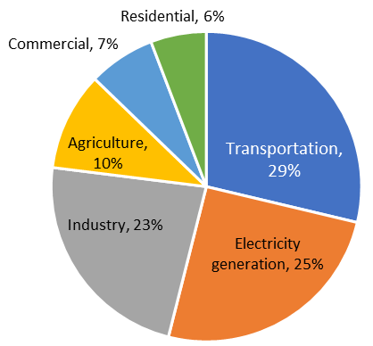
2. Framework concepts: (i) US CO2 Emissions
US CO2 emissions from energy: historical and projected (US EIA, Annual Energy Outlook 2021)
US GHG Emissions by Sector, 2019
Sources: EPA Greenhouse Gas Inventory, EIA AEO 2021

Slide 14
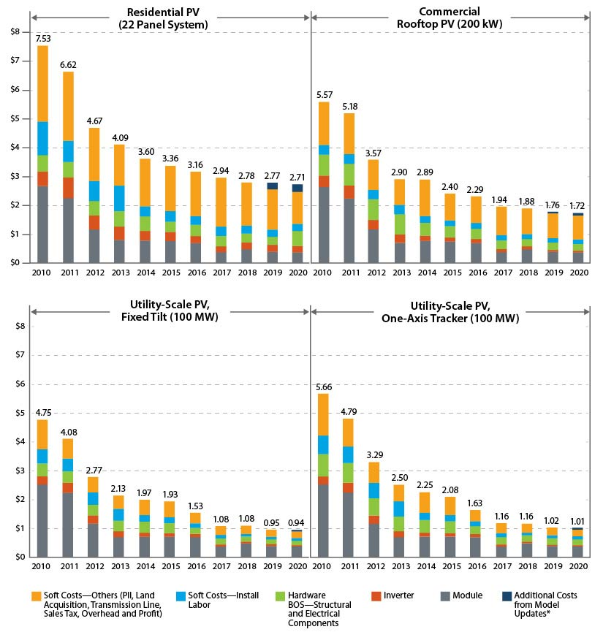
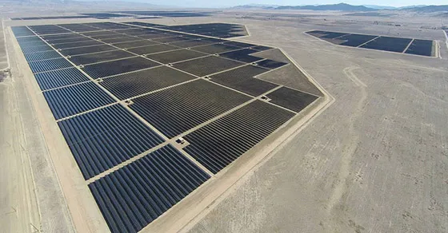
Framework concepts: (ii) Evolving cost landscape
The cost of US utility-scale solar farms fell 16% from 2010-2020
Costs are for a fully installed operational system, excluding financing costs
Cost declines were driven by module cost declines, which in turn were driven in large part by learning-by-doing (Nemet 2019, Gerarden 2019)
There were also some learning-by-doing cost reductions in residential solar installation (Bollinger & Gillingham 2019)
Source: NREL (2021)
Solar Star, California (579 MW, 13 km²)

Slide 15
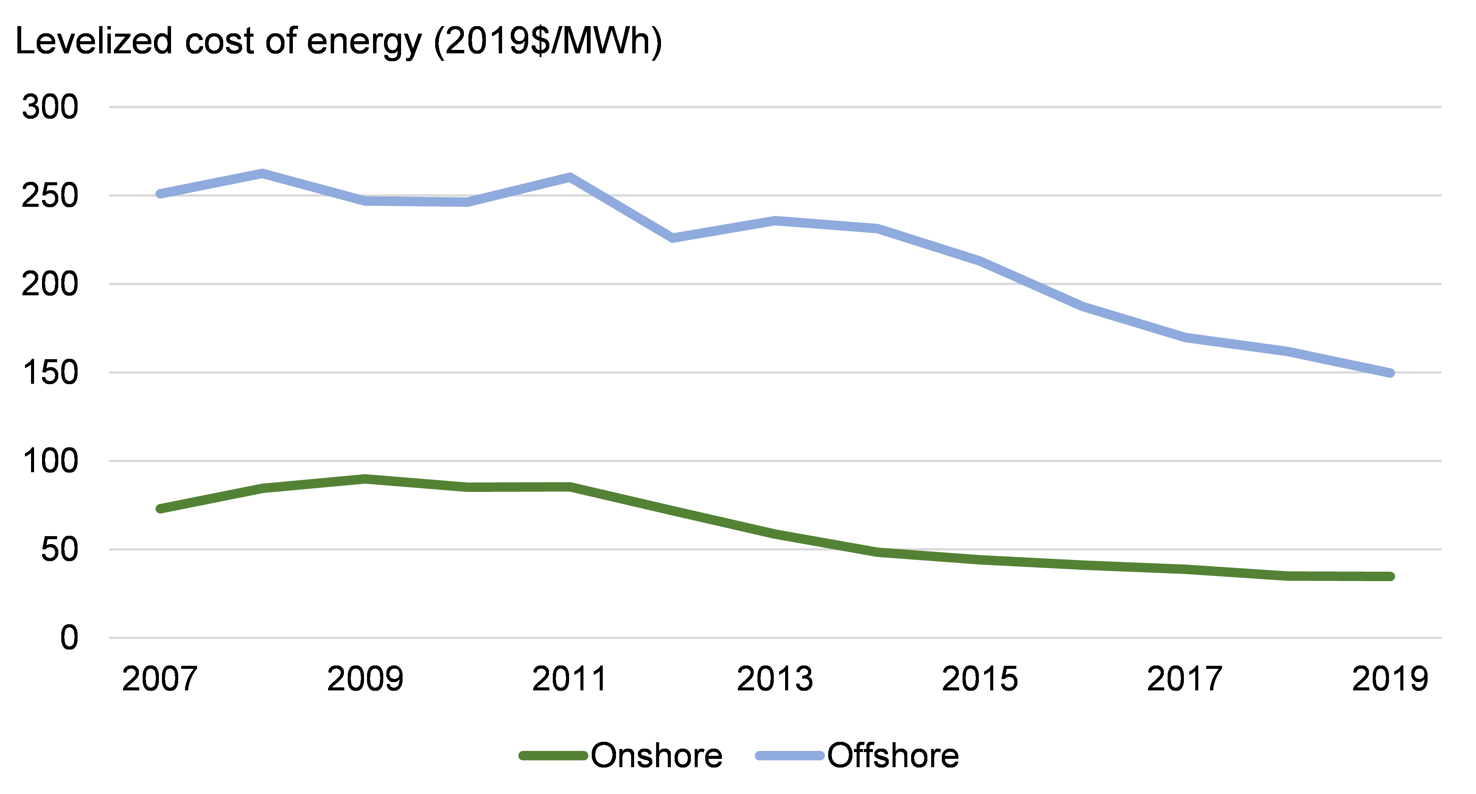
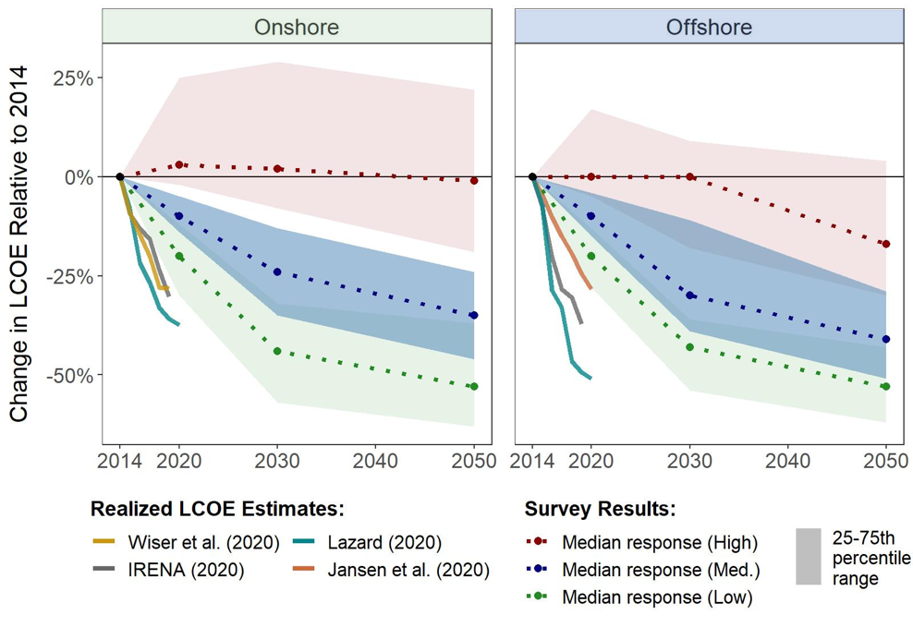

Framework concepts: (ii) Evolving cost landscape
Wind generation prices fell more than predicted
  Upper: Average levelized cost of wind energy (2019 = $35/MWh)
  Lower: 2015 predicted declines and actuals
Source: Lawrence Berkeley Lab (2021); Wiser et al (Nature Energy, 2021)
Aurora Wind Project, North Dakota (2999 MW, 71 turbines)

Slide 16
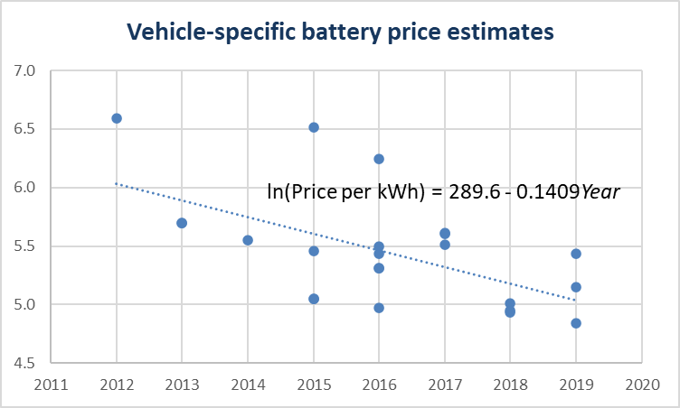
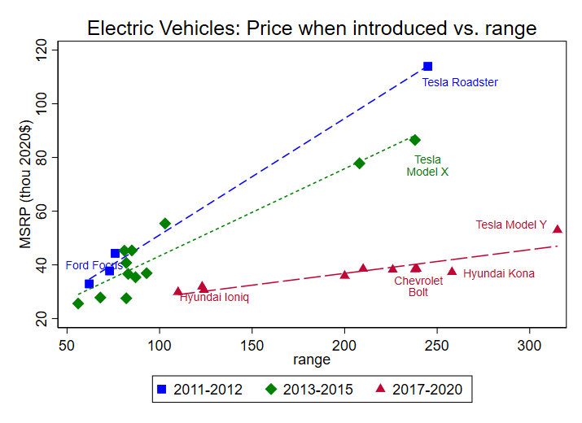
Framework concepts: (ii) Evolving cost landscape
And so have the costs of batteries & EVs
  Upper: Estimated battery pack costs for EVs, 2012-2019 (Kapoor et al Nature Climate Change 2015, updated). Annual price decline 14%/yr
  Lower: MSRPs for EVs v. Range, 2011-2020. Rate of decline of slope is ~16%/yr.
Source: Lawrence Berkeley Lab (2021); Wiser et al (Nature Energy, 2021)

Slide 17
Framework economic concepts: (iii) Optimal carbon pricing
Economic policy for mitigating emissions emerged when low-carbon energy was prohibitively expensive
Nordhaus (AER P&P 1982):
where
f = economy-wide production function assuming energy use is proportional to emissions
h = damage function from cumulative CO2 emissions
b = CO2 Earth uptake rate (close to zero – very long half-life in atmosphere)
Social planner optimal steady state: Let q(t) = shadow value of carbon = incremental consumption cost from increment in emissions. In steady state,
In words: Shadow cost of carbon = marginal cost of abatement = marginal NPV of damages
That is: Carbon price = marginal cost of abatement = SCC (dynamic version of Pigovian taxation)
Key features: => single energy source, single externality, single policy tool (carbon price)
=> Policy analysis as marginal cost = marginal benefit that is carbon price = SCC
=> economics of self-restraint

Slide 18
Framework concepts: (iv) Multiple externalities, multiple policies
Externalities/market failures
Greenhouse gas externality
Innovation externality
  Any non-appropriable invention or idea: scientific/engineering invention, learning-by-doing, process & management innovations
Network externalities (e.g., EV charging stations and chargers)
Other market failures: market power, incomplete information, …
Policies
General principle: Need (at least) as many policy instruments as market failures
Carbon pricing
Subsidies for R&D, commercialization
Network-specific policies such as charging station subsidies & grid modernization
Policy analysis
Policy effects & overlapping policies
Cost-benefit analysis
  Climate benefits & the Social Cost of Carbon (SCC)
Cost-effectiveness analysis
  Carbon budget and target-consistent price
Retrospective v. prospective
  How much did RPSs cost in hindsight?
  How much will CES cost going forward?
Very important to recognize/address policy interactions & overlapping policies

Slide 19
Framework economic concepts: (v) Chaotic policy landscape
Policy landscape
Sectoral
Clean Electricity Standard
Fuel economy standards
EV subsidies
Fossil methane production regulations
Green (or brown) tax breaks – ITC, PTC, intangible drilling, CCS tax credit,…
Economy-wide
Carbon tax
Border carbon adjustments
Innovation policy
EU Hydrogen initiative
R&D support
Nascent technology tax credits
Demonstration projects
Demand-pull programs (standards)
Supply side
Pipelines
Transmission lines
Keep-it-in-the-ground
Subnational
Renewable portfolio standards
Natural gas mandates
Building codes, gas hookups,…
EV subsidies…
Private contributions
Fly less
Eat vegetarian
Buy carbon offsets
Corporate green pledges
ESG
Activist investors
Financial/monetary
Carbon disclosures
Climate risk disclosures
Green bonds
Green infrastructure banks
Green monetary policy

Slide 20
3. Cost-benefit & cost-effectiveness analysis: the SCC & the TCP
Three views on decarbonization policy:
Adopt a policy if the benefits exceed the costs (CBA)
Adopt the lowest-cost projects & policies that keep below (say) +2ºC
We are in a climate emergency: do everything, whatever it takes, to decarbonize

Slide 21
Cost-benefit & cost-effectiveness analysis: the SCC & the TCP
Three views on decarbonization policy:
Adopt a policy if the benefits exceed the costs (CBA)
Adopt the lowest-cost projects & policies that keep below (say) +2ºC
We are in a climate emergency: do everything, whatever it takes, to decarbonize
Cost-benefit analysis is the estimation the costs and benefits of a policy, and the comparison of costs and benefits.
For an emissions mitigation policy, the costs are the abatement costs of reducing CO2 emissions by one ton.
Costs can be static or dynamic, and in any event are measured over a discrete time period.
A “small” policy is cost-beneficial if its abatement cost < SCC (marginal cost < marginal benefit)
The Social Cost of Carbon (SCC) is the monetized net present value of the damages arising from emitting 1 extra (metric) ton of CO2 in a given year.
The SCC is a schedule and varies by year, mainly because marginal damages are increasing in CO2 concentrations
The SCC is a general economic concept (“estimand”) which is estimated using a combination of theoretical models, calibrated structural models, and econometric estimates.
The estimates are very sensitive to the discount rate or method.
Current USG estimate $51/mton. Two leading US teams have estimates in the $150-$200/ton (more later, perhaps).

Slide 22
Cost-benefit & cost-effectiveness analysis: the SCC & the TCP
Three views on decarbonization policy:
Adopt a policy if the benefits exceed the costs (CBA)
Adopt the lowest-cost projects & policies that keep below (say) +2ºC
We are in a climate emergency: do everything, whatever it takes, to decarbonize
Cost-effectiveness analysis is the estimation of costs of competing policies that achieve the same (narrowly-defined) goal and comparing costs across policies to find the least-coast (most cost-effective) way to achieve that goal.
For example, among 3 policies that achieve the same goal, the policy with the lowest cost is the most cost-effective.
In climate policy, CEA arises from an exogenously-determined carbon budget or temperature target.
The Target-consistent price (TCP) is least-cost price (path) for a suite of policies and projects to achieve the target.
Project evaluation no longer requires comparing costs to benefits – just choosing projects with a price ~≤ TCP
The TCP is very hard to calculate – it depends on future technologies.
Comments
View #3 won’t lead to durable, or even necessarily effective, decarbonization policy. Optimize s.t. budget constraint.
CBA and CEA are related but fundamentally different. A policy could pass a CEA test but not a CBA test & vice versa.

Slide 23
4. Marginal abatement curve
The marginal abatement curve is a supply curve – but for less of a “bad” (greenhouse gas) instead of more of a good
Price ($/metric ton CO2)
Marginal abatement curve
Expensive stuff –
like removing CO2 from a power plant exhaust stream and injecting it permanently underground (carbon capture & storage, or CCS)
Inexpensive stuff – like using LED light bulbs
Tons of CO2 abated
The marginal abatement curve informs policy in two ways:
Adopt policies up to some cutoff price – but what is that price?
Adopt policies that might make the marginal abatement curve more attractive over time

Slide 24
Marginal abatement curve and SCC
Maximization principle: Marginal cost = marginal benefit
Price ($/metric ton CO2)
Marginal abatement curve
Marginal benefit curve
SCC
Tons of CO2 abated
Benefits = benefits from avoided emissions = avoided damages
The monetized value of damages from emitting an additional ton of CO2 is called the Social Cost of Carbon
At a given point in time, we think the marginal benefits curve (marginal damages) is essentially constant, at the SCC
This delivers the rule, undertake abatement up to the point that its marginal cost = SCC

Slide 25
Marginal abatement curve and SCC
An important criticism of the approach so far is that it ignores effects of policies over time
Policies that drive technologies shift the marginal abatement curve
Price ($/metric ton CO2)
Marginal abatement curve
SCC
Tons of CO2 abated
Technological innovations today reduce the cost of abatement in the future
Driving down costs of electric vehicles, wind, and solar
New technologies, such as hydrogen for long-haul trucking…

Slide 26
Marginal abatement curve and SCC
An important criticism of the approach so far is that it ignores effects of policies over time
Policies that drive technologies shift the marginal abatement curve
Price ($/metric ton CO2)
Marginal abatement curve
with carbon removal backstop?
SCC
Tons of CO2 abated
Technological innovations today reduce the cost of abatement in the future
Driving down costs of electric vehicles, wind, and solar
New technologies, such as hydrogen for long-haul trucking…
And carbon removal technologies become a backstop

Slide 27
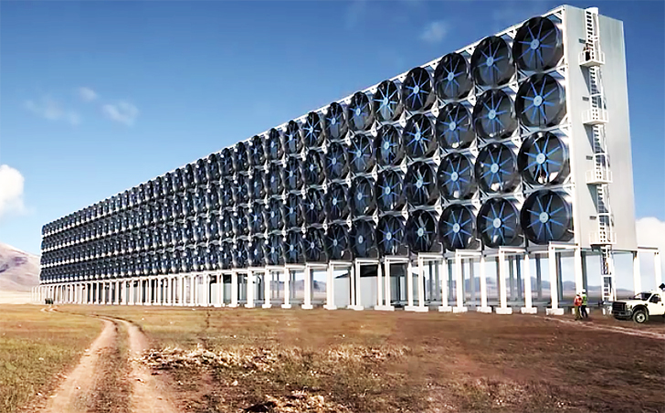
Marginal abatement curve and SCC
Digression – what is a carbon removal technology?
Planting trees
Planting trees, burning them, capturing the carbon, and burying it
Direct air capture

Slide 28
Marginal abatement curve and SCC
A negative emissions future?
Price ($/metric ton CO2)
Marginal abatement curve
Marginal benefit curve
Tons of CO2 abated

Slide 29
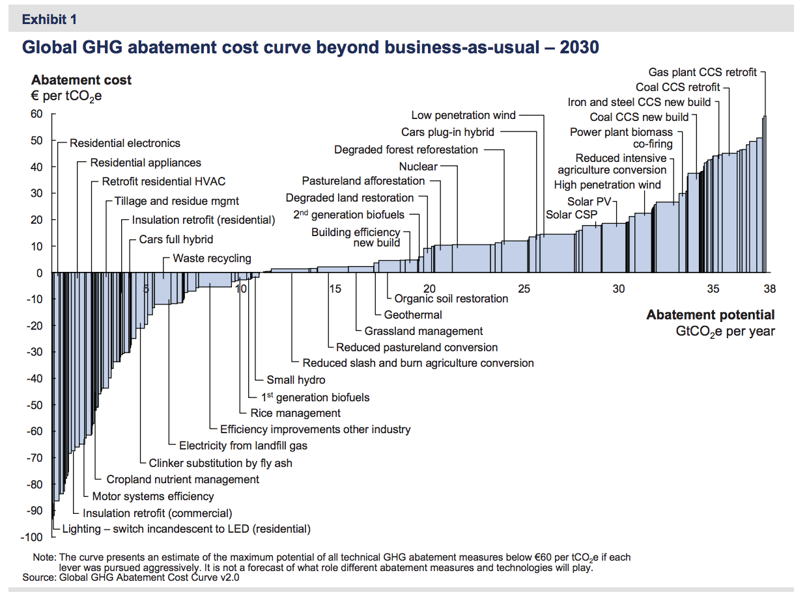
Marginal abatement curve
The McKinsey marginal abatement cost curve (McKinsey (2009))
Shortcomings/critiques
Out of date
Engineering estimates that might not be realized in practice
Doesn’t incorporate behavioral response (no rebound effect)
Average, not marginal, within block
Large “free” reductions!?
  Energy efficiency paradox
  Fowlie, Greenstone, & Wolfram (QJE 2018)
  Brandon et al, “Smart Tech, Dumb Humans” (ms 2021)
More importantly:
  States and the USG generally don’t build these projects – they implement policies that incentive/mandate these projects.

Slide 30
Marginal abatement curve: Engineering approach
Technology | Cost Estimate ($2017/ton CO₂)
Onshore Wind | 25
Natural Gas Combined Cycle | 27
Utility-scale Solar Photovoltaic | 29
New Natural Gas with 90% CCS | 43
Advanced Nuclear | 59
Coal Retrofit with 90% CCS | 85
New Coal with 90% CCS | 95
Offshore Wind | 105
Solar Thermal | 133
Notes: CCS = Carbon Capture & Storage
Methodology
Methodology follows Clean Air Task Force (2013)
LCOE from EIA AEO (2018)
Coal costs are for plants “still standing”
Displaced fuel: existing coal
Cost/ton reduction computed as
Facility comes online in 2022
LCOEs:
  Exclude tax credits
  CCS, not CCSU (i.e. no recouping of costs for oil recovery)
  Renewables don’t include storage
Comparison
USG SCC = $52/ton CO₂ (Aug. 2016 update for emissions in 2022)
Source: Gillingham and Stock (Journal of Economic Perspectives, 2018)

Slide 31
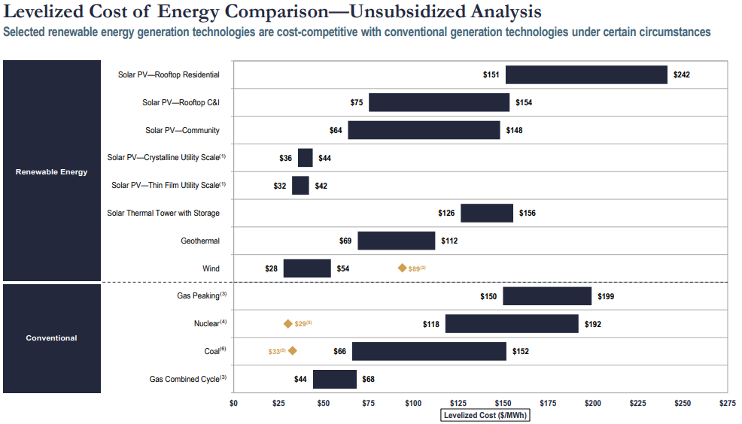
Marginal abatement curve: Engineering approach
Source: Lazard
(2019)
Units: $/MWh
$63
$165
$60 (onshore) $138 (offshore)
$93
$120 (90% CCS)
$49
LCOE is the installed capital costs and ongoing operating costs of a power plant, converted to a level stream of payments over the plant’s assumed financial lifetime (EIA).

Slide 32
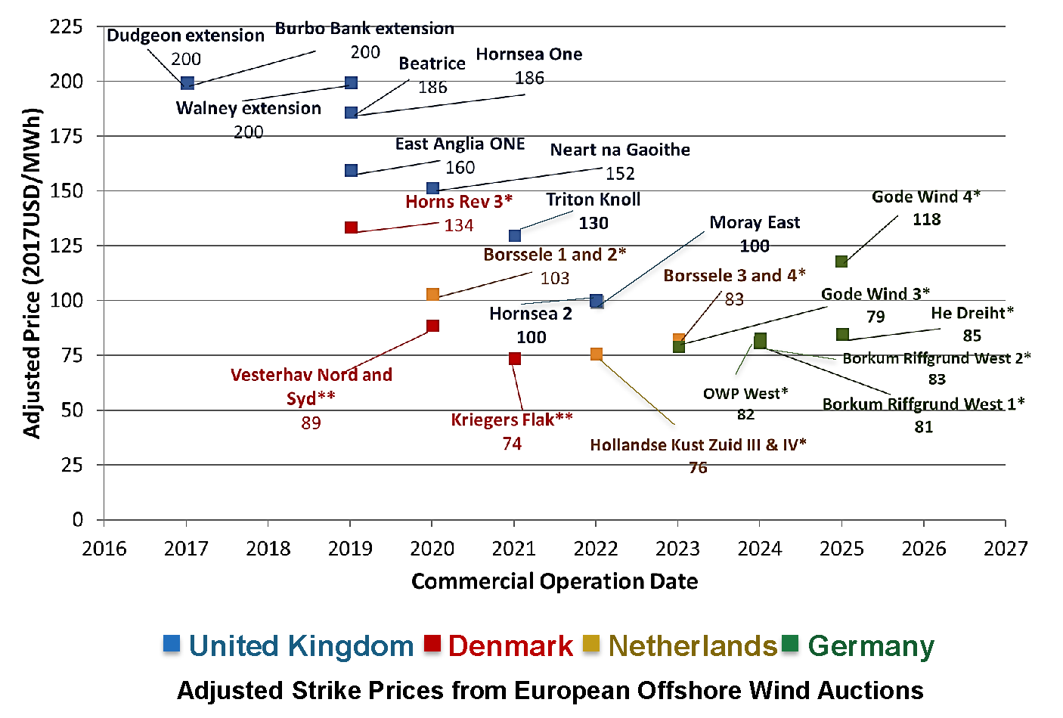

Marginal abatement curve: Engineering approach
Vineyard Wind bid (Aug 2018): $65/MWh
Source: DOE (2018), Offshore Wind Update

Slide 33
Marginal abatement curve: Static estimates for selected policies
Policy | $2017/ton CO_{2e}
Behavioral Energy Efficiency | -190
Corn starch ethanol (U.S.) | -18 – +310
Renewable Portfolio Standards | 0-190
Reforestation | 1-10
CAFE Standards | -110-310
Wind Energy Subsidies | 2-260
Clean Power Plan | 11
Gasoline Tax | 18-47
Methane Flaring Regulation | 20
Reducing Federal Coal Leasing | 33-68
Agricultural Emissions Policies | 50-65
National Clean Energy Standard | 51-110
Soil Management | 57
Livestock Management Policies | 71
Concentrating Solar Power (China, India) | 100
Low Carbon Fuel Standard | 100-2900
Solar PV Subsidies | 140-2100
Biodiesel | 150-420
Energy Efficiency Programs (China) | 250-300
Cash for Clunkers | 270-420
Weatherization Assistance Program | 350
Dedicated BEV Subsidy | 350-640
Notes:
Rounded to two significant digits.
CO_{2e} denotes conversion of tons of non-CO₂ greenhouse gases to their CO₂-equivalent based on their global warming potential
Source: Gillingham and Stock (Journal of Economic Perspectives, 2018)

Slide 34
Marginal abatement curve: Static estimates for selected policies
Policy | $2017/ton CO_{2e}
Behavioral Energy Efficiency | -190
Corn starch ethanol (U.S.) | -18 – +310
Renewable Portfolio Standards | 0-190
Reforestation | 1-10
CAFE Standards | -110-310
Wind Energy Subsidies | 2-260
Clean Power Plan | 11
Gasoline Tax | 18-47
Methane Flaring Regulation | 20
Reducing Federal Coal Leasing | 33-68
Agricultural Emissions Policies | 50-65
National Clean Energy Standard | 51-110
Soil Management | 57
Livestock Management Policies | 71
Concentrating Solar Power (China, India) | 100
Low Carbon Fuel Standard | 100-2900
Solar PV Subsidies | 140-2100
Biodiesel | 150-420
Energy Efficiency Programs (China) | 250-300
Cash for Clunkers | 270-420
Weatherization Assistance Program | 350
Dedicated BEV Subsidy | 350-640
Extremely wide range of costs

Slide 35
Marginal abatement curve: Static estimates for selected policies
Policy | $2017/ton CO_{2e}
Behavioral Energy Efficiency | -190
Corn starch ethanol (U.S.) | -18 – +310
Renewable Portfolio Standards | 0-190
Reforestation | 1-10
CAFE Standards | -110-310
Wind Energy Subsidies | 2-260
Clean Power Plan | 11
Gasoline Tax | 18-47
Methane Flaring Regulation | 20
Reducing Federal Coal Leasing | 33-68
Agricultural Emissions Policies | 50-65
National Clean Energy Standard | 51-110
Soil Management | 57
Livestock Management Policies | 71
Concentrating Solar Power (China, India) | 100
Low Carbon Fuel Standard | 100-2900
Solar PV Subsidies | 140-2100
Biodiesel | 150-420
Energy Efficiency Programs (China) | 250-300
Cash for Clunkers | 270-420
Weatherization Assistance Program | 350
Dedicated BEV Subsidy | 350-640
2. There are negative-cost policies (but…)
  Behavioral EE
    OPower type pamphlets: very small quantities
      This estimate is from Allcott & Mullainathan’s (2010) meta-analysis of EE behavioral interventions (nudges)

Slide 36
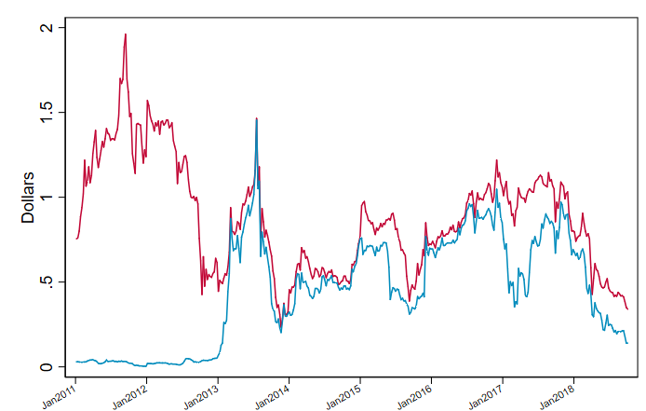
Marginal abatement curve: Static estimates for selected policies
Policy | $2017/ton CO_{2e}
Behavioral Energy Efficiency | -190
Corn starch ethanol (U.S.) | -18 – +310
Renewable Portfolio Standards | 0-190
Reforestation | 1-10
CAFE Standards | -110-310
Wind Energy Subsidies | 2-260
Clean Power Plan | 11
Gasoline Tax | 18-47
Methane Flaring Regulation | 20
Reducing Federal Coal Leasing | 33-68
Agricultural Emissions Policies | 50-65
National Clean Energy Standard | 51-110
Soil Management | 57
Livestock Management Policies | 71
Concentrating Solar Power (China, India) | 100
Low Carbon Fuel Standard | 100-2900
Solar PV Subsidies | 140-2100
Biodiesel | 150-420
Energy Efficiency Programs (China) | 250-300
Cash for Clunkers | 270-420
Weatherization Assistance Program | 350
Dedicated BEV Subsidy | 350-640
2. There are negative-cost policies (but…)
  Behavioral EE
    OPower type pamphlets: very small quantities
  Corn starch ethanol
    Up to E10: already in use
      In 2012, US gasoline supply was 10% ethanol even though the volumetric ethanol excise tax credit had expired, and RFS RIN prices were zero.
D4 and D6 RIN prices

Slide 37
Marginal abatement curve: Static estimates for selected policies
Policy | $2017/ton CO_{2e}
Behavioral Energy Efficiency | -190
Corn starch ethanol (U.S.) | -18 – +310
Renewable Portfolio Standards | 0-190
Reforestation | 1-10
CAFE Standards | -110-310
Wind Energy Subsidies | 2-260
Clean Power Plan | 11
Gasoline Tax | 18-47
Methane Flaring Regulation | 20
Reducing Federal Coal Leasing | 33-68
Agricultural Emissions Policies | 50-65
National Clean Energy Standard | 51-110
Soil Management | 57
Livestock Management Policies | 71
Concentrating Solar Power (China, India) | 100
Low Carbon Fuel Standard | 100-2900
Solar PV Subsidies | 140-2100
Biodiesel | 150-420
Energy Efficiency Programs (China) | 250-300
Cash for Clunkers | 270-420
Weatherization Assistance Program | 350
Dedicated BEV Subsidy | 350-640
2. There are negative-cost policies (but…)
  Behavioral EE
    O-power type pamphlets: very small quantities
  Corn starch ethanol
    Up to E10: already in use
      In 2012, US gasoline supply was 10% ethanol even though the volumetric ethanol excise tax credit had expired, and RFS RIN prices were zero.
      Calculation here compares ethanol to its alternative – a more expensive petroleum octane booster
    In E15 or E85: High RIN prices since 2012 incentivize the use of higher blends (E15, E85).

Slide 38
Marginal abatement curve: Static estimates for selected policies
Policy | $2017/ton CO_{2e}
Behavioral Energy Efficiency | -190
Corn starch ethanol (U.S.) | -18 – +310
Renewable Portfolio Standards | 0-190
Reforestation | 1-10
CAFE Standards | -110-310
Wind Energy Subsidies | 2-260
Clean Power Plan | 11
Gasoline Tax | 18-47
Methane Flaring Regulation | 20
Reducing Federal Coal Leasing | 33-68
Agricultural Emissions Policies | 50-65
National Clean Energy Standard | 51-110
Soil Management | 57
Livestock Management Policies | 71
Concentrating Solar Power (China, India) | 100
Low Carbon Fuel Standard | 100-2900
Solar PV Subsidies | 140-2100
Biodiesel | 150-420
Energy Efficiency Programs (China) | 250-300
Cash for Clunkers | 270-420
Weatherization Assistance Program | 350
Dedicated BEV Subsidy | 350-640
2. There are negative-cost policies (but…)
  Behavioral EE
    O-power type pamphlets: very small quantities
  Corn starch ethanol
    Up to E10: already in use
      In 2012, US gasoline supply was 10% ethanol even though the volumetric ethanol excise tax credit had expired, and RFS RIN prices were zero.
      Calculation here compares ethanol to its alternative – a more expensive petroleum octane booster
    In E15 or E85: High RIN prices since 2012 incentivize the use of higher blends (E15, E85).
  RPS’s have zero marginal cost when they aren’t binding

Slide 39
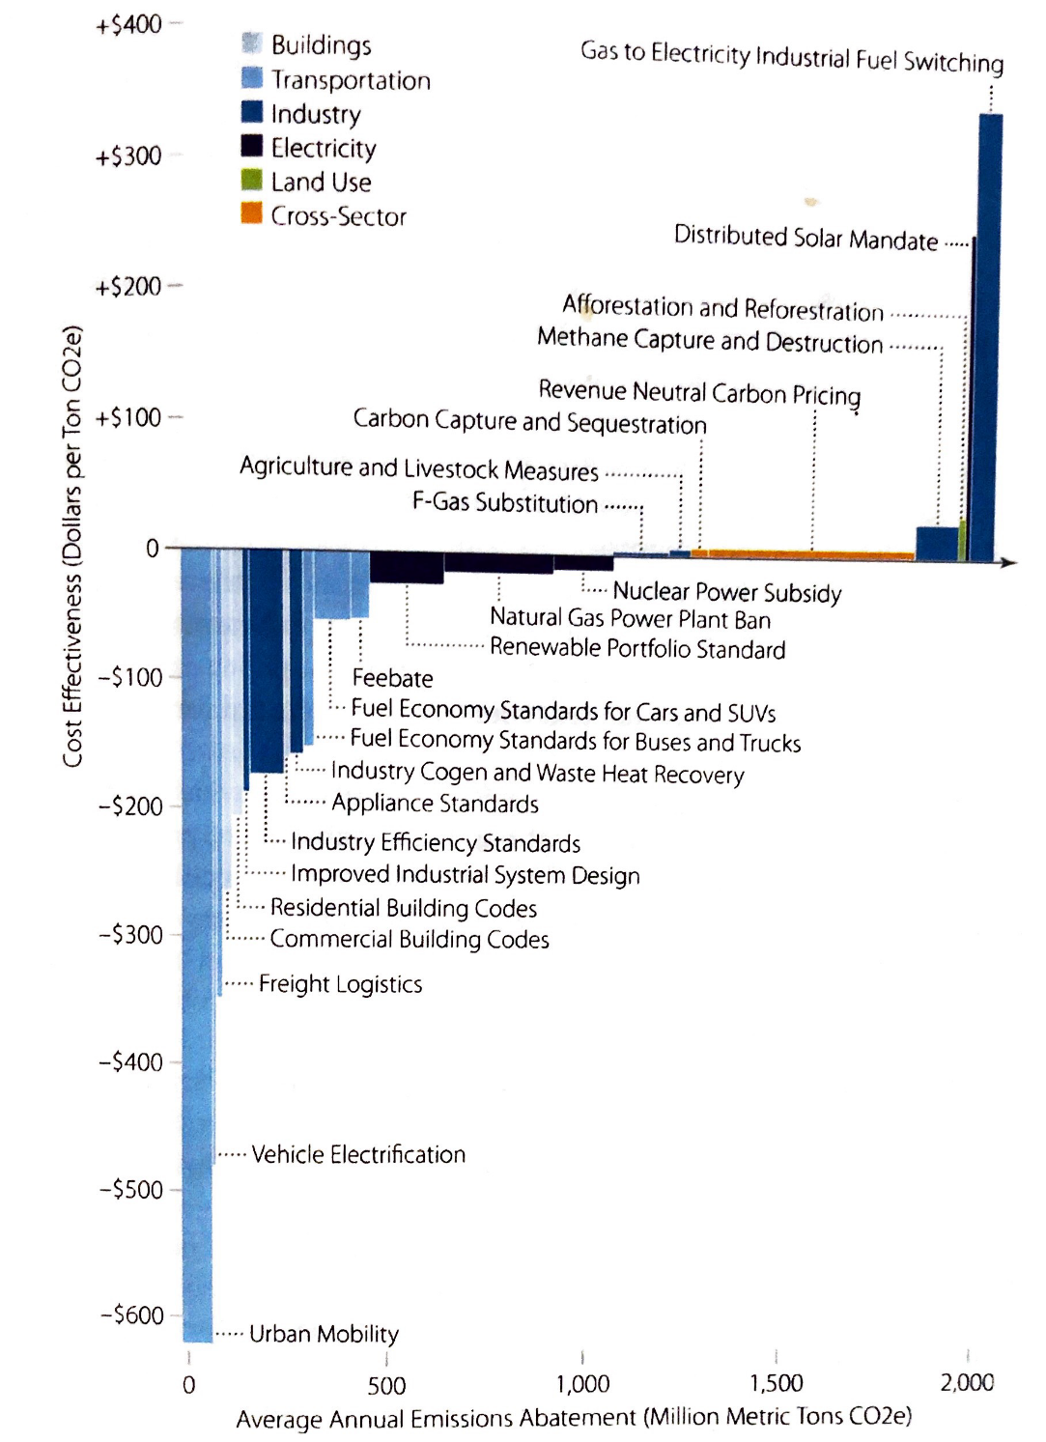
Marginal abatement curve: Static estimates for selected policies
Policy | $2017/ton CO_{2e}
Behavioral Energy Efficiency | -190
Corn starch ethanol (U.S.) | -18 – +310
Renewable Portfolio Standards | 0-190
Reforestation | 1-10
CAFE Standards | -110-310
Wind Energy Subsidies | 2-260
Clean Power Plan | 11
Gasoline Tax | 18-47
Methane Flaring Regulation | 20
Reducing Federal Coal Leasing | 33-68
Agricultural Emissions Policies | 50-65
National Clean Energy Standard | 51-110
Soil Management | 57
Livestock Management Policies | 71
Concentrating Solar Power (China, India) | 100
Low Carbon Fuel Standard | 100-2900
Solar PV Subsidies | 140-2100
Biodiesel | 150-420
Energy Efficiency Programs (China) | 250-300
Cash for Clunkers | 270-420
Weatherization Assistance Program | 350
Dedicated BEV Subsidy | 350-640
Compare to Hal Harvey et al. (2018) policy cost curve

Slide 40
Marginal abatement curve: Static estimates for selected policies
Policy | $2017/ton CO_{2e}
Behavioral Energy Efficiency | -190
Corn starch ethanol (U.S.) | -18 – +310
Renewable Portfolio Standards | 0-190
Reforestation | 1-10
CAFE Standards | -110-310
Wind Energy Subsidies | 2-260
Clean Power Plan | 11
Gasoline Tax | 18-47
Methane Flaring Regulation | 20
Reducing Federal Coal Leasing | 33-68
Agricultural Emissions Policies | 50-65
National Clean Energy Standard | 51-110
Soil Management | 57
Livestock Management Policies | 71
Concentrating Solar Power (China, India) | 100
Low Carbon Fuel Standard | 100-2900
Solar PV Subsidies | 140-2100
Biodiesel | 150-420
Energy Efficiency Programs (China) | 250-300
Cash for Clunkers | 270-420
Weatherization Assistance Program | 350
Dedicated BEV Subsidy | 350-640
3. There are wide ranges of reductions within technologies
  Wind subsidies
    Large variation in regional wind potential
    Large variation in displaced fuel (coal, NG)
    Declining wind costs, so costs vary over time
    We don’t always have market-based policies

Slide 41
Marginal abatement curve: Static estimates for selected policies
Policy | $2017/ton CO_{2e}
Behavioral Energy Efficiency | -190
Corn starch ethanol (U.S.) | -18 – +310
Renewable Portfolio Standards | 0-190
Reforestation | 1-10
CAFE Standards | -110-310
Wind Energy Subsidies | 2-260
Clean Power Plan | 11
Gasoline Tax | 18-47
Methane Flaring Regulation | 20
Reducing Federal Coal Leasing | 33-68
Agricultural Emissions Policies | 50-65
National Clean Energy Standard | 51-110
Soil Management | 57
Livestock Management Policies | 71
Concentrating Solar Power (China, India) | 100
Low Carbon Fuel Standard | 100-2900
Solar PV Subsidies | 140-2100
Biodiesel | 150-420
Energy Efficiency Programs (China) | 250-300
Cash for Clunkers | 270-420
Weatherization Assistance Program | 350
Dedicated BEV Subsidy | 350-640
3. There are wide ranges of reductions within technologies
  Wind subsidies
    Large variation in regional wind potential
    Large variation in displaced fuel (coal, NG)
    Declining wind costs, so costs vary over time
    We don’t always have market-based policies
  Solar PV subsidies
    Variation in insolation
    Variation in displaced fuel
    Declining PV costs
    Rooftop ($$$$) v. grid ($)

Slide 42
Marginal abatement curve: Static estimates for selected policies
Policy | $2017/ton CO_{2e}
Behavioral Energy Efficiency | -190
Corn starch ethanol (U.S.) | -18 – +310
Renewable Portfolio Standards | 0-190
Reforestation | 1-10
CAFE Standards | -110-310
Wind Energy Subsidies | 2-260
Clean Power Plan | 11
Gasoline Tax | 18-47
Methane Flaring Regulation | 20
Reducing Federal Coal Leasing | 33-68
Agricultural Emissions Policies | 50-65
National Clean Energy Standard | 51-110
Soil Management | 57
Livestock Management Policies | 71
Concentrating Solar Power (China, India) | 100
Low Carbon Fuel Standard | 100-2900
Solar PV Subsidies | 140-2100
Biodiesel | 150-420
Energy Efficiency Programs (China) | 250-300
Cash for Clunkers | 270-420
Weatherization Assistance Program | 350
Dedicated BEV Subsidy | 350-640
4. Some of the McKinsey “winners,” aren’t.
  Weatherization
    Fowlie, Greenstone, Wolfram (2018) $350/ton RCT
      They conclude the problem was the engineering assessments were off
      The rebound effect was less important
      Note the policy really was more about helping low-income households than reducing GHGs
  Energy efficiency paradox
    Debate over whether CAFE fuel savings should be counted as a consumer benefit continues to rage

Slide 43
Marginal abatement curve: Static estimates for selected policies
Policy | $2017/ton CO_{2e}
Behavioral Energy Efficiency | -190
Corn starch ethanol (U.S.) | -18 – +310
Renewable Portfolio Standards | 0-190
Reforestation | 1-10
CAFE Standards | -110-310
Wind Energy Subsidies | 2-260
Clean Power Plan | 11
Gasoline Tax | 18-47
Methane Flaring Regulation | 20
Reducing Federal Coal Leasing | 33-68
Agricultural Emissions Policies | 50-65
National Clean Energy Standard | 51-110
Soil Management | 57
Livestock Management Policies | 71
Concentrating Solar Power (China, India) | 100
Low Carbon Fuel Standard | 100-2900
Solar PV Subsidies | 140-2100
Biodiesel | 150-420
Energy Efficiency Programs (China) | 250-300
Cash for Clunkers | 270-420
Weatherization Assistance Program | 350
Dedicated BEV Subsidy | 350-640
5. Some large-scale interventions do have low cost
  Obama Admin Clean Power Plan
    Cost estimates depend on vintage and vary regionally
    CPP allowances today would be trading at or near $0 in some regions (ACE RIA)

Slide 44
Marginal abatement curve: Static estimates for selected policies
Policy | $2017/ton CO_{2e}
Behavioral Energy Efficiency | -190
Corn starch ethanol (U.S.) | -18 – +310
Renewable Portfolio Standards | 0-190
Reforestation | 1-10
CAFE Standards | -110-310
Wind Energy Subsidies | 2-260
Clean Power Plan | 11
Gasoline Tax | 18-47
Methane Flaring Regulation | 20
Reducing Federal Coal Leasing | 33-68
Agricultural Emissions Policies | 50-65
National Clean Energy Standard | 51-110
Soil Management | 57
Livestock Management Policies | 71
Concentrating Solar Power (China, India) | 100
Low Carbon Fuel Standard | 100-2900
Solar PV Subsidies | 140-2100
Biodiesel | 150-420
Energy Efficiency Programs (China) | 250-300
Cash for Clunkers | 270-420
Weatherization Assistance Program | 350
Dedicated BEV Subsidy | 350-640
5. Some large-scale interventions do have low cost
  Clean Power Plan
    Cost estimates depend on vintage and vary regionally
    CPP allowances today would be trading at or near $0 in some regions (ACE RIA)
  Methane flaring
    Lade-Rudik (2017) – North Dakota command & control policy
      But cf. change in royalty calculations

Slide 45
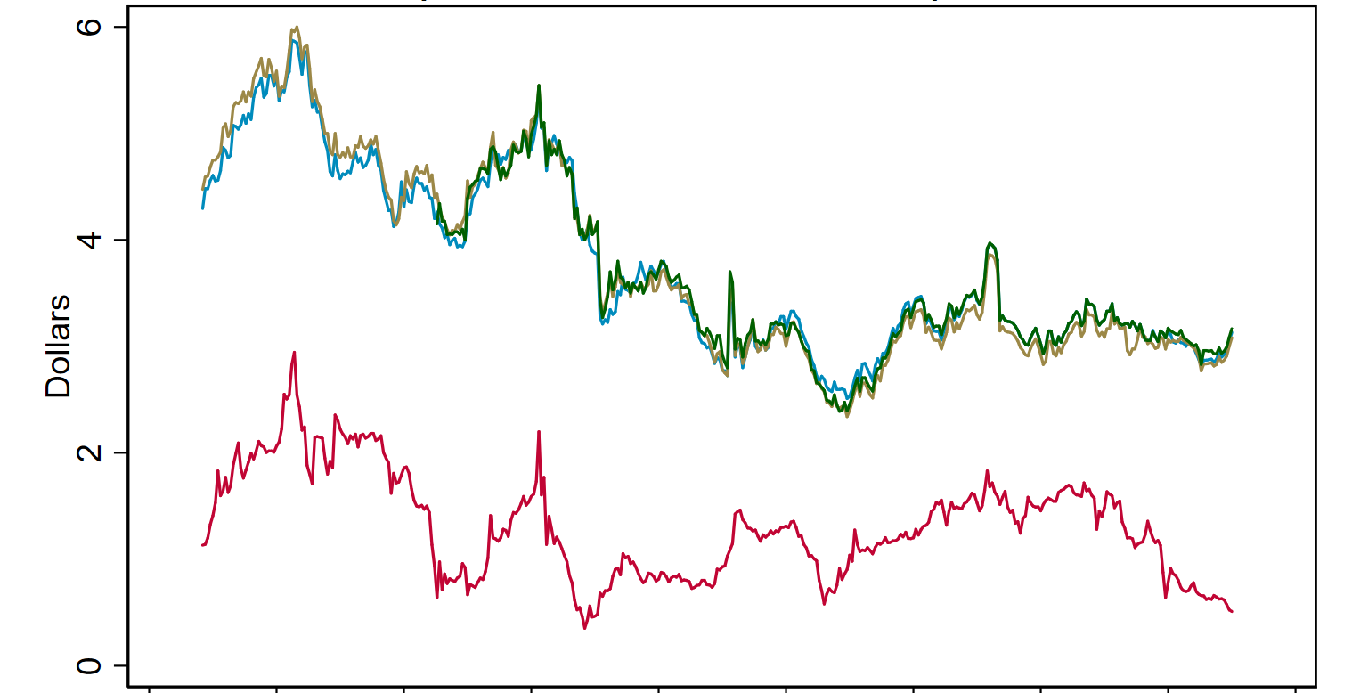
Marginal abatement curve: Static estimates for selected policies
Policy | $2017/ton CO_{2e}
Behavioral Energy Efficiency | -190
Corn starch ethanol (U.S.) | -18 – +310
Renewable Portfolio Standards | 0-190
Reforestation | 1-10
CAFE Standards | -110-310
Wind Energy Subsidies | 2-260
Clean Power Plan | 11
Gasoline Tax | 18-47
Methane Flaring Regulation | 20
Reducing Federal Coal Leasing | 33-68
Agricultural Emissions Policies | 50-65
National Clean Energy Standard | 51-110
Soil Management | 57
Livestock Management Policies | 71
Concentrating Solar Power (China, India) | 100
Low Carbon Fuel Standard | 100-2900
Solar PV Subsidies | 140-2100
Biodiesel | 150-420
Energy Efficiency Programs (China) | 250-300
Cash for Clunkers | 270-420
Weatherization Assistance Program | 350
Dedicated BEV Subsidy | 350-640
6. Some popular programs are very high cost
  Biomass-based diesel subsidies
    biodiesel and renewable diesel are first-generation
    Subsidy: RFS + Biodiesel blenders’ tax credit
    Under the RFS and BTC, Each gallon of biodiesel gets the same subsidy, but different feedstocks have different GHG reductions (waste grease v. soybeans)
    Spot biodiesel price and RIN subsidy/gallon, 2011-2018

Slide 46
Marginal abatement curve: Static estimates for selected policies
Policy | $2017/ton CO_{2e}
Behavioral Energy Efficiency | -190
Corn starch ethanol (U.S.) | -18 – +310
Renewable Portfolio Standards | 0-190
Reforestation | 1-10
CAFE Standards | -110-310
Wind Energy Subsidies | 2-260
Clean Power Plan | 11
Gasoline Tax | 18-47
Methane Flaring Regulation | 20
Reducing Federal Coal Leasing | 33-68
Agricultural Emissions Policies | 50-65
National Clean Energy Standard | 51-110
Soil Management | 57
Livestock Management Policies | 71
Concentrating Solar Power (China, India) | 100
Low Carbon Fuel Standard | 100-2900
Solar PV Subsidies | 140-2100
Biodiesel | 150-420
Energy Efficiency Programs (China) | 250-300
Cash for Clunkers | 270-420
Weatherization Assistance Program | 350
Dedicated BEV Subsidy | 350-640
6. Some popular programs are very high cost
  Biomass-based diesel subsidies
    biodiesel and renewable diesel are first-generation
    Subsidy: RFS + Biodiesel blenders’ tax credit
    Under the RFS and BTC, Each gallon of biodiesel gets the same subsidy, but different feedstocks have different GHG reductions (waste grease v. soybeans)
  Cash for clunkers
    Inframarginal transfers by shifting forward demand

Slide 47
Marginal abatement curve: Static estimates for selected policies
Policy | $2017/ton CO_{2e}
Behavioral Energy Efficiency | -190
Corn starch ethanol (U.S.) | -18 – +310
Renewable Portfolio Standards | 0-190
Reforestation | 1-10
CAFE Standards | -110-310
Wind Energy Subsidies | 2-260
Clean Power Plan | 11
Gasoline Tax | 18-47
Methane Flaring Regulation | 20
Reducing Federal Coal Leasing | 33-68
Agricultural Emissions Policies | 50-65
National Clean Energy Standard | 51-110
Soil Management | 57
Livestock Management Policies | 71
Concentrating Solar Power (China, India) | 100
Low Carbon Fuel Standard | 100-2900
Solar PV Subsidies | 140-2100
Biodiesel | 150-420
Energy Efficiency Programs (China) | 250-300
Cash for Clunkers | 270-420
Weatherization Assistance Program | 350
Dedicated BEV Subsidy | 350-640
7. Land use policies can be cost-effective
  Reforestation
    U.N. REDD+ mechanism
    Jayachandran et. al. (2017) RCT for forest preservation in Uganda (randomized at village level), data from satellite imagery cost of $0.57/ton CO2 for two years
    Lots of issues…
      Permanent or temporary
        Temporary has some benefits in NPV sense, but they are small
      Doesn’t incorporate demand shifting
        urban charcoal users switch sources?
        usual problem with supply-side policies

Slide 48
Policy MACC: A dynamic perspective
Policy | $2017/ton CO_{2e}
Behavioral Energy Efficiency | -190
Corn starch ethanol (U.S.) | -18 – +310
Renewable Portfolio Standards | 0-190
Reforestation | 1-10
CAFE Standards | -110-310
Wind Energy Subsidies | 2-260
Clean Power Plan | 11
Gasoline Tax | 18-47
Methane Flaring Regulation | 20
Reducing Federal Coal Leasing | 33-68
Agricultural Emissions Policies | 50-65
National Clean Energy Standard | 51-110
Soil Management | 57
Livestock Management Policies | 71
Concentrating Solar Power (China, India) | 100
Low Carbon Fuel Standard | 100-2900
Solar PV Subsidies | 140-2100
Biodiesel | 150-420
Energy Efficiency Programs (China) | 250-300
Cash for Clunkers | 270-420
Weatherization Assistance Program | 350
Dedicated BEV Subsidy | 350-640
Policies with large potential carbon reductions are estimated to be expensive
  Battery electric vehicles
    Holland, Mansur, Mullen, & Yates (2016)
  Solar PV subsidies
  Wind energy subsidies
Dynamic v. static MACs.
  Dynamics:
    R&D externality
    Learning-by-doing externality
    Network externalities (in some cases)
    [Economies of scale]
    Irreversibility and state-dependent paths (lock-in)
      Vogt-Schilb et al (2018): “optimal strategy to reach a short-term target depends on the long-term target”
  The EE economics literature overwhelmingly focuses on static, not dynamic, costs

Slide 49
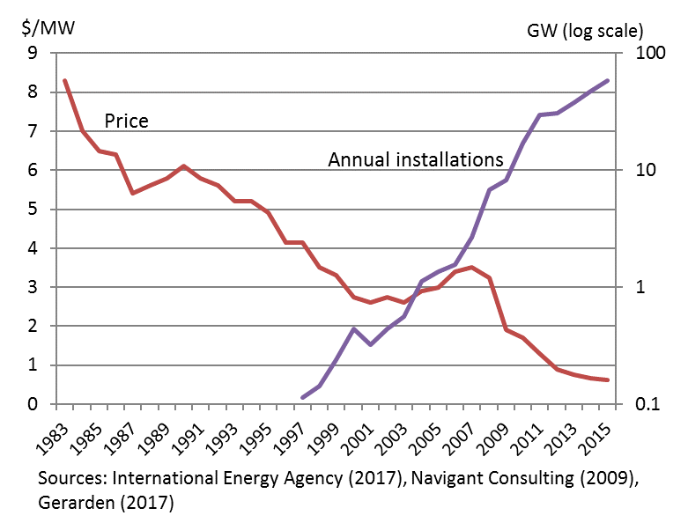
Policy MACC: A dynamic perspective
Solar PV subsidies
  California Solar Initiative: $130-$200/ton (Hughes and Podolefsky 2015)
  Feed-in tariffs in Germany and Spain: $570-$1490/ton (Abrell et al. 2017)
  Dynamic effects: Demand pull?
    Nemet (2006): ~60% of early cost reduction in solar PV was from R&D and LBD, ~40% was scale
    Gerarden (2018): induced innovation effects (not LBD or scale) increased social benefits of global solar adoption by 22%
Solar panel price indexes (left, excluding subsidies) and cumulative worldwide installed capacity (right), 1983-2015

Slide 50
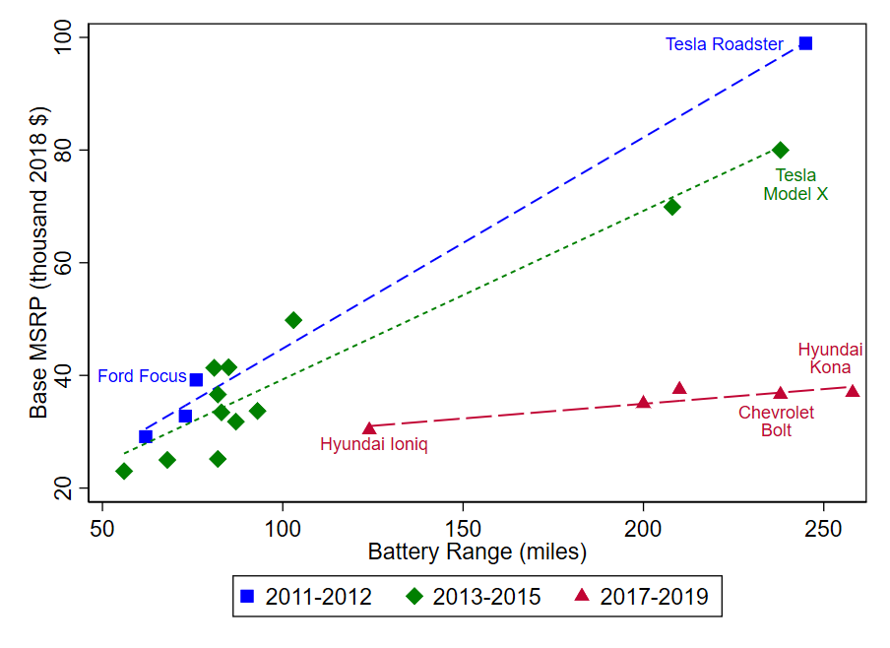
Policy MACC: A dynamic perspective
Battery EV subsidies
  US Federal tax credit of $7500 (phasing out by 200,000 vehicle quantity cap)
  Additional state incentives
    $2500 in MA, $3000 in CT
    CA has ZEV mandate that produces hidden subsidies
  Dynamic effects: demand pull?
    DOE (2016) estimates that the price of batteries for BEVs fell by 75% from 2009-2015, accounting for most of the decline in the finished vehicle price
    In addition to R&D, LBD externalities, a network externality (charging stations) (Li 2017, Springel 2018)
Electric vehicle MSRP’s v. battery range by year of model introduction
Source: Li (2018) updated with latest estimates

Slide 51
Additional Slides

Slide 52
Climate Science & Climate Econometrics: a quick tour
A.4.4 The equilibrium climate sensitivity is an important quantity used to estimate how the climate responds to radiative forcing. Based on multiple lines of evidence, the very likely range of equilibrium climate sensitivity is between 2°C (high confidence) and 5°C (medium confidence). The AR6 assessed best estimate is 3°C with a likely range of 2.5°C to 4°C (high confidence), compared to 1.5°C to 4.5°C in AR5, which did not provide a best estimate.
B.1 Global surface temperature will continue to increase until at least the mid-century under all emissions scenarios considered. Global warming of 1.5°C and 2°C will be exceeded during the 21st century unless deep reductions in CO2 and other greenhouse gas emissions occur in the coming decades.
  B.1.1 Compared to 1850–1900, global surface temperature averaged over 2081–2100 is very likely to be higher by 1.0°C to 1.8°C under the very low GHG emissions scenario considered (SSP1-1.9), by 2.1°C to 3.5°C in the intermediate scenario (SSP2-4.5) and by 3.3°C to 5.7°C under the very high GHG emissions scenario (SSP5-8.5). The last time global surface temperature was sustained at or above 2.5°C higher than 1850–1900 was over 3 million years ago (medium confidence).
B.2 Many changes in the climate system become larger in direct relation to increasing global warming. They include increases in the frequency and intensity of hot extremes, marine heatwaves, and heavy precipitation, agricultural and ecological droughts in some regions, and proportion of intense tropical cyclones, as well as reductions in Arctic sea ice, snow cover and permafrost.
Source: IPCC AR6, SPM (August 2021)

Slide 53
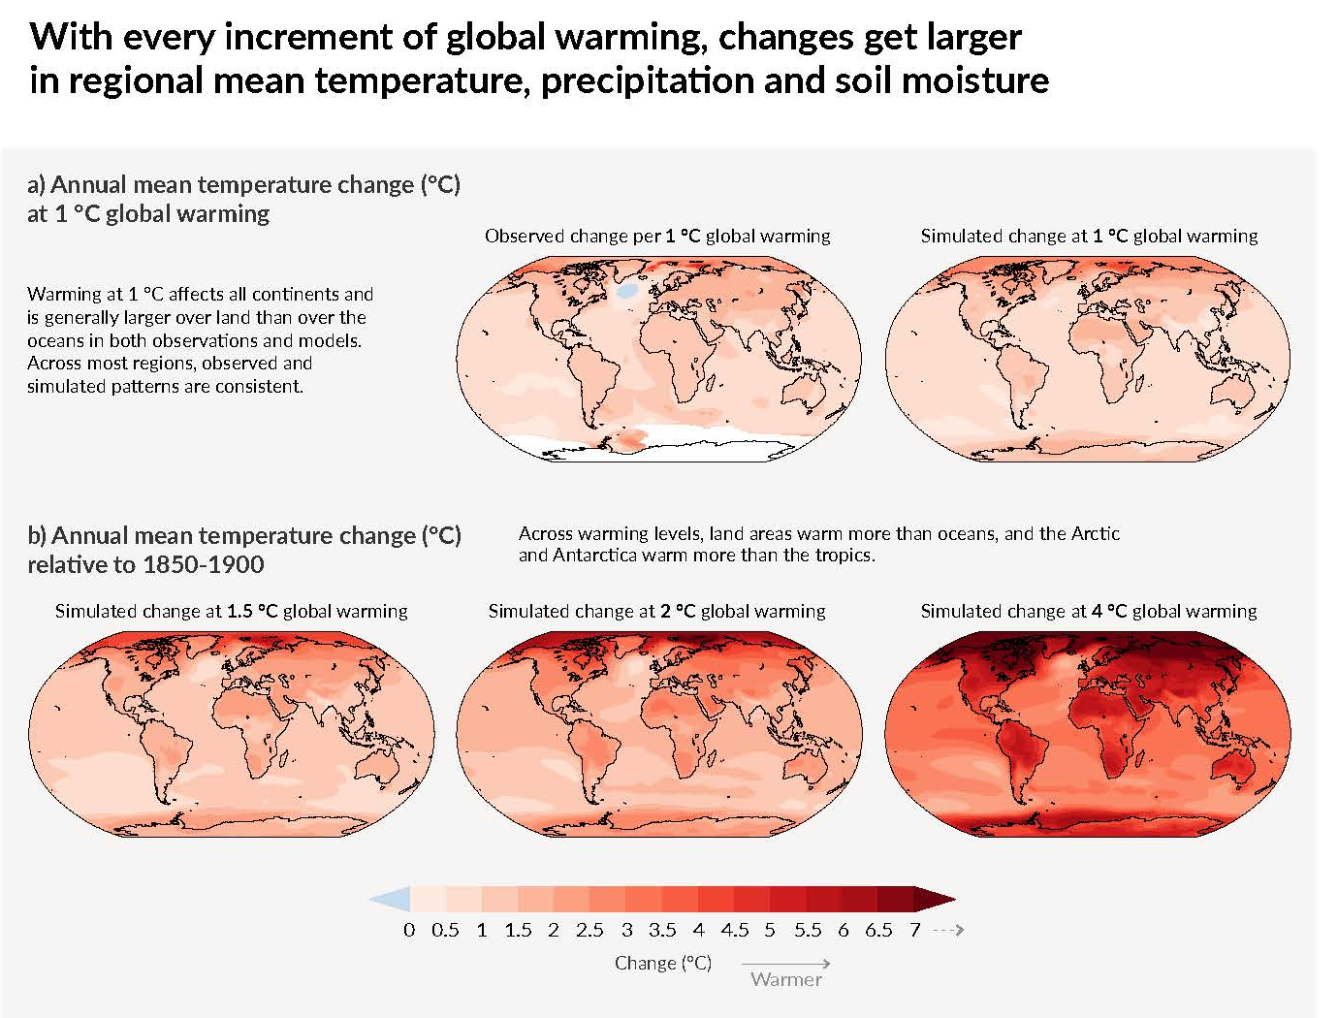
Climate Science & Climate Econometrics: a quick tour
Source: IPCC AR6, SPM (August 2021)

Slide 54
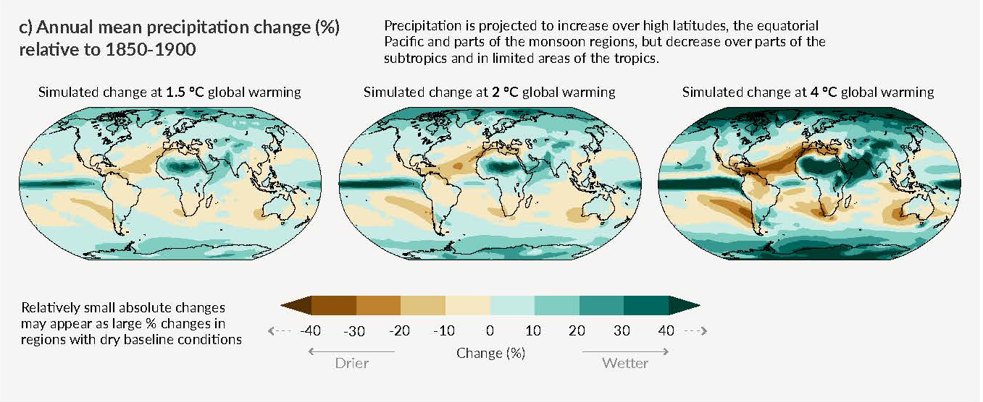
Climate Science & Climate Econometrics: a quick tour
Source: IPCC AR6, SPM (August 2021)

Slide 55
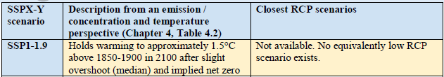
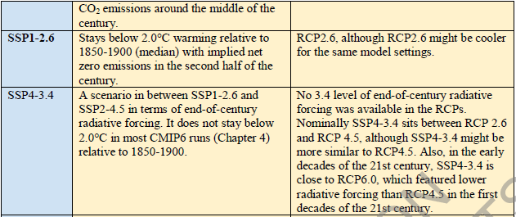
Climate Science & Climate Econometrics: a quick tour
SSPs and RCPs
SSPX-Y means: X is the shared socioeconomic pathway (SSP), Y is additional radiative forcing (in W/m²) under the scenario in 2100
RCPs were used through IPCC AR5, now they are integrated with the SSPs starting in AR6

Slide 56
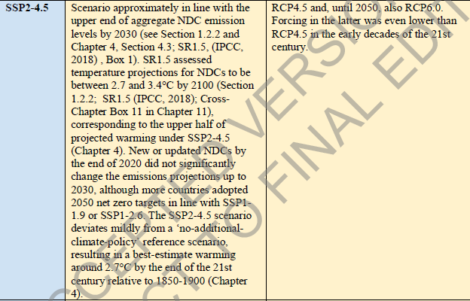
Climate Science & Climate Econometrics: a quick tour
SSPs and RCPs

Slide 57
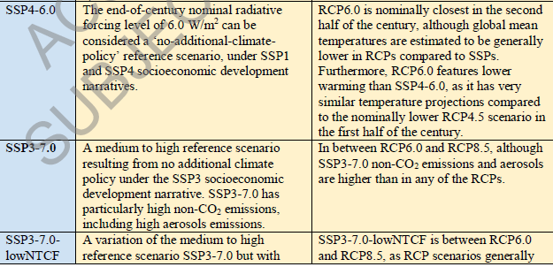
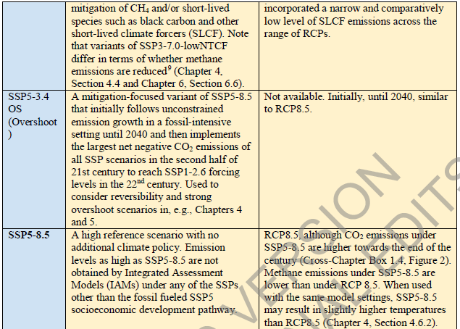
Climate Science & Climate Econometrics: a quick tour
SSPs and RCPs

Slide 58
Climate Science & Climate Econometrics: a quick tour
SSPs and RCPs

Slide 59
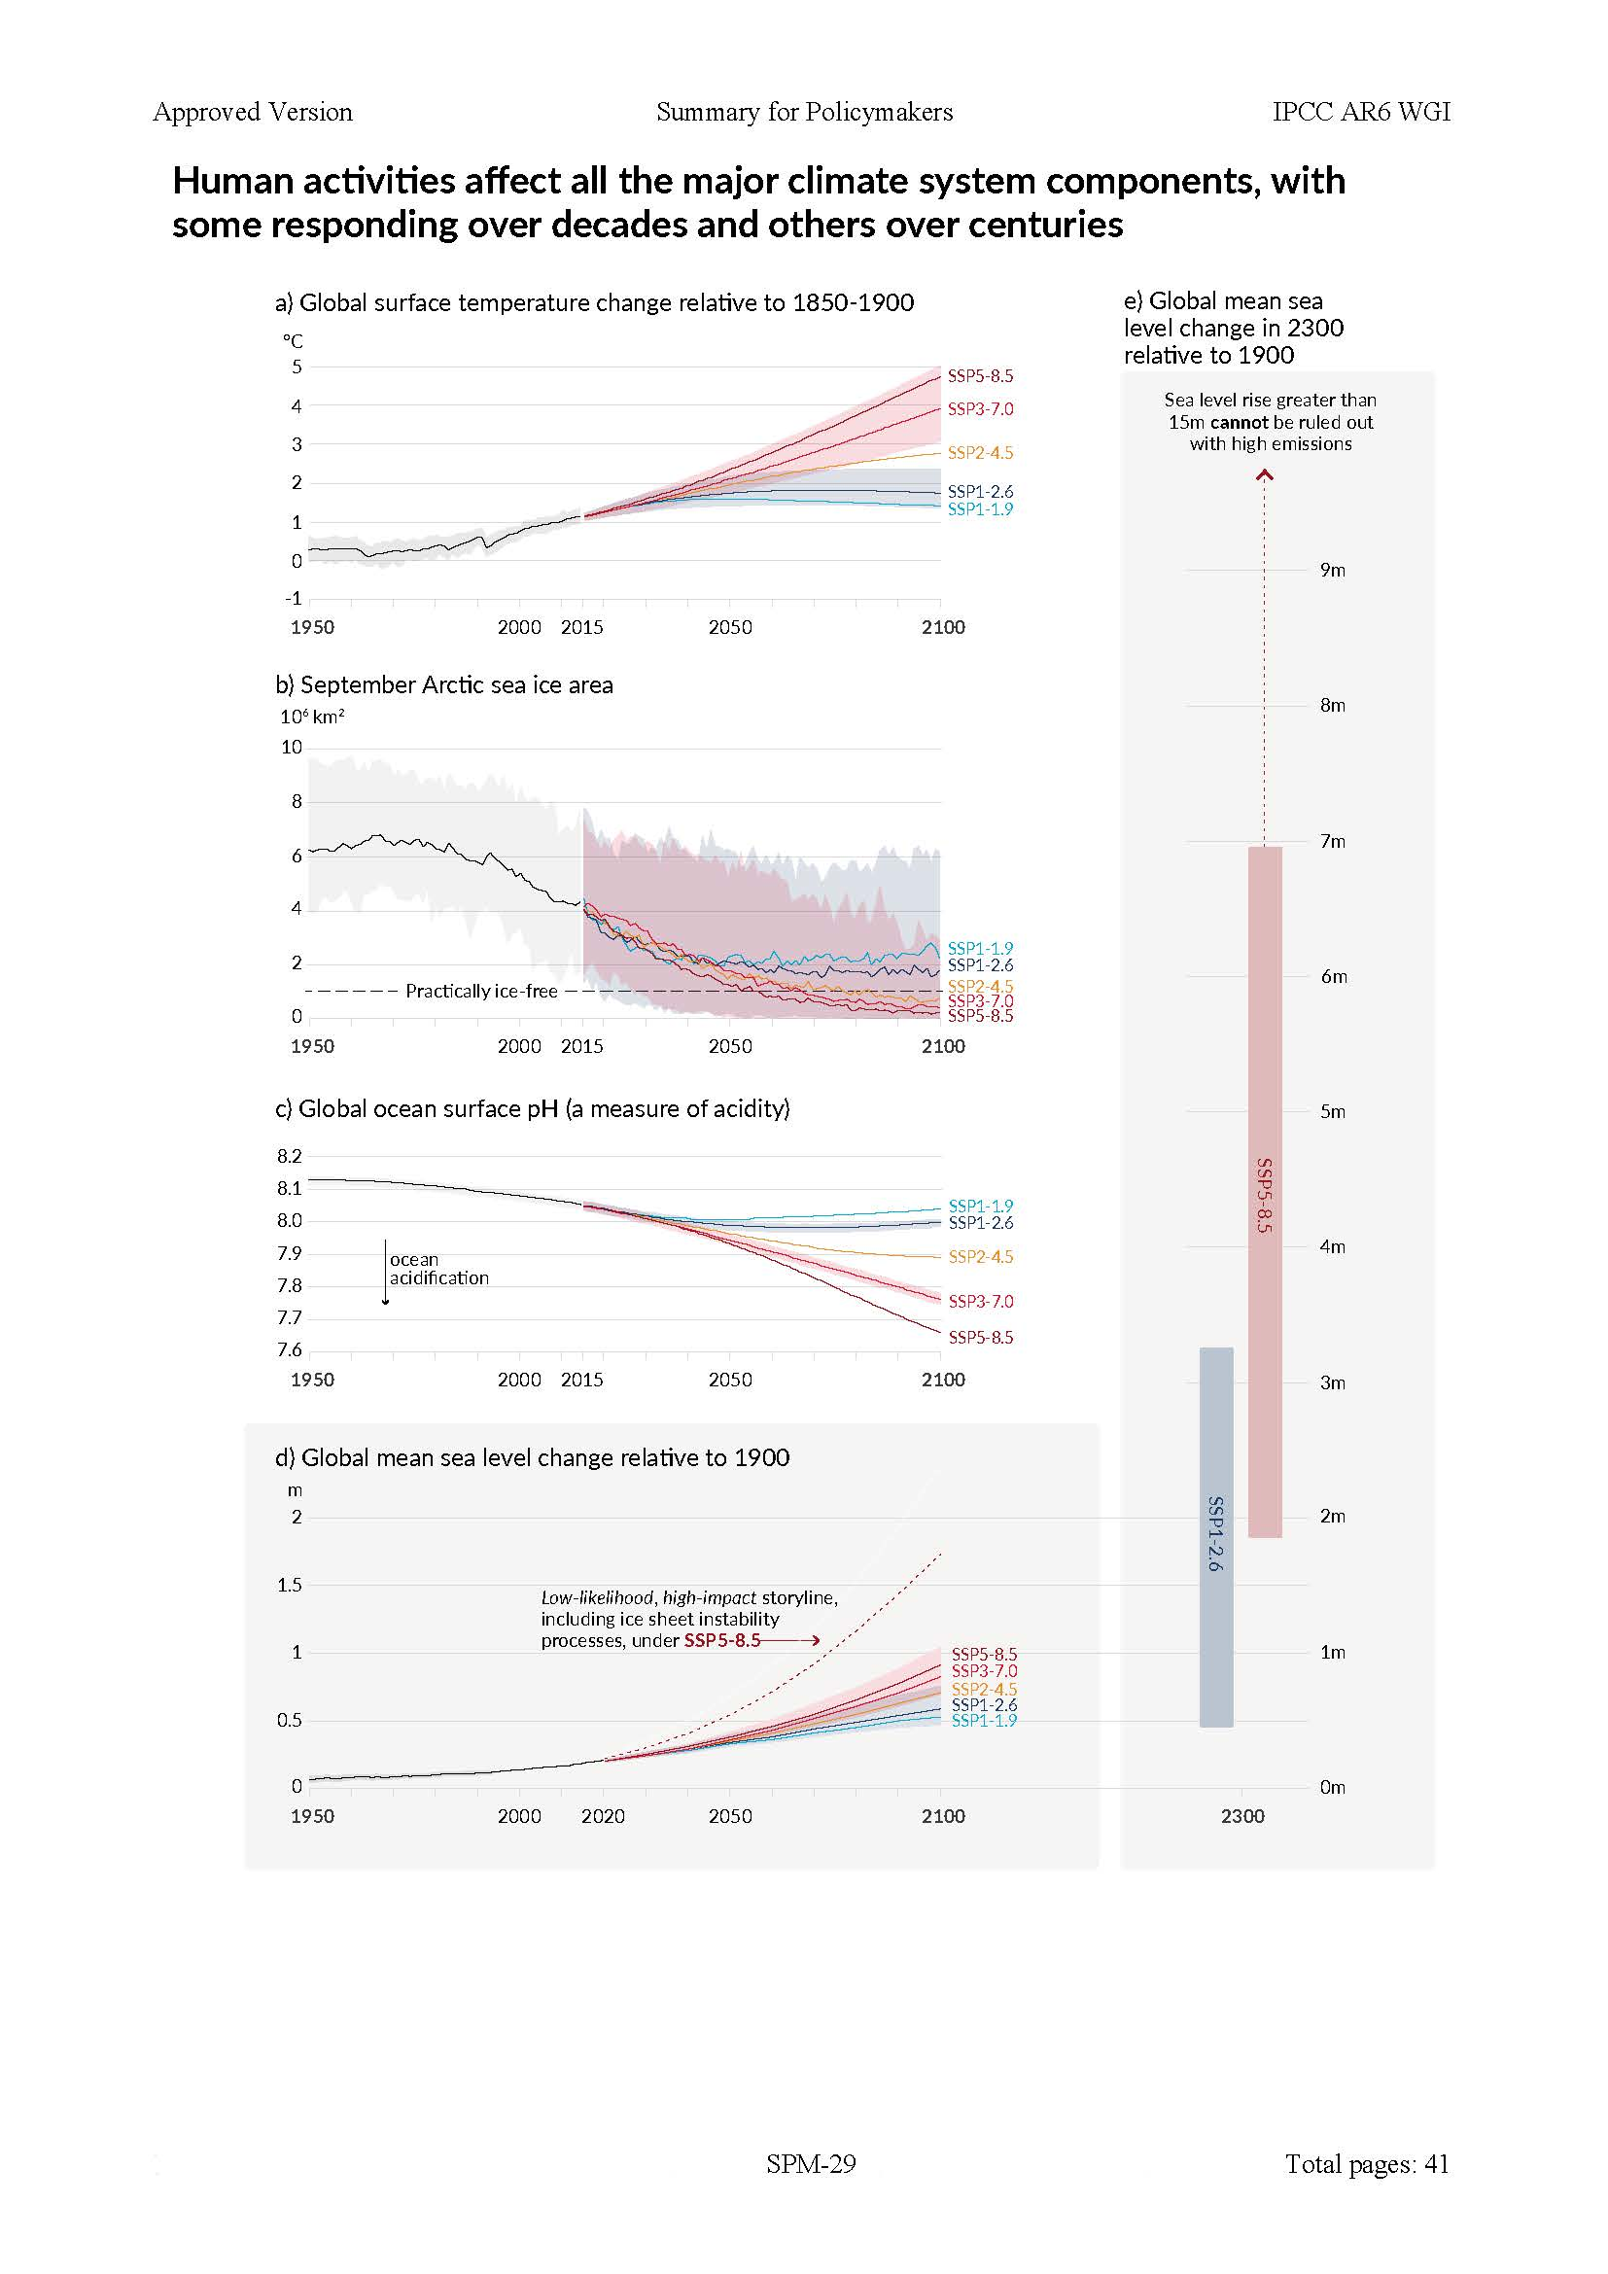
Climate Science & Climate Econometrics: a quick tour
Source: IPCC AR6 SPM (August 2021)

Slide 60
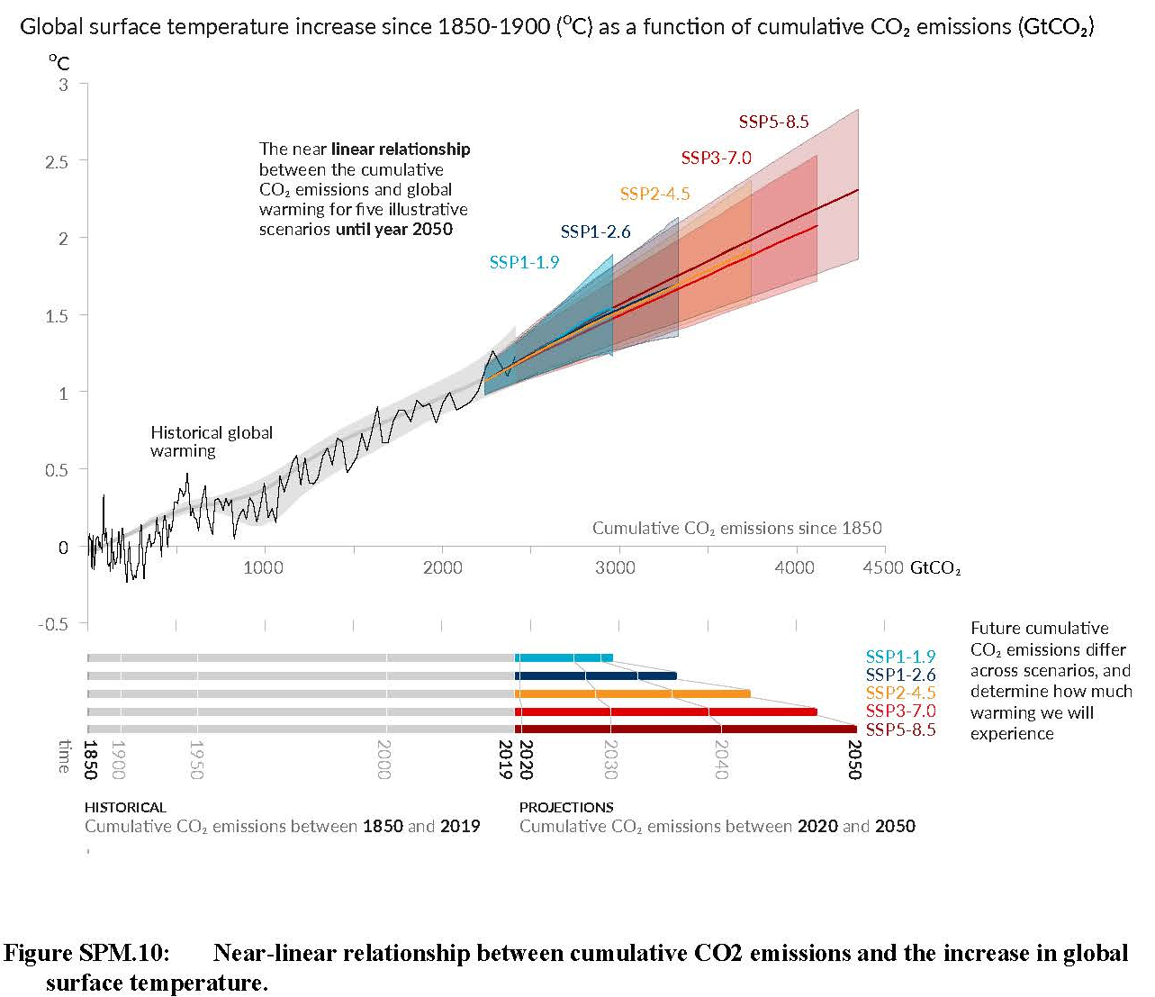
Climate Science & Climate Econometrics: a quick tour
D.1.1 This Report reaffirms with high confidence the AR5 finding that there is a near-linear relationship between cumulative anthropogenic CO2 emissions and the global warming they cause. Each 1000 GtCO2 of cumulative CO2 emissions is assessed to likely cause a 0.27°C to 0.63°C increase in global surface temperature with a best estimate of 0.45°C41. This is a narrower range compared to AR5 and SR1.5. This quantity is referred to as the transient climate response to cumulative CO2 emissions (TCRE). This relationship implies that reaching net zero anthropogenic CO2 emissions is a requirement to stabilize human-induced global temperature increase at any level, but that limiting global temperature increase to a specific level would imply limiting cumulative CO2 emissions to within a carbon budget.
Source: IPCC AR6 SPM (August 2021)

