Slide 1

Study Center Gerzensse: Advanced Courses in Economics
The Economics and Econometrics of Climate Change Policy:
B. Sectoral Carbon Policies
James H. Stock
Economics Department and Harvard Kennedy School,
Harvard University
May 30 – June 3, 2022

Slide 2
Course outline
I. Introduction
Introduction & Overview
  Climate change science and CC econometrics (brief)
  Framework economic concepts
  Cost-benefit analysis, cost effectiveness analysis, SCC & TCP
  Marginal abatement curve
III. Damages
Macroeconomic implications of the energy transition
  Physical & transition costs
  Physical costs: damage estimates
  Transition costs: policy
    Carbon tax
    Cap & trade
    Policy uncertainty
The Social Cost of Carbon: Recent developments (time permitting)
II. Emissions reduction (mitigation/decarbonization)
Sectoral carbon policies – theory & empirical evidence
  Carbon tax, cap & trade
  Clean energy standards; investment & production tax credits
  Policy simulations
  Criticisms & the case for sectoral standards
Carbon pricing with leakage: Supply side policies
  Supply side policies as carbon pricing with leakage
  Supply side policy with leakage: US O&G royalties
  Extension to international trade & BCA
The electric vehicle revolution
  Transport sector overview, EVs, & literature review
  Modeling charging station v. vehicle subsidies
  More on charging stations & current research

Slide 3
1. Carbon pricing fundamentals
Recall Nordhaus (1982):
Social planner problem:
where
f = economy-wide production function assuming energy use is proportional to emissions
h = damage function from cumulative CO2 emissions
b = CO2 Earth uptake rate (close to zero – very long half-life in atmosphere)
Social planner optimal steady state: Let q(t) = shadow value of carbon = incremental consumption cost from increment in emissions. In steady state,
In words: Shadow cost of carbon = marginal cost of abatement = marginal NPV of damages
That is: Carbon price = marginal cost of abatement = SCC (dynamic version of Pigovian taxation)
Single energy source (fossil fuel), single technology, single externality, single policy tool (carbon price)

Slide 4
Carbon pricing fundamentals
Carbon tax and cap-and-trade: Static case/no uncertainty
Consider market for demand for electricity generated from natural gas:
(a) with a carbon tax (b) under cap-and-trade
Price
Price
P’
S
P’
S
P*
P*
Price of tradeable permit
tax
D
Q’
Q*
Quantity of electricity
Q’
Q*
Quantity of electricity
Implementation
Tax on fossil fuel consumption (utilities)
Or, tax fossil fuel production (drilling companies)
  Usual suggestion is upstream
Implementation
Auction off tradeable permits
Or, hand out permits to all generators, then allow trading
Hand in 1 allowance for each ton emitted

Slide 5
Carbon pricing fundamentals: overlapping policies
Overlapping policies
In practice, there can be multiple policies with same mitigation goal
Example: Carbon tax and cap & trade
(a) C&T nonbinding (b) C&T binding
Price
Price
P’’
P’
S
P’
Permit price
S
P*
P*
tax
tax
D
Q’
Q’’
Q*
Quantity of electricity
Q’’
Q’
Q*
Quantity of electricity
Prices add, quantities don’t
Examples
California cap-and-trade (AB32) + economy-wide carbon tax
  If RGGI is binding, leakage
State RPS + economy-wide CES
  If state RPS is binding, leakage
State\Nation | Carbon Tax | C&T
Carbon tax | additionality | No effect or leakage
C&T | No effect or additionality | Near-complete leakage

Slide 6
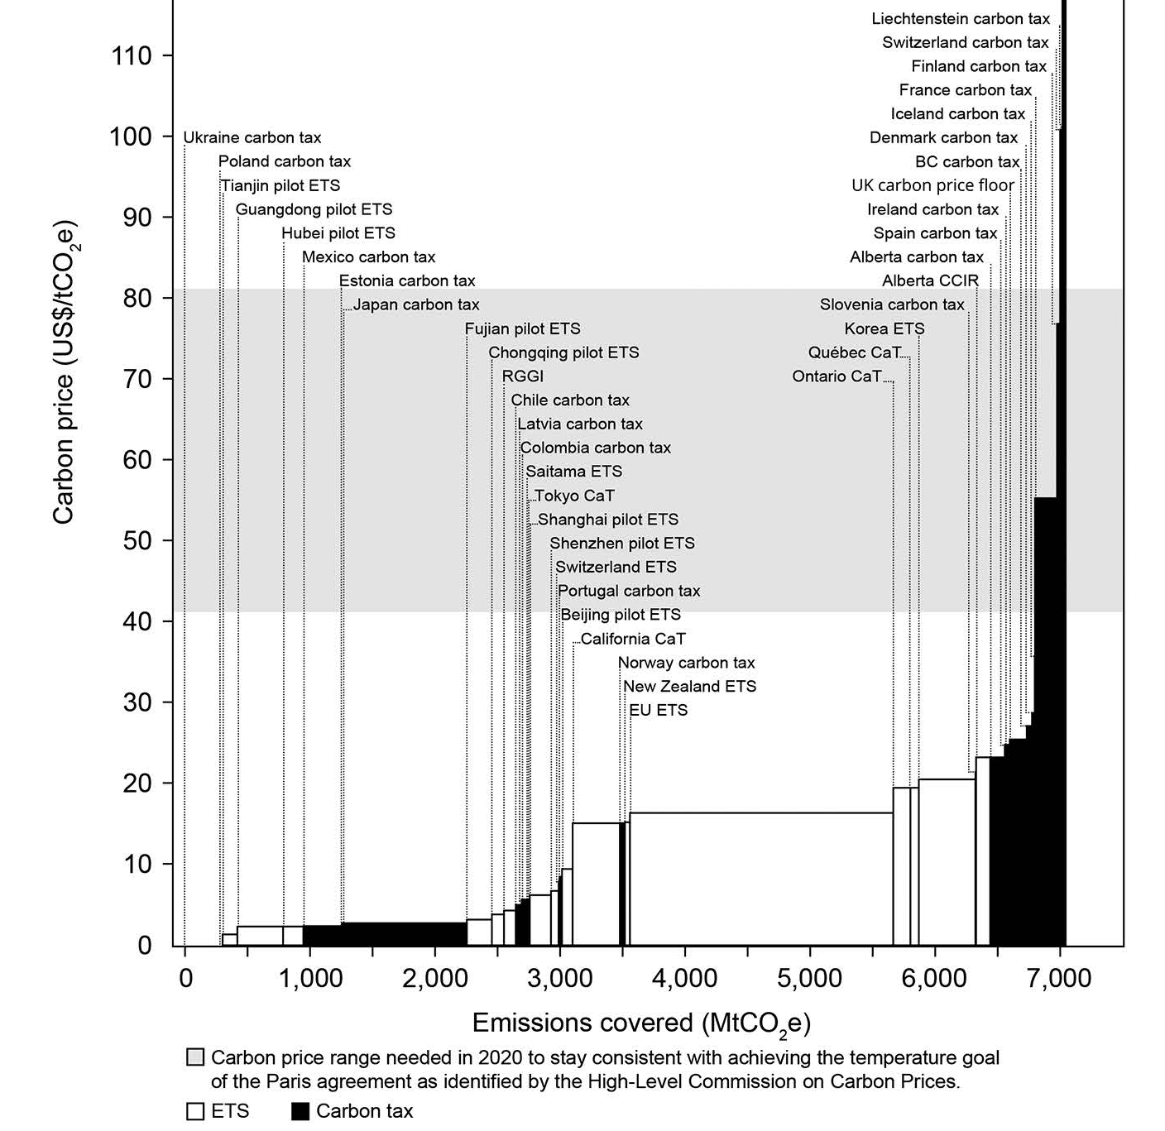
Carbon pricing fundamentals: beyond static/certainty case
Carbon tax, cap & trade
Not equivalent in more complicated settings
  Equivalence in static case
  Under uncertainty, static case: Weitzman (1974)
    Tax preferred if & only if slope(marginal abatement cost) > slope(marginal damages)
    In climate case, marginal damages=SCC, which is essentially constant, while level of abatement costs are uncertain, so W (1974) supports tax
  Under uncertainty, dynamic case:
    Karp & Traeger (2018)
    Aldy & Armitage (2021; JAERE forthcoming)
    Pindyck (1988, 1991), Dixit & Pindyck (2012)
In practice
  20% of global emissions covered by a carbon price (World Bank) (see WB Carbon Pricing Dashboard)
Carbon prices as of 2019: carbon tax and cap & trade. Source: Stavins (2020)

Slide 7
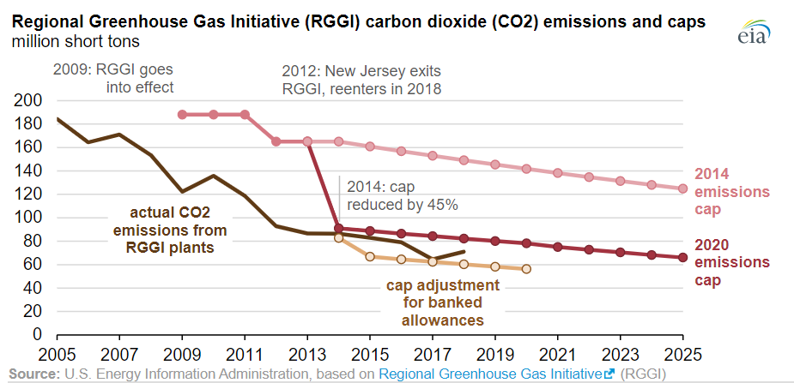
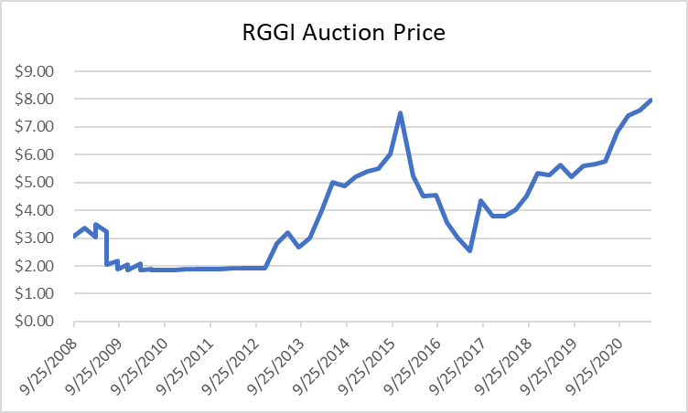
Carbon pricing fundamentals: beyond static/certainty case
Cap & trade in practice: Multiple sources of price volatility
(i) Regional Greenhouse Gas Initiative (10 East-coast States) - RGGI
RGGI emissions caps
RGGI tradable allowance prices
In 2009, the US Congress considered economy-wide CO2 cap & trade legislation (Waxman-Markey), which was defeated

Slide 8
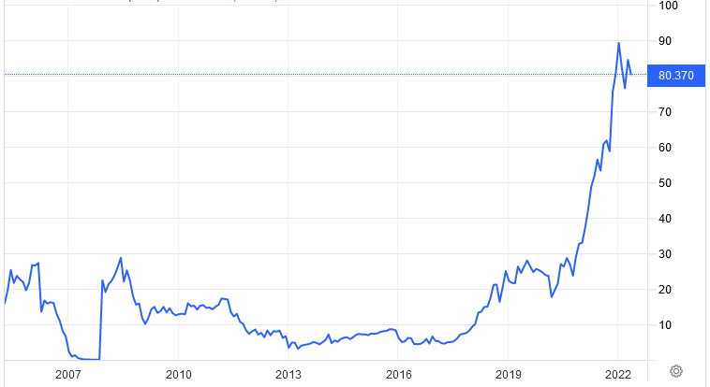
Carbon pricing fundamentals: beyond static/certainty case
Cap & trade in practice: Multiple sources of price volatility
(ii) EU Emissions Trading System (ETS) carbon permit price
EU ETS carbon permit price (€/metric ton CO2)

Slide 9




Carbon pricing fundamentals: standards with tradable allowances (permits)
Standards: how the tradable allowance system works
Standards regulate on a per-unit of output basis (miles per gallon; tons CO2/MWh; % clean per MWh, etc.)
Example: Clean Electricity Standard (CES) with an 80% clean mandate administered by US EPA
$ for CEC
0.8 CEC
0.8 CEC
3.2 CECs
1 MWh
4 MWh
The CES in effect is a tax on fossil generation & a subsidy to renewable generation, where the tax & subsidy net out systemwide
Price of CEC adjusts so that demand for fossil generation equals 20% of market; importance of pass-through
This results in a (possibly small) increase in consumer electricity price
  If the CEC price > 0 then the CEC is binding – so the additional clean build would not have happened on its own (more expensive)
  Even if wind is cheaper than coal, wind needs to be accompanied by storage and/or transmission buildout
That price increase can be partially or fully offset by tax credits to renewable producers
Theory: Goulder, Hafstead, & Williams (JEP 2016), Goulder-Hafstead (book, 2019)

Slide 10
Carbon pricing fundamentals
Cash flows and prices under various carbon pricing strategies
Example: only generation is by coal or wind, C&T & CES assume 80% emissions reduction relative to all-coal.
Static accounting and prices:
If C&T permits are auctioned off, C&T is equivalent to a carbon tax
If the only fossil fuel generation is coal (undifferentiated) and if demand is inelastic (a good approximation for electricity), then C&T with permits given to generators is equivalent to CES
If demand is elastic, then CES is equivalent to carbon tax with an output subsidy (the $40 in the carbon tax that would otherwise go to the government.
Who? | Carbon tax-and-dividend | Cap & trade with permits auctioned | Clean electricity standard (80%)
Coal generator | -$40 | -$40 | -$32
Wind generator | 0 | 0 | +$8
Ratepayer: price | Up to cover $40 + new wind system cost | Up to cover $40 + new wind system cost | Up to cover new wind system cost
Government | +$40 | +$40 | 0

Slide 11
Different policy instruments yield different price wedges
Policy | Description
(b) 90% CES | National clean electricity standard, starting at 38% non-fossil in 2022, increasing linearly to 90% in 2035. 90% partial crediting for CCS, no partial crediting for gas generation.
(c) 100% CES with $40 APS (“Hybrid CES”) | National CES, starting at 38% non-fossil generation in 2022, increasing linearly to 80% in 2030, then increasing linearly to 100% in 2035. Partial crediting with benchmark intensity factor 1.0 mton CO₂/MWh. ACP’s at $40/ton CO₂ increasing 3%/year.
(d) TPS | National tradable performance standard (emissions rate based) that imposes a national emissions rate cap starting at 0.33 tons CO₂/MWh in 2022, decreasing linearly to 0.04 ton CO₂/MWh in 2035.
(e) PTC/ITC extension | Extension of the $24/MWh production tax credit (indexed to inflation), 30% investment tax credit through 2035, and 45Q tax credit for CCS.
(f) Hybrid 100% CES + PTC/ITC extension | Combines hybrid 100% CES ($40 ACP) with PTC/ITC extension.
(h) $40 Carbon tax | National carbon tax, starting at $40 in 2022, increasing 3% per year.
(j) State CES | CA, CO, CT, MA, MD, ME, NJ, NM, NY, NV, OR, RI, WA, VA, and VT adopt an accelerated state clean electricity standard which increases linearly to 100% clean electricity by 2035. No partial crediting for gas generation.
(k) State CES + PTC/ITC extension | Combines state CES policies with PTC/ITC extension.
Source: Stock and Stuart (NBER WP 28677, 2021)

Slide 12
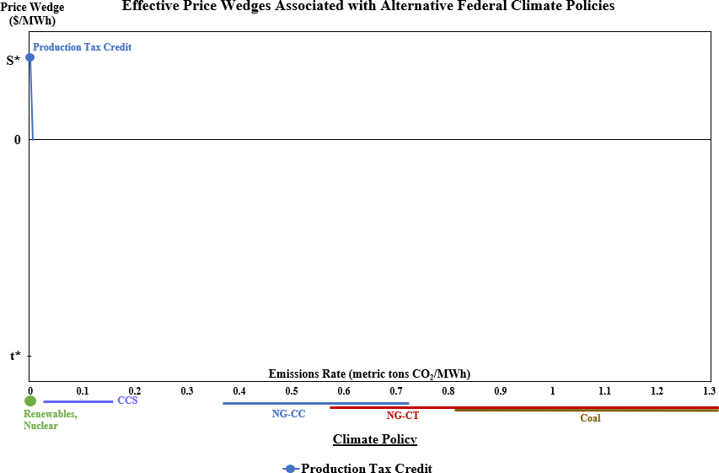
Different policy instruments yield different price wedges
Source: Stock and Stuart (NBER WP 28677, 2021)

Slide 13
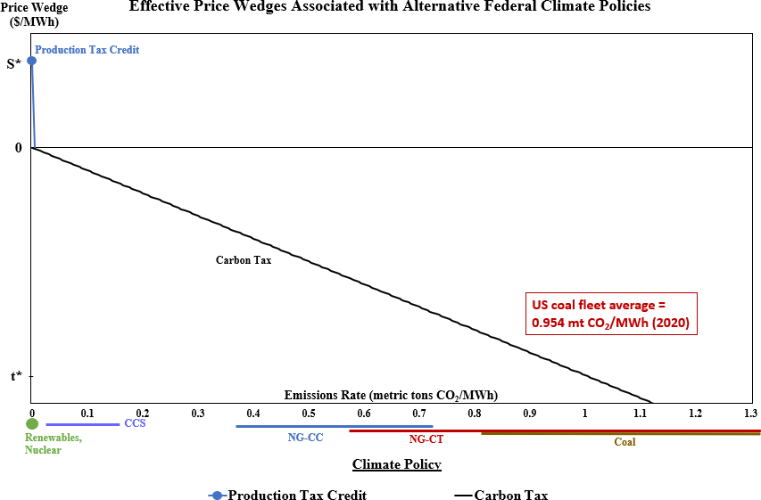
Different policy instruments yield different price wedges

Slide 14
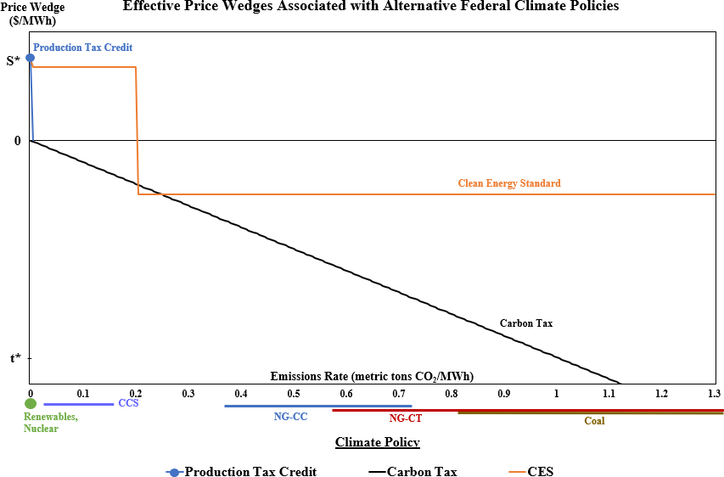
Different policy instruments yield different price wedges

Slide 15
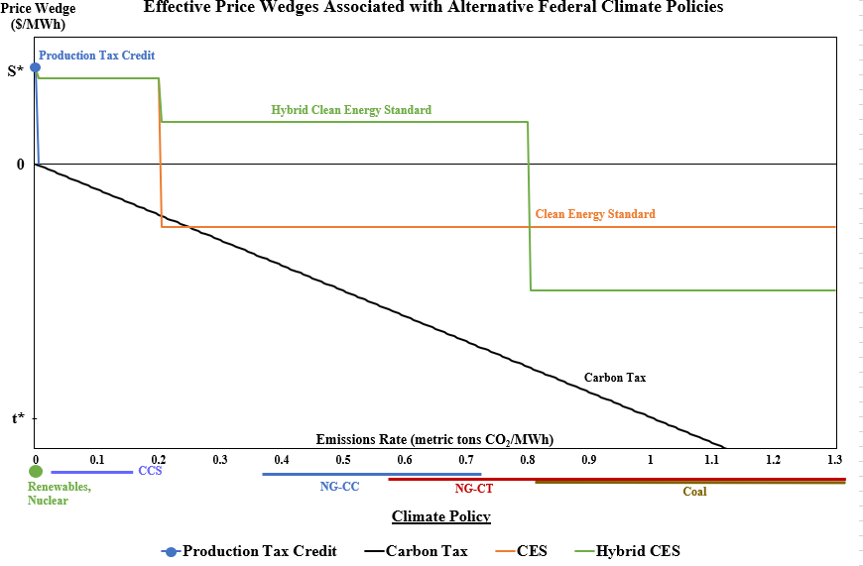
Different policy instruments yield different price wedges

Slide 16
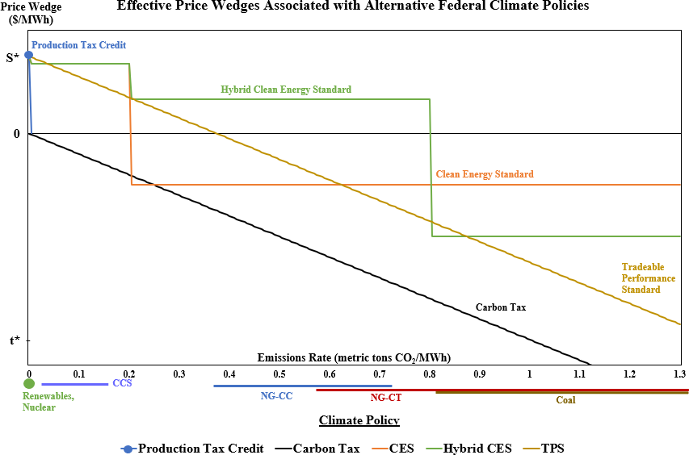
Different policy instruments yield different price wedges

Slide 17
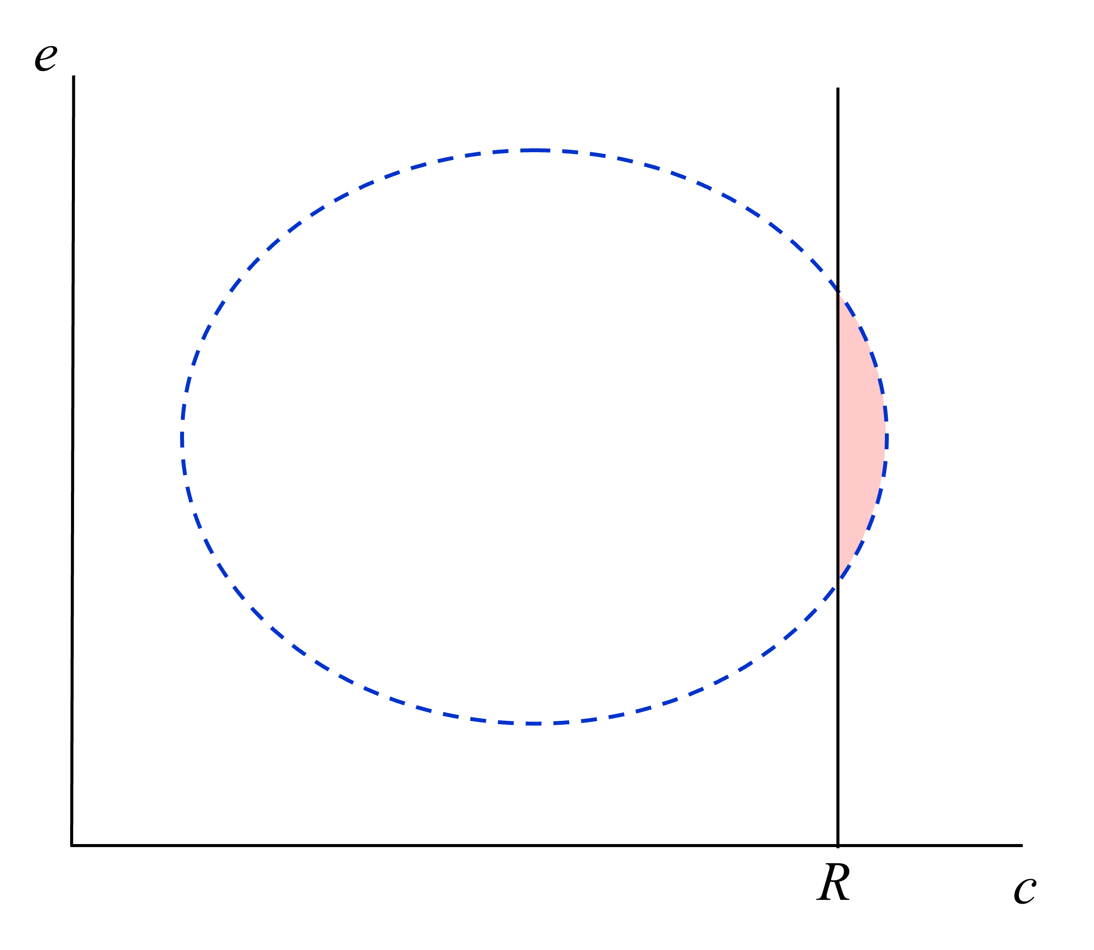
Carbon tax & CES: Graphical representation (Borenstein & Kellogg 2022)
Both a CES and a carbon price truncate the distribution of fossil fuel generators
Distribution of fossil fuel generators, characterized by e (emissions per MWh) and c (cost per MWh)
No FF generators will be dispatched if their marginal cost exceeds R
Private cost of renewables
Source: Borenstein & Kellogg (2022)

Slide 18
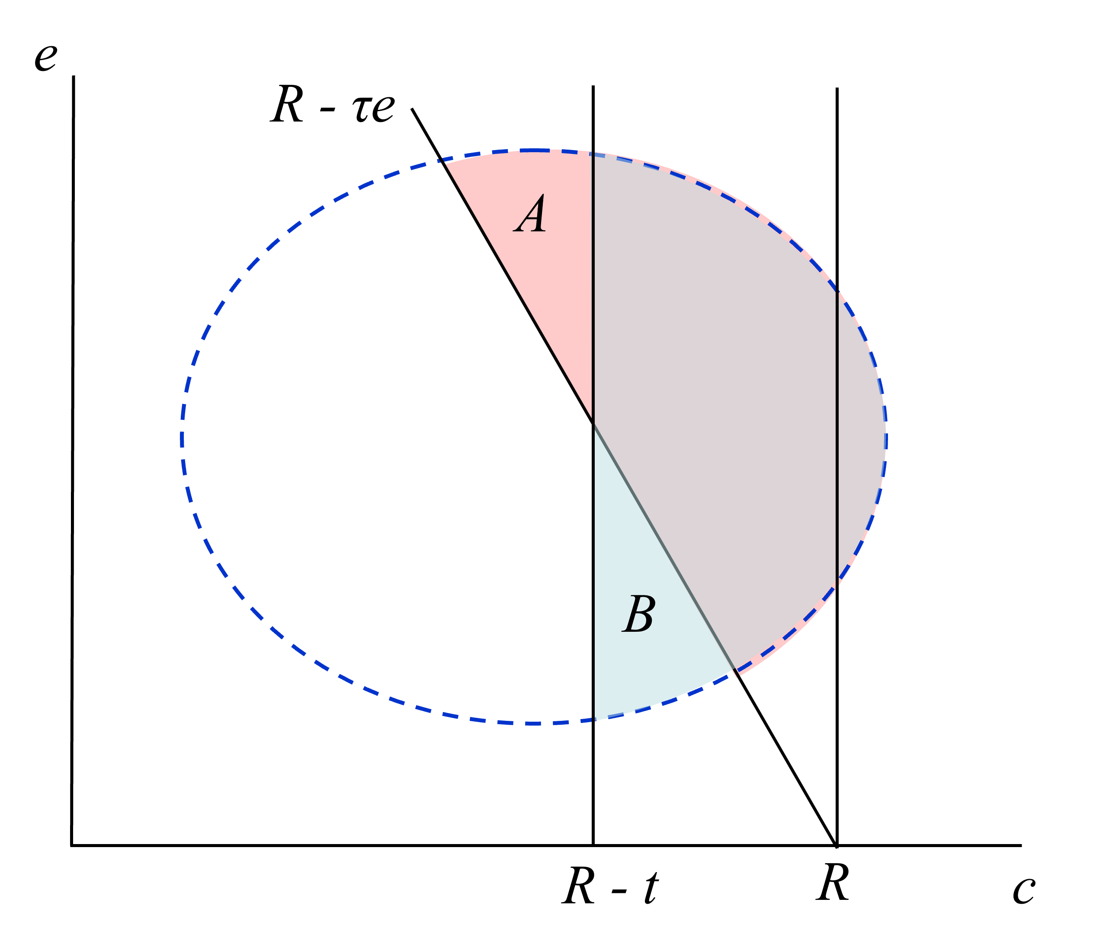
Carbon tax & CES: Graphical representation (Borenstein & Kellogg 2022)
Both a CES and a carbon price truncate the distribution of fossil fuel generators
A carbon price introduces a clean/FF price wedge that depends linearly on the emissions intensity
FF generators that won’t produce under a carbon price, but will under a CES
FF generators that won’t produce under a CES, but will under a carbon tax
A CES without partial crediting introduces a price wedge t between clean and undifferentiaged non-clean (FF) generation
Source: Borenstein & Kellogg (2022)

Slide 19
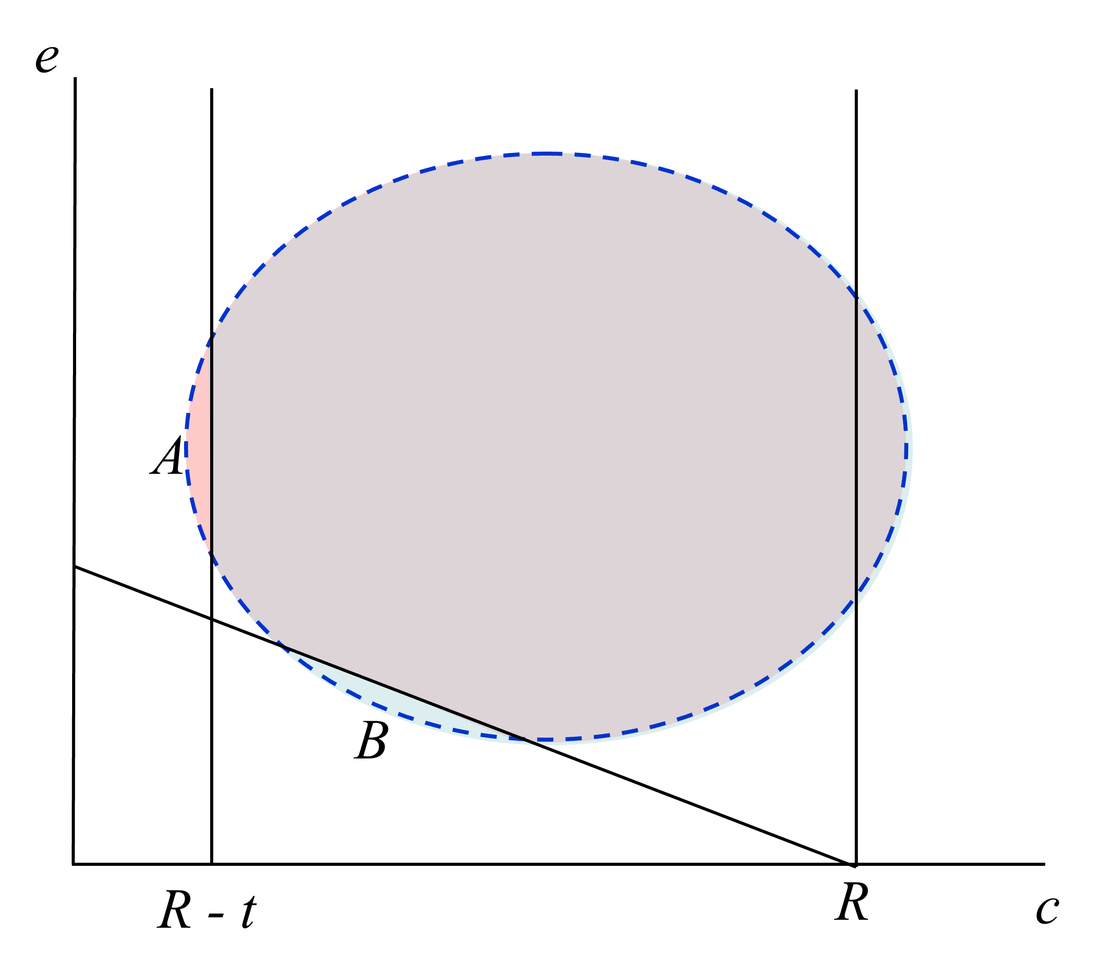
Carbon tax & CES: Graphical representation (Borenstein & Kellogg 2022)
Both a CES and a carbon price truncate the distribution of fossil fuel generators
Eventually, a carbon price and a CES end up in (nearly) the same place
Source: Borenstein & Kellogg (2022)

Slide 20
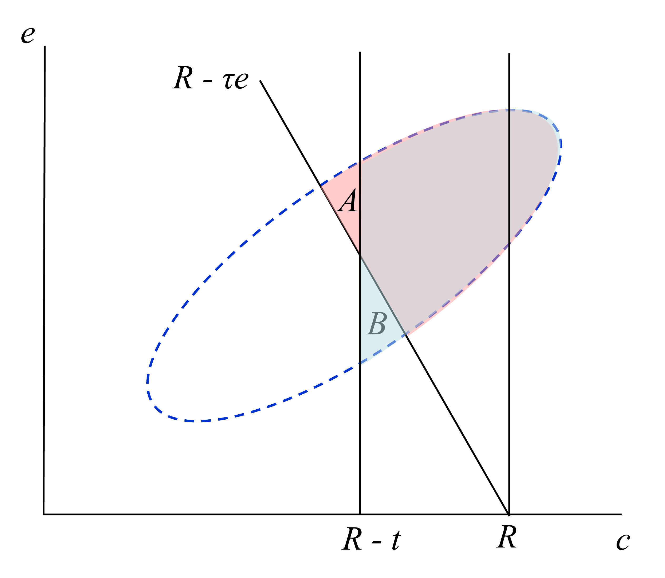
Carbon tax & CES: Graphical representation (Borenstein & Kellogg 2022)
Both a CES and a carbon price truncate the distribution of fossil fuel generators
The greater the correlation between c and e in the FF fleet, the less the difference between a carbon price and a CES
Source: Borenstein & Kellogg (2022)

Slide 21
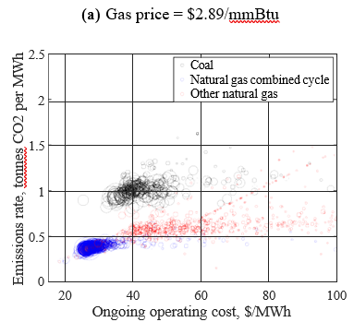
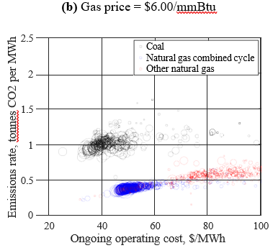
Carbon tax & CES: Graphical representation (Borenstein & Kellogg 2022)
Both a CES and a carbon price truncate the distribution of fossil fuel generators
At 2019 natural gas prices, corr(e,c) = 0.66: a CT and CES largely sweep out the same generators
At high natural gas prices, corr(e,c) = -0.33: a CT sweeps out coal, a CES sweeps out gas
Source: Borenstein & Kellogg (2022)

Slide 22
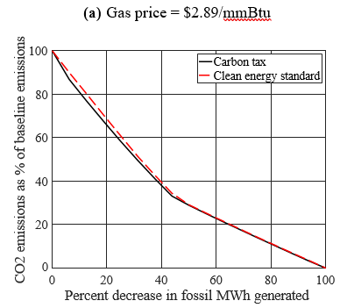
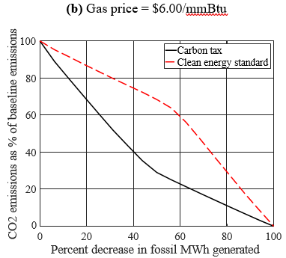
Carbon tax & CES: Graphical representation (Borenstein & Kellogg 2022)
Both a CES and a carbon price truncate the distribution of fossil fuel generators
At 2019 natural gas prices, corr(e,c) = 0.66: a CT and CES largely sweep out the same generators
At high natural gas prices, corr(e,c) = -0.33: a CT sweeps out coal, a CES sweeps out gas
Emissions along the reduction path
Source: Borenstein & Kellogg (2022)

Slide 23
Investment & production tax credits
Both a CES and a carbon price truncate the distribution of fossil fuel generators
PTC provides a given subsidy per MWh of clean generation (e.g., $0.023/kWh)
ITC pays for a given percentage of clean investment (e.g., 30%)
Comparisons:
PTC incentivizes maintenance and choosing productive sites; but the owner has similar incentives under the ITC.
PTC allows wind & solar to bid in at negative prices while they are operating – can cause problems for baseload sources like nuclear which must continue to run but potentially at a loss – leading to nuclear subsidies as an unintended consequence
Negative prices are an occasional problem now, when natural gas (or coal) is the marginal producer (so it sets the market price in wholesale markets)
But in the future negative marginal pricing (or zero pricing) will be more frequent
Complicated grid economics! Storage?

Slide 24
Policy simulations (Stock & Stuart 2021)
NREL ReEDS power sector model
Capacity expansion model developed and updated annually by NREL staff.
Mixed-integer programming problem to minimize aggregate system costs while meeting load constraints, transmission constraints and capacity planning constraints
Geographic representation: 3 interconnections, 134 load balancing areas, 356 wind and solar regions
Temporal representation: 17 time slices per year (seasonal + daily)
Endogenous capacity additions and coal retirements; no long-distance transmission additions
Model build decisions have been validated against historical capacity build-out and forecasts are regularly benchmarked to EIA AEO, IEA World Energy Outlook and BNEF New Energy Outlook.
No uncertainty; simulations here use four-year myopic solution
ReEDS Augur:
Solves dynamic problem of optimal hourly dispatch of storage technologies in each solve year

Slide 25
Policy simulations (Stock & Stuart 2021)
Policy | Description
(b) 90% CES | National clean electricity standard, starting at 38% non-fossil in 2022, increasing linearly to 90% in 2035. 90% partial crediting for CCS, no partial crediting for gas generation.
(c) 100% CES with $40 APS (“Hybrid CES”) | National CES, starting at 38% non-fossil generation in 2022, increasing linearly to 80% in 2030, then increasing linearly to 100% in 2035. Partial crediting with benchmark intensity factor 1.0 mton CO₂/MWh. ACP’s at $40/ton CO₂ increasing 3%/year.
(d) TPS (C&T system equivalent to carbon tax) | National tradable performance standard (emissions rate based) that imposes a national emissions rate cap starting at 0.33 tons CO₂/MWh in 2022, decreasing linearly to 0.04 ton CO₂/MWh in 2035.
(e) PTC/ITC extension | Extension of the $24/MWh production tax credit (indexed to inflation), 30% investment tax credit through 2035, and 45Q tax credit for CCS.
(f) Hybrid 100% CES + PTC/ITC extension | Combines hybrid 100% CES ($40 ACP) with PTC/ITC extension.
(h) $40 Carbon tax | National carbon tax, starting at $40 in 2022, increasing 3% per year.
(j) State CES | CA, CO, CT, MA, MD, ME, NJ, NM, NY, NV, OR, RI, WA, VA, and VT adopt an accelerated state clean electricity standard which increases linearly to 100% clean electricity by 2035. No partial crediting for gas generation.
(k) State CES + PTC/ITC extension | Combines state CES policies with PTC/ITC extension.

Slide 26
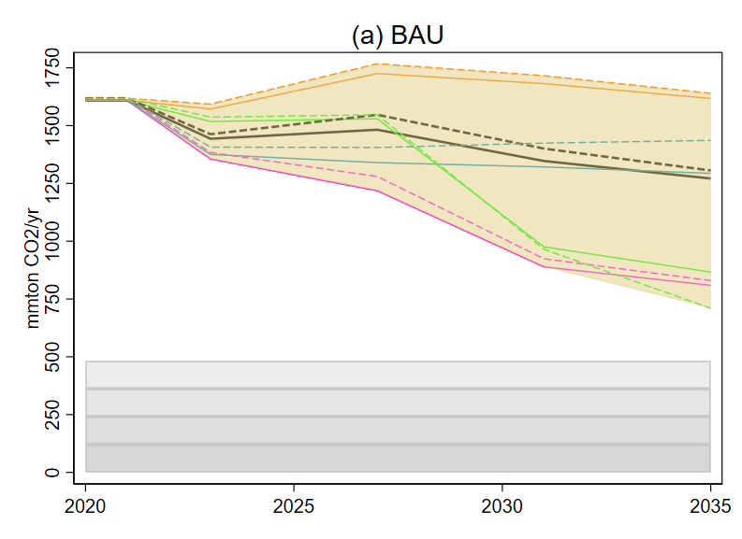
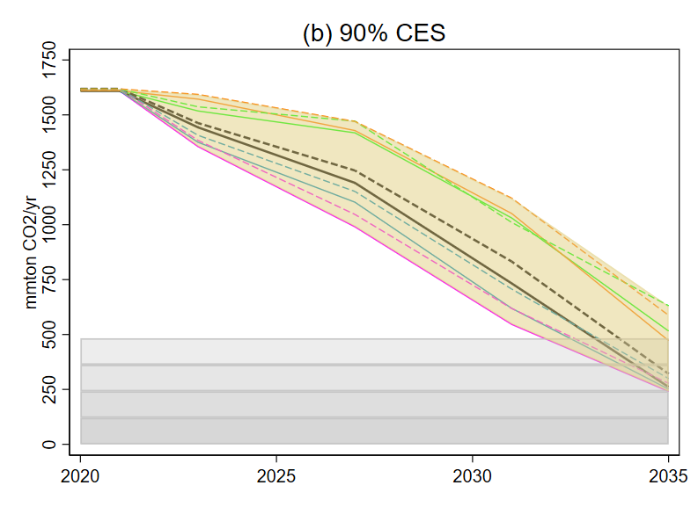
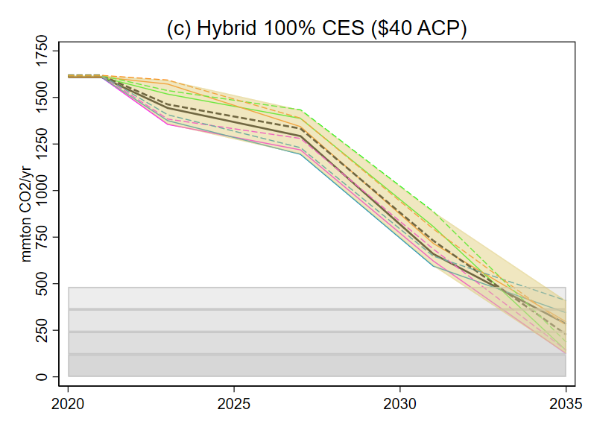
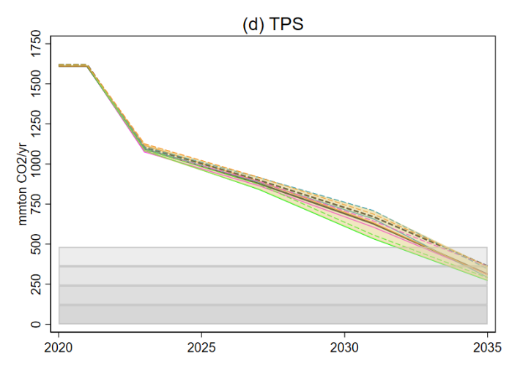
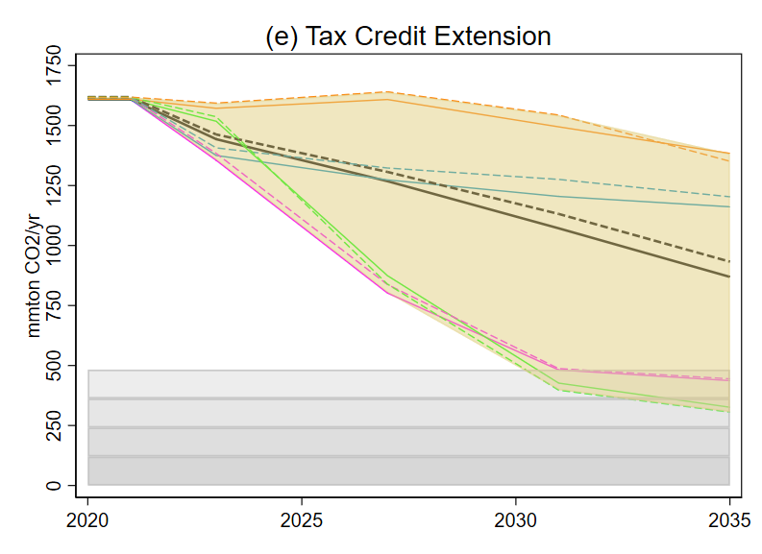
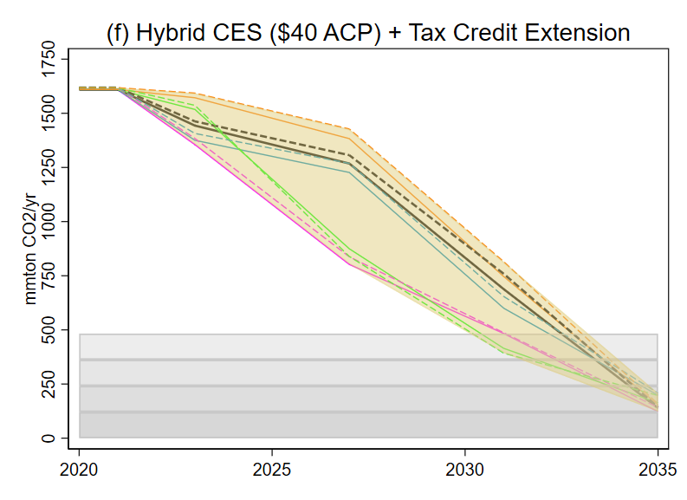
Results: Annual Power Sector CO2 Emissions by Policy

Slide 27
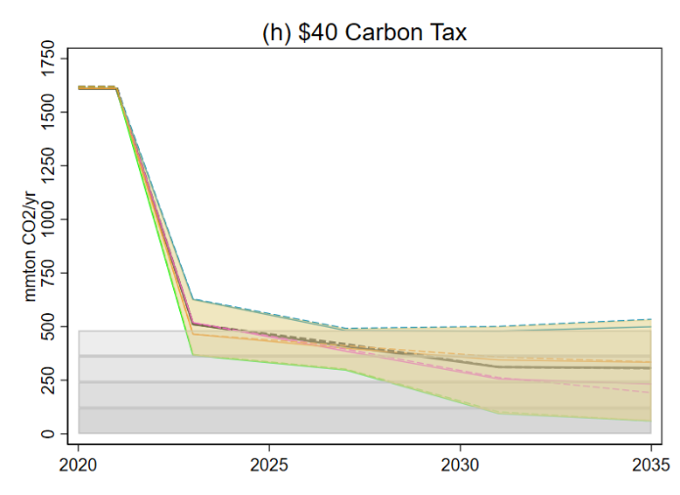
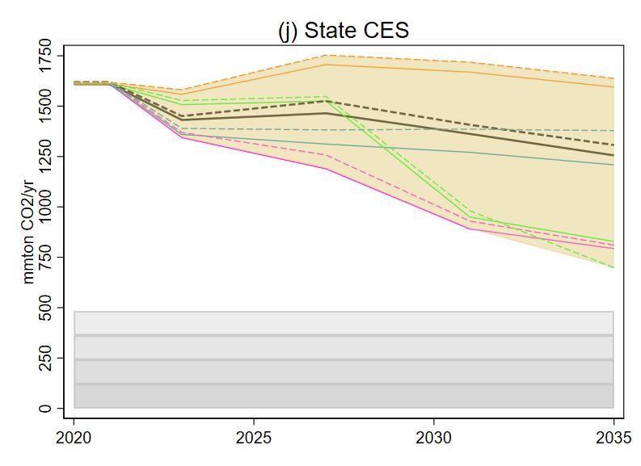
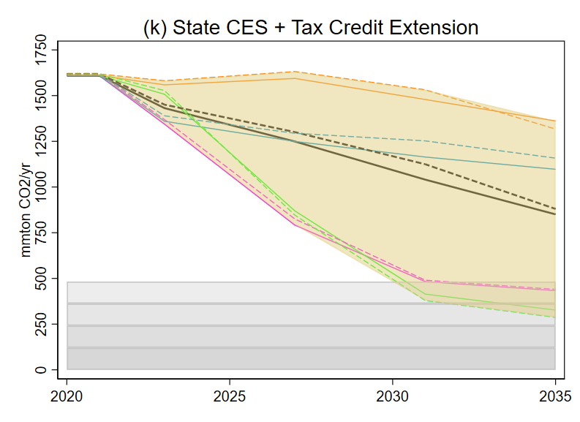
Results: Annual Power Sector CO2 Emissions by Policy
Summary: Emissions reductions
Tax credits alone aren’t enough
State ambition isn’t enough because of leakage, even with tax credits
Carbon tax alone isn’t enough
TPS decarbonizes (of course!)
The CES design matters: partial crediting creates a tax on emissions
Tax credit extension acts like insurance policy for hybrid CES (emissions reductions when renewables are expensive and gas is cheap)

Slide 28
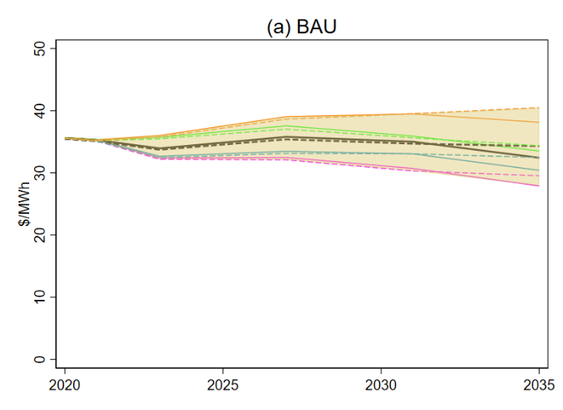
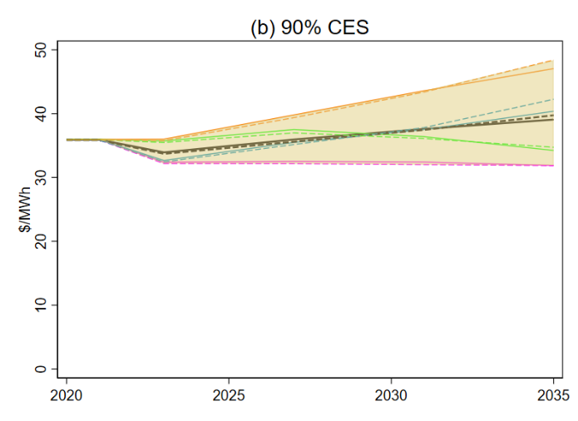
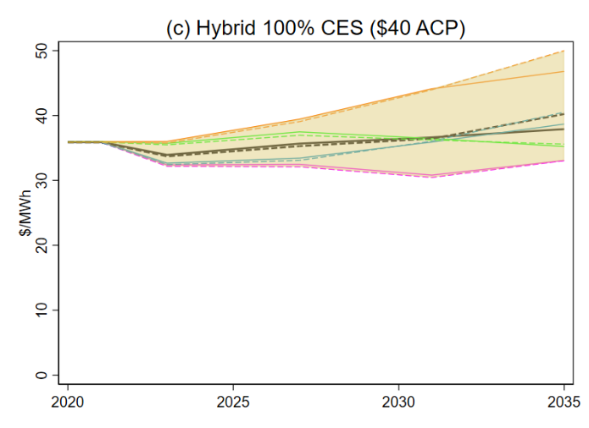
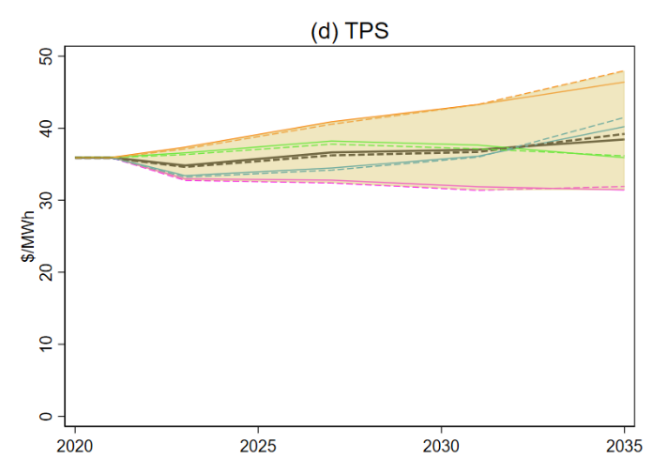
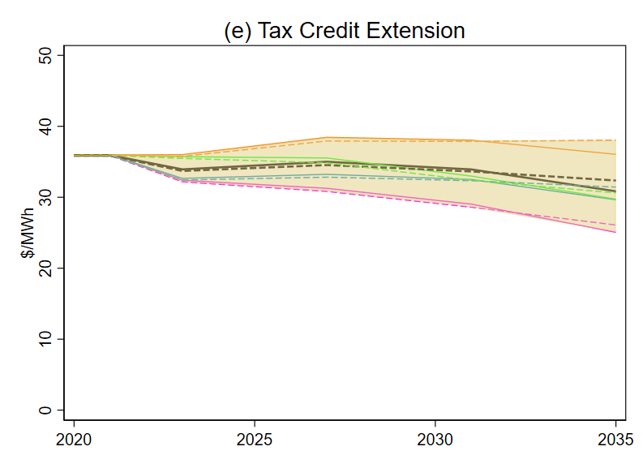
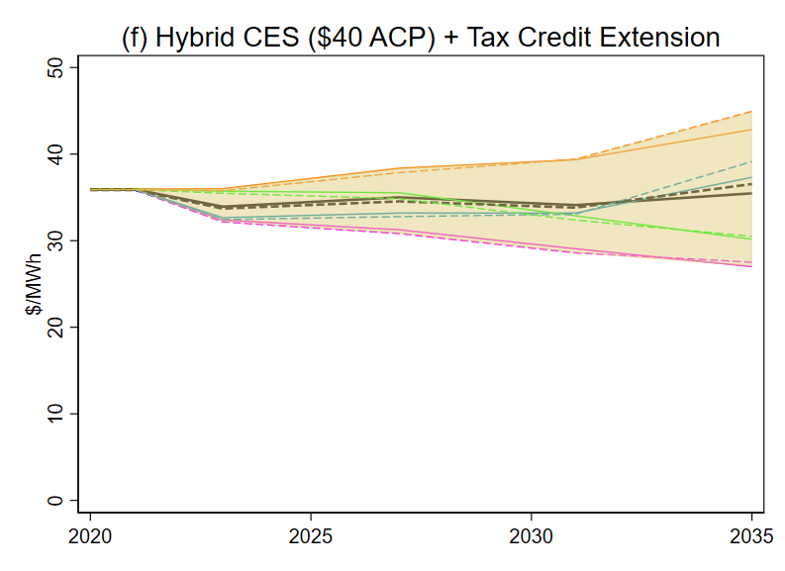
Results: National Average Wholesale Prices by Policy

Slide 29
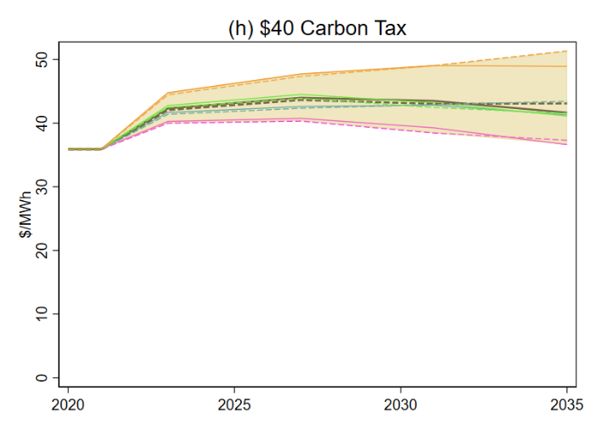
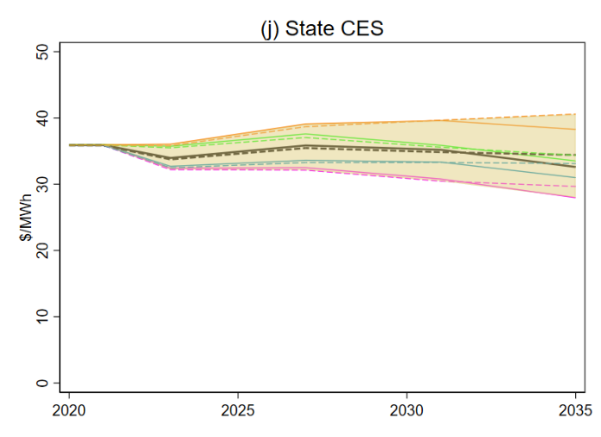
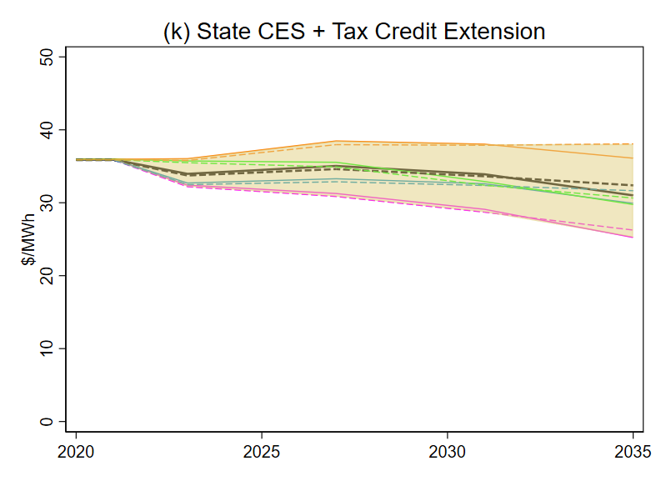
Results: National Average Wholesale Prices by Policy
Summary: Wholesale prices
Under a carbon tax, prices increase ~$2-15/MWh. Current national average retail price is $120/MWh
Under CES, TPS, without tax credits, price increase is -$4 to $12/MWh – only slightly higher than BAU
Hybrid CES + tax credit extension ≈ BAU

Slide 30
Results: Abatement costs, reference demand
Climate Policy | Annual CO2 Emissions in 2035 | 2035 Emissions as fraction of 2005 Emissions | Cumulative Abatement | Average Abatement Cost | Average Abatement Cost, Equivalent C&T | Cost ratio: Policy to C&T
Reference Technology Scenario:
BAU | 1,271 | 0.526 | - | - | - | -
$20 Carbon Tax | 531 | 0.220 | 12,260 | $12.9 | $12.9 | 1.00
$40 Carbon Tax | 307 | 0.127 | 16,020 | $22.9 | $22.9 | 1.00
TPS | 312 | 0.129 | 10,526 | $19.8 | $19.2 | 1.03
90% CES | 261 | 0.108 | 7,665 | $23.9 | $21.3 | 1.12
100% Hybrid CES, $20 ACP | 457 | 0.189 | 6,764 | $11.3 | $10.7 | 1.05
100% Hybrid CES, $40 ACP | 284 | 0.118 | 7,455 | $19.8 | $19.1 | 1.04
PTC/ITC Extension | 869 | 0.360 | 3,565 | $35.4 | $4.4 | 8.14
State CES | 1,256 | 0.520 | 119 | $81.0 | -* | -*
PTC/ITC Extension and State CES | 850 | 0.352 | 3,888 | $33.5 | $4.3 | 7.73
100% Hybrid CES ($40 ACP) + Extension | 139 | 0.057 | 8,021 | $52.9 | $30.0 | 1.76
Notes: Carbon dioxide emissions are expressed in millions of metric tons. Average costs are expressed in 2018$ per metric ton CO2 and include all privately-borne system costs (defined as capital, O&M, fuel and transmission costs) plus federal tax expenditures (defined as ITC and PTC expenditures). ``Equivalent C&T'' refers to a cap-and-trade policy calibrated to the emissions declines from a given climate policy. The difference in abatement cost between the carbon tax and the emissions-equivalent cap & trade fall within ReEDS numerical error.

Slide 31
Results: Abatement costs, high demand
Climate Policy | Annual CO2 Emissions in 2035 | 2035 Emissions as fraction of 2005 Emissions | Cumulative Abatement | Average Abatement Cost | Average Abatement Cost, Equivalent C&T | Cost ratio: Policy to C&T
Reference Technology Scenario:
BAU | 1,306 | 0.541 | - | - | - | -
$20 Carbon Tax | 532 | 0.220 | 12,721 | $14.6 | $14.7 | 1.00
$40 Carbon Tax | 306 | 0.126 | 16,675 | $24.2 | $24.2 | 1.00
TPS | 363 | 0.150 | 10,711 | $18.6 | $18.5 | 1.01
90% CES | 321 | 0.133 | 7,414 | $23.4 | $18.5 | 1.27
100% Hybrid CES, $20 ACP | 430 | 0.178 | 7,039 | $13.7 | $13.1 | 1.05
100% Hybrid CES, $40 ACP | 227 | 0.094 | 7,850 | $23.5 | $23.1 | 1.01
PTC/ITC Extension | 933 | 0.386 | 3,529 | $47.6 | $7.1 | 6.69
State CES | 1,307 | 0.541 | 103 | $67.6 | $11.4 | 5.94
PTC/ITC Extension and State CES | 880 | 0.364 | 3,841 | $46.4 | $7.5 | 6.22
100% Hybrid CES ($40 ACP) + Extension | 143 | 0.059 | 8,179 | $61.1 | $29.3 | 2.09
Notes: Carbon dioxide emissions are expressed in millions of metric tons. Average costs are expressed in 2018$ per metric ton CO2 and include all privately-borne system costs (defined as capital, O&M, fuel and transmission costs) plus federal tax expenditures (defined as ITC and PTC expenditures). ``Equivalent C&T'' refers to a cap-and-trade policy calibrated to the emissions declines from a given climate policy. The difference in abatement cost between the carbon tax and the emissions-equivalent cap & trade fall within ReEDS numerical error.

Slide 32
Results: Annuitized Federal Net Revenues, reference demand ($B)
Federal Net Revenues under reference case
$B annually (2022-2035 totals annuitized)
Climate Policy | Expenditures: ITC | Expenditures: PTC | Receipts | Net Revenues | Net Revenues minus BAU
Reference Technology Scenario:
BAU | -2.8 | -4.8 | 0.0 | -7.6
$20 Carbon Tax | -5.4 | -7.9 | 16.5 | 3.2 | 10.8
$40 Carbon Tax | -7.2 | -10.0 | 20.2 | 3.0 | 10.5
TPS | -5.1 | -5.7 | 0.0 | -10.8 | -3.3
90% CES | -4.3 | -4.8 | 0.0 | -9.1 | -1.5
100% Hybrid CES, $20 ACP | -3.8 | -4.8 | 1.1 | -7.5 | 0.0
100% Hybrid CES, $40 ACP | -4.1 | -4.8 | 0.5 | -8.4 | -0.8
PTC/ITC Extension | -5.2 | -10.9 | 0.0 | -16.1 | -8.5
State CES | -2.9 | -4.8 | 0.0 | -7.7 | -0.2
PTC/ITC Extension and State CES | -5.4 | -10.8 | 0.0 | -16.2 | -8.7
100% Hybrid CES ($40 ACP) +Extension | -7.7 | -16.4 | 0.1 | -24.0 | -16.4
Notes: Annuitized using 5% discount rate, 20 year horizon.

Slide 33
Results: Annuitized Federal Net Revenues ($B), ctd.
Federal Net Revenues for Hybrid CES with tax credit extension
$B annually (2022-2035 totals annuitized)
Demand | Renewables prices | Gas prices | Expenditures: ITC | Expenditures: PTC | Receipts | Net Revenues | Net Revenues minus BAU
Reference | Reference | Reference | -7.7 | -16.4 | 0.1 | -24.0 | -16.4
Reference | Low | Low | -5.7 | -25.1 | 0.0 | -30.8 | -23.2
Reference | High | Low | -6.5 | -11.2 | 0.3 | -17.3 | -10.2
Reference | Low | High | -6.3 | -27.9 | 0.0 | -34.1 | -25.6
Reference | High | High | -9.6 | -16.8 | 0.1 | -26.3 | -18.4
High | Reference | Reference | -10.0 | -19.0 | 0.0 | -29.0 | -20.6
High | Low | Low | -6.7 | -28.4 | 0.0 | -35.1 | -26.9
High | High | Low | -8.4 | -13.2 | 0.3 | -21.3 | -13.5
High | Low | High | -7.7 | -30.6 | 0.0 | -38.2 | -29.0
High | High | High | -12.1 | -19.7 | 0.1 | -31.8 | -22.9
Notes: $billions of annual flows, 2022-2035, annuitized using 5% discount rate, 20 year horizon.

Slide 34
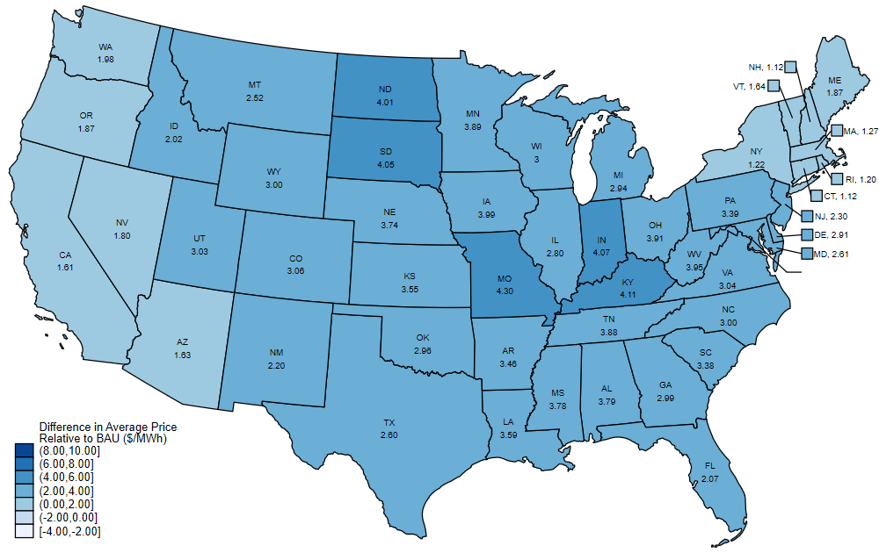
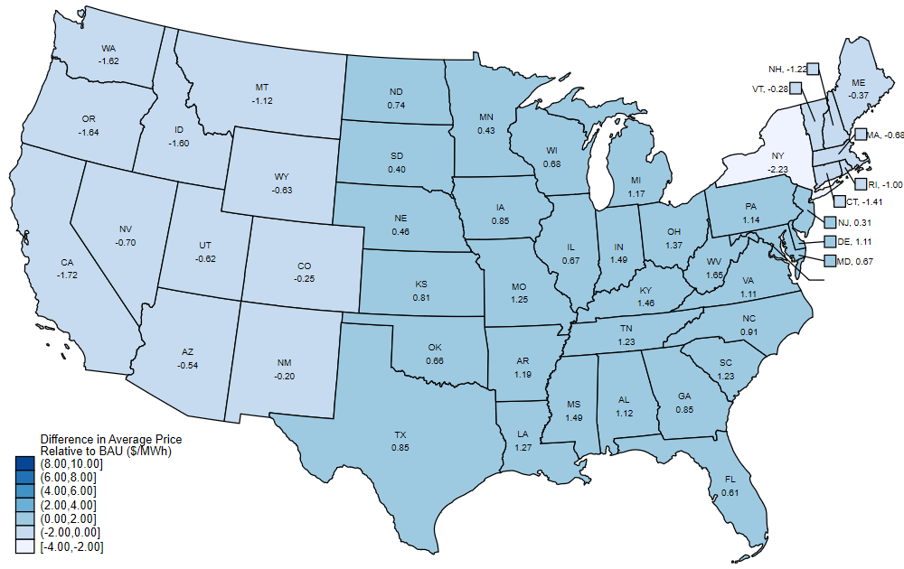
Results: Regional price impacts
Average wholesale electricity price change by state (reference demand, reference prices)
TPS ($/MWh) Hybrid CES + tax credit extension

Slide 35
Carbon pricing: Criticisms & the case for sectoral standards
Criticisms
Price uncertainty under tradable allowance programs (cap & trade, standards) retards green investment
  real options theory (e.g., Aldy & Armitage 2021)
Are carbon taxes regressive?
  Depends on how revenues are used
  Per-capita redistribution (“fee & dividend”)
  Metcalf (Energy Policy 2019) (survey with references)
Political economy
  Visible taxation is politically unpopular
  C&T, standards have problem of diffuse benefits but concentrated entities bearing transition costs (owners & employees of coal plants are not the same as owners & employees of wind & solar)
Carbon pricing (especially taxes) is bad for economic growth & employment (address later)
Carbon pricing increases energy prices
Carbon pricing won’t produce necessary emissions reductions

Slide 36
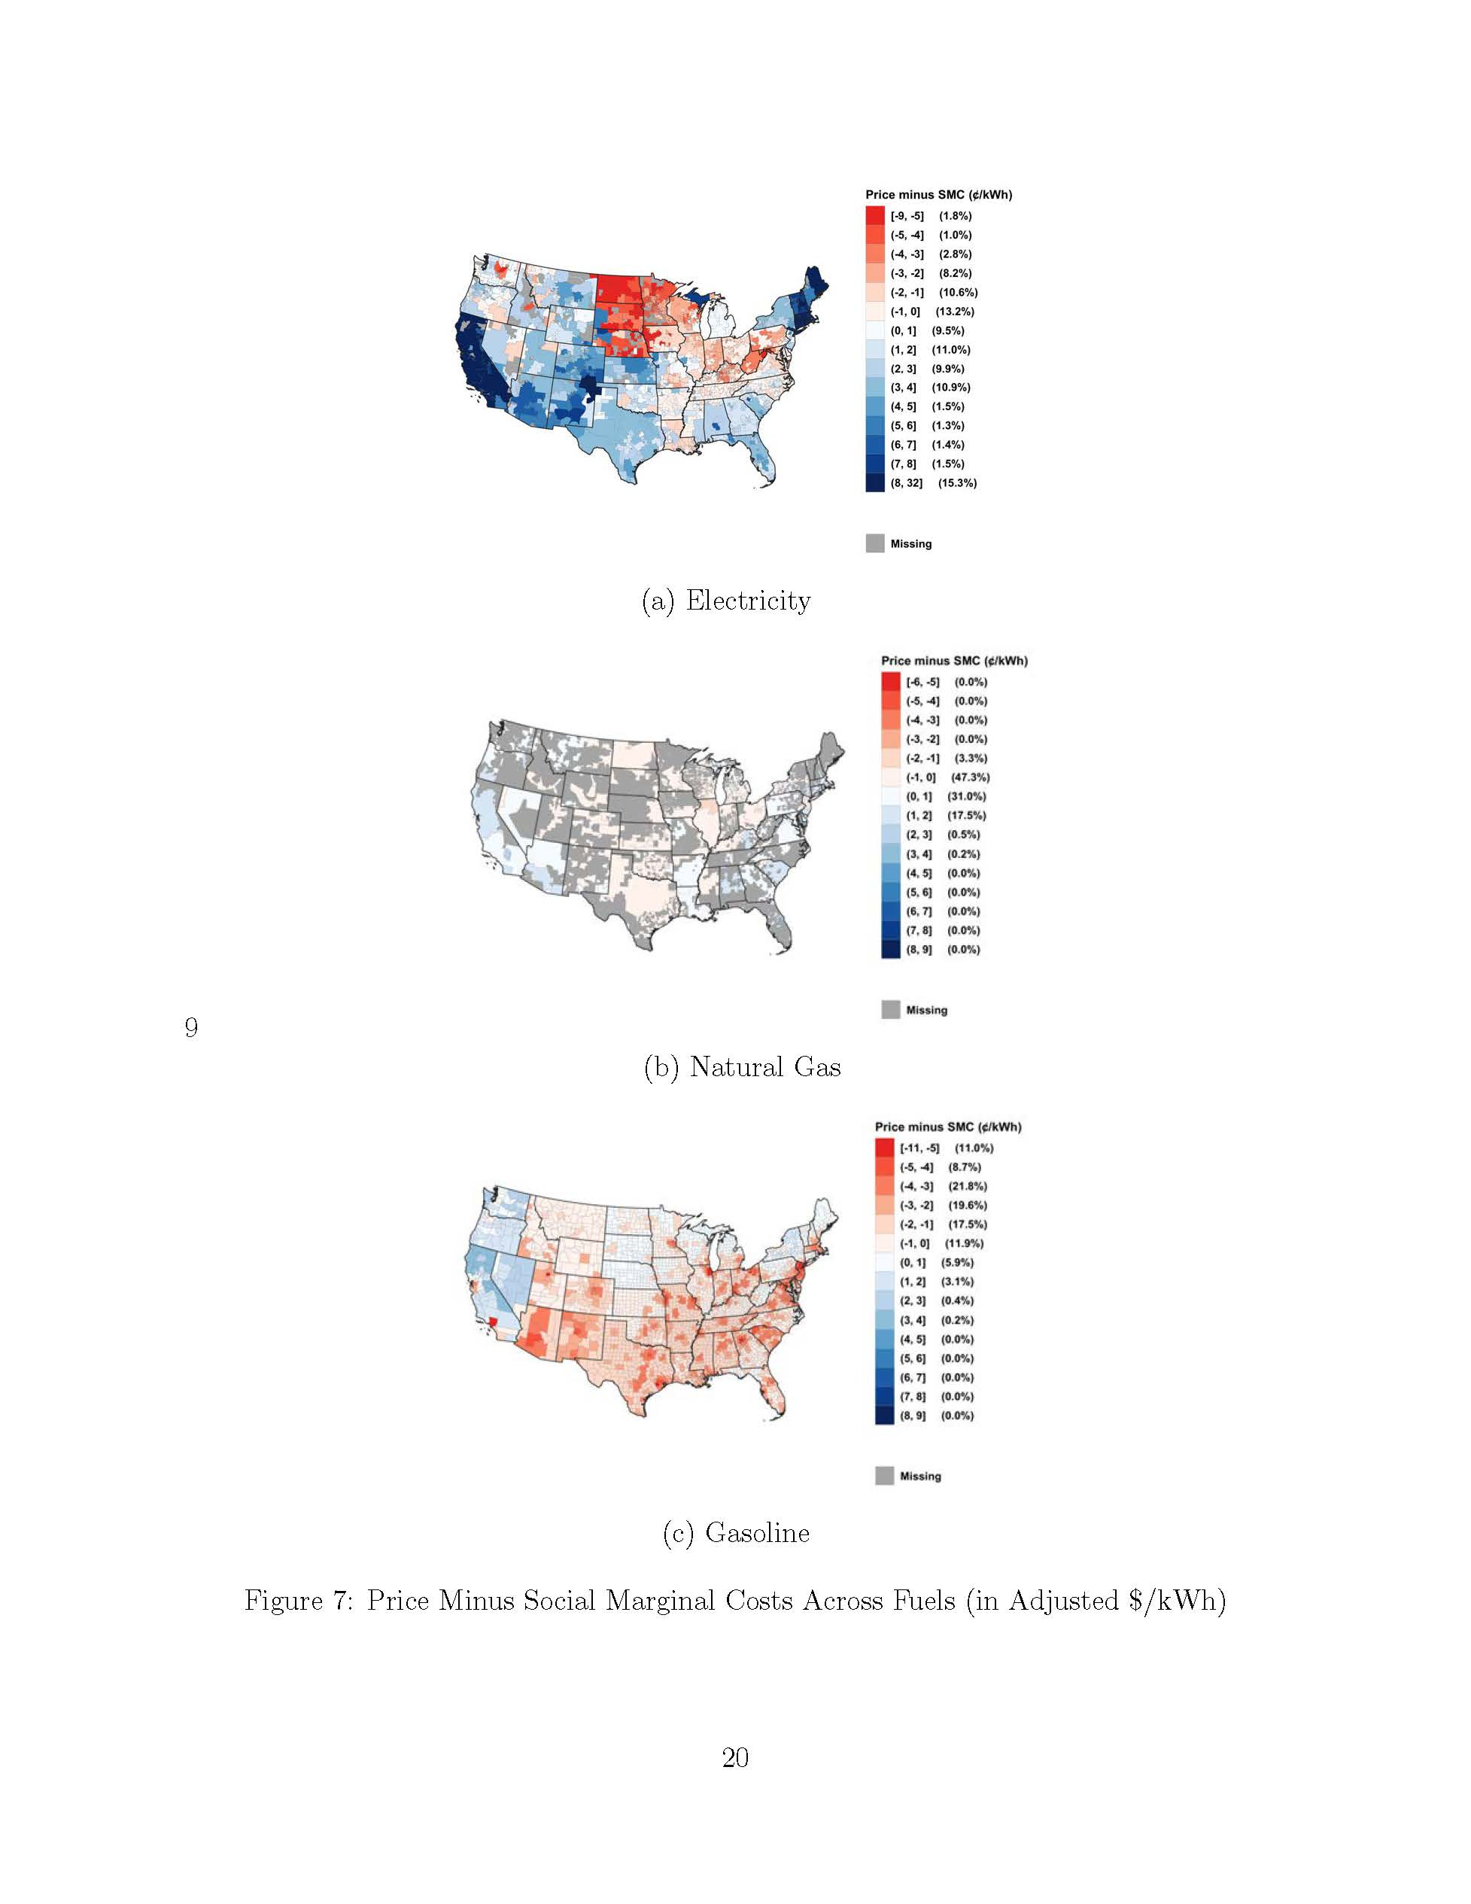
(v) Carbon pricing increases energy prices
Initial reaction – isn’t that the point? But that reaction assumes the no-tax price is at private marginal cost
Estimates of retail prices of electricity, gas, & gasoline minus social marginal cost (in ¢/kWh equivalent)
  Source: Borenstein & Bushnell (NBER WP 29118, August 2021)
  Social marginal cost = private marginal cost + external costs
  External costs: carbon cost; air pollution; not driving externalities for gasoline
  Prices are estimates of residential marginal prices (subtracting off fixed component)
Major implication for “electrify everything” - electricity prices are already “too high” in much of the country
Favors CES or tax credits, or combination, over (sectoral) carbon tax or C&T

Slide 37
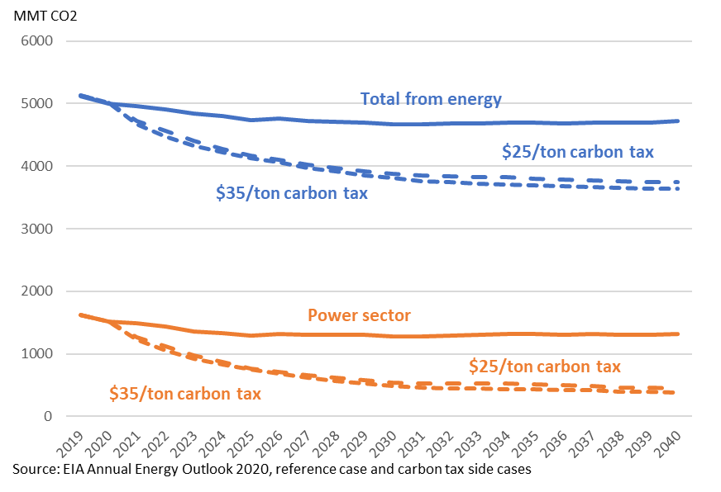
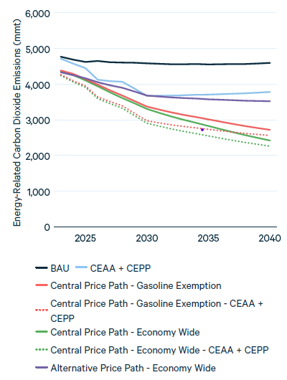
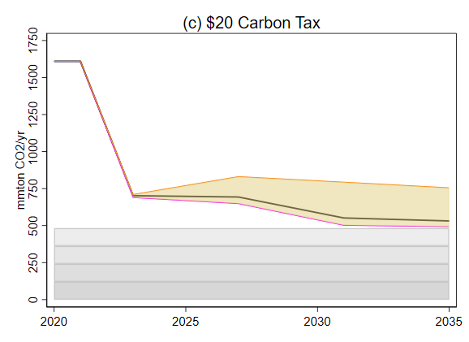
(vi) Carbon pricing won’t produce necessary emissions reductions
Growing evidence that carbon tax has small effect on emissions (Green (2021), Metcalf-Stock)
But most CT’s – like the EU CT – cover mainly the transportation sector, where demand is inelastic & few substitutes are available.
In the power sector, low-carbon substitutes are available, so emissions elasticities are likely much larger than in the general CT literature.
Three Recent Carbon Tax Simulations for the US
(a) EIA (2021):
Reference case and $25 & $35 carbon tax cases
(b) Stock & Stuart (2021):
BAU & TPS, power sector only
(c) RFF (2021):
BAU and $15 carbon tax cases
$15 Carbon tax excluding gasoline

Slide 38
Sectoral carbon pricing: summary
General comments
Emerging economic case for:
  Sectoral policies
  Policy certainty (CES, CT, tax credits > cap & trade)
    Real options investment literature
  CES, tax credits instead of CT or cap & trade
  Keeping electricity prices low (CES, tax credits > CT, cap & trade)
  Efficiency of CES depends on correlation between (e, c) in fossil fuel fleet
Other considerations
  Standards typically have interim reviews that favor established entities (lobbying, engagement)
  Standards can lock in existing technologies (lock out new technologies not as far along the cost curve)
    Think deep geothermal, fusion, SMRs
  This discussion has focused on the power sector.
    Sectoral details matter!!!!
    Situation in the fuels sector is very different because of the lack of economically competitive deep decarbonization fuels

