Slide 1

Study Center Gerzensse: Advanced Courses in Economics
The Economics and Econometrics of Climate Change Policy:
C. Carbon Pricing with Leakage:
Supply Side Policies
James H. Stock
Economics Department and Harvard Kennedy School,
Harvard University
May 30 – June 3, 2022

Slide 2
Course outline
I. Introduction
Introduction & Overview
  Climate change science and CC econometrics (brief)
  Framework economic concepts
  Cost-benefit analysis, cost effectiveness analysis, SCC & TCP
  Marginal abatement curve
III. Damages
Macroeconomic implications of the energy transition
  Physical & transition costs
  Physical costs: damage estimates
  Transition costs: policy
    Carbon tax
    Cap & trade
    Policy uncertainty
The Social Cost of Carbon: Recent developments (time permitting)
II. Emissions reduction (mitigation/decarbonization)
Sectoral carbon policies – theory & empirical evidence
  Carbon tax, cap & trade
  Clean energy standards; investment & production tax credits
  Policy simulations
  Criticisms & the case for sectoral standards
Carbon pricing with leakage: Supply side policies
  Supply side policies as carbon pricing with leakage
  Supply side policy with leakage: US O&G royalties
  Extension to international trade & BCA
The electric vehicle revolution
  Transport sector overview, EVs, & literature review
  Modeling charging station v. vehicle subsidies
  More on charging stations & current research

Slide 3
High-level motivation: Supply side policies
Economists focus on demand-side policies
Carbon pricing policies (carbon tax, C&T, standards)
Subsidies for clean energy (tax credits)
Direct regulation (energy efficiency standards)
Activists and the public focus on supply-side policies
Stopping pipelines
Changing direction of major fossil fuel companies
Restricting supply through ending mining of coal or production of oil & gas
Climate scientists’ letter of July 27, 2016 to Interior Secretary Jewell – PEIS comment
The science is clear: … to hold global temperature increase well below 2ºC, the US must keep the vast majority of its coal in the ground. We urge you to end federal coal leasing, extraction, and burning in order to advance US climate objectives…
James Hansen (Columbia)
Susan Solomon (MIT)
Ken Arrow (Stanford)
Mark Jacobson (Stanford)
Anne Erlich (Stanford)
Larry Crowder (Stanford)
Michael McGee (Stanford)
Kerry Emanuel (MIT)
67 total
The economist’s case for downstream regulation only
Overlapping policies challenge
Leakage: substitution of non-federal for federal
Abuse of “double counting” in the popular debate
Inefficiency, compared to carbon tax
But, what about (non-covered) prices if demand-side is in fact effective?

Slide 4
1. Supply side policies as carbon pricing with leakage: Basics
Supply side policy is typically framed as restricting quantity (blocking pipelines etc.)
But restricting quantity has the effect of increasing the price of the restricted FF (static no-uncertainty model)
So by P, Q static equivalence, supply side policy can be framed as increasing the price of the restricted FF
For example, by a mine-mouth carbon tax on the covered fuel
Or, by increasing the royalty rate for FF extracted on government lands.
The substitution argument:
It will be produced elsewhere instead
  Supply side policy shifts supply in, so price goes up. The question is, by how much?
Restated in quantities, for each barrel not drilled on government land, λ barrels are drilled on land not covered by the royalty surcharge.
1-λ = the leakage rate
Given leakage, what should the optimal carbon royalty surcharge (mine-mouth carbon tax) be?
Setup
Static social planner problem:
Where Q = Q^{c} + Q^{u}, E = emissions = eQ, C = cost functions, D(E) = damage function, τ = tax rate (per ton),
c = covered, u = uncovered fuel (taxed and non taxed)

Slide 5
Supply side policies as carbon pricing with leakage: Basics (e.g., Holland 2012)
Static social planner problem:
First order condition:
Or, using Q = Q^{c} + Q^{u} :
Market clearing: and
Envelope theorem:
So a lot of terms in (*) cancel, leaving: or

Slide 6
Supply side policies as carbon pricing with leakage: Basics
Discussion
Recall θ = marginal damages = Social Cost of Carbon
If there are no uncovered emissions, then E^{c} = E^{tot} so τ = θ = SCC
If there is leakage, then λ < 1 and the optimal carbon tax = (1-leakage rate)*SCC
If there is complete leakage (perfectly elastic supply of uncovered fuel), then optimal carbon tax = 0.

Slide 7
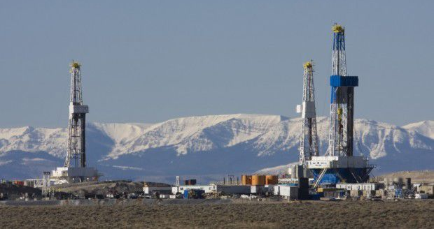
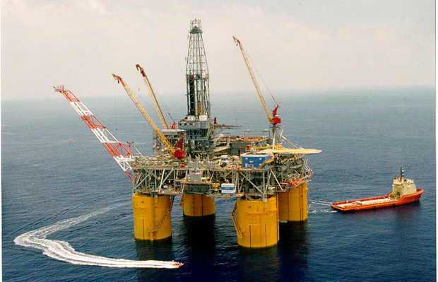
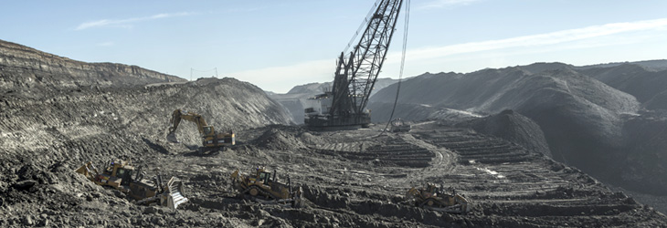
2. Supply side policies with leakage: application to US Oil & gas royalties
US Federal fossil fuel leasing program
Historical goals:
  Settle West
  Ensure domestic supply
    Energy abundance
    Energy security
  Low-sulfur coal from PRB
40% of US coal, 22% of US oil, 12% of US gas
O&G royalties are 12.5% (18.75% offshore)

Slide 8
Supply side policies with leakage: US Oil & gas royalties
Federal fossil fuel leasing program
Historical goals:
  Settle West
  Ensure domestic supply
    Energy abundance
    Energy security
  Low-sulfur coal from PRB
40% of US coal, 22% of US oil, 12% of US gas
O&G royalties are 12.5% (18.75% offshore)
Biden administration started comprehensive review of Federal O&G program in January 2021.
Very small literature
Fair return
  Covert & Kellogg (2021) (O&G)
Welfare/address climate externalities
  Gillingham & Stock (2016)
  Greenstone & Stuart (2016)
  Gillingham, Bushnell, Fowlie, Greenstone, Kolstad, Krupnick, Morris, Schmalensee, Stock (2016) (coal)
  Gerarden, Reeder, Stock (2020) (coal)
  Prest (2021) (O&G)
  Prest & Stock (2021) (O&G)
  Survey, supply side lit: Lazarus & van Asslet (Climatic Change 2018)

Slide 9
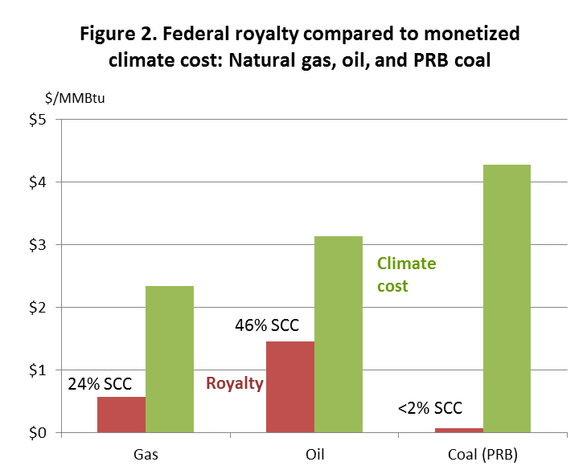
2. Supply side policies with leakage: US Oil & gas royalties

Slide 10
Specialize to US O&G leasing
Some principles for determining royalty rates
Maximize royalty revenues
  Fair value justification
  Generates meaningful emissions reductions
  Maximizes revenues for ~50% share with impacted communities
Maximize social welfare
  This is a standard principle in taxation theory – it leads to Pigovian taxes, 100+ years old
  This approach leads to the principle: set marginal costs = marginal benefits. For a single fuel, this leads to the royalty adder = SCC*(1 – leakage rate), in $/ton.
Manage within a carbon budget or a target date
  Not operational without a defined budget
  We approximate this by setting the royalty surcharge sufficiently high to achieve very large emissions reductions without shutting down the program

Slide 11
Main policy options for federal fossil fuel program reform
Policy Approach | Potentially Based On | Units
Higher royalty | Fair return, maximizing revenues | % of revenues
Carbon fee | Climate costs, perhaps as measured by social cost of carbon (SCC) | $/ton CO2
Climate surcharge (%) | Climate costs, calculated to approximately reflect SCC | % of revenues
End leasing | Carbon budget
Jargon
Carbon fee: $/ton CO2 additional fee, translated into $/bbl or $/mcf
Royalty surcharge: pp on top of existing 12.5% (e.g. 12.5 + 10 = 22.5%)
Leakage: Reducing production on federal lands by 1bbl increases production on nonfederal lands by λ bbl, 0 ≤ λ ≤ 1.
  Actually, cross-terms between oil and gas because of co-production

Slide 12

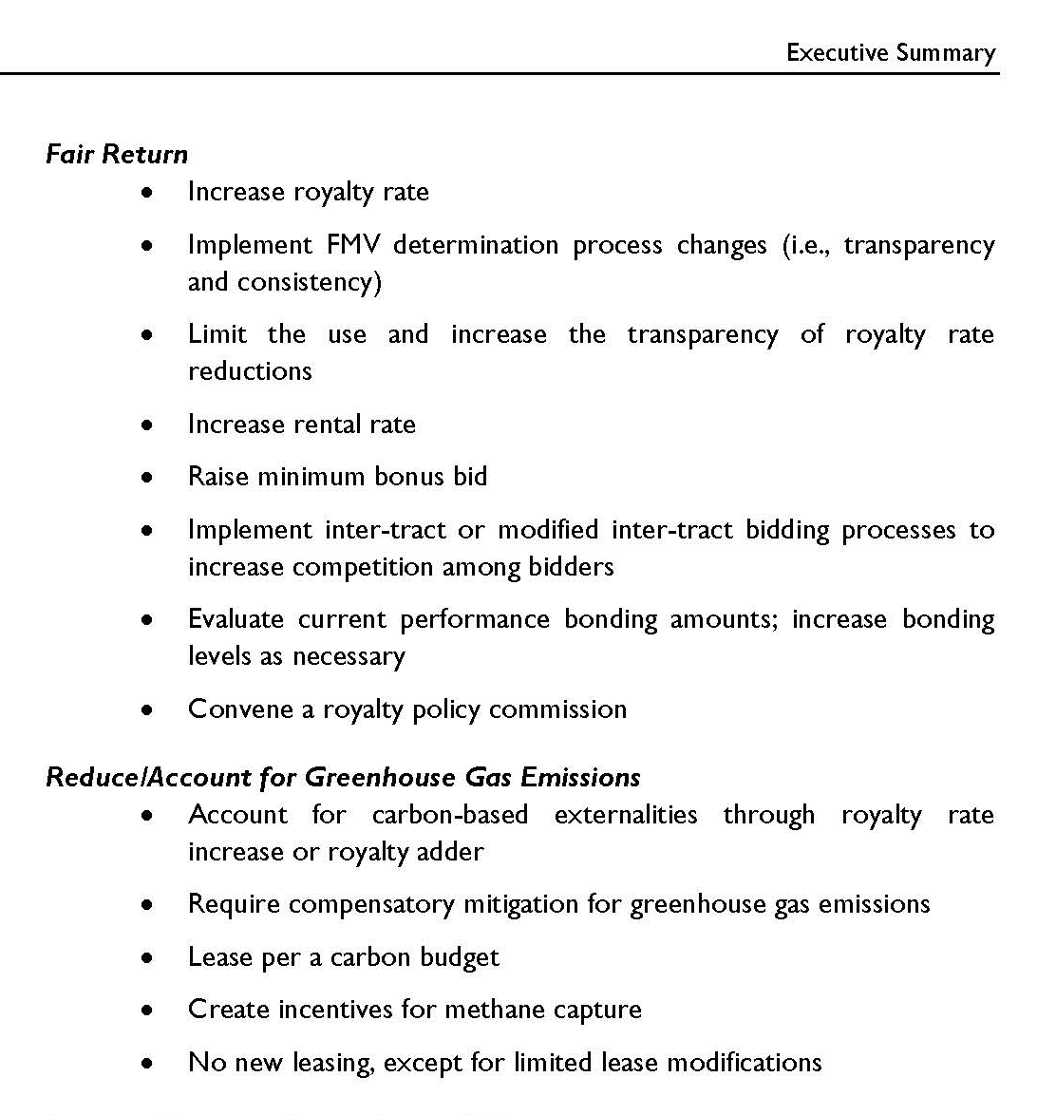
Federal fossil fuel leasing program: Recent reform efforts
Obama
Federal Coal Program PEIS (2015)
Coal leasing moratorium
Trump
Lifted coal leasing moratorium
Accelerated O&G leasing
[ANWR]
Biden
Jan. 27, 2021: EO 14008
  Review of oil & gas leasing program: climate
  Oil & gas leasing moratorium
June 15, 2021: Leasing moratorium stayed
Nov. 17, 2021: Largest single offshore O&G lease
Nov. 26, 2021: DOI report on O&G leasing program
Jan. 27, 2022: Nov. lease sale invalidated
Federal Register Vol. 86, No. 19
Monday, February 1, 2021 / Presidential Documents 7625
…In conducting this analysis, and to the extent consistent with applicable law, the Secretary of the Interior shall consider whether to adjust royalties associated with coal, oil, and gas resources extracted from public lands and offshore waters, or take other appropriate action, to account for corresponding climate costs.

Slide 13
Generalization of optimal tax rate (royalty per-ton surcharge) to multiple fuels
Multiple fuels: Oil, gas, coal. Each can substitute, partially, in production of energy services (electricity)
Will specialize to just O&G in the empirical work
Representative consumer gets utility from consumption of the fuels (ignore intermediate production of electricity or transport services)
Welfare includes damages from emissions
Static problem! No technical change, no dynamic pricing
Quantities of covered & uncovered fuels:
Cost functions:
Fuel emission intensity and total emissions:
Representative consumer’s utility:
External damages from emissions:
Social welfare function:

Slide 14
Generalization of optimal tax rate (royalty per-ton surcharge) to multiple fuels
Welfare maximization:
First order condition:
Where:
Market clearing:
Envelope theorem:
Subsitute in & collect terms: so

Slide 15
Generalization of optimal tax rate (royalty per-ton surcharge) to multiple fuels
Discussion
Recall θ = marginal damages = Social Cost of Carbon
If there are no uncovered emissions, then E^{c} = E^{tot} so τ = θ = SCC
In scalar case,
If no substitution between fuels, then
The entries in the partials can be computed from own and cross-price supply elasticities for the various fuels, since is known for each fuel (using emission rates)
The vector can be thought of as generalized leakage rates

Slide 16
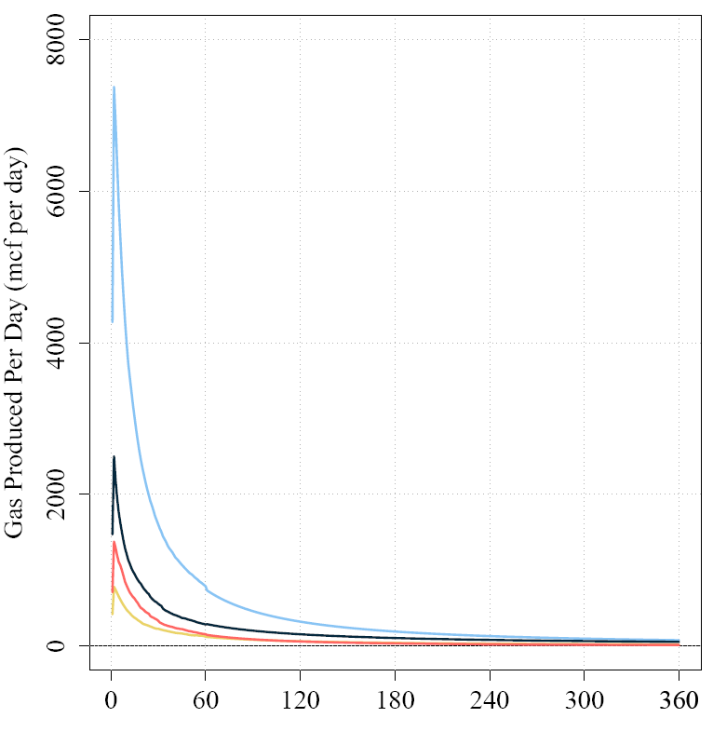
Empirical model is taken from Prest (forthcoming)
1. O&G prices, royalty rates, carbon adders
Approach: Price projections,
policy assumptions
2. Drilling
Approach: Econometrically estimated effect of price changes on drilling activity.
3. New wells online
Approach: Empirically estimated time lags between drilling and production
4a. Oil and gas production
Approach: Empirically estimated production profiles over time
5. Rest of World (ROW) Supply & Demand Module
Approach: IEA projections, demand elasticities from the literature.
4b. Production from existing wells
Approach: Well-level “Arps” projections for each of ~1 million existing wells

Slide 17
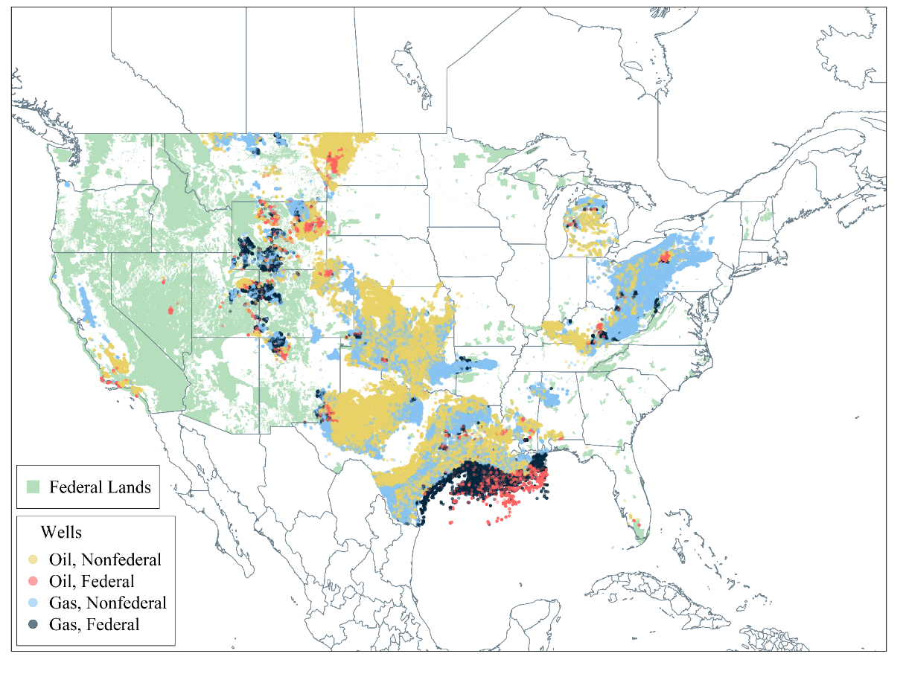
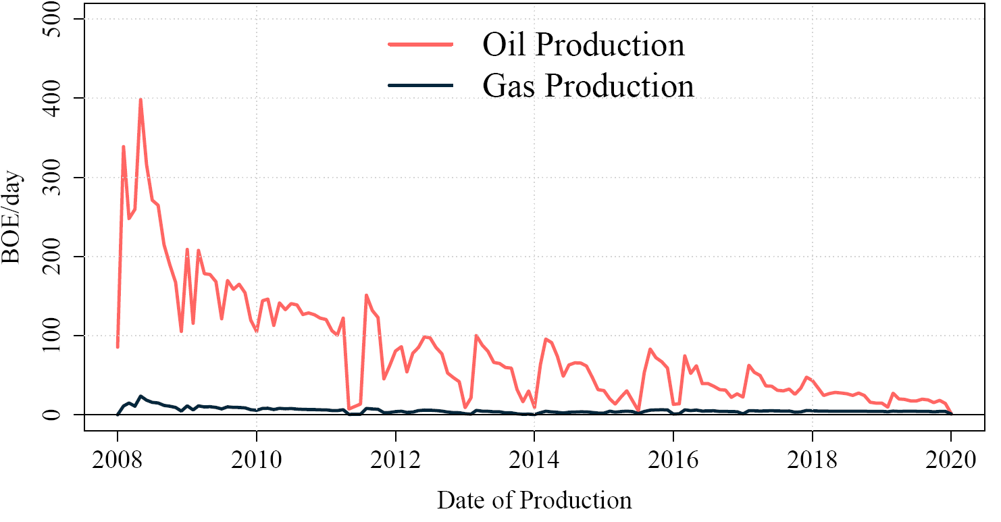
Data: Microdata on more than 1 million wells
Climate Royalty Surcharges: Empirical model (Prest, forthcoming)
Drilling info (Enverus)
Geotag and split wells into groups:
  Federal vs. Nonfederal
  Oil vs. Gas
  Onshore vs. Offshore
2 x 2 x 2 = 8 well “classes”
Notes:
Alaska not shown for space, but the data include wells in AK.

Slide 18
Climate Royalty Surcharges: Empirical results
Wholesale fuel prices and carbon fees in fuel price units
 | Oil ($/barrel) | Natural gas ($/thousand cubic feet) | PRB Coal ($/short ton)
2019 wholesale price [update May 2022] | $57 [$115] | $2.56 [$8.71] | $12.5 [$15.50]
12.5% royalty rate | $7.13 | $0.32 | $1.56
18.75% royalty rate | $10.69 | $0.48 | $2.34
$25 carbon fee | $10.75 | $1.65 | $42.41
$50 carbon fee | $21.50 | $3.30 | $84.42
$75 carbon fee | $32.25 | $4.95 | $127.23

Slide 19
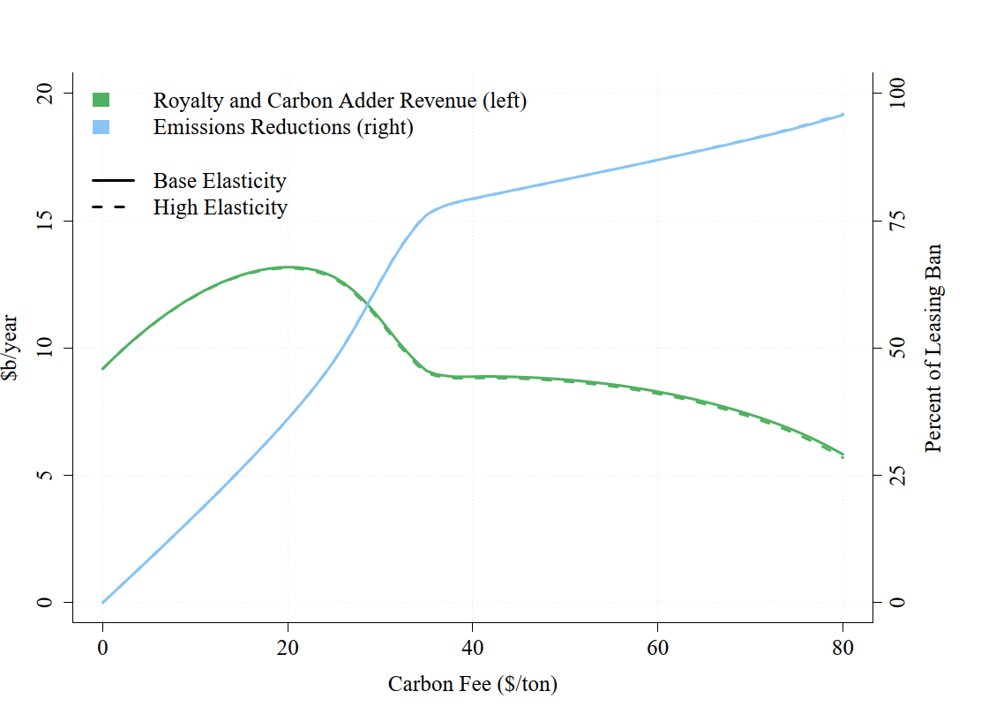
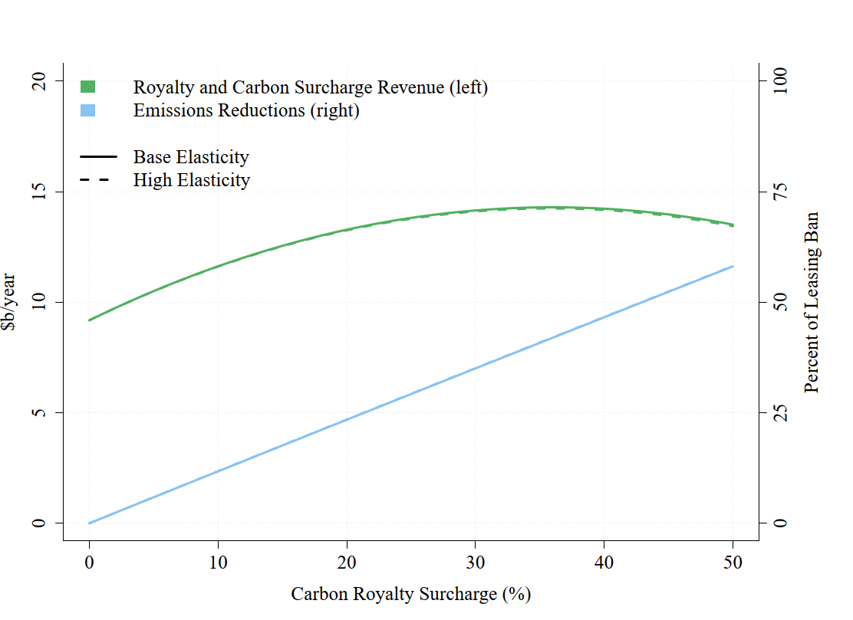
Climate Royalty Surcharges: Empirical results
2020-2050 annual average royalty and carbon revenues (left axis) and emissions reduction, relative to leasing ban
(a) Common per-ton carbon fee (b) Common percent royalty surcharge
Royalties ~36pp higher could achieve more revenues & cut emissions

Slide 20
Summary:
BAU, revenue-maximizing, and welfare-maximizing carbon fees and royalty surcharges
Climate Royalty Surcharges: Empirical results (summary)
 | Effective Carbon Fee ($/ton CO₂e) |  | Effective Climate Royalty Surcharge (%) |  | CO₂e reduced |  | Royalties ($B/year)
 | Oil | Gas | Oil | Gas | million tons/year | % of ban
(a) Conventional Policy
BAU | $0 |  | 0% |  | 0 | 0% | $9.2
18.75% Onshore Royalty Rate | $0 |  | 6.25%, onshore only |  | 4 | 5% | $10.0
Leasing ban | $0 |  | 0% |  | 80 | 100% | $4.0
(b) Common Carbon Fees ($/ton CO₂e)
Revenue-maximizing | $20 |  | 15% | 52% | 29 | 36% | $13.2
Welfare-maximizing: $50 SCC | $14 |  | 10% | 36% | 18 | 23% | $12.6
Welfare-maximizing: $125 SCC | $34 |  | 26% | 89% | 60 | 74% | $9.4
CO₂e reduced: 80% of ban | $41 |  | 31% | 106% | 65 | 80% | $8.9
(c) Common Royalty Surcharge (% of Revenues)
Revenue-maximizing | $48 | $14 | 36% |  | 34 | 42% | $14.3
Welfare-maximizing: $50 SCC | $25 | $7 | 19% |  | 18 | 22% | $13.2
Welfare-maximizing: $125 SCC | $60 | $17 | 45% |  | 42 | 52% | $14.0
CO₂e reduced: 80% of ban | $91 | $27 | 69% |  | 65 | 80% | $7.8
(d) Separate Carbon Fees for Oil and Gas ($/ton CO₂e)
Revenue-maximizing | $40 | $5 | 30% | 13% | 31 | 39% | $14.5
Welfare-maximizing: $50 SCC | $20 | $15 | 15% | 39% | 24 | 29% | $13.4
Welfare-maximizing: $125 SCC | $40 | $30 | 30% | 77% | 55 | 65% | $11.1

Slide 21
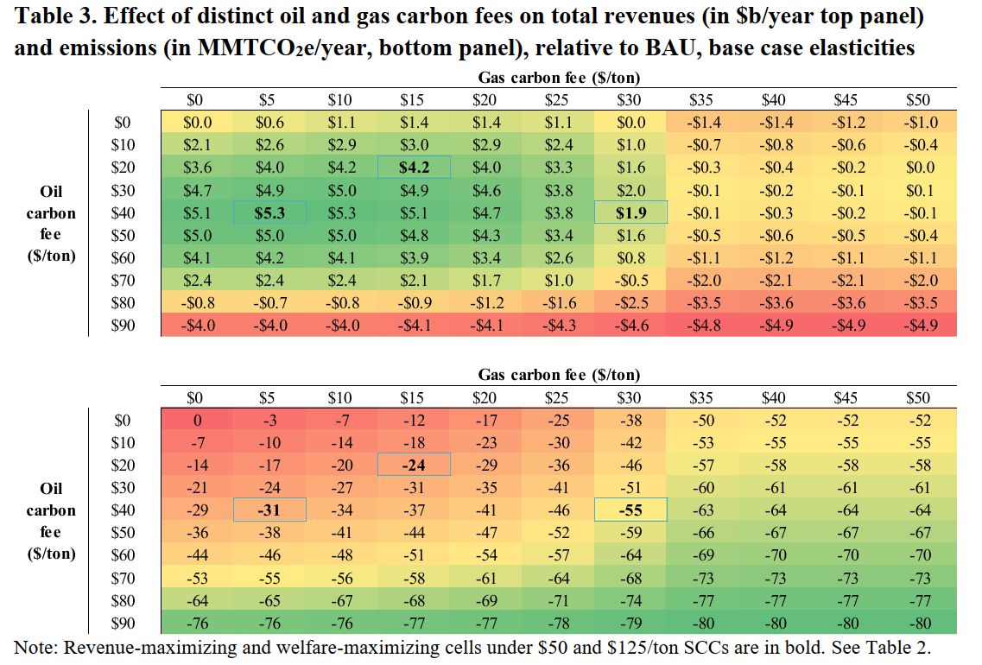
Separate fees for oil and gas, relative to BAU
Climate Royalty Surcharges: Empirical results
Revenues ($B/yr)
Emissions (mmtCO2e)

Slide 22
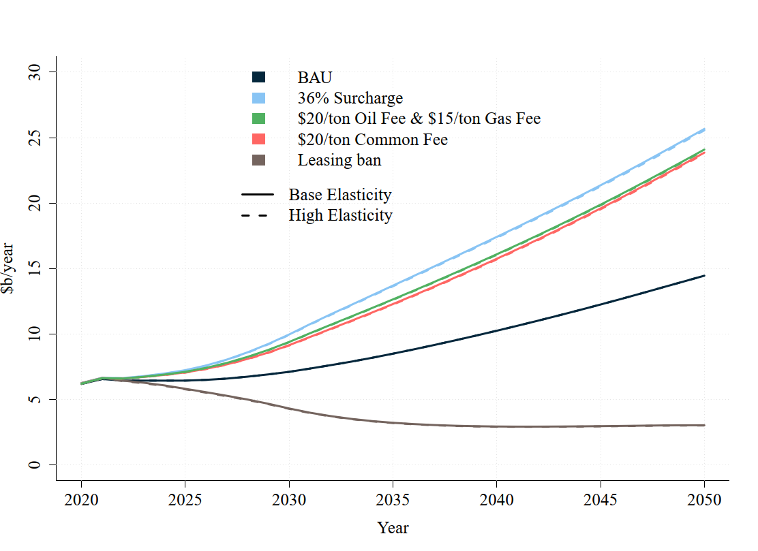
Revenues over time, by policy
Climate Royalty Surcharges: Empirical results

Slide 23
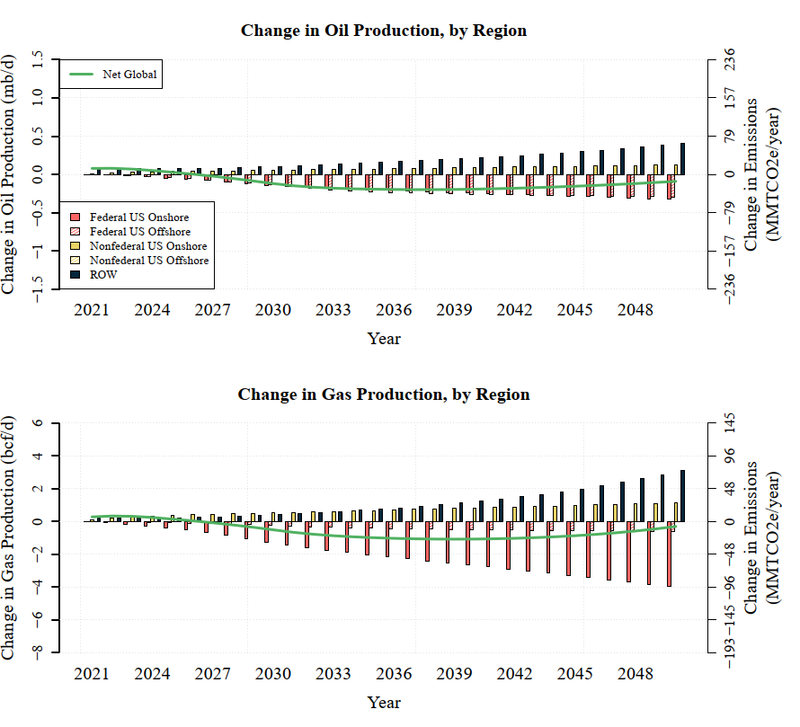
Production Impacts by Supply Region, $20/ton CO2e fee
Source: Figure A.7 from Prest, Brian C., Supply-Side Reforms to Oil and Gas Production on Federal Lands, Resources for the Future, 2021.

Slide 24

3. Supply policies with leakage and partial downstream policy: International trade
References
Weisbach, Kortum, Wang, and Yao, “Trade, Leakage, and the Design of a Carbon Tax,” manuscript (May 2022)
Kortum and Weisbach, “Optimal Unliateral Carbon Policy,” Cowles Foundation DP 2311 (2021)
Harstad (JPE 2012)
Here, a brief tour of Weisbach et al (2022) in figures.
Under autarky, a carbon tax increases the consumer’s price of energy, & lowers the producer’s, so less is consumed & produced
Point of obligation doesn’t matter – on extraction (well-head) or on consumption (end user surtax)

Slide 25
3. Supply policies with leakage and partial downstream policy: International trade
Consumption carbon tax with exports (1)
If there is trade in energy, this can’t be an equilibrium: the lower price to the producer would be the world price, so global supply & demand don’t balance

Slide 26
3. Supply policies with leakage and partial downstream policy: International trade
Consumption carbon tax with exports (2)
Instead, net foreign demand is met by Home producers, leading to net exports
Taxing energy consumption at Home lowers the world price and induces exports to Foreign to meet increasing foreign demand
Foreign consumption rises (leakage)

Slide 27
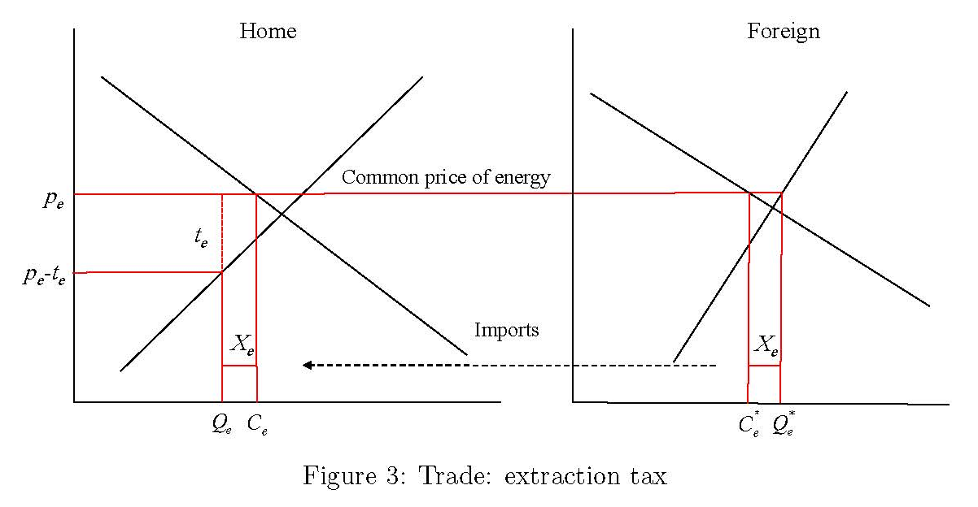
Supply policies with leakage and partial downstream policy: International trade
If there is an extraction tax (royalty surcharge) then domestic production falls, the world price rises, domestic & foreign consumption falls, and Home imports increase
With trade, the equivalence of the point of obligation (well-head or consumer) no longer applies, because of this leakage
Weisbach et al (2022) show that a combination of consumption & extraction policies is optimal under trade (+ optimality of incomplete BCA)
i.e. use both supply & demand policies at once
This assumes no border carbon adjustment
Extraction carbon tax with exports

Slide 28
Supply side policies: Summary
Leakage & supply side policies
Once you introduce leakage, there is a role for both upstream policy (e.g. extraction tax) and downstream (consumption tax).
The conventional irrelevance of the point of obligation is fragile.
In the case of extraction taxes only, the optimal extraction fee is λSCC, where 1–λ is the leakage rate (this generalizes to multiple fuels)
The leakage rate, measured as marginal total emissions per marginal covered emissions, subsumes the market supply & demand elasticities in the Weisbach et al diagrams

Slide 29
Additional Slides

Slide 30
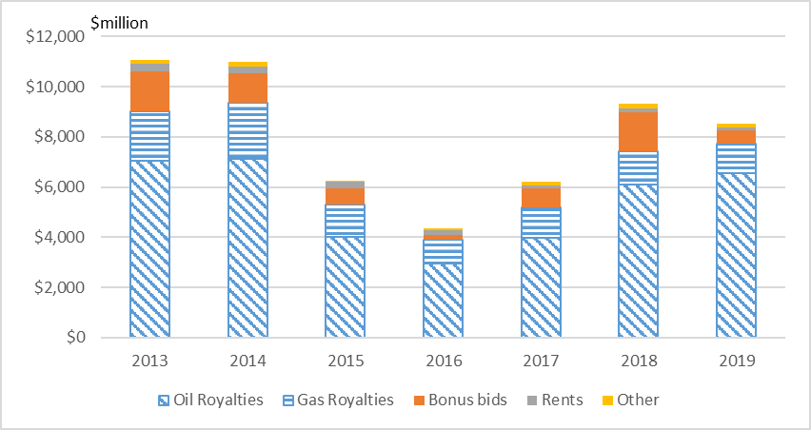


Federal FF leasing process: brief summary
Tracts are nominated for lease
Sealed “bonus bid” auctions
  Bonus bids are one-time payments in $/acre
  Minimum bid price, else failed auction -> secondary system
Lease is awarded
Economic development must commence within 10 years
Production assessed a predetermined royalty (12.5% onshore, 18.75% offshore, split between Federal/state)
  Royalty is assessed on product sold – flared/leaked gas not assessed
  Discretionary royalty relieve frequently granted ex post
Federal oil & gas leasing revenues

Slide 31
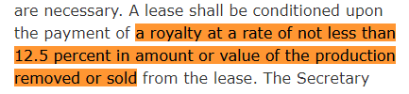
Federal fossil fuel leasing program: Legal authority
Coal Lands Act of 1864
Coal Lands Act of 1873
Agricultural Coal Lands Act of 1909 (split estate)
Mineral Leasing Act of 1920
  Sets minimum royalty rate of 12.5% for coal, oil, & gas
Federal Land Policy Management Act of 1976 (FLPMA)
  Dual use mandate
  Fair market value
Federal Coal Leasing Amendments of 1976
  Motivated by speculation, fair return, environmental protection
  1979, 1982 regulations required competitive bidding in “coal producing regions”
  1990 BLM PRB decision
Mineral Leasing Act of 1920
(30 USC 226: Lease of Oil & Gas Lands)
Federal Land Policy Management Act of 1976
“the United States receive fair market value of the use of the public lands and their resources unless otherwise provided for by statute.”
[support] “the orderly and economic development of domestic mineral resources, reserves, and reclamation of metals and minerals to help assure satisfaction of industrial, security and environmental needs”

Slide 32
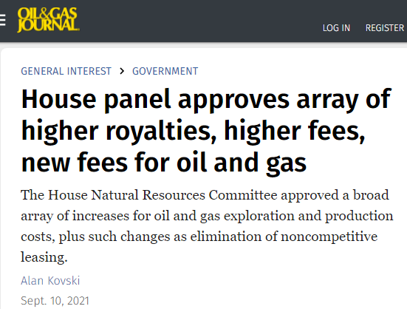
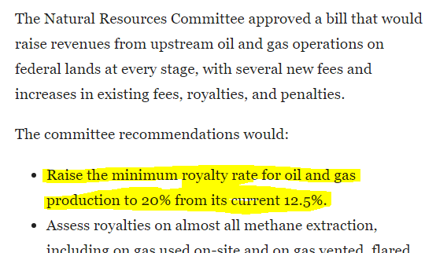

Federal fossil fuel leasing program: Recent reform efforts
Obama
Federal Coal Program PEIS (2015)
Coal leasing moratorium
Trump
Lifted coal leasing moratorium
Accelerated O&G leasing
[ANWR]
Biden
Jan. 27, 2021: EO 14008
  Review of oil & gas leasing program: climate
  Oil & gas leasing moratorium
June 15, 2021: Leasing moratorium stayed
Nov. 17, 2021: Largest single offshore O&G lease
Nov. 26, 2021: DOI report on O&G leasing program
Jan. 27, 2022: Nov. lease sale invalidated
+ Congressional interest

