Slide 1

Study Center Gerzensse: Advanced Courses in Economics
The Economics and Econometrics of Climate Change Policy:
D. The Electric Vehicle Revolution
James H. Stock
Economics Department and Harvard Kennedy School,
Harvard University
May 30 – June 3, 2022

Slide 2
Course outline
I. Introduction
Introduction & Overview
  Climate change science and CC econometrics (brief)
  Framework economic concepts
  Cost-benefit analysis, cost effectiveness analysis, SCC & TCP
  Marginal abatement curve
III. Damages
Macroeconomic implications of the energy transition
  Physical & transition costs
  Physical costs: damage estimates
  Transition costs: policy
    Carbon tax
    Cap & trade
    Policy uncertainty
The Social Cost of Carbon: Recent developments (time permitting)
II. Emissions reduction (mitigation/decarbonization)
Sectoral carbon policies – theory & empirical evidence
  Carbon tax, cap & trade
  Clean energy standards; investment & production tax credits
  Policy simulations
  Criticisms & the case for sectoral standards
Carbon pricing with leakage: Supply side policies
  Supply side policies as carbon pricing with leakage
  Supply side policy with leakage: US O&G royalties
  Extension to international trade & BCA
The electric vehicle revolution
  Transport sector overview, EVs, & literature review
  Modeling charging station v. vehicle subsidies
  More on charging stations & current research

Slide 3
1. Transport sector overview, the EV revolution, & literature review

Slide 4
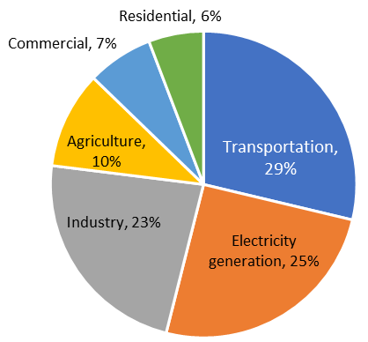
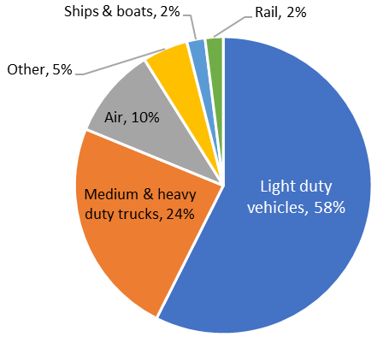
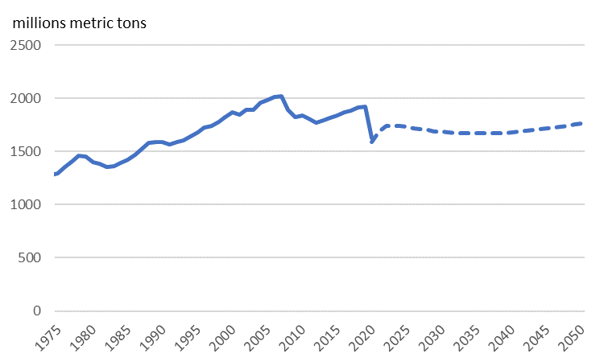
Emissions from the US Transportation Sector
US GHG Emissions by Sector, 2019
US Transport CO2 Emissions by Mode, 2019
Sources: EPA Greenhouse Gas Inventory, EIA AEO 2021
AEO 2021 reference scenario: Transport emissions

Slide 5
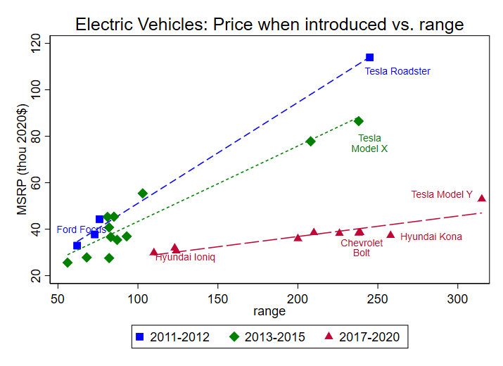
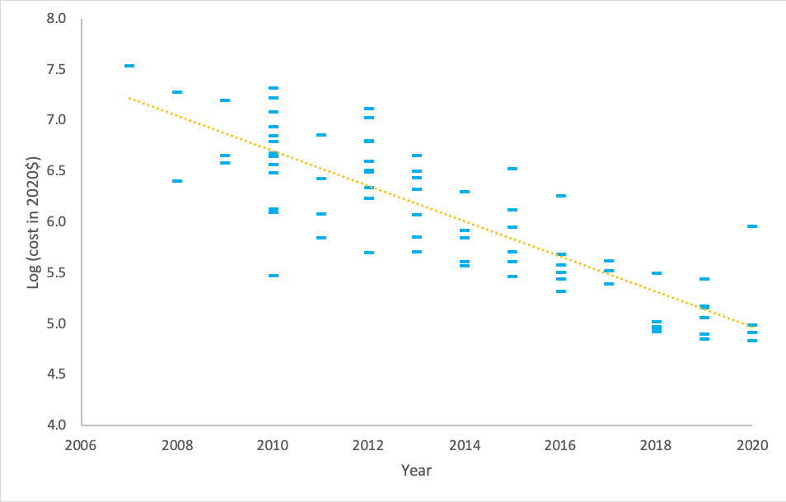
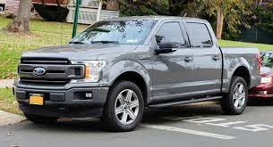

EV transition: Overview
The EV transition
Price
  Battery price declines
  EV-ICE price parity 2024-2030?
Attributes
  + : performance, other battery uses
  - : charging time & availability, range, cold weather
Penetration
  Norway: ~80% of new sales
  US: 5% of new LDV sales 2022Q1
Industry
  GM, Ford announcements
EV Battery pack prices (log scale, 2020$)
Source: Kapoor et al, updated 9/13/21)

Slide 6

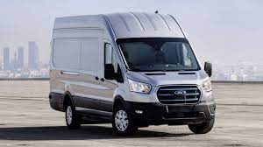
BEV prices are dropping rapidly (but temporary plateau because of supply chain?)
 | 2021 Ford Transit | 2022 Ford e-Transit
Ford transit cargo van, medium roof, regular length, 9500 GVWR payload package | 3.73 limited slip axel, 10 spd auto transmission | 67kWh battery, 108 mi range
MSRP | $38,945 | $48,280
one-time L2 installation cost | $0 | $2,000
Fuel efficiency | 15 mpg | 1.6 mi/kWh
Total annual energy | 1,460 gal | 13,550 kWh
Annual energy cost | $3,786 | $1,355
Annual maintenance | $1,172 | $600
Lifetime fuel & maintenance (NPV) | $22,537 | $8,887
Full user cost (NPV) | $61,482 | $59,167
Sources: Ford Build & Price Web tool; Car and Driver; Edmunds.com; Green Car Reports; Forbes; EIA accessed July 10-11, 2021. Assumes 70 mi/day, 312 days/year, 5 year lifetime, 5% interest rate; 2021 dollars.
Engineering complexity: BEVs < ICEs < PHEVs

Slide 7
Will the EV transformation step on the gas?
EV share of new light duty vehicle sales: US
Increasing ambition:
CA, NY to require 100% ZEV LDVs by 2035
COP26: Global end to new ICEs by 2040, in “leading markets” by 2035
  Signed by Ford, GM, Mercedes-Benz, Volvo, Jaguar Land Rover + Uber + 30 countries (incl. Canada, UK, Denmark, Ireland, Mexico, Norway, Sweden).
  But not Toyota, Nissan-Renault, Volkswagen,…
  And not US, China, Germany, South Korea, Japan,…
IIJA has up to $7.5B in charging station support
  $5B for Level 3 on charging corridors
  $2.5B for ZEV infrastructure
Automaker enthusiasm
  Rivian IPO;
  Ford, GM
 |  | 2020 | 2021 | Y-O-Y
BEVs | Number | 257,872 | 487,460 | 89.0%
 | share | 1.8% | 3.2%
HEVs/PHEVs | Number | 525,605 | 969,407 | 84.4%
 | share | 3.6% | 6.4%
Total market |  | 14,568,364 | 15,061,885 | 3.4%
Notes: 2022Q1 EV sales share was 5.2% (Kelly Blue Book). Europe, March 2022: 14% BEV, 8% PHEV (Inside EVs April 28, 2022).
US BEV LDV sales share projections, 2030
Source | share | Policy
EIA AEO 2021 | 2.2% | Reference case
EIA AEO 2022 | 4.5% | Reference case
Bank of America (6/21) | 20% | w/ $7500 tax credit
IHS Markits (8/21) | 37% | In place as of Jan. 2021
Bident target (8/21) | 50% | Includes PHEVs

Slide 8
EV Revolution: References
Main papers with EV adoption models (consumer discrete choice models)
Li, Tong, Xing, & Zhou (2017)
Springel AEJ-EP (2021)
Zhou & S. Li (2018)
J. Li (2019)
Armitage & Pinter, “Regulatory Mandates and EV Product Variety,” ms (2022)
Lohawala, “Roadblock or Accelerator? The Effect of EV Subsidy Elimination” (2022)
Sinyashin, “Optimal Policies for Differentiated Green Products: Characterstics and Usage of EVs” (2021)
Non-structural empirical papers on misc. topics
Jenn, Springel, & Gopal, “Effectiveness of EV Incentives in the US,” Energy Policy (2018)
Xing, Leard, and Li, “What Does an EV Replace?” NBER wp 25771 (2021)
Sommer & Vance, “Do More Chargers Mean More Electric Cars?” EnvResLett (2021)
Kumar & Alok, “Adoption of EV: A literature Review and Prospects for Sustainability,” J. Cleaner Production (2020)
Clinton & Steinberg, “Providing the Spark: Impact of Financial Incentives on BEV Adoption,” JEEM (2019)
Clinton, Knittel, & Metaxoglou, “Electrifying Transportation: Issues and Opportunities,” (2020)
Cole, Droste, Knittel, S. Li, & Stock (2021)
Delacretaz et al, “Technology Adoption and Early Network Infrastructure Provision in the Market for EVs, CEEPR wp (2021)
Bushnell, Muehlegger, and Rapson, Energy Prices and EV Adoption, NBER wp 29842 (2022)
Papers linking EVs emissions rate to grid carbon intensity
Holland, Mansur, & Yates, “The EV Transition and the Economics of Banning Gasoline Vehicles,” AEJ-EP (2021)
Archsmith, Muehlegger, & Rapson (2021)
Rapson & Mueghlegger, Economics of EVs (2022)
(Network theory): Meunier & Ponssard, “Optimal policy and network effects for the deployment of zero emission vehicles,” EER (2020)

Slide 9
2. Modeling charging stations v. vehicle subsidies
We don’t subsidize gas stations – so why should we subsidized EV charging stations?
Actually, we do subsidize gas stations –
Directly, e.g.
  Biofuels Infrastructure Partnership & successors (blender pumps)
  biodiesel blenders tax credit
Indirectly by not internalizing GHG (and many other) externalities
Low- and high-EV penetration equilibria Source: Zhou and Li (2018)
And there is a market failure: the classic chicken-and-egg problem with two equilibria:
  Low-EV (high CO2 emissions) equilibrium
  High-EV (low CO2 emissions) equilibrium
  Empirically plausible – driven by penetration S-curve
  Exacerbated by learning-by-doing
  Absence of charging stations holds back sales which delays innovation & economies of scale
Important: Existence of 2 equilibria doesn’t imply that the high-EV equilibrium is better – that is a calculation. But intuition:
  Full user cost of EVs < ICEs within a few years
  Social cost of EVs < ICEs (climate + local env. externalities)
  So for low-EV equilibrium to be welfare-maximizing would require a substantial, widespread distaste for EVs.
(Charging Stations)
(EVs)

Slide 10
Model of EV adoption
LDV model: EV-ICE choice
Based on Cole, Droste, Knittel, Li, & Stock (2021)
Key elements:
  Discrete choice model of EV demand (by cars, SUVs+)
    Focus is ICE v. BEVs
    What about PHEVs?
  Private charging station buildout (differentiate Level 2, Level 3 chargers)
Multiple equilibria
Parameter values drawn from literature
  Key references: Zhou & Li (2017, 2018), Springel (2020), Archsmith, Muehlegger, & Rapson (2021); also see Holland, Mansur, Yates (AEJ-EP forthcoming)
Prices & costs in 2020 $’s
Address (massive) uncertainty by Monte Carlo simulation
Policies detailed later…
Cost estimates focus on $/ton of policies
  total system costs = EVs – ICEs + O&M differential + charging stations + power system upgrades (all gross of federal support)

Slide 11
LDVs: Model
Consumer demand
Two categories of vehicles: cars or SUVs (which includes light trucks & vans)
Within category, choose EV vs. ICE
Demand depends on relative price, charger availability (Level 2, Level 3), and other attributes/tastes
where
Notes: Based on Springel (2020), with the following modifications: (a) Springel uses price, I use log price. (b) Springel estimates demand at the vehicle model level, this aggregates to (EV, ICE) × (car, SUV); (c) Springel doesn’t differentiate among charging station level; I differentiate between Level 2 &3. Here L2 is treated on a per-vehicle basis, L3 is treated on geographic density (or equivalently per road-mile) basis. Springel and Zhou-Li (2017) use ln(N) specifications. (d) I follow Archsmith et al (2021) and introduce the term ψ_{t} to capture attribute and taste drift (modeled here as a random walk). (e) I model consumer choice in year t as depending on (observed) charging stations in year t-1, while charging stations are built on an as-needed basis.

Slide 12
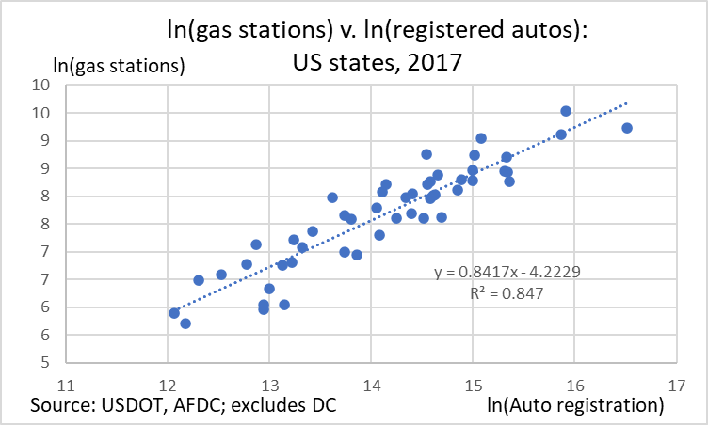
LDVs: Model
Private-sector charging station provision
Separately model L2 and L3 chargers because of different costs and different saturation values
where
Source: Zhou & Li (2018-US), Springel (2020)
Stock/flow accounting
LDV scrappage rate = 1/11.5
Charging station scrappage rate 10%/year
Calibration

Slide 13
LDVs: Parameterization & MC
Model:
Demand:
References: η_{P}: Springel (2020): -1.5 to 2.0; Xing et al (2019): -2.7; Li (2019): -1.3; Muehlegger & Rapson (2018): -3.9;
Archsmith, Muehlegger, & Rapson (2021) simulation values -1, -2 -3
η_{N2}: Springel (2020): -0.418 (SE = 0.038) mean in random coefficients model @ ~12% market share (2014)
Technology: ICE, SUV price model based on Lutsey & Nicholas (ICCT (2019)) + Clinton, Knittel, and Metaxoglu (2020).
      Full user cost = initial vehicle cost + valuation factor × O&M costs
      Manufacturing cost breakdown from Lutsey & Nicholas (2019).
      Valuation factor.
        References, all for ICEs: Gillingham, Houde, & van Bentham (forthcoming): 0.16-0.39; Allcott & Wozny (2014): 0.72; Grigolon, Raynaert, and Verboven (2018): 00.91; Leard, Linn, and Zho (2019): 0.54 and <0.30; Goldberg (1998): near 1.
        We use the Allcott & Wozny approach: consumer discount rate of 15% & valuation factor = 1
      Battery prices: -16% per year 2007-2019; project N(-.09,.02), with $50/kWh floor
      EV (mi/kWh): 3.2 (cars – Chevy Bolt), 2.0 (SUVs & lt trucks – Car & Driver estimate for F150 Lightening)

Slide 14
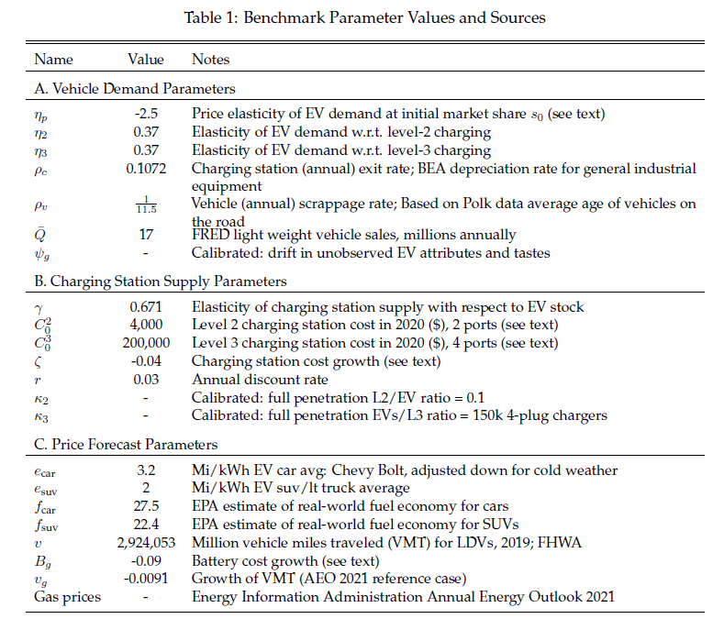
LDVs: Parameterization & MC

Slide 15
LDVs: Odds & ends
Model limitations
National – no regional heterogeneity in tastes, charger buildout, etc.
Only 2 vehicle types, no substitution across types, only 2 drive trains (!)
  Loose justification: start from equilibrium, then Ford introduces 2 drive trains in otherwise identical F150s etc.
Exogenous technical change (no induced, no LBD)
No expectational channels
Functional form assumptions
Odds & ends
Specification details
  Baseline attribute drift calibrated to have substantial but long-run incomplete EV penetration
  Oil price path from AEO 2021 + random AR(1) departure estimated 1990-2021
  Power sector marginal emissions rate and incremental costs from added EV load:
    Main case: TPS from ReEDS (Stock-Stuart (2021)):
      80% emissions reduction, relative to 2005, by 2030; 90% by 2035; 100% by 2050
    No-policy alternative: current power sector marginal emissions rate (Holland, Kotchen, Mansur, Yates (2021))
  VMT growth from AEO 2021 reference case
Costs
  System costs = additional power system costs, vehicle costs, & liquid fuel costs
  Total costs = system costs + federal share (set marginal cost of public funds = 1, cf. Hendren & Sprung-Keyser (2020))
Simulations span 2021-2060, 2021 fixed at (estimated) 2021 initial conditions
Discount rate: 3% real
Monte Carlo to capture uncertainty over prices (oil, batteries, vehicles, chargers), elasticities, & attributes/tastes

Slide 16
Policies
Model:
Baseline Policy
  ICE fuel efficiency (new ICE LDVs):
    2021-2022: SAFE; 2023-2026: Revised 2023 and Later Proposed Rule (86 FR 43726); 2027-2031: increase @5%; 2032-: increase 1.5%)
  Power sector: Tradeable Performance Standard starting from status quo in 2022, 80% emissions reduction by 2030, 90% by 2035, 100% by 2050
  No new LDV policies + ignore current EV tax credit (200k per OEM cap)
A. Charging station subsidy
  Public-private cost-share starting 2022, ending when budget cap is hit or in 2030, whichever is sooner
B. EV point-of-sale rebate
  $7500 2022-2031 (refundable tax credit, ignoring domestic content bonuses) + variants
C. Enhanced Clean Air Act regulation (ZEV mandate)
  Decouple EPA (CAA) & NHTSA (EPCA) rules
  NHTSA sets ICE mpg standard, to match ICE fuel efficiency standard in baseline (i.e. no change in ICE mpg standards)
  EPA implements CAA via clean vehicle standard (ZEV standard) with tradable allowance price cap. ZEV standard. SUV ZEV standard lags car ZEV standard by 2 years. Combined standard (rounded): 2025, 6%; 2030, 50%; 2035, 77%; 2040, 92%. Operates through cross-subsidy scheme with tradable allowances generated by EV sales and which must be retired when an ICE is purchased, with a price cap.
E. Carbon tax
Note: assume full pass-through of government taxes/subsidies to end consumer (Mueghlegger-Rapson (2020), Knittel, Meiselman, Stock (2017),…)

Slide 17
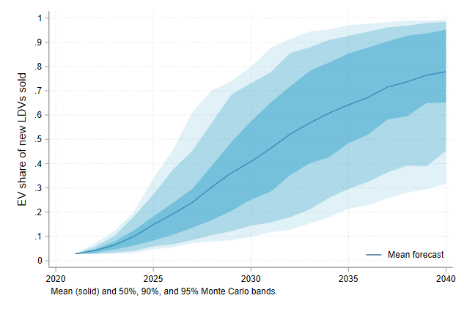
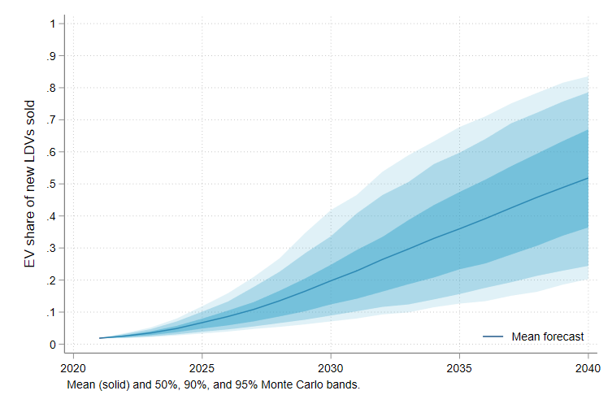
Results: No-policy projections, benchmark cse
EV sales share: No new policy, IHS benchmark case
EV sales share: No new policy, low benchmark case

Slide 18
Results: Summary, low baseline penetration
 | Policies |  |  |  |  | EV share & Emissions |  |  | Fiscal costs (not discounted)
 | Station cost share |  | EV sales rebate |  | ZEV permit price cap ($) (c) | EV Sales Share by 2030 | Cst/ton CO2 ($/ton) (b) | ΔCO2 in 2030 (mmt) | Total | Chargers | Rebates | Infra-marginal rebates
 | Percent | Budget ($B) | 2022 - 2026 | 2027+
0 | - | - | - | - | - | 0.251 | - | - | - | - | - | -
A1 | 0.67 | 7.5 | - | - | - | 0.330 | 146 | -35 | 9 | 8.6 | - | -
A6 | 0.67 | 7.5 | 7,500 | 7,500 | - | 0.439 | 42 | -76 | 347 | 9.0 | 338 | 151
A4 | 0.67 | 7.5 | - | - | 10,000 | 0.464 | 47 | -58 | 9 | 8.7 | - | -
A7 | 0.67 | 7.5 | 7,500 | 7,500 | 10,000 | 0.547 | 51 | -91 | 382 | 9.0 | 373 | 151
Fiscal cost calculation: $1B federal spending on charging stations ≈ $10 federal spending on consumer subsidies
Notes: Estimates are means of 1000 Monte Carlo draws over model parameters, oil price paths, and technology cost paths.
These are costs of tax credits provided to consumers who would have bought an EV in the no-policy (BAU) case.
Costs are total system costs under the policy, minus BAU total system costs, where system costs are net costs of EV-ICE production, operation, and maintenance cost, and cost of additional power system capacity required for additional EVs (computed under 80% TPS using ReEDS). Emissions are cumulative through 2060 in policy case minus BAU.
The ZEV standard works by setting a required ZEV sales share in a given year, with compliance by requiring tradeable ZEV credits to be retired with EPA. For example, suppose the ZEV standard is 33% EVs and the price of the tradeable allowances is $1,000; then, assuming full pass-through, the standard would reduce the EV sales price by $667 and would increase the ICE sales price by $333. If the price cap is binding in a given year, the actual ZEV share will fall short of the standard.

Slide 19
Results: Summary, high baseline penetration
 | Policies |  |  |  |  | EV share & Emissions |  |  | Fiscal costs (not discounted)
 | Station cost share |  | EV sales rebate |  | ZEV permit price cap ($) (c) | EV Sales Share by 2030 | Cost/ton CO2 ($/ton) (b) | ΔCO2 in 2030 (mmt) | Total | Chargers | Rebates | Infra-marginal rebates
 | Percent | Budget ($B) | 2022 - 2026 | 2027+
0 | - | - | - | - | - | 0.418 | - | - | - | - | - | -
A1 | 0.67 | 7.5 | - | - | - | 0.478 | 190 | -34 | 9 | 8.9 | - | -
A6 | 0.67 | 7.5 | 7,500 | 7,500 | - | 0.585 | 74 | -76 | 434 | 9.4 | 425 | 236
A4 | 0.67 | 7.5 | - | - | 10,000 | 0.558 | 91 | -48 | 9 | 9 | - | -
A7 | 0.67 | 7.5 | 7,500 | 7,500 | 10,000 | 0.634 | 81 | -84 | 454 | 9.4 | 444 | 236
Fiscal cost calculation: $1B federal spending on charging stations ≈ $10 federal spending on consumer subsidies
Notes: Estimates are means of 1000 Monte Carlo draws over model parameters, oil price paths, and technology cost paths.
These are costs of tax credits provided to consumers who would have bought an EV in the no-policy (BAU) case.
Costs are total system costs under the policy, minus BAU total system costs, where system costs are net costs of EV-ICE production, operation, and maintenance cost, and cost of additional power system capacity required for additional EVs (computed under 80% TPS using ReEDS). Emissions are cumulative through 2060 in policy case minus BAU.
The ZEV standard works by setting a required ZEV sales share in a given year, with compliance by requiring tradeable ZEV credits to be retired with EPA. For example, suppose the ZEV standard is 33% EVs and the price of the tradeable allowances is $1,000; then, assuming full pass-through, the standard would reduce the EV sales price by $667 and would increase the ICE sales price by $333. If the price cap is binding in a given year, the actual ZEV share will fall short of the standard.

Slide 20
Results: Enhanced charger budget, small tax credit, various CAA allowance price caps
 | Policy parameters |  |  |  | Federal Fiscal, cumulative through 2030
 | Charging stations: Federal share for L2, for L3, total budget | EV rebate: 2022-25 value, 2026+ value, phaseout trigger | CAA ZEV standard: Tradable allowance price cap | EV share by 2030 | Charging stations | EV tax credit | Total | Inframarginal portion of EV tax credit (a) | Cost per ton CO2 (b)
D1 | 0.67, 0.67, 30B | $4k, $2.667k, 40% | $5k | 0.460 | 21 | 93 | 113 | 38 | 69
D2 | 0.67, 0.67, 30B | $4k, $2.667k, 40% | $7.5k | 0.479 | 21 | 95 | 116 | 38 | 63
D3 | 0.67, 0.67, 30B | $4k, $2.667k, 40% | $10k | 0.495 | 21 | 96 | 118 | 38 | 60
D4 | 0.67, 0.67, 30B | $4k, $2.667k, 40% | $12.5k | 0.506 | 22 | 97 | 119 | 38 | 58
D5 | 0.67, 0.67, 30B | $4k, $2.667k, 40% | $15k | 0.515 | 22 | 98 | 120 | 38 | 57

Slide 21
Results: Alternative policy combinations, low baseline penetration
 | Policies |  |  |  |  | EV share & Emissions |  |  | Fiscal costs ($B, not discounted)
 | Station cost share |  | EV sales rebate |  | ZEV permit price cap ($) (c) | EV Sales Share by 2030 | Cst/ton CO2 ($/ton) (b) | ΔCO2 in 2030 (mmt) | Total | Of which:
 | Percent | Budget ($B) | 2022 - 2026 | 2027+ |  |  |  |  |  | Chargers | Rebates | Inframarginal Rebates (a)
0 | - | - | - | - | - | 0.199 | - | - | - | - | - | -
E1 | 0.67 | 7.5 | 6,000 | 3,900 | - | 0.338 | 165 | -44 | 158 | 8.6 | 149 | 63
E2 | 0.67 | 15.0 | 5,500 | 3,500 | - | 0.436 | 117 | -55 | 160 | 15.6 | 145 | 56
E3 | 0.70 | 25.0 | 5,000 | 3,250 | - | 0.462 | 106 | -59 | 158 | 20.9 | 137 | 51
E4 | 0.75 | 28.0 | 5,000 | 2,750 | - | 0.485 | 110 | -66 | 158 | 26.0 | 132 | 45
E5 | 0.80 | 30.0 | 4,600 | 2,400 | - | 0.510 | 117 | -74 | 156 | 31.0 | 125 | 39
E6 | 0.85 | 40.0 | 3,900 | 2,100 | - | 0.554 | 118 | -87 | 158 | 42.2 | 116 | 32
F1 | 0.67 | 7.5 | 6,000 | 3,900 | 10,000 | 0.450 | 64 | -57 | 178 | 8.6 | 169 | 63
F2 | 0.67 | 15.0 | 5,500 | 3,500 | 10,000 | 0.517 | 72 | -64 | 174 | 16.2 | 157 | 56
F3 | 0.70 | 25.0 | 5,000 | 3,250 | 10,000 | 0.535 | 77 | -67 | 170 | 22.4 | 148 | 51
F4 | 0.75 | 28.0 | 5,000 | 2,750 | 10,000 | 0.547 | 82 | -73 | 167 | 27.4 | 139 | 45
F5 | 0.80 | 30.0 | 4,600 | 2,400 | 10,000 | 0.558 | 87 | -79 | 162 | 32.1 | 130 | 39
F6 | 0.85 | 40.0 | 3,900 | 2,100 | 10,000 | 0.586 | 94 | -90 | 162 | 43.0 | 119 | 32

Slide 22
Simulations of dependence of EV sales share on charging stations
2030 EV sales share for charger-only policies
Starts at $7.5B in Infrastructure Investment and Jobs Act
Notes: Evaluated under high EV penetration scenario. Estimates are means of 1000 Monte Carlo draws over model parameters, oil price paths, and technology cost paths. Source: Cole, Droste, Knittel, Li, & Stock (2021)

Slide 23
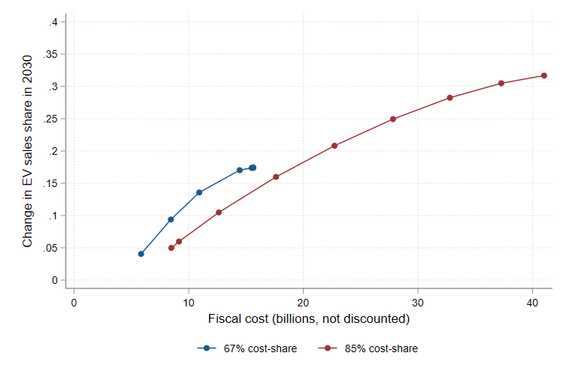
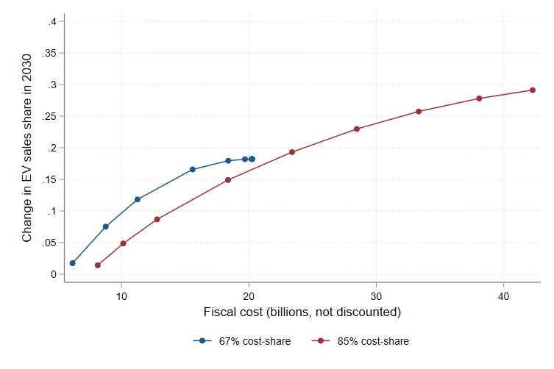
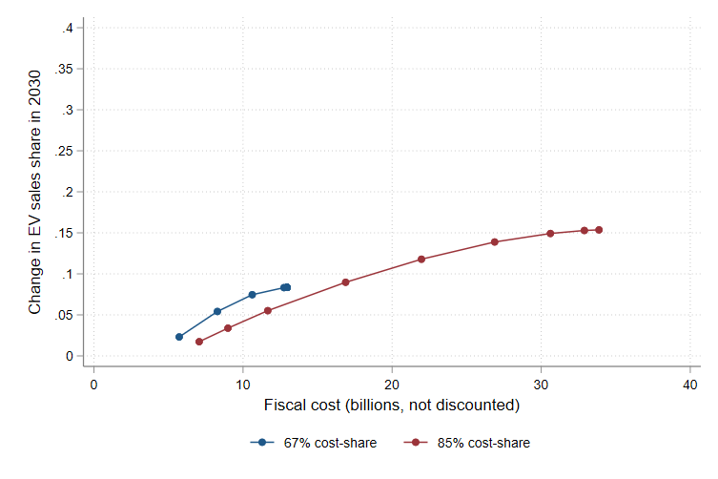
Results: Change in EV sales share in 2030 from charging buildout, various scenarios
EV sales share as a function of charging station budget, charging-only policy
Left: Benchmark. Middle: High EV penetration. Right: Low charger elasticity

Slide 24
Uncertainty plots: Charging: 67%/$30B; Rebate $4k/$2.7k/40%; ZEV cap $10k (51% EV mean)
Time series plots show the mean and 5%, 10%, 25%, 75%, 90%, and 95% percentiles of the indicated variable under the no-policy BAU (gray) and policy case (red). Histograms show the value of the indicated summary variable. Uncertainty is over Monte Carlo draws.

Slide 25
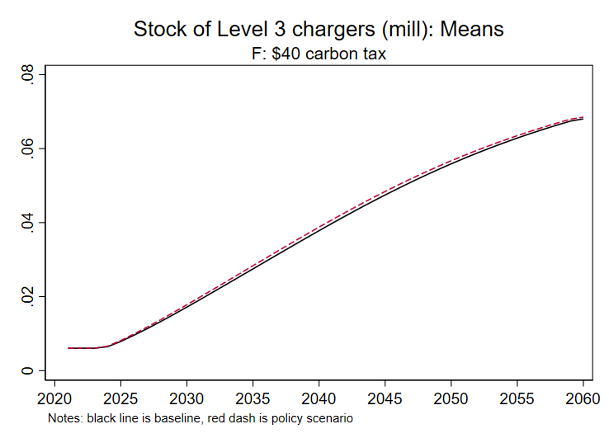
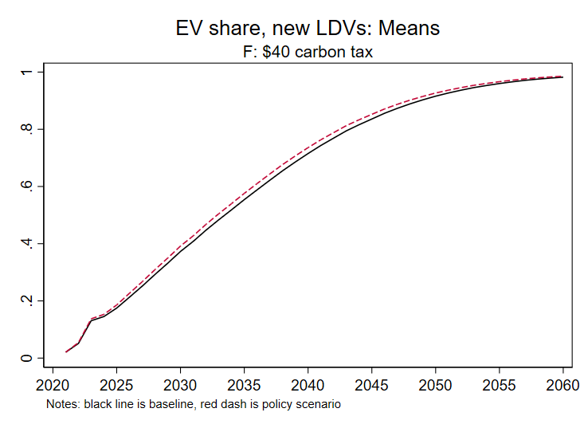
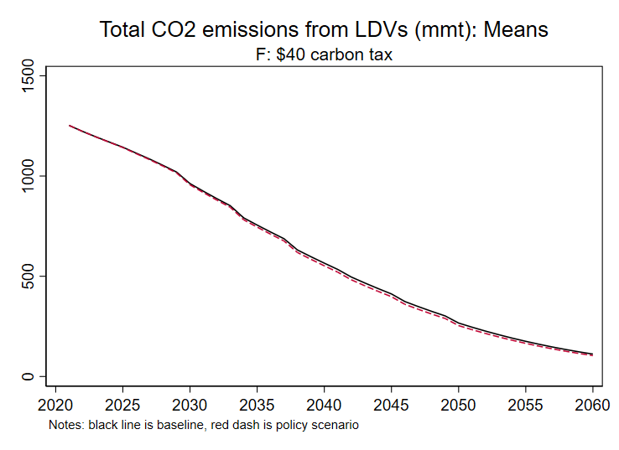
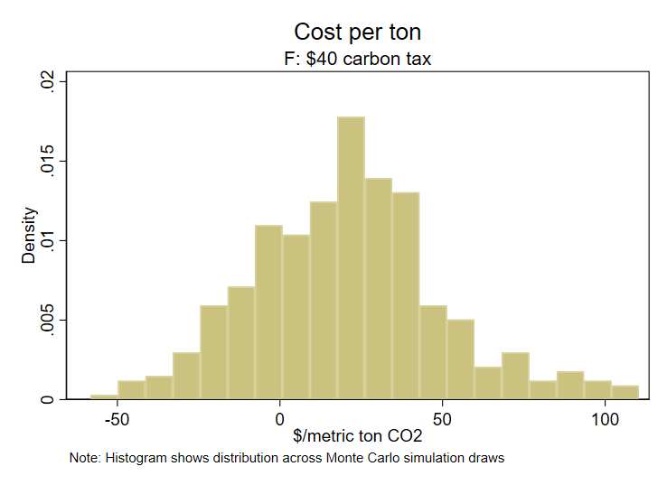
Results: $40 Carbon tax increasing at 5%/yr (only)
Carbon tax with revenue recycling so no net fiscal impact

Slide 26
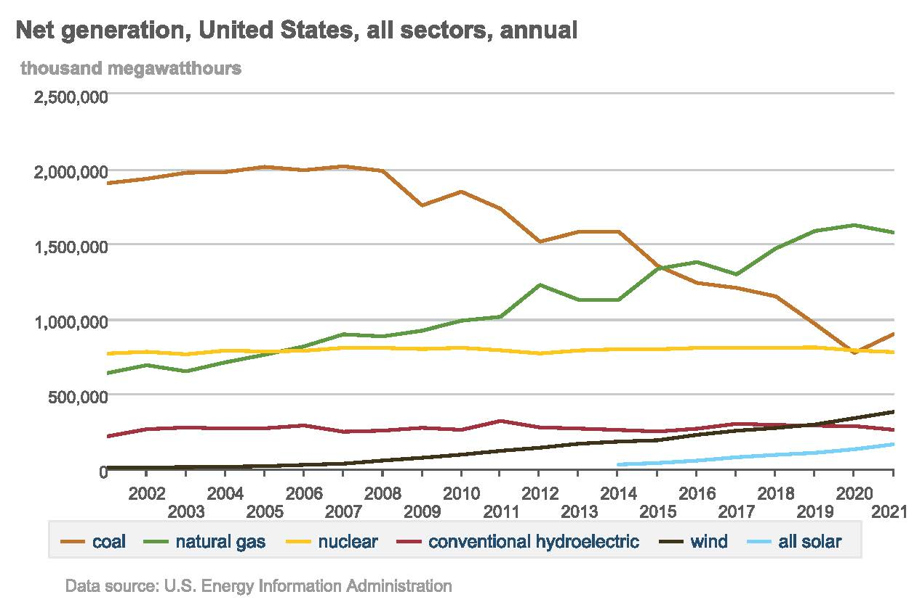
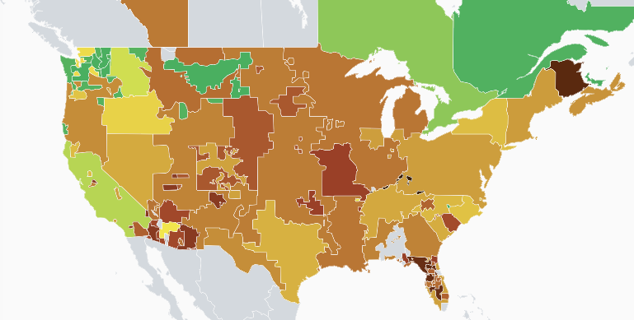
Results sensitive to grid decarbonization: Current power sector is 56% fossil-fuels
Carbon intensity of electricity production, US
Source: https://app.electricitymap.org/map
In 2021, the US grid was 36% natural gas and 20% coal
So on average you are charging EVs with fossil fuels
On the margin, the marginal generator is likely to be FF (gas peakers or coal cycling) (Holland et al (2021), NARUC (2020)) (marginal emissions rate > average emissions rate)
Large regional variation – lots of coal in southeast and upper Midwest, while CA is quite clean
EV transition needs to be accompanied by grid decarbonization

Slide 27
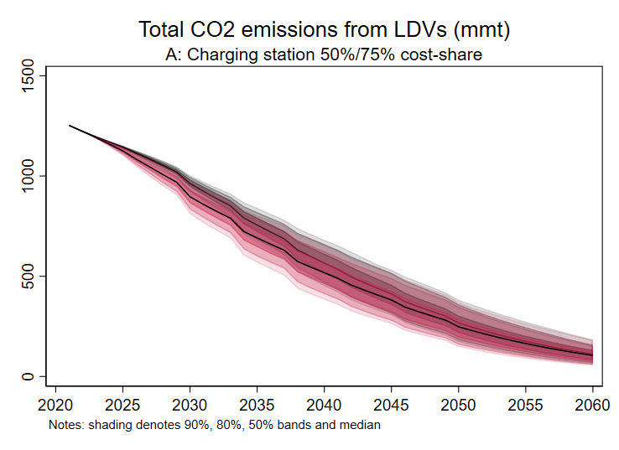
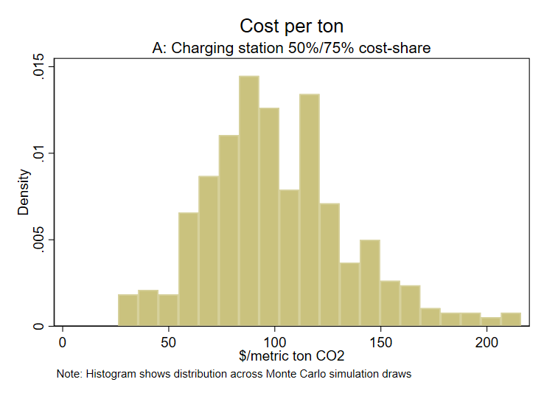
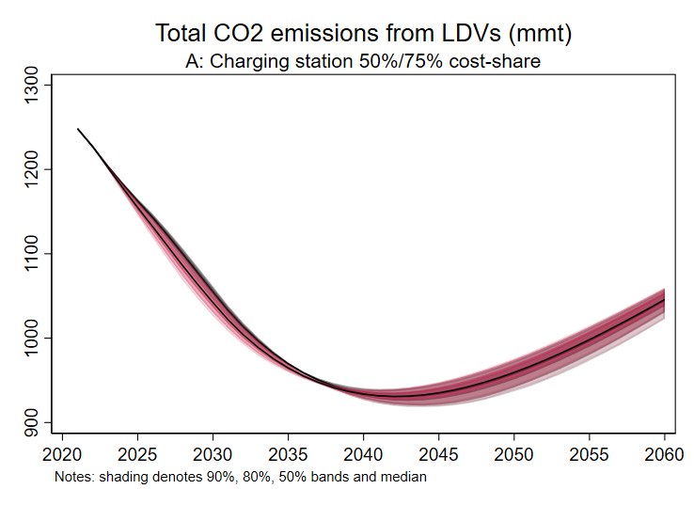
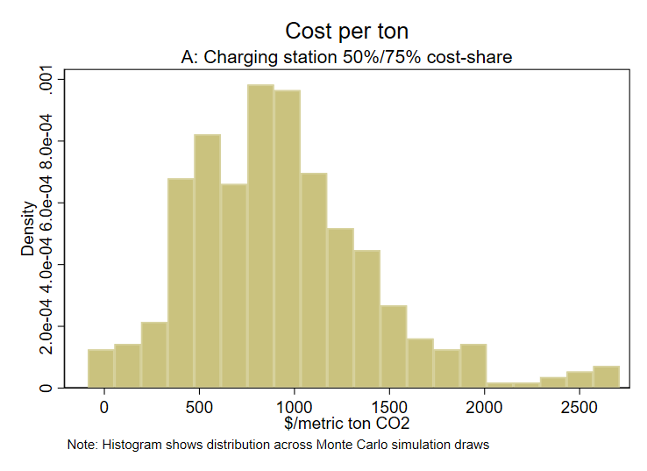
Results sensitive to grid decarbonization: With and without power sector policy
With power sector policy
This is assumed in the calculations
Tradable performance standard (90% emission reduction by 2035), marginal emissions rates and costs from ReEDS (Stuart-Stock 2021)
No new power sector policy
Marginal power sector emissions from Holland et al (2021) (similar to AEO2021 NEMS)
Marginal emissions are high because coal plants have become marginal (load-following), see NARUC (2020)

Slide 28
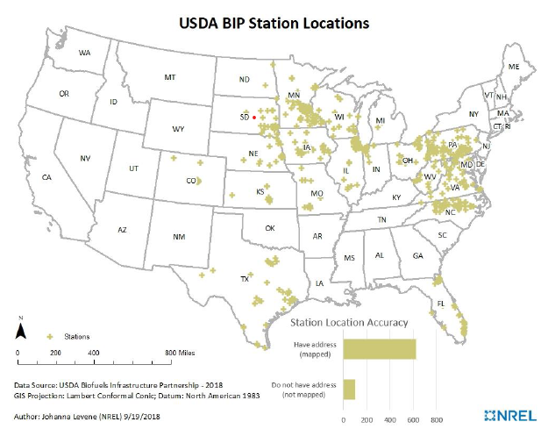
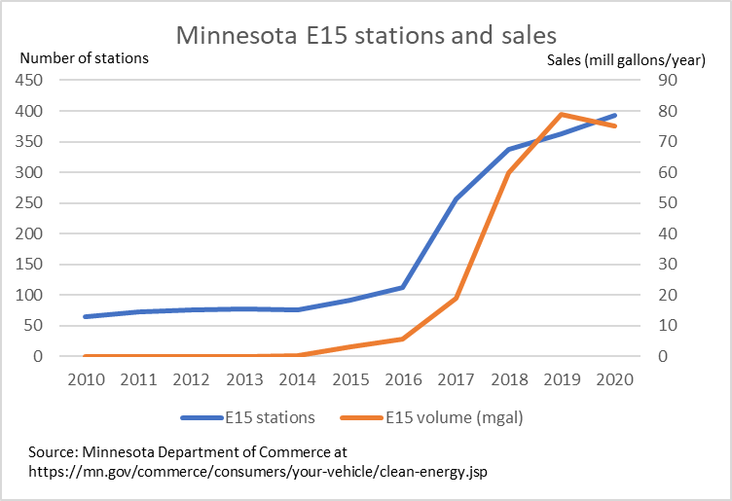
3. More on charging: does fueling infrastructure really drive consumption?
Some (limited) evidence from the USDA Blender Infrastructure Partnership (BIP) program
E15 is 15% ethanol and can be burned in nearly all engines; E10 is the national norm
USDA BIP: $100m in 50% cost-share grants to states for installing blender pumps
Applications closed July 2015, funds dispersed to 20 states
EIA doesn’t collect E15 sales data; nationally, ethanol share in gasoline increased 0.3pp 2015-2020
But no evidence of passing E15 tipping point where E15 takes over the market
Minnesota E15 Stations and E15 Sales
Source: USDA, NREL, Minnesota Department of Commerce, and authors’ calculations.

Slide 29
More on charging: Norway evidence - Springel (AEJ-EP 2021)
Springel, K. “Network Externality and Subsidy Structure in Two-Sided Markets: Evidence from Electric Vehicle Incentives,” AEJ-EP (2021)
EV market share model in the two-car setting (Springel actually has multiple models, this abstracts to EV/ICE):
where N is the number of charging stations, P is the relative price (EV to ICE), and ψ is a common taste time series term.
Econometric challenge is that N and s are simultaneously determined (chicken and egg)
Estimation requires an instrument that is independent of ψ but correlated with N
Springel IV: government subsidies to charging stations, which varied over time and region

Slide 30
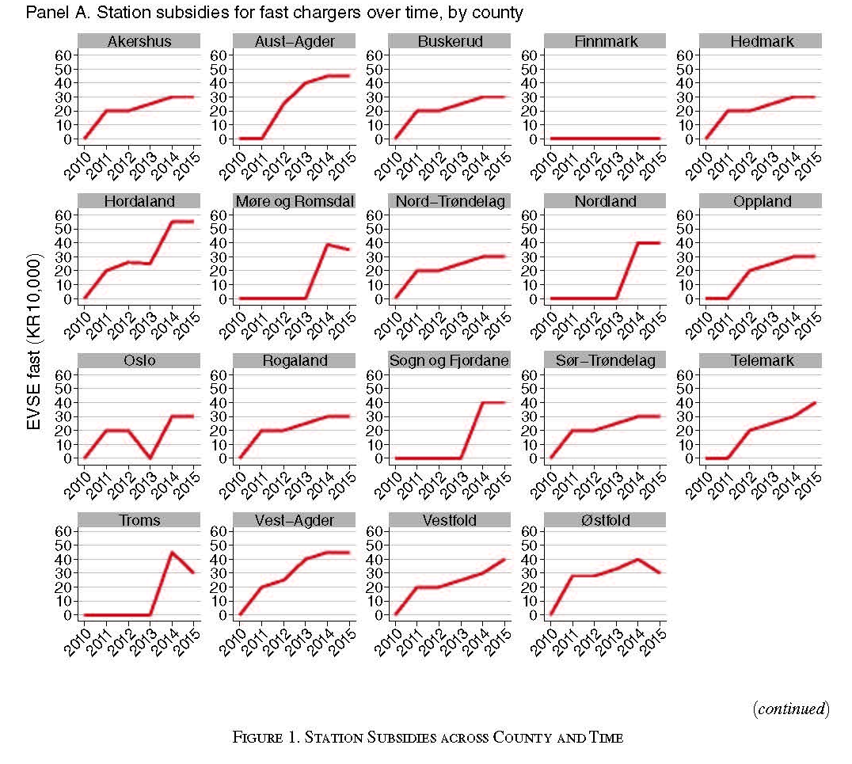
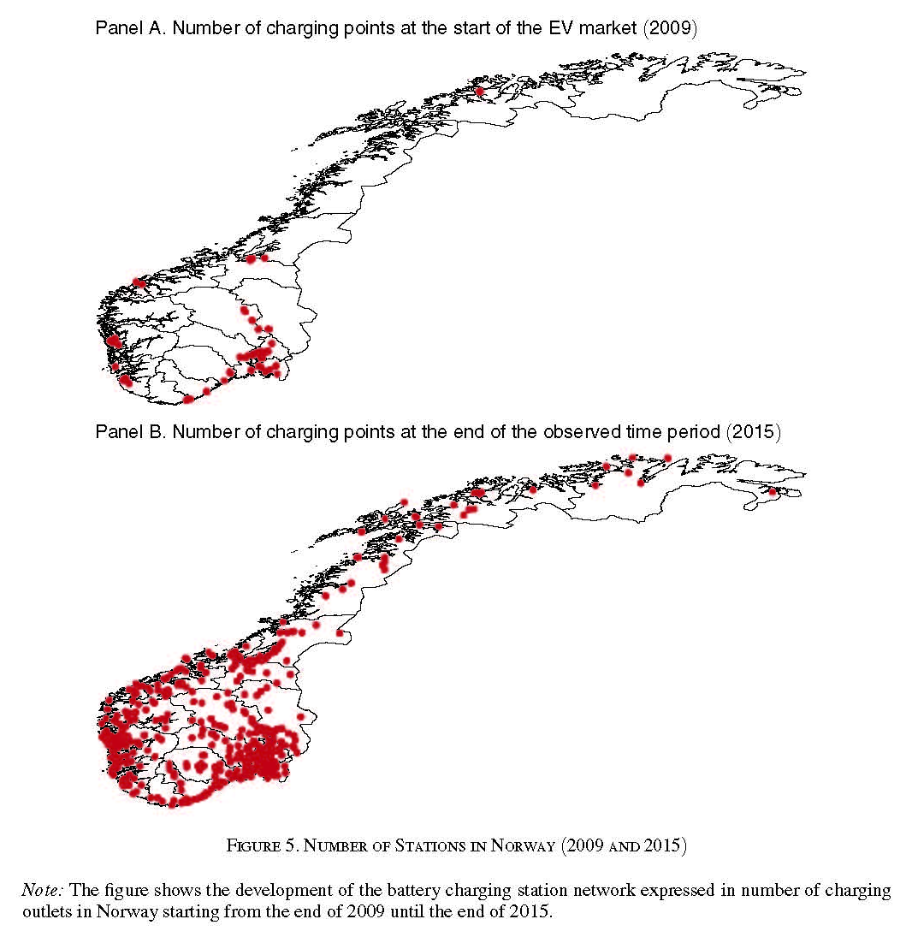
More on charging: Norway evidence - Springel (AEJ-EP 2021)
Subsidies for charging stations by region and time Installed charging stations in 2008 and 2015

Slide 31
More on charging: Norway evidence - Springel (AEJ-EP 2021)
Springel, K. “Network Externality and Subsidy Structure in Two-Sided Markets: Evidence from Electric Vehicle Incentives,” AEJ-EP (2021)
Springel IV estimate is
Interpretation: Can interpret in terms of semi-elasticity, which for logistic is given by:
Implied semi-elasticity as a function of share:
s | elasticity
0.05 | 0.188
0.1 | 0.356
0.12 | 0.417
0.2 | 0.632
0.3 | 0.830
0.4 | 0.948
0.5 | 0.988

Slide 32
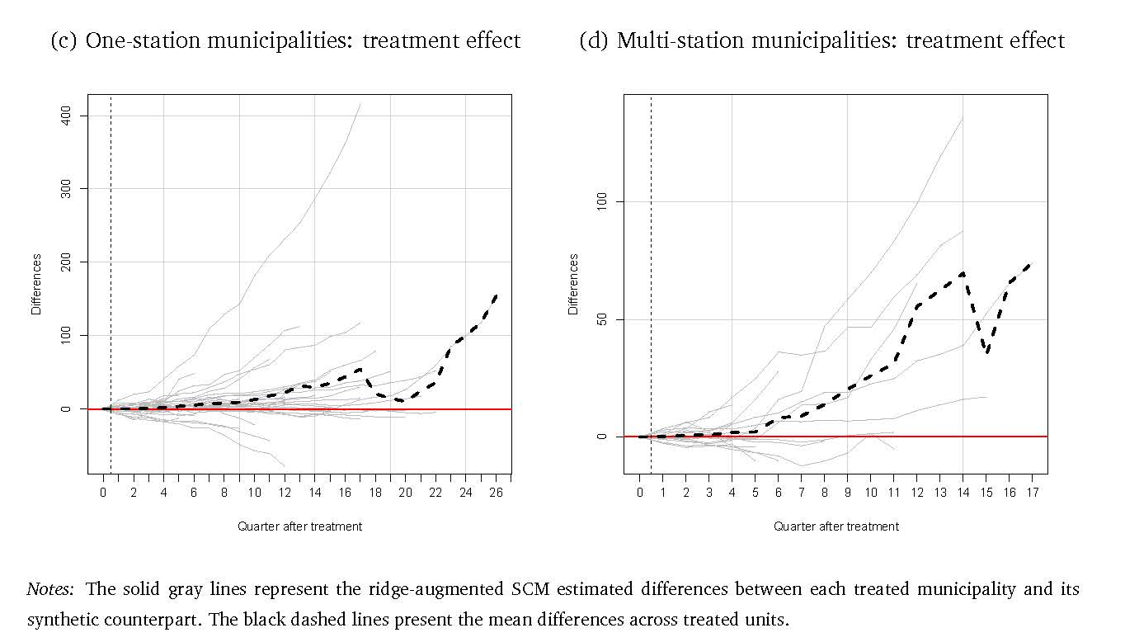
More on charging: Norway evidence – Delacrétaz et al (wp 2021)
Delacrétaz et al, MIT CEEPR discussion paper (2021)
2 approaches: IV approach and “event study” approach (synthetic controls)
Suggestive evidence that vehicle elasticity wrt charging stations declines with charging stations (saturation effect)
Synthetic control approach: examine no. EVs sold in municipality which went from 0 to 1+ charging station (L3 charger)
422 municipalities, 2010Q3 – 2017Q4, quarterly data
1+ charger: 248
0 -> 1 charger: 47
0 -> >1 charger: 17
No chargers: 110

Slide 33
More on charging: EU evidence
Sommer & Vance, EnvResLett (2021)
L2 & L3 chargers separately (great!)
Fixed effects panel regression of EV sales on chargers, IV =
  Li et al (2017) IV, number of grocery stores in MSA x lagged national chargers (some supermarkets host charging stations)
  Count of local transformers on grid (capacity measure)
  Count of interstate gas stations
Data: (almost) all EV purchases, by county (400 counties, 30 months: July 2016-Dec 2018)
EVs by location, 2018)
Charging stations (L2&L3) by location, 2018

Slide 34
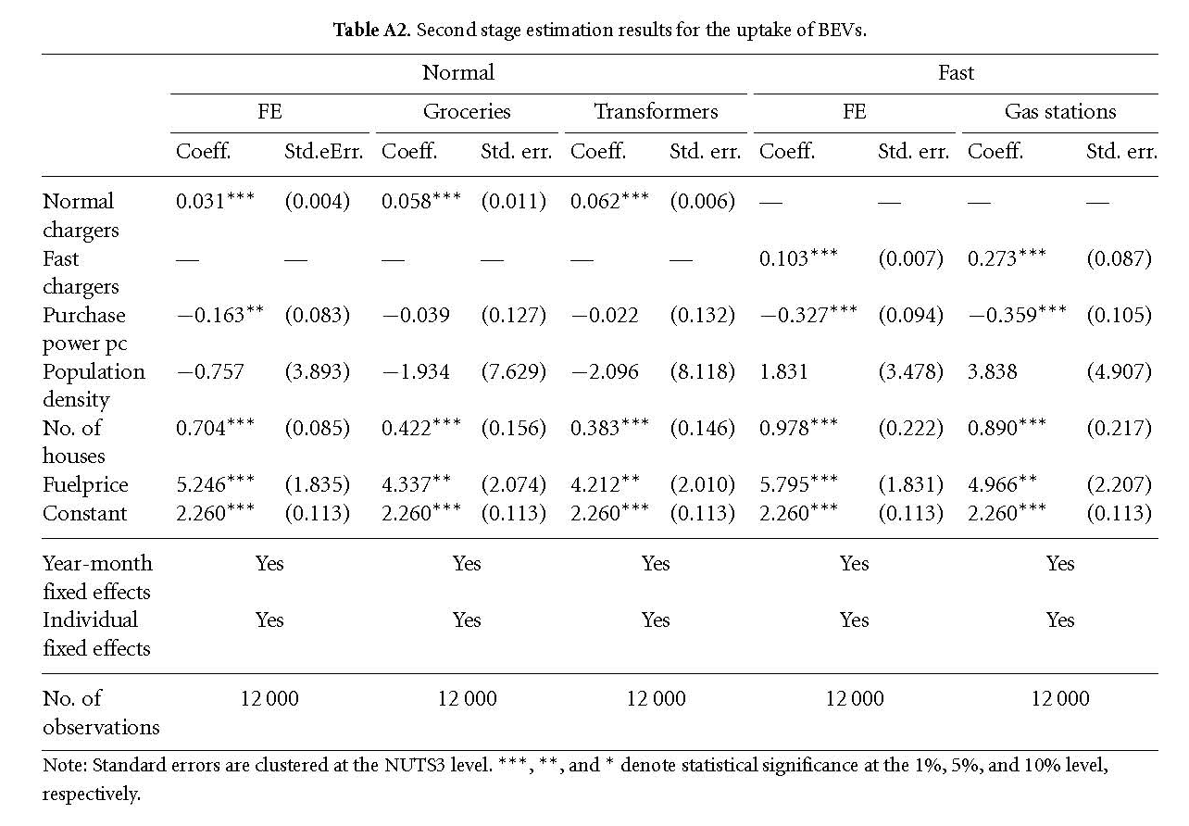
More on charging: EU evidence (Sommer & Vance 2021, ctd)
Dependent vble: no. of EVs in county i in period t
Key points
Larger effect on EV uptake of L3 than L2
These levels regressions imply an elasticity estimate (evaluated at sample means) of 0.54. (!!)
If you translate into cost-of-charger they find that a subsidy to L2 has same effect as subsidy to L3!
Odds & ends:
  IVs really exog?
  Instruments are strong (first-stage F >= 1923)
  Linear in EVs – misses EV update inflection
  Time series issues including HAR SEs

Slide 35
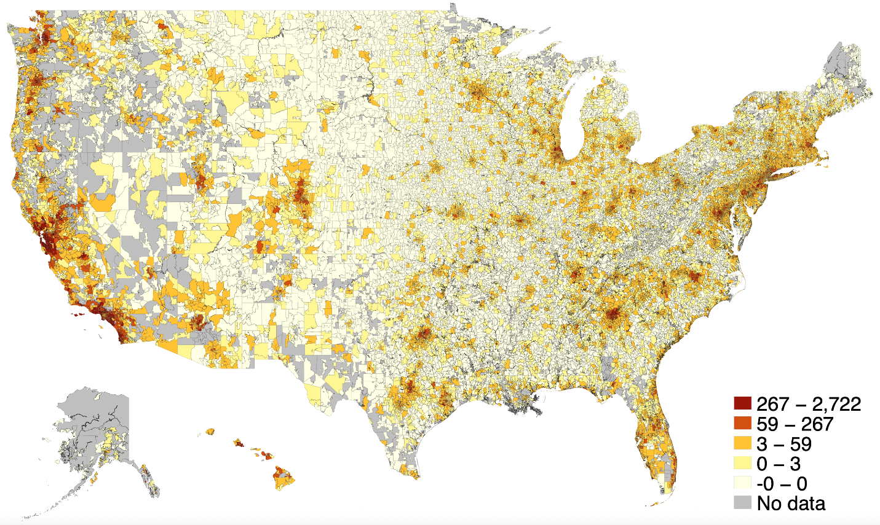
Where are US chargers now?
Number of EVs by zip code
Number of public chargers by zip code
Source: Polk registration data for 2019 (EVs), DOE AFDC (chargers), and authors’ calculations.

Slide 36
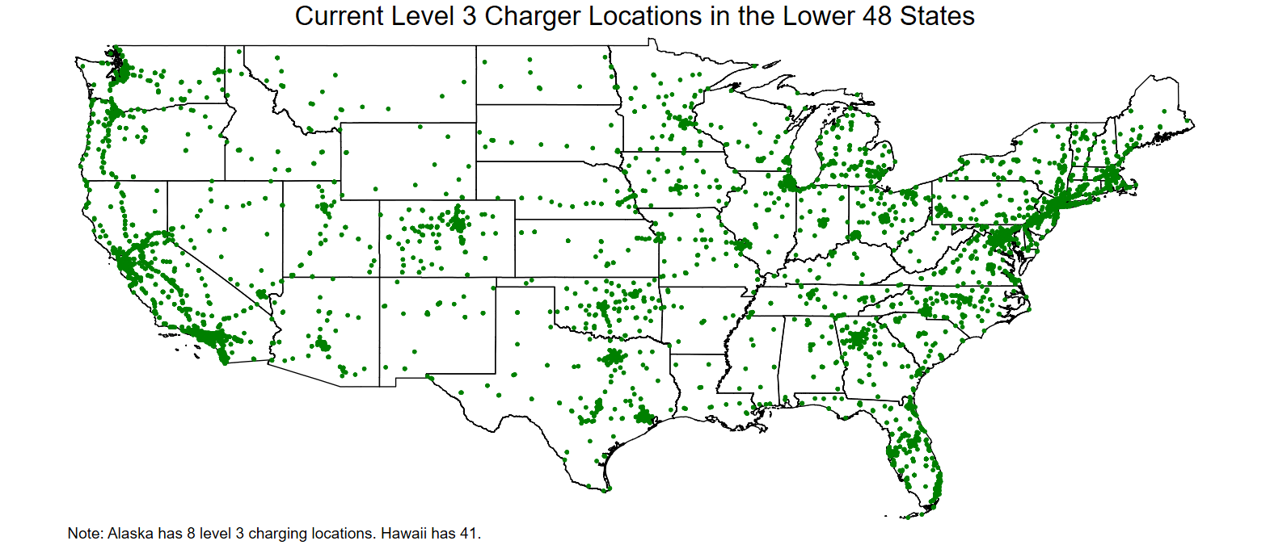
Where are US chargers now?
Source: DOE AFDC and authors’ calculations.

Slide 37
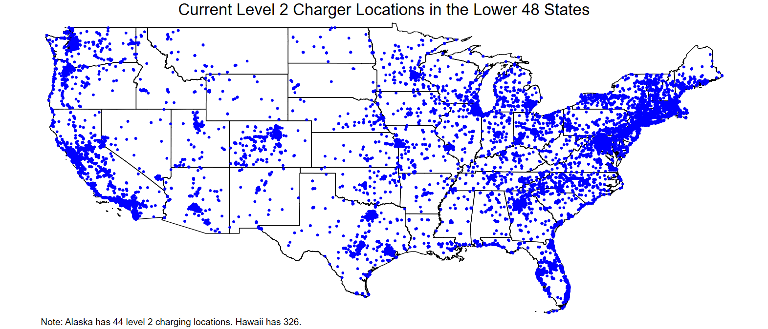
Where are US chargers now?
Source: DOE AFDC and authors’ calculations.

Slide 38
Where are US chargers now?
Share of chargers and chargers per thousand people by State
Source: DOE AFDC and authors’ calculations. Only 25% of zip codes have at least one charger.

Slide 39
Where are US chargers now?
Zip Code Level Demographics: Charging Haves and Have-nots
Shares of Charging Sites by Facility Type
Source: DOE AFDC and authors’ calculations

Slide 40
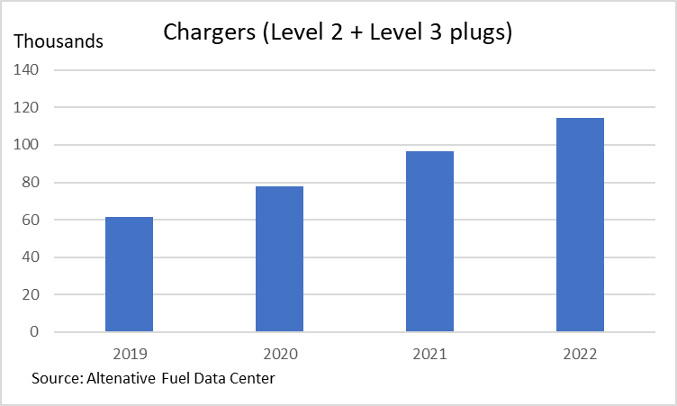
Charger growth (L2 & L3 ports)

Slide 41
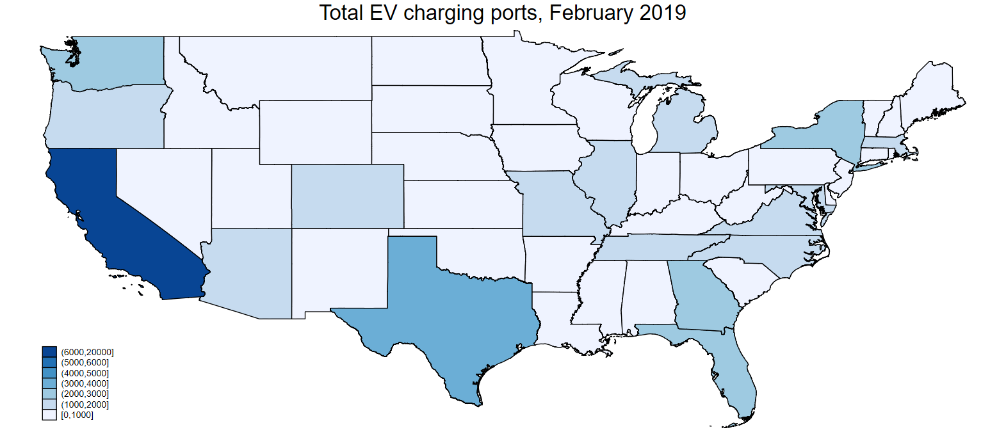
Charger growth (L2 & L3 ports)
Source: DOE AFDC and authors’ calculations

Slide 42
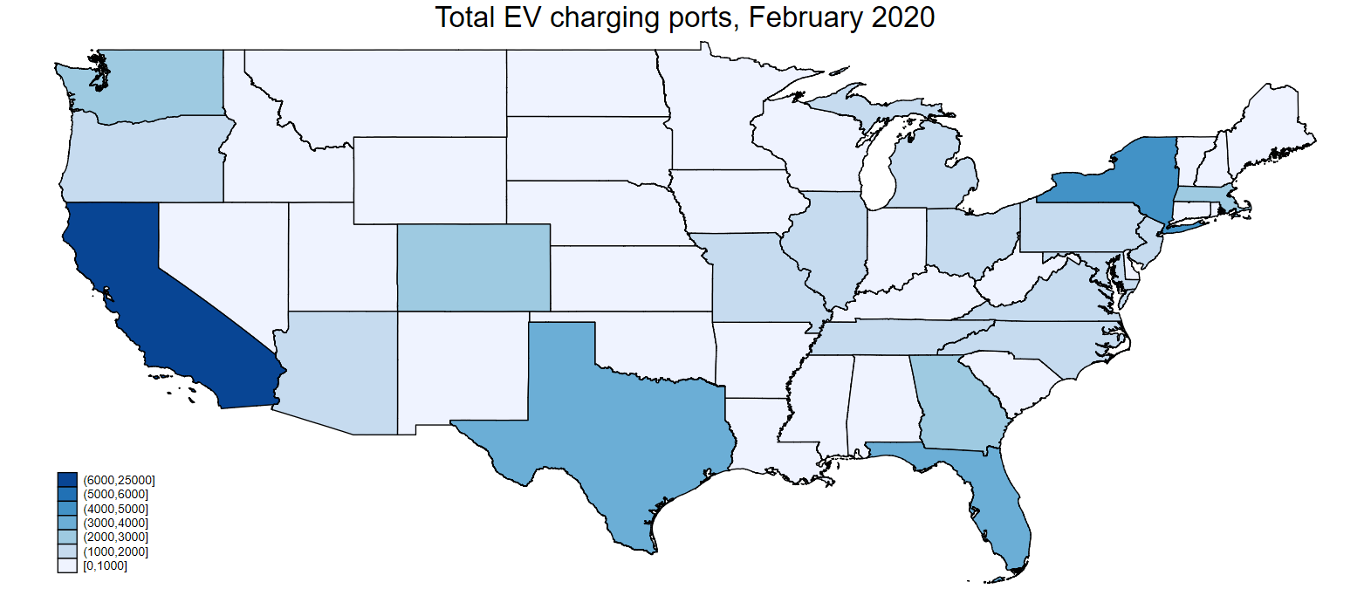
Charger growth (L2 & L3 ports)
Source: DOE AFDC and authors’ calculations

Slide 43
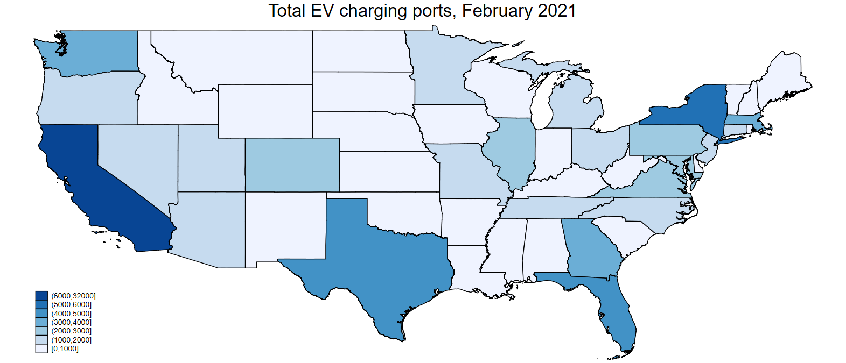
Charger growth (L2 & L3 ports)
Source: DOE AFDC and authors’ calculations

Slide 44
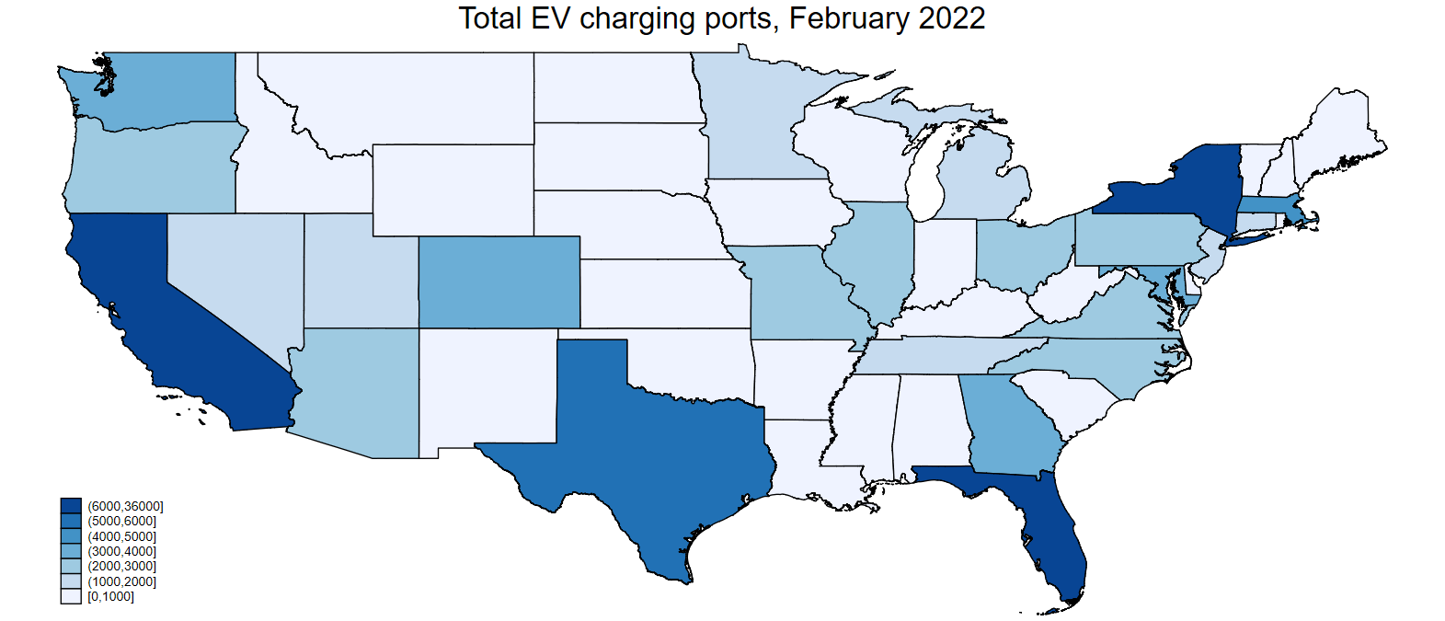
Charger growth (L2 & L3 ports)
Source: DOE AFDC and authors’ calculations

Slide 45

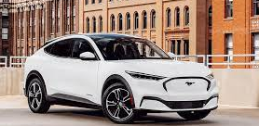
Summary
Main findings
Policy levers likely to be very effective in expediting EV shift
Charging infrastructure is key
.. As is a cleaner power sector
Carbon tax barely moves the needle
Important role for ZEV mandate
  ZEV mandate can replicate tax wedge (without domestic content provisions), but both EV and ICE are higher than under rebate
  ZEV mandate a feasible path towards deep EV penetration
Caveats & more work is needed…
Charging subsidy program design
Refine policies: first-best suite?
Modeling:
  EV-ICE cross-price elasticity
  Private charging station response
  Differentiate the Level 2 and Level 3 markets (both demand & supply)/improve modeling (Sommer & Vance [ERL 2021])
  Better understanding of evolution of EV acceptance (attributes & tastes) (e.g., Archsmith et al (2021))
  Take dynamics (expectations) more seriously?
  Methods: out-of-sample functional form issues; welfare v. system costs

Slide 46
Additional Slides

Slide 47
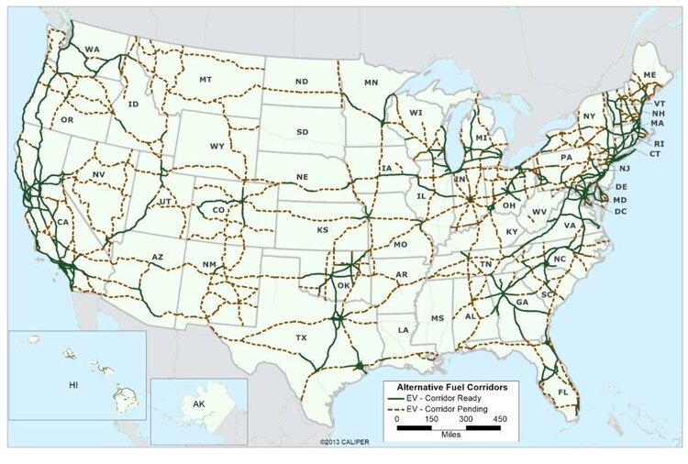
IIJA: $7.5B, mainly for chargers
IIJA – some details
$5B for National EV Formula Program
  State grants, allocated by formula
  Must build on alternative fueling corridors
$2.5B for EV – and hydrogen, propane, NG – fueling
  50% in community grants: publicly accessible, priority to rural areas, low- and moderate-income neighborhoods, & low private parking
Data collection and analysis components
Program guidance due Feb. 11, 2020
Biden EV Charging Action Plan (12/13/21)
  New Alternative Fuel Corridors
  New Joint Office of Energy & Transportation
Challenges: IIJA & beyond
Details matter
  Minimize inframarginal subsidies
  New L3 v. L2 at hotels off exits
  Incentives for maintenance
  How best to address EJ considerations?
  How to balance apartment residents v. L3?
  Learn! Regional variation, experimentation!
Level 3 standards?
$45B would deliver much more than $7.5B!
Industry structure & pricing – wild West
US DOT EV Fueling Corridors: Ready & Pending
EV ready corridor: charging stations ≤50 miles apart, within 5 miles of freeway. Source: US DOT

Slide 48
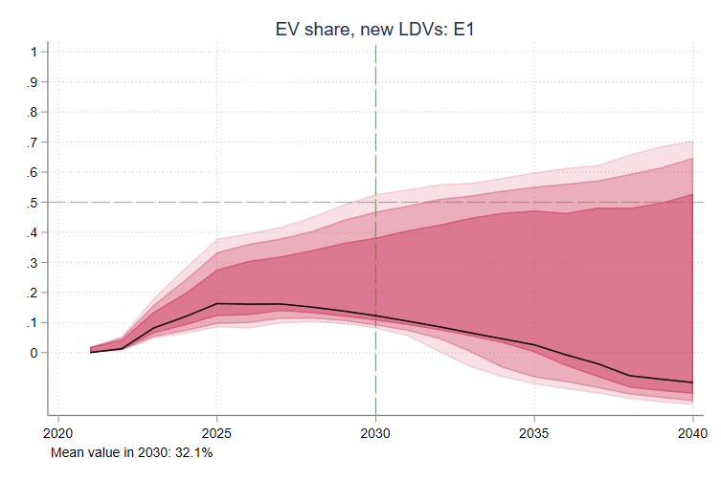
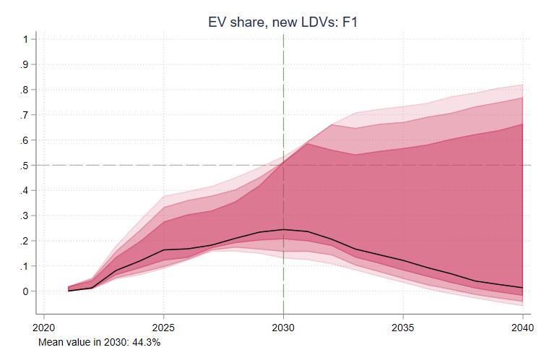
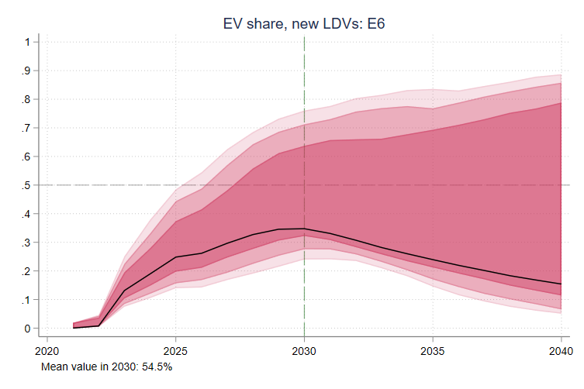
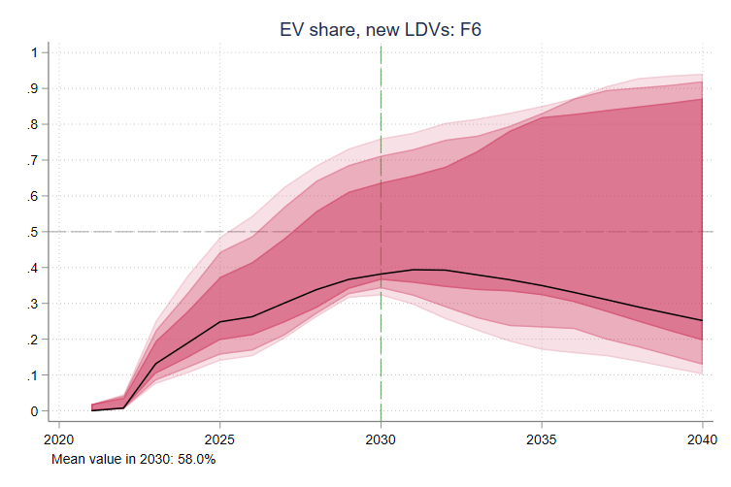
Results: Change in EV sales share in 2030, relative to no-policy case
Change in EV sales share, benchmark parameters
Top:
  67% cost-share, $7.5B; $6000/$3900 credits
Bottom:
  85% cost-share, $40B; $3900/$2100 credits
Left:
  No ZEV policy
Right:
  ZEV policy, $10k price cap

Slide 49
Uncertainty plots: Charging: 67%/$30B; Rebate $4k/$2.7k/40%; ZEV cap $10k (51% EV mean)
Time series plots show the mean and 5%, 10%, 25%, 75%, 90%, and 95% percentiles of the indicated variable under the no-policy BAU (gray) and policy case (red). Histograms show the value of the indicated summary variable. Uncertainty is over Monte Carlo draws.

Slide 50
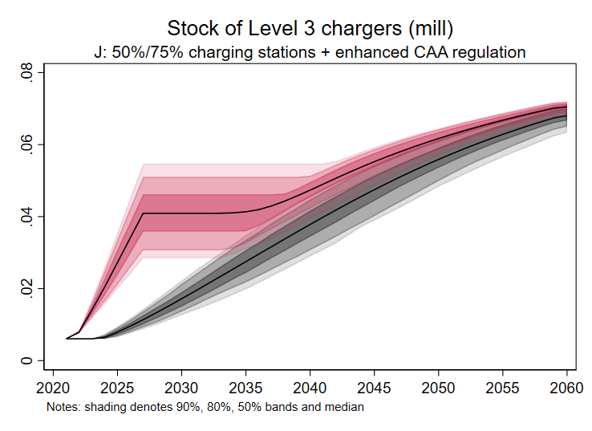
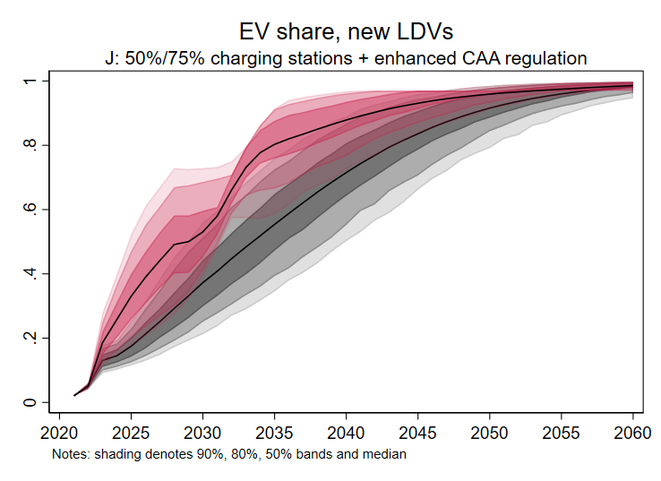
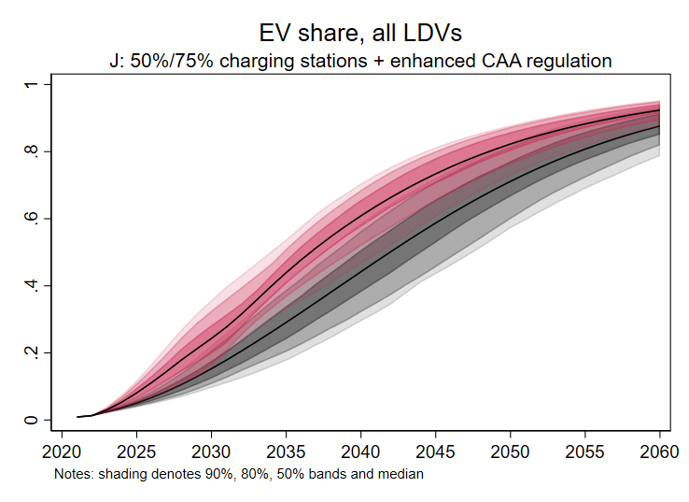
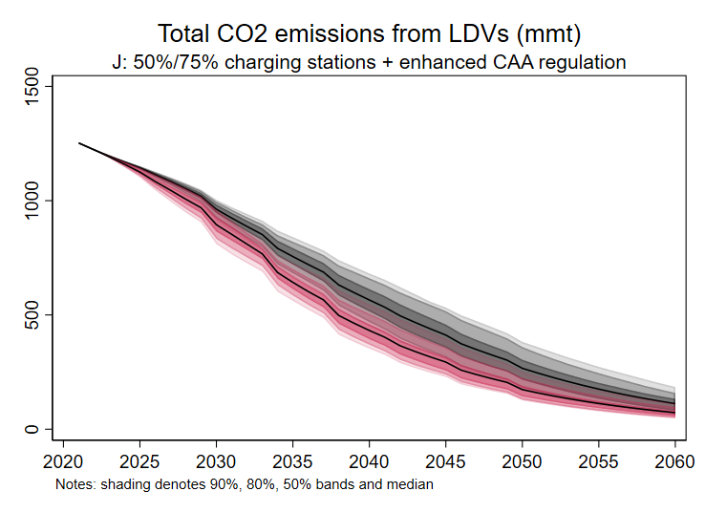
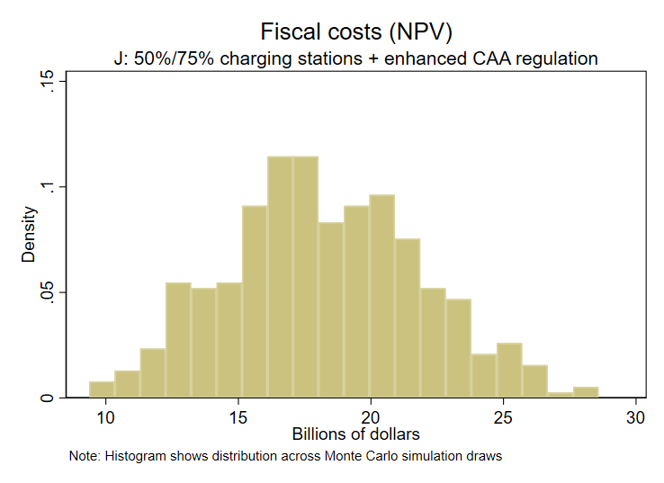
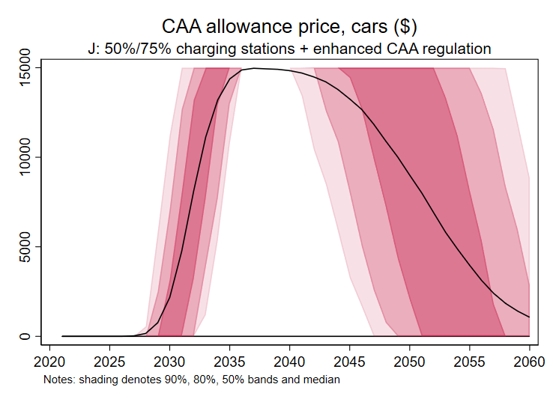

Results: J. 50%/75% charging station cost-share + Enhanced CAA standards ($15k cap)

