Slide 1

Study Center Gerzensse: Advanced Courses in Economics
The Economics and Econometrics of Climate Change Policy:
E. Macro Implications
of the Energy Transition – Part I
James H. Stock
Economics Department and Harvard Kennedy School,
Harvard University
May 30 – June 3, 2022

Slide 2
Course outline
I. Introduction
Introduction & Overview
  Climate change science and CC econometrics (brief)
  Framework economic concepts
  Cost-benefit analysis, cost effectiveness analysis, SCC & TCP
  Marginal abatement curve
III. Damages
Macroeconomic implications of the energy transition
  Overview: Physical & transition costs
  Long run
  Short run
    Case studies – short run policy transition costs
      Carbon tax
      Cap & trade
      Policy uncertainty
The Social Cost of Carbon: Recent developments (time permitting)
II. Emissions reduction (mitigation/decarbonization)
Sectoral carbon policies – theory & empirical evidence
  Carbon tax, cap & trade
  Clean energy standards; investment & production tax credits
  Policy simulations
  Criticisms & the case for sectoral standards
Carbon pricing with leakage: Supply side policies
  Supply side policies as carbon pricing with leakage
  Supply side policy with leakage: US O&G royalties
  Extension to international trade & BCA
The electric vehicle revolution
  Transport sector overview, EVs, & literature review
  Modeling charging station v. vehicle subsidies
  More on charging stations & current research

Slide 3
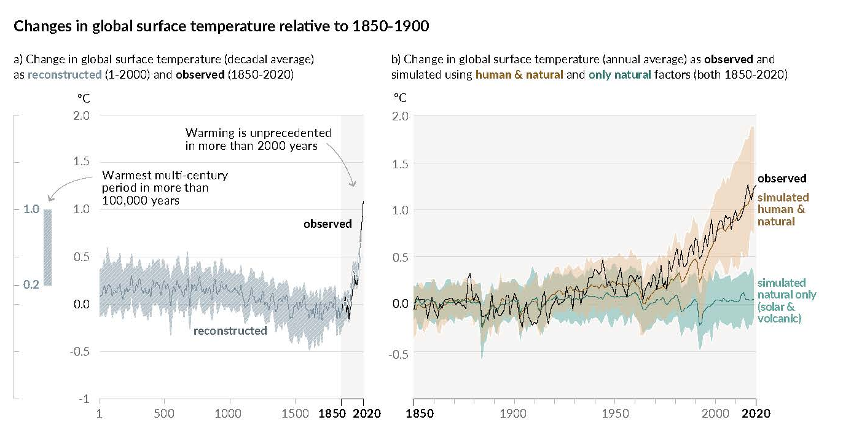
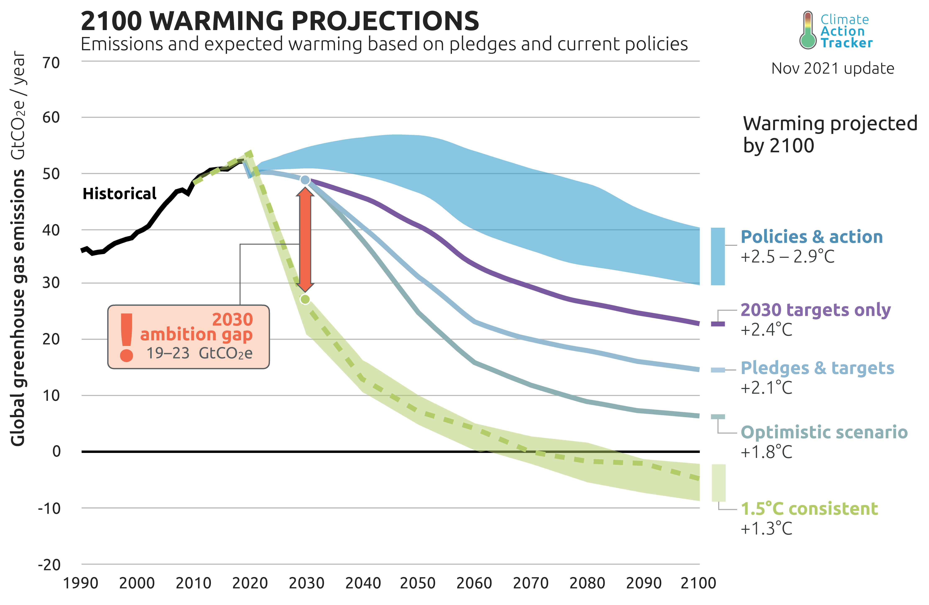
1. Macro risks of climate change: Overview
A. Role of monetary policy in climate arena
Climate => monetary policy (macro risks of climate)
Monetary policy => climate policy (ECB yes, Fed no)
B. Three risks (Carney 2015) (exogenous disturbances)
Physical risks
  Extreme weather (storms, floods, etc.)
  Crop failures
  Productivity, health, & mortality impacts
  Sea level rise
  Climate migration
  …
Transition risks
  Asset revaluation
  Energy price volatility
  Sectoral reallocation/dislocation
  Food price volatility
  Policy risks
  Political risks
  …
Liability risks (public, private; will not discuss)
C. Macro consequences (endogenous response)
Long run (Low frequency)
Short run (Business cycle frequency)

Slide 4
Timeline of physical and transition risks
Physical
Heat waves
Storms
Regional crop failures
Sea level rise
Climate migration
Transition
Asset revaluation
Energy price volatility
Sectoral reallocation
Food price volatility
Policy effects

Slide 5
Timeline of physical and transition risks Macro impacts
Examples of channels at different horizons
 | Long run π*, R*, u*, μ | Short run π, u, shocks, business cycles
Physi-cal | Lower average crop yields Lower productivity sea level rise adaptation costs,… | Hurricanes Floods & fires droughts (food price shocks, famines) heat waves (acute productivity shocks) Grid failures/blackouts
Transi-tion | green investment demand shifts in types of jobs/skills monetary policy decision (no accommodation of smooth increase) long run productivity growth | Energy price shocks Asset price shocks Transitional unemployment (mine closures, battery factory openings, etc.) Policy transition shocks (implementation of carbon price,…) Policy uncertainty shocks
Physical
Heat waves
Storms
Regional crop failures
Sea level rise
Climate migration
Transition
Asset revaluation
Energy price volatility
Sectoral reallocation
Food price volatility
Policy effects

Slide 6
2. Macro impacts of climate change: Long run
Organizational framework
  Key long-run parameters
  Long run growth per capita (μ)
    Long run growth rate of capital
    Long run growth rate of total factor productivity (TFP)
  Long run equilibrium interest rate (R*)
  Long run unemployment rate (u*)
  Long run rate of inflation/inflation target (π*)
  Outline
    Physical risks/damages
    Transition risks/damages
    Put them together in the context of the key parameters

Slide 7
2(a). Macro impacts of climate change: physical/long run
(i) Top-down using country or region-level data on GDP & climate variables, typically 1960-present
Econometric estimates of damage functions. Recent:
  Dell, Jones, Olken (AEJ-Macro 2012, JEL 2014)
  Auffhammer (JEP 2018)
  Burke, Hsiang, Miguel (Nature 2018)
  Burke, Davis, & Diffenbaugh (Nature 2018)
  Burke & Tanutama (NBER WP 2019)
  Kahn et al. (Energy Economics 2021)
  Carleton & Greenstone, JEEM forthcoming (2021) (partial survey)
  Rennert et al, BPEA (2021) (final version posted) (partial survey)
  Newell, R., B. Prest, and S. Sexton, “The GDP-Temperature relationship: Implications for climate change damages,” JEEM (2021) (survey/meta-analysis)
  Piontek et. al., “Integrated perspective on translating biophysical to economic impacts of climate change,” Nature Climate Change (2021) (survey)

Slide 8
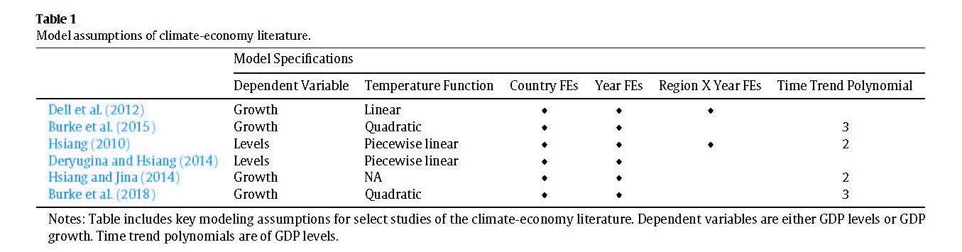
Macro impacts of climate change: physical/long run
Source: Newell, Prest, and Sexton (2021)
Typical growth specification:
  L is lag operator (some papers include lagged temp)
  BHM use long differences (multi-decade GDP growth) which turns panel into cross-section
  Typically estimated with country- or regional data
Econometric issues include:
  Functional form, e.g. h trend function: quadratic? Cubic? What is h(t) a proxy for?
  Levels and nonstationarity, e.g. is X = Temp or = ΔTemp?
  Functional form for X: linear in temp? Bins? Breaks over a certain temp (human physical threshold, ~30C
  Omitted variable bias: what are confounders? (e.g., demographic slowdown in developed economies)

Slide 9
Macro impacts of climate change: physical/long run
(i) Top-down using country or region-level data on GDP & climate variables, typically 1960-present
Newell, Prest, & Sexton (JEEM 2021): 800 variants of panel regression above, differing in:
Functional form for temp (none, linear, quadratic, cubic, spline);
  GDP growth v. levels, specification lags or not;
  Time and region controls (year FE, region FE, country time trends, country polynomials)
  Select empirically plausible “winner” specifications using cross-validation.
Digression on cross-validation – a method for model selection among a large number of models/high dim parameters
  Intro reference: Stock & Watson (Introduction to Econometrics, 4e), Chapter 14 (Key Concept 14.1)
    Divide the test sample into an estimation or “training“ subsample, and a “test” subsample
    Estimate the model on the training subsample, make predictions on the test subsample, compute SSR on test subsample
  Time series notes:
    To preserve time-series structure the training set needs to be a continuous (in t) block – so that the test set evaluations amount to pseudo out-of-sample forecasts. NPS implement this using rolling windows, both forward and backwards.
    There is a technical problem with time effects – NPS evaluate time effects using the full sample, the rest of the coefficients using subsample.
NPS construct confidence sets as the set of models not rejected by forecast comparison tests (Hansen JBES 2005)
  They end up with 25 models in growth rates, and 49 in log-levels of GDP, in the model confidence sets
  Full confidence set for impact is sampling uncertainty on top of model uncertainty
Given the 95% confidence set of non-rejected models, what are the implications for estimated effects of temperature on GDP?

Slide 10
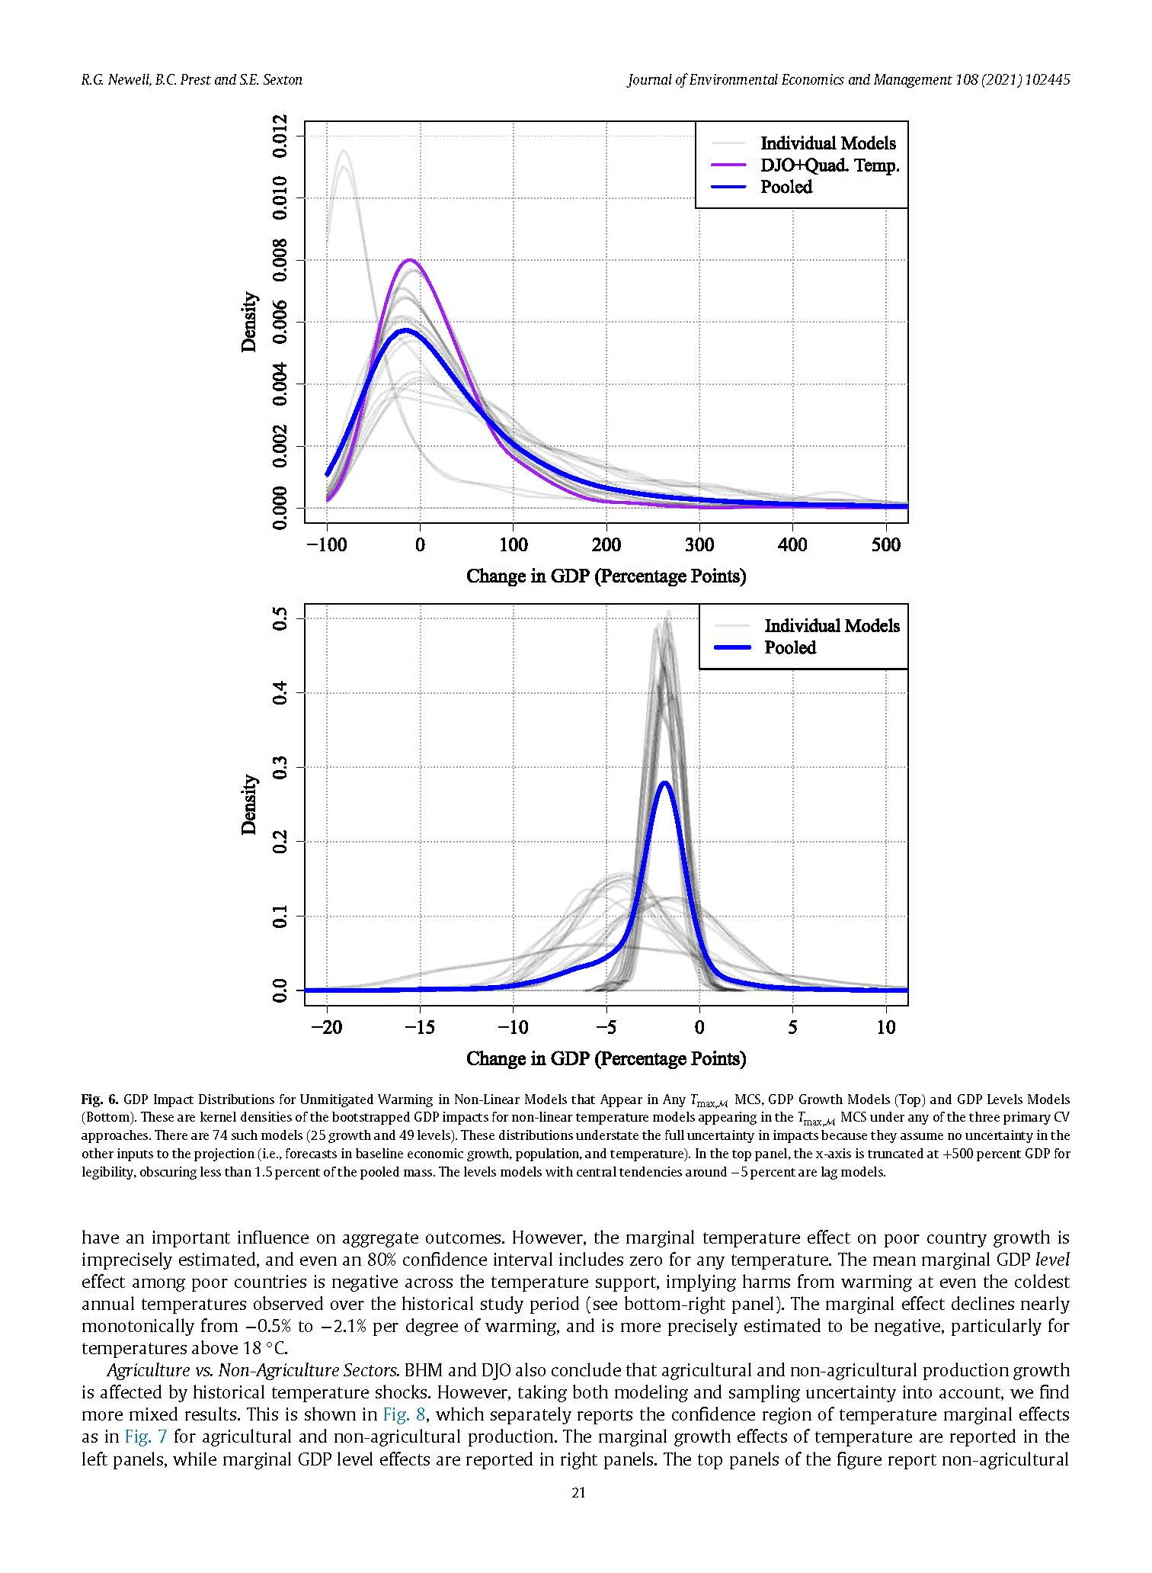
Macro impacts of climate change: physical/long run
(i) Top-down using country or region-level data on GDP & climate variables, typically 1960-present
Newell, Prest, & Sexton (JEEM 2021) results: Distribution of effect on the level of GDP in 2100 under RCP8.5, taking into account model uncertainty and estimation uncertainty. For levels model, range of effects is -1 to -3% of GDP in 2100.
The reason for the low levels estimates is that the non-rejected model forecast sets include models that don’t have Temp in them.
Growth rate specifications have huge range – small uncertainty in growth rate estimates compounds over 80 years!
Growth rate specifications Log level specifications

Slide 11
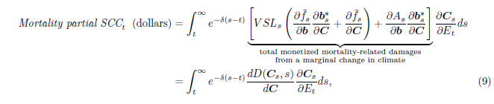
Macro impacts of climate change: physical/long run
(ii) Bottom-up using studies of specific (component) damages
Econometric estimates of component damage functions (selected):
    Mortality
    Energy use
    Productivity
Illustration: Carleton et al (NBER wp 2020) - mortality
  Conceptual framework: let D be the adaptation-inclusive economic damages from climate-induced mortality:
  Age-specific temperature-mortality relations: Let M = all-cause mortality, T = temperature, R = precipitation
    Adaptation is captured by the slow drift of T^{mean}: St. Louis eventually has the same heat-protection technology as Dallas (and Minneapolis, of St. Louis), etc.
  Adaptation costs: exploit idea that optimal adaptation means marginal benefits = marginal costs; estimates marginal benefits from T^{mean} term; and impute marginal costs.

Slide 12
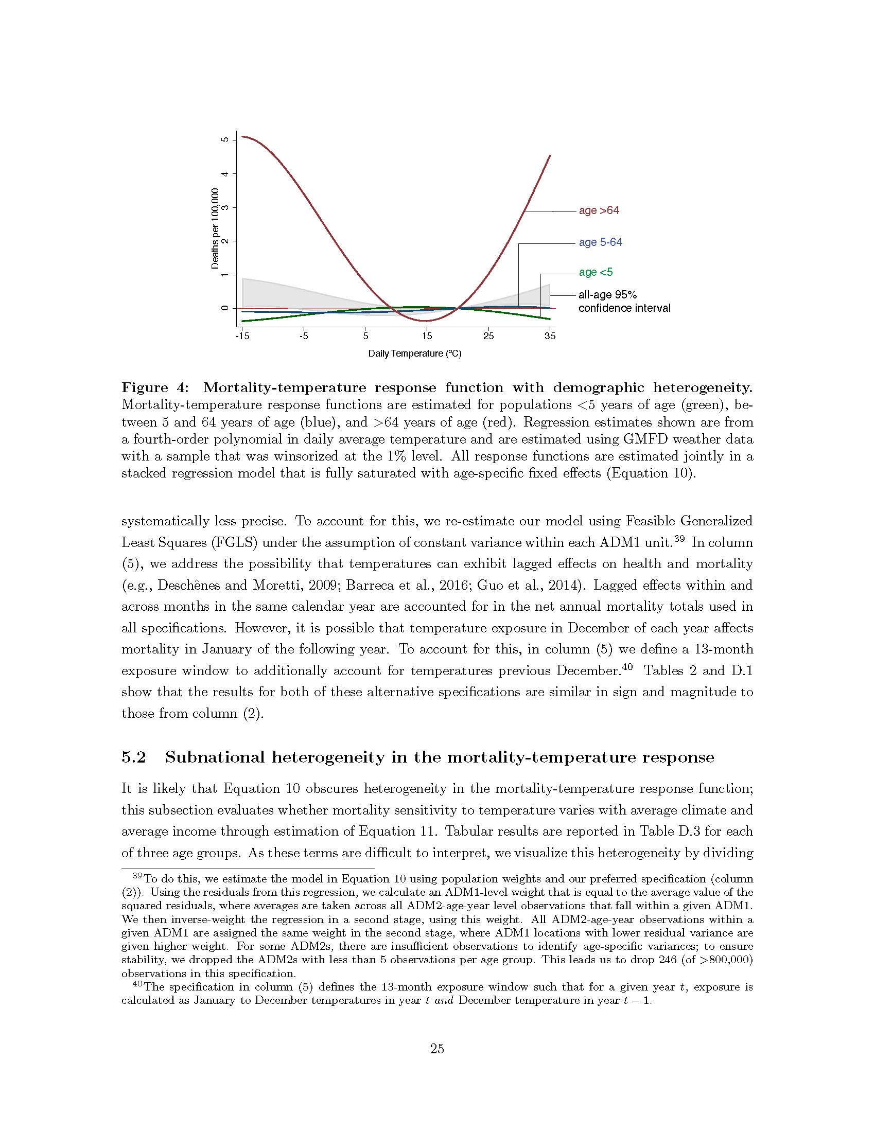
Macro impacts of climate change: physical/long run
(ii) Bottom-up using studies of specific (component) damages: Carleton et al (2020) results (mortality)

Slide 13
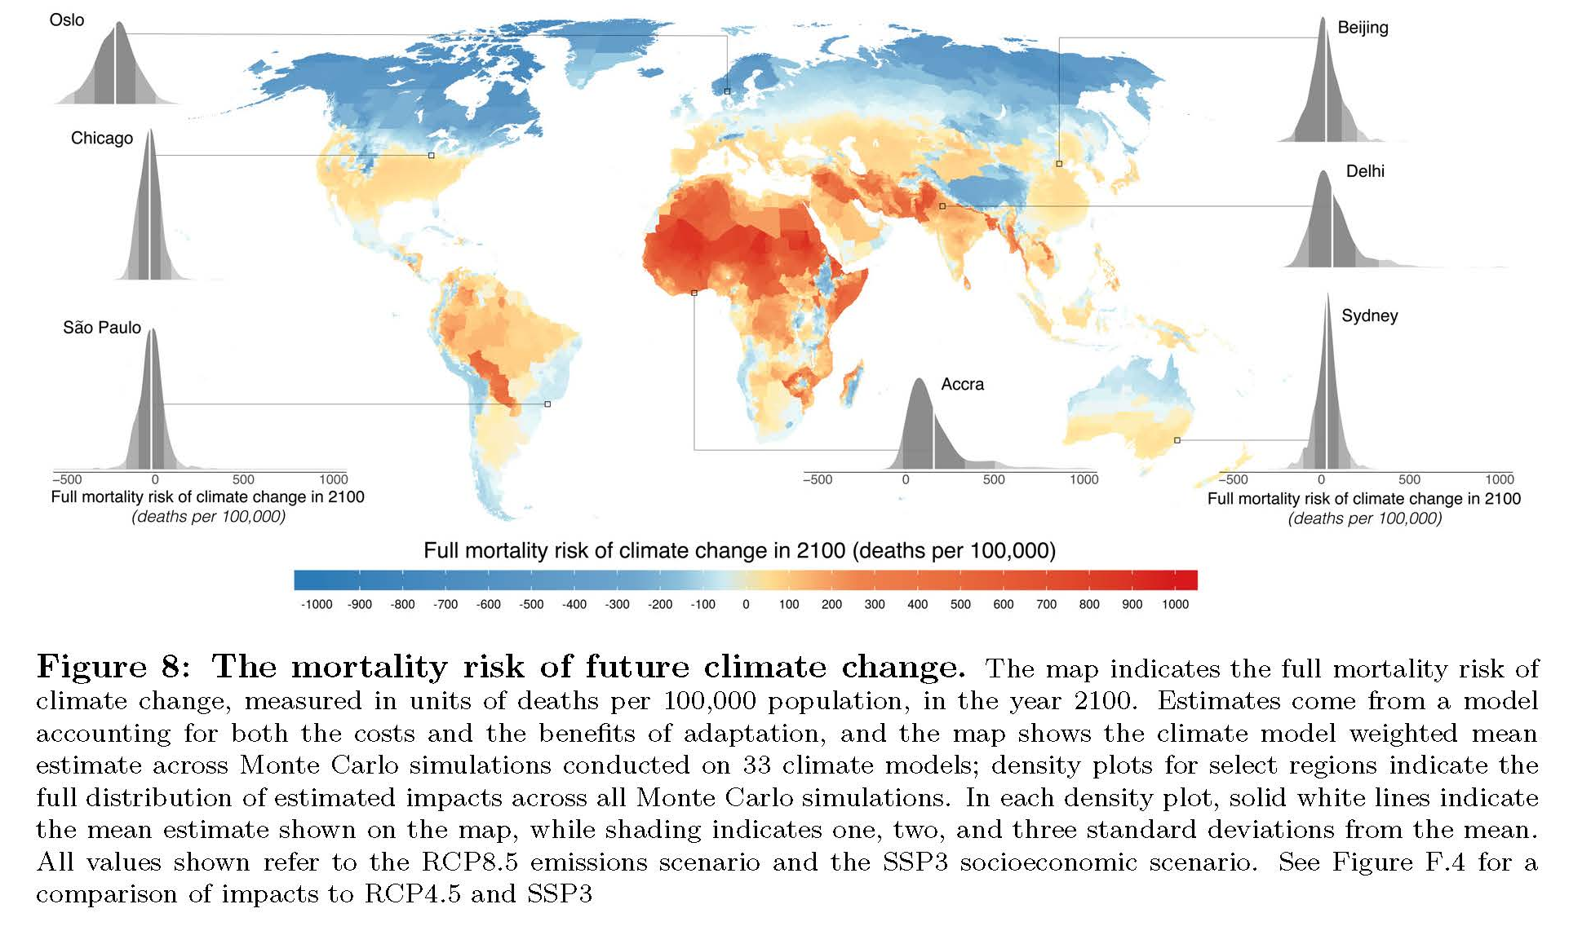
Macro impacts of climate change: physical/long run
(ii) Bottom-up using studies of specific (component) damages: Carleton et al (2020) results (mortality with adaptation)

Slide 14
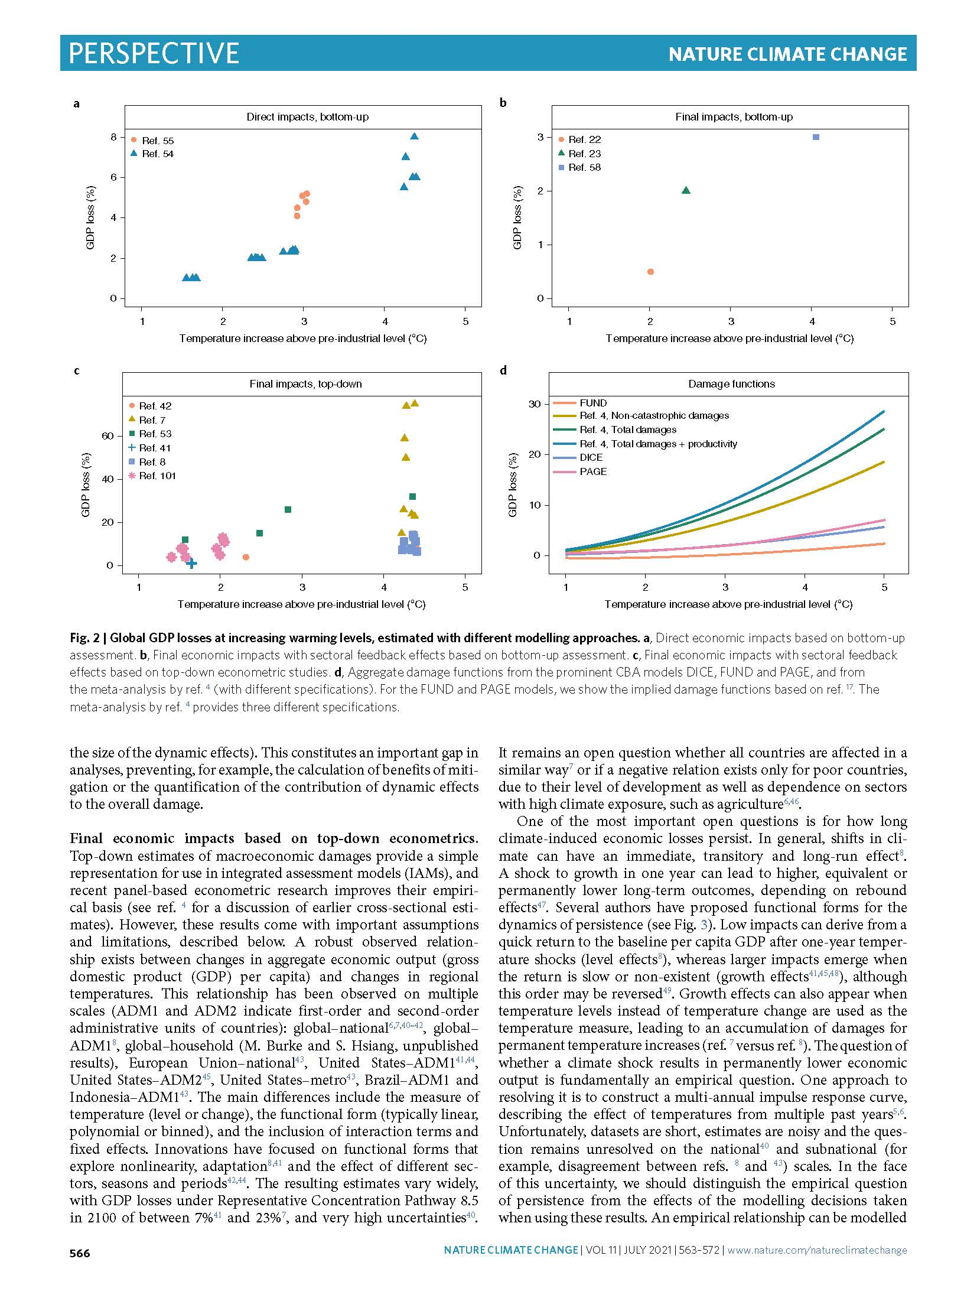
Macro impacts of climate change: physical/long run – Piontek et al (2021) survey
Piontek et. al., “Integrated perspective on translating biophysical to economic impacts of climate change,” Nature Climate Change (2021)

Slide 15
Macro impacts of climate change: physical/long run – Piontek et al (2021) survey

Slide 16
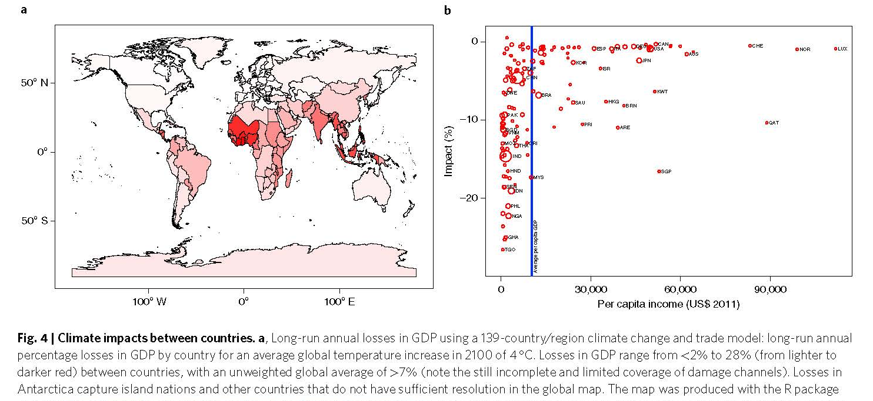
Macro impacts of climate change: physical/long run
Source: Piontek et al, Nature Climate Change (2021)

Slide 17
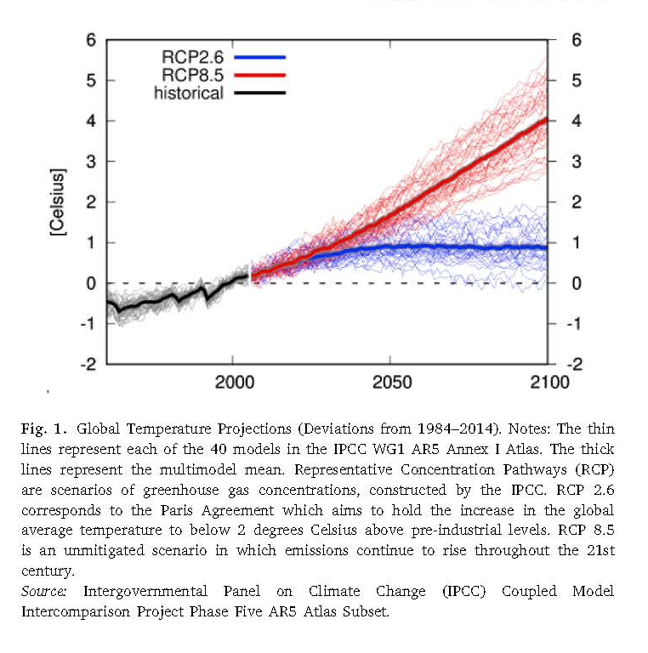
Macro impacts of climate change: physical/long run
Kahn et al, “Long-term Macroeconomic Effects of Climate Change: A Cross-Country Analysis, Energy Economics (2021)
Method
Cross-country panel regressions, with various econometric adjustments:
  split-sample jacknife SEs [adjusts for Nickel bias in short panels]
  tests for differences (growth) effect
  deviations from long-term moving averages to get around time polynomial problem
  allow for effect of weather shocks to depend on climate and income.
Evaluate models under RCP 8.5 and 2 degree target (!)

Slide 18
Climate Science: Emissions paths

Slide 19
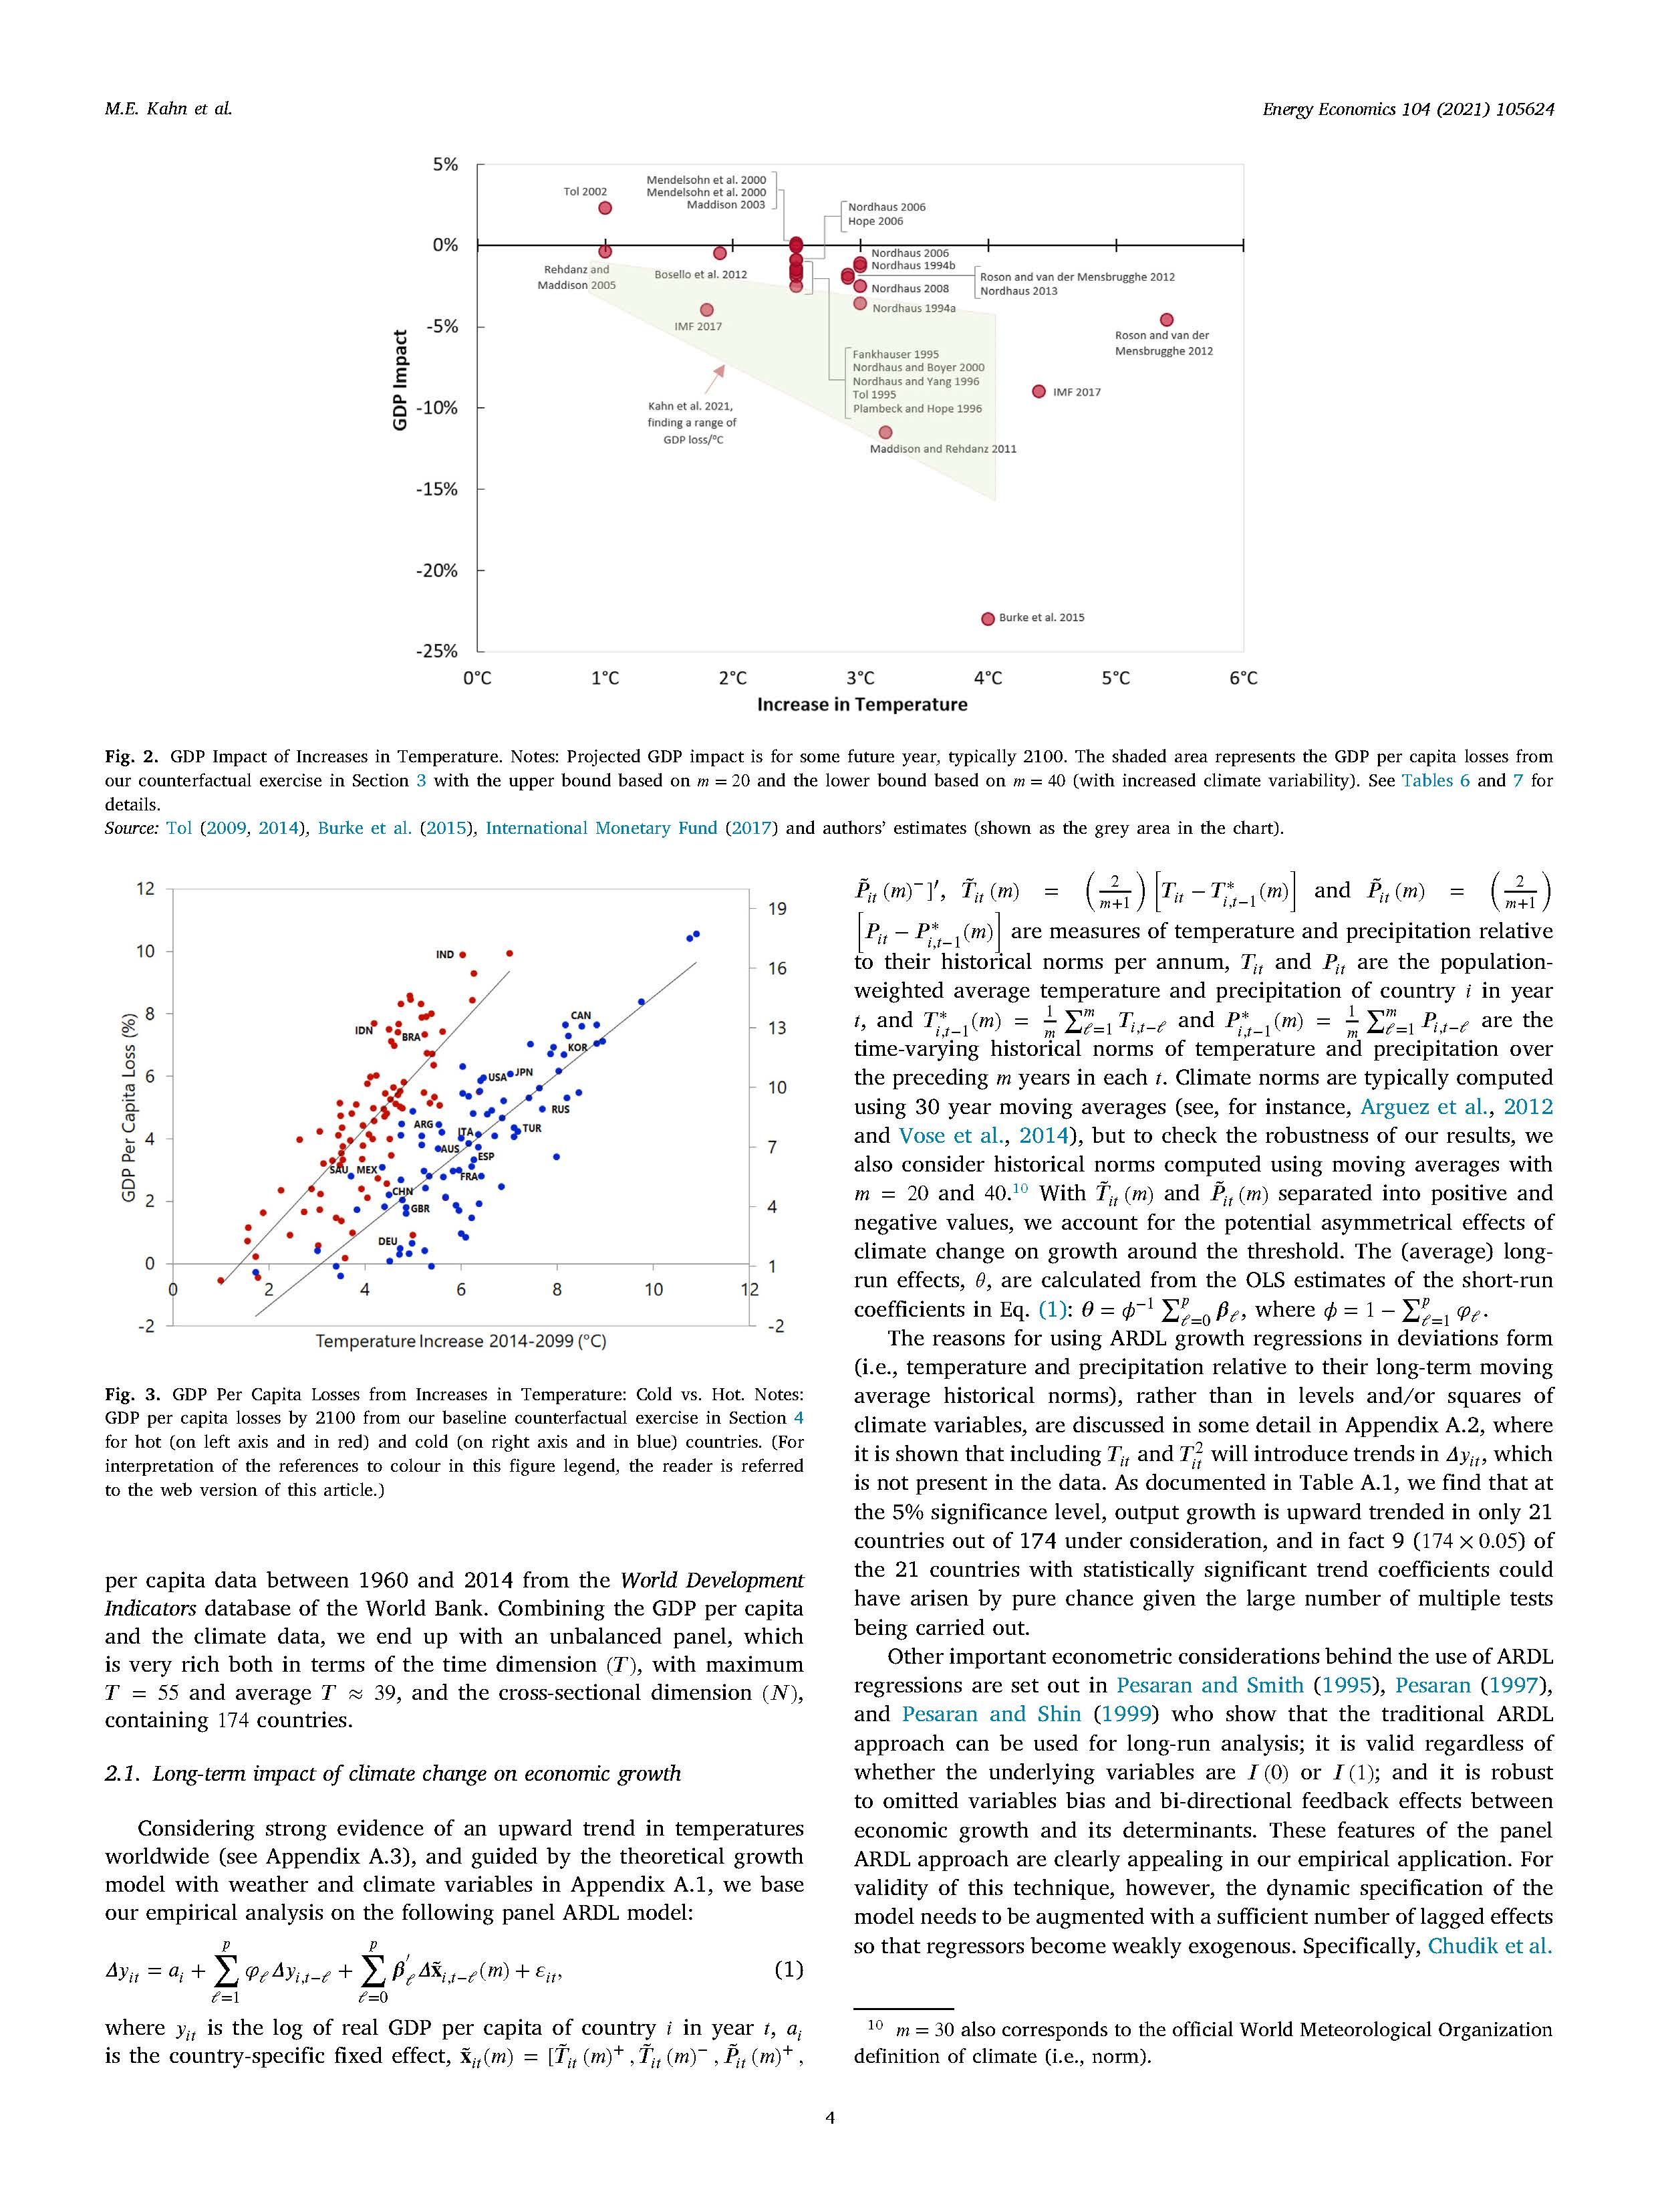
Macro impacts of climate change: physical/long run
Source: Kahn et al, Energy Economics (2021)

Slide 20
Macro impacts of climate change: physical/long run
Source: Piontek et al, NCC (2021)
Source: Kahn et al, Energy Economics (2021)

Slide 21
Macro impacts of climate change: physical/long run
Source: Kahn et al, Energy Economics (2021)
Strange feature of these results is that cold countries suffer larger losses than hot…

Slide 22
Physical damage functions: discussion
Top-down
comprehensive among factors that enter into GDP
  But GDP isn’t welfare; and GDP is a flow concept and doesn’t measure stock losses like submerged land, except as those affect output through productivity or the capital stock; same comment for value of life
Not fully satisfactory treatment of adaptation
Econometric issues significant Newell, Prest, & Sexton, and generally low signal-to-noise ratio (climate is a small factor among many affecting GDP over the past 60 years)
Extrapolations based on shakily-estimated functional forms (NPS)
Bottom-up
More credible identification of weather effect and of adaptation effect
More closely tied to physical consequences of climate change (heat waves, droughts, changing growing conditions)
Only estimates a subset of effects!! – those that you can list and credibly estimate (“looking under the lamp-post”)
However these are often in welfare units (e.g. VSL of mortality), NOT in GDP units. A GDP-centric application, like economic growth and monetary policy, doesn’t line up with some of the damage estimates.
And both miss…
Econometrics: Omitted variables/OVB? SEs? handling of trends?
Yet-unseen larger impacts such as climate migrations
  Broader challenge of out-of-sample extrapolation
Ocean acidification
Species loss (how to monetize)?
Unknown unknowns…

Slide 23
2(b). Macro impacts of climate change: transition/long run
Policy
Carbon tax/carbon price
  GDP growth (TFP growth) effects of obsolete capital and investment in new (green) capital
  Long-term change in relative prices.
Innovation policy
  Spillover TFP effects
Financial market policy
  Persistent financial market forces for investment not at private optimum?
Fiscal exposure (debt-GDP increase if transition publicly funded)
Non-policy
Private green investment demand
Asset revaluations
Job creation & destruction (new green industry v. FF industry)
Growth accounting effects of industry shifts away from fossil fuels
Shifts in types of jobs/skills

Slide 24
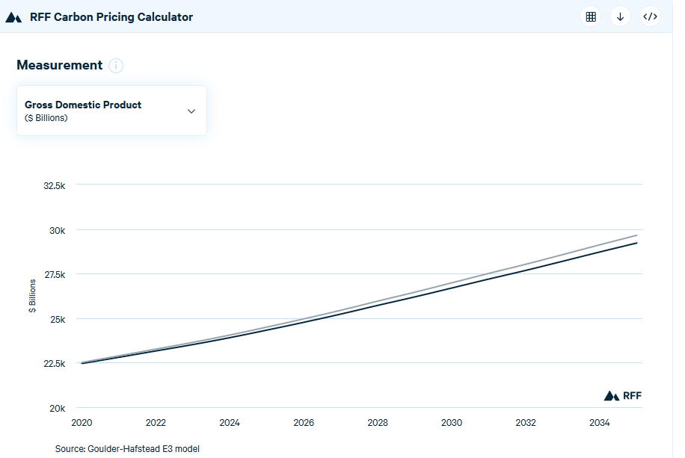
GDP under a carbon tax: standard theory
CGE models:
GDP effect (e.g. Goulder and Hafstead, Confronting the Climate Challenge (2018); Jorgenson (2013), etc.; RFF Carbon Pricing Calculator
Employment effect:
  Hafstead and Williams, NBER EEPE, (2019)
Parallel shift down
Importance of revenue recycling method
Example:
  Tax of $40/ton @5%/year GDP loss in 2035 =
  -1.5% (tax & dividend)
  -1.2% (payroll tax cut)
Survey: Metcalf (BPEA, 2019)
Alternative view: spur green innovation? (Metcalf & Finkelstein-Shapiro (2021)
Source: RFF Carbon Pricing Calculator at https://www.rff.org/cpc/

Slide 25
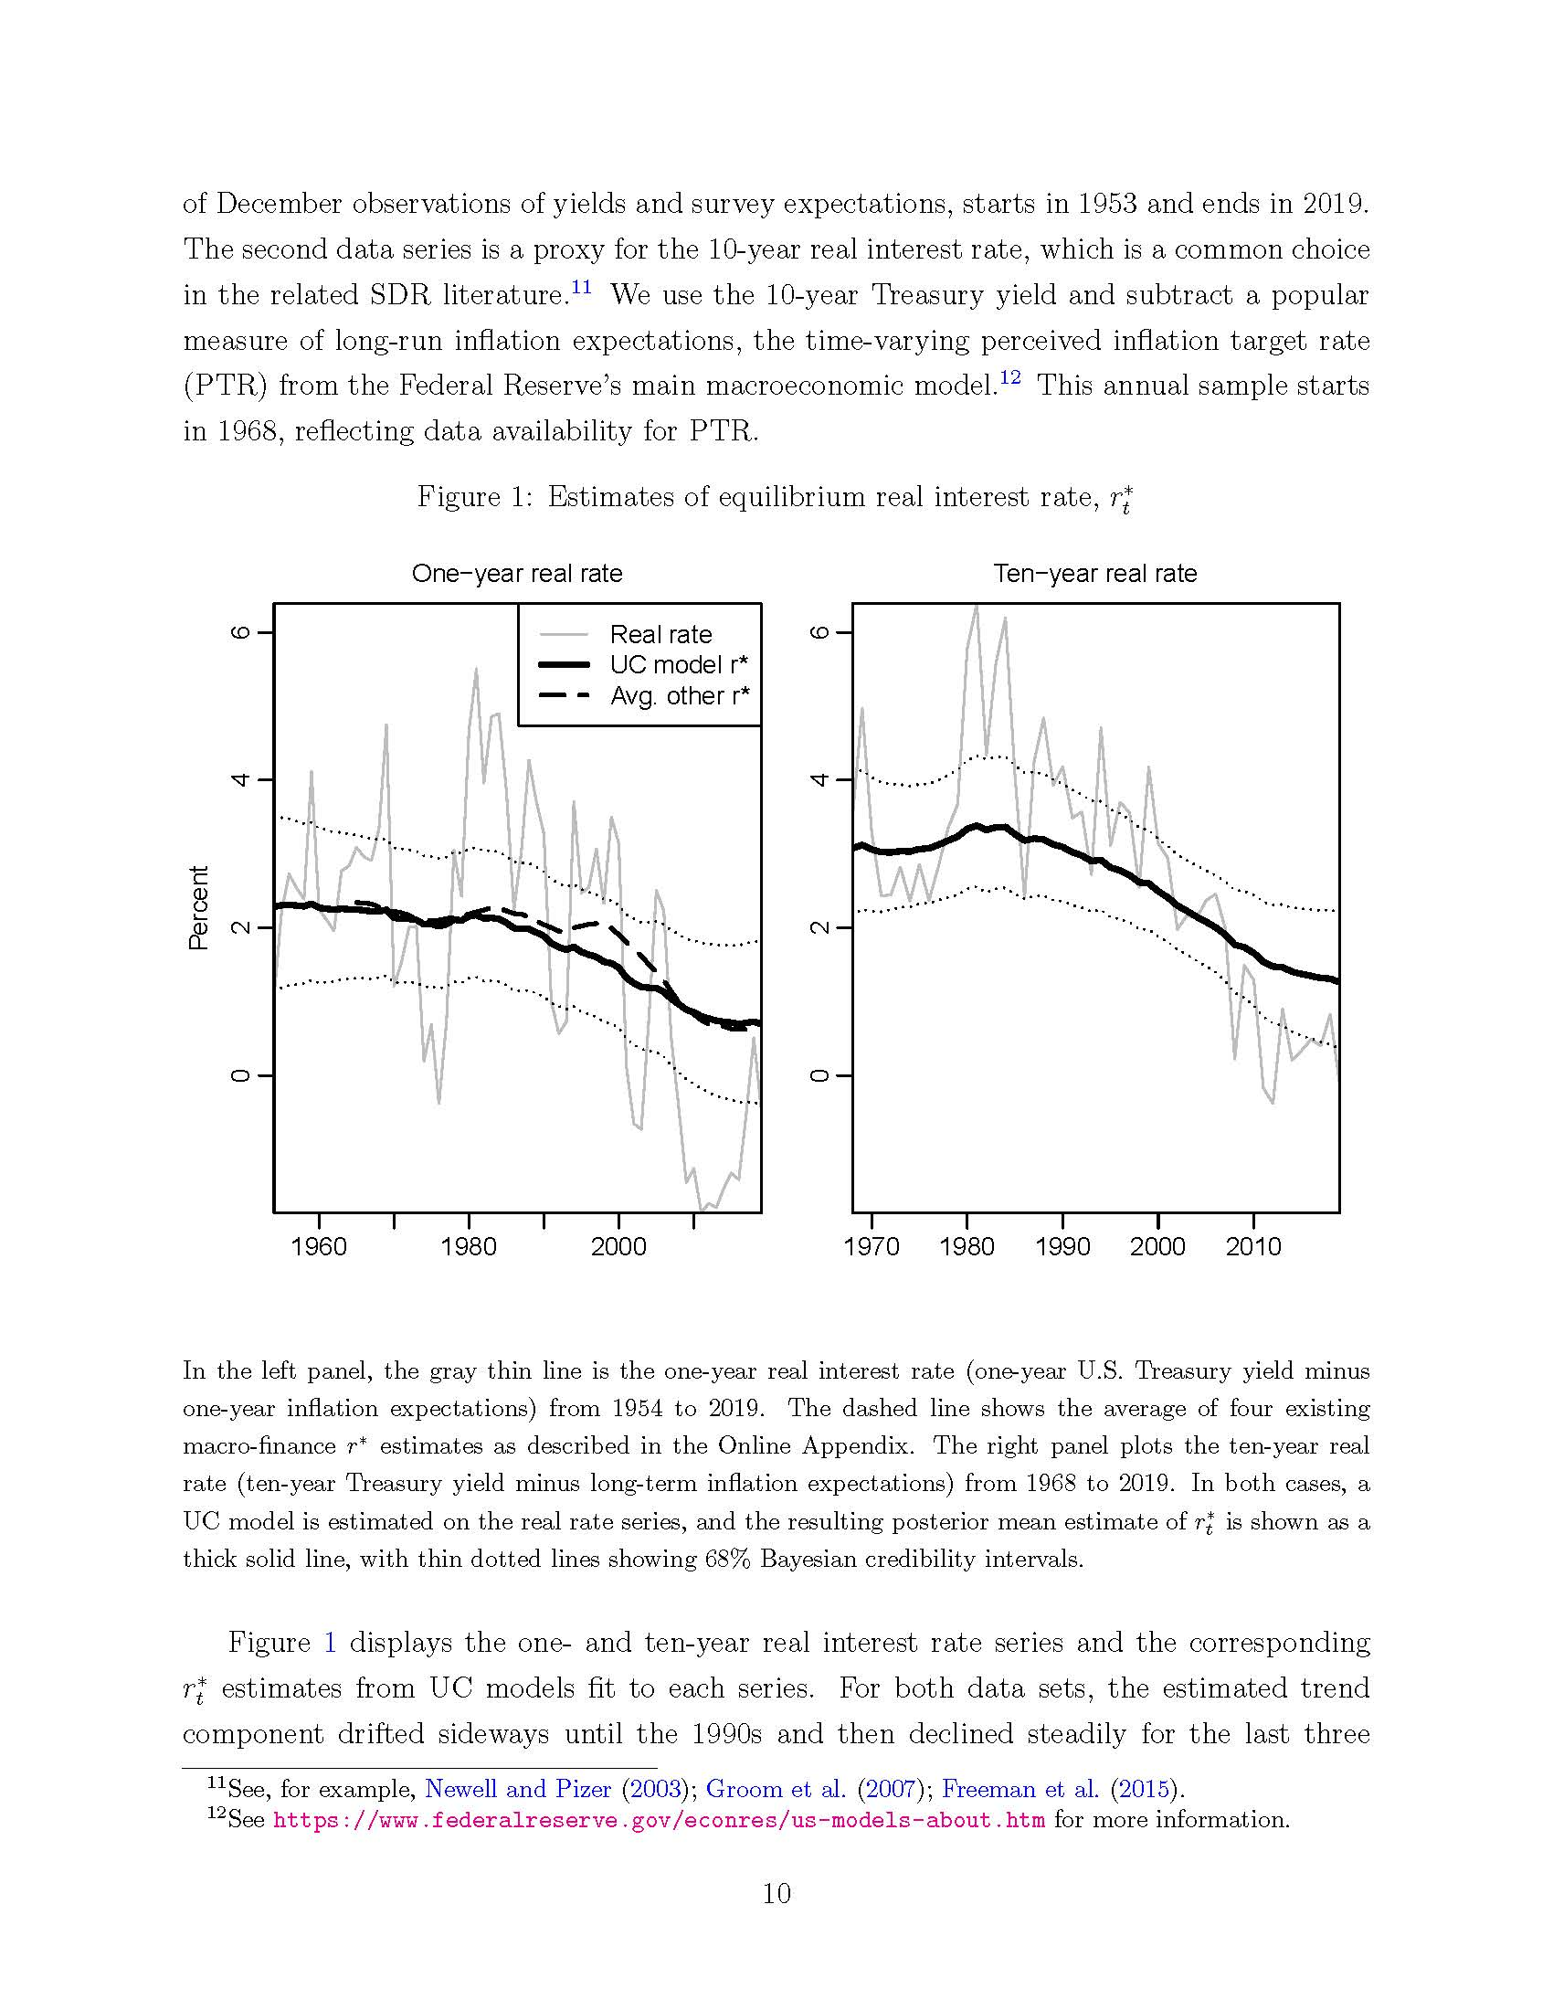
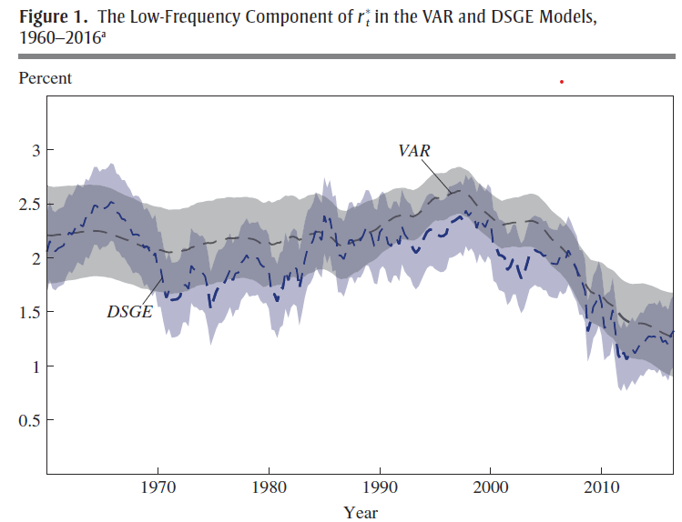
What about R*? Global developed-economy real interest rates exhibit a trend decline
The decline in real interest rates is well documented…
Mainly, macro/monetary policy literature
Decline of ~1-2 pp since ~2000
OMB Circular A-4 computed mean ex-post 10-year rate for 30 years ending 2001 (CPI) and got 3%
  Repeating that now gives 2% (through 2019)
Not just a US phenomenon – true in global developed markets
Implications for:
Monetary policy
Debt sustainability
SCC
Source: Bauer & Rudebusch (ms 2021)
 | 1998 | 2016 | delta
Laubach-Williams (2003) | 2.5 | 0.2 | -2.3
Holston-Laubach-Williams (2016) | 3 | 0.4 | -2.6
Kiley (2016) | 2.5 | 0.9 | -1.7
Lubik-Matthes (2016) | 2.4 | -0.2 | -2.6
Johanssen-Mertens (2016) | 2.5 | 0.8 | -1.7
Christensen-Rudebusch (2017) | 2.6 | 0.4 | -2.2
Crump-Eusepi-Moench (2016) | 2.4 | 1 | -1.4
DGGT VAR – consumption | 2.6 | 1.2 | -1.4
DGGT VAR – productivity | 2.7 | 1.1 | -1.6
DGGT- DSGE (10-year forward) | 2.7 | 0.3 | -2.4
mean-7 |  |  | -1.98
SD-7 |  |  | 0.454
Source: Del Negro et al (BPEA 2017)
Source: Rosengren (BPEA 2017)

Slide 26
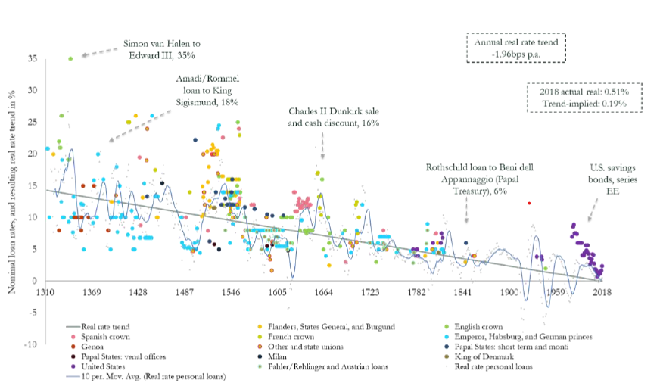
Real interest rates exhibit a trend decline
Why have rates declined?
Long-term improvements in financial market technologies (Schmelzing (2020))
Demographics (Lunsford & West (2019))
Safety and liquidity premia (Del Negro et al (2017))
Change in public savings
Change in private demand for savings (Bernanke (2000))
Productivity slowdown (or not: Lunsford & West (2019))
Inadequate aggregate demand (secular stagnation) (Rachel & Summers (2019))
Implication for SCC is that a lower value of the discount rate is appropriate – say, 2% instead of 3%, for nonstochastic discounting.
Source: Bauer & Rudebusch (2021)
Source: Schmelzing (2020)

Slide 27
Ramsey discounting
Ramsey setup:
Reference: C. Gollier, J. Risk and Uncertainty (2008) 171-186; Weitzman, REEP (2012): 309-321
Social welfare function:
Invest ε at riskless rate r_{T},
payoff in t:
For c₀, c_{T} at the optimum:
or (*)
Adopt CRRA utility:
Define:
Plug CRRA utility into (*), assume that consumption growth is normally distributed, collect terms (see Gollier 2008):
The usual Ramsey formula, with nonstochastic consumption growth, doesn’t have the final term (var(X)).

Slide 28
Ramsey discounting
Cases:
(i) Consumption growth is i.i.d.:
Ramsey without uncertainty:
Uncertainty provides a risk premium that reduces the discount rate
(ii) Consumption growth is a random walk:
So discount rate falls (linearly) with the horizon: declining discount rate (DDR).
General point: In both (i) and (ii),
Declining term structure of discount rates
Higher uncertainty -> lower R*
Lower underlying growth rate of consumption -> lower R*

Slide 29
Summary: Conjectured effects (physical & transition) on long-run macro parameters
LR transition risk | μ | u* | R* | π*
Physical damages | – | + | – (growth channel) – (volatility channel) | CB choice
Transition
Carbon tax | ? | ~0 |  | CB choice
Innovation policy | + | ~0/+ |  | CB choice
Financial market policy | – |  |  | CB choice
Fiscal exposure | – |  | + | CB choice
Private green investment demand | ? |  | + | CB choice
Asset revaluations | ~0 |  |  | CB choice
Sectoral job reallocation | ? | + |  | CB choice
Growth accounting: shift from FF | + |  |  | CB choice

Slide 30
3(a). Macro impacts of climate change: physical/short run
Kiley, Michael, “Growth at Risk From Climate Change,” FEDS DP (2021)
Is there more variability in GDP growth as temperatures warm? More business cycle risk?
Method:
Mirrors Growth-at-Risk literature
Quantile panel data regression relating GDP growth to temperature:
  where W are control variables (including quadratics in time, country FE) and F is quadratic or quadratic with interactions – basic Burke et al specification &
Data
  Burke et al data.

Slide 31
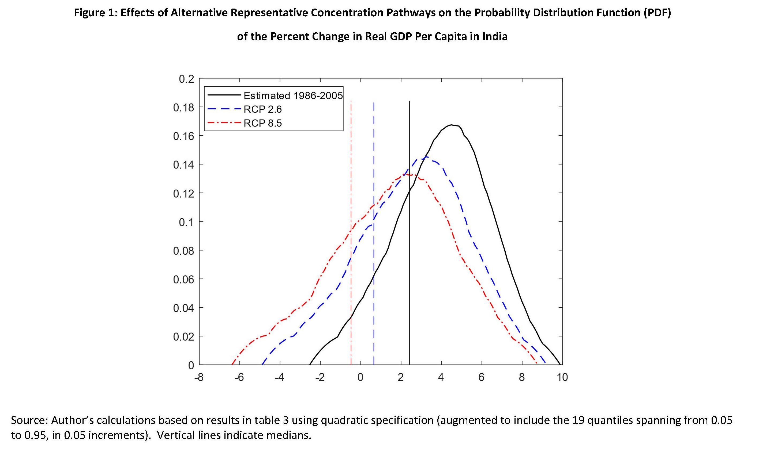
Macro impacts of climate change: physical/short run
Source: Kiley (2021)

Slide 32
Macro impacts of climate change: physical/short run
Kim, Matthes, and Phan, “Extreme Weather and the Macroeconomy,” wp (2021)
Data
Actuary Climate Index (American Academy of Actuaries): T90+, T10-, max 5-day monthly precip, No consec days <1mm precip, W90, SLR.
Method
Smooth transition VAR (IP, CPI inflation, unemployment rate, short-term interest rate), ACI treated as exogenous
ST-VAR allows for nonlinearities

Slide 33
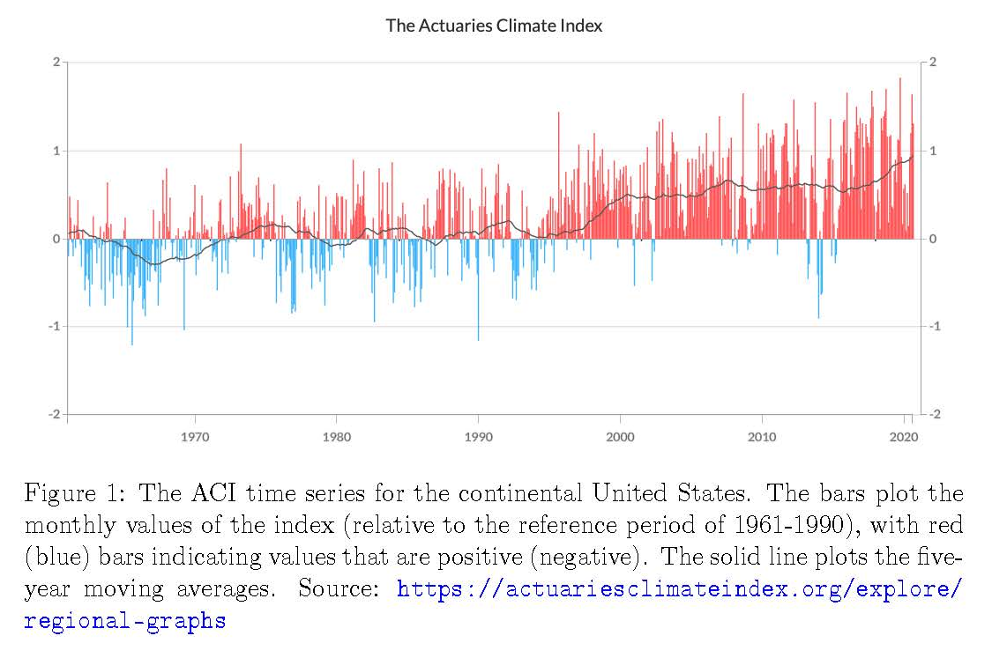
Macro impacts of climate change: physical/short run
Source: Kim, Matthes, and Phan (2021)
Higher values indicate more extreme weather

Slide 34
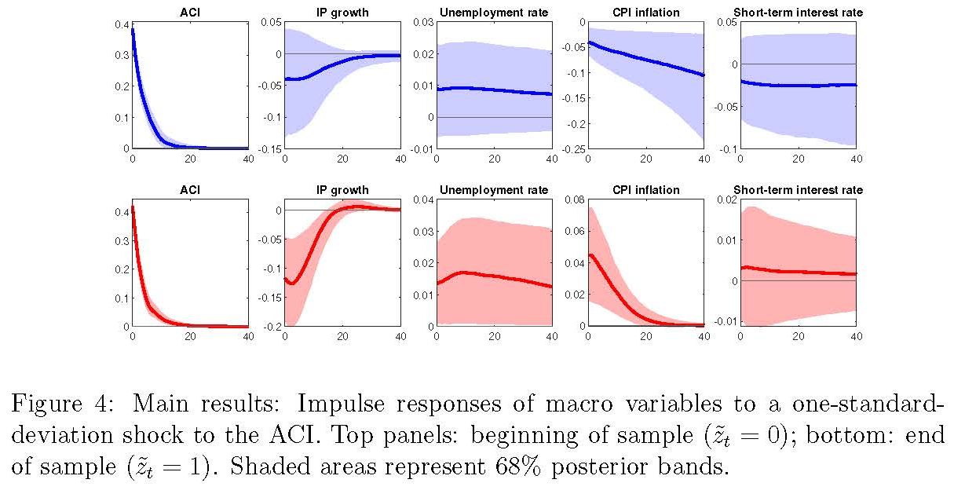
Macro impacts of climate change: physical/short run
Source: Kim, Matthes, and Phan (2021)

