Slide 1

Study Center Gerzensse: Advanced Courses in Economics
The Economics and Econometrics of Climate Change Policy
F. The Social Cost of Carbon
James H. Stock
Economics Department and Harvard Kennedy School,
Harvard University
May 30 – June 3, 2022

Slide 2
Course outline
I. Introduction
Introduction & Overview
  Climate change science and CC econometrics (brief)
  Framework economic concepts
  Cost-benefit analysis, cost effectiveness analysis, SCC & TCP
  Marginal abatement curve
III. Damages
Macroeconomic implications of the energy transition
  Overview: Physical & transition costs
  Long run
  Short run
    Case studies – short run policy transition costs
      Carbon tax
      Cap & trade
      Policy uncertainty
The Social Cost of Carbon: Recent developments (time permitting)
II. Emissions reduction (mitigation/decarbonization)
Sectoral carbon policies – theory & empirical evidence
  Carbon tax, cap & trade
  Clean energy standards; investment & production tax credits
  Policy simulations
  Criticisms & the case for sectoral standards
Carbon pricing with leakage: Supply side policies
  Supply side policies as carbon pricing with leakage
  Supply side policy with leakage: US O&G royalties
  Extension to international trade & BCA
The electric vehicle revolution
  Transport sector overview, EVs, & literature review
  Modeling charging station v. vehicle subsidies
  More on charging stations & current research

Slide 3
The SCC
The SCC, Cost-benefit analysis, and cost-effectiveness analysis
The Social Cost of Carbon (SCC) is the monetized net present value of the damages arising from emitting 1 extra (metric) ton of CO2 in a given year.
The SCC is a schedule and varies by year, mainly because marginal damages are increasing in CO2 concentrations
The SCC is a general economic concept (“estimand”) which is estimated using a combination of theoretical models, calibrated structural models, and econometric estimates.
Cost-benefit analysis is the estimation the costs and benefits of a policy, and the comparison of costs and benefits.
For an emissions mitigation policy, the costs are the abatement costs of reducing CO2 emissions by one ton.
Costs can be static or dynamic, and in any event are measured over a discrete time period.
A “small” policy is cost-beneficial if its abatement cost < SCC (marginal cost < marginal benefit)
Cost-effectiveness analysis is the estimation of costs of competing policies that achieve the same (narrowly-defined) goal and comparing costs across policies to find the least-coast (most cost-effective) way to achieve that goal.
For example, among 3 policies that achieve 50% EV penetration by 2050, the policy with the lowest cost is the most cost-effective.
In climate policy, CEA is associated with exogenously-determined carbon budgets and with “target-consistent” prices to achieve those budgets.
CBA and CEA are related but fundamentally different. A policy could pass a CEA test but not a CBA test.

Slide 4
The SCC
Selected references
  Aldy, J., M.J. Kotchen, R.N. Stavins, and J.H. Stock, “Keep Climate Policy Focused on the Social Cost of Carbon,” Science, August 20, 2021.
  Carleton, T. et al., “Valuing the Global Mortality Consequences of Climate Change Accounting for Adaptation Costs and Benefits,” NBER wp 27599, July 2020
  Carleton, T. et al., “Updating the US Government’s Social Cost of Carbon,” manuscript, 2021
  Dietz, S., J. Rising, T. Stoerk, G. Wagner, “Economic Impacts of Tipping Points in the Climate System,” PNAS 2021.
  Pindyck, R.S., “Uncertain Outcomes and Climate Change Policy,” JEEM 2012
  Rennert, K. et al., “The Social Cost of Carbon: Innovation and Application,” BPEA, September 2021
  Műller, U., J.H. Stock, and M.W. Watson, “An Econometric Model of International Long-run Growth Dynamics,” forthcoming, Review of Economics and Statistics (2021)
  National Academy of Sciences, “Valuing Climate Damages: Updating Estimates of the Social Cost of Carbon,” 2017.
  Stern, N. and J. Stiglitz, “The Social Cost of Carbon, Risk, Distribution, Market Failures: An Alternative Approach,” NBER wp 28472, February 2021.
  Weitzman, M., “On modeling and interpreting the economics of catastrophic climate change.” Review of Economics and Statistics 91: 1–19, 2009

Slide 5
Estimation of the SCC
Components of estimating the SCC
Establish baseline trajectories of population, GDP, and emissions.
Establish a baseline climate path (Z_{t} , Z_{t+1} , Z_{t+2} ,…), where C is a (large) vector of regional climate variables (mean temperature, heat waves, precipitation, droughts, storms,…)
Emit 1 more ton of CO2 in year t+j and compute (ΔZ_{t +j} , ΔZ_{t+j+1} , ΔZ_{t+j+2} ,…).
Compute economic damages, measured in dollars of lost consumption (ΔC_{t +j} , ΔC_{t+j+1} , ΔC_{t+j+2} ,…)
Discount (ΔC_{t +j} , ΔC_{t+j+1} , ΔC_{t+j+2} ,…) to the present.
This is done using an Integrated Assessment Model (IAM):
Original IAM: Nordhaus’s Dynamic Integrated model of
Climate and the Economy (DICE). DICE economic module:
Welfare:
Net production:
Climate damages:
Abatement costs:
Anthropogenic
emissions:
Emission Reduction Measures
Economic Model
Emissions
Political Response
Carbon Cycle
Damages
Ecosystem Impacts
Climate System Response

Slide 6
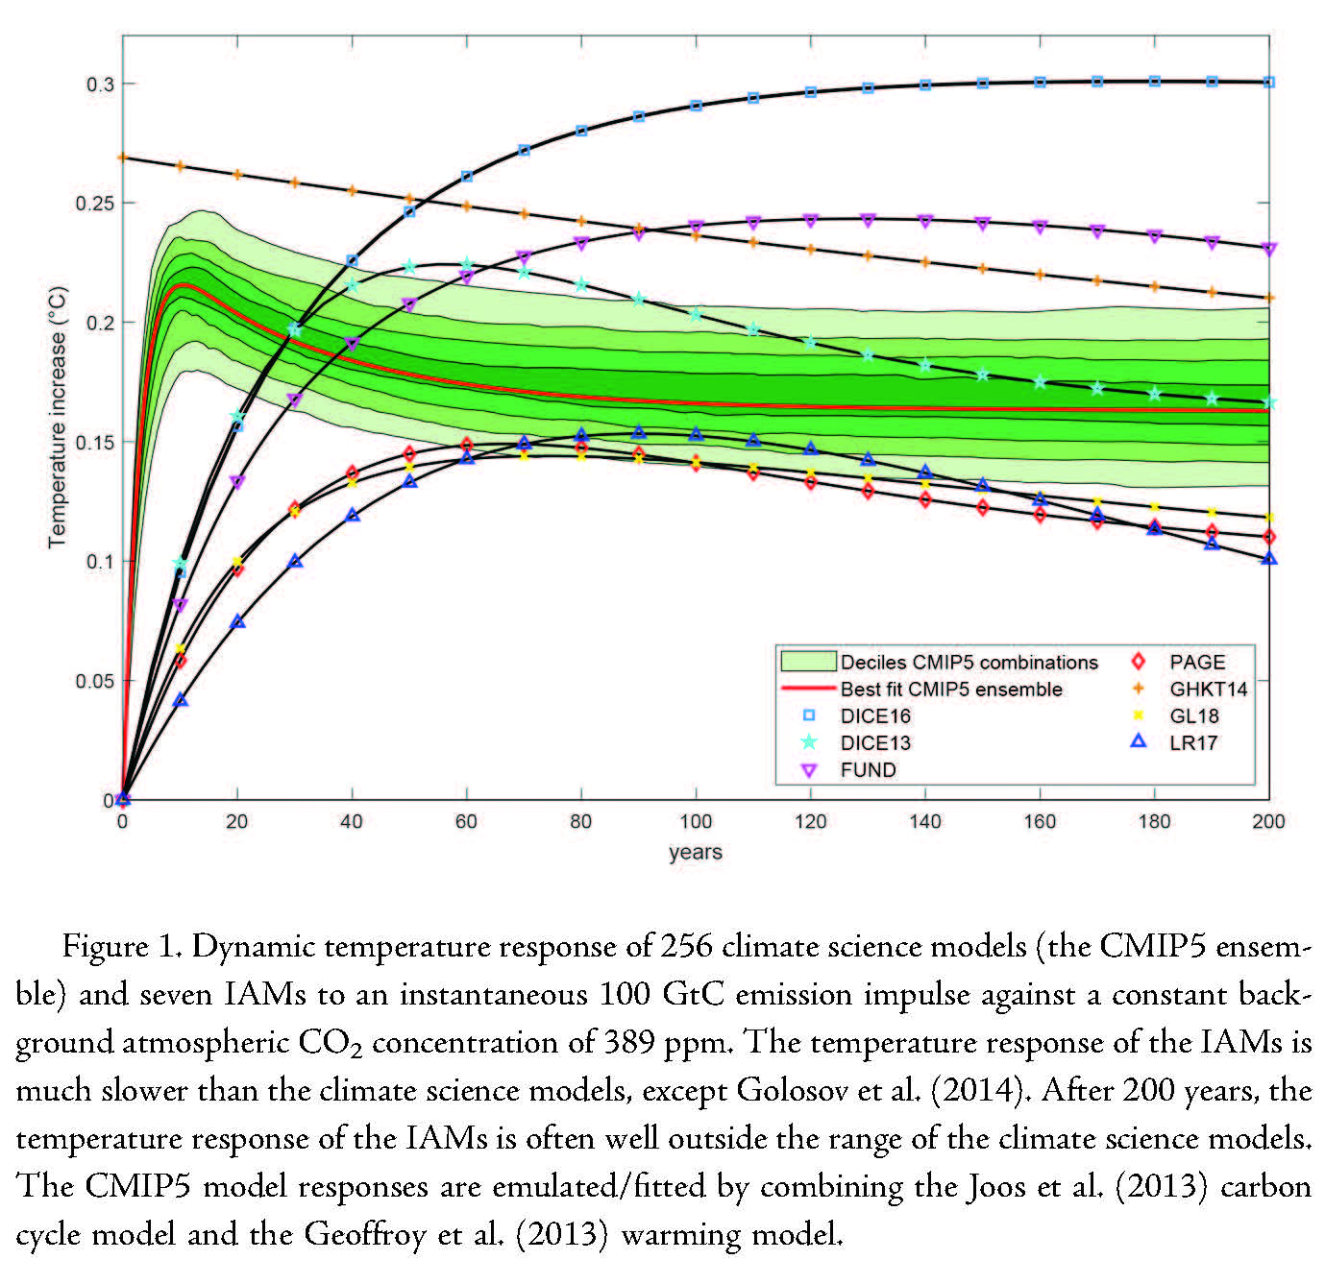
Estimation of the SCC
A. Climate module
Typical outputs are regional mean temperatures, SLR, possibly precipitation
See Dietz et al (JAERE 2021) for survey
Standard IAMs include at most some extreme events (detachment of WAIS, Greenland, methane hydrates, thawing permafrost, disruption of North Atlantic Oscillation); but see Dietz et al (PNAS 2021)
Source: Dietz et al. (JAERE 2021)

Slide 7
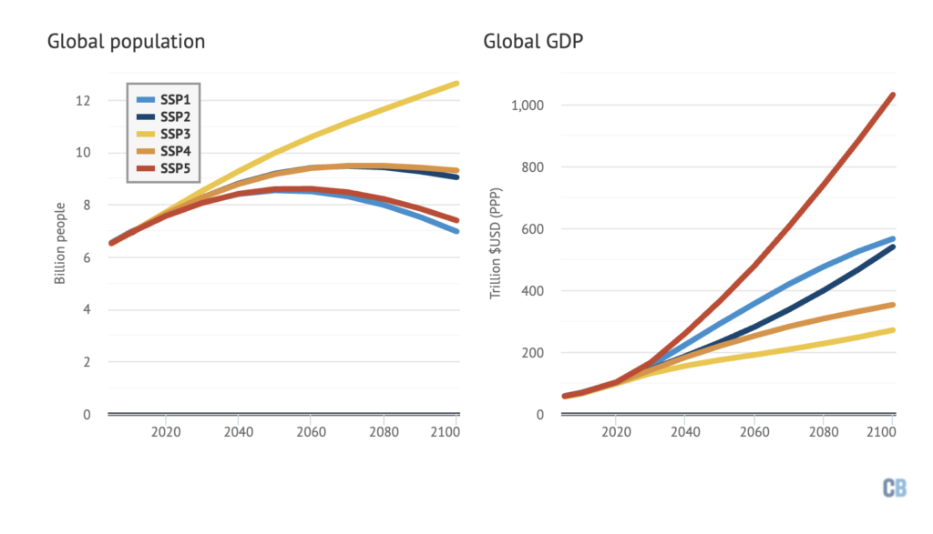
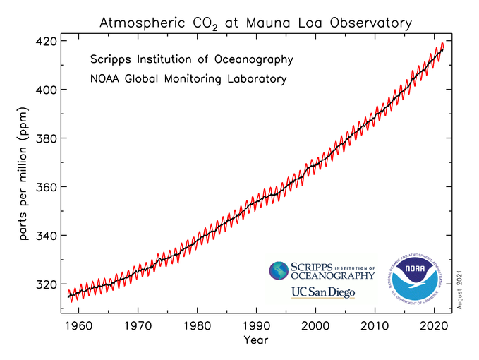
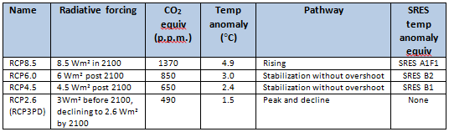
Estimation of the SCC
B. Baseline socioeconomic pathways
B(i) Scenario approach
Interim USG SCC (2016 version):
  4 reference scenarios with 612-889 ppm CO2 in 2100
  plus one assuming moderate mitigation
IPCC scenarios:
  SSPs: Shared Socioeconomic Pathways
  RCPs: Representative Concentration Pathways
    General view now that RCP8.5 is not realistic BAU given policies in place throughout the world, and slowing emissions

Slide 8
Estimation of the SCC
B. Baseline socioeconomic pathways
B(ii) Probability distribution approach
SSC scenario approach is a weak link: non-expert judgment, no probability distribution (hard to justify “high confidence” etc conclusions)
Alternatively, construct distribution from IPAT (Impact = Population × Affluence × Technology)/Kaya Identity:
  Emissions = Population × (GDP/capita) × (Energy/GDP) × (Emissions/Energy)
Illustration: GDP per capita: Műller, Stock & Watson (REStat 2021)
Joint international growth model using Műller-Watson low-frequency representation & club-of-clubs model
Model exhibits “β-convergence” to common growth trend f_{t}.
f_{t} has a unit root around a very slowly-varying stochastic trend (local to I(2))
All disturbances jointly Gaussian (MW theory), estimation by Gibbs with conditionally Gaussian posteriors.
MSW (2021): Log GDP per-capita for 113 countries – Trend components

Slide 9
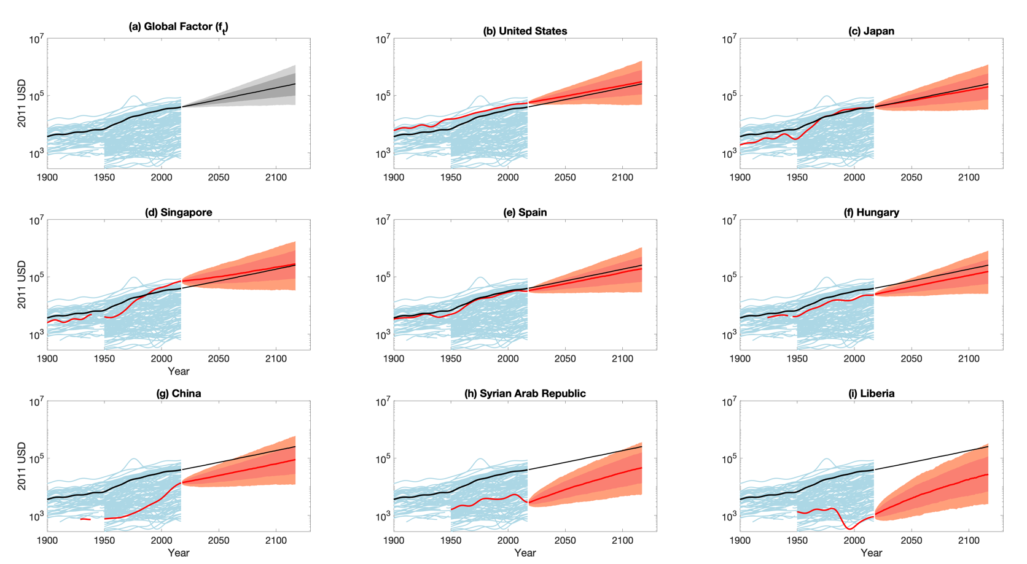
Estimation of the SCC
MSW results – distributions across countries
Prediction intervals for per-capita GDP
Posterior distribution of m_{t} with 67% band
Remaining steps: merge with population, emissions/GDP models (Rennert et al, forthcoming, Brookings Papers on Economic Activity 2021)

Slide 10
Estimation of the SCC
C. Damage functions
C(i) Top-down using country or region-level data on GDP & climate variables, typically 1960-present
Econometric estimates of damage functions. Recent:
    Dell, Jones, Olken (AEJ-Macro 2012, JEL 2014)
    Auffhammer (JEP 2018)
    Burke, Hsiang, Miguel (Nature 2018)
    Burke & Tanutama (NBER WP 2019)
    Newell, Pizer, & Preston (JEEM 2021)
Typical specification:
  L is lag operator (some papers include lagged temp)
  BHM use long differences (multi-decade GDP growth) which turns panel into cross-section
  Typically estimated with country- or regional data
Econometric issues include:
  Functional form, e.g. h trend function: quadratic? Cubic? What is h(t) a proxy for?
  Levels and nonstationarity, e.g. is X = Temp or = ΔTemp?
  Functional form for X: linear in temp? Bins? Breaks over a certain temp (human physical threshold, ~30C
  Omitted variable bias: what are confounders? (e.g., demographic slowdown in developed economies)

Slide 11
Estimation of the SCC
C. Damage functions
C(i) Top-down using country or region-level data on GDP & climate variables, typically 1960-present
Newell, Prest, & Sexton (JEEM 2021): 800 variants of panel regression above, differing in:
Functional form for temp (none, linear, quadratic, cubic, spline);
  GDP growth v. levels, specification lags or not;
  Time and region controls (year FE, region FE, country time trends, country polynomials)
  Select empirically plausible “winner” specifications using cross-validation.
Digression on cross-validation – a method for model selection among a large number of models/high dim parameters
  Intro reference: Stock & Watson (Introduction to Econometrics, 4e), Chapter 14 (Key Concept 14.1)
    Divide the test sample into an estimation or “training“ subsample, and a “test” subsample
    Estimate the model on the training subsample, make predictions on the test subsample, compute SSR on test subsample
  Time series notes:
    To preserve time-series structure the training set needs to be a continuous (in t) block – so that the test set evaluations amount to pseudo out-of-sample forecasts. NPS implement this using rolling windows, both forward and backwards.
    There is a technical problem with time effects – NPS evaluate time effects using the full sample, the rest of the coefficients using subsample.
NPS construct confidence sets for models as the set of models not rejected by forecast comparison tests (Hansen JBES 2005)
  They end up with 25 models in growth rates, and 49 in log-levels of GDP, in the model confidence sets
  Full confidence set for impact is sampling uncertainty on top of model uncertainty
Given the 95% confidence set of non-rejected models, what are the implications for estimated effects of temperature on GDP?

Slide 12
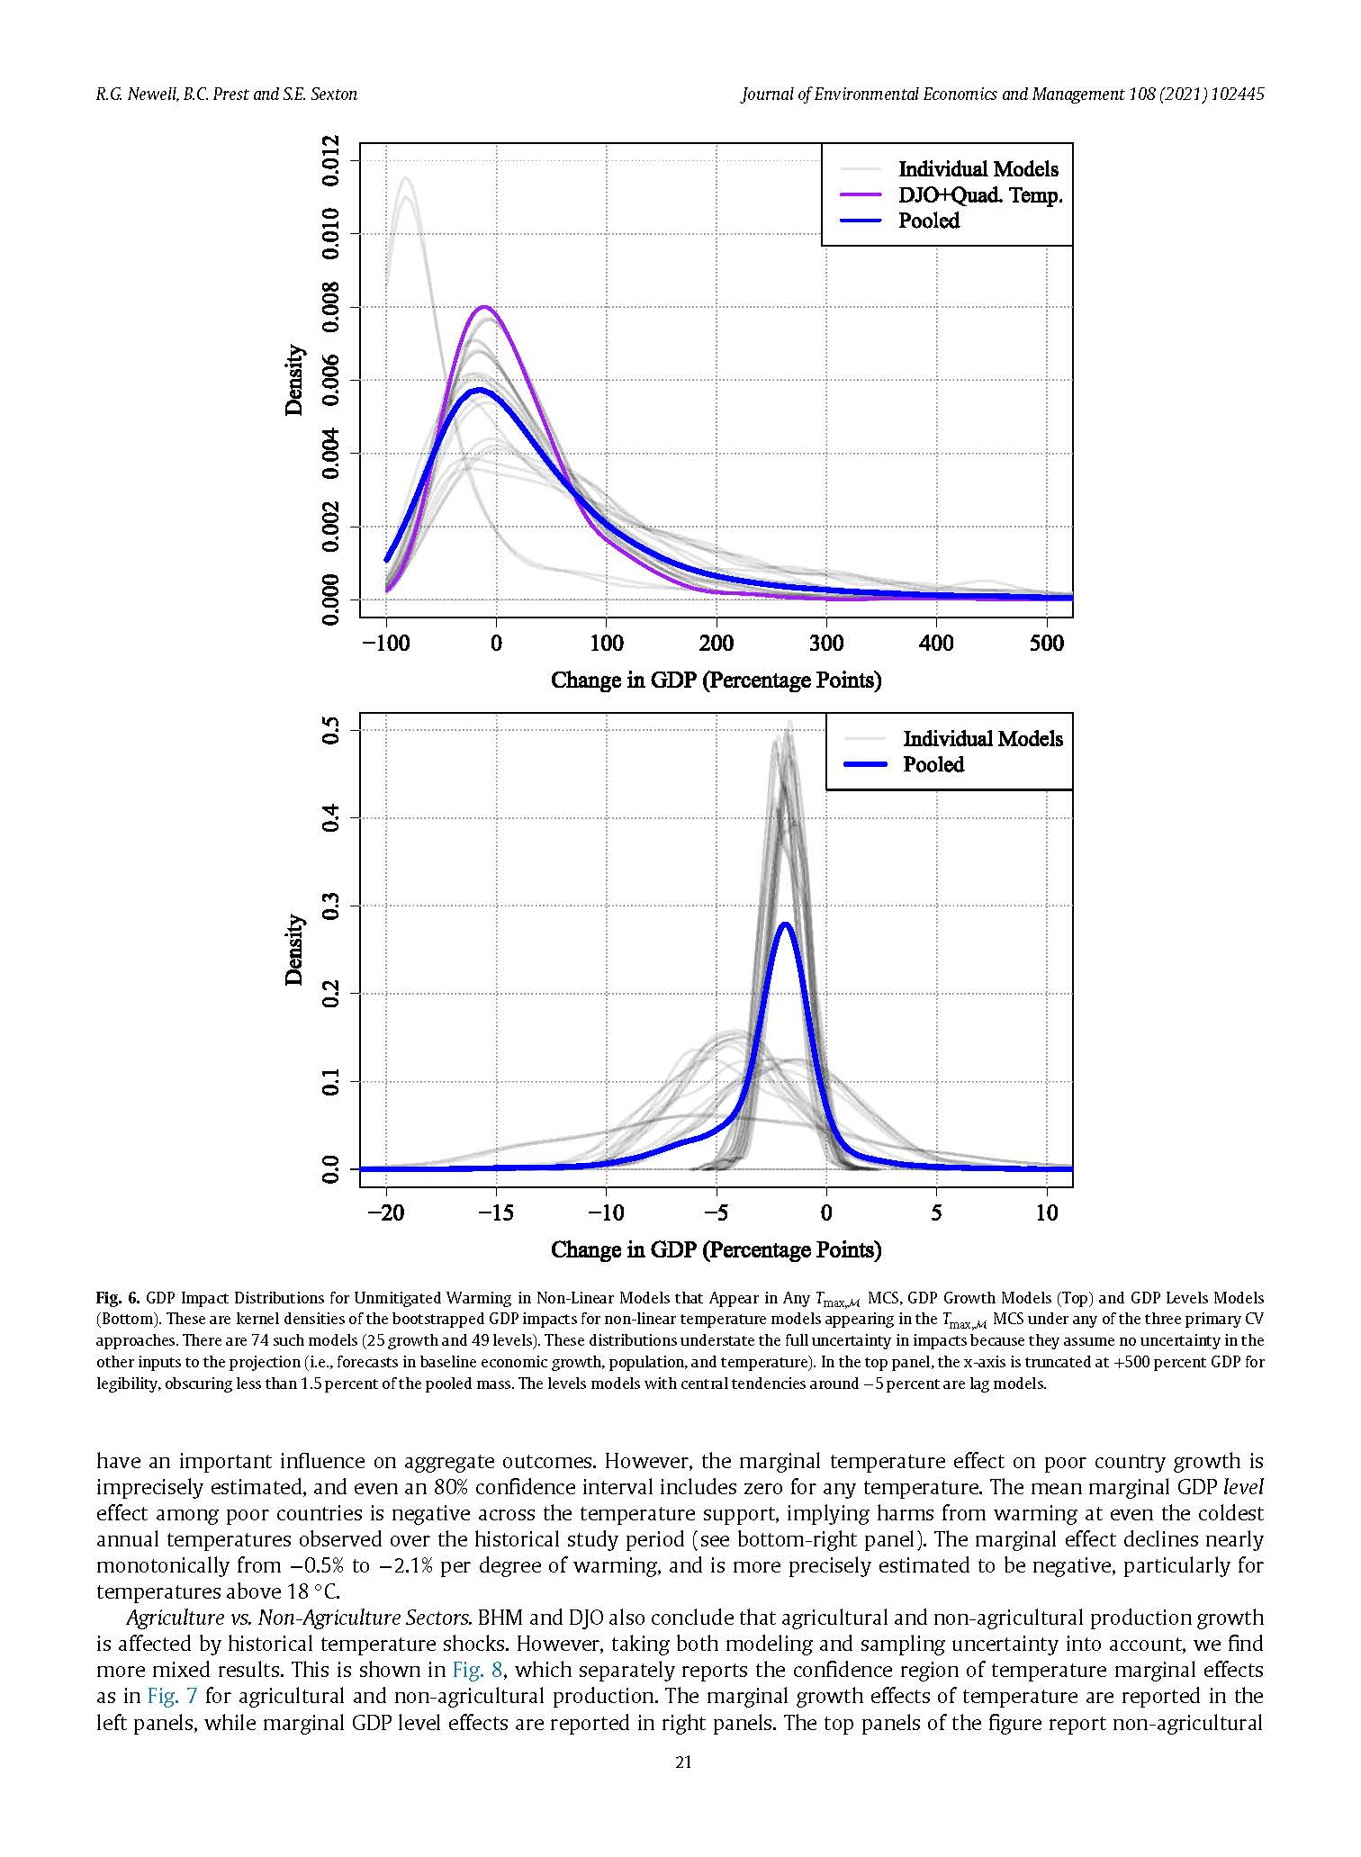
Estimation of the SCC
C. Damage functions
C(i) Top-down using country or region-level data on GDP & climate variables, typically 1960-present
Newell, Prest, & Sexton (JEEM 2021) results: Distribution of effect on the level of GDP in 2100 under RCP8.5, taking into account model uncertainty and estimation uncertainty. For levels model, range of effects is -1 to -3% of GDP in 2100.
The reason for the low levels estimates is that the non-rejected model forecast sets include models that don’t have Temp in them.
Growth rate specifications have huge range – small uncertainty in growth rate estimates compounds over 80 years!
Growth rate specifications Log level specifications

Slide 13
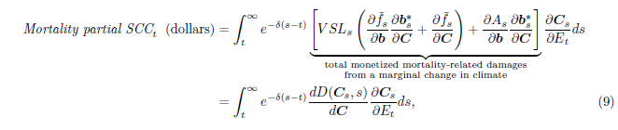
Estimation of the SCC
C. Damage functions
C(ii) Bottom-up using studies of specific (component) damages
Econometric estimates of component damage functions (selected):
    Mortality
    Energy use
    Productivity
Illustration: Carleton et al (NBER wp 2020)
  Conceptual framework: let D be the adaptation-inclusive economic damages from climate-induced mortality:
  Age-specific temperature-mortality relations: Let M = all-cause mortality, T = temperature, R = precipitation
    Adaptation is captured by the slow drift of T^{mean}: St. Louis eventually has the same heat-protection technology as Dallas (and Minneapolis, of St. Louis), etc.
  Adaptation costs: exploit idea that optimal adaptation means marginal benefits = marginal costs; estimates marginal benefits from T^{mean} term; and impute marginal costs.

Slide 14
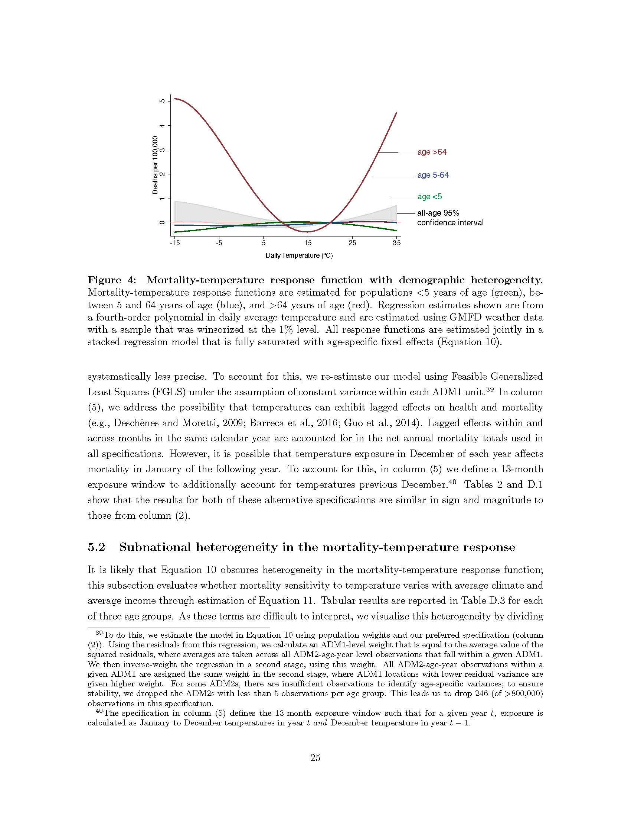
Estimation of the SCC
C. Damage functions
C(ii) Bottom-up using studies of specific (component) damages: Carleton et al (2020) results (mortality)

Slide 15
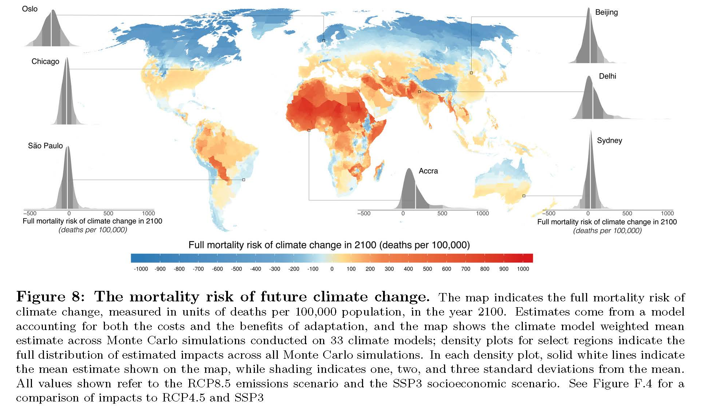
Estimation of the SCC
C. Damage functions
C(ii) Bottom-up using studies of specific (component) damages: Carleton et al (2020) results (mortality with adaptation)

Slide 16
Estimation of the SCC
C. Damage functions: discussion
Top-down
comprehensive among factors that enter into GDP
  But GDP isn’t welfare; and GDP is a flow concept and doesn’t measure stock losses like submerged land, except as those affect output through productivity or the capital stock; same comment for value of life
Not fully satisfactory treatment of adaptation
Econometric issues significant Newell, Prest, & Sexton, and generally low signal-to-noise ratio (climate is a small factor among many affecting GDP over the past 60 years)
Extrapolations based on shakily-estimated functional forms (NPS)
Bottom-up
More credible identification of weather effect and of adaptation effect
More closely tied to physical consequences of climate change (heat waves, droughts, changing growing conditions)
Only estimates a subset of effects!! – those that you can list and credibly estimate (“looking under the lamp-post”)
And both miss…
Yet-unseen larger impacts such as climate migrations
  Broader challenge of out-of-sample extrapolation
Ocean acidification
Species loss (how to monetize)?
Unknown unknowns…

Slide 17
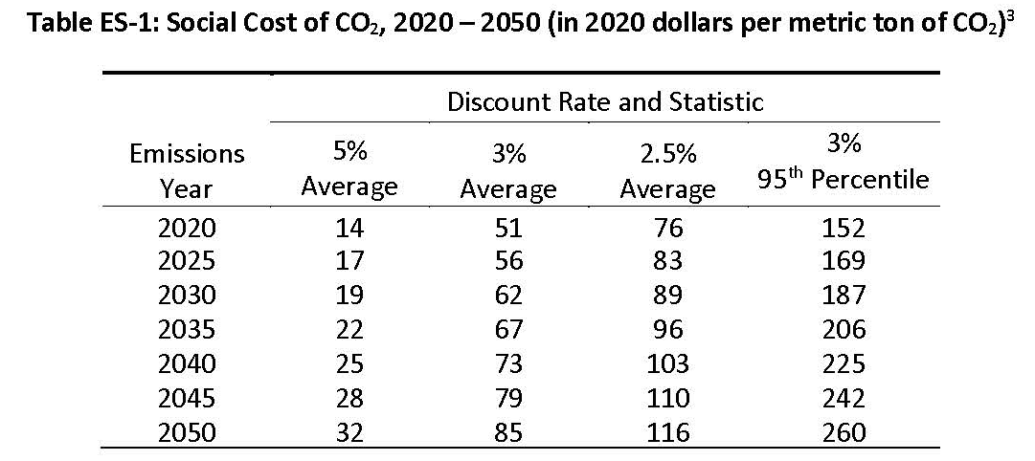
Estimation of the SCC
D. Discounting
The SCC is the NPV of climate damages:
The worst damages are in the distant future, so the discount rate matters a great deal in practice:
    Source: Interagency Working Group on the Social Cost of Greenhouse Gases, February 2021
Using the IWG’s data (interim value), New York State adopted a 2% discount rate and computed a SCC of $125.
Note that the SCC increases over time because concentrations rise along the baseline trajectory, and damages are increasing in concentrations.

Slide 18
Estimation of the SCC
D. Discounting
Discounting topics:
Nonstochastic discounting:
  Which discount rate?
    Social costs =>
      long-term social discount rate
  The empirical decline in r*
Normative approach:
  Ramsey discounting
  Ramsey discounting under uncertainty
Positive approach:
  Discounting with stochastic discount factors
Covariance between r and D: the “climate beta”
Notation & conventions:
SCC is computed “today” = year 0, for damages occurring this year (year 0), next year (year 1), etc., with a truncation horizon T years hence.
E₀ is conditional expectation based on information available in year 0 (today)
r is in general stochastic and depends on horizon – term structure of discount rates – so r = r_{t}

Slide 19
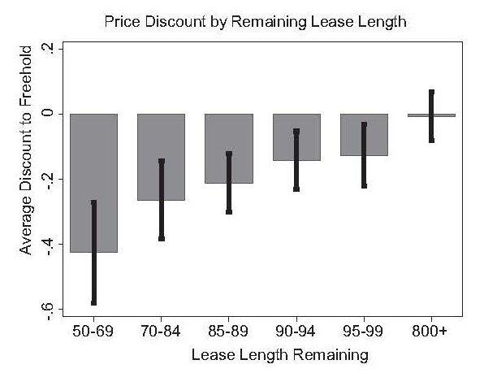
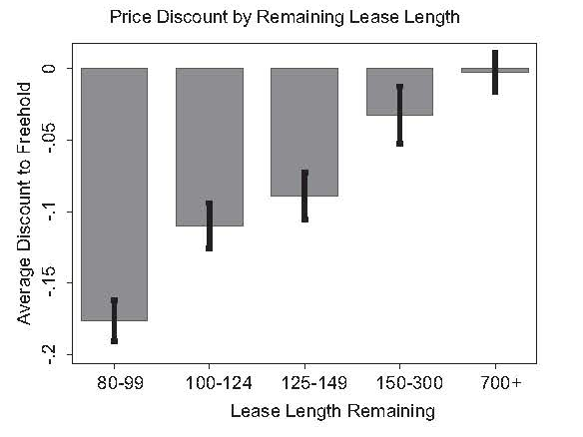
Evidence on very long-term rates
Giglio, Maggiori, Stroebel (QJE 2015)
Compare leaseholds and freeholds in UK and Singapore
  Leaseholds: Prepaid temporary ownership contracts, 99-999 years
  Freeholds: Perpetual ownership
Methodology
  Hedonic regression to find permanent ownership premium (standard property valuation control variables)
  Compute premium from perpetual growth discounting formula (Gordon model)
Results:
  Estimate permanent ownership premium ~10% on 100-year leasehold
  Implies discount rate ~2.6%
Caveat for SCC application: these are private rates, not social discount factors

Slide 20
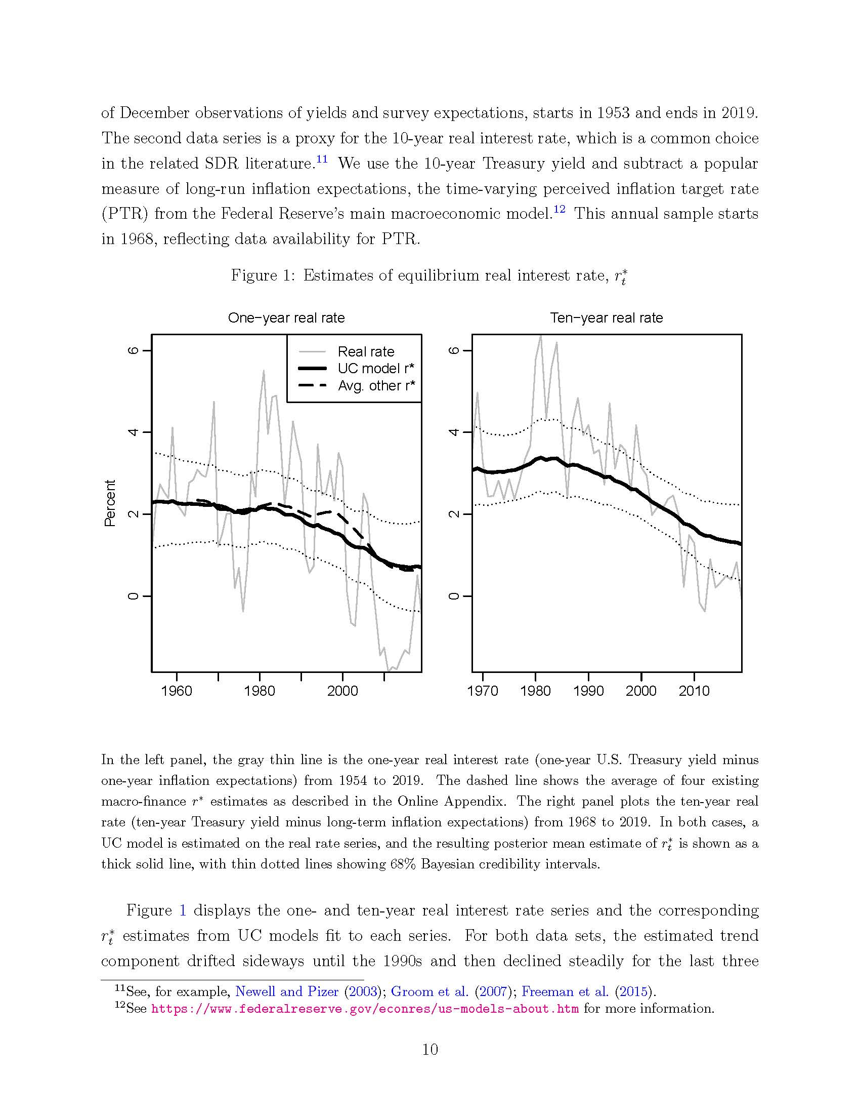
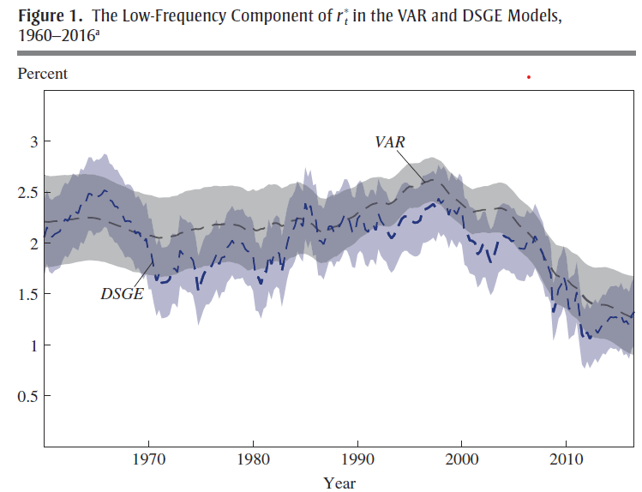
Global developed-economy real interest rates exhibit a trend decline
The decline in real interest rates is well documented…
Mainly, macro/monetary policy literature
Decline of ~1-2 pp since ~2000
OMB Circular A-4 computed mean ex-post 10-year rate for 30 years ending 2001 (CPI) and got 3%
  Repeating that now gives 2% (through 2019)
Not just a US phenomenon – true in global developed markets
Implications for:
Monetary policy
Debt sustainability
SCC
Source: Bauer & Rudebusch (ms 2021)
 | 1998 | 2016 | delta
Laubach-Williams (2003) | 2.5 | 0.2 | -2.3
Holston-Laubach-Williams (2016) | 3 | 0.4 | -2.6
Kiley (2016) | 2.5 | 0.9 | -1.7
Lubik-Matthes (2016) | 2.4 | -0.2 | -2.6
Johanssen-Mertens (2016) | 2.5 | 0.8 | -1.7
Christensen-Rudebusch (2017) | 2.6 | 0.4 | -2.2
Crump-Eusepi-Moench (2016) | 2.4 | 1 | -1.4
DGGT VAR – consumption | 2.6 | 1.2 | -1.4
DGGT VAR – productivity | 2.7 | 1.1 | -1.6
DGGT- DSGE (10-year forward) | 2.7 | 0.3 | -2.4
mean-7 |  |  | -1.98
SD-7 |  |  | 0.454
Source: Del Negro et al (BPEA 2017)
Source: Rosengren (BPEA 2017)

Slide 21
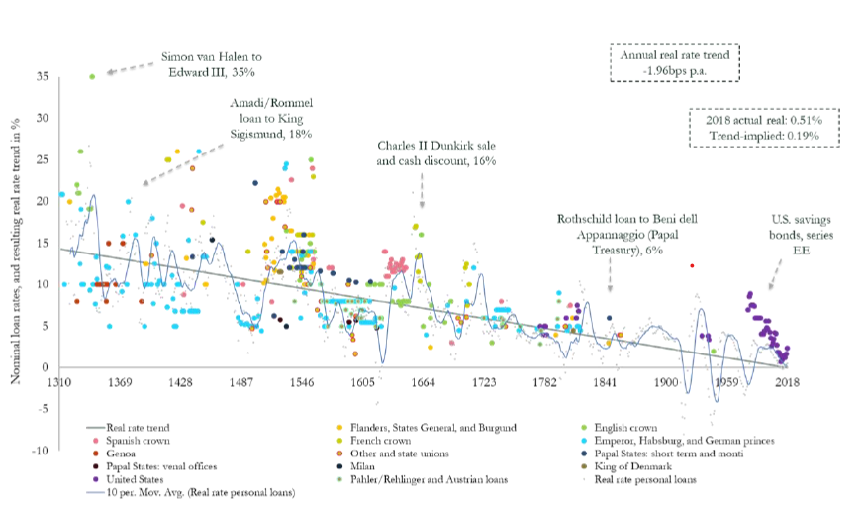
Real interest rates exhibit a trend decline
Why have rates declined?
Long-term improvements in financial market technologies (Schmelzing (2020))
Demographics (Lunsford & West (2019))
Safety and liquidity premia (Del Negro et al (2017))
Change in public savings
Change in private demand for savings (Bernanke (2000))
Productivity slowdown (or not: Lunsford & West (2019))
Inadequate aggregate demand (secular stagnation) (Rachel & Summers (2019))
Implication for SCC is that a lower value of the discount rate is appropriate – say, 2% instead of 3%, for nonstochastic discounting.
Source: Bauer & Rudebusch (2021)
Source: Schmelzing (2020)

Slide 22
Ramsey discounting
Ramsey setup:
Reference: C. Gollier, J. Risk and Uncertainty (2008) 171-186; Weitzman, REEP (2012): 309-321
Social welfare function:
Invest ε at riskless rate r_{T},
payoff in t:
For c₀, c_{T} at the optimum:
or (*)
Adopt CRRA utility:
Define:
Plug CRRA utility into (*), assume that consumption growth is normally distributed, collect terms (see Gollier 2008):
The usual Ramsey formula, with nonstochastic consumption growth, doesn’t have the final term (var(X)).

Slide 23
Ramsey discounting
Cases:
(i) Consumption growth is i.i.d.:
Ramsey without uncertainty:
Uncertainty provides a risk premium that reduces the discount rate
(ii) Consumption growth is a random walk:
So discount rate falls (linearly) with the horizon: declining discount rate (DDR).
General point: if future uncertainty compounds then the discount rate will decline with the horizon
Declining term structure of discount rates
Comments:
theoretical reason to use lower discount rates in the deep future;
but this is a highly simplified model (representative agent, CRRA) – hard to take to real world calculation

Slide 24
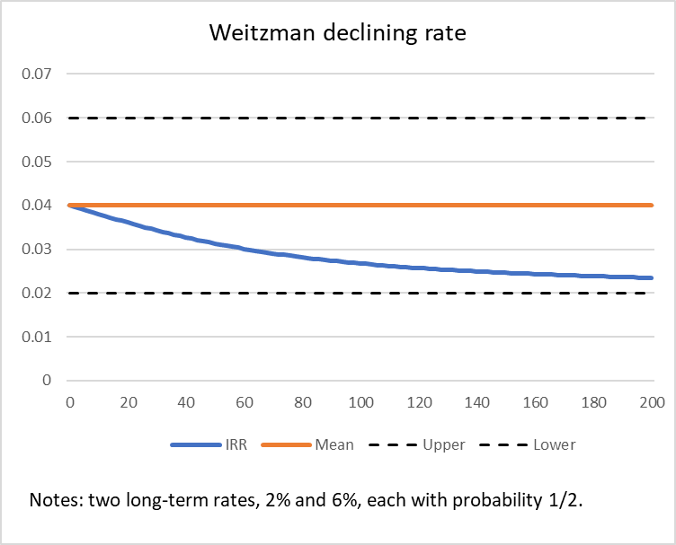
Discounting: Positive approach
Weitzman (1998) lowest-rate argument
Weitzman, M., “Why the Far-Distant Future Should Be Discounted at its Lowest Possible Rate,” JEEM 1998
Consider single-year payout t years hence, with nonrandom future payout D_{t}, and two equally probably interest rates, rª and r^{b}:
Present value:
Plug in two-point distribution
Definition of single discount rate
Solve:
This is just Jensen’s inequality
– but implies a declining discount rate when future rates are uncertain!
Numerical Example

Slide 25
Discounting: Positive approach
Modeling the long-term rate
Bauer, MD & GD Rudebusch, “The Rising Cost of Climate Change: Evidence from the Bond Market,” ms June 2021
Term structure of stochastic discount rates:
We don’t know what those rates will be in the future – but if their distribution is the same as over history (stationarity in a broad sense), we can estimate an empirical process for these rates and compute the expectation
BR empirical model
        Unobserved components model in which the “short” rate has a unit root (stochastic trend)
        Here, “short” is (say) 10-years to abstract from business cycles and other high frequency events

Slide 26
Low-frequency modeling is difficult however.
BR empirical model
Modified BR model
Summary
Humility about long-run trends
Not surprising: 70 years post-war but 280-year projection

Slide 27
Estimation of the SCC
Discounting – additional comments
The SCC is an expectation.
  Stochastic discount factors => take expectation
  What does scenario analysis mean here?
Interest rates have been highly volatile over time
  We should expect that to be true in the future
Normative and positive have similar implications:
  Declining discount rate
  Implies greater SCC since the greatest damages occur in the distant future
What about the “climate beta”?
(recall Ramsey without uncertainty: )

Slide 28
Critiques of the SCC – and responses
Original 2012 USG SCC used primitive climate models, damage functions, and discounting
Much of the recent work surveyed here is response to this critique, following the research program laid out in NAS (2017)
Ignores income inequality
Equity weighting feasible in principle (weight at “individual” level by marginal utility of income, and with differential impacts)
Requires localized impacts, impacts by income category, utility function
Use domestic values, not international
Legalistic argument that domestic policy should only count domestic benefits (Gayer & Viscusi, REEP 2016)
Invoked by Trump Administration to reduce SCC to $7 (3% discount rate)
But SCC is used in international context; all countries adopting domestic-only leads to globally suboptimal; also see Kotchen (JAERE 2018).
Too much uncertainty to be useful (“Pindyck (2012) critique”; “Stern-Stiglitz (2021) critique”)
But, lots of research since 2012; science uncertainty has narrowed short- & long-term impacts (IPCC AR6)l; some damages now well understood (e.g., mortality from heat). Lots of uncertainty about discounting but all the evidence (declining r*, Ramsey under uncertainty, Weitzman + modeling of LT rate) points to lower certainty-equivalent rate than 3%).
In a regulatory context, this isn’t an acceptable answer (US 9th Circuit 2008): “[w]hile the record shows that there is a range of values, the value of carbon emissions reduction is certainly not zero.”
Stern-Stiglitz endorse an alternative pricing approach – Target-Consistent Pricing – more later
Ignores potential “climate catastrophes” (aka tipping points, irreversible events, etc)
Try to model them using best available science: Dietz et al (PNAS 2021)
Or, take climate insurance approach: Wieitzman dismal theorem (2009, 2011), Pindyck (2013)

Slide 29
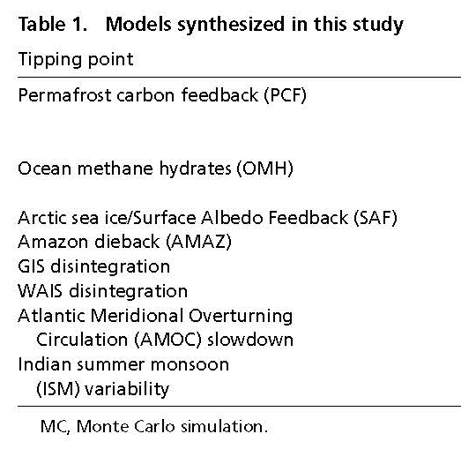
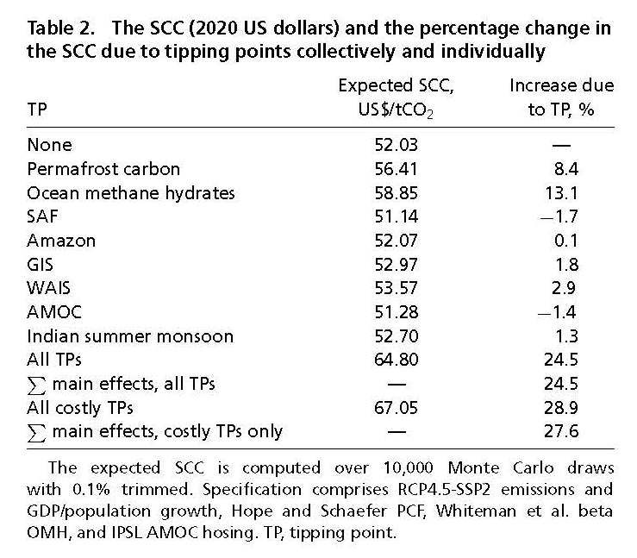
Including tipping points (climate catastrophes) in the SCC
Dietz et al (PNAS 2021)
  Draw on multiple IAMs, examine tipping points in a way that adheres to climate literature

Slide 30
Target-consistent pricing
References
  Stern & Stiglitz (NBER wp, February 2021)
  Kaufman et al. (Nature Climate Change 2020)
  Van der Ploeg (Climatic Change 2018)
  Aldy, Kotchen, Stavins, & Stock (Science 2021)
Carbon budget approach
Because of unknown or highly uncertain tail risks, we adopt scientists’ recommendation to keep temperature increase to (say) 2 degrees C
This implies a carbon budget (random because of climate model uncertainty)
With a fixed stock of carbon to use, we can apply the classic theory of finite-resource pricing to obtain the Hotelling price trajectory
  Optimal paths are modified if abatement costs vary over time, or benefits vary over time
  Hotelling calculations are typically done for single-externality case (GHG externality)
Cost-effectiveness approach
Suppose you adopt a carbon budget. Then the task is to complete the green transition as cost-effectively as possible
Absent uncertainty: line up all the possible policies, choose the most cost-effective
With uncertainty: don’t know the policies or technologies or future abatement costs. How do decide whether a candidate policy is cost-effective?
  Compare to a price benchmark: a target-consistent price (TCP). TCP adopted (for some purposes) by UK (DECC 2009)
  Target-consistent price path is an estimate of the sequence of cost-effective policies
  Estimating the TCP doesn’t require damages or benefits – but requires modeling abatement technologies and policy costs.
  IPCC SR1.5 calculated TCP as between $135-$5500/ton CO2e (2030 price) (!)

Slide 31
SCC: final comments
Institutional implementation
USG update ongoing, report due January 2021
SCC or TCP? (CBA or CEA?)
Critical importance of cost discipline!
  Worse case outcome is spending trillions of dollars but not getting the decarbonization job done
Hard to argue with cost-benefit analysis in theory
SCC and TCP both very difficult to compute (which is harder, future mortality or future technology)?
TCP also depends on policy target: Trump, no target so TCP = 0; Biden, 2050 net zero
Targets seem to be very popular politically
  But voting for a target is a lot easier than voting for a policy with teeth
Personal views…
Researchable topics
Harder-to-measure damages:
  Ecosystem damages
  Extinctions
  Migration and political disruption
  …
Discounting really important yet unresolved

