Slide 1
Statistical Analysis of Climate Data
Jim Stock
Department of Economics, Harvard University
SDSCon 2017, MIT
April 21, 2017
Thanks to Robert Kaufmann (BU), Felix Prentis (Oxford), and Giselle Montamat (Harvard)

Slide 2
Climate science: the policy landscape
EPA Administrator Scott Pruitt, CNBC, March 9, 2017
  “I think that measuring with precision human activity on the climate is something very challenging to do and there’s tremendous disagreement about the degree of impact, so no, I would not agree that it’s a primary contributor to the global warming that we see… But we don’t know that yet. We need to continue the debate and continue the review and the analysis.”

Slide 3
Climate science: the political landscape
EPA Administrator Scott Pruitt, CNBC, March 9, 2017
  “I think that measuring with precision human activity on the climate is something very challenging to do and there’s tremendous disagreement about the degree of impact, so no, I would not agree that it’s a primary contributor to the global warming that we see… But we don’t know that yet. We need to continue the debate and continue the review and the analysis.”
Executive Order on Promoting Energy Independence and Economic Growth, March 28, 2017
  (b) The Interagency Working Group on Social Cost of Greenhouse Gases (IWG), which was convened by the Council of Economic Advisers and the OMB Director, shall be disbanded, and the following documents issued by the IWG shall be withdrawn as no longer representative of governmental policy:
  Social Cost of Carbon for Regulatory Impact Analysis (February 2010);
  Technical Updates of the Social Cost of Carbon (May 2013, November 2013, July 2015, August 2016);
  Application of the Methodology to Estimate the Social Cost of Methane and the Social Cost of Nitrous Oxide (August 2016)

Slide 4
Climate science: the political landscape
EPA Administrator Scott Pruitt, CNBC, March 9, 2017
  “I think that measuring with precision human activity on the climate is something very challenging to do and there’s tremendous disagreement about the degree of impact, so no, I would not agree that it’s a primary contributor to the global warming that we see… But we don’t know that yet. We need to continue the debate and continue the review and the analysis.”
Executive Order on Promoting Energy Independence and Economic Growth, March 28, 2017
  (b) The Interagency Working Group on Social Cost of Greenhouse Gases (IWG), which was convened by the Council of Economic Advisers and the OMB Director, shall be disbanded, and the following documents issued by the IWG shall be withdrawn as no longer representative of governmental policy:
  Social Cost of Carbon for Regulatory Impact Analysis (February 2010);
  Technical Updates of the Social Cost of Carbon (May 2013, November 2013, July 2015, August 2016);
  Application of the Methodology to Estimate the Social Cost of Methane and the Social Cost of Nitrous Oxide (August 2016)
This talk
  What can simple data analysis say about causality, magnitudes, and climate science?
  What would you say to Scott Pruitt in a 15 minute meeting?

Slide 5
Global data

Slide 6
Global data

Slide 7
Global data

Slide 8
It seems obvious, but…

Slide 9
It seems obvious, but…
The endogeneity problem
Earth system feedbacks determine some of radiative forcing (e.g. CO2 uptake)

Slide 10
It seems obvious, but…
The endogeneity problem
Earth system feedbacks determine some of radiative forcing (e.g. CO2 uptake)
The spurious regression problem
Suppose x and y are independent random walks with x₀ = 0 and y₀ = 0. Then

Slide 11
Outline
Introduction and some data
Causality 1: Accounting for the 1998-2013 warming hiatus
  The hiatus debate
  Three simple models
  Out of sample conditional predictions
  Decomposition
  Extensions
Causality 2: from anthropogenic emissions to temperatures
Transient climate response, equilibrium climate sensitivity, and the Social Cost of Carbon
Related work (brief overview)

Slide 12
The 1998-2013 warming hiatus

Slide 13
The hiatus: Multiple explanations
Anthropogenic sulfur
  Kaufmann, Kauppi, Mann, Stock (2011)
Declining solar irradiance
  Tollefson (2013), Trenberth (2015), Kaufmann et. al. (2011)
Volcanic aerosols
  Andersson et. al. (2016)
  Gregory et. al. (2016)
Temperature mismeasurement
  Karl et. al. (2015)
  Fyfe et. al. (2016)
  Hausfather et. al. (2017)
Ocean heat uptake (internal variability)
  Meehl et al. (2011)
  Kosaka and Xie (2013)
  Liu, Xie, and Lu (2016)
Not easily explained/poses problems for models
    Curry (2014)

Slide 14
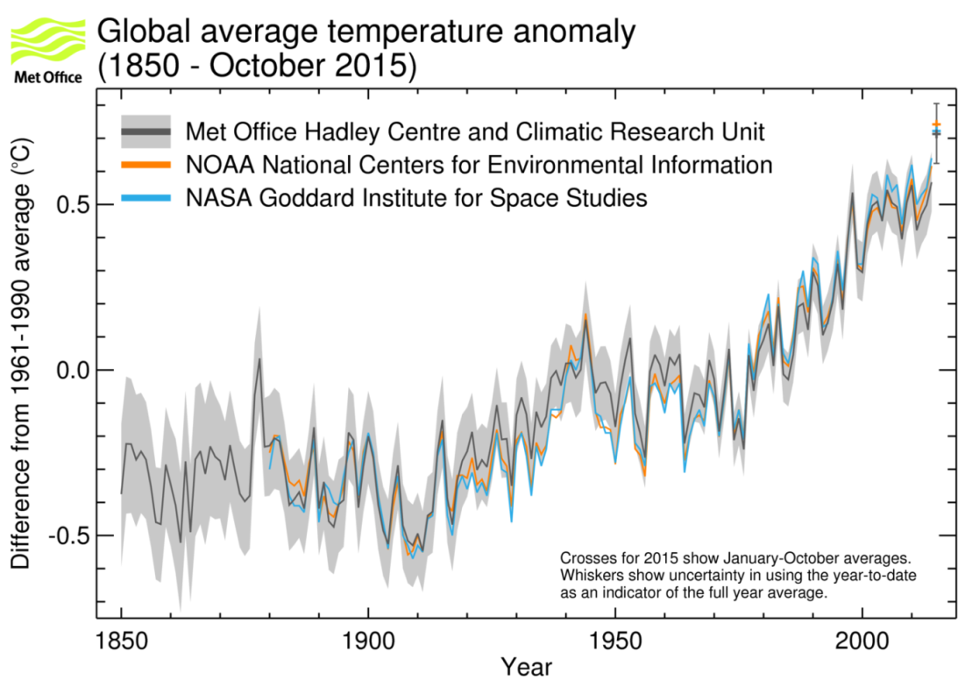
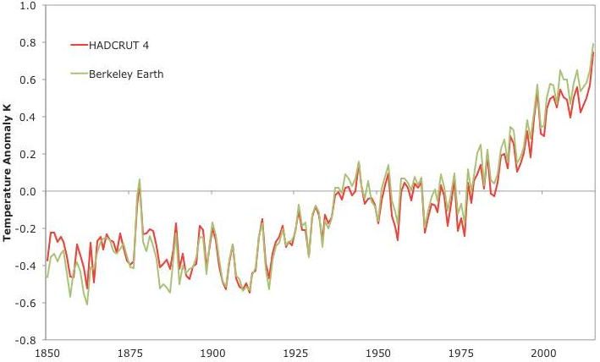
The temperature measurement debate
Source: Burns et. al (2017), Berkeley Earth
Source: WMO/Met Office Hadley Center

Slide 15
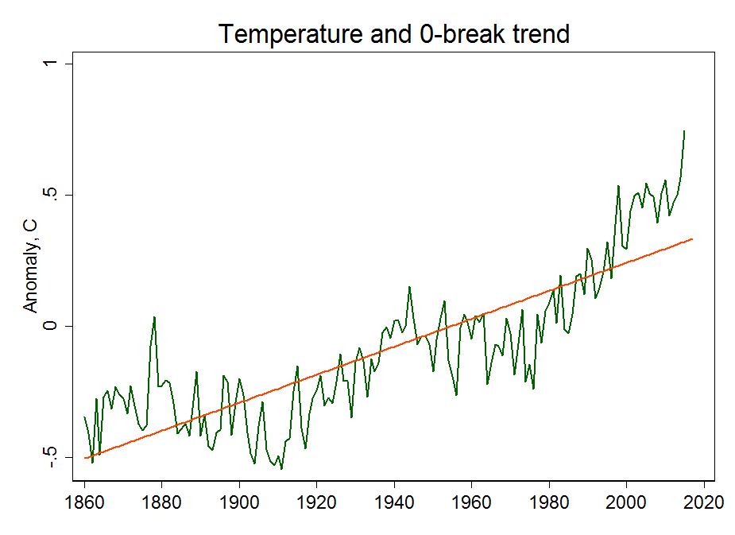
Digression: the debate over trends

Slide 16
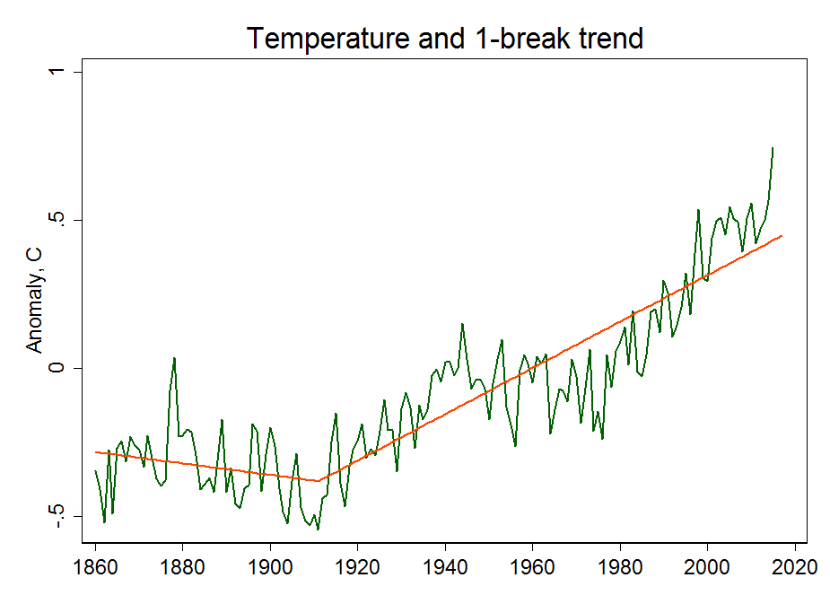
Digression: the debate over trends

Slide 17
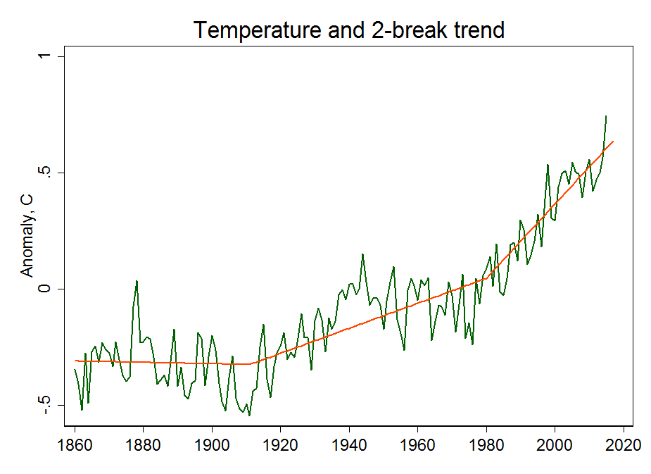
Digression: the debate over trends

Slide 18
Digression: the debate over trends

Slide 19
Digression: the debate over trends
Good overall discussion
  Rajaratnam, Romano, Tsiang, and Diffenbaugh, Climatic Change (2015)
Stochastic trends v. breaks
  Kaufmann, Kauppi, Mann, Stock (2013)
  McKitrick and Vogelsang (2014)

Slide 20
The hiatus: three simple models
Can simple models that condition on RF “predict” the hiatus?
Estimate simple models through 1998, make conditional projections (“dynamic simulations”)
This addresses the spurious regression concern but not necessarily the endogeneity concern

Slide 21
The hiatus: three simple models
Can simple models that condition on RF “predict” the hiatus?
Estimate simple models through 1998, make conditional projections (“dynamic simulations”)
This addresses the spurious regression concern but not necessarily the endogeneity concern
1. Error-correction model, homogeneous response to RF (Kaufmann, Kauppi, Stock 2006)

Slide 22
The hiatus: three simple models
Can simple models that condition on RF “predict” the hiatus?
Estimate simple models through 1998, make conditional projections (“dynamic simulations”)
This addresses the spurious regression concern but not necessarily the endogeneity concern
1. Error-correction model, homogeneous response to RF (Kaufmann, Kauppi, Stock 2006)
2. Error-correction model, different static response to RF-gas and RF-sun

Slide 23
The hiatus: three simple models
Can simple models that condition on RF “predict” the hiatus?
Estimate simple models through 1998, make conditional projections (“dynamic simulations”)
This addresses the spurious regression concern but not necessarily the endogeneity concern
1. Error-correction model, homogeneous response to RF (Kaufmann, Kauppi, Stock 2006)
2. Error-correction model, different static response to RF-gas and RF-sun
3. Different dynamic response to RF-gas and RF-sun (Poppick, Moyer, Stein 2017)

Slide 24
Hiatus: Simple model 1

Slide 25
Hiatus: Simple model 2

Slide 26
Hiatus: Simple model 3

Slide 27
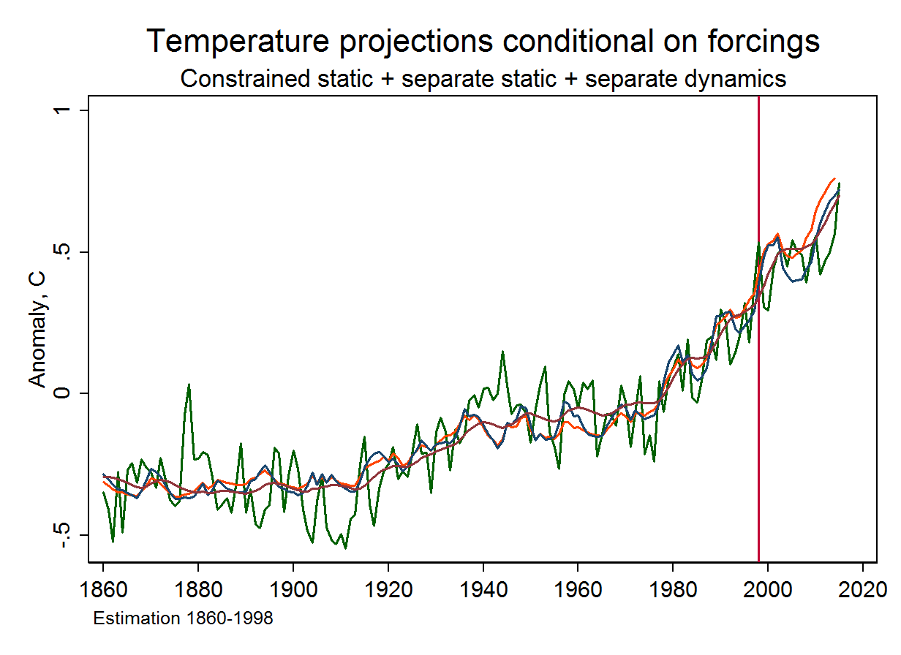
Hiatus: all three simple models

Slide 28
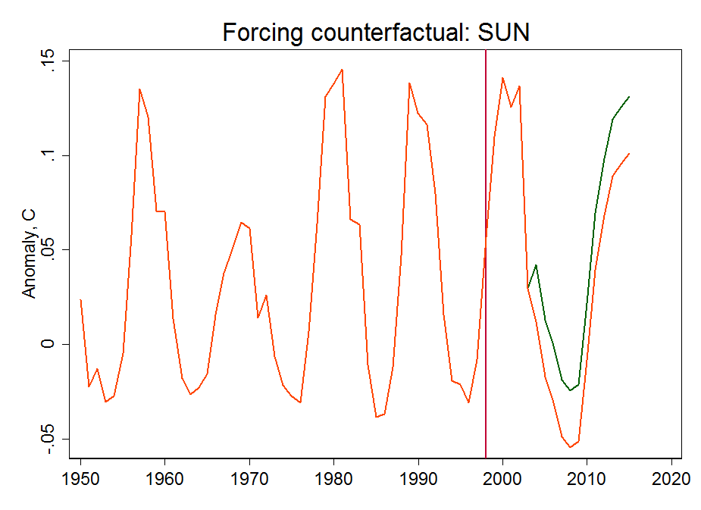
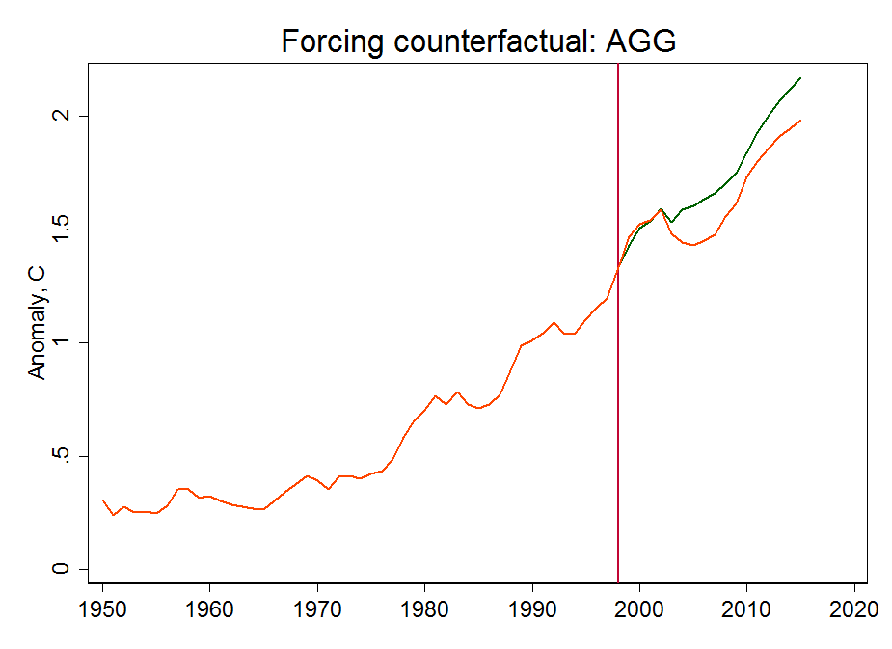
Hiatus: Counterfactual and decomposition
These models admit a linear decomposition of “reasons” for the hiatus.
The decomposition requires a counterfactual. Here we consider “BAU”:
All gas radiative forcings grow over 1999-2015 at their rate over the previous 10 years (1989-1998)
Solar RF mean over the 2004-2015 equals its mean over the 1984-2003 cycles

Slide 29
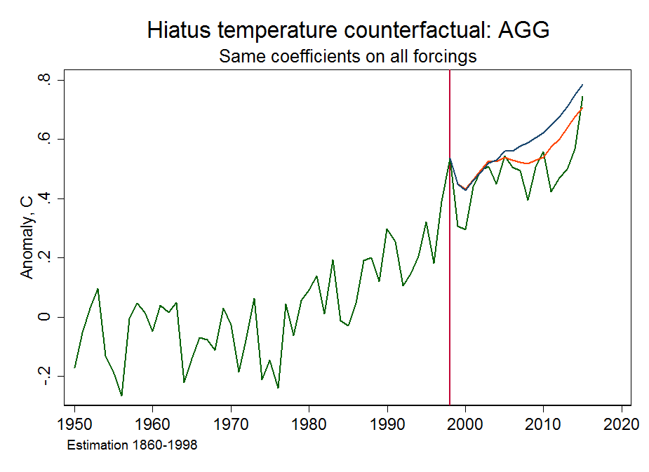
Hiatus: actual, conditional & counterfactual projection
Counterfactual
projection
Conditional
projection

Slide 30
Hiatus decomposition
 | Model 1 | Model 2
Total gap | 0.103 | 0.066
Explained components
CO2 | -0.006 | -0.006
SOX | 0.026 | 0.025
CFC | 0.002 | 0.002
N2O | -0.002 | -0.002
CH4 | 0.009 | 0.008
Subtotal, Gases | 0.029 | 0.028
SUN | 0.007 | 0.017
Total explained | 0.036 | 0.045
Unexplained | 0.066 | 0.021
Different counterfactuals give different decompositions.
Estrada et al (2014), Estrada and Perron (2016) give more weight to CFC reductions.

Slide 31
Hiatus: extensions
Two of many…
Kaufmann, Kaupi, Stock (2006, 2011)
Endogenize (model) CO2, CH4 net emissions sensitivity to temperature changes
Volcanic sulfates as instrumental variables
Estimate a small positive feedback
Bruns, Csereklyei, Stern (2017)
Include endogenous ocean heat uptake (RFAGG exogenous)
3-variable error correction model that incorporates ocean heat uptake
Ocean dynamics
Lower TCR estimates because of ocean damping (adjustment lags)

Slide 32
Causality 2: from anthropogenic emissions to temperatures
Endogeneity
Much of the earth system is endogenous: water vapor, CO2 absorption, El Nino, etc
But there are exogenous drivers: Solar flux, CFCs, fossil fuel CO2
Spurious regression
Changes in these exogenous drivers provide quasi-experiments to study their effect on changes in temperature
For example, the widespread use of CFCs after WWI, and their reduction/elimination in the Montreal protocol, provide quasi-experiments
How long should a “change” be?

Slide 33
Causality 2: from anthropogenic emissions to temperatures

Slide 34
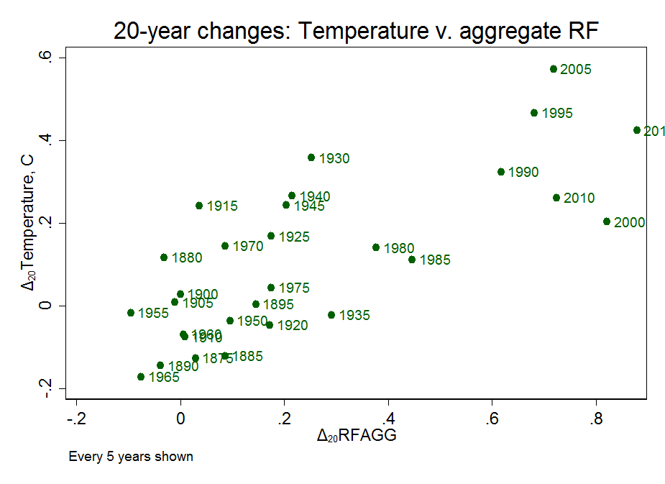
Causality 2: from anthropogenic emissions to temperatures

Slide 35
Digression: Instrumental variables regression
Linear regression with an endogenous regressor:
Conditions for a valid instrumental variable z :
            relevance
            exogeneity
Then

Slide 36
Digression: Instrumental variables regression
Linear regression with an endogenous regressor:
Conditions for a valid instrumental variable z :
            relevance
            exogeneity
Then
Example (Stinebrinckner and Stinebrinckner 2008)
  y = first-semester GPA
  x = study hours per day
  z = 1(randomly assigned freshman year roommate brings video game console)
  Δx, treatment – control = -0.668 hours/day
  Δy, treatment – control = -0.241 GPA points
  (These estimates include controls for major, sex, other student characteristics.)

Slide 37
Causality 2: from anthropogenic emissions to temperatures

Slide 38
Causality 2: from anthropogenic emissions to temperatures

Slide 39
Causality 2: from anthropogenic emissions to temperatures

Slide 40
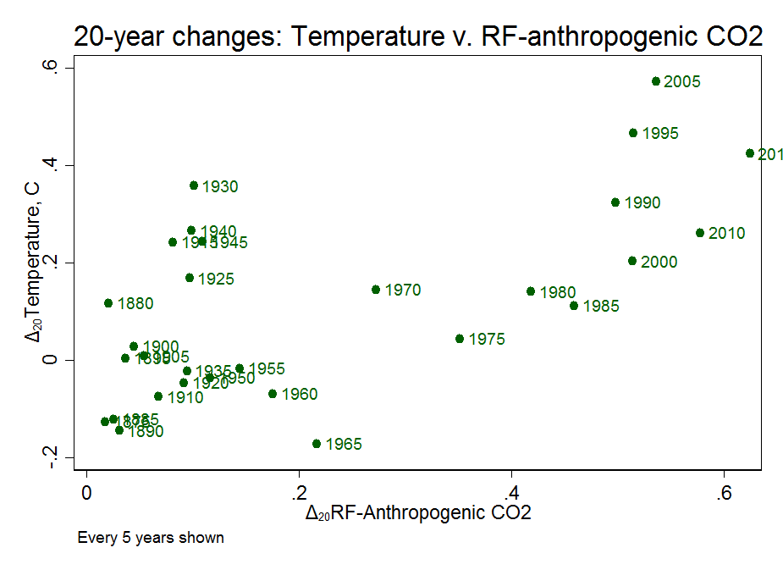
Causality 2: from anthropogenic emissions to temperatures

Slide 41
IV estimation of 10-year differences relation, 1860-2015
Method | Instruments | Estimate | 95% CI | First-stage F
OLS | -- | 0.43 (0.08) | (0.25, 0.61) | --
IV | RFACO2 | 0.36 (0.12) | (0.16, 0.55) | 62.3
IV | RFSUN | 0.29 (0.26) | (-0.97, 1.12) | 5.7
IV | RFACO2, RFCFC, RFSUN | 0.37 (0.10) | (0.19, 0.55) | 27.5
Notes
RFACO2 = RF due to fossil fuel emissions of CO2, RFCFC = RF due to CFCs
Dependent variable, regressor, and instrument are all 10-year differences
SEs (in parentheses below estimates) are heteroskedasticity- and autocorrelation-robust (HAR : QS kernel, BW = 15)
First-stage F is HAR
95% CI is weak-instrument robust (inverts HAR conditional LR)

Slide 42
ECS and TCR
Equilibrium climate sensitivity (ECS):
Equilibrium (long-run) temperature response to CO2 doubling.
IPCC AR5 likely range 1.5-4.5 ºC
Transient climate response (TCR):
Temperature response to CO2 doubling at 1% annual rate over those 70 years.
IPCC AR5 likely range 1-2.5 ºC
Method | Instruments/Model | Estimate | TCR
OLS |  | 0.43 (0.08) | 1.9 (0.3)
IV | RFACO2 | 0.36 (0.12) | 1.6 (0.5)
IV | RFACO2, RFCFC, RFSUN | 0.37 (0.10) | 1.6 (0.4)
Levels, DOLS | Model 1 (all RF has same coefficient) | 0.52 (0.03) | 2.3 (0.1)
Levels, DOLS | Model 2 (RFGAS, RFSUN separate static) | 0.46 (0.03) | 2.0 (0.1)
Levels, NLLS | Model 3 (RFGAS, RFSUN separate static & dynamic) | 0.52 (0.15) | 2.3 (0.6)
Notes: DOLS uses 2 leads/lags of regressors, HAR SEs.

Slide 43
The TCR, ECS, and the Social Cost of Carbon
The Social Cost of Carbon
The net present value of the net economic damages arising from emitting an additional ton of CO2
The USG estimate of the SCC
$42 per Mton CO2 emitted in 2017, in 2017 dollars
Is at https://www.epa.gov/climatechange/social-cost-carbon (!)
Has been used in dozens of regulatory assessments for cost-benefit analysis, most notably including the Clean Power Plan
Recently reviewed by NAS panel. Key issues for work (research):
  ECS (and TCR)
  climate damage functions
  discounting
  economic scenarios
  uncertainty

Slide 44
Some related work
Spatial-temporal
  Atak, Linton, and Xiao, J. Econometrics (2011)
  Bau, McInerny, and Stein, Environmetrics (2016)
  Castruccio and Stein, Ann. Appl. Stat. (2013)
  Chang et. al. (2016)
Longer data sets (500 year; paleo)
  Dergiades and Kaufmann, J Env Econ Mgt (2016)
  Davidsonm, Stephenson, Turasie, Environmetrics (2016)
  Kaufmann and Pretis, ms, (2017)
ECS/TCR
  Storelvmo, Leirvik, Johmann, Phillips, Nature Geoscience (2016)

