Slide 1
Prospects for a Coal Renaissance
Jim Stock
Harvard University
Member, Council of Economic Advisers, 2013-2014
  MIT CEEPR Spring 2017 Research Workshop
  Cambridge, MA
  April 27, 2017
This presentation draws on work with John Coglianese and Todd Gerardan, Harvard

Slide 2
Prospects for a Coal Renaissance
Recent coal trends
Explaining the decline in coal production
Trump policies: a Coal Renaissance?
Policies for a realistic future for coal

Slide 3
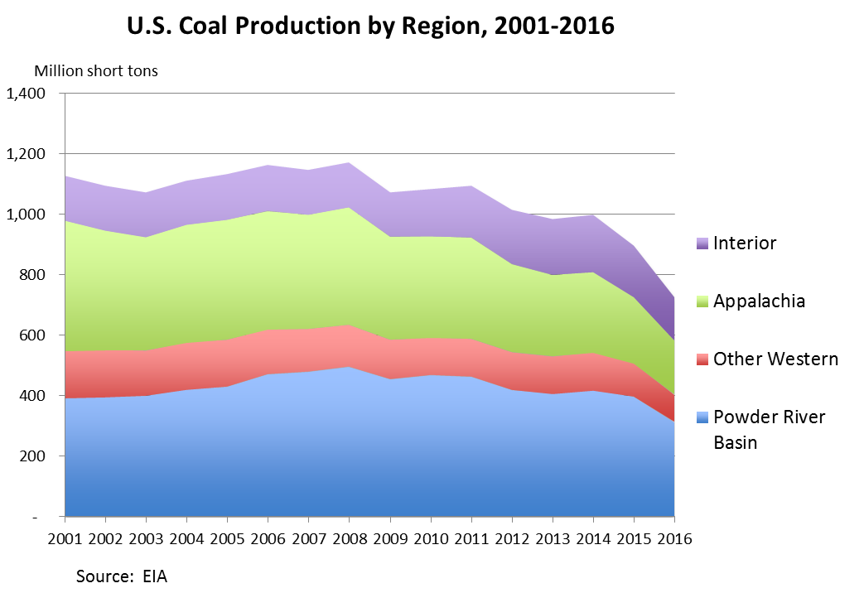
Recent coal trends: production

Slide 4
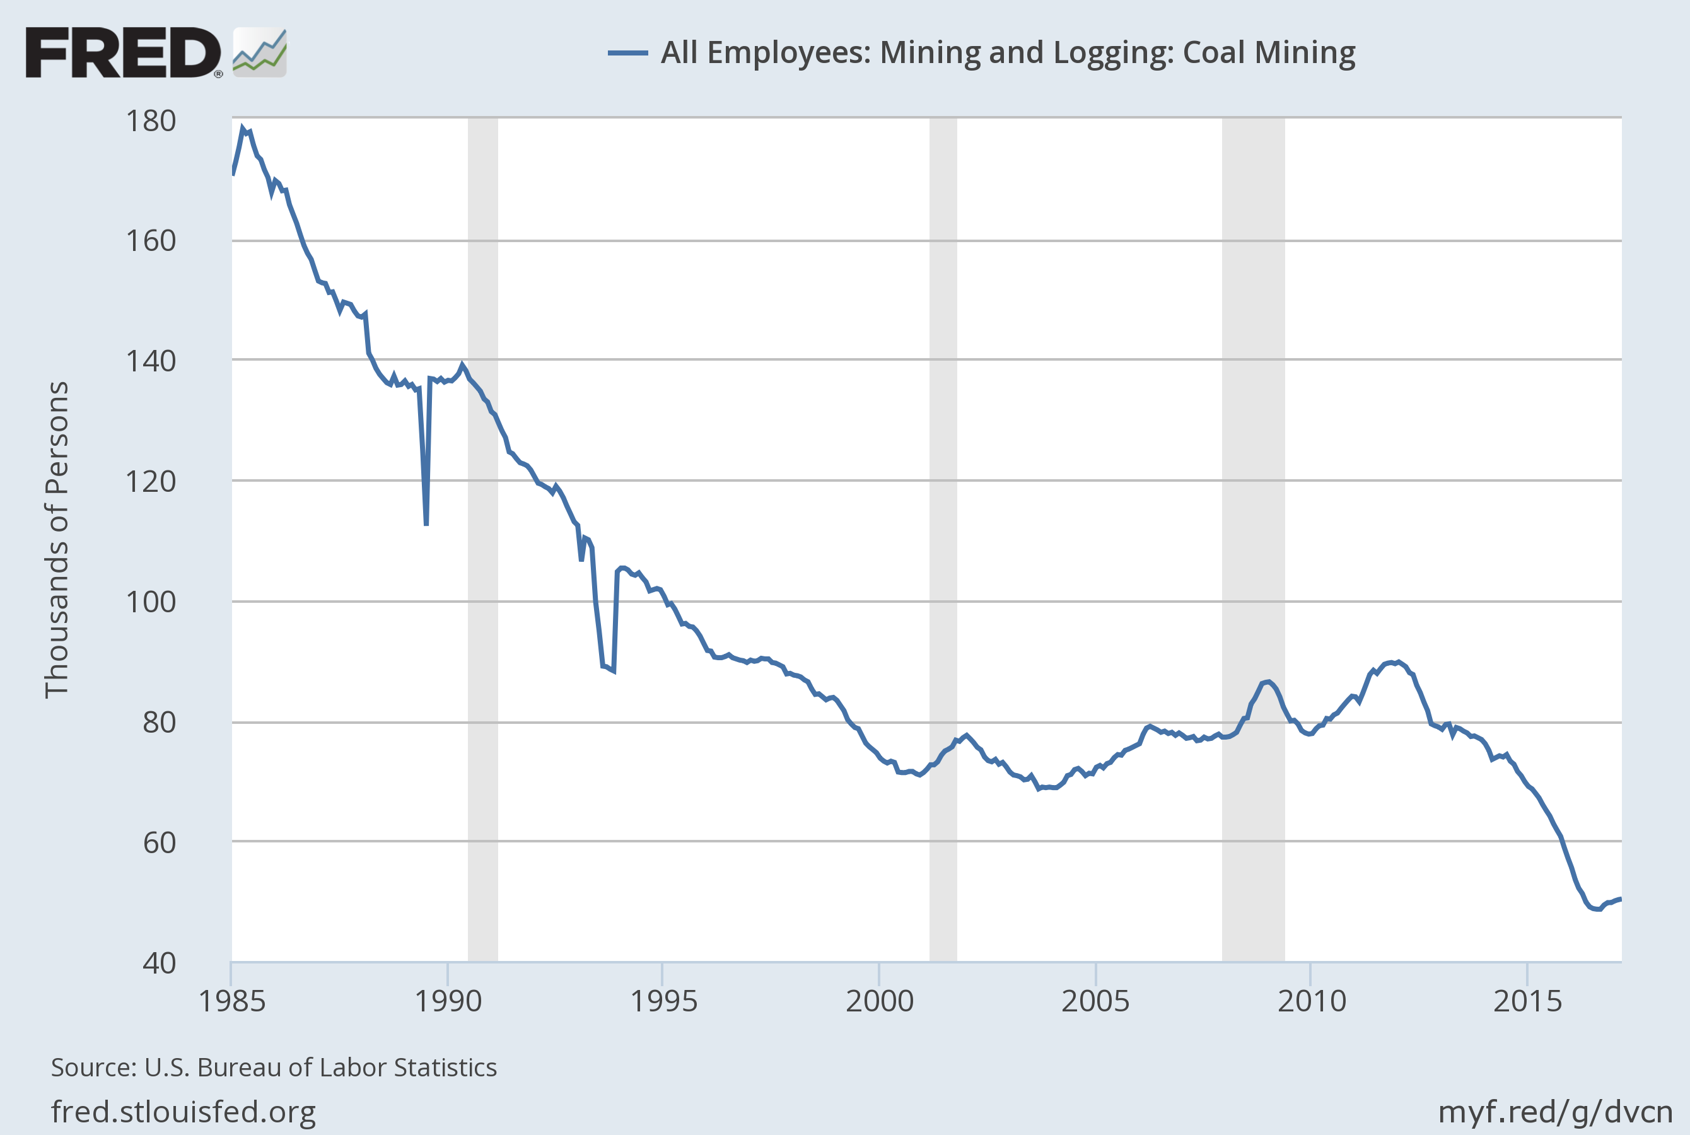
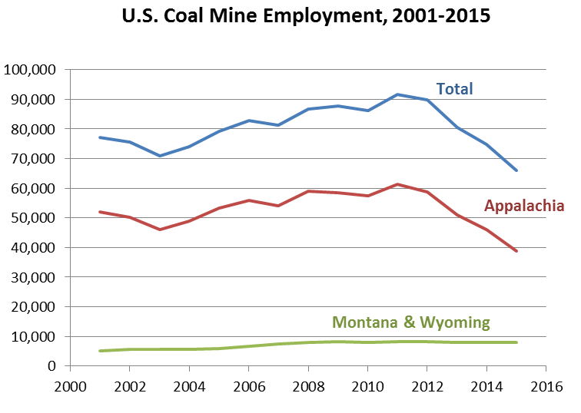
Recent coal trends: employment
2015 coal mining employment (EIA)
Western: 13,725 (WY+MT = 7,965)
Appalachia: 37,576
Interior: 14,558
Total: 65,971

Slide 5
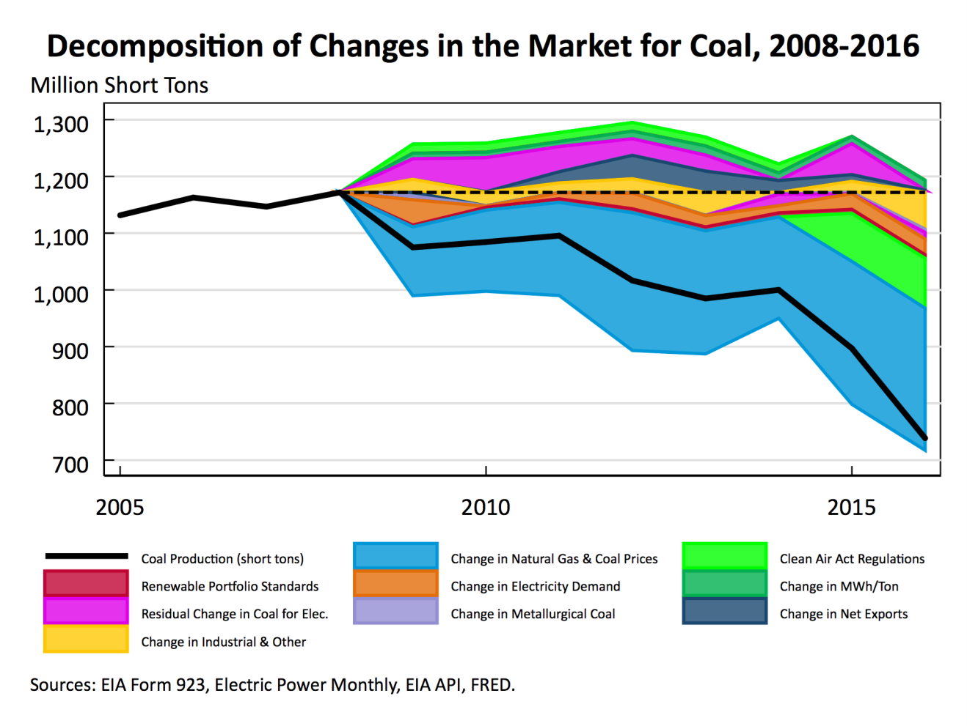
Explaining the decline: a decomposition

Slide 6
Trump administration policies: a coal Renaissance?
Oil & gas production policies (–, small)
  EO13783 actions
    “Suspend”/withdraw EPA methane rule, BLM fracking rule, etc.
    Broader regulatory review
  Expand offshore O&G leasing areas
Make wind, solar permitting on public lands more difficult (+, small)
Tax reform provisions (TBD) (small)
One-off deals, e.g. Navajo Generating Station (small)
Lift coal moratorium/terminate coal program PEIS (potentially large if permanent)
Withdraw/re-propose CPP (EO13783) (potentially large if permanent)

Slide 7
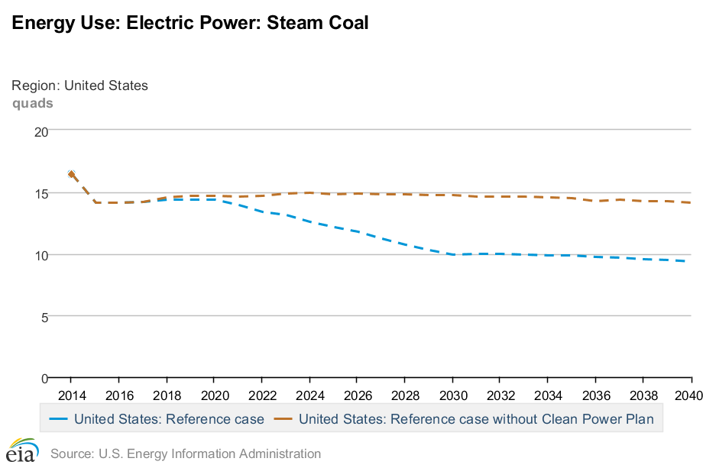
Projected effect of withdrawing CPP: EIA AEO (NEMS)
EIA AEO 2016 Steam coal projection 2015-2040 (Quad Btu) with and without the CPP

Slide 8
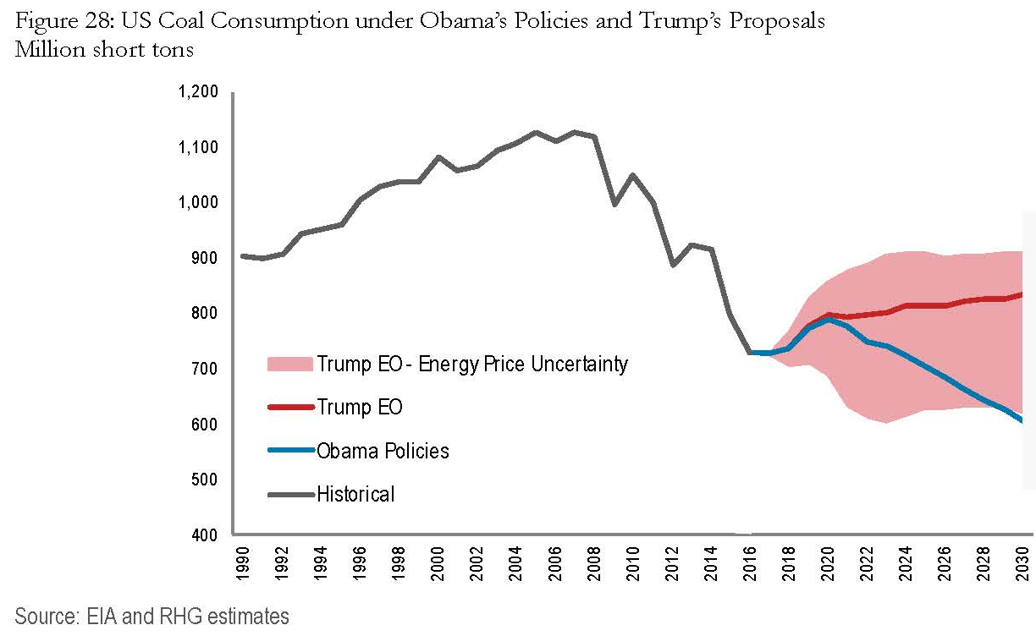
Trump administration policies: effect of EO13783 if permanent
Source: Hauser, Bordoff, and Marsten (Columbia CGEP, 2017)

Slide 9
What policies would bring a Coal Renaissance?
Permanently:
Remove CO2 from the Clean Air Act
  Legislative removal (filibuster)
  Void the endangerment finding (won’t work – would lose in court)
  Win (i.e. lose) in DC Circuit/SCOTUS: prevail on fence-line interpretation (maybe, but will Pruitt risk this? EPA winning (Pruitt losing) at SCOTUS would make subsequent withdrawal and re-proposal highly problematic.
Remove climate as a consideration in the federal coal program
  Legislative prohibition (no, filibuster)
Disengage from international climate negotiations
  Legislative prohibition (no, filibuster)
No carbon tax, ever
  No credible commitment device
Coal Renaissance = highest production case imaginable = plateau at current level
All four are necessary for coal production to plateau – and each is highly unlikely to occur.

Slide 10
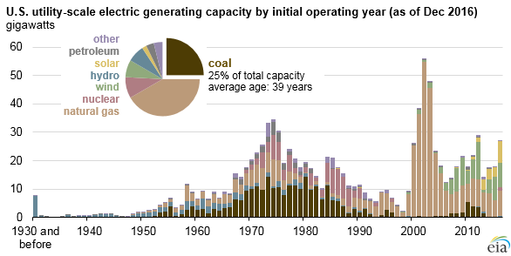
Challenges confronting a coal Renaissance
Challenge #1: cost of competing technologies
Challenge #2:
Aging coal fleet
Challenge #3: Science & facts
  “I think that measuring with precision human activity on the climate is something very challenging to do and there’s tremendous disagreement about the degree of impact, so no, I would not agree that it’s a primary contributor to the global warming that we see… But we don’t know that yet. We need to continue the debate and continue the review and the analysis.”
    Administrator Scott Pruitt, CNBC, March 9, 2017

Slide 11
Challenge #3: Science

Slide 12
Challenge #3: Science

Slide 13
Challenge #3: Science

Slide 14
Challenge #3: Science

Slide 15
Challenge #3: Science

Slide 16
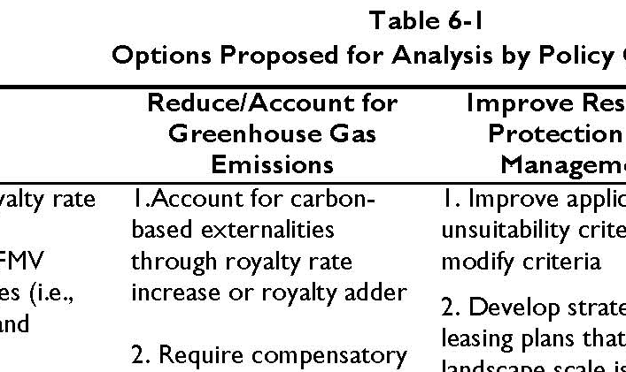
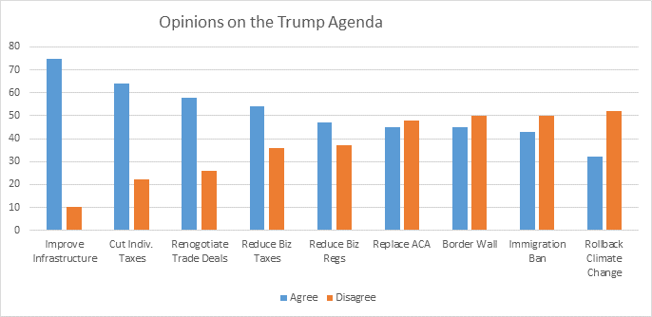
Challenges confronting a coal Renaissance
Challenge #4:
Keep it in the ground
constituency
Challenge #5:
Public opinion
Source: CNBC,
April 12, 2017
Challenge #6: Time isn’t the coal industry’s friend
Source: DOI PEIS Scoping Document, Jan. 2017

Slide 17
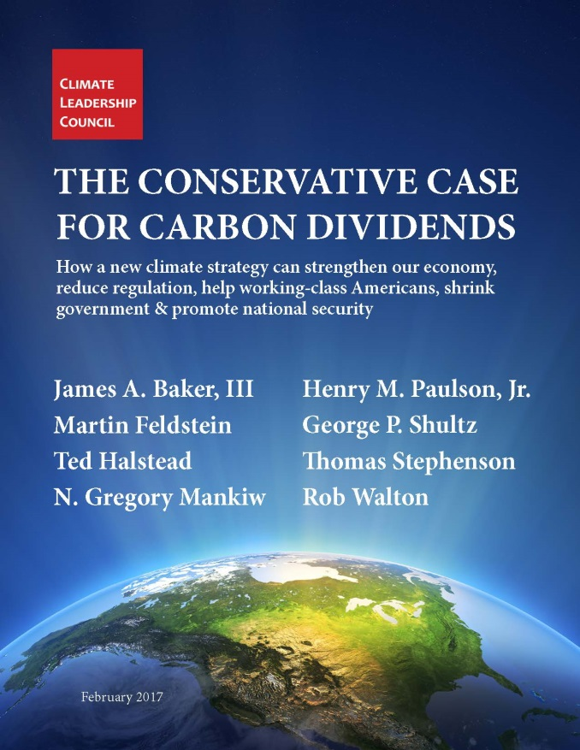
Coal: Policies for a realistic future
Acknowledge the science
Acknowledge public support for GHG mitigation
Promote policy certainty
Promote transition to certain, effective, and efficient policy:
  carbon fee + CO2 out of CAA + transitional CCS supports

