Slide 1
An Econometrician’s Take on the CO₂-Climate Debate
Giselle Montamat, Harvard Economics
Jim Stock, Harvard Economics
NYU-Stern 10th Annual Volatility Conference
April 27, 2018
Thanks to Robert Kaufmann (BU) and Felix Prentis (Oxford/U. Victoria)

Slide 2
Climate science: the political landscape
EPA Administrator Scott Pruitt, CNBC, March 9, 2017
  “I think that measuring with precision human activity on the climate is something very challenging to do and there’s tremendous disagreement about the degree of impact, so no, I would not agree that it’s a primary contributor to the global warming that we see… But we don’t know that yet. We need to continue the debate and continue the review and the analysis.”

Slide 3
Climate science & climate change skepticism
EPA Administrator Scott Pruitt, CNBC, March 9, 2017
  “I think that measuring with precision human activity on the climate is something very challenging to do and there’s tremendous disagreement about the degree of impact, so no, I would not agree that it’s a primary contributor to the global warming that we see… But we don’t know that yet. We need to continue the debate and continue the review and the analysis.”
This talk
  What can simple data analysis say about causality, magnitudes, and climate science?
  Use atmospheric physical chemistry but not global circulation models

Slide 4
Global data

Slide 5
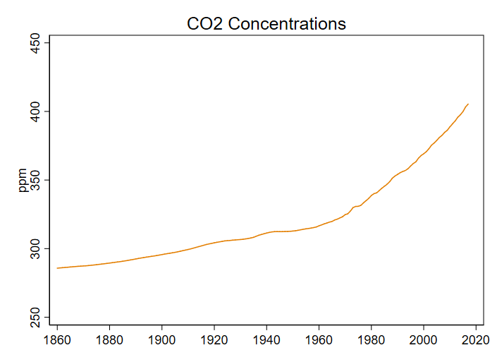
Global data

Slide 6
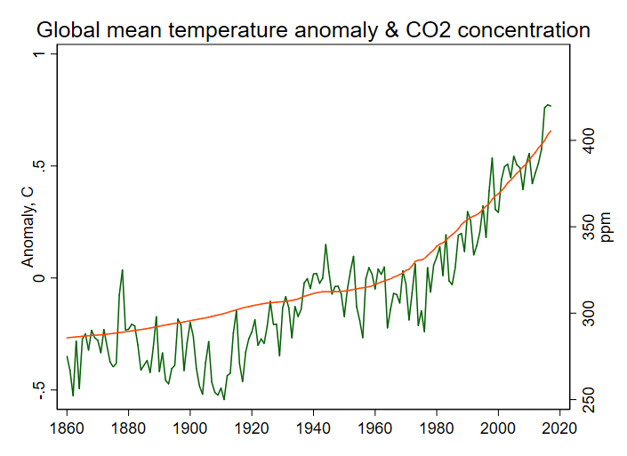
It seems obvious

Slide 7
It seems obvious, but…
There are other sources of warming & cooling, some natural
  Solar
  Other GHG (CH4, N20, CFCs,…)
The endogeneity problem
  Earth system feedbacks determine some of radiative forcing (e.g. CO2 uptake)
The spurious regression problem
  You can generate high correlations in persistent time series, with no true relationship

Slide 8
Outline
Introduction and some data
  Motivation
  Radiative forcing
Causality 1: Accounting for the 1998-2013 warming hiatus
  The hiatus debate
  Two simple models
  Out of sample conditional predictions
  Decomposition
  Extensions
Causality 2: from anthropogenic emissions to temperatures
Transient climate response, equilibrium climate sensitivity, and the Social Cost of Carbon
Related work (brief overview)

Slide 9
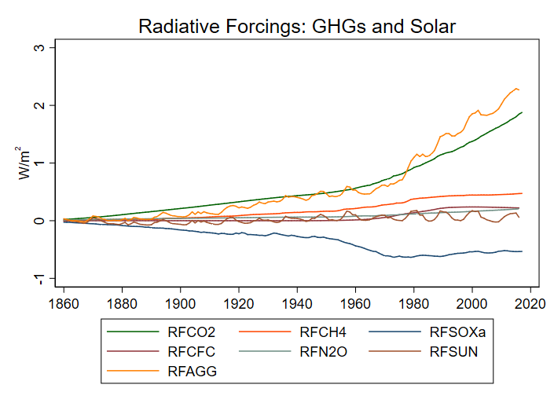
Radiative Forcing

Slide 10
The 1998-2013 warming hiatus

Slide 11
The hiatus: Multiple explanations
Anthropogenic sulfur
  Kaufmann, Kauppi, Mann, Stock (2011)
Declining solar irradiance
  Tollefson (2013), Trenberth (2015), Kaufmann et. al. (2011)
Volcanic aerosols
  Andersson et. al. (2016)
  Gregory et. al. (2016)
Temperature mismeasurement
  Karl et. al. (2015)
  Fyfe et. al. (2016)
  Hausfather et. al. (2017)
Ocean heat uptake (internal variability)
  Meehl et al. (2011)
  Kosaka and Xie (2013)
  Liu, Xie, and Lu (2016)
Not easily explained/poses problems for models
    Curry (2014)

Slide 12
The hiatus: two simple models
Can simple models that condition on RF “predict” the hiatus?
Estimate simple models through 1998, make conditional projections (“dynamic simulations”)
This addresses the spurious regression concern but not necessarily the endogeneity concern

Slide 13
The hiatus: two simple models
Can simple models that condition on RF “predict” the hiatus?
Estimate simple models through 1998, make conditional projections (“dynamic simulations”)
This addresses the spurious regression concern but not necessarily the endogeneity concern
1. Error-correction model, homogeneous response to RF (Kaufmann, Kauppi, Stock 2006)

Slide 14
The hiatus: two simple models
Can simple models that condition on RF “predict” the hiatus?
Estimate simple models through 1998, make conditional projections (“dynamic simulations”)
This addresses the spurious regression concern but not necessarily the endogeneity concern
1. Error-correction model, homogeneous response to RF (Kaufmann, Kauppi, Stock 2006)
2. Error-correction model, different static response to RF-gas and RF-sun

Slide 15
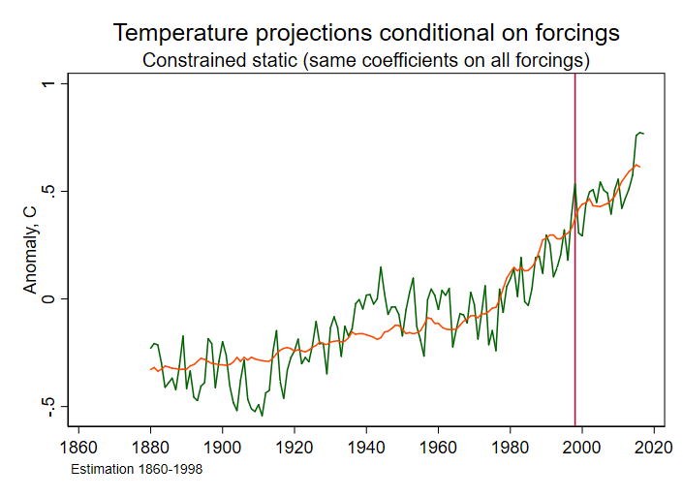
Hiatus: Simple model 1

Slide 16
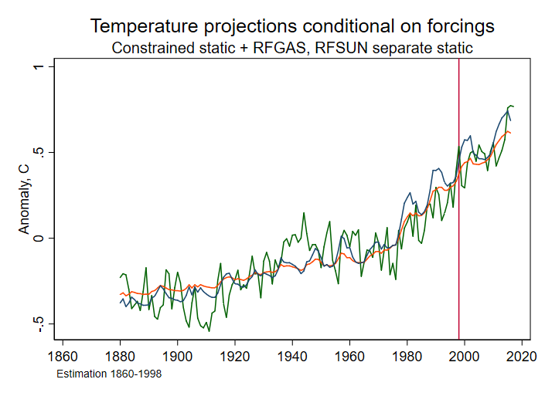
Hiatus: Simple models 1 & 2

Slide 17
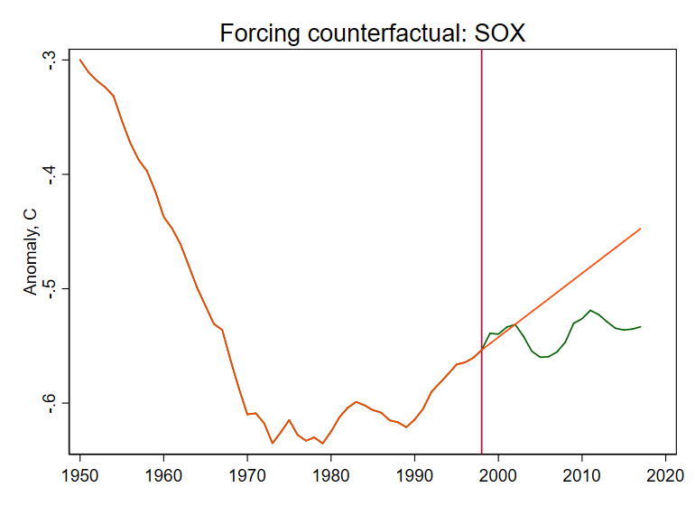
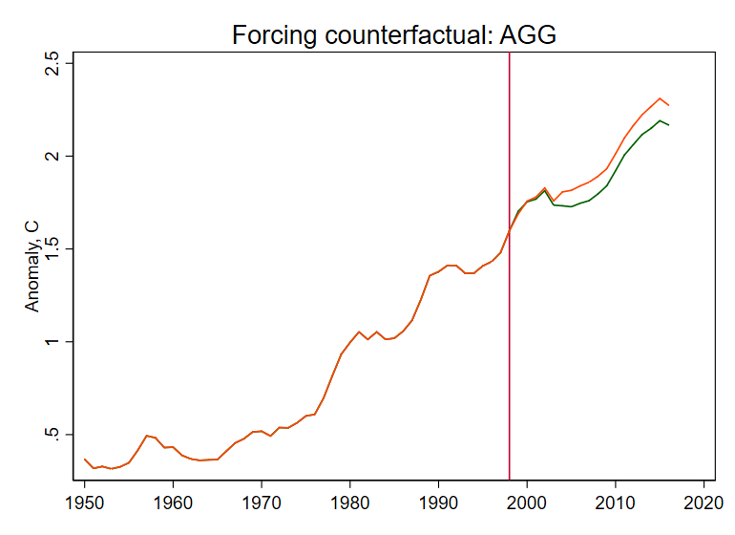
Hiatus: Counterfactual and decomposition
These models admit a linear decomposition of “reasons” for the hiatus.
The decomposition requires a counterfactual. Here we consider “BAU”:
All gas radiative forcings grow over 1999-2015 at their rate over the previous 10 years (1989-1998)
Solar RF mean over the 2004-2015 equals its mean over the 1984-2003 cycles

Slide 18
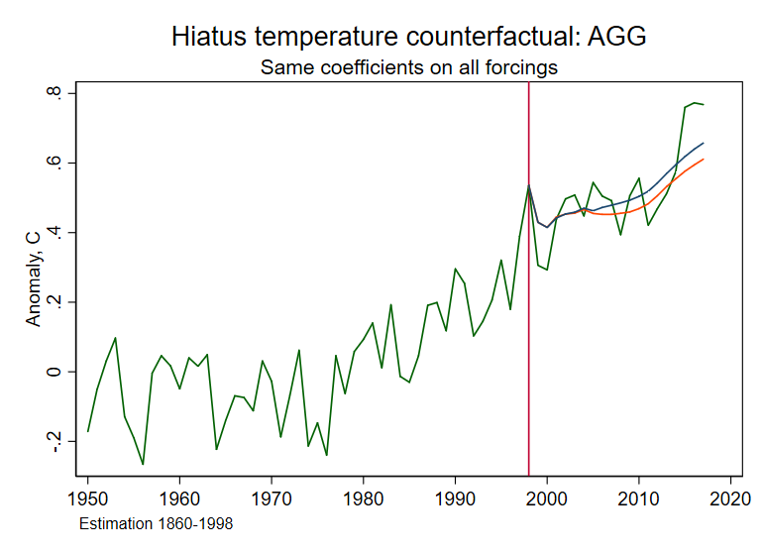
Hiatus: actual, conditional & counterfactual projection
Counterfactual
projection
Conditional
projection

Slide 19
Hiatus decomposition
 | Model 1
Total gap | -0.020
Explained components
CO2 | 0.008
SOX | -0.008
CFC | -0.009
N2O | 0.001
CH4 | -0.004
Subtotal, Gases | -0.012
SUN | -0.005
Total explained | -0.018
Unexplained | 0.003
Different counterfactuals give different decompositions.
Estrada et al (2014), Estrada and Perron (2016) give more weight to CFC reductions.

Slide 20
Hiatus: extensions
Two of many…
Kaufmann, Kaupi, Stock (2006, 2011)
Endogenize (model) CO2, CH4 net emissions sensitivity to temperature changes
Volcanic sulfates as instrumental variables
Estimate a small positive feedback
Bruns, Csereklyei, Stern (2017)
Include endogenous ocean heat uptake (RFAGG exogenous)
3-variable error correction model that incorporates ocean heat uptake
Ocean dynamics
Lower TCR estimates because of ocean damping (adjustment lags)

Slide 21
Causality 2: from anthropogenic emissions to temperatures
Objects of interest
Equilibrium climate sensitivity (ECS):
Equilibrium (long-run) temperature response to CO2 doubling.
IPCC AR5 likely range 1.5-4.5 ºC
Transient climate response (TCR):
Temperature response to CO2 doubling at 1% annual rate over those 70 years.
IPCC AR5 likely range 1-2.5 ºC

Slide 22
Causality 2: from anthropogenic emissions to temperatures
Objects of interest
Equilibrium climate sensitivity (ECS):
Equilibrium (long-run) temperature response to CO2 doubling.
IPCC AR5 likely range 1.5-4.5 ºC
Transient climate response (TCR):
Temperature response to CO2 doubling at 1% annual rate over those 70 years.
IPCC AR5 likely range 1-2.5 ºC
Why not use the levels relations?
Time horizon unclear
Endogeneity problem
Inference requires additional modeling (cointegration?)

Slide 23
Causality 2: from anthropogenic emissions to temperatures
Objects of interest
Equilibrium climate sensitivity (ECS):
Equilibrium (long-run) temperature response to CO2 doubling.
IPCC AR5 likely range 1.5-4.5 ºC
Transient climate response (TCR):
Temperature response to CO2 doubling at 1% annual rate over those 70 years.
IPCC AR5 likely range 1-2.5 ºC
Why not use the levels relations?
Time horizon unclear
Endogeneity problem
Inference requires additional modeling (cointegration?)
Goal: Causal inference with minimal assumptions
No GCMs
No persistent time series
Credible identification
Use instrumental record only (1959-)

Slide 24
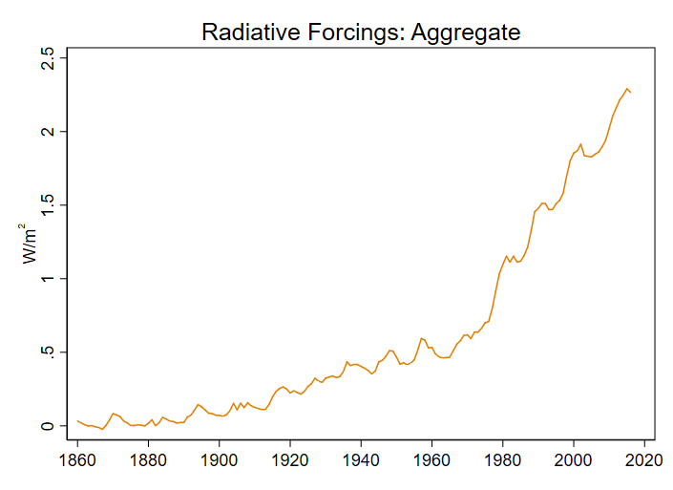
Causality 2: from anthropogenic emissions to temperatures
One “experiment”: Invention and withdrawal of CFS
CFCs introduced 1930s for refrigeration – use took off after WWII
Withdrawn under Montreal Protocl
Other “experiments”:
  Solar cycles
  Invention of automobile -> CO2 emissions from automobiles
  Perhaps, all anthropogenic CO2 emissions
Technical note: restrict to era of instrumental CO2 measurement (1959-)

Slide 25

IV estimation – methods
Instrument exogeneity:
u_{t} includes lag effects
Instrument (e.g. ∆_{h}RFSOLAR) is serially correlated
=> exogeneity condition violated
=> use innovation of original instrument as z_{t}
This is basically LP-IV, see Stock & Watson, EJ (2018)
Instruments are potentially weak
=> Both strong-IV and Anderson-Rubin confidence intervals
Potential serial correlation in process
  => HAR intervals (here, use QS kernel with fixed-b critical values)
  Lazarus, Lewis, Stock (2017); Lazarus, Lewis, Stock, Watson (2018)
$$u_{t}^{h}z_{t}$$

Slide 26
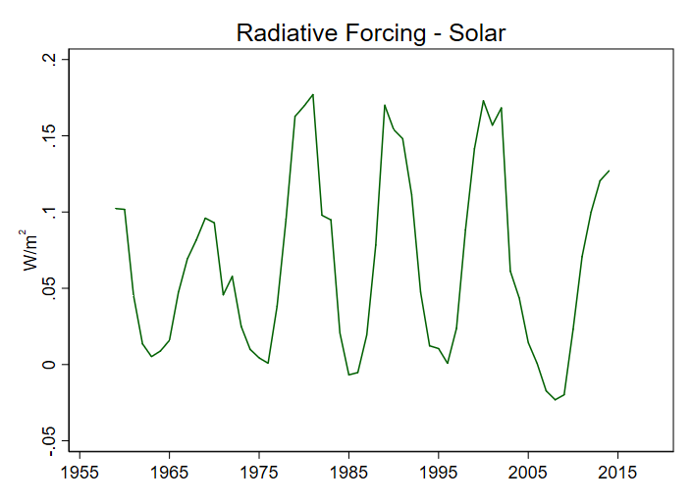
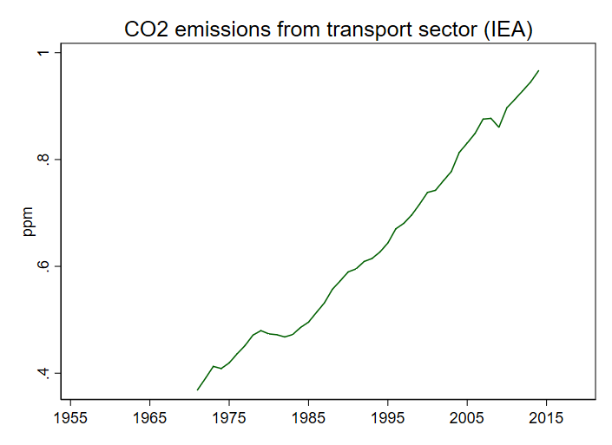
IV estimation – Instruments
Instrument Group A
Radiative forcing – solar
Contribution to CO2 RF from CO2 emitted from surface transport
  IEA, augmented with vehicle production
Instrument Group B
Contribution to CO2 RF from all anthropogenic
  IEA, Boden et al (2011)
RF from tropospheric SOX
  University of Melbourne

Slide 27
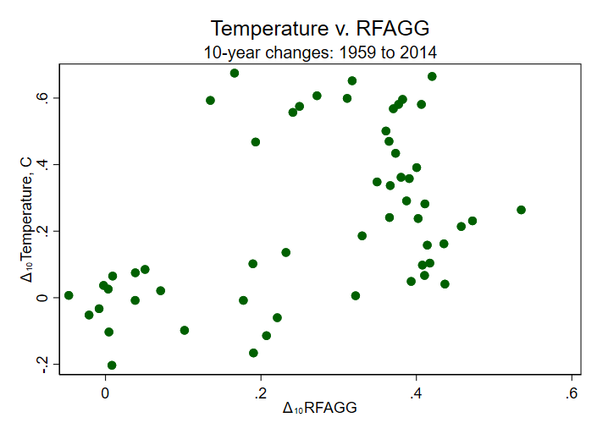
Temperature and Aggregate RF: 10-year changes

Slide 28
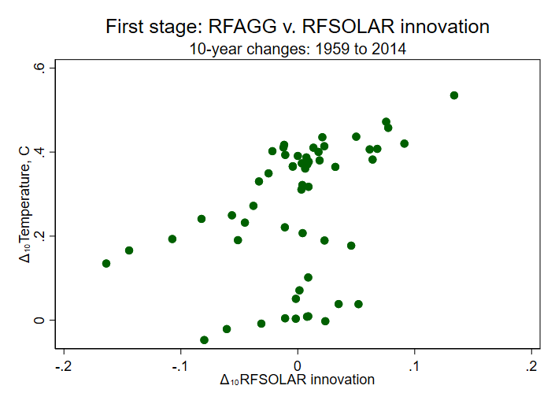
First stage scatterplots, 10-year diffs

Slide 29
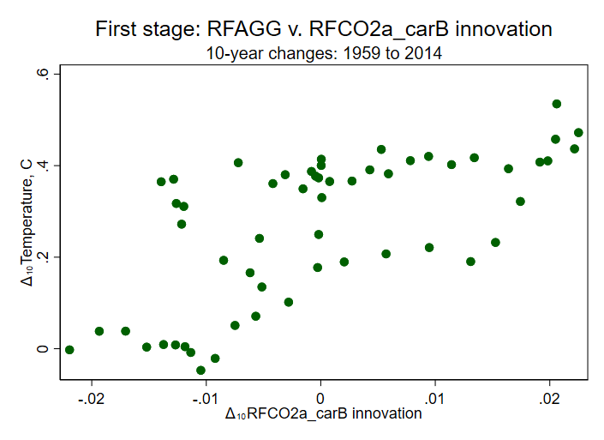
First stage scatterplots, 10-year diffs

Slide 30
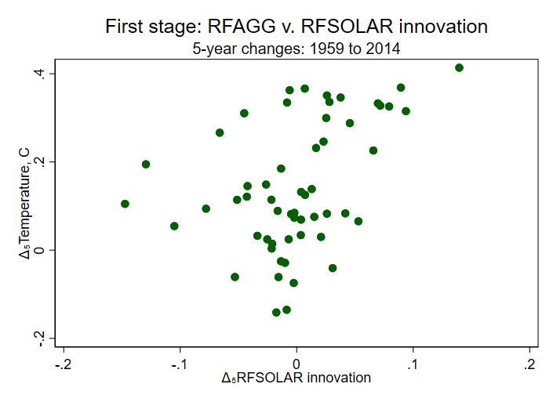
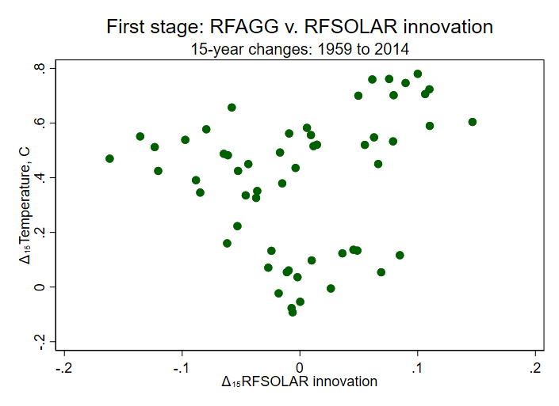
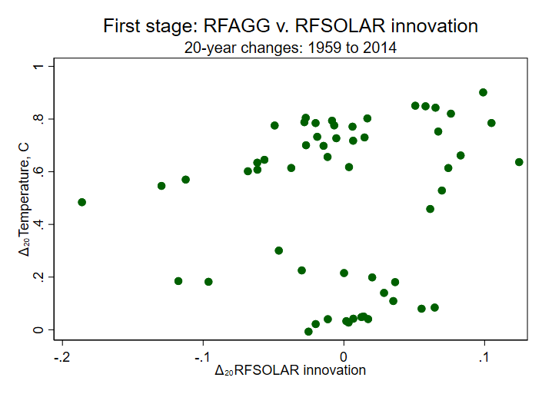
First stage scatterplots: 5, 10, 15, 20 year diffs - Solar

Slide 31
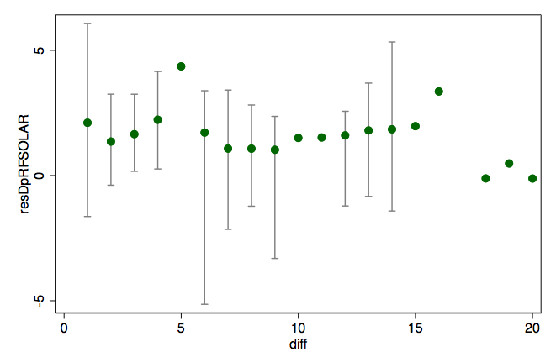
IV Results by horizon: IV = Solar
2SLS estimate and 95% HAR weak-IV robust CIs
IV: RFSOLAR innovation
Control variable: RF-Volcanic (stratospheric SOX)
Sample: 1959-2014

Slide 32
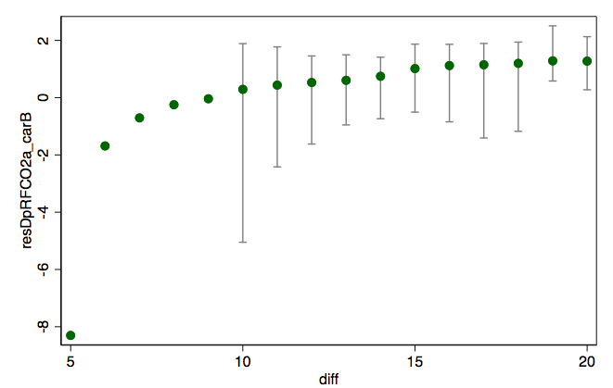
IV Results by horizon: IV = Car emissions
2SLS estimate and 95% HAR weak-IV robust CIs
IV: RFCO2-Cars innovation
Control variable: RF-Volcanic (stratospheric SOX)
Sample: 1959-2014

Slide 33
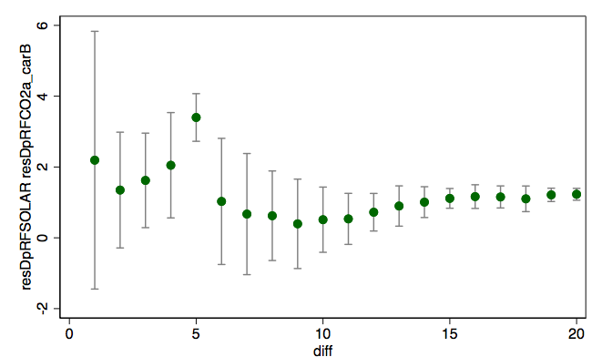
IV Results by horizon: IV = Solar, Car emissions
2SLS estimate and 95% HAR strong-IV CIs
IV: RFSOLAR, RFCO2-Cars innovation
Control variable: RF-Volcanic (stratospheric SOX)
Sample: 1959-2014

Slide 34
Estimates of TCR-h
Method | Instruments | Diff (h) | Estimate | 95% CI | First-stage F | Sample
OLS (Levels) | -- | -- | 1.5 |  | -- | 1860-2014
DOLS | -- | -- | 1.6 | (1.5, 1.7) |  | 1860-2014
DOLS | -- | -- | 1.4 | (1.2, 1.6) |  | 1959-2014
IV | RFSUN, RFCO2-Cars (k=2) | 15 | 1.1 | (.8, 1.4) | 24.9 | 1959-2014
IV | RFSUN, RFCO2-Cars (k=2) | 20 | 1.2 | (1.1, 1.4) | 41.5 | 1959-2014
IV | RFCO2-Anth + RFSOX-Anth | 10 | 1.5 | (0.6, 2.6) | 329.8 | 1959-2014
IV | RFCO2-Anth + RFSOX-Anth | 15 | 1.7 | (1.1, 2.5) | 327.8 | 1959-2014
IV | RFCO2-Anth + RFSOX-Anth | 20 | 2.1 | (1.1, 5.1) | 136.9 | 1959-2014
First-stage F’s are HAR. TCR-h is TCR estimated using h-differences IV. IV confidence intervals for k=1 are HAR-AR; for k=2 are HAR-strong-instrument. Temperature series is Hadley-4. IPCC-AR5 range for TCR is 1-2.5.

Slide 35
Some related work
Spatial-temporal
  Atak, Linton, and Xiao, J. Econometrics (2011)
  Bau, McInerny, and Stein, Environmetrics (2016)
  Castruccio and Stein, Ann. Appl. Stat. (2013)
  Chang et. al. (2016)
Longer data sets (500 year; paleo)
  Dergiades and Kaufmann, J Env Econ Mgt (2016)
  Davidson, Stephenson, Turasie, Environmetrics (2016)
  Kaufmann and Pretis, ms, (2017)
ECS/TCR
  Storelvmo, Leirvik, Johmann, Phillips, Nature Geoscience (2016)

Slide 36
Additional Slides

Slide 37
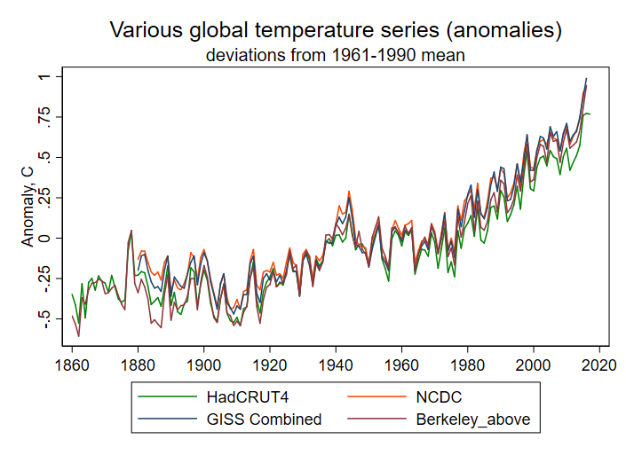
The temperature measurement debate

Slide 38
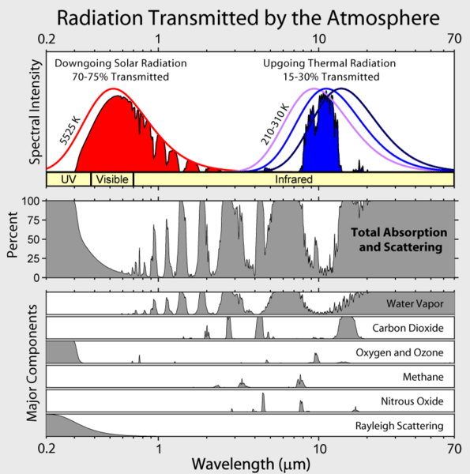
Radiative Forcing
Radiative forcing is computed by integrating intensity-emissions equations by altitude and by wavelength for a column of the atmosphere.
Radiative forcing is not linear in concentrations. For CO2,

