Slide 1
2016 Inflation: Drivers and Dynamics
Federal Reserve Bank of Cleveland
Sectoral Inflation Measures and
Cyclically Sensitive Inflation
September 30, 2016
James Stock, Harvard Economics
Mark Watson, Princeton University

Slide 2
1. What is the current value of the rate of price inflation?
U.S PCE inflation, headline and core, 1960q1-2016q2

Slide 3
U.S PCE inflation, headline and core, 2000m1-2016m3
 | 4-quarter inflation
 | PCE | Core PCE | CPI | Core CPI | 17-component trend
2015q3 | 0.3 | 1.3 | 0.1 | 1.8 | 1.4
2015q4 | 0.4 | 1.4 | 0.4 | 2.0 | 1.4
2016q1 | 0.9 | 1.6 | 1.1 | 2.3 | 1.4
2016q2 | 1.0 | 1.6 | 1.1 | 2.2 | 1.3

Slide 4
2. Where is the cyclical pressure on inflation?

Slide 5
Outline
Motivation & literature
PCE components: selective discussion
Measuring trend inflation using components
Cyclically sensitive inflation
  Cyclical behavior of different sectors
  methods
  results (preliminary/in progress)
Next steps

Slide 6
Selected literature
Productivity measurement: Byrne, Fernald, & Reinsdorf (2015), Feldstein (2016)
Core inflation & disaggregated inflation: Gordon (1975), Eckstein (1981), Bryan and Cecchetti (1993); Cristadoro, Forni, Reichlin, Veronese (2005), Boivin, Giannoni, and Mihov (2009), Reis and Watson (2010)
Trend inflation: Stock and Watson (2007), Cecchetti, Hooper, Kasman, Schoenholtz, and Watson (2007), Mertens (2012), Cogley, Primiceri, and Sargent (2010), Cogley and Sargent (2015), Chan, Koop, and Potter (2013), Garnier, Mertens, and Nelson (2013), Mertens and Nason (2015)
Inflation forecasting: vast
Phillips curve post-2009: Ball-Mazumder (2011, 2014), Stock (2011), Gordon (2013), Watson (2014), Kiley (2015), Blanchard (2016), many others
PC using sectoral inflation: Tallman and Zaman (2015), “Forecasting Inflation: Phillips Curve Effects on Services Price Measures,” ms, Cleveland Fed; Peach, Rich, and Lindner (2013)

Slide 7
2. PCE inflation components:
Data and Review of BLS and BEA Methods

Slide 8
PCE components and their shares, sorted by 2000-2014 share
Sector | 1960-2014 | 1960-1979 | 1980-1999 | 2000-2014
Housing and utilities | 0.18 | 0.17 | 0.18 | 0.18
Health care | 0.11 | 0.07 | 0.13 | 0.16
Other services | 0.08 | 0.08 | 0.08 | 0.09
Other nondurable goods | 0.08 | 0.08 | 0.07 | 0.08
Food and beverages for off-premises consumption | 0.12 | 0.16 | 0.10 | 0.08
Financial services and insurance | 0.06 | 0.05 | 0.07 | 0.08
Food services and accommodations | 0.06 | 0.06 | 0.07 | 0.06
Motor vehicles and parts | 0.05 | 0.06 | 0.05 | 0.04
Recreation services | 0.03 | 0.02 | 0.03 | 0.04
Clothing and footwear | 0.05 | 0.07 | 0.05 | 0.03
Recreational goods and vehicles | 0.03 | 0.03 | 0.03 | 0.03
Gasoline and other energy goods | 0.04 | 0.04 | 0.04 | 0.03
Transportation services | 0.03 | 0.03 | 0.03 | 0.03
Furnishings and durable household equipment | 0.04 | 0.04 | 0.03 | 0.03
Final consumption expenditures of nonprofit institutions serving households (NPISHs) | 0.02 | 0.02 | 0.02 | 0.03
Other durable goods | 0.02 | 0.02 | 0.02 | 0.02

Slide 9
The PCE price index: a brief review of methods
The PCE price index is computed by the Bureau of Economic Analysis (BEA)
  Most component price series are CPI indexes for components, computed by the Bureau of Labor Statistics (BLS)
  Differences between PCE-PI and CPI:
    PCE concept is final consumption, CPI is “out of pocket” spending
    Share weights are from the NIPA surveys
    PCE-PI is revised for methodological changes (if possible), CPI is not
    Some divergence in price concepts, in which PCE uses PPI not CPI prices
The market price component of the CPI has 211 item strata
  Goods and services. Nondurables: < 3 yrs life. Services: cannot be inventoried.
  Main sampling rotation structures:
    food at home, lodging, most consumer end-energy goods, telephone services, used cars, some odds and ends: Single panel sample monthly
    Everything else except rent (most regions): 2 panels, alternating months
    rent: 6 panels, each sampled every 6 months
  The market price component of the CPI has 211 item strata
  Market-based CPI has several well-known problems
    New goods problem: no quality adjustment, just skip first month price
    Replacement goods problem: quality adjustment by (a) hedonic regression or, if not possible, (b) production cost

Slide 10
The PCE price index: a brief review of methods, ctd.
The PCE-PI and the CPI are also computed for sectors without posted market prices. There are various methodologies:
  The first step is defining the unit to be priced. For example
    For legal services:
      an end-consumer legal service (e.g. will), with a fixed production function (hours of attorney, legal aide, etc) and changing input wages;
      or, an hour of a law office’s time
    For hospital services: a service bundle (e.g., 2 day stay + 1 cardiac catheterization + 2 EKGs + 2 IV doses blood thinner drug + …)
  These are priced from (randomly selected) bills or interviews
  Other price indexes for unpriced services include unpriced services of nonprofits (religious institutions, etc.), unpriced banking services (liquidity services)
  However, many services have market prices (Red Sox ticket; a room at Sonesta)
Special indexes:
  PCE-xE: excludes gasoline & other energy goods + energy utilities component of housing
  PCE-xFE: also excludes food at home (but not food at restaurants)
  Market-based CPI (excludes all non-market price estimates)

Slide 11
PCE (green) and component (orange): Housing ex energy util. (qtrly)
Rent paid by renters | Actual market rent excluding utilities 6 rotating panels, surveyed every 6 months Price index(t) = This month’s panel price relative × price index(t-1)
Owner-equivalent rent | Post-1983: Actual market rent excluding utilities Pre-1983: Payment flows (mortgage payments, etc) 6 rotating panels, index construction as for renters
Misc. | Surveyed units fractionally represent rental and owned units Boarding schools, group homes use renter’s rent index Utilities: CPI for water & sewer maint; CPI for garbage & trash collection

Slide 12
Food services & accommodations (0.06)
Purchased meals & beverages | CPI for categories of purchased meals & beverages (restaurant meals, bars, fast food, etc)
Institutional food & drink | Use market-based CPI for purchased meals & beverages by category
Accommodations | CPI for purchased lodging away from home. Boarding at schools: separate (market-price) CPI

Slide 13
Recreation services (0.04)
Sports centers & clubs, theaters, museums, etc. | CPI for specific categories, e.g. club dues and fees; admission to sporting events. Monthly/bi-monthly/6-month sample
Audio/video & info processing services | CPI for cable & satellite TV; CPI for film processing; CPI for video/audio rental
Other | Gambling: CPI-U; pet care: CPI-veterinary services, etc.

Slide 14
Food & beverages off-premises (0.08)
Food & nonalcoholic beverages, off-premises | Detailed price components for food at home
Alcohol, off-premises | Various CPIs (beer, wine, distilled spirits) for off-premises

Slide 15
Other nondurable goods (0.08)
Tobacco | CPI-tobacco
Pharmaceuticals | CPIs for prescription & OTC drugs, CPI for med. eqpt sold to consumers
Recreational nondurables | CPIs for toys, plants & flowers, pets, photographic supplies,…
Personal care | Various CPIs for personal care items
Misc. home goods | CPIs: newspapers & magazines, household supplies
Spending abroad | (net, including in-kind personal remittances) complicated, non-mkt

Slide 16
Other services (0.09)
Communication | CPI for wireless phone service, CPI for land line phone service
Internet | CPI for internet services
Education | CPI for college education; CPI for private primary & secondary schools
Legal, accounting | Cost basis (cost of 1 hr law office time, or mix of time for given service)
Social services | Cost basis, some CPI (child care)
Misc. | CPI for postage, CPI for funeral services, CPI for haircuts; net foreign travel (complicated)

Slide 17
Clothing & footwear (0.03)
Market purchased clothing | Various CPIs. Note new/replacement goods issue however.
Military & uniforms | Cost-based

Slide 18
Financial services & insurance (0.08)
Financial services provided w/out payment | Estimated based on imputed below-market interest on checking account. Alternative interest rate changed to “stabilized” (smoothed) rate in 2013, revised back to 1985
Financial fees | CPI for checking account and other bank services (market prices).
Insurance | Price index is for the value of insurance services provided (risk pooling, intermediation) = all premiums – expected losses; cost-based using PPI
Brokers’ fees | PPI (cost-based)

Slide 19
Final consumption expenditures of
nonprofit institutions serving households (NPISHs) (0.03)
NPISH definition | Current operating expenditures by nonprofits less sales to households and other sectors.
Prices | By construction, essentially everything in NPISHs does not have a market price, so costs of inputs are used for priced outputs. Example: price of 1 hour of a minister’s time = minister’s hourly wage

Slide 20
PCE price index measurement: Summary
Sector | Share (2000s) | Subtotals
A. Well-measured
Housing ex utilities | 0.16 | 0.34
Recreation services | 0.04
Food and beverages for off-premises consumption | 0.08
Food services and accommodations | 0.06
Housing - energy utilities component | 0.02 | 0.05
Gasoline and other energy goods | 0.03
B. Some information content
Other services | 0.09 | 0.29
Other nondurable goods | 0.08
Transportation services | 0.03
Motor vehicles and parts | 0.04
Other durable goods | 0.02
Furnishings and durable household equipment | 0.03
Health care | 0.16 | 0.16
C. Poorly measured
Recreational goods and vehicles | 0.03 | 0.17
Clothing and footwear | 0.03
Financial services and insurance | 0.08
NPISH | 0.03

Slide 21
3. Estimating Trend Inflation Using Components:
Time-series smoothing (trend)
+ cross-section signal extraction (core)

Slide 22
Unobserved component/stochastic volatility model
Stock-Watson (2007) UC-SV model, extended for internally handled outliers
trend + stationary component
random walk trend
stationary component serially uncorrelated
stochastic volatility in trend
stochastic volatility in stationary
normal errors, except for:
outlier adjustment (new)
The model has a TV-IMA(1,1) representation (TV Nelson-Schwert (1977))
3 parameters: γ_{ε}, γ_{Δτ}, p, estimated by Bayes methods (diffuse prior over parameters)

Slide 23
Multivariate extension: smooth over time and components
Data: 17 top-level components of PCE (housing divided into energy and ex-E)
MUCSVO model:
trend i and common trend follow random walk with SV
stationary i and common stationary are serially uncorrelated with SV
trend and stationary components follow SV processes (like univariate)
outliers indicators s_{it} are independent
Aggregate (average) inflation and trend is computed using share weights w_{it}
full Bayes estimation
note that cointegration of components is possible but not imposed

Slide 24
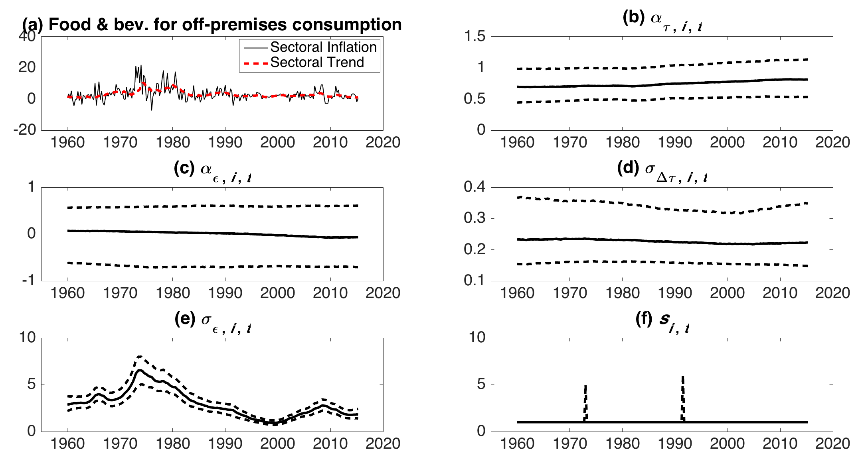
MUCSVO estimates: Food & bev. off-premises
Notes: Panel (a) inflation is the sector shown in the figure heading and the full-sample posterior mean of the sectoral trend. The other panels plot the full-sample posterior median and (point-wise) 67% intervals for the sector-specific parameters

Slide 25
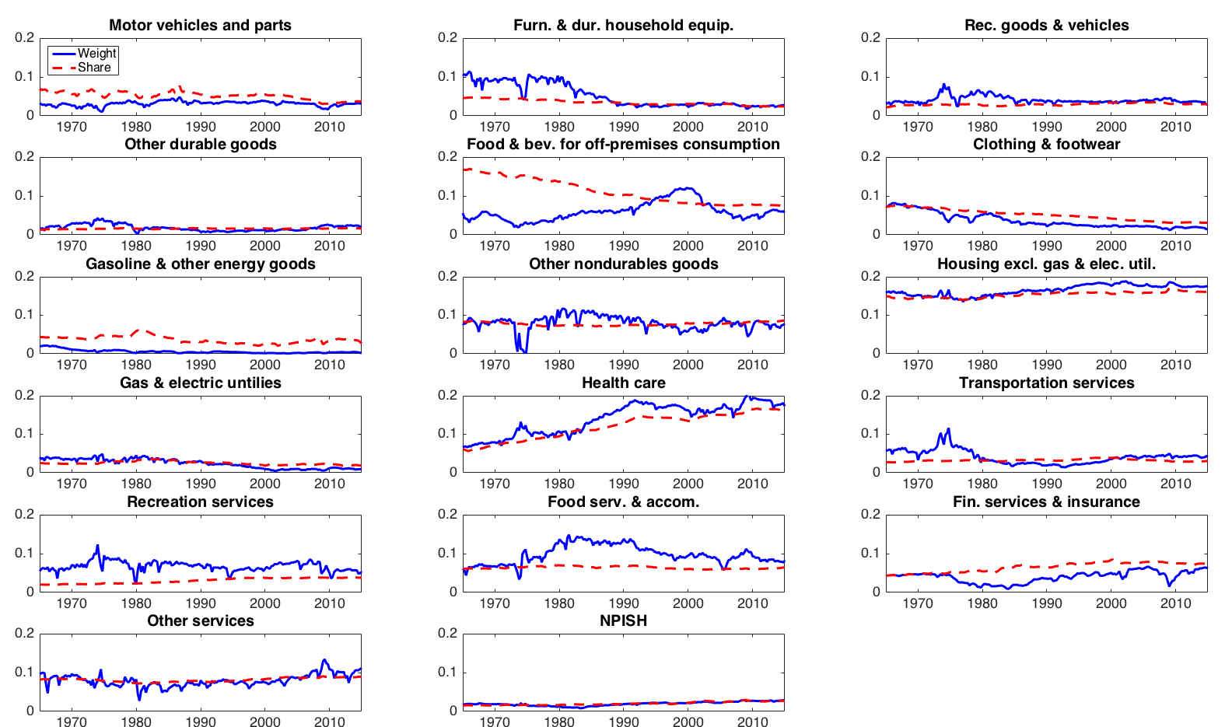
Approximate weights: MUCSVO-17 and expenditure share
–––– MUCSVO weight - - - - - Expenditure share

Slide 26
PCE-all and 17-component trend estimate (quarterly)

Slide 27
PCE-xE and 17-component trend estimate (quarterly)

Slide 28
Smoothed estimates of τ_{t}: PCE-all, 17 components (updated 9/26/16)
 |  | MUCSVO 17-component smoothed values
Date | PCE-all | Mean | .05 | .33 | .50 | .67 | .95
2008Q1 | 3.14 | 2.35 | 1.84 | 2.04 | 2.34 | 2.67 | 2.90
2008Q2 | 5.47 | 2.47 | 1.84 | 2.08 | 2.45 | 2.86 | 3.15
2008Q3 | 1.78 | 2.00 | 1.38 | 1.66 | 2.00 | 2.34 | 2.61
2008Q4 | -8.91 | 1.50 | 0.92 | 1.19 | 1.52 | 1.81 | 2.02
2009Q1 | 0.75 | 1.19 | 0.60 | 0.85 | 1.20 | 1.52 | 1.73
2009Q2 | 3.51 | 1.14 | 0.58 | 0.80 | 1.15 | 1.46 | 1.66
2009Q3 | 1.54 | 1.43 | 0.94 | 1.14 | 1.43 | 1.72 | 1.93
2009Q4 | 2.37 | 1.13 | 0.69 | 0.87 | 1.12 | 1.38 | 1.57
… | … | … | … | … | … | … | …
2015Q1 | -0.34 | 1.38 | 1.03 | 1.18 | 1.38 | 1.57 | 1.72
2015Q2 | 1.86 | 1.41 | 1.08 | 1.22 | 1.41 | 1.6 | 1.73
2015Q3 | 0.34 | 1.44 | 1.09 | 1.24 | 1.44 | 1.63 | 1.78
2015Q4 | 0.39 | 1.44 | 1.09 | 1.24 | 1.44 | 1.65 | 1.79
2016Q1 | 0.44 | 1.43 | 1.09 | 1.24 | 1.43 | 1.64 | 1.78
2016Q2 | 2.42 | 1.28 | 0.86 | 1.04 | 1.29 | 1.53 | 1.69
Actuals are 3-month percentage changes ending final month of quarter (saar).
Average width of 67% Interval = 1.04 (2008-2014)

Slide 29
Smoothed estimates of τ_{t}: PCE-xE, PCE-xFE (updated 9/26/16)
PCE-xE
 |  | UCSVO Univariate Smoothed Values
Date | PCE-xE | Mean | .05 | .33 | .50 | .67 | .95
2015Q1 | 1.58 | 1.39 | 1.09 | 1.22 | 1.40 | 1.56 | 1.68
2015Q2 | 1.45 | 1.39 | 1.10 | 1.22 | 1.39 | 1.55 | 1.67
2015Q3 | 1.23 | 1.36 | 1.07 | 1.20 | 1.36 | 1.53 | 1.65
2015Q4 | 1.52 | 1.40 | 1.10 | 1.23 | 1.40 | 1.57 | 1.70
2016Q1 | 1.59 | 1.39 | 1.07 | 1.21 | 1.38 | 1.57 | 1.70
2016Q2 | 1.00 | 1.29 | 0.90 | 1.07 | 1.29 | 1.50 | 1.66
PCE-xFE
 |  | UCSVO Univariate Smoothed Values
Date | PCE-xFE | Mean | .05 | .33 | .50 | .67 | .95
2015Q1 | 1.48 | 1.50 | 1.23 | 1.35 | 1.50 | 1.65 | 1.75
2015Q2 | 1.60 | 1.50 | 1.23 | 1.35 | 1.50 | 1.65 | 1.76
2015Q3 | 1.43 | 1.51 | 1.23 | 1.35 | 1.51 | 1.66 | 1.76
2015Q4 | 1.01 | 1.56 | 1.28 | 1.40 | 1.56 | 1.72 | 1.84
2016Q1 | 2.12 | 1.56 | 1.26 | 1.40 | 1.56 | 1.73 | 1.86
2016Q2 | 1.76 | 1.52 | 1.20 | 1.34 | 1.53 | 1.70 | 1.84

Slide 30
Cyclical Properties of Components
and “Cyclically Sensitive Inflation”

Slide 31
Cyclically Sensitive Inflation
Motivating question: is there any evidence of cyclical movements in inflation now that we are approaching/at full employment?
We propose “cyclically sensitive inflation”
Treat the Phillips curve as a statistical measurement problem
  Some components of inflation are poorly measured
  We would expect other components to exhibit extreme price sluggishness
  Other components of inflation would be expected to have a very low signal-to-noise ratio – so their demand/Phillips response would be difficult to decipher
Combine measurement quality considerations (BLS methods) and time series techniques
Organization:
  Quick tour of cyclical properties of selected components
  CSI: methods and preliminary estimates

Slide 32
π_{t} - π_{t-4} vs. ugap_{t}
1960-1983

Slide 33
π_{t} - π_{t-4} vs. ugap_{t}
1984-1999
1960-1983

Slide 34
π_{t} - π_{t-4} vs. ugap_{t}
2000-2016
1984-1999
1960-1983

Slide 35
Cyclical Properties of Components
Do components have different cyclical properties?
Do some components observe a more stable relation between changes in inflation and the unemployment rate/gap?
If so,
  have cyclical properties of components changed over time?
  how does the cyclicality of measured component inflation relate to the measurement quality of that component?
Figures
Band-pass filtered component rates of inflation (quarterly) and GDP growth
6-32 quarter pass band
“cyclical component of inflation and statistical estimate of GDP gap”

Slide 36
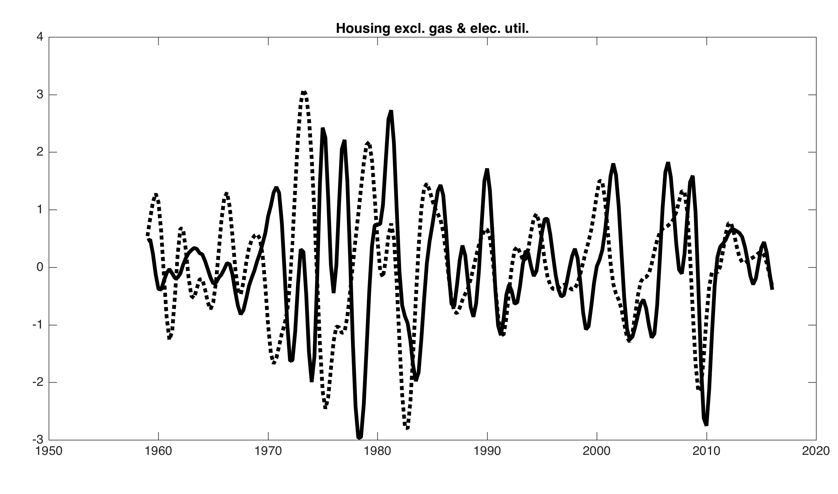
Band-pass filtered components and GDP (6-32 qtrs, standardized)

Slide 37
Phillips Curve Scatterplot: 4-qtr changes v. lagged short-term unempl
1960-1983
1984-1999
2000-2016

Slide 38
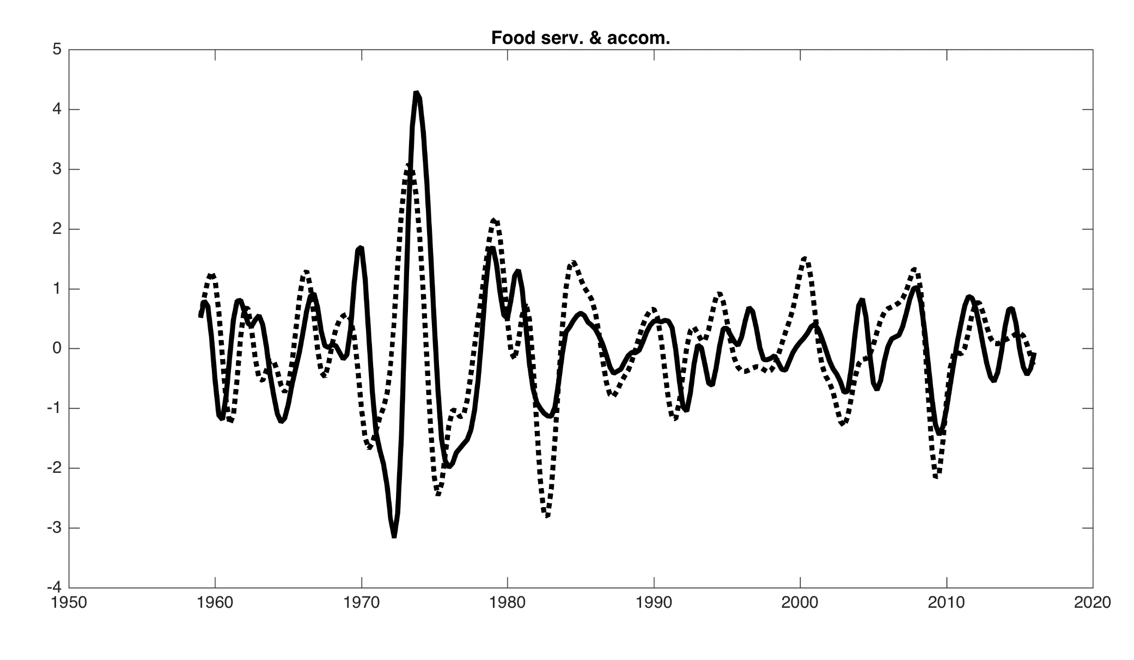
Band-pass filtered components and GDP (6-32 qtrs, standardized)

Slide 39
Phillips Curve Scatterplot: 4-qtr changes v. lagged short-term unempl
1960-1983
1984-1999
2000-2016

Slide 40
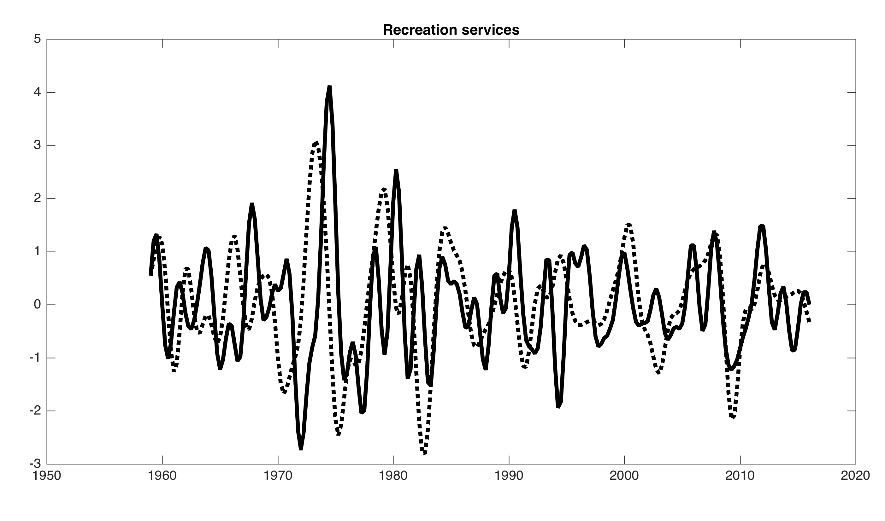
Band-pass filtered components and GDP (6-32 qtrs, standardized)

Slide 41
Phillips Curve Scatterplot: 4-qtr changes v. lagged short-term unempl
1960-1983
1984-1999
2000-2016

Slide 42
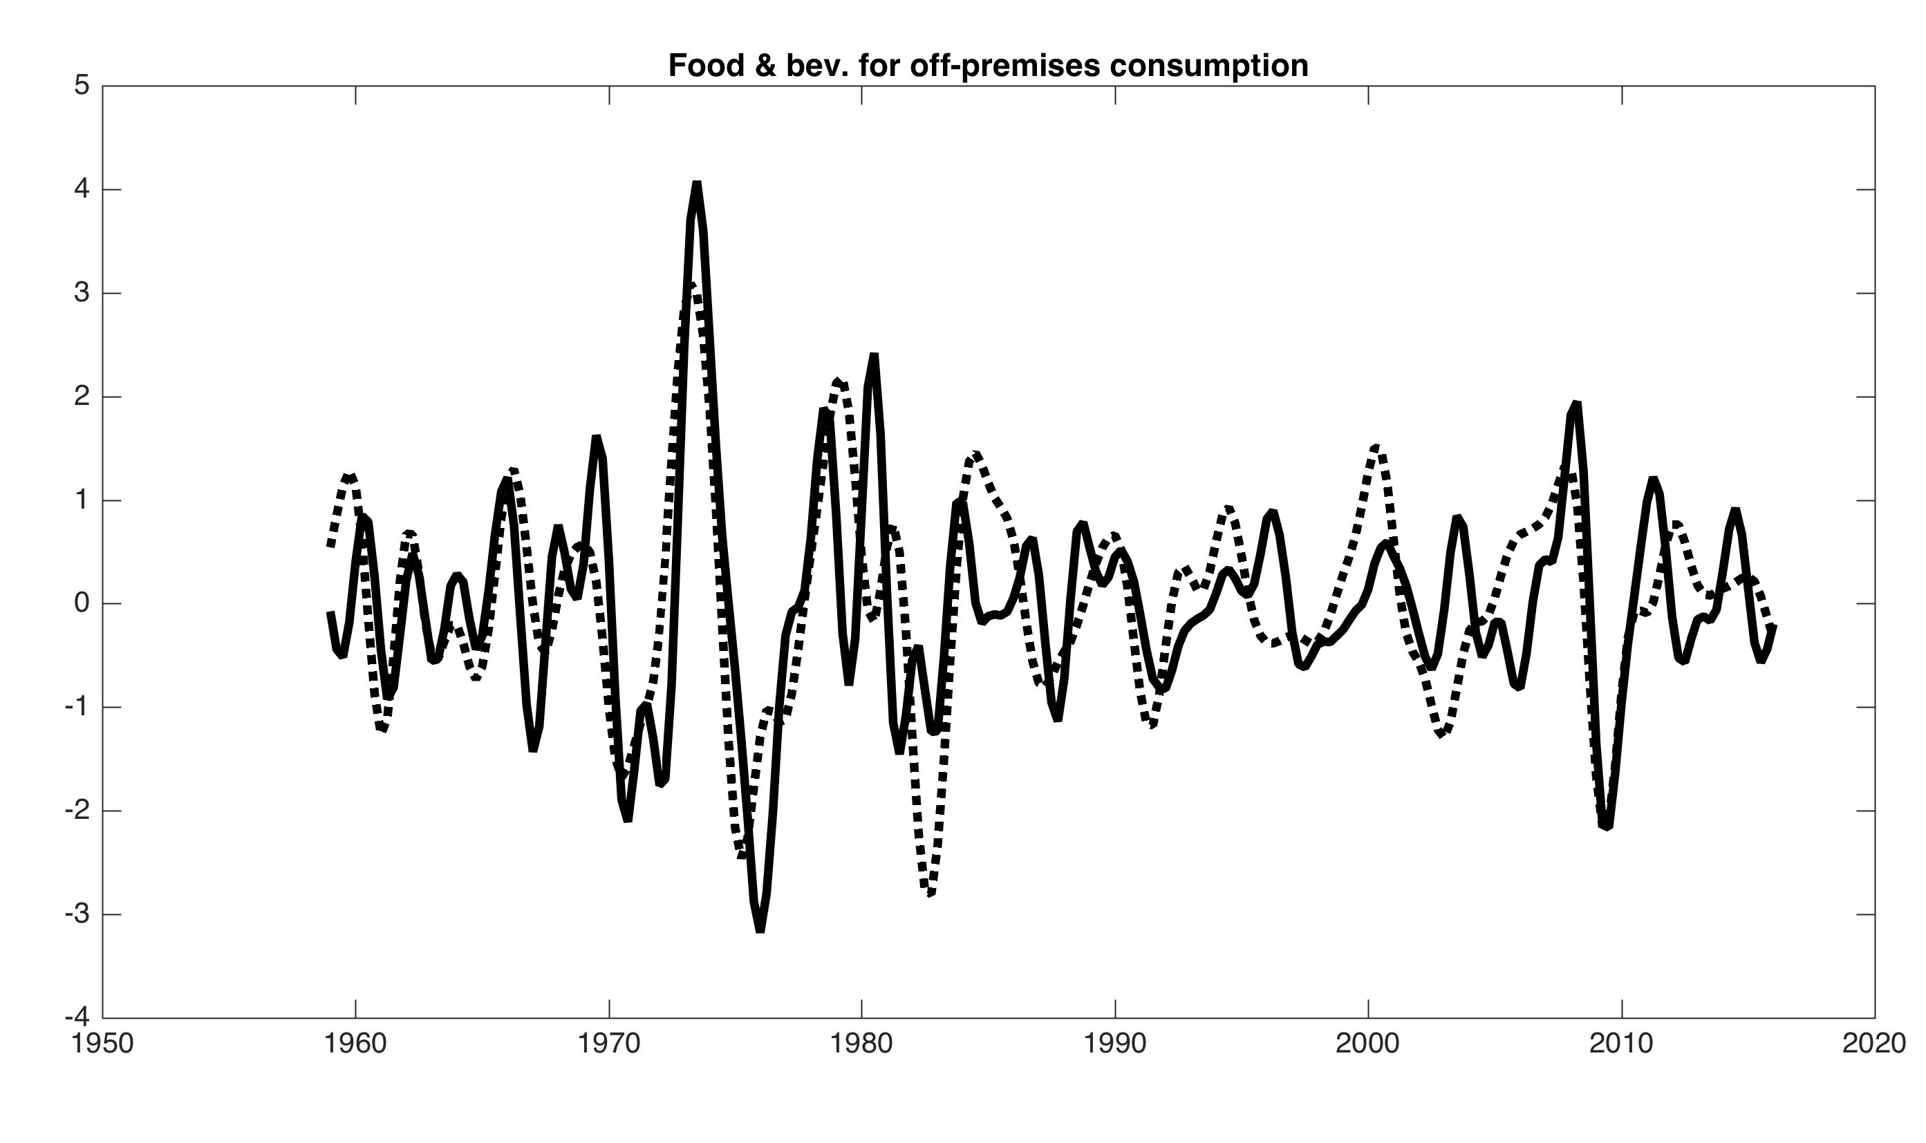
Band-pass filtered components and GDP (6-32 qtrs, standardized)

Slide 43
Phillips Curve Scatterplot: 4-qtr changes v. lagged short-term unempl
1960-1983
1984-1999
2000-2016

Slide 44
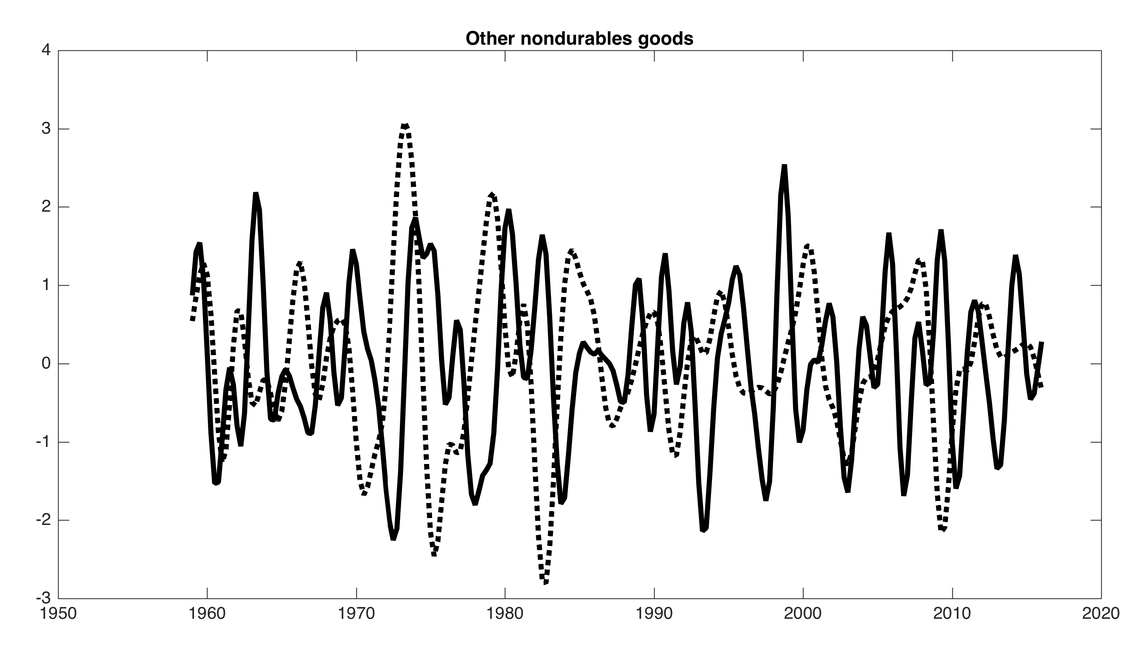
Band-pass filtered components and GDP (6-32 qtrs, standardized)

Slide 45
Phillips Curve Scatterplot: 4-qtr changes v. lagged short-term unempl
1960-1983
1984-1999
2000-2016

Slide 46
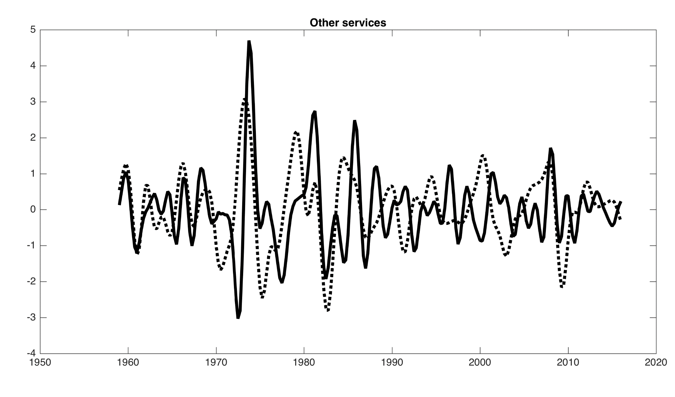
Band-pass filtered components and GDP (6-32 qtrs, standardized)

Slide 47
Phillips Curve Scatterplot: 4-qtr changes v. lagged short-term unempl
1960-1983
1984-1999
2000-2016

Slide 48
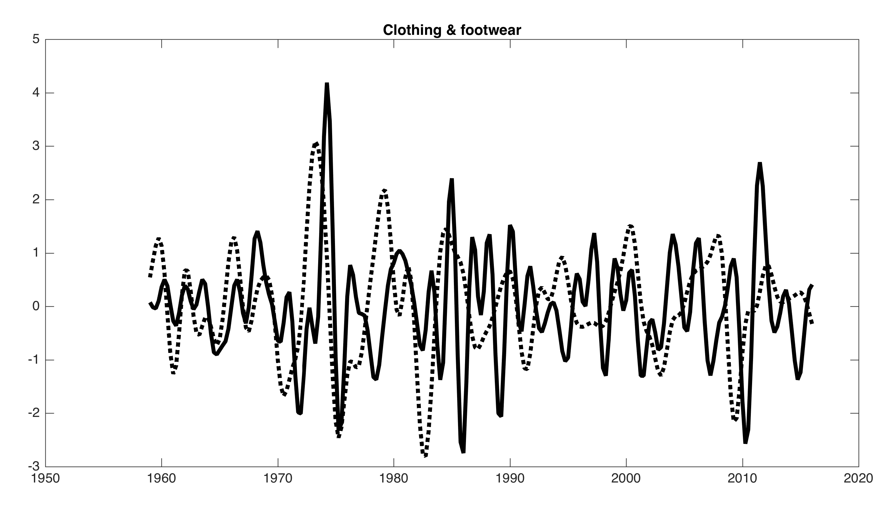
Band-pass filtered components and GDP (6-32 qtrs, standardized)

Slide 49
Phillips Curve Scatterplot: 4-qtr changes v. lagged short-term unempl
1960-1983
1984-1999
2000-2016

Slide 50
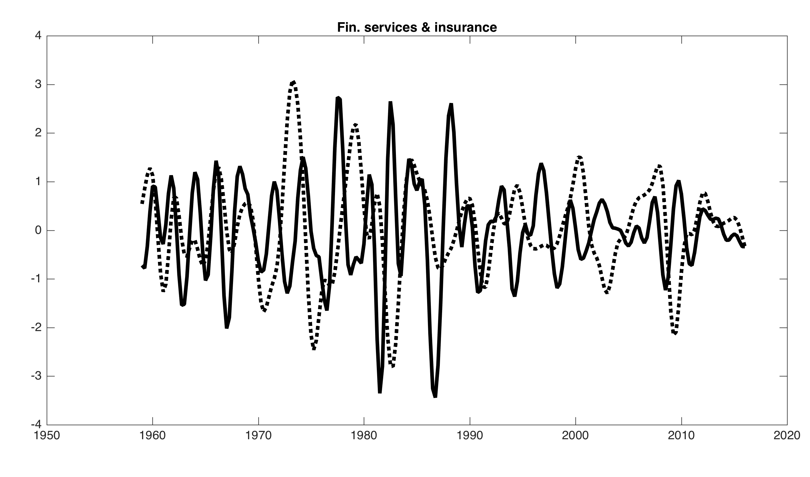
Band-pass filtered components and GDP (6-32 qtrs, standardized)

Slide 51
Phillips Curve Scatterplot: 4-qtr changes v. lagged short-term unempl
1960-1983
1984-1999
2000-2016

Slide 52
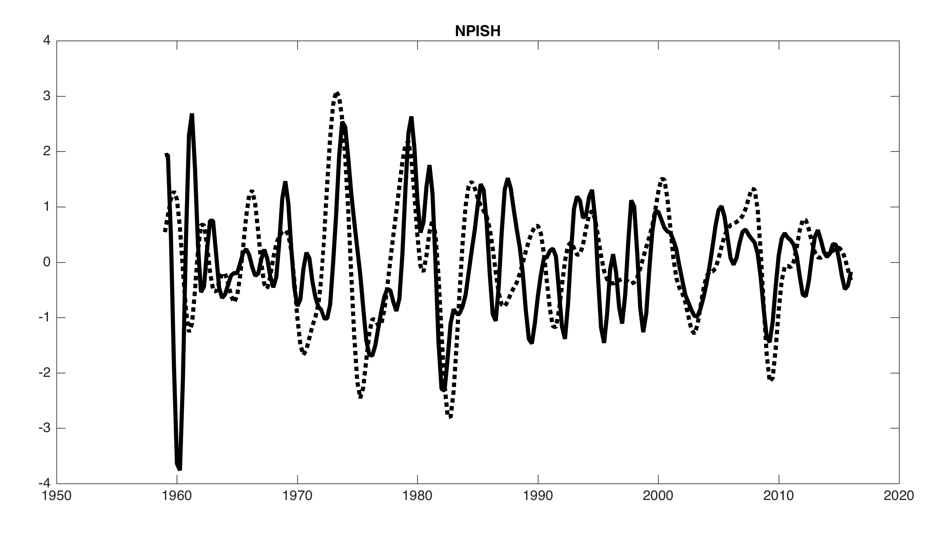
Band-pass filtered components and GDP (6-32 qtrs, standardized)

Slide 53
Phillips Curve Scatterplot: 4-qtr changes v. lagged short-term unempl
1960-1983
1984-1999
2000-2016

Slide 54
Exploratory regressions: components Phillips curves, 1984q1-2016q1
 | Unempl | Ugap-CBO | U<27
Housing ex gas & electric util | 0.000 | 0.000 | 0.000
Gas & electric util | 0.683 | 0.547 | 0.205
Health care | 0.006 | 0.196 | 0.121
Other services | 0.013 | 0.033 | 0.000
Other nondurable goods | 0.000 | 0.000 | 0.000
Food & beverages-off-premises | 0.027 | 0.021 | 0.022
Financial services & insurance | 0.059 | 0.094 | 0.309
Food services & accommodations | 0.000 | 0.001 | 0.000
Motor vehicles and parts | 0.078 | 0.149 | 0.135
Recreation services | 0.002 | 0.002 | 0.000
Clothing & footwear | 0.026 | 0.020 | 0.000
Recreational goods & vehicles | 0.559 | 0.635 | 0.219
Gasoline & other energy goods | 0.081 | 0.011 | 0.130
Transportation services | 0.016 | 0.042 | 0.002
Furnishings & durable hh eqpt | 0.232 | 0.294 | 0.012
NPISH | 0.022 | 0.020 | 0.021
Other durable goods | 0.593 | 0.384 | 0.326
PCE-all | 0.051 | 0.036 | 0.060
PCE-xE | 0.159 | 0.115 | 0.002
PCE-xFE | 0.024 | 0.037 | 0.006
Direct 4-qtr ahead forecasting regression
Dependent variable is cumulative 4-qtr inflation over next 4 quarters
Predictors are 4 lags of Δπ, u
No out-of-sample!
Entries are p-values on lags of the unemployment rate (HAC SEs)

Slide 55
Cyclically Sensitive Inflation

Slide 56
Measuring Cyclically Sensitive Inflation
Treat the Phillips curve as a statistical measurement problem
  Some components of inflation are poorly measured
  We would expect other components to exhibit extreme price sluggishness
  Other components of inflation would be expected to have a very low signal-to-noise ratio – so their demand/Phillips response would be difficult to decipher
Define cyclically sensitive inflation to be the weighted average of inflation that provides the most co-movement with a cyclical indicator.
Incorporate judgmental assessment of measurement quality
  Eliminate four categories based on a-priori concerns about measurement:
    Recreational goods & vehicles
    Clothing & footwear
    Financial services & insurance
    NPISH

Slide 57
Cyclically sensitive inflation: Methods (exploratory/preliminary)
Using the remaining 13 components:
Maximize the R² of the regression:
where BP is 6-32 quarter band-pass and x is one or more activity variables
Base case uses 0-3 lags of the unemployment rate
computed using 15-year rolling windows
Following figures
PC scatter for the series + TV weights and share weights by component
Rolling R2 (unadjusted) and R2 of comparison series
Cyclically sensitive inflation

Slide 58
PC plot and CSI share weights: Housing ex energy utilities

Slide 59
PC plot and CSI share weights: Food services & accommodations (0.06)

Slide 60
PC plot and CSI share weights: Recreation services (0.04)

Slide 61
PC plot and CSI share weights: Food & beverages off-premises (0.08)

Slide 62
PC plot and CSI share weights: Other nondurable goods (0.08)

Slide 63
PC plot and CSI share weights: Other services (0.09)

Slide 64
PC plot and CSI share weights: Gasoline & other energy goods (0.03)

Slide 65
Rolling R²s: BP inflation on 0-3 lags of BP unemployment rate

Slide 66
Rolling PCExE and CSI (4 quarter inflation)

Slide 67
Recent values: rolling CSI (quarterly inflation)

Slide 68
Summary
Components seem to have useful but time-varying information:
  Considerable changes in component series
  There are measurement-grounded reasons to allow the weights of core to evolve
  Automatic (hands-free) outlier adjustment useful & justified
  There is a case for including food-at-home in core (PCE-xE)
  There is no case for including energy in a trend/core estimate
Cyclical behavior varies substantially across components.
  Cyclically synchronized components:
    Housing ex energy (rent + OER)
    Food services & accommodations
    Recreation services
    Food & beverages off-premises
  Common features of these series:
    These cyclical series are a mix of durables and nondurbles
    They are all generally well-measured
    They are generally goods produced locally (not internationally priced)
  Some clearly not synchronized: durables + poorly-measured 4

Slide 69
Next steps
“Proper” time series model
    Rabbit hole problem: e.g. handling the 6-month rotating panel for rent, mixed 1-/2- month problem for other series, etc.
Out of sample stability
  This could include forecasting (e.g. Tallman and Zaman (2015) but note that we have cast this as a measurement/detection issue, not a forecasting problem
Further disaggregation?
  e.g. well-measured components of recreational services, or of food services & accommodations

Slide 70
Additional Slides

Slide 71
π_{t} - π_{t-4} vs. short-term unemployment rate: CSI
2000-2016
1984-1999
1960-1983

Slide 72
π_{t} - π_{t-4} vs. short-term unemployment rate: PCExE
2000-2016
1984-1999
1960-1983

Slide 73
Smoothed estimates of τ_{t}: PCE-all, 17 components (updated 5/23/16)
 |  | MUCSVO 17-component smoothed values
Date | PCE-all | Mean | .05 | .33 | .50 | .67 | .95
2008Q1 | 3.14 | 2.61 | 2.06 | 2.26 | 2.59 | 2.96 | 3.27
2008Q2 | 5.47 | 2.51 | 1.94 | 2.15 | 2.47 | 2.86 | 3.18
2008Q3 | 1.78 | 2.35 | 1.80 | 2.00 | 2.32 | 2.70 | 2.99
2008Q4 | -8.91 | 1.97 | 1.43 | 1.65 | 1.97 | 2.29 | 2.54
2009Q1 | 0.75 | 1.69 | 1.15 | 1.38 | 1.70 | 2.00 | 2.20
2009Q2 | 3.51 | 1.52 | 0.96 | 1.21 | 1.53 | 1.82 | 2.05
2009Q3 | 1.54 | 1.34 | 0.83 | 1.05 | 1.34 | 1.63 | 1.85
2009Q4 | 2.37 | 1.23 | 0.74 | 0.93 | 1.22 | 1.52 | 1.72
… | … | … | … | … | … | … | …
2014Q4 | -1.42 | 1.18 | 0.62 | 0.92 | 1.21 | 1.46 | 1.62
2015Q1 | -0.32 | 1.24 | 0.71 | 0.99 | 1.28 | 1.51 | 1.67
2015Q2 | 2.40 | 1.38 | 0.86 | 1.14 | 1.41 | 1.64 | 1.80
2015Q3 | 0.08 | 1.29 | 0.75 | 1.05 | 1.32 | 1.56 | 1.72
2015Q4 | 0.47 | 1.24 | 0.72 | 0.99 | 1.27 | 1.50 | 1.66
2016Q1 | 0.35 | 1.45 | 0.91 | 1.18 | 1.47 | 1.73 | 1.91
Actuals are 3-month percentage changes ending final month of quarter (saar).
Average width of 67% Interval = 1.04 (2008-2014)

Slide 74
Smoothed estimates of τ_{t}: PCE-xE, PCE-xFE (updated 5/23/16)
PCE-xE
 |  | UCSVO Univariate Smoothed Values
Date | PCE-xE | Mean | .05 | .33 | .50 | .67 | .95
2014Q4 | 0.80 | 1.33 | 0.97 | 1.14 | 1.34 | 1.52 | 1.66
2015Q1 | 1.15 | 1.34 | 1.01 | 1.16 | 1.35 | 1.53 | 1.65
2015Q2 | 1.58 | 1.39 | 1.07 | 1.21 | 1.38 | 1.56 | 1.70
2015Q3 | 1.42 | 1.37 | 1.03 | 1.19 | 1.38 | 1.56 | 1.70
2015Q4 | 0.88 | 1.34 | 0.98 | 1.14 | 1.35 | 1.54 | 1.70
2016Q1 | 1.72 | 1.41 | 1.02 | 1.19 | 1.41 | 1.64 | 1.81
PCE-xFE
 |  | UCSVO Univariate Smoothed Values
Date | PCE-xFE | Mean | .05 | .33 | .50 | .67 | .95
2014Q4 | 0.73 | 1.41 | 1.06 | 1.22 | 1.42 | 1.59 | 1.70
2015Q1 | 1.53 | 1.45 | 1.15 | 1.29 | 1.46 | 1.62 | 1.74
2015Q2 | 1.70 | 1.48 | 1.19 | 1.31 | 1.48 | 1.65 | 1.76
2015Q3 | 1.38 | 1.47 | 1.16 | 1.3 | 1.48 | 1.65 | 1.77
2015Q4 | 1.10 | 1.48 | 1.14 | 1.29 | 1.48 | 1.66 | 1.80
2016Q1 | 2.03 | 1.55 | 1.18 | 1.34 | 1.54 | 1.75 | 1.94

Slide 75
U.S PCE inflation, headline and core (monthly, MA(3))

Slide 76
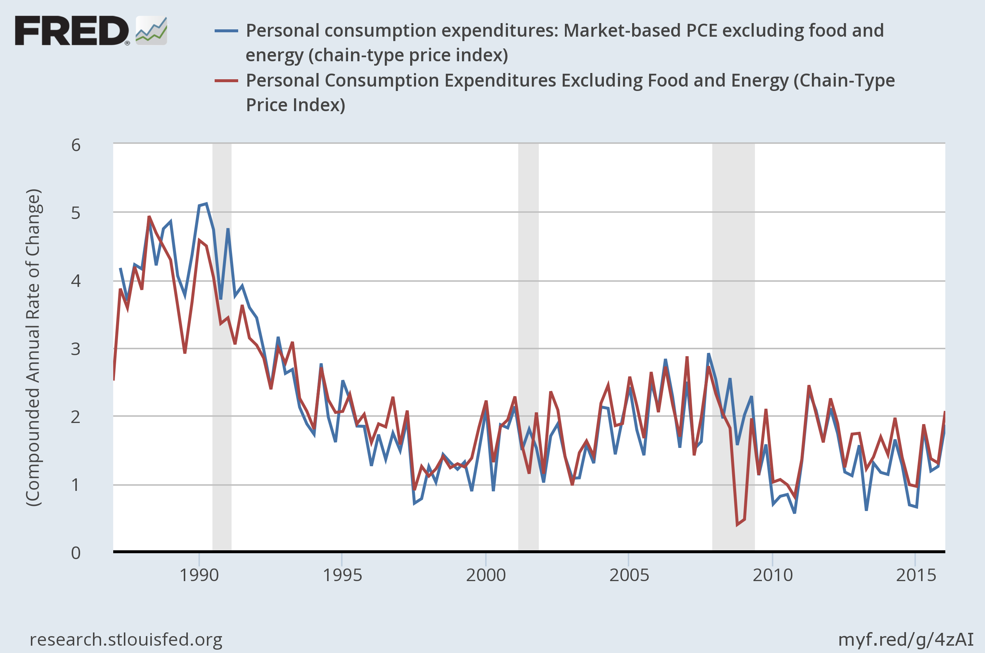
PCE-xFE and Market-based PCE-xFE

Slide 77
Core Inflation and Trend Inflation
Eckstein (1981), as quoted in Zeldes (1994) and Wynne (2008) defined core inflation as:
  the core rate reflects those price increases made necessary by increases in the trend costs of the inputs to production. The cost increases, in turn, are largely a function of underlying price expectations. These expectations are the results of previous experience, which, in turn, is created by the history of demand and shock inflation
Bryan and Cecchetti (1994): core inflation is an estimate of trend inflation
In practice:
Trend inflation is a time-series smoothing problem
Core inflation is implemented as cross-sectional averaging

Slide 78
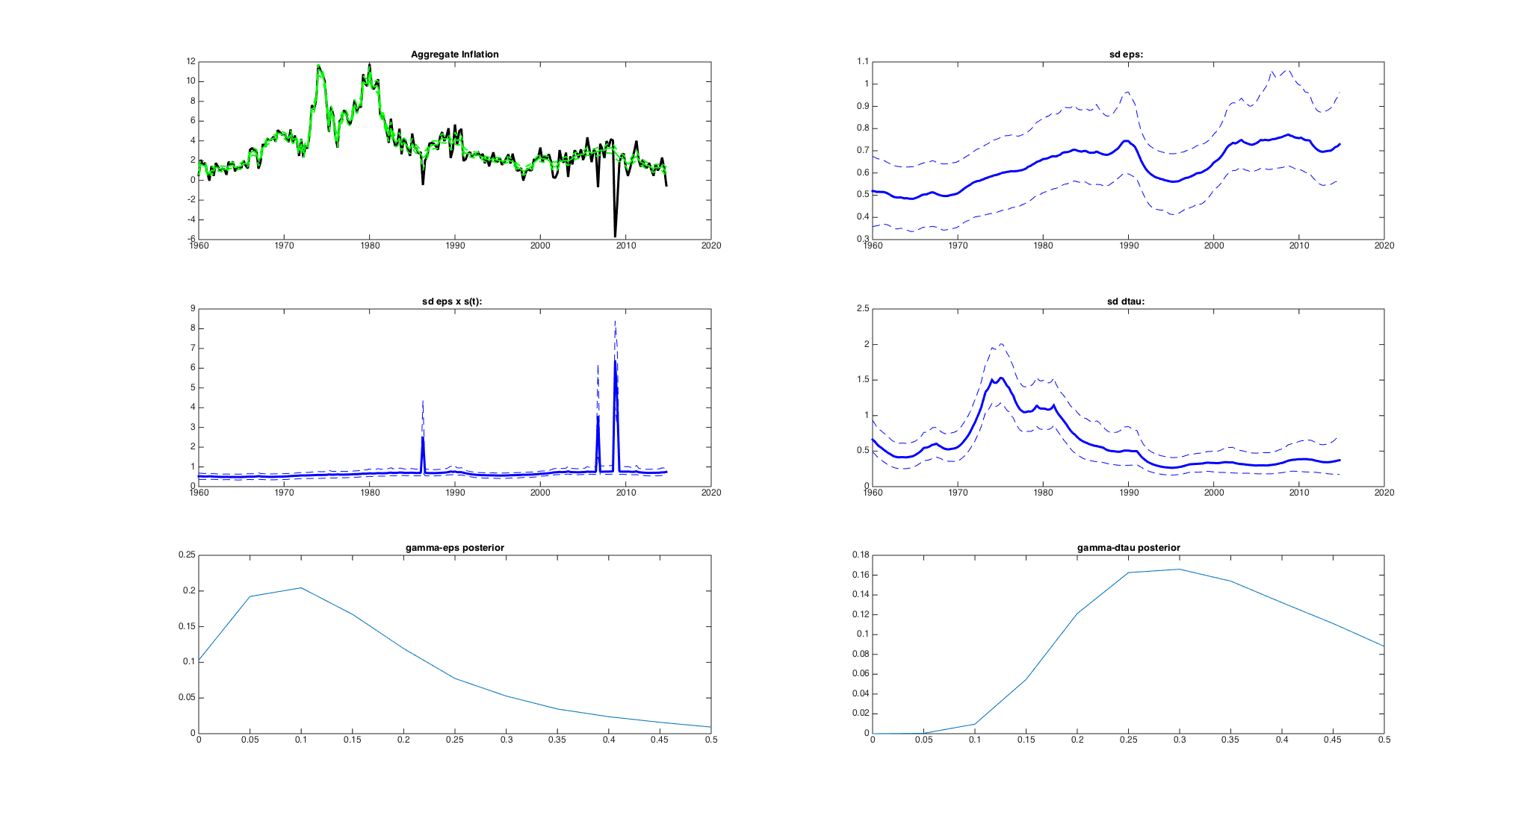
Time variation in the inflation process: trend estimates
There has been a large amount of time variation in the processes for headline and core inflation
  Decrease in relative volatility of trend component since 70s-80s
  This has the effect of increasing optimal amount of smoothing (trend varies less so use longer smoother to reduce transitory noise)
PCE-all, qtrly: Trend estimate (smoothed) and 67% bands

Slide 79
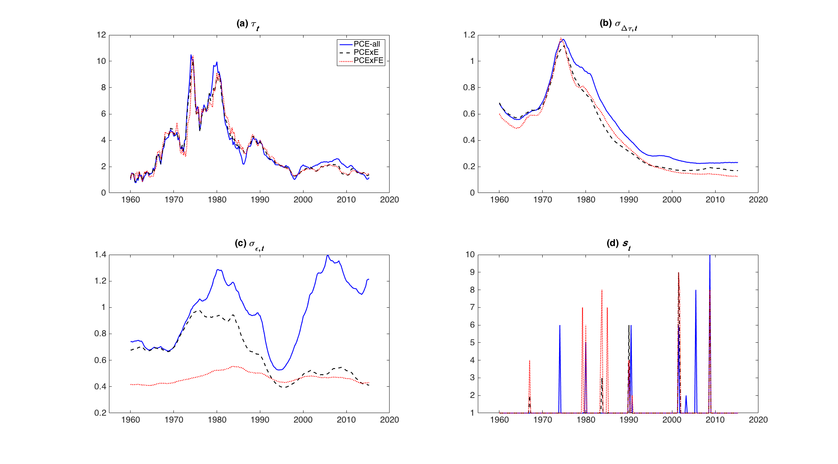
Full-sample posterior for SV processes
PCE-all (blue), PCExE (blue dash), PCExFE (red)
Trend volatility (above right) has declined sharply from 70s-80s
for PCE-all, transitory volatility is as high now as in 70s (left) –
but (left)
  XE transitory volatility has fallen
  XFE transitory volatility remains low

Slide 80
Housing: energy utilities
Electricity | CPI for electricity
Natural gas | CPI for utllity-provided natural gas

Slide 81
Health care (expenditure share 2000-2016 = 0.16): CPI
CPI v. PCE | CPI covers out-of-pocket medical (paid by consumers). PCE covers consumption of medical services. Most medical services in the U.S. do not have a market price – they are negotiated health plan prices
CPI: Outpatient physician’s services, paramedics, hospitals, nursing homes | Provision-of-services concept. CPI outpatient: price of visit for a specific illness. CPI hospital (post-87): price of bundle of services provided (3-day stay + 1 catheterization + 2 EKGs +… ) by insurer reimbursement category. CPI pharma: by drug. Pre-87: cost of hospital inputs
Dental & other medical | CPI for dental services, CPI for other medical services

Slide 82
Health care (0.16): PCE
PPI concept | PPI usually first transaction price rec’d by producer. For health care, PPI since 1993 is DRG-based, broken out by service providers
PCE: Physician services | PPI for physician offices. Unit is office visit for a given condition
PCE: hospital services | PPI for hospitals. Unit is a hospital episode for a given condition
PCE: nursing homes | PPI for nursing homes. Cost of inputs basis (hourly wages etc.)
PCE: paramedical | PPI for paramedical
Dental & other medical | Uses CPIs for dental services, for other medical services

Slide 83
Motor vehicles & parts (0.04)
New cars & trucks | CPI-new cars: sticker price + 30-day average dealer markup or discount. Year to year quality changes priced on production cost.
Used cars & trucks | Secondary source price data, with quality adjustments when new
Parts | CPI for tires; CPI for parts

Slide 84
Recreational goods & vehicles (0.03)
Video, audio, home computers | Various CPIs including CPI for home computers, CPI for computer software and accessories, and CPI for consumer digital communications and information processing eqpt
Sporting eqp | CPI for sporting eqpt
Recreational books | CPI for recreational books
Musical instruments | CPI for musical instruments

Slide 85
Gasoline & other energy goods (0.03)
Motor fuels | CPI for motor fuels
Other fuels | CPIs for propane, kerosene, wood

Slide 86
Transportation services (0.03)
Airline travel | PPI (cost-based: passenger revenues/total passenger-miles) (however CPI is based on actual prices, currently sampled off the Web)
Intracity | CPI (covers taxis, busses, etc.)
Intercity busses, trains | CPI (market prices)
Water | CPI (ferries, etc.)

Slide 87
Furnishings & household durables (0.03)
Furniture & bedding | CPI for furniture & bedding; CPI for clocks & lamps; related CPIs
Household appliances | Various CPIs
Tools, house & garden eqpt | Various CPIs

Slide 88
Other durable goods (0.02)
Misc. durable goods | Watches, jewelry, educational books, luggage, telephone equipment. All based on CPIs (market prices)

Slide 89
π_{t} - π_{t-4} vs. Short-term unemployment rate_{t}
1960-1983

Slide 90
π_{t} - π_{t-4} vs. Short-term unemployment rate_{t}
1984-1999
1960-1983

Slide 91
π_{t} - π_{t-4} vs. Short-term unemployment rate_{t}
2000-2016
1984-1999
1960-1983

Slide 92
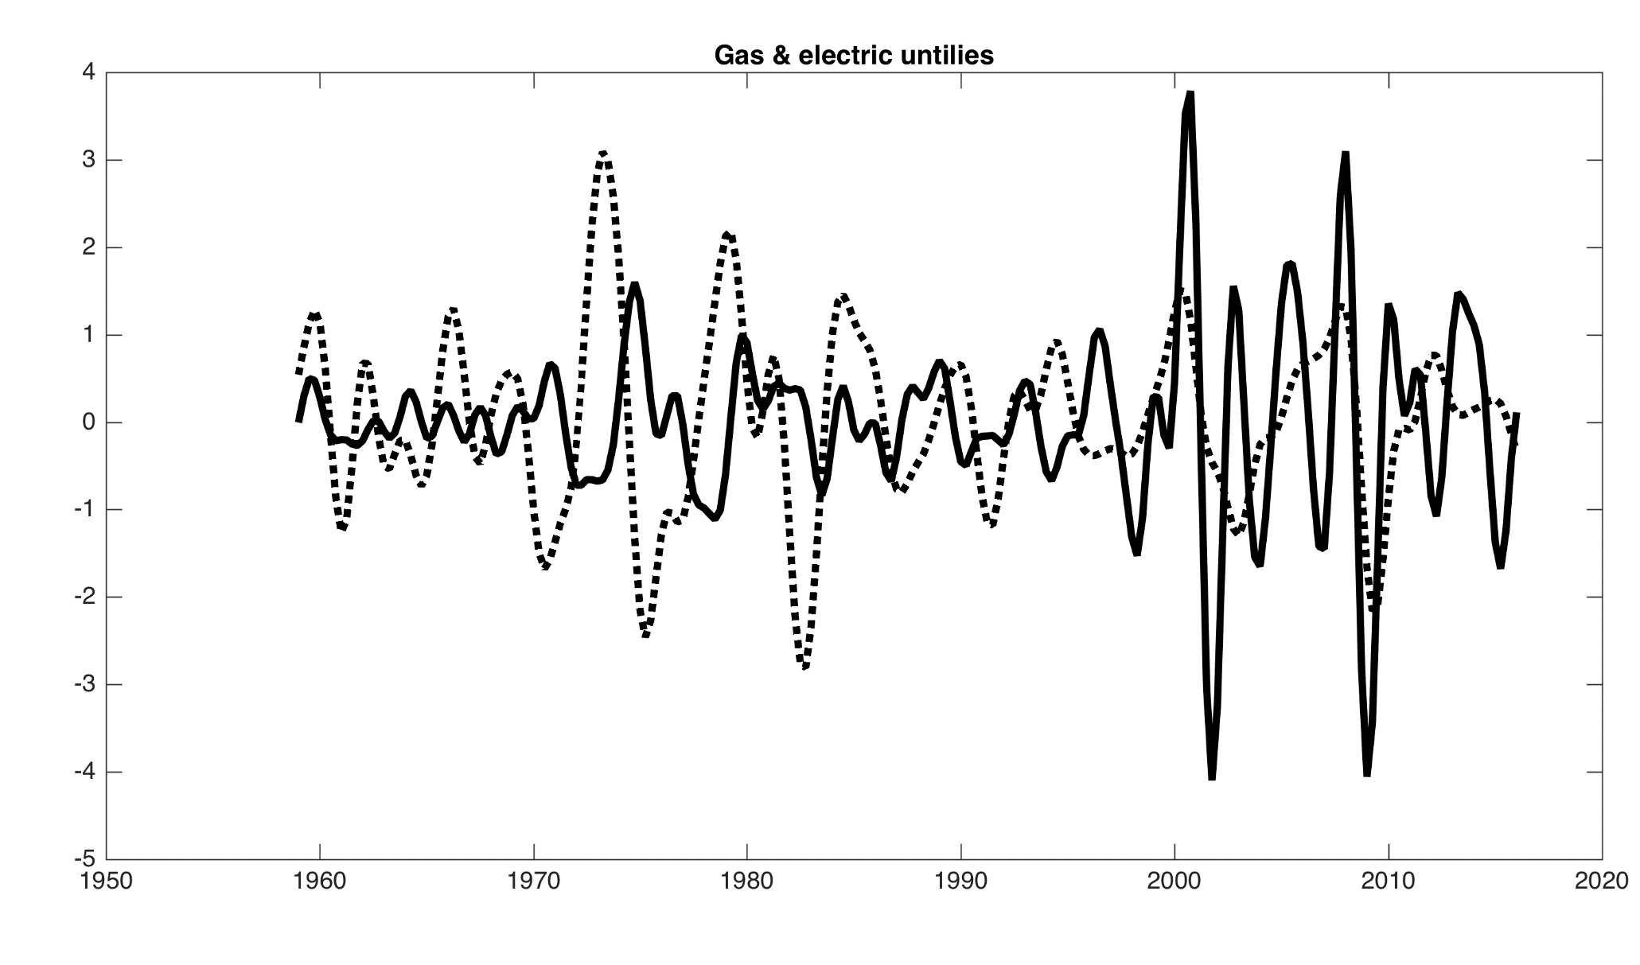
Band-pass filtered components and GDP (6-32 qtrs, standardized)

Slide 93
Phillips Curve Scatterplot: 4-qtr changes v. lagged short-term unempl
1960-1983
1984-1999
2000-2016

Slide 94
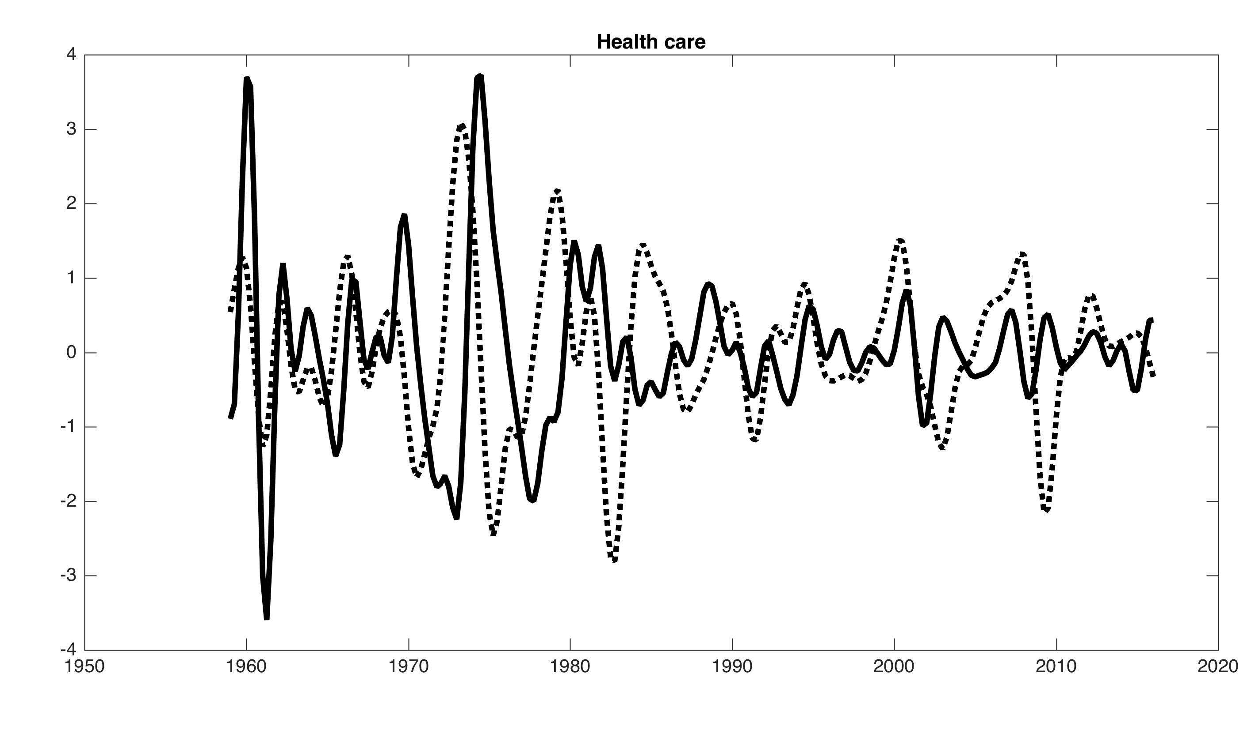
Band-pass filtered components and GDP (6-32 qtrs, standardized)

Slide 95
Phillips Curve Scatterplot: 4-qtr changes v. lagged short-term unempl
1960-1983
1984-1999
2000-2016

Slide 96
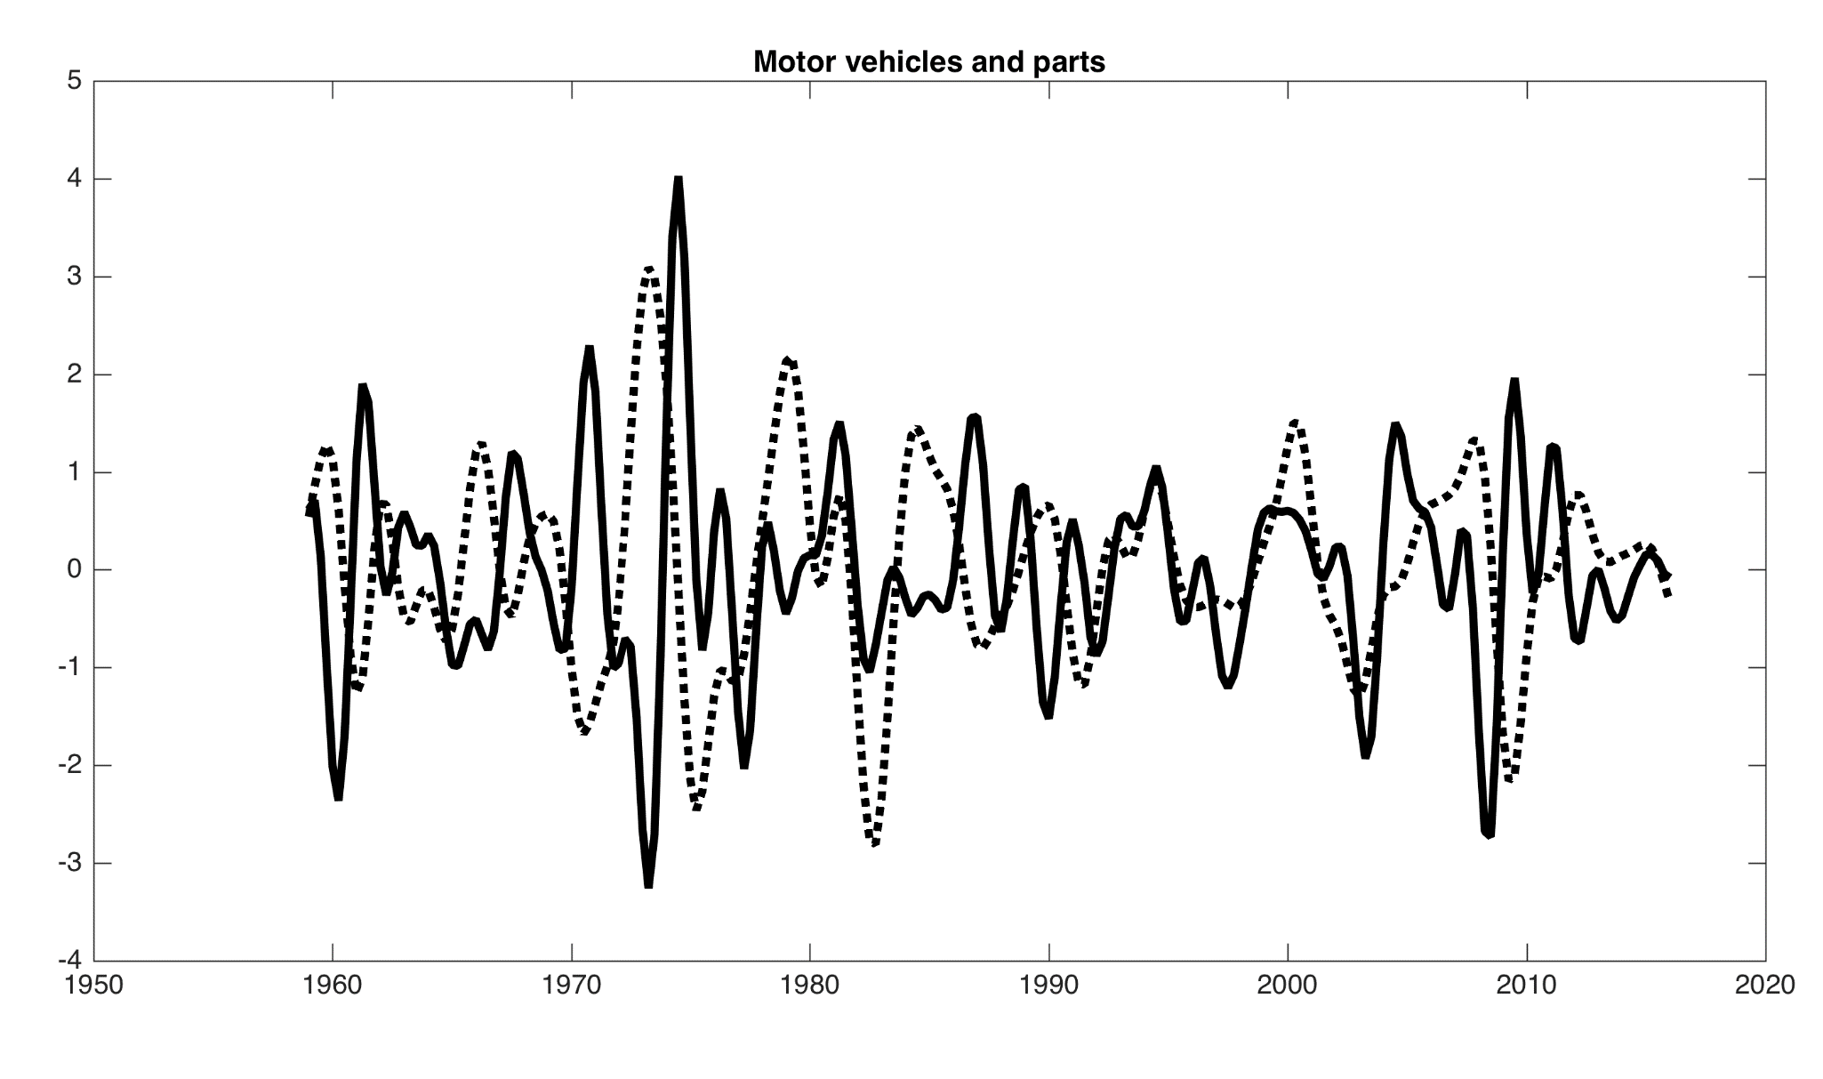
Band-pass filtered components and GDP (6-32 qtrs, standardized)

Slide 97
Phillips Curve Scatterplot: 4-qtr changes v. lagged short-term unempl
1960-1983
1984-1999
2000-2016

Slide 98
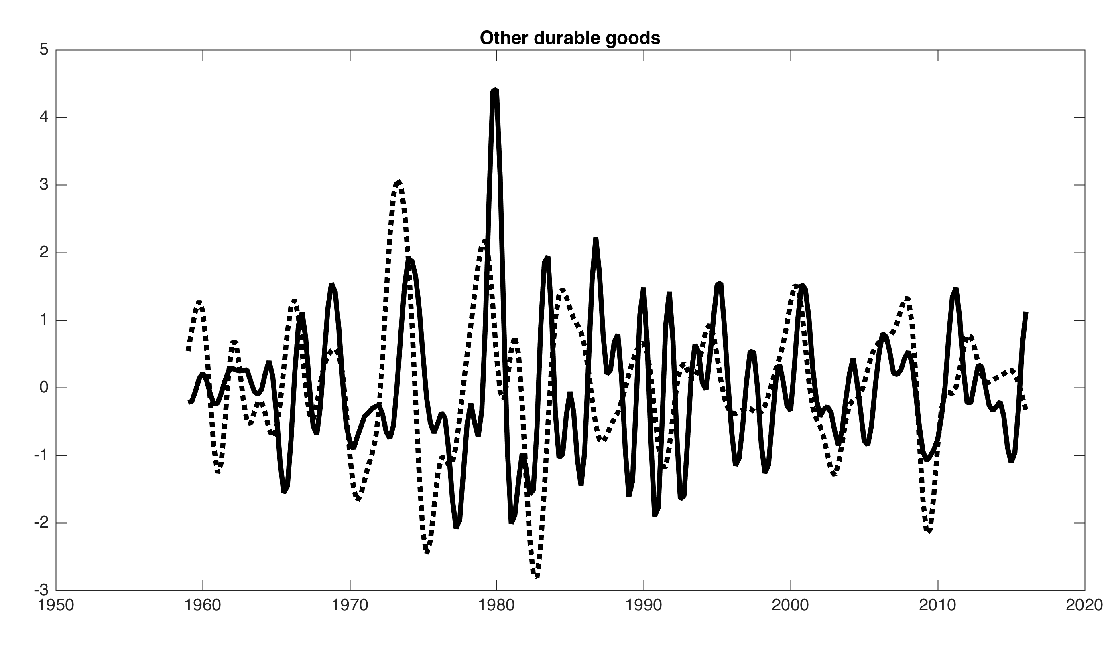
Band-pass filtered components and GDP (6-32 qtrs, standardized)

Slide 99
Phillips Curve Scatterplot: 4-qtr changes v. lagged short-term unempl
1960-1983
1984-1999
2000-2016

Slide 100
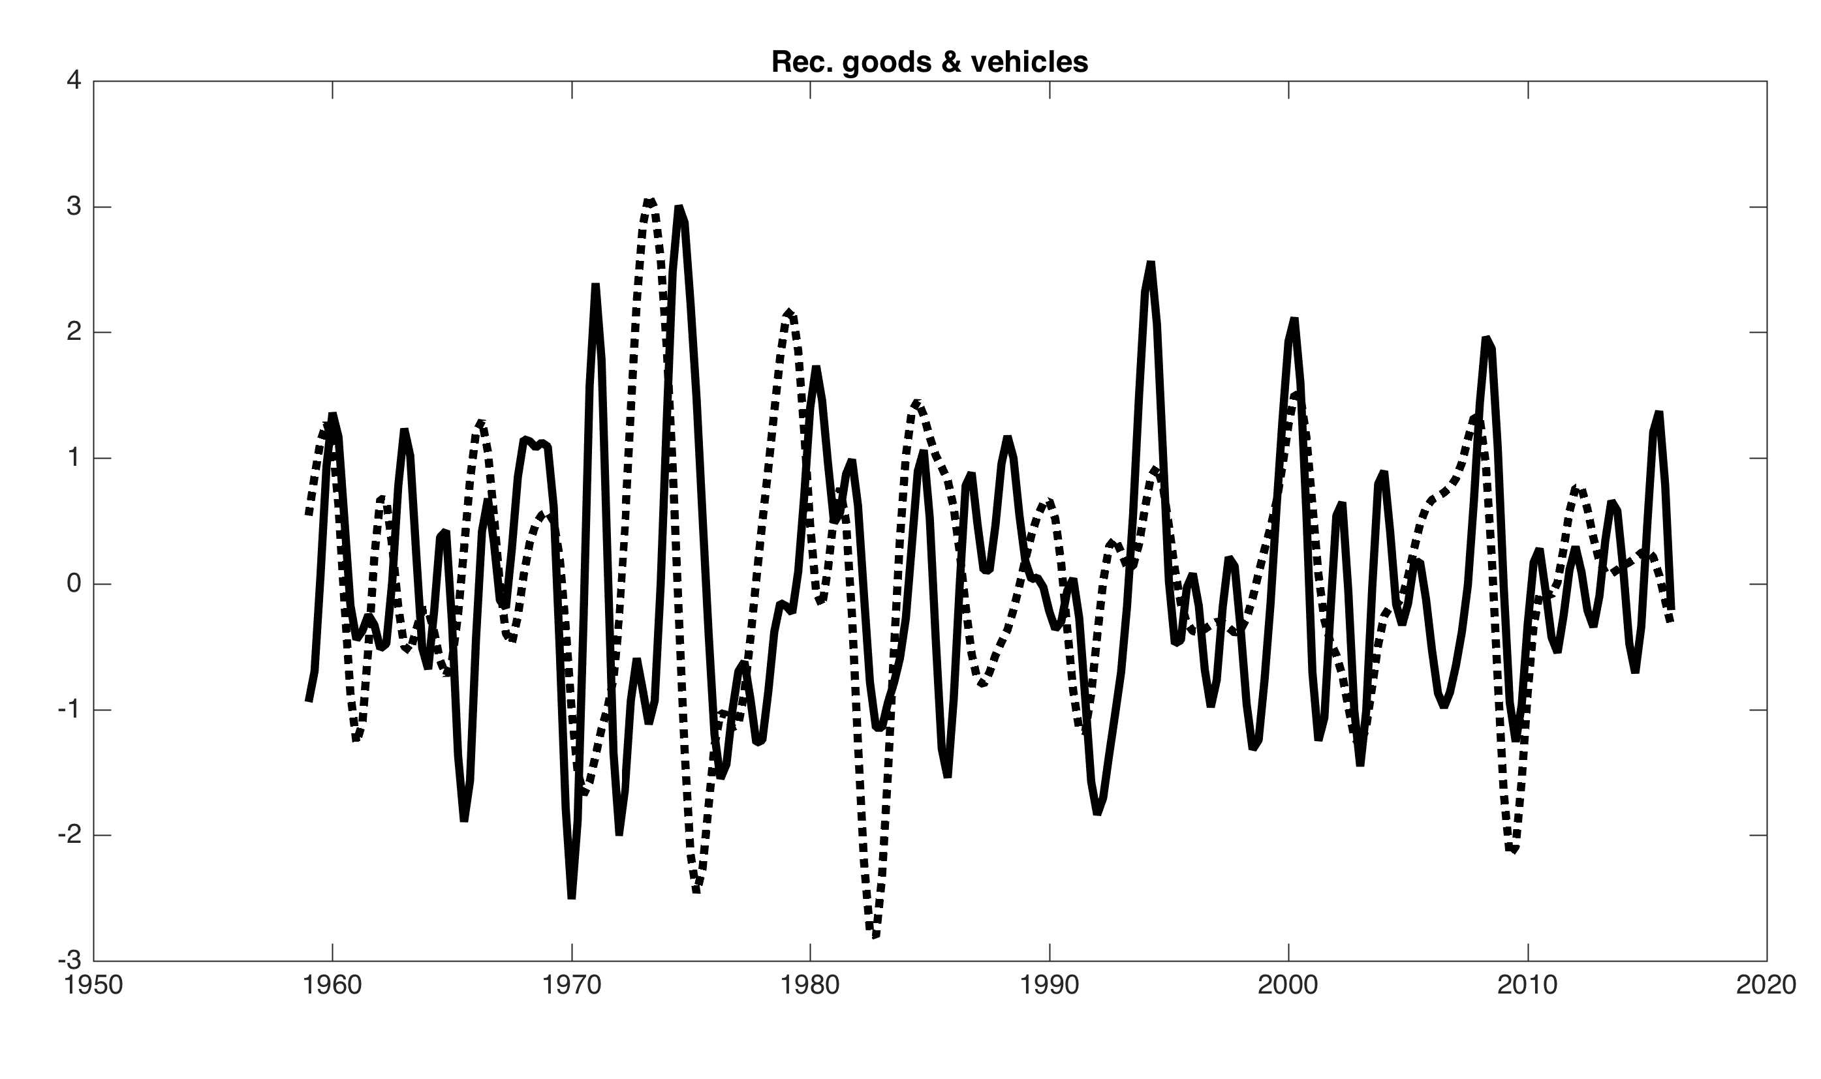
Band-pass filtered components and GDP (6-32 qtrs, standardized)

Slide 101
Phillips Curve Scatterplot: 4-qtr changes v. lagged short-term unempl
1960-1983
1984-1999
2000-2016

Slide 102
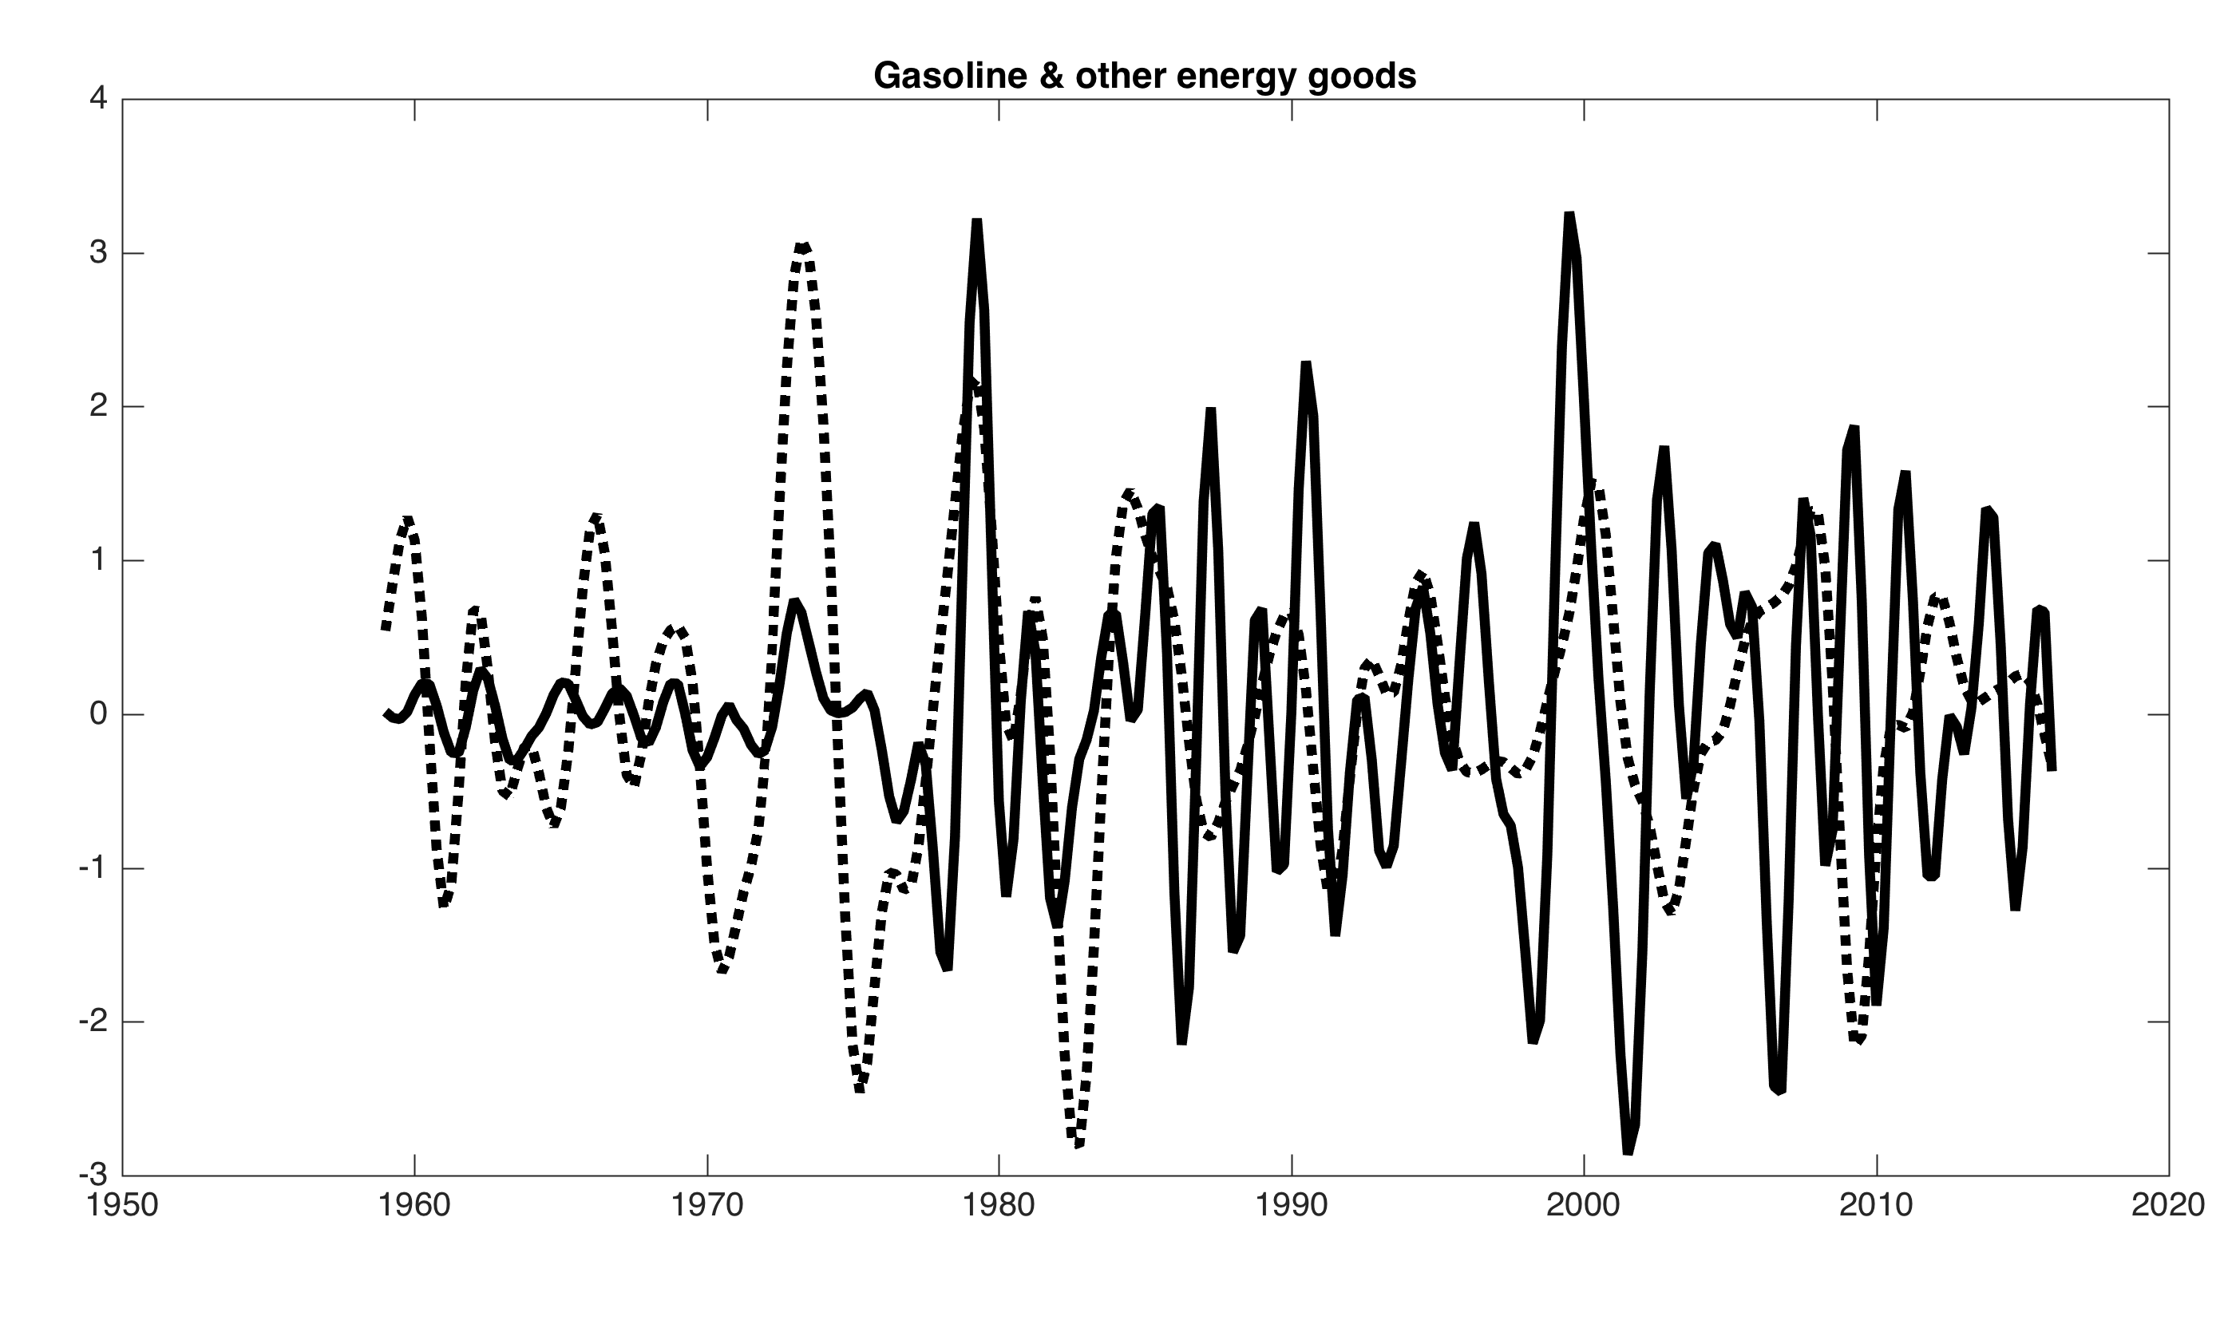
Band-pass filtered components and GDP (6-32 qtrs, standardized)

Slide 103
Phillips Curve Scatterplot: 4-qtr changes v. lagged short-term unempl
1960-1983
1984-1999
2000-2016

Slide 104
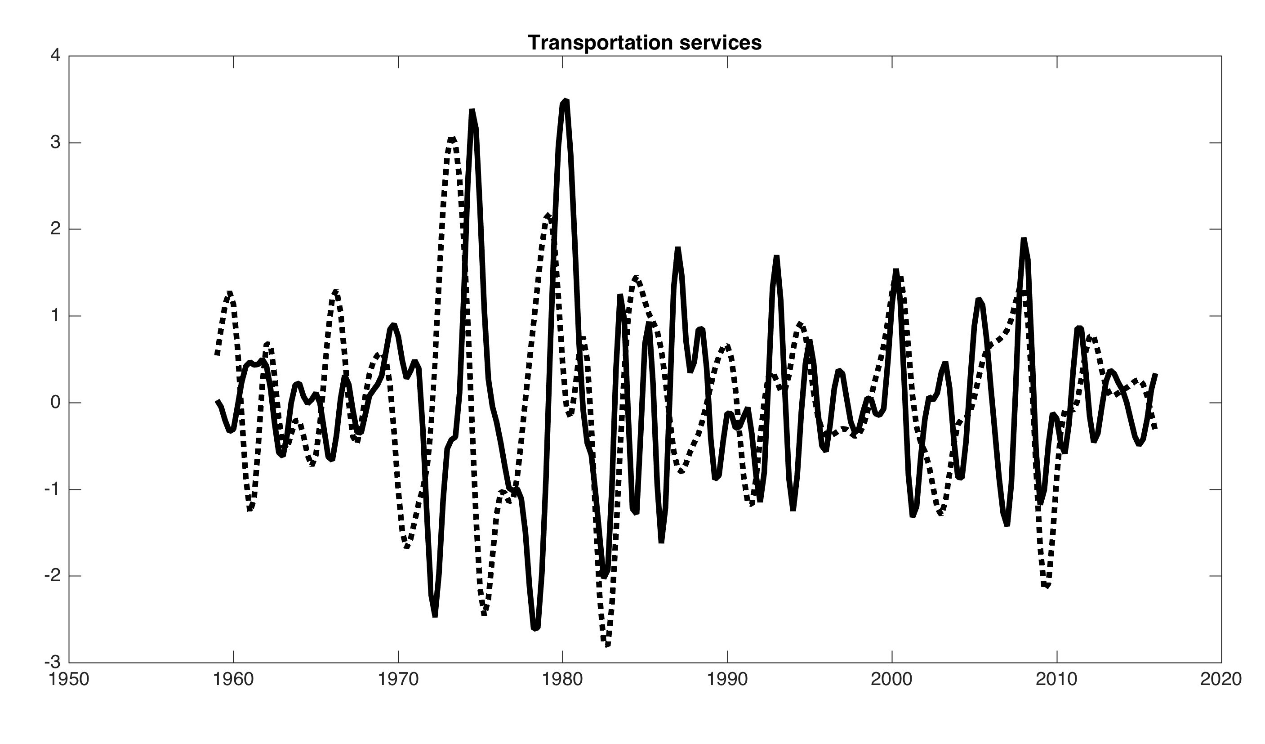
Band-pass filtered components and GDP (6-32 qtrs, standardized)

Slide 105
Phillips Curve Scatterplot: 4-qtr changes v. lagged short-term unempl
1960-1983
1984-1999
2000-2016

Slide 106
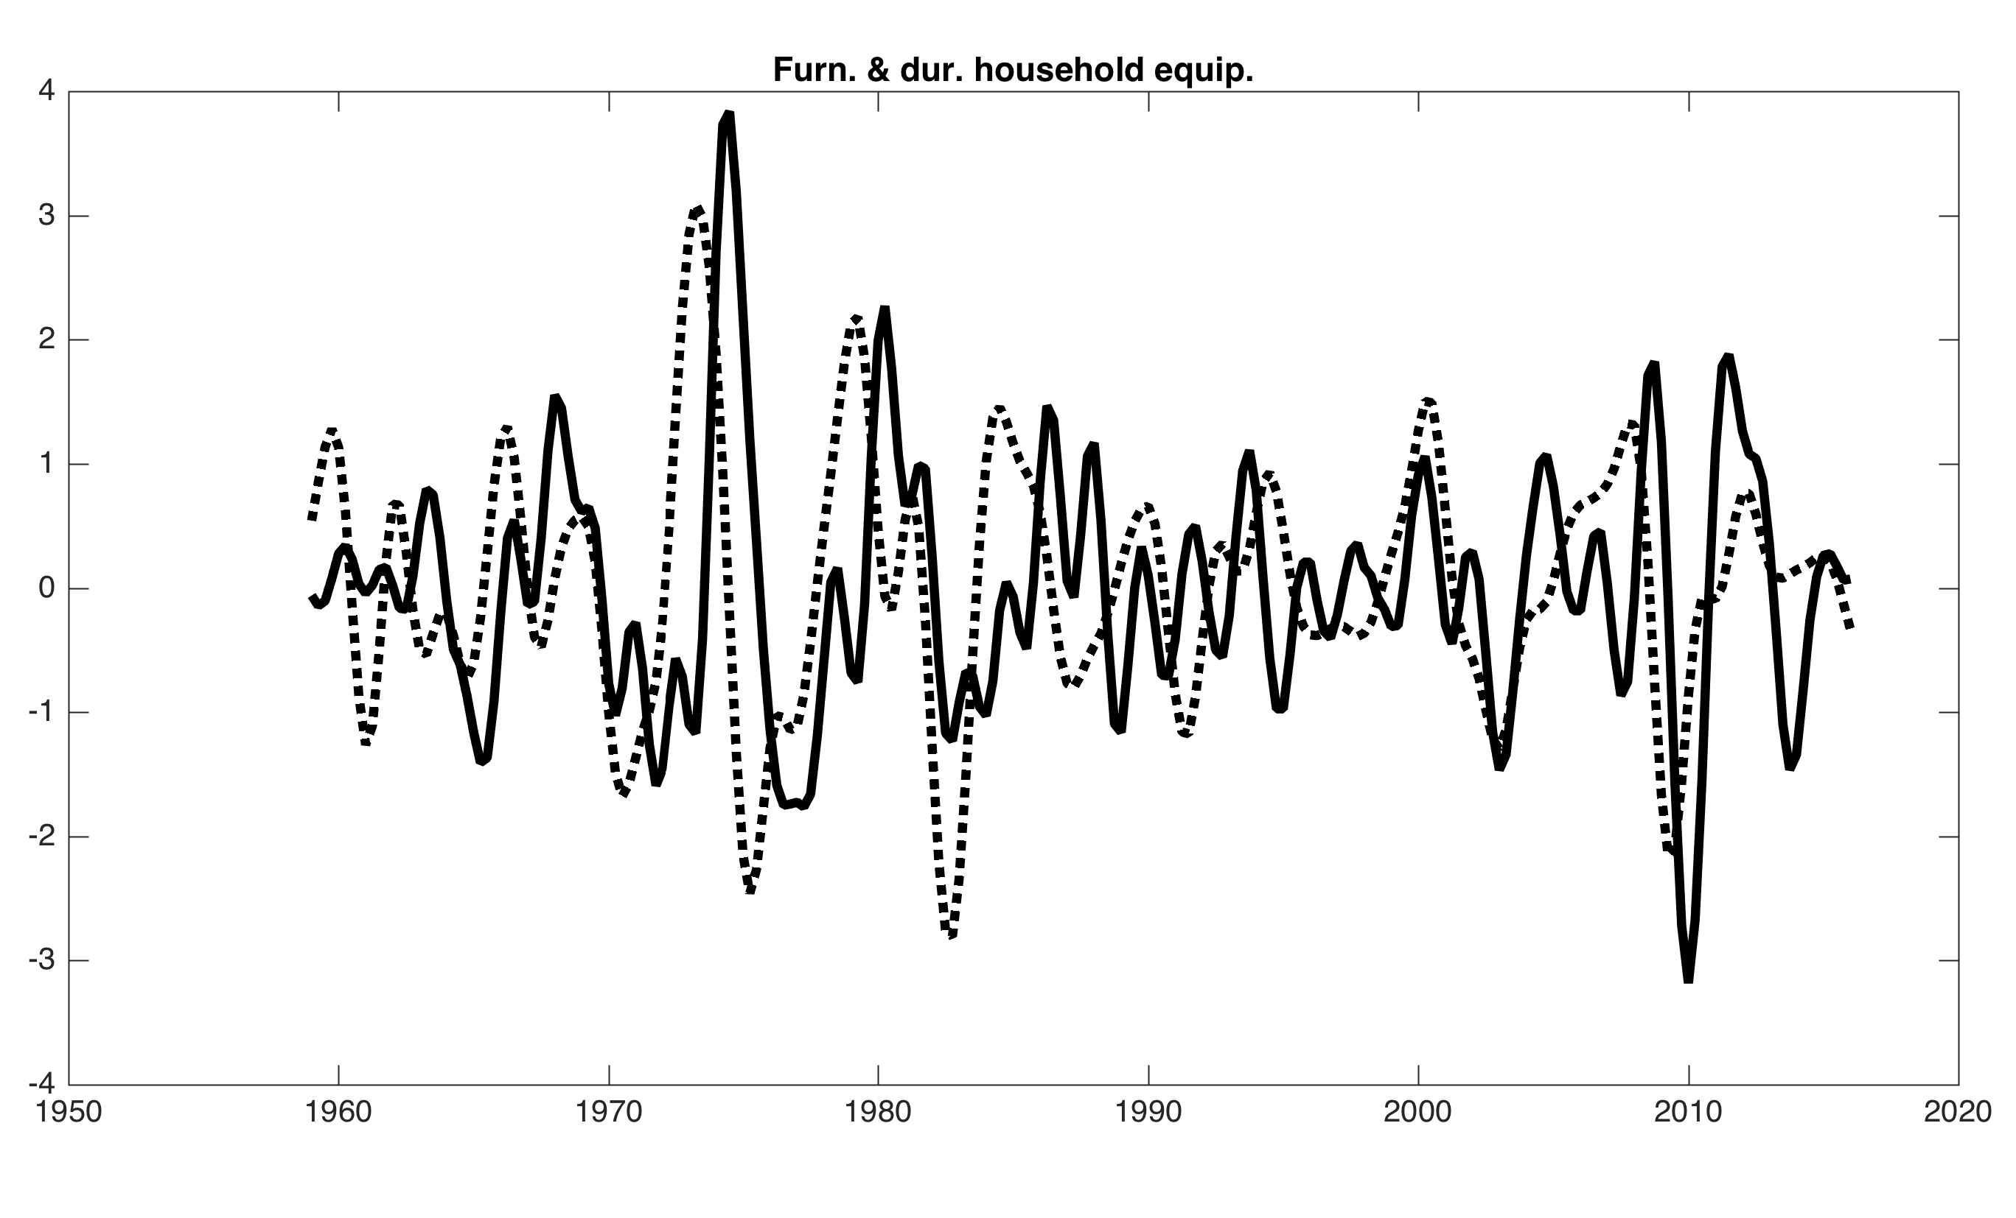
Band-pass filtered components and GDP (6-32 qtrs, standardized)

Slide 107
Phillips Curve Scatterplot: 4-qtr changes v. lagged short-term unempl
1960-1983
1984-1999
2000-2016

Slide 108
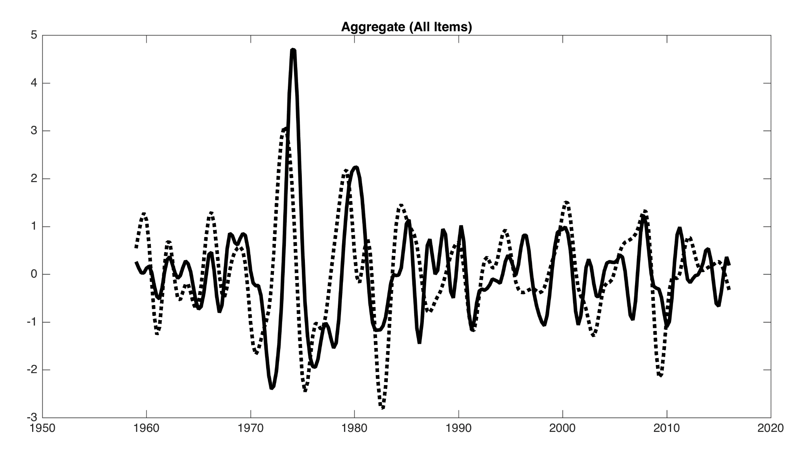
Band-pass filtered PCE-xE and GDP (6-32 qtrs, standardized)

Slide 109
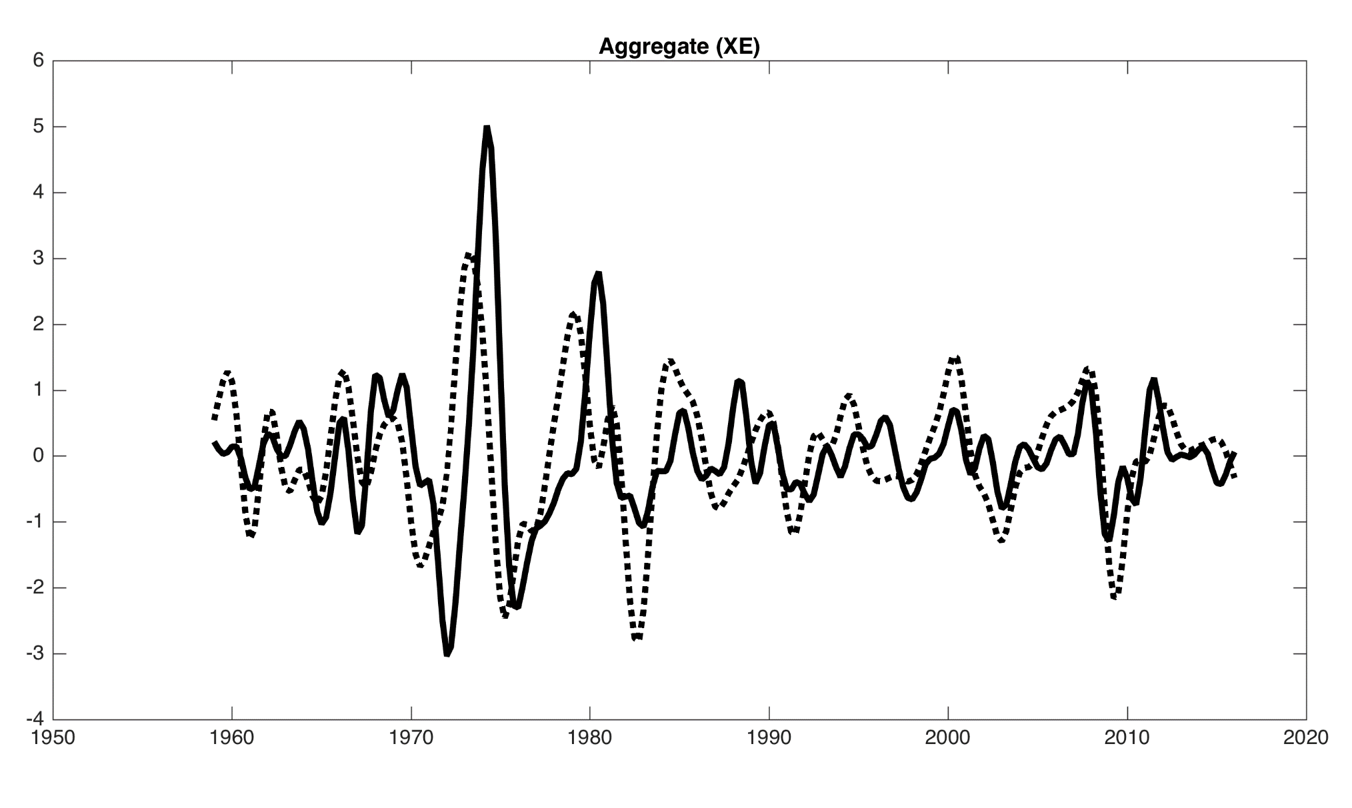
Band-pass filtered PCE-xE and GDP (6-32 qtrs, standardized)

Slide 110
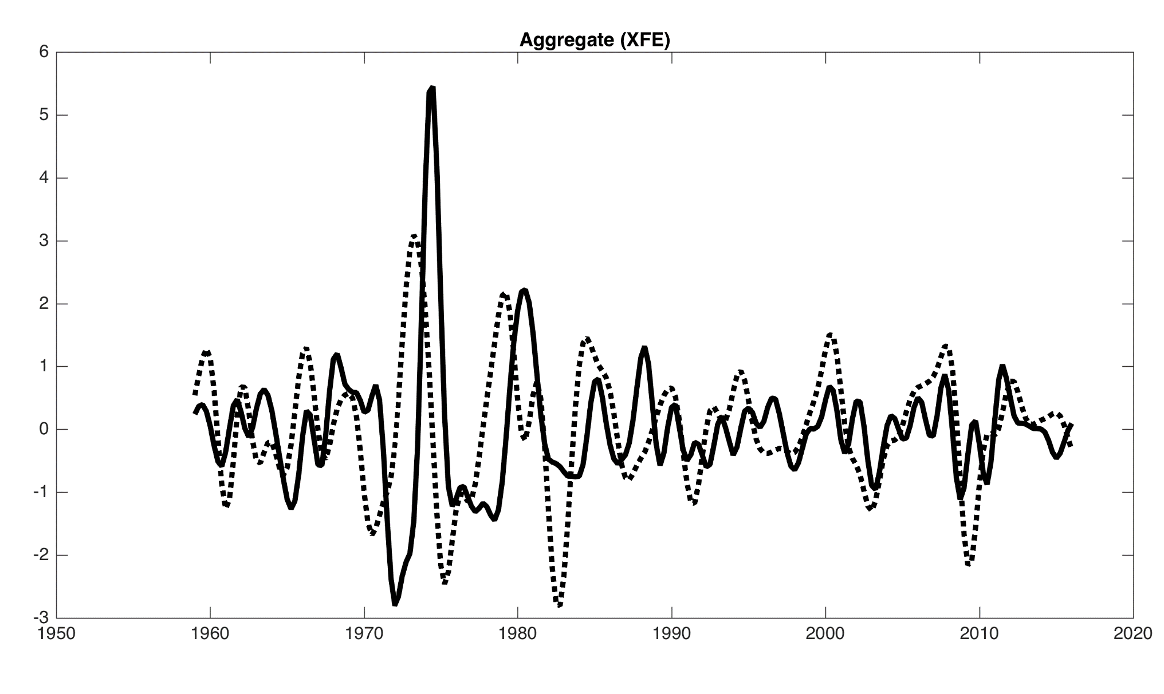
Band-pass filtered PCE-xE and GDP (6-32 qtrs, standardized)

Slide 111
PC plot and CSI share weights: Furnishings & household durables (0.03)

Slide 112
Housing: energy utilities

Slide 113
Health care (0.16)

Slide 114
Other services (0.09)

Slide 115
Gasoline & other energy goods (0.03)

Slide 116
Motor vehicles & parts (0.04)

Slide 117
Transportation services (0.03)

Slide 118
The components have large time variation in their process
At the level of components, there is even more variation in the process than in aggregate inflation
  Food at home is especially noteworthy
  Some of the evolution reflects changes in monetary policy and the economy…
  But some of the changes are pure measurement effects
      … a reminder that the evolution of the headline and core processes reflects measurement effects.
  Technical comment: outlier adjustment is particularly important at the component level

