Slide 1
Slack and Cyclically Sensitive Inflation
June 19, 2018
James Stock, Harvard Economics
Mark Watson, Princeton University
2018 ECB Forum on Central Banking
Sintra, Portugal

Slide 2
Where is the cyclical pressure on inflation?
US:
Unemployment rate
4-quarter inflation
PCExFE
PCE - total

Slide 3
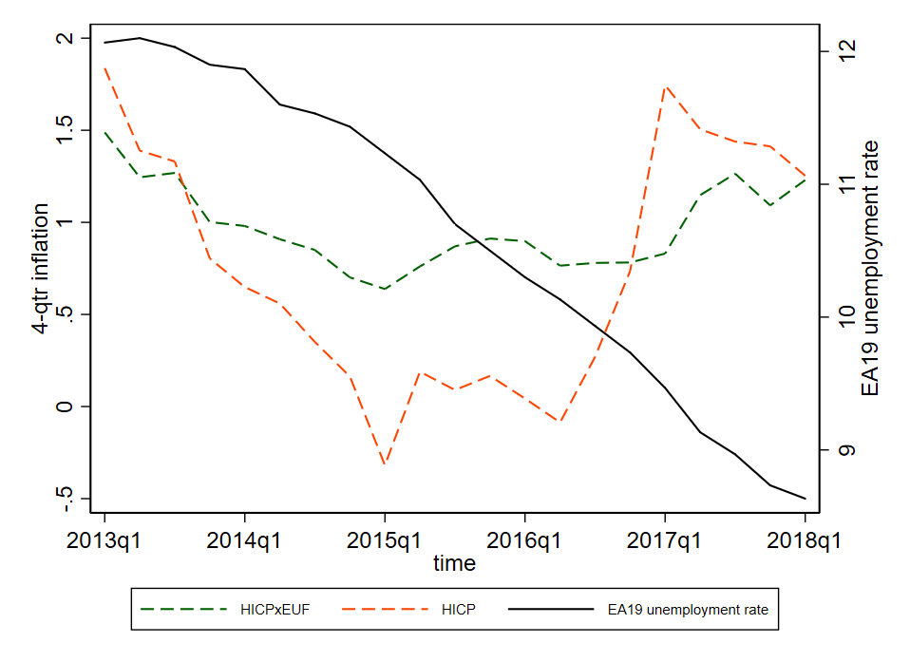
Where is the cyclical pressure on inflation?
Euro Area data:
Unemployment rate
4-quarter inflation
HICP x EuF
HICP - total

Slide 4
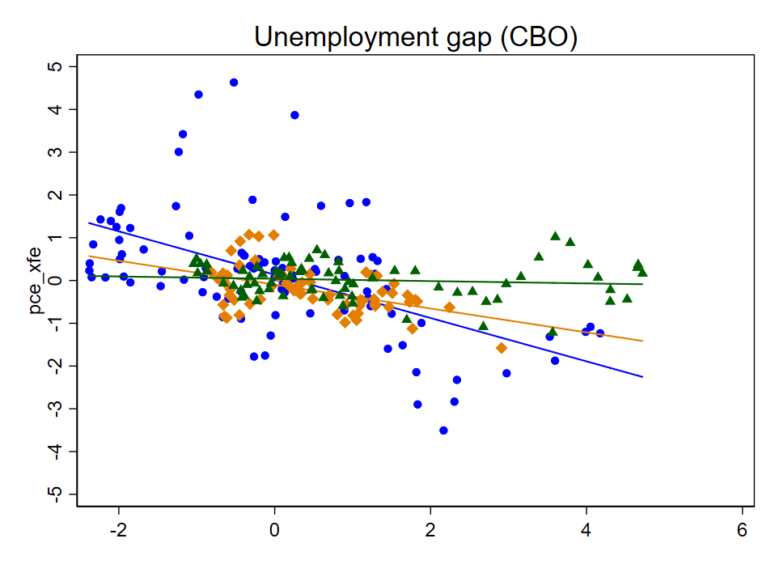
The Flattening U.S. Phillips Curve – using PCExFE & CBO unemployment gap
Four-quarter changes of four-quarter inflation
2000-2018q1
1984-1999
1960-1983

Slide 5
Slack and Cyclically Sensitive Inflation
Outline
US
  Can the (aggregate) PC be resuscitated by using a different slack measure? (no)
  Do some components move cyclically (yes)
  Construct index of cyclically sensitive inflation (CSI)
EA
  Do some components move cyclically (yes)
  Construct index of cyclically sensitive inflation (CSI)
Discussion & implications
Data comments
All data are quarterly
Inflation is 4-quarter inflation (e.g. Q1-to-Q1):
Changes in inflation are 4-quarter change:

Slide 6
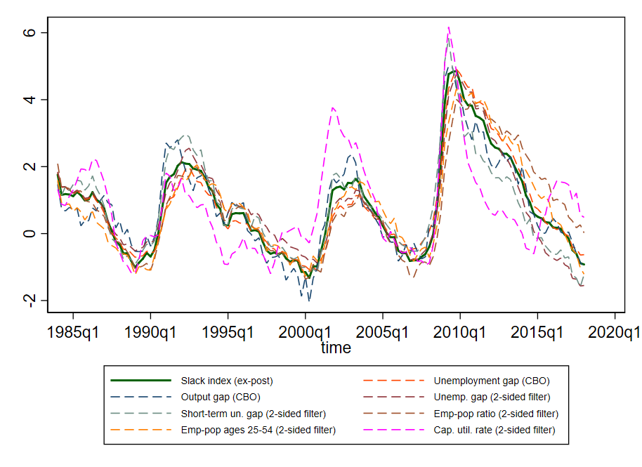
US: Can the Phillips Curve be Resuscitated by Using a Different Slack Measure?
Gaps and Slack
The real-time gap problem (Orphanides & van Norden (2003))
Theory doesn’t provide a single gap measure
The depth of this recession might pose special problems for some slack measures
We consider 7 gap measures: 2 CBO gaps, 5 two-sided smoother estimates of potential
  Also gap index (1st principal component)

Slide 7
US: Contemporaneous Phillips correlations & slopes: various gaps & PCExFE (4Q change)

Slide 8
US: Phillips correlations & slopes: various gaps, ctd

Slide 9
US: PCE Inflation Components: Measurement Issues & Cyclical Properties
Sector | Share (2000s) | Subtotals
A. Well-measured
Housing ex utilities | 0.16 | 0.34
Recreation services | 0.04
Food and beverages for off-premises consumption | 0.08
Food services and accommodations | 0.06
Housing - energy utilities component | 0.02 | 0.05
Gasoline and other energy goods | 0.03
B. Some information content
Other services | 0.09 | 0.29
Other nondurable goods | 0.08
Transportation services | 0.03
Motor vehicles and parts | 0.04
Other durable goods | 0.02
Furnishings and durable household equipment | 0.03
Health care | 0.16 | 0.16
C. Poorly measured
Financial services and insurance | 0.08 | 0.17
Clothing and footwear | 0.03
Recreational goods and vehicles | 0.03
NPISH | 0.03
We consider ~39% of consumption to have well-measured price inflation
~17% of consumption has poorly measured price inflation.
The main problems are:
  New/improved goods
  Use of input costs instead of consumer prices for some services
  Lack of market prices for some services

Slide 10
US: Cyclical activity measures (32 quarter band-pass filtered)
The cyclical activity index (CAI) is the first principal component of the 6 band-passed activity variables

Slide 11
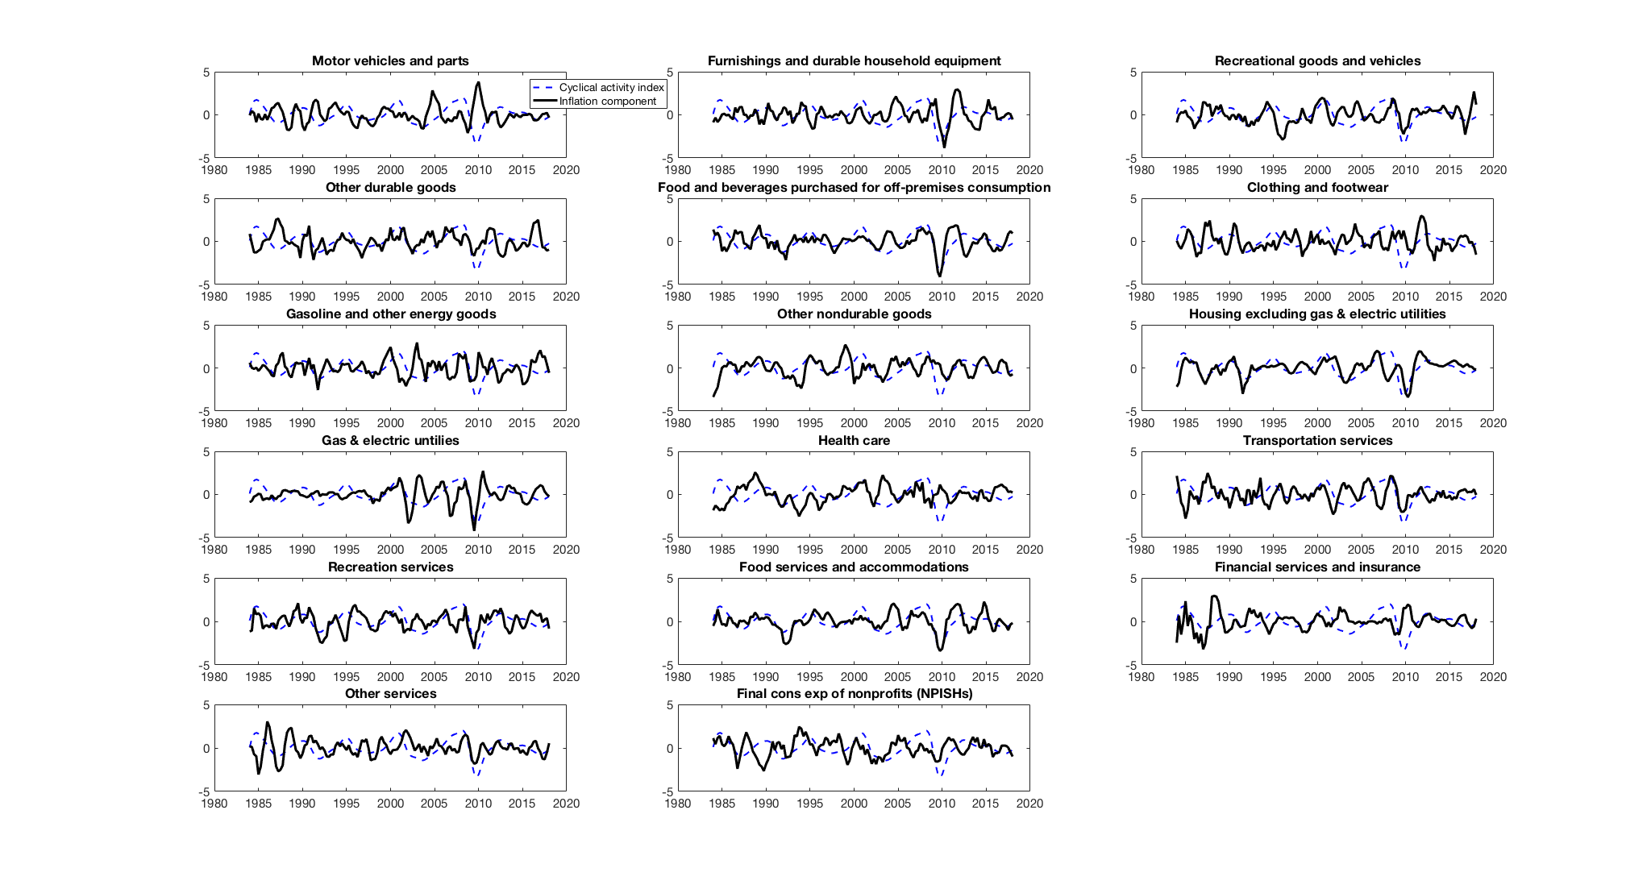
US: Cyclical Properties of PCE Components: Four Examples
Correlation = 0.46
Correlation = 0.48
Correlation = -0.11
Correlation = -0.09
Black: inflation component Blue: Cyclical Activity Index

Slide 12
US: Correlation of 4Q differences of 4Q inflation with Cyclical Activity Index
Housing excluding gas & electric utilities | 0.475
Food services & accommodations | 0.463
Food and beverages purchased for off-premises consumption | 0.426
Recreation services | 0.278
Recreational goods and vehicles | 0.255
Other services | 0.153
NPISH | 0.138
Gas & electric utilities | 0.130
Other durable goods | 0.100
Furnishings & durable household equipment | 0.095
Other nondurable goods | 0.061
Transportation services | 0.019
Gasoline & other energy goods | -0.040
Clothing & footwear | -0.089
Health care | -0.107
Financial services & insurance | -0.114
Motor vehicles and parts | -0.366

Slide 13
Cyclically Sensitive Inflation: Methods
Treat the Phillips curve as a statistical measurement problem
    Components each have different amounts of signal and noise
Incorporate judgmental assessment of measurement quality
    Eliminate Recreational goods & vehicles, Clothing & footwear, Financial services & insurance, and NPISH
CSI - single slack indicator approach
    What are the inflation index weights that yields the most cyclical inflation index?
    Estimate the regression,

Slide 14
US: Benchmark CSI specification using CAI – estimated 1984-2018q1
Component | Corr with CAI | CSI weight
Housing excluding gas & electric utilities | 0.475 | 0.627
Food services & accommodations | 0.463 | 0.040
Food and beverages purchased for off-premises consumption | 0.426 | 0.159
Recreation services | 0.278 | 0.080
Recreational goods and vehicles | 0.255 | excluded
Other services | 0.153 | 0.072
NPISH | 0.138 | excluded
Gas & electric utilities | 0.13 | 0.022
Other durable goods | 0.1 | 0
Furnishings & durable household equipment | 0.095 | 0
Other nondurable goods | 0.061 | 0
Transportation services | 0.019 | 0
Gasoline & other energy goods | -0.04 | 0
Clothing & footwear | -0.089 | excluded
Health care | -0.107 | 0
Financial services & insurance | -0.114 | excluded
Motor vehicles and parts | -0.366 | 0

Slide 15
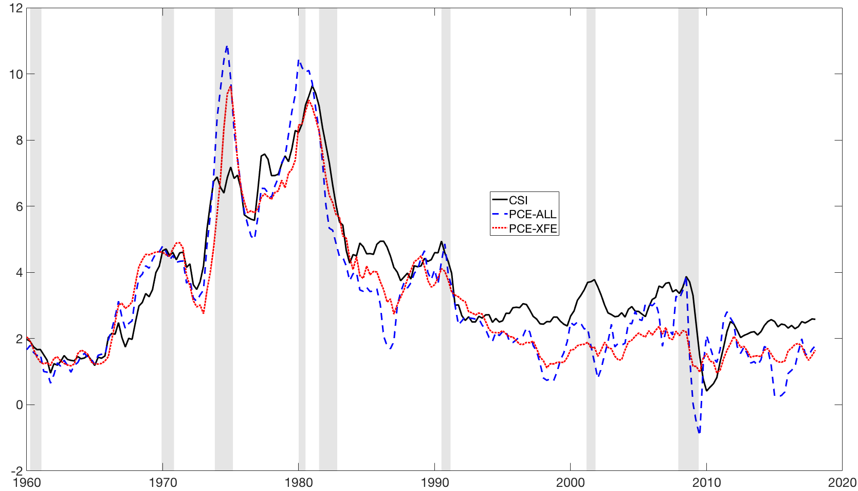
US: CSI, PCExFE, and PCE-all inflation (4 quarter inflation)

Slide 16
US: CSI Phillips correlations & slopes

Slide 17
EA CSI : Slack Measures and Cyclical Activity Index
EA slack measures
Unemployment gap (EC)
Output gap (IMF)
Band-passed activity variables:
  GDP
  Capacity utilization
  Industrial production
EA Cyclical Activity Index = average of three band-passed variables (standardized)

Slide 18
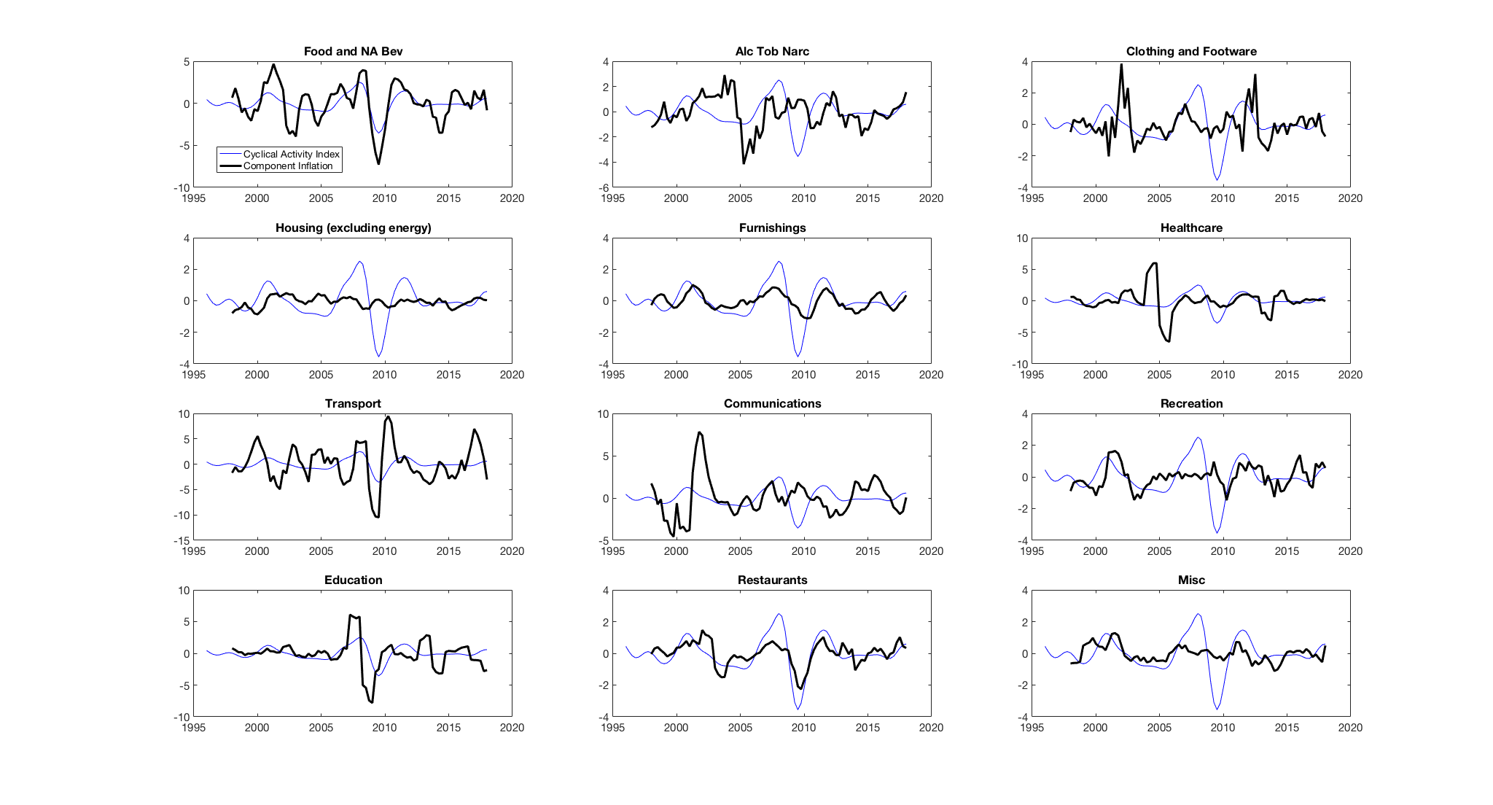
EA: HICP Components: 12 Second-Tier Components (Housing is ex energy)
Correlation = 0.72
Correlation = 0.02
Correlation = 0.12
Correlation = 0.16
Black: inflation component Blue: Cyclical Activity Index

Slide 19
EA: Benchmark CSI specification using CAI – estimated 1996-2018q1
Component and HICP code | Consumption share (2018) | Correlation between cyclical activity index and 4-qtr change in 4-qtr inflation | CSI weight (w_{i})
Food & non-alcoholic beverages (01) | 0.155 | 0.73 | 0.125
Alcohol, tobacco, & narcotics (02) | 0.040 | -0.05 | 0.000
Clothing & footwear (03) | 0.059 | 0.16 | 0.000
Housing excluding energy (04x) | 0.064 | 0.02 | 0.000
Furnishings, household items, & maintenance (05) | 0.062 | 0.63 | 0.440
Health (06) | 0.048 | 0.12 | 0.042
Transport goods & services (07) | 0.154 | 0.21 | 0.043
Communications (08) | 0.032 | -0.06 | 0.000
Recreation & culture (09) | 0.092 | 0.24 | 0.000
Education (10) | 0.010 | 0.27 | 0.011
Restaurants & hotels (11) | 0.098 | 0.72 | 0.338
Misc. goods & services (12) | 0.092 | 0.35 | 0.000

Slide 20
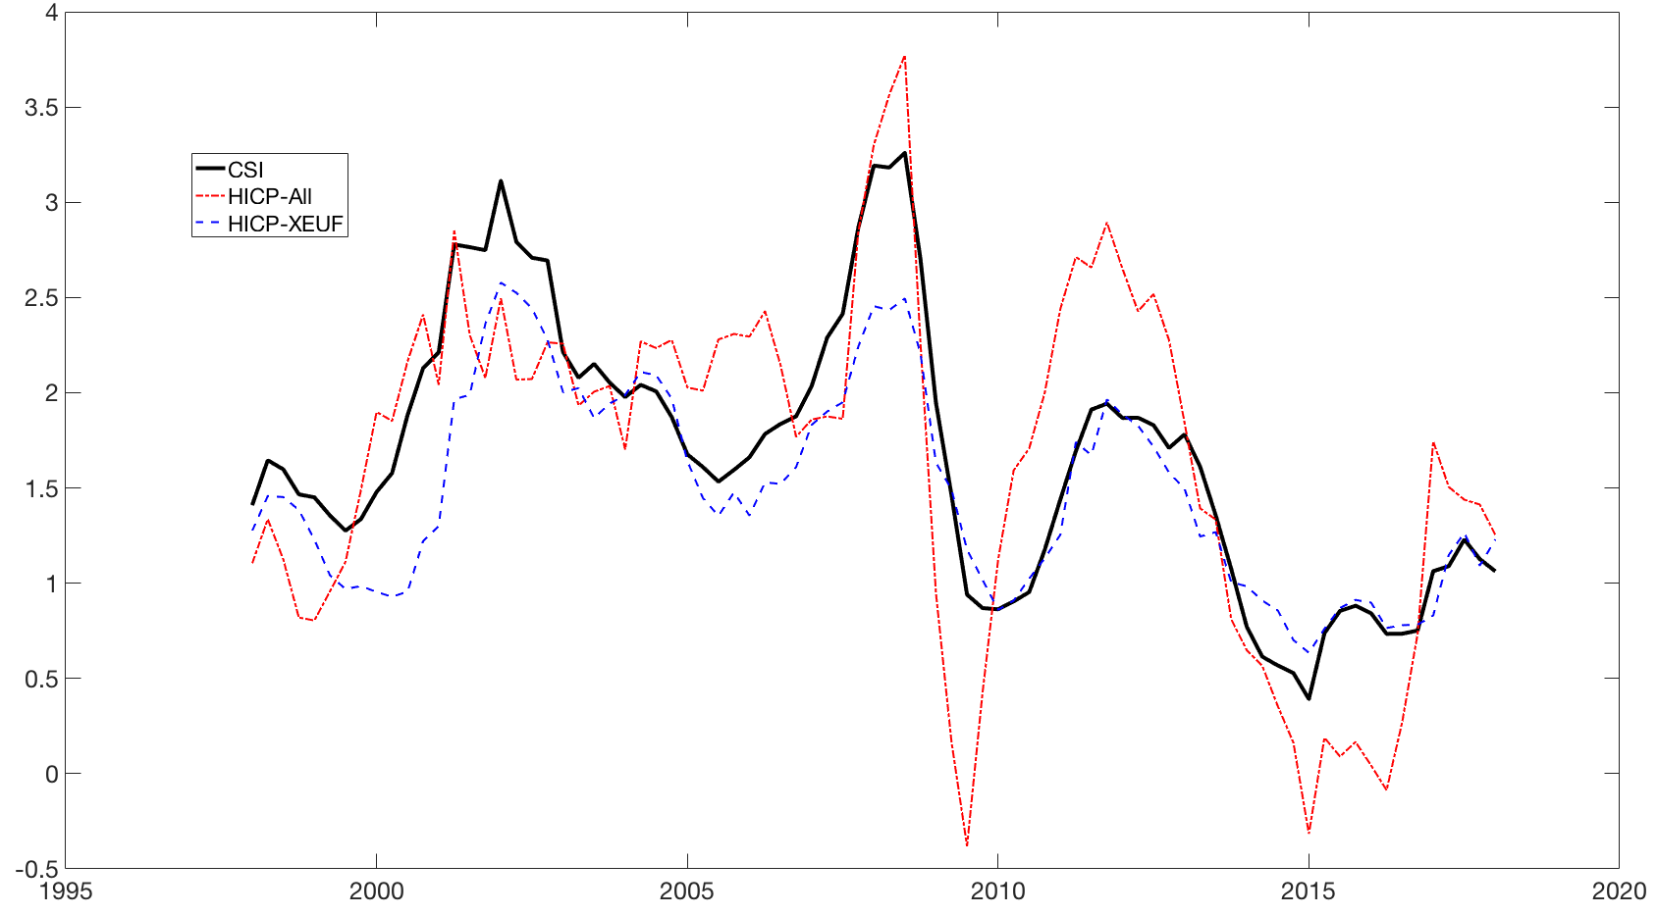
EA CSI, HICPxEUF, and HICP-all inflation (4 quarter inflation)

Slide 21
Sensitivity check: Gap index instead of band-passed activity index
4-quarter inflation
CSI using gap index
CSI with index weights estimated (band-passed, unemployment gap, output gap). 82% of the weight is on band-passed.

Slide 22
Take-aways
Changing slack measures doesn’t solve the PC puzzle (US)
Cyclical behavior varies substantially across components.
  In ways that largely make sense based on the nature of the markets (local v. global) and on measurement quality
Current outlook: US
  From 2013q1-2018q1, PCExFE is unchanged (1.5%), CSI has increased from 2.1% to 2.6%
Current outlook: EA
  CSI has different weights than HICPxEUF – but recent behavior is very similar
  2016q1-2018q1: EA-CSI increased from 0.9% to 1.2%, same as HICPxEUF
Next steps
  Implement monthly (12-month inflation)
  Work with third-tier components – especially in EA (differentiate goods and services)
  Resolve conceptual/empirical issue: band-passed activity index or gap or ???

Slide 23
Additional Slides

Slide 24
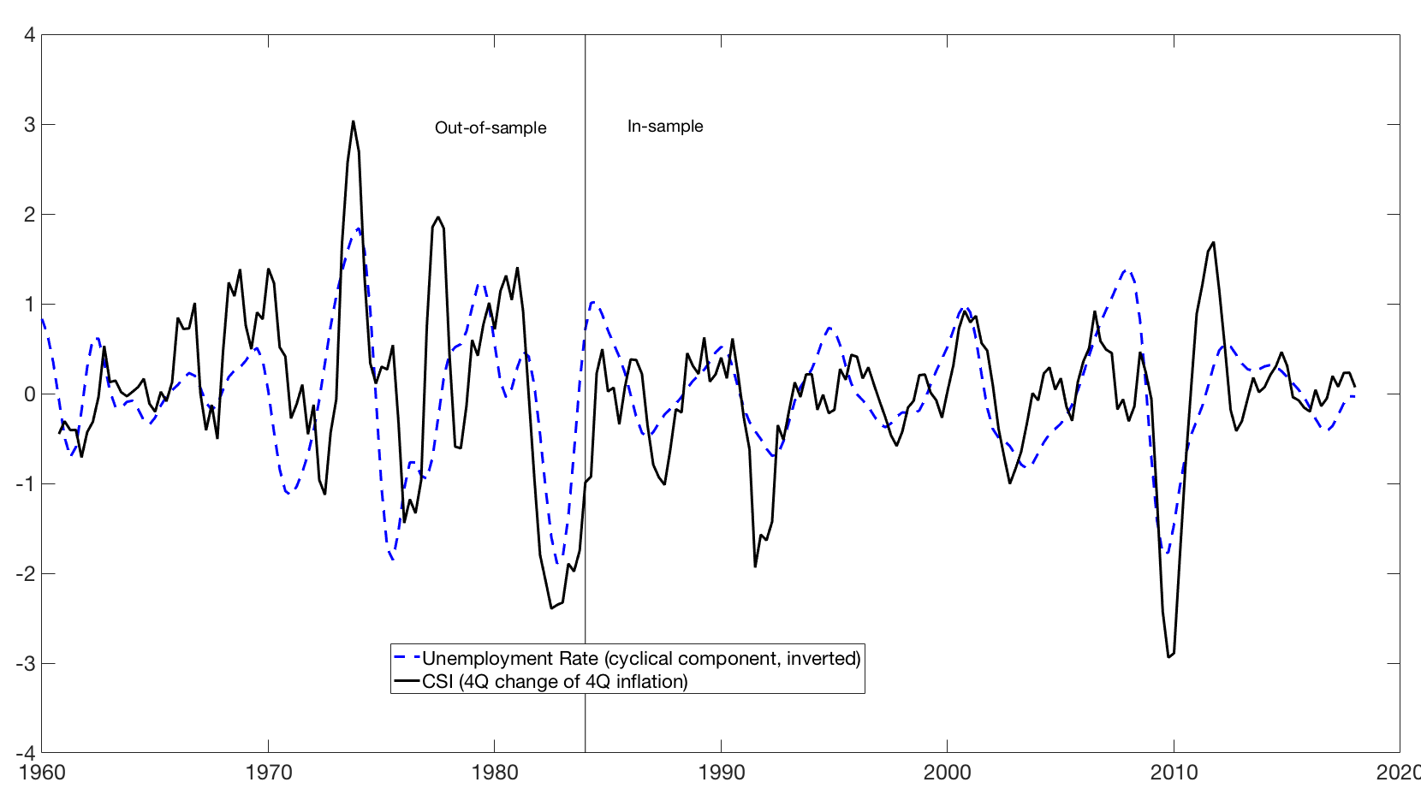
US: Sensitivity check: Pre-sample stability
Other sensitivity checks
Rolling regression
Use all 17 components
Constrained canonical correlations using all 7 band-pass activity variables
Use gap instead of band-passed activity indexes
Corr = 0.57
Corr = 0.57

Slide 25
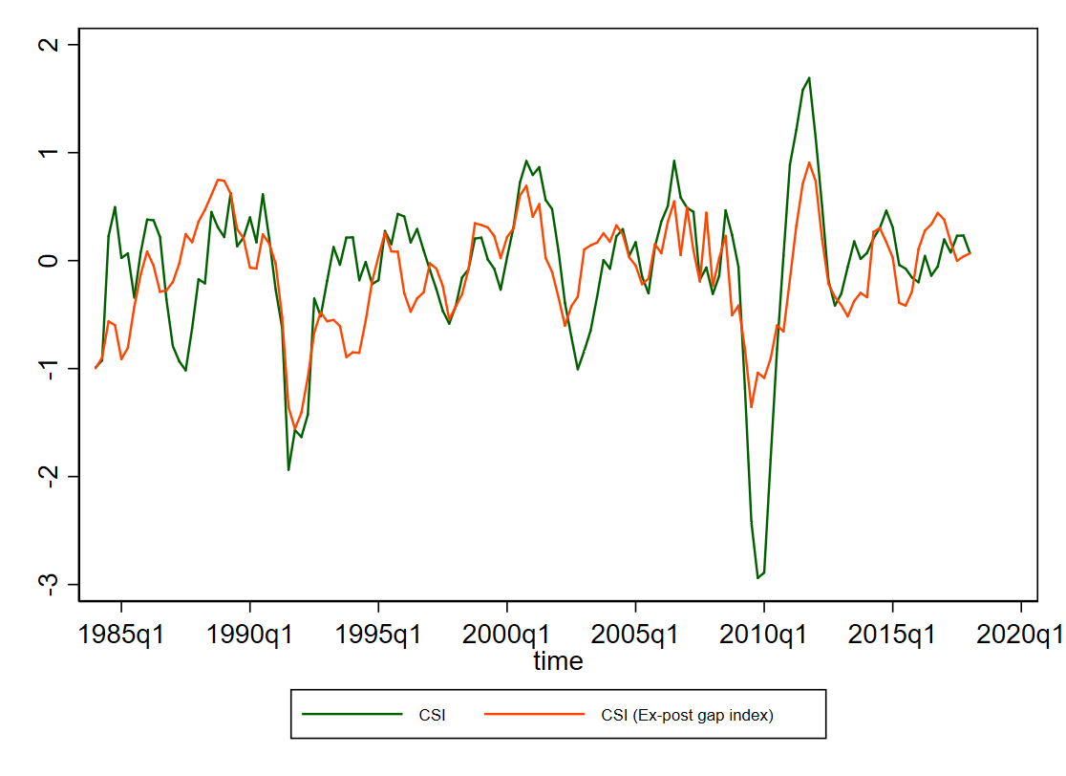
US: Sensitivity check: Gap index instead of band-passed activity index
4-quarter change of 4-quarter inflation
CSI inflation index differs if gap index is used instead of band-passed.
If activity weights and CSI weights are chosen simultaneously, the slack variable chosen is band-passed activity index – not a gap!

Slide 26
US: Recent values, CSI and PCExFE (quarterly inflation)

Slide 27
US: PCE components and their shares, sorted by 2000-2014 share
Sector | 1960-2014 | 1960-1979 | 1980-1999 | 2000-2014
Housing and utilities | 0.18 | 0.17 | 0.18 | 0.18
Health care | 0.11 | 0.07 | 0.13 | 0.16
Other services | 0.08 | 0.08 | 0.08 | 0.09
Other nondurable goods | 0.08 | 0.08 | 0.07 | 0.08
Food and beverages for off-premises consumption | 0.12 | 0.16 | 0.10 | 0.08
Financial services and insurance | 0.06 | 0.05 | 0.07 | 0.08
Food services and accommodations | 0.06 | 0.06 | 0.07 | 0.06
Motor vehicles and parts | 0.05 | 0.06 | 0.05 | 0.04
Recreation services | 0.03 | 0.02 | 0.03 | 0.04
Clothing and footwear | 0.05 | 0.07 | 0.05 | 0.03
Recreational goods and vehicles | 0.03 | 0.03 | 0.03 | 0.03
Gasoline and other energy goods | 0.04 | 0.04 | 0.04 | 0.03
Transportation services | 0.03 | 0.03 | 0.03 | 0.03
Furnishings and durable household equipment | 0.04 | 0.04 | 0.03 | 0.03
Final consumption expenditures of nonprofit institutions serving households (NPISHs) | 0.02 | 0.02 | 0.02 | 0.03
Other durable goods | 0.02 | 0.02 | 0.02 | 0.02

Slide 28
The PCE price index: a brief review of methods
The PCE price index is computed by the Bureau of Economic Analysis (BEA)
  Most component price series are CPI indexes for components, computed by the Bureau of Labor Statistics (BLS)
  Differences between PCE-PI and CPI:
    PCE concept is final consumption, CPI is “out of pocket” spending
    Share weights are from the NIPA surveys
    PCE-PI is revised for methodological changes (if possible), CPI is not
    Some divergence in price concepts, in which PCE uses PPI not CPI prices
The market price component of the CPI has 211 item strata
  Goods and services. Nondurables: < 3 yrs life. Services: cannot be inventoried.
  Main sampling rotation structures:
    food at home, lodging, most consumer end-energy goods, telephone services, used cars, some odds and ends: Single panel sample monthly
    Everything else except rent (most regions): 2 panels, alternating months
    rent: 6 panels, each sampled every 6 months
  The market price component of the CPI has 211 item strata
  Market-based CPI has several well-known problems
    New goods problem: no quality adjustment, just skip first month price
    Replacement goods problem: quality adjustment by (a) hedonic regression or, if not possible, (b) production cost

Slide 29
The PCE price index: a brief review of methods, ctd.
The PCE-PI and the CPI are also computed for sectors without posted market prices. There are various methodologies:
  The first step is defining the unit to be priced. For example
    For legal services:
      an end-consumer legal service (e.g. will), with a fixed production function (hours of attorney, legal aide, etc) and changing input wages;
      or, an hour of a law office’s time
    For hospital services: a service bundle (e.g., 2 day stay + 1 cardiac catheterization + 2 EKGs + 2 IV doses blood thinner drug + …)
  These are priced from (randomly selected) bills or interviews
  Other price indexes for unpriced services include unpriced services of nonprofits (religious institutions, etc.), unpriced banking services (liquidity services)
  However, many services have market prices (Red Sox ticket; a room at Sonesta)
Special indexes:
  PCE-xE: excludes gasoline & other energy goods + energy utilities component of housing
  PCE-xFE: also excludes food at home (but not food at restaurants)
  Market-based CPI (excludes all non-market price estimates)

Slide 30
PCE (green) and component (orange): Housing ex energy util. (qtrly)
Rent paid by renters | Actual market rent excluding utilities 6 rotating panels, surveyed every 6 months Price index(t) = This month’s panel price relative × price index(t-1)
Owner-equivalent rent | Post-1983: Actual market rent excluding utilities Pre-1983: Payment flows (mortgage payments, etc) 6 rotating panels, index construction as for renters
Misc. | Surveyed units fractionally represent rental and owned units Boarding schools, group homes use renter’s rent index Utilities: CPI for water & sewer maint; CPI for garbage & trash collection

Slide 31
Housing: energy utilities
Electricity | CPI for electricity
Natural gas | CPI for utllity-provided natural gas

Slide 32
Health care (expenditure share 2000-2016 = 0.16): CPI
CPI v. PCE | CPI covers out-of-pocket medical (paid by consumers). PCE covers consumption of medical services. Most medical services in the U.S. do not have a market price – they are negotiated health plan prices
CPI: Outpatient physician’s services, paramedics, hospitals, nursing homes | Provision-of-services concept. CPI outpatient: price of visit for a specific illness. CPI hospital (post-87): price of bundle of services provided (3-day stay + 1 catheterization + 2 EKGs +… ) by insurer reimbursement category. CPI pharma: by drug. Pre-87: cost of hospital inputs
Dental & other medical | CPI for dental services, CPI for other medical services

Slide 33
Health care (0.16): PCE
PPI concept | PPI usually first transaction price rec’d by producer. For health care, PPI since 1993 is DRG-based, broken out by service providers
PCE: Physician services | PPI for physician offices. Unit is office visit for a given condition
PCE: hospital services | PPI for hospitals. Unit is a hospital episode for a given condition
PCE: nursing homes | PPI for nursing homes. Cost of inputs basis (hourly wages etc.)
PCE: paramedical | PPI for paramedical
Dental & other medical | Uses CPIs for dental services, for other medical services

Slide 34
Other services (0.09)
Communication | CPI for wireless phone service, CPI for land line phone service
Internet | CPI for internet services
Education | CPI for college education; CPI for private primary & secondary schools
Legal, accounting | Cost basis (cost of 1 hr law office time, or mix of time for given service)
Social services | Cost basis, some CPI (child care)
Misc. | CPI for postage, CPI for funeral services, CPI for haircuts; net foreign travel (complicated)

Slide 35
Other nondurable goods (0.08)
Tobacco | CPI-tobacco
Pharmaceuticals | CPIs for prescription & OTC drugs, CPI for med. eqpt sold to consumers
Recreational nondurables | CPIs for toys, plants & flowers, pets, photographic supplies,…
Personal care | Various CPIs for personal care items
Misc. home goods | CPIs: newspapers & magazines, household supplies
Spending abroad | (net, including in-kind personal remittances) complicated, non-mkt

Slide 36
Food & beverages off-premises (0.08)
Food & nonalcoholic beverages, off-premises | Detailed price components for food at home
Alcohol, off-premises | Various CPIs (beer, wine, distilled spirits) for off-premises

Slide 37
Financial services & insurance (0.08)
Financial services provided w/out payment | Estimated based on imputed below-market interest on checking account. Alternative interest rate changed to “stabilized” (smoothed) rate in 2013, revised back to 1985
Financial fees | CPI for checking account and other bank services (market prices).
Insurance | Price index is for the value of insurance services provided (risk pooling, intermediation) = all premiums – expected losses; cost-based using PPI
Brokers’ fees | PPI (cost-based)

Slide 38
Food services & accommodations (0.06)
Purchased meals & beverages | CPI for categories of purchased meals & beverages (restaurant meals, bars, fast food, etc)
Institutional food & drink | Use market-based CPI for purchased meals & beverages by category
Accommodations | CPI for purchased lodging away from home. Boarding at schools: separate (market-price) CPI

Slide 39
Motor vehicles & parts (0.04)
New cars & trucks | CPI-new cars: sticker price + 30-day average dealer markup or discount. Year to year quality changes priced on production cost.
Used cars & trucks | Secondary source price data, with quality adjustments when new
Parts | CPI for tires; CPI for parts

Slide 40
Recreation services (0.04)
Sports centers & clubs, theaters, museums, etc. | CPI for specific categories, e.g. club dues and fees; admission to sporting events. Monthly/bi-monthly/6-month sample
Audio/video & info processing services | CPI for cable & satellite TV; CPI for film processing; CPI for video/audio rental
Other | Gambling: CPI-U; pet care: CPI-veterinary services, etc.

Slide 41
Clothing & footwear (0.03)
Market purchased clothing | Various CPIs. Note new/replacement goods issue however.
Military & uniforms | Cost-based

Slide 42
Recreational goods & vehicles (0.03)
Video, audio, home computers | Various CPIs including CPI for home computers, CPI for computer software and accessories, and CPI for consumer digital communications and information processing eqpt
Sporting eqp | CPI for sporting eqpt
Recreational books | CPI for recreational books
Musical instruments | CPI for musical instruments

Slide 43
Gasoline & other energy goods (0.03)
Motor fuels | CPI for motor fuels
Other fuels | CPIs for propane, kerosene, wood

Slide 44
Transportation services (0.03)
Airline travel | PPI (cost-based: passenger revenues/total passenger-miles) (however CPI is based on actual prices, currently sampled off the Web)
Intracity | CPI (covers taxis, busses, etc.)
Intercity busses, trains | CPI (market prices)
Water | CPI (ferries, etc.)

Slide 45
Furnishings & household durables (0.03)
Furniture & bedding | CPI for furniture & bedding; CPI for clocks & lamps; related CPIs
Household appliances | Various CPIs
Tools, house & garden eqpt | Various CPIs

Slide 46
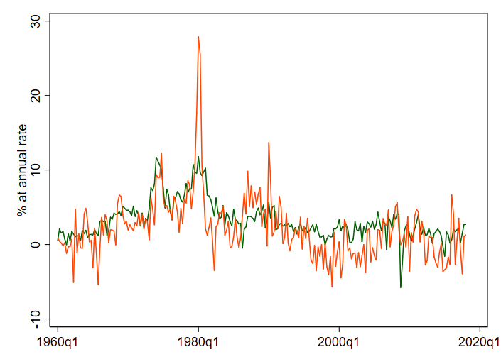
Other durable goods (0.02)
Misc. durable goods | Watches, jewelry, educational books, luggage, telephone equipment. All based on CPIs (market prices)

Slide 47
Final consumption expenditures of
nonprofit institutions serving households (NPISHs) (0.03)
NPISH definition | Current operating expenditures by nonprofits less sales to households and other sectors.
Prices | By construction, essentially everything in NPISHs does not have a market price, so costs of inputs are used for priced outputs. Example: price of 1 hour of a minister’s time = minister’s hourly wage

