Slide 1
CBO Panel of Economic Advisors
Inflation & Prospects
James H. Stock, Harvard University
November 4, 2022

Slide 2
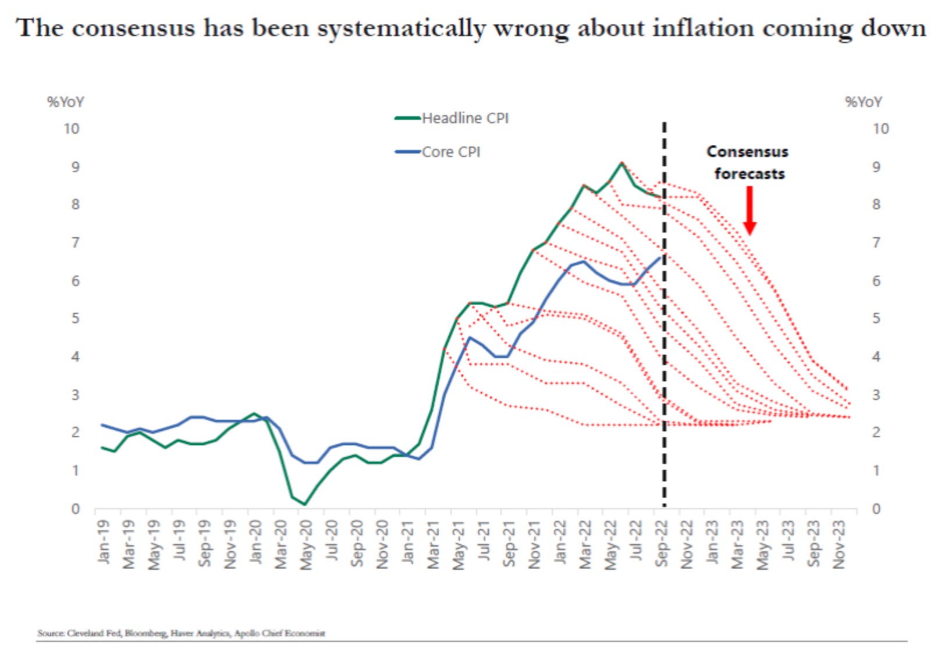
Outline
Inflation plots
Evolution of energy price pass-through over time
Past 2 years through a Phillips Curve lens (what works and what doesn’t)
Source: Torsten Slok, Apollo Global Management

Slide 3
A. High-level inflation measures

Slide 4
High-level inflation measures

Slide 5
High-level inflation measures

Slide 6
Expected inflation

Slide 7
B. Energy price pass-through
Plot is cumulative coefficients
Monthly data
Inflation: PCE-xfe
Energy: PCE-energy
1960-1983
XFE doesn’t mean no energy-sensitive components!
Goods & services for which energy is an embodied good
  Air travel services
  Freight delivery services
Mechanically, working through the supply chain will result in long and increasing CIRF (Minton 2022)
2020-2022
1984-1999
2000-2019

Slide 8
Energy price pass-through
Plot is cumulative coefficients
Monthly data
Inflation: PCE-all
Energy: PCE-energy
1960-1983
2020-2022
1984-1999
2000-2019

Slide 9
C. Phillips curves out of sample: Benchmark breakdown
π: PCE-all*
π^{e}: SPF 10-yr CPI**
x: ugap
w: PCE-energy*
Estn: 1984m1-2020m2
Notes
No lags
*12-month inflation
**Extended by Ball et al (2022)
Actual
Predicted
π^{e} contribution
energy contribution
Slack contribution

Slide 10
What doesn’t “work”: cpi-all
π: CPI-all*
π^{e}: SPF 10-yr CPI**
x: ugap
w: PCE-energy*
Estn: 1984m1-2020m2
Notes
No lags
*12-month inflation
**Extended by Ball et al (2022)

Slide 11
What doesn’t “work”: services inflation
π: PCE-services*
π^{e}: SPF 10-yr CPI**
x: ugap
w: PCE-energy*
Estn: 1984m1-2020m2
Notes
No lags
*12-month inflation
**Extended by Ball et al (2022)
***Ball et al (2022)

Slide 12
What doesn’t “work”: CPI-housing inflation
π: CPI-housing*
π^{e}: SPF 10-yr CPI**
x: ugap
w: PCE-energy*
Estn: 1984m1-2020m2
Notes
No lags
*12-month inflation
**Extended by Ball et al (2022)
***Ball et al (2022)

Slide 13
What doesn’t “work”: + car price inflation + FRBNY global supply chain pressures index
π: PCE-all*
π^{e}: SPF 10-yr CPI**
x: ugap
w: PCE-energy*
wtd avg car inflation***
Estn: 1998m1-2020m2
Notes
No lags
*12-month inflation
**Extended by Ball et al (2022)
***Ball et al (2022)

Slide 14
What doesn’t “work”: estimate over 2000m1-2020m2
π: PCE-all*
π^{e}: SPF 10-yr CPI**
x: ugap
w: PCE-energy*
Estn: 2000m1-2020m2
Notes
No lags
*12-month inflation
**Extended by Ball et al (2022)
***Ball et al (2022)

Slide 15
What doesn’t “work”: Brent
π: PCE-all*
π^{e}: SPF 10-yr CPI**
x: v/u
w: Brent oil price*
Estn: 1984m1-2020m2
Notes
No lags
*12-month inflation
**Extended by Ball et al (2022)

Slide 16
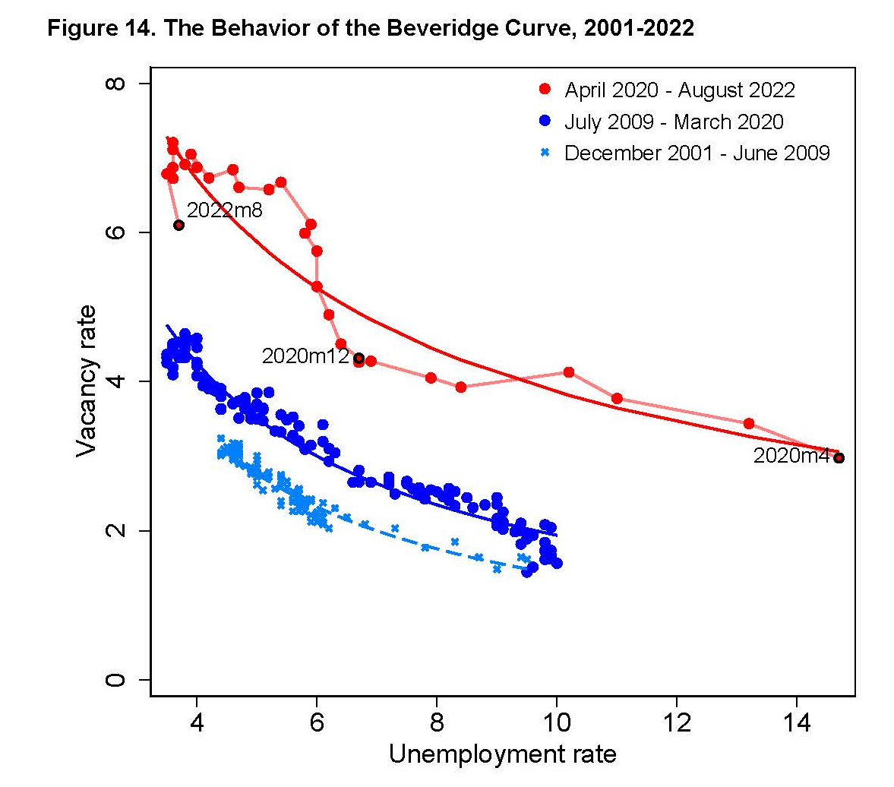
What doesn’t “work”: v/u
π: PCE-all*
π^{e}: SPF 10-yr CPI**
x: v/u
w: PCE-energy*
Estn: 1984m1-2020m2
Notes
No lags
*12-month inflation
**Extended by Ball et al (2022)
Source: Ball, Leigh, and Mishra (Oct. 2022)

Slide 17
What does “work”: Michigan expectations
π: PCE-all*
π^{e}: Michigan 1-yr
x: ugap
w: PCE-energy*
Estn: 1984m1-2020m2
Notes
No lags
*12-month inflation
**Extended by Ball et al (2022)

Slide 18
What does “work”: fix by estimating over 1968-1983
π: PCE-all*
π^{e}: SPF 10-yr CPI**
x: ugap
w: PCE-energy*
Estn: 1968m1-1983m12
Notes
No lags
*12-month inflation
**Extended by Ball et al (2022)

Slide 19
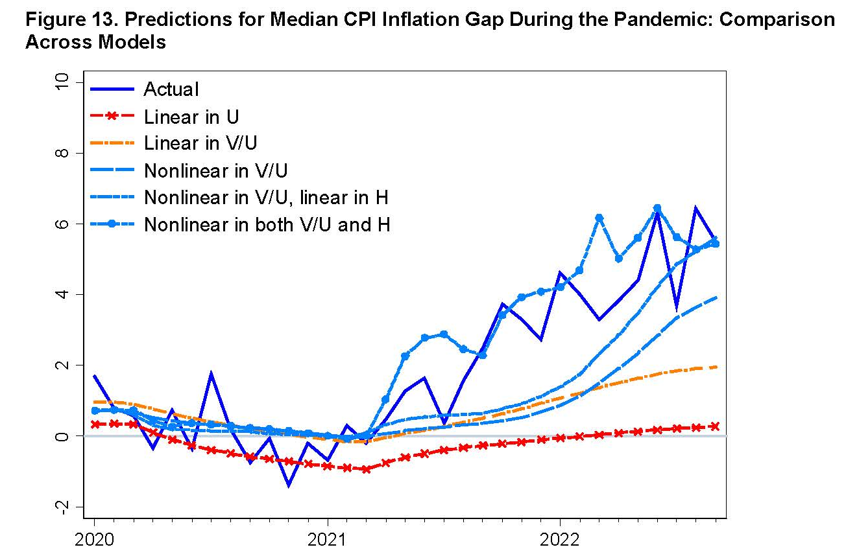
What does “work”: median CPI + (v/u)³ + (new measure of shock )³ (Ball et al. (2022))
π: Median CPI*
π^{e}: SPF 10-yr CPI**
x: (v/u), (v/u)², (v/u)³,
w: Alternative measure
Estn: 1984m1-2020m2
Notes
No lags
*12-month inflation
**Extended by Ball et al (2022)
Source: Ball, Leigh, and Mishra (2022; BPEA forthcoming)

Slide 20
Discussion
1960-1983
2020-2022
1984-1999
2000-2019
Empirical patterns of 1970s redux
Clear change of energy price pass-through coefficients
  Long lags as price shocks work through supply chain
1970s PC fits well
Looking ahead: Consistent with quick reversion under (a) aggressive management of expectations & (b) abating/reversing of supply chain shocks

