Slide 1

2024 ASSA Meetings, San Antonio, TX
Climate Implications of U.S. LNG Exports
James H. Stock, Harvard University
Matthew Zaragoza-Watkins, Vanderbilt University
with the assistance of Constanza Abuin and Georgia Bradley
January 6, 2024

Slide 2
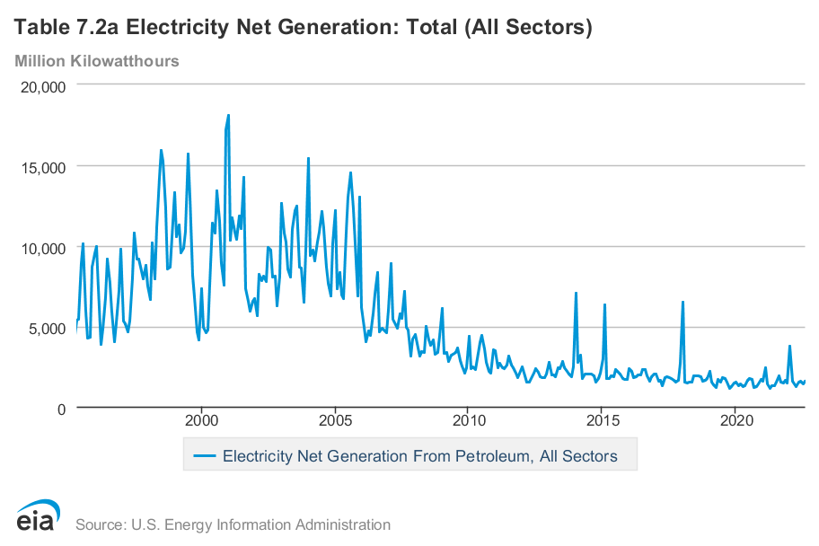
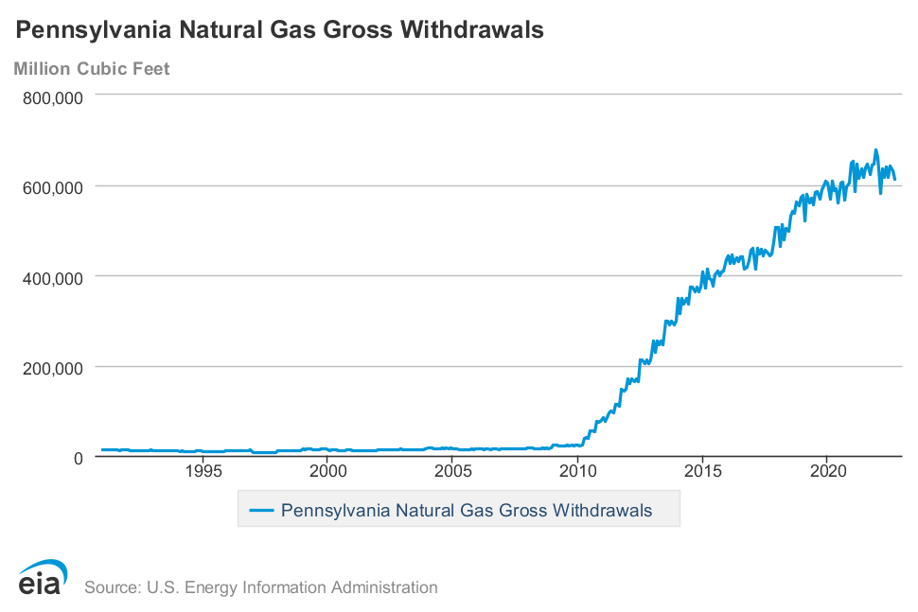
Brief history: The fracking boom led to lower prices….
Early 2000s: Conventional production, oil-gas co-firing
Steam boilers
NGCC
~January 2010: Start of fracking
Gas prices fell after the financial crisis – then stayed low because of fracking

Slide 3
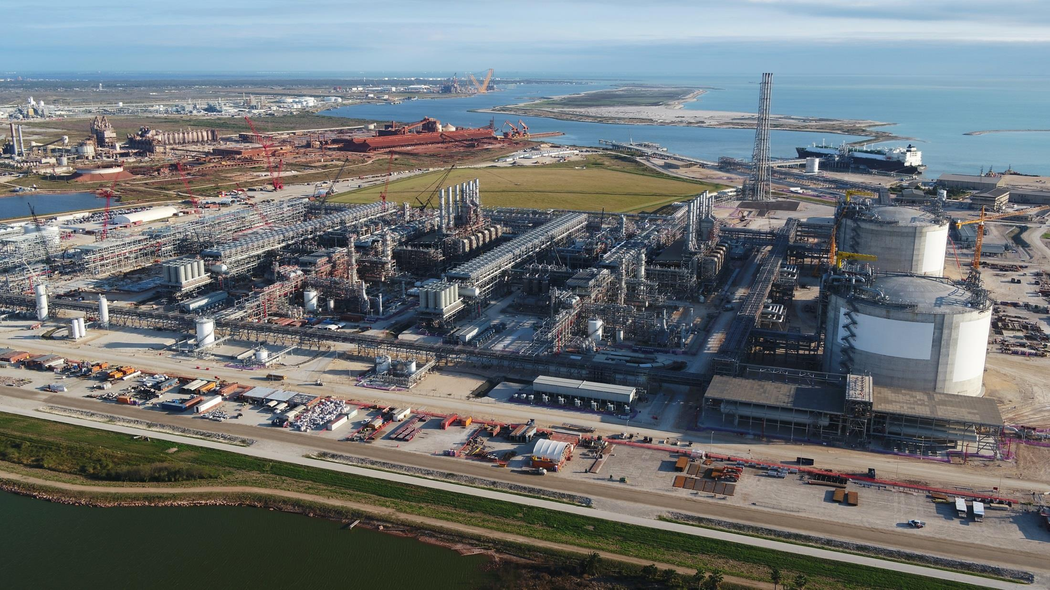
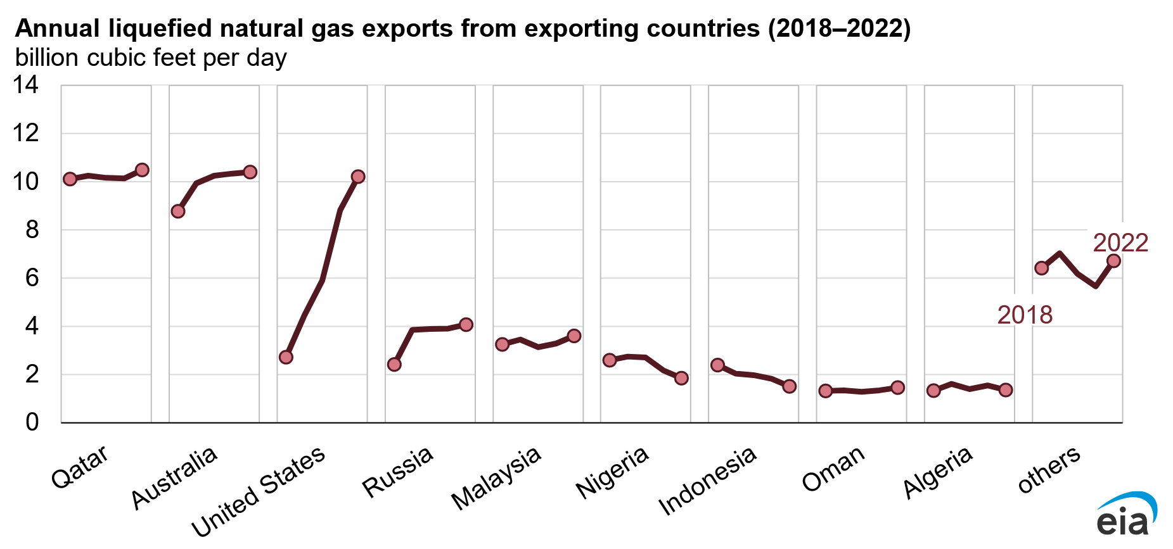
….and to pressure for expanding exports, …
LNG exports to non-FTA countries require a DOE license
Section 3 of the Natural Gas Act (15 U.S.C. § 717b).
May 29, 2014 DOE completed EIA and proposed regulations for reviewing LNG export applications
May 2016: LNG exports begin
Chenier Sabine Pass train 1 begins shipments
Pipeline exports to Mexico ramped up in spring 2015
The U.S. currently exports 20% of production
…but imports LNG to regions with limited pipeline capacity (New England)
Source: EIA

Slide 4
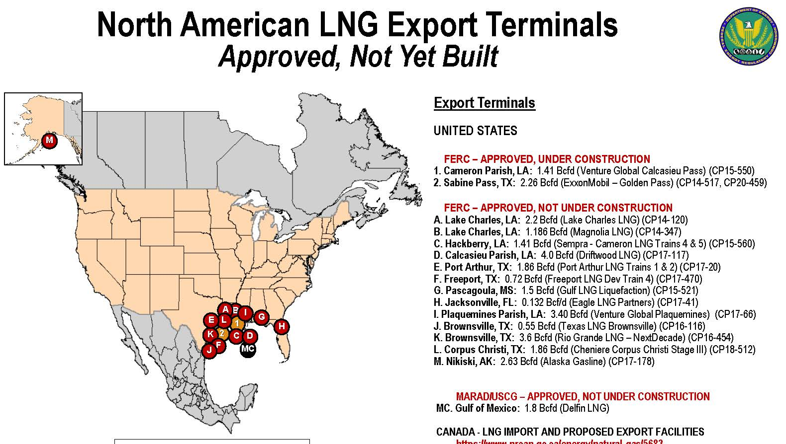








…and more LNG export facilities are approved or proposed
Potentially doubling onshore export capacity (S&P Global)….
…plus Fast Gas and FSRUs!
…amidst climate controversy.

Slide 5
This paper
Three questions
What has been the effect of LNG exports on U.S. gas prices?
What are implications for U.S. gas and coal prices going forward, assuming increased LNG export capacity?
What are implications for the U.S. energy transition?
Literature
Most closely related: Chiapipini, Jegourel, and Raymond (Energy Economics 2019), Aguiar-Conraria (wp 2021), Han et al (J. Nat. Gas Science & Engineering 2021) Halser et al. (wp 2023)
Older literature: Brown and Yücel (Energy Journal 2008), Ramberg & Parsons (Energy Journal 2012), Zhang and Ji (Energy Policy 2018)…
Others: Gilbert & Roberts (JAERE 2018),…
Contribution relative to literature
Take advantage of Covid/Ukraine cycle
Incorporate coal prices
Align institutional episodes with estimated break dates and rolling estimates
Empirical estimation of liquefaction, transport, and regasification costs
Implications for U.S. fuel prices and power sector decarbonization

Slide 6
Summary: Three regimes in natural gas prices (institutional regime dates)
U.S. natural gas regimes
Ia. Oil-gas cofiring (“burner tip parity”): < April 2006
Ib. Pre-fracking transition/financial crisis: April 2006 – January 2010
Fracking with shut-in gas: 2010 – May 2016
LNG: May 2016 – present

Slide 7
Regime III: Imposing NGCC parity cointegrating coefficients & $3.50 liqn/transport/regas
 | Unit root tests with trend p-value |  | Cointegra-ting coeffi-cient (SE)
 | DF | DF-GLS | Cointegra-ting coeffi-cient (SE)
HH | 0.338 | >0.10 | -
WTI | 0.402 | >0.10 | -
Coal | 0.727 | >0.10 | -
HH-WTI | 0.013 | <.05 | 1.013
 |  |  | (0.115)
HH-coal | 0.092 | <.05 | 0.906
 |  |  | (.049)
WTI-coal | 0.079 | <.05 | 0.962
 |  |  | (0.143)
III
DF, DF-GLS use automatic lag length selection.
Unit root tests of spreads impose NGCC parity.
Cointegrating coefficient estimated by DOLS with 6 leads & lags with Newey-West SEs (6 lags)
Sample: 5/27/16 – 11/27/23
Source for $3.50 liquefaction/transport/regasification cost: CSIS (2019) industry analysts

Slide 8
Outline
Outline
Natural gas history – some key events
Summary
Empirical analysis
Implications for the energy transition
  Price projections
  Emissions impacts (U.S. only – not global equilibrium)

Slide 9
Empirical analysis
Methods: Unit roots, cointegration, break date estimation, rolling cointegrating estimators (DOLS)
  Methods notes:
    This is a nonstandard break problem – end or commencement of a cointegration regime
    No formal break tests b/c maintained hypotheses for break tests require stationarity or cointegration – under non-cointegration a break date test/estimator is meaningless
Results:
All series have unit roots full-sample
Evidence for cointegration varies by regime
Estimated cointegrating coefficients vary by regime
Empirically estimated break dates roughly correspond to institutional break dates

Slide 10
Digression: EU NG prices (TTF) track Brent
International gas price contracts are indexed to Brent, although the indexation factor has fallen from ~0.18 to ~0.12

Slide 11
HH and WTI: Cointegration by institutional regime
Ia
Ib
Note: Theoretical cointegrating coefficients:
Energy parity = 0.172
NGCC parity = 0.127
II
III

Slide 12
HH and WTI: Cointegration by estimated regime
Ia
Ib
Note: Theoretical cointegrating coefficients:
Energy parity = 0.172
NGCC parity = 0.127
II
III

Slide 13
HH and WTI: Predicted oil price, with 3 institutional break dates

Slide 14
HH and WTI: Predicted oil price, with 3 estimated break dates

Slide 15
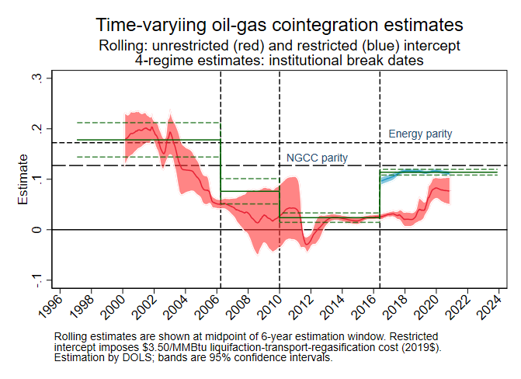
HH and WTI: Rolling & estimated-break DOLS estimates

Slide 16
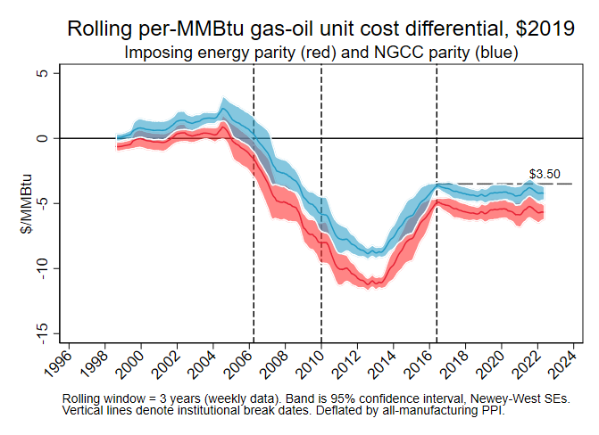
HH and WTI: Estimate of liquefaction, transport, and regasification cost
Note: estimated as 6-year rolling mean of HH price minus WTI price at energy parity (red) or at NGCC parity (blue) (Newey West SEs). Price deflator: all-manufacturing PPI.

Slide 17
HH and Central App coal: Cointegration, full sample
There seems to be some coefficient instability, with larger coal price movements associated with a given gas price movement in the latter part of the sample (increasing sensitivity of coal prices to gas)
Coal price movements lag gas price movements by about 15 weeks (for some reason)
Note: Coal price led by 15 weeks. Energy parity coefficient = 25.0

Slide 18
HH and Central App coal: Cointegration by 2016 institutional break
Ib & II
III
Theoretical cointegrating coefficients:
Energy parity = 25.0
NGCC parity = 32.8
Note: Coal price led by 15 weeks.

Slide 19
Cointegration, break, and rolling analysis: Summary
Post 2016, one common trend (world oil prices) with cointegrating coefficients consistent with
  (i) U.S. power system dispatching arbitrage and
  (ii) indexation of global LNG pricing to Brent
Pre-2007 gas-oil traded at thermal efficiency (“burner tip parity”)
Pre-LNG fracking is the historical exception, when U.S. gas was disconnected from global markets.
Caveats: mysterious 15-week lag in coal prices, 3 week lag in gas prices

Slide 20
Implications for U.S. energy transition: forecasts
Cointegration? | Method
None | First differences VAR
Gas - coal | Triangular system, CI imposes NGCC parity
Gas – coal & gas – oil | Triangular system, CI imposes NGCC parity
Gas – coal & gas – oil | Triangular system, CI estimation by DOLS

Slide 21
Implications for U.S. energy transition: forecasts, ctd.
4-year ahead (Nov. 2027) fuel price forecasts:
With and without fuel cointegration
Cointegration? | Method | HH ($/mmBtu) | Cent. App. Low-Sulfur Bit. Coal ($/st)
None | First differences VAR | $2.99 | $81
Gas - coal | Triangular system, CI imposes NGCC parity | $3.23 | $68
Gas – coal & gas – oil | Triangular system, CI imposes NGCC parity | $4.65 | $113
Gas – coal & gas – oil | Triangular system, CI estimation by DOLS | $4.80 | $115
 | Comparisons:
 | EIA projection (AEO 2023 reference case) | $3.23 | $74
 | Price as of 12/29/2023 | $2.58 | $79
 | Delta from $20/ton carbon tax | $1.06 | $43

Slide 22
Implications for U.S. energy transition: Emissions
Estimates of U.S. power sector emissions in 2030, relative to 2007 peak, for various natural gas prices
Scenario | HH price (2022 $/mmBtu) | 2030 emissions relative to 2007 peak | Delta rel to BAU (pp)
BAU | $3.10 | 46% | -
IRA only | $3.10 | 62% | -15 pp
LNG only | $5.10 | 57% | -11 pp
IRA + LNG | $5.10 | 72% | -26 pp
IRA + LNG | $7.10 | 76% | -30 pp
Notes: based on response surfaces from ReEDS simulations in Stuart & Stock (2021)

Slide 23
Summary
Because of increasing LNG exports, accelerated by the invasion of Ukraine, U.S. natural gas prices have reconnected to global natural gas & oil markets.
We can therefore anticipate a prolonged period of U.S. higher natural gas prices ($4-$8?) if more LNG terminals come on line.
Coal prices will rise proportionately.
Thus, decarbonization of the power sector is likely to be faster than most models predict (e.g. Bistline et al (2023))

Slide 24
Additional Slides

Slide 25
Natural gas 101
Prices: $/mmBTU
Quantities & rates:
1 Mcf (1000 cubic feet )
  = 1.037 mmBTU
1 MTPA (1 million tons annually)
  = 48.7 Bcf/year
  = 4 Bcf/month
  = 0.133 Bcf/day
Energy content:
1 mmBTU gas (boiler) = 0.176 bbl oil (boiler)
1 mmBTU gas (NGCC) = 0.128 bbl oil (boiler)
Carbon:
53 kgCO2/mmBTU
$20 carbon tax => $1.06/mmBTU

Slide 26
New: Fast LNG export and FSRUs
“Fast LNG”
Repurposed offshore rigs, mainly jackup rigs, to provide a seaborne liquefaction facility
  6 exist so far; 5 under construction
  Estimated ~160 jackup rigs > 30 yrs old available for Fast Gas repurposing
  Typical 1.4 MPTA capacity/facilty (0.19 Bcf/d)
  Takes ~18 months to complete
Floating Storage & Regasification Units (FSRUs)
Modified tankers/LNG vessels capable of regasification
Mobile

Slide 27

Henry Hub, Erath LA

Slide 28
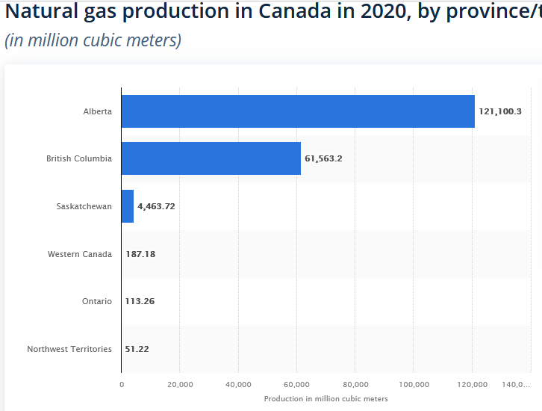
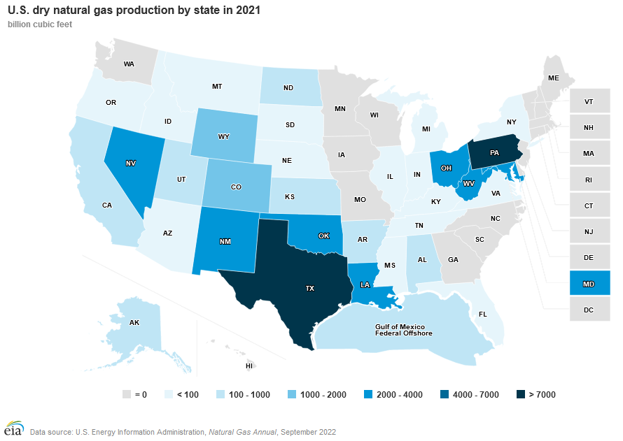
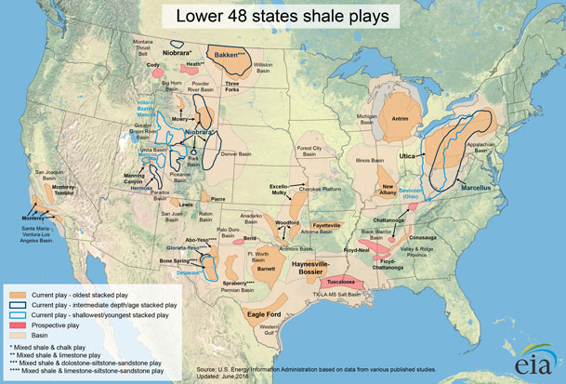
U.S. & Canadian gas production
U.S. & Canadian natural gas production
Pipeline network
LNG export licensing policy
LNG import & export facilities (history and pending)

Slide 29
Data: Weekly 3-month futures prices, compared to spot
We use 3-month futures prices:
  To eliminate spike outliers (hurricanes, Feb. Texas freeze, COVID onset, etc.)
  Coal prices are 3-mo futures (no true spot market for coal)
Weekly price data (Mondays) for regressions analysis
  Gas, oil: Feb 1, 1997 – Nov 27, 2023
  Coal: March 12, 2007 – Nov. 27, 2023
  Quantity data are monthly
Source: EIA (oil, gas), SNL (coal)

Slide 30
Data: Domestic spreads open up across hubs because of pipeline constraints

Slide 31
Data: EU country prices largely track each other

Slide 32
EU TTF gas and Brent (both spot): Cointegration (through May 1, 2021)

